Slide 1
Comparative Reliability Analysis of Passive and Active Emergency Core Cooling Systems for Small Modular Reactors
Katrina I.S. Mamenta¹
Lixuan Lu ¹
¹Ontario Tech University — Department of Energy and Nuclear Engineering
Notes:
Good morning/afternoon everyone. My name is Lixuan Lu, presenting on behalf of Katrina Mamenta, from the Department of Energy and Nuclear Engineering at Ontario Tech University.
Today I will present a comparative reliability analysis of passive and active emergency core cooling systems for small modular reactors. The two case studies are the NuScale VOYGR, a fully passive design, and the GE-Hitachi BWRX-300, which relies on active safety trains.
The central question: does the choice of safety philosophy, passive versus active, materially change the risk profile, and what does that mean for SMR deployment in emerging markets?

Slide 2
Outline
Introduction
Challenges and Objectives
Main Work
  System Characterization: NuScale VOYGR vs. GE-Hitachi BWRX-300
  Event Tree and Fault Tree Analysis of the LONHR Initiating Event
Results
  Reliability Quantification, Uncertainty, and Risk Importance
  Regulatory, Workforce, and Financing Implications for Emerging Markets
Conclusions
Notes:
Here is the outline of the presentation.
I will begin with an introduction to the deployment context that motivates this work, followed by the specific challenges and the objectives of the study.
The main work covers the characterization of the two reactor safety systems and the event tree and fault tree analysis of the Loss of Normal Heat Removal initiating event.
I will then present the results: the quantified reliability of each system, the associated uncertainty, the risk importance measures, and the implications for regulation, workforce, and financing in emerging markets.
I will close with the conclusions.

Slide 3
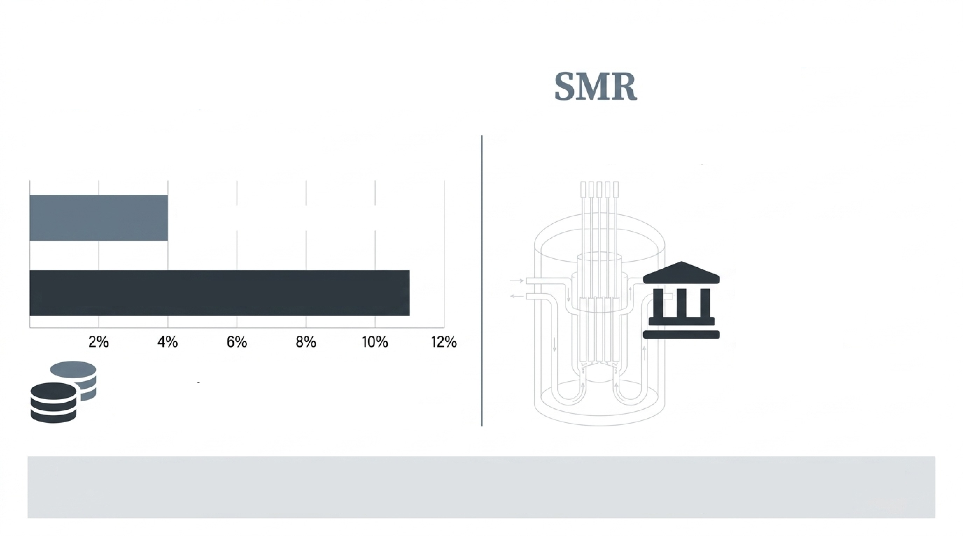
Introduction
The Financing Penalty
The Regulatory Constraint
Newcomer regulatory bodies operate with: limited PRA experience, rely on vendor safety cases, and lack independent thermal-hydraulic operational databases.
OECD Real Discount Rates: 3-5
Emerging Market Real Discount Rates: 8-12%
Cost of capital is the dominant factor in SMR levelized cost. High technical risk perceptions directly inflate these premiums.
Deployment hinges on demonstrating quantifiable safety-system reliability to stakeholders whose risk perceptions govern both licensing timelines and project bankability.
Notes:
To set the context: for SMRs, the cost of capital is the dominant factor in levelized cost of electricity. OECD projects see real discount rates of roughly 3 to 5 percent, while emerging markets face 8 to 12 percent. High perceived technical risk directly inflates these financing premiums.
On the regulatory side, newcomer regulatory bodies typically have limited PRA experience, rely heavily on vendor safety cases, and lack independent thermal-hydraulic operational databases.
So deployment ultimately hinges on demonstrating quantifiable safety-system reliability to stakeholders whose risk perceptions govern both licensing timelines and project bankability. That is the motivation for a transparent, side-by-side reliability comparison.

Slide 4
Challenges and Objectives
Nu Scale VOYGR
GE Hitachi BWRX-300
77 MWe integral PWR (First NRC approved light-water SMR)
Core mechanism: Natural circulation gravity to a large reactor pool
Key components: Reactor Vent Valves (RVV)
Zero active components, no electrical power dependency
72-hour grace period (no operator action)
300 MWe BWR (Selected for Darlington, UK GDA Step 2)
Core mechanism: Powered isolation condensers (IC) & motor-driven ECCS
Key components: trains, motor-operated valves, pumps
Relies on power + control signals
Leverages decades of BWR operational data
The Initiating Event: Loss of Normal Heat Removal (LONHR) Frequency: 10⁻² to 10⁻¹ per reactor-year (NUREG/CR-6928)
Notes:
The challenge is that the two leading light-water SMR designs embody two diverging safety philosophies, and there is no common quantitative basis for comparing them.
The NuScale VOYGR is a 77 MWe integral PWR, the first light-water SMR approved by the NRC. Its emergency core cooling relies on natural circulation and gravity to a large reactor pool, actuated through Reactor Vent Valves. It has zero active components, no electrical power dependency, and a 72-hour grace period with no operator action.
The BWRX-300 is a 300 MWe BWR, selected for Darlington and in UK GDA Step 2. It uses isolation condenser trains and motor-driven ECCS, so it depends on power and control signals, but it leverages decades of BWR operational data.
The objective of this work is to quantify and compare the reliability of both systems for the same initiating event: Loss of Normal Heat Removal, with a frequency of 10^-2 to 10^-1 per reactor-year based on NUREG/CR-6928.

Slide 5
Main Work: Structural Comparison of Safety Systems
Structural Comparison Matrix
Parameter | NuScale VOYGR | BWRX-300
Active Safety Components | 0 | 8+
Power Dependencies | None | DC + AC (EDGs)
Event Tree Sequences | 5 total, 3 lead to Core Damage | 7 total, 4 lead to Core Damage
Basic Events in Dominant Fault Tree | 7 | ~20
Single-Point Vulnerability | Complete RVV failure | Isolation Condenser failure
The passive design achieves safety by eliminating entire failure categories, while the active design achieves safety by multiplying success paths.
Notes:
The main work begins with a structural comparison of the two safety architectures.
The matrix shows the contrast: NuScale has zero active safety components and no power dependencies, while the BWRX-300 has eight or more active components and requires both DC and AC power from emergency diesel generators.
The NuScale event tree produces 5 sequences, 3 leading to core damage; the BWRX-300 produces 7 sequences, 4 leading to core damage. The dominant NuScale fault tree contains only 7 basic events versus roughly 20 for the BWRX-300.
The key structural insight: the passive design achieves safety by eliminating entire failure categories, while the active design achieves safety by multiplying success paths. Each carries a distinct single-point vulnerability: complete RVV failure for NuScale, and isolation condenser failure for the BWRX-300.

Slide 6
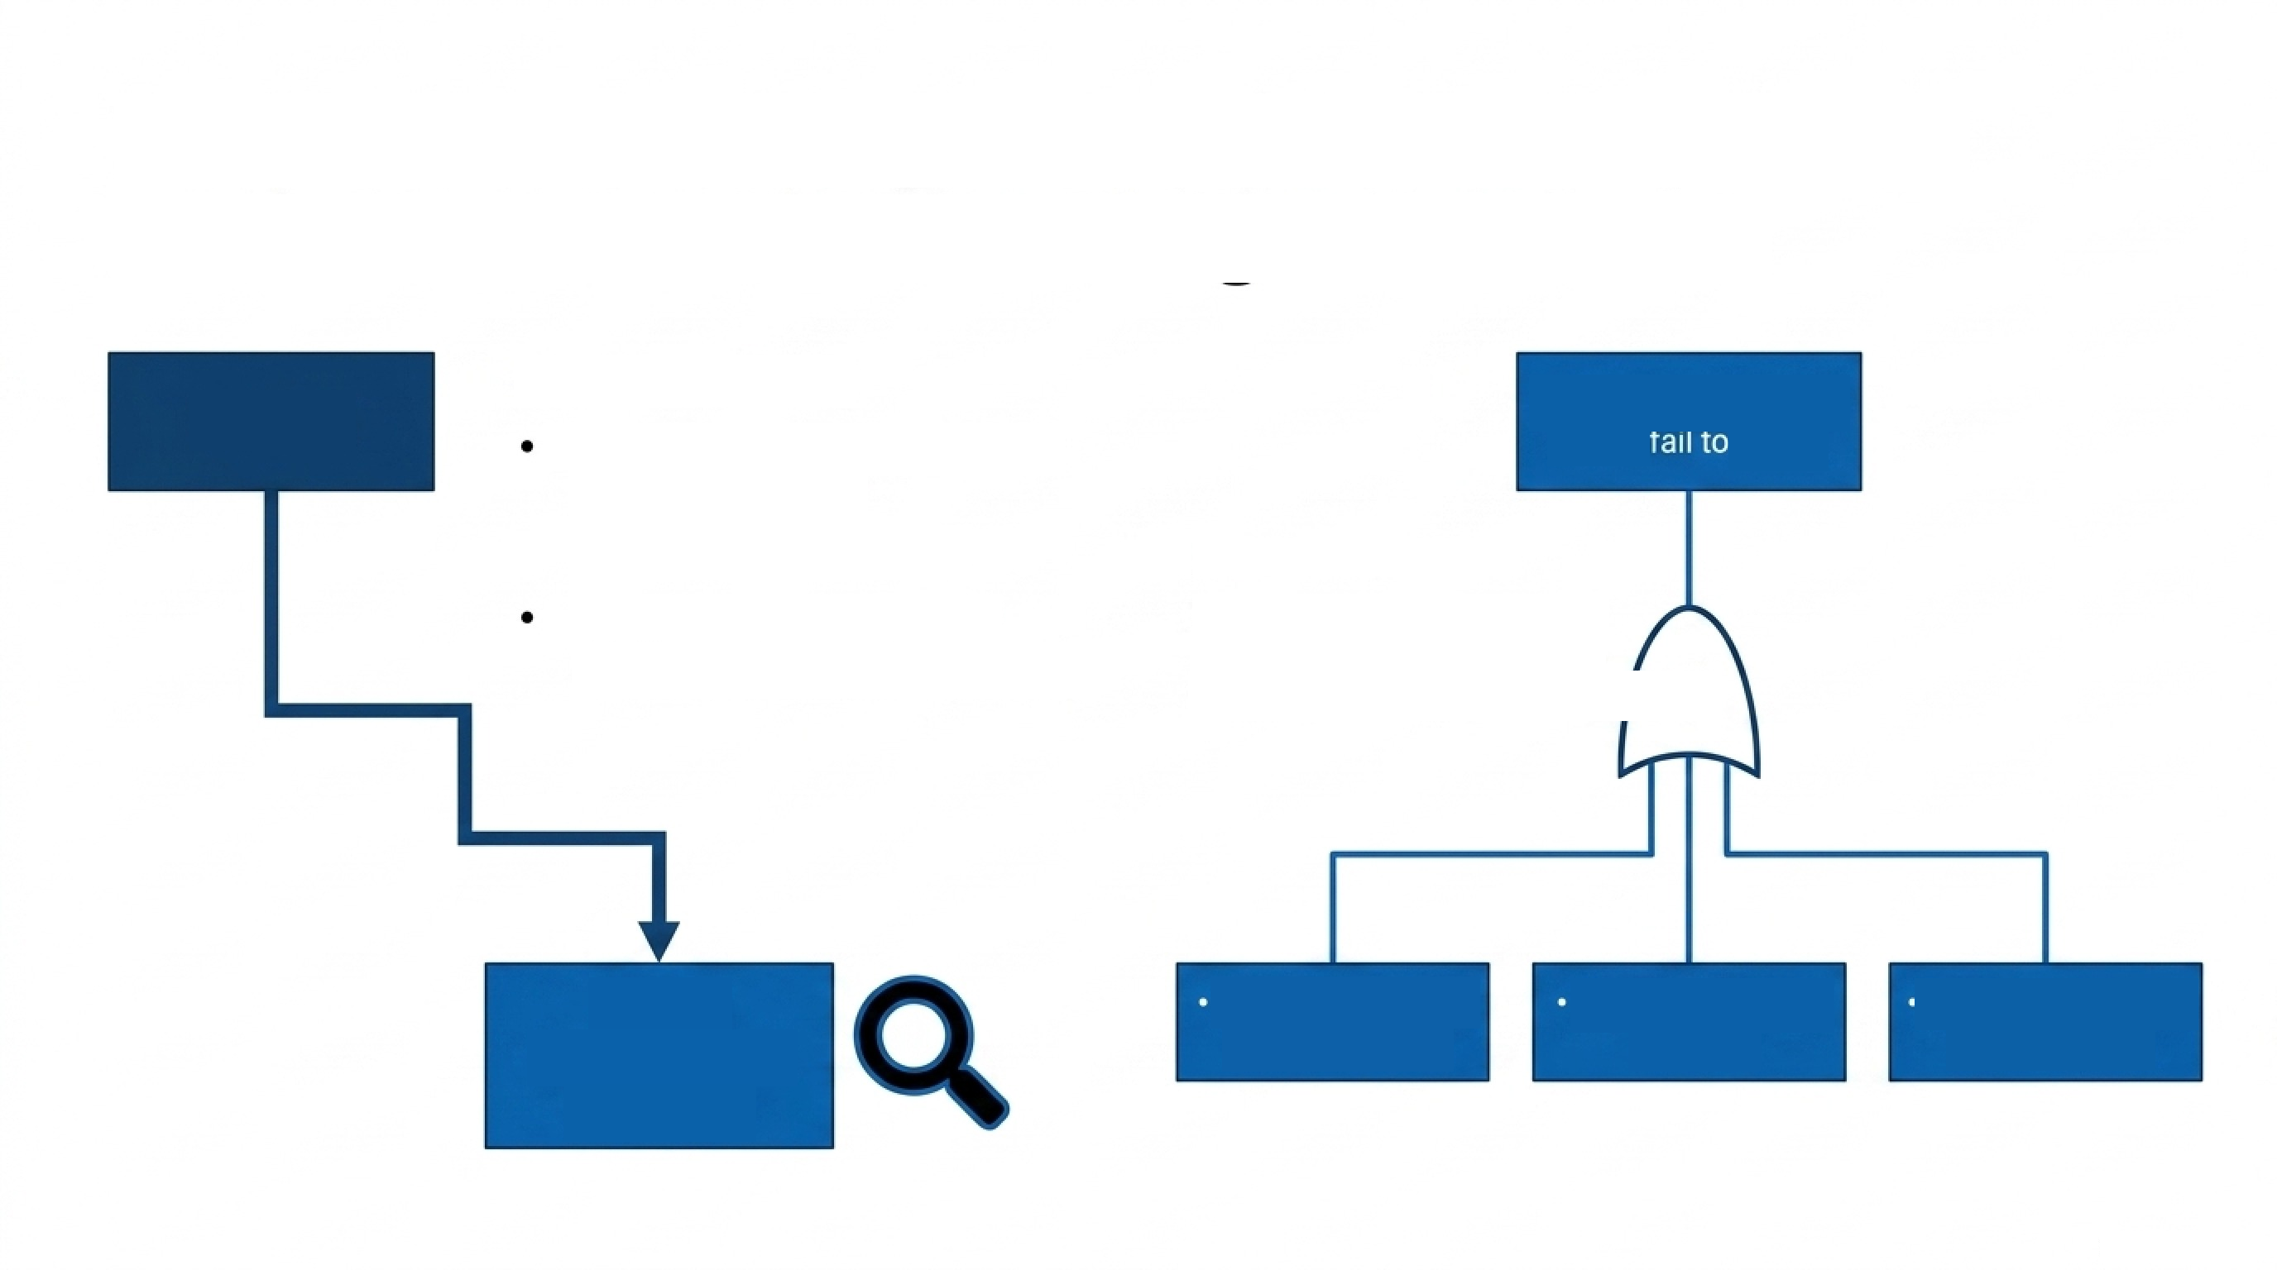
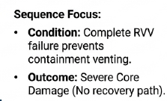
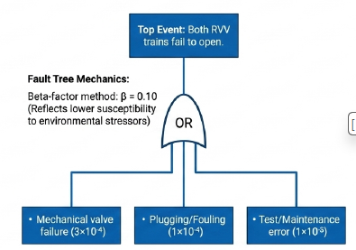
Main Work: NuScale Event Tree and Fault Tree Analysis
LONHR
SEQ-5
(Severe Core
Damage)
Notes:
This slide shows the NuScale event tree and fault tree for the LONHR initiating event.
Because the design eliminates pumps, diesels, and support systems, the accident progression is short: the limiting sequence, SEQ-5, corresponds to severe core damage following complete failure of the reactor vent valves.
The important point is that eliminating failure modes does not eliminate risk; it concentrates it. Virtually all of the residual risk collapses into a single valve class, and specifically into common cause failure of the redundant RVVs. This becomes central to the results later in the presentation.

Slide 7
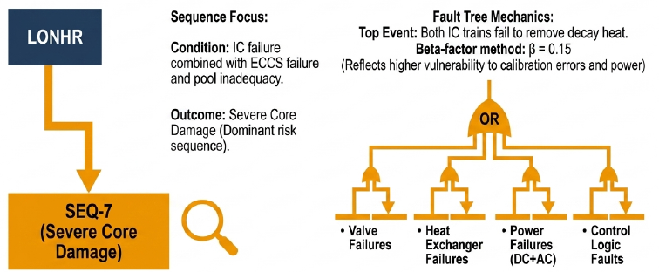
Main Work: BWRX-300 Event Tree and Fault Tree Analysis
Notes:
This is the corresponding model for the BWRX-300 active system.
The fault tree is substantially larger, around 20 basic events, reflecting the isolation condenser trains, motor-operated valves, pumps, and the supporting power and control systems.
Redundancy across trains provides multiple success paths, but that benefit is partially offset by shared dependencies: common cause failure across the identical IC trains, shared control logic, and, importantly, a shared physical heat sink, the suppression pool, which bypasses train-level redundancy entirely.
So the two models set up a clean contrast: a small, concentrated fault tree versus a large, distributed one.

Slide 8
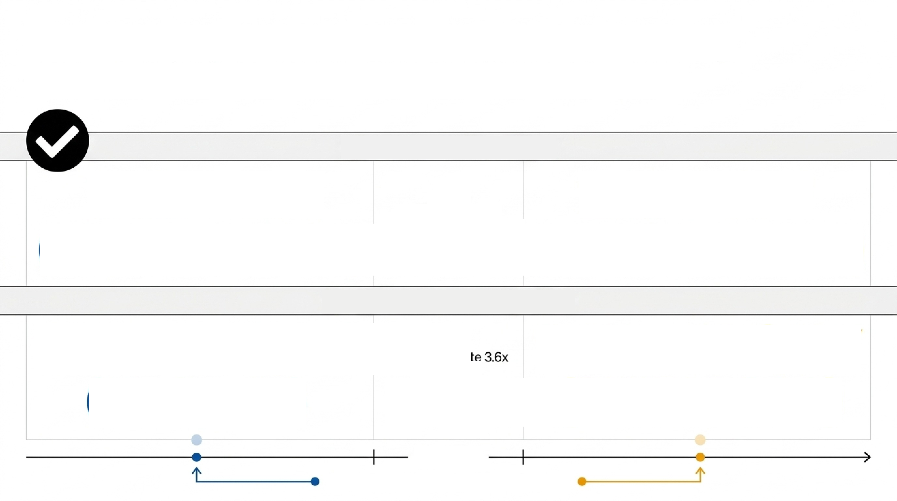

Results: Core Damage Frequency Comparison
1.42 x 10⁻⁴
(NuScale RVV)
Result:
A 48% difference. NuScale exhibits a lower failure probability.
2.10 x 10⁻⁴
(BWRX-300 IC)
Result:
A ~3.6x magnitude difference in LONHR-induced CDF.
1.92 x 10⁻⁶/RY
(NuScale)
7.00 x 10⁻⁶/RY
(BWRX-300)
$${10}^{−5} /RY$$
Advanced Reactor Safety Goal Threshold
Notes:
Turning to the results. Both systems are highly reliable and both comfortably satisfy advanced reactor safety goals.
The LONHR-induced core damage frequency is 1.92 times 10 to the minus 6 per reactor-year for NuScale versus 7.00 times 10 to the minus 6 for the BWRX-300, roughly a 3.6-fold difference.
At the system level, the failure probability on demand is 1.42 times 10 to the minus 4 for the NuScale RVV function versus 2.10 times 10 to the minus 4 for the BWRX-300 isolation condensers, about a 48 percent difference in favour of the passive design.
The headline here is reliability parity in the sense that both meet the safety goals with margin; the difference is real but modest.

Slide 9
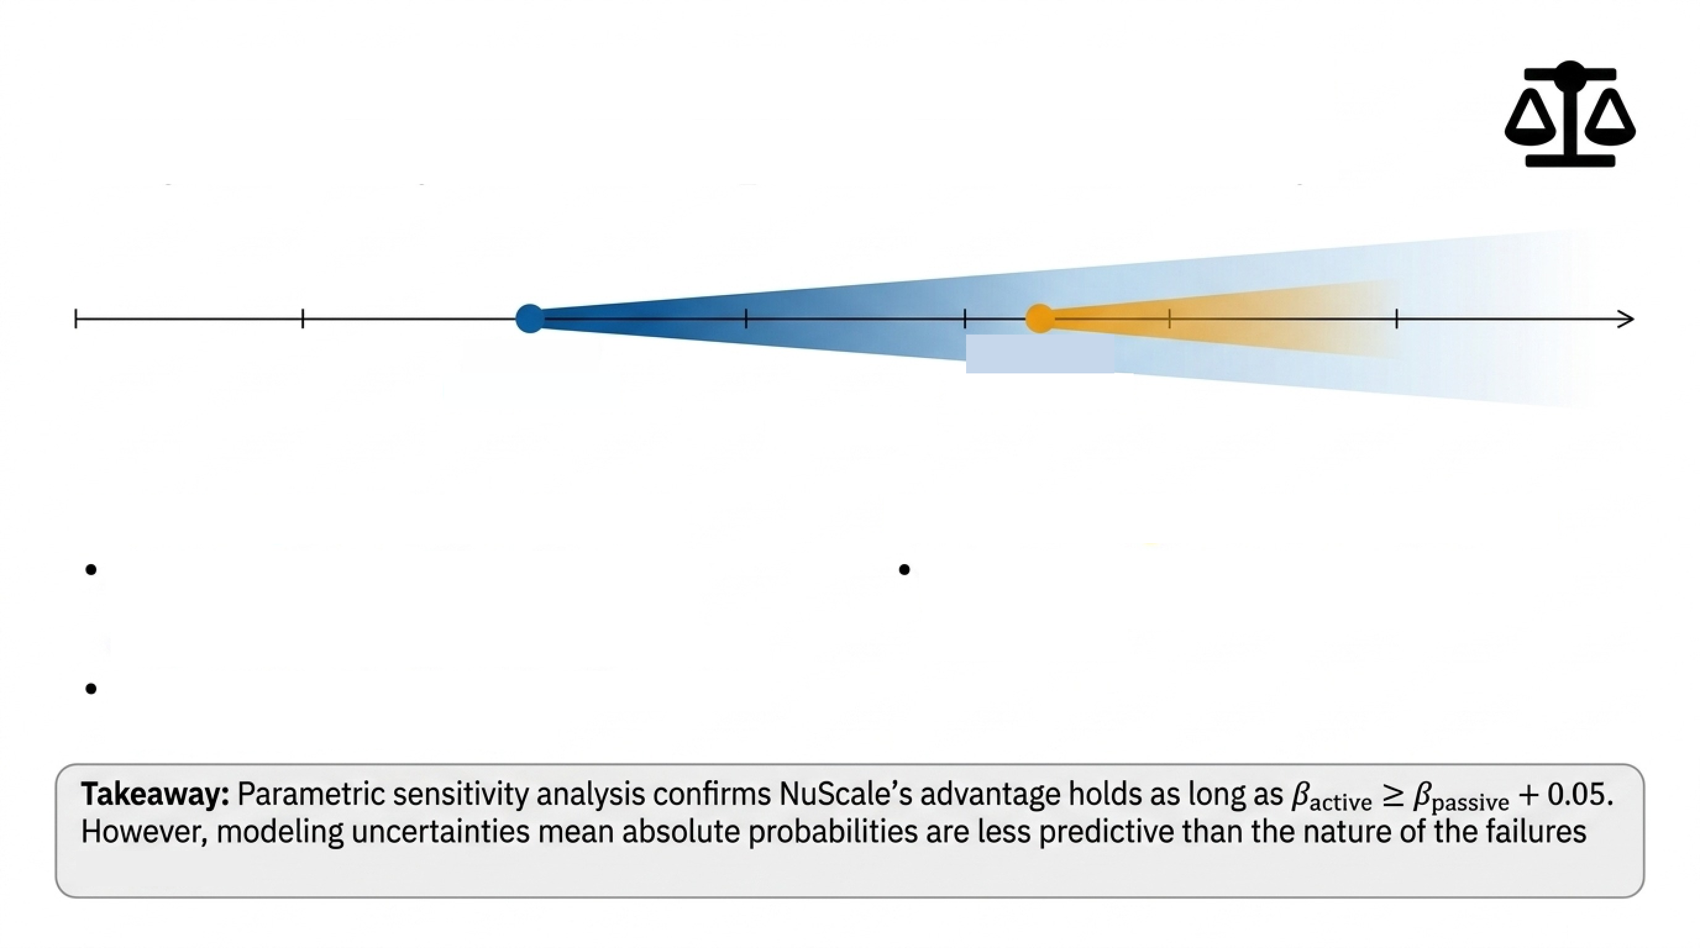
Results: Uncertainty Analysis
1.42×10⁻⁴
2.10×10⁻⁴
(NuScale RVV)
(BWRX-300 IC)
NuScale Epistemic Constraints
BWRX-300 Epistemic Constraints
Success criteria modeled as binary; omits thermal-hydraulic functional degradation (buoyant driving head, non-condensable gas).
Single-parameter beta representation misses higher-order active component failure
combinations.
Relies on generic LWR data applied to a novel,
first-of-a-kind RVV component.
Notes:
That 48 percent gap, however, is a point estimate subject to asymmetric epistemic uncertainty, and the sources of uncertainty differ by design.
For NuScale, the analysis relies on generic light-water reactor data applied to a novel, first-of-a-kind RVV component, and success criteria are modeled as binary, which omits thermal-hydraulic functional degradation such as reduced buoyant driving head or non-condensable gas accumulation.
For the BWRX-300, the single-parameter beta-factor representation of common cause failure misses higher-order combinations among active components.
So the honest conclusion is that the quantitative gap should be interpreted with caution; the more robust finding is architectural, which brings us to the importance analysis.

Slide 10
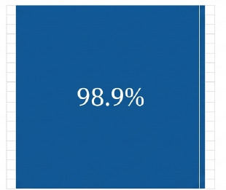
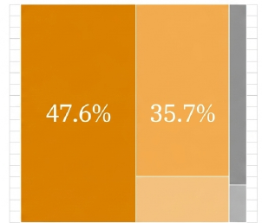
Results: Risk Importance Analysis
NuScale: Common Cause Dominance (FV = 0.989)
BWRX-300: Distributed Physical Vulnerability
98.9% failure probability concentrates in a single first-order CCF cut set.
Risk is fundamentally monolithic: removing CCF would reduce top-event probability by ~89x (RRW = 89.2).
47.6% Suppression Pool Inadequacy: A shared physical heat sink that bypasses train-level redundancy entirely.
35.7% Common Cause Failure (IC trains).
Operational risk is decentralized: active-component CCF (35.7%) and resource-sharing vulnerabilities (47.6%) together account for 83.3% of the failure profile, requiring distinct, operationally addressable mitigation strategies.
Notes:
Risk importance measures reveal the real differentiator between the designs: the architecture of their vulnerability, not the absolute reliability gap.
For NuScale, 98.9 percent of the failure probability concentrates in a single first-order common cause cut set, with a Fussell-Vesely importance of 0.989. The risk is monolithic: removing that CCF would reduce the top-event probability by a factor of about 89, a risk reduction worth of 89.2.
For the BWRX-300, the risk is distributed: suppression pool inadequacy contributes 47.6 percent, a shared physical heat sink that bypasses train-level redundancy, and IC-train common cause failure contributes 35.7 percent. Together these account for 83.3 percent of the failure profile, and each is operationally addressable through distinct mitigation strategies.

Slide 11

Results: Regulatory and Workforce Implications
Regulatory Licensing Strategy
Workforce & Operational Planning
Passive CCF Risk: Leverages decades of established BWR precedent, but demands diverse, multidisciplinary regulatory engineering teams to verify integrated software/hardware logic.
Passive CCF Risk: 72-hour grace period dramatically lowers operator psychological stress. Eliminates reliance on scarce I&C calibration experts in developing labor markets.
Active Complexity: Demands constant multidisciplinary staffing (mechanical, electrical, software). However, the 47.6% suppression pool vulnerability is a concrete, monitorable target suitable for automated decision-support mitigation.
Active Complexity: Leverages decades of established BWR precedent, but demands diverse, multidisciplinary regulatory engineering teams to verify integrated software/hardware logic.
Notes:
These failure-mode architectures translate directly into regulatory and workforce implications.
On regulatory licensing: the BWRX-300 can leverage decades of established BWR precedent, but its active complexity demands diverse, multidisciplinary regulatory engineering teams able to verify integrated software and hardware logic. That is a heavy ask for a nascent regulator.
On workforce and operations: the active design requires constant multidisciplinary staffing across mechanical, electrical, and software disciplines, although its dominant suppression pool vulnerability is a concrete, monitorable target well suited to automated decision support.
For NuScale, the 72-hour grace period dramatically lowers operator burden and stress, and the design eliminates reliance on scarce I&C calibration expertise, an important consideration in developing labour markets.

Slide 12
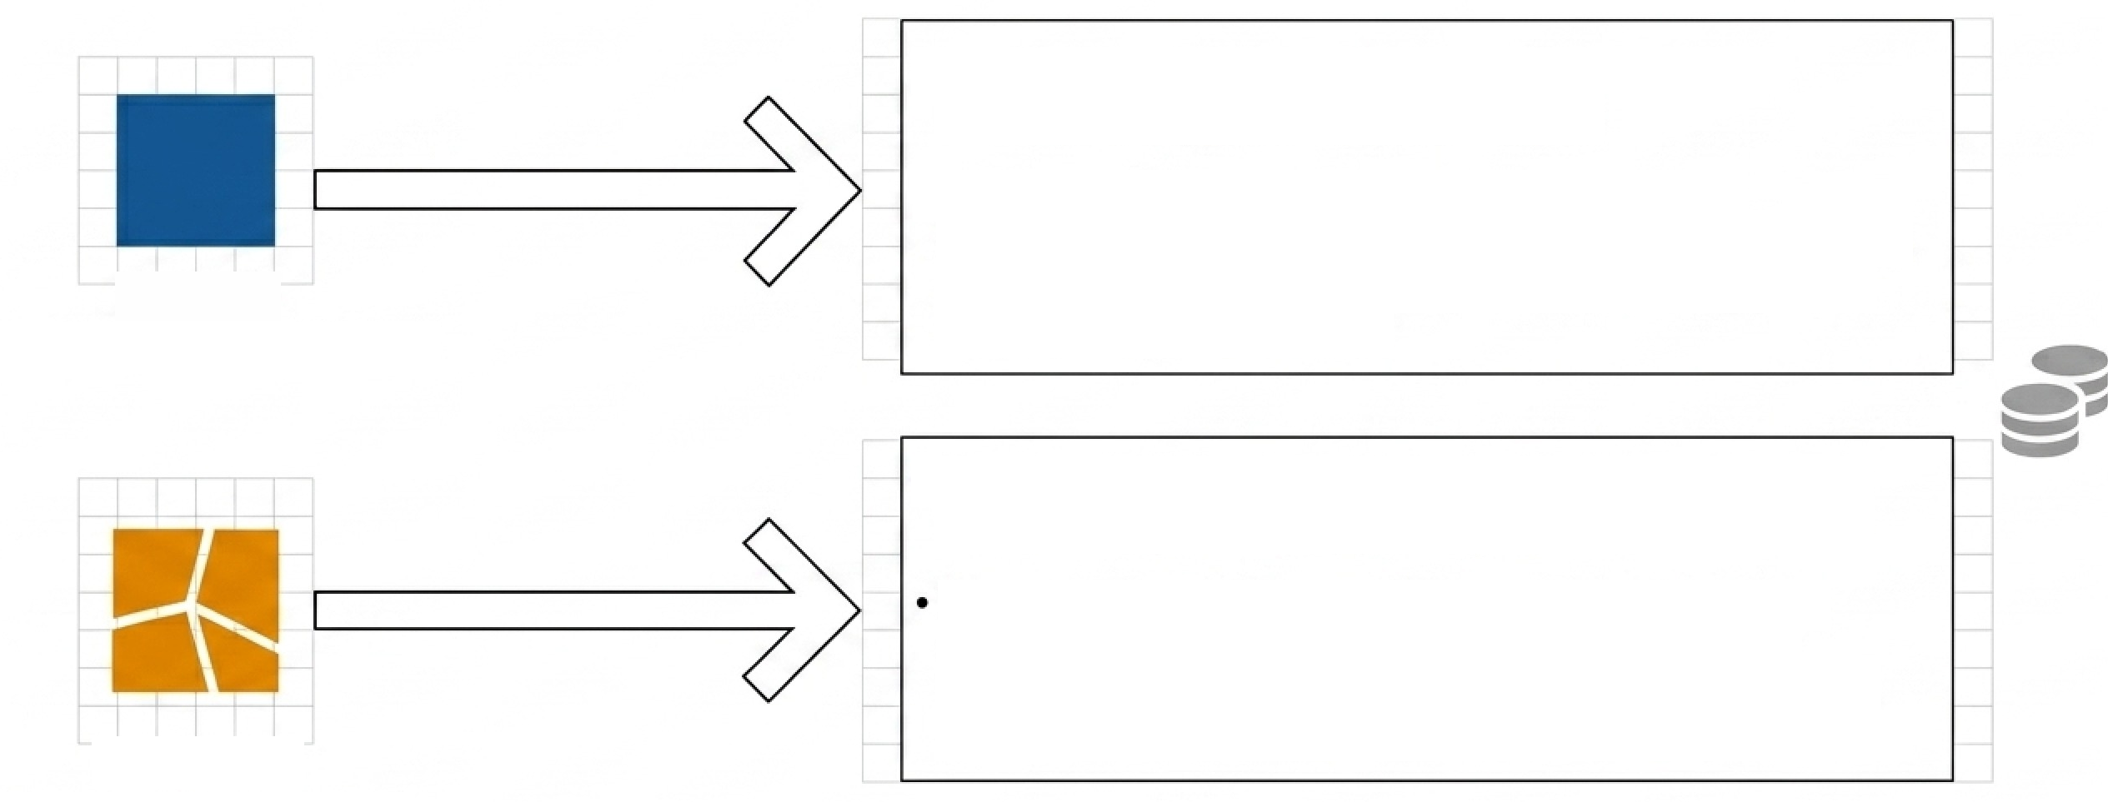
Results: Financing Implications
The absence of active surveillance provides O&M cost certainty—highly prioritized by debt financiers.
Financial Strategy: risk is concentrated in manufacturing QA, projects need vendor warranty provisions or government loan guarantees specifically covering passive component performance risk.
NuScale
(Managing Monolithic CCF Risk)
Decades of BWR actuarial data provide high confidence in failure rate predictions, appeasing conservative financiers.
Financial Strategy: 47.6% pool vulnerability can be mitigated with inexpensive enhanced instrumentation. Operational cost variability managed via long-term O&M contracts to convert variable costs into fixed schedules.
BWRX-300
(Managing Distributed Risk)
Notes:
Financial structuring must likewise align with each technology's specific failure-mode architecture.
For NuScale, the risk is concentrated in manufacturing quality assurance of the RVVs, so projects need vendor warranty provisions or government loan guarantees specifically covering passive component performance. In return, the absence of active surveillance provides O&M cost certainty, which debt financiers prioritize highly.
For the BWRX-300, decades of BWR actuarial data provide high confidence in failure rate predictions, which appeases conservative financiers. The 47.6 percent suppression pool vulnerability can be mitigated with relatively inexpensive enhanced instrumentation, and O&M cost variability can be managed through long-term O&M contracts that convert variable costs into fixed schedules.

Slide 13
Results: Technology Selection Framework for Emerging Markets
Profile A: Constrained Infrastructure Nations
Profile B: Transitioning Technical Nations
Characteristics: Nascent regulatory body, limited technical workforce, low risk tolerance for O&M variability.
Technology Match: NuScale VOYGR
Critical Success Factor: Contracting aggressive vendor warranties to offload the 98.9% CCF risk.
Characteristics: Established technical universities, regional nuclear cooperation, desire for operational technology transfer.
Technology Match: GEHitachi BWRX-300
Critical Success Factor: Utilizing long-term O&M contracts to hedge the financial risk of multidisciplinary workforce requirements.
Notes:
Bringing this together into a technology selection framework for emerging markets, we can distinguish two national profiles.
Profile A, constrained infrastructure nations: a nascent regulatory body, a limited technical workforce, and low tolerance for O&M variability. The better match is the NuScale VOYGR, and the critical success factor is contracting aggressive vendor warranties to offload the concentrated CCF risk.
Profile B, transitioning technical nations: established technical universities, regional nuclear cooperation, and a desire for operational technology transfer. Here the GE-Hitachi BWRX-300 is the better match, with long-term O&M contracts used to hedge the financial risk of the multidisciplinary workforce requirement.

Slide 14
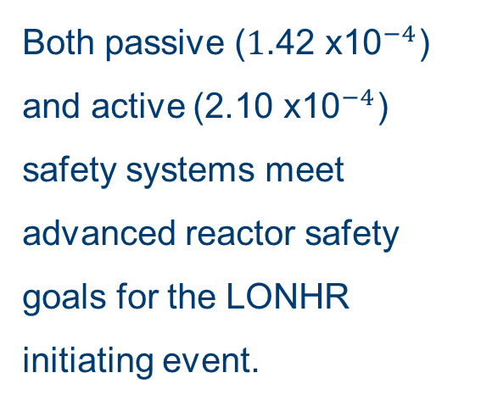
Conclusions
1. Reliability Parity
2. The Failure Mode Divergence
3. Deployment Reality
Both passive (${\text{1}\text{.}\text{42} \text{x}\text{10}}^{−4}$) and active (${\text{2.10 }\text{x}\text{10}}^{−4}$) safety systems meet advanced reactor safety goals for the LONHR initiating event.
Passive risk is a monolithic manufacturing vulnerability
(98.9% CCF). Active risk is a distributed operational vulnerability (83% shared sink + active CCF).
SMR viability in resource constrained markets is not decided by a 48% pro gap. It is decided by aligning a nation’s regulatory capacity, financing structure, and workforce with the reactor’s specific failure mode profile.
Notes:
To conclude, three takeaways.
First, reliability parity: both the passive and the active safety systems meet advanced reactor safety goals with substantial margin, so absolute reliability is not the deciding factor.
Second, failure-mode divergence: passive risk is a monolithic manufacturing vulnerability, with 98.9 percent concentrated in RVV common cause failure, while active risk is a distributed operational vulnerability, with the shared heat sink and active-component CCF accounting for 83 percent.
Third, deployment reality: SMR viability in resource-constrained markets is not decided by a 48 percent probability gap. It is decided by aligning a nation's regulatory capacity, financing structure, and workforce with the reactor's specific failure-mode profile.
Thank you for your attention. I would be happy to take questions.

