Slide 1
Causal Machine Learning for Risk Informed Decision Making in Probabilistic Safety Assessment
Presenter: Wen-Chi Cheng, Ph.D.
Computational Scientist at Idaho National Laboratory
Authors: Karen D’Souza, Wen-Chi Cheng
PSAM 18, Pittsburgh, PA
July 23, 2026

Slide 2
Motivation
Why Integrate Causal Machine Learning (ML) with Probabilistic Risk Assessment (PRA)?
PRA supports risk-informed decision making
PRA relies on fault trees, event trees, simulations, and expert judgment
Rare failures make many conditional probabilities difficult to estimate
Research Question
Can causal ML improve these probability estimates?
Objective
Explore how causal ML can complement and not replace traditional probabilistic risk assessment

Slide 3
Current Gap
Existing Approaches
Traditional PRA | Dynamic PRA | Predictive ML
Fixed logical models | Captures time evolution | Learns correlations
Expert defined dependencies | Sequential behavior | Good prediction
Limited causal reasoning | Limited interventions | Not causal
Gap
Limited Research shows explicitly estimates causal effects for risk-informed decisions

Slide 4
Background Comparison of Methods
Category | Objective | Example Output
Predictive Machine Learning | Predict future outcomes from patterns in data | Classification, prediction, anomaly detection
Causal Machine Learning | Identify and quantify the causes and effects in relationships | Causal effects, interventions, counterfactuals
Probabilistic Risk Assessments (PRA) | Quantify risk | Risk metrics, failure sequences

Slide 5
What is Causal Machine Learning?
Causal ML
Understanding cause-and-effect relationships instead of just correlations
Traditional PRA
Causal ML
Counterfactual Reasoning
What is the probability of system failure given pump failure?
What happens if we deliberately cause pump failure?
What if the pump had never failed?

Slide 6
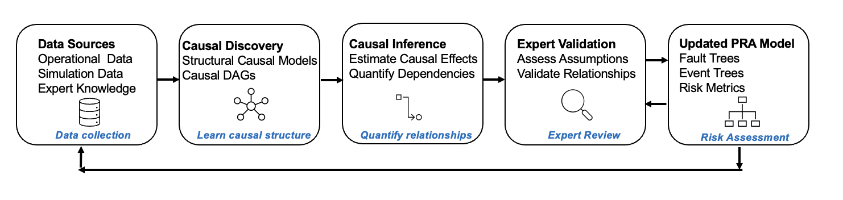
Framework
Conceptual workflow for integrating causal machine learning (ML) into probabilistic risk assessment (PRA)

Slide 7
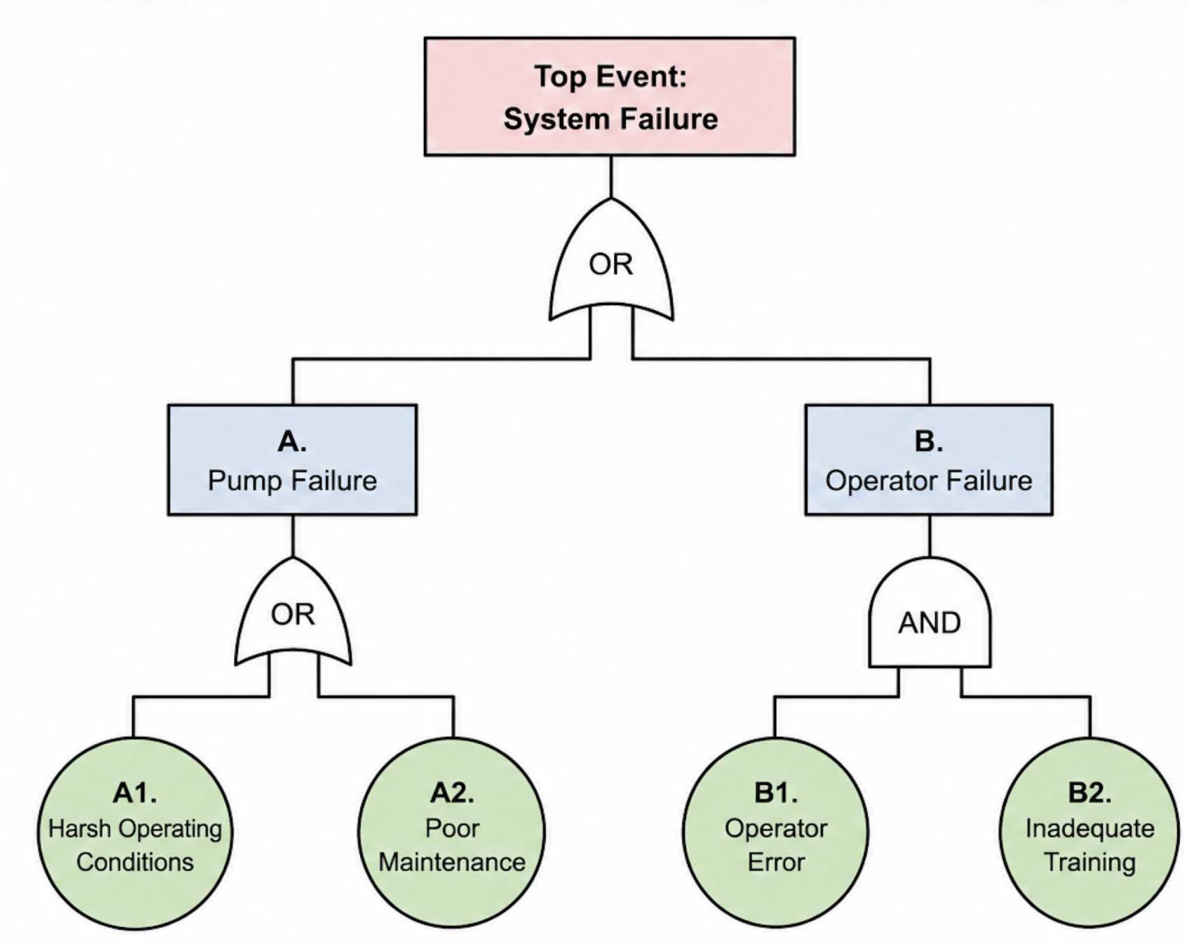
Illustrative Pump System Example
Variable | Type | Role in Analysis
Maintenance Quality | Binary | Predictor
Operator Success | Binary | Predictor
Harsh Operating Conditions | Binary | Confounder
Pump Failure | Binary | Treatment variable
System Failure | Binary | Outcome variable
Causal Machine Learning
Predictor – Influencing variable
Confounder – Influences both cause and effect
Treatment variable – Cause being evaluated
Outcome variable – Effect being measured
Distribution of data
Value | Pump Failure | System Failure | Harsh Operating | Maintenance Quality | Operator Success
0 | 8,546 | 8,952 | 6,603 | 2,572 | 1,502
1 | 1,454 | 1,048 | 3,397 | 7,428 | 8,498
Fault Tree for Simulated Pump System

Slide 8
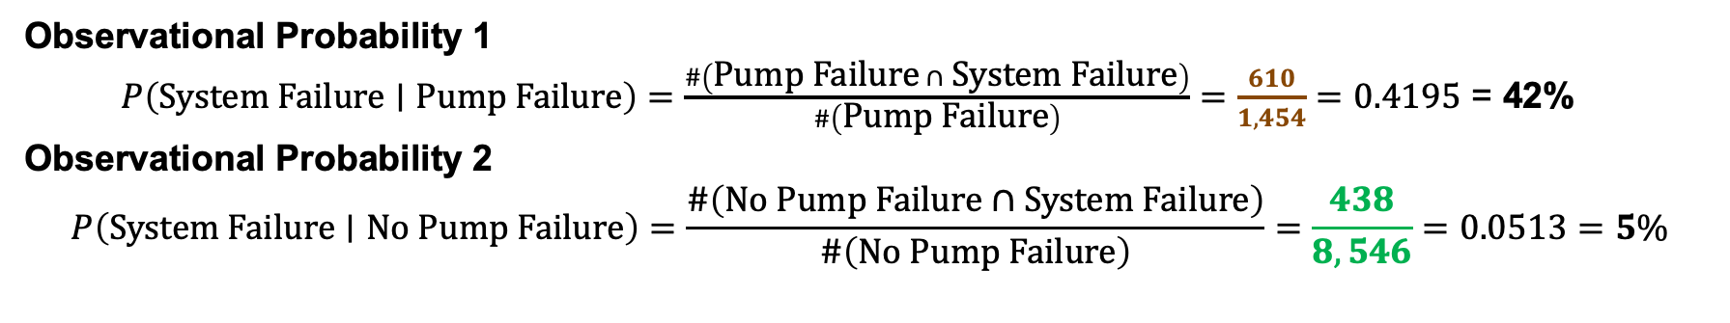
I. How is the Observational Probability Calculated?
Simulated Dataset
Total simulated observations = 10,000
Pump Failure | System Failure = No | System Failure = Yes | Total
No | 8,108 | 438 | 8,546
Yes | 844 | 610 | 1,454
Total | 8,952 | 1,048 | 10,000
Observational Probability 1
$P\left(\text{System} \text{Failure}∣\text{Pump} \text{Failure}\right)=\frac{\#\left(\text{Pump} \text{Failure} ∩ \text{System} \text{Failure}\right)}{\#\left(\text{Pump} \text{Failure}\right)}=\frac{610}{1,454}=0.4195$ = 42%
Observational Probability 2
$$P\left(\text{System} \text{Failure}∣\text{No} \text{Pump} \text{Failure}\right)=\frac{\#\left(\text{No} \text{Pump} \text{Failure}∩\text{System} \text{Failure}\right)}{\#\left(\text{No} \text{Pump} \text{Failure}\right)}=\frac{438}{8,546}=0.0513=5\%$$

Slide 9
Simulation and Results
Observational Probabilities: system failure occurs in approx. 42% of observations involving pump failure
Quantity | Value
P(System Failure | Pump Failure) | 0.4195 = 42%
P(System Failure | No Pump Failure) | 0.0513 = 5%
I

Slide 10
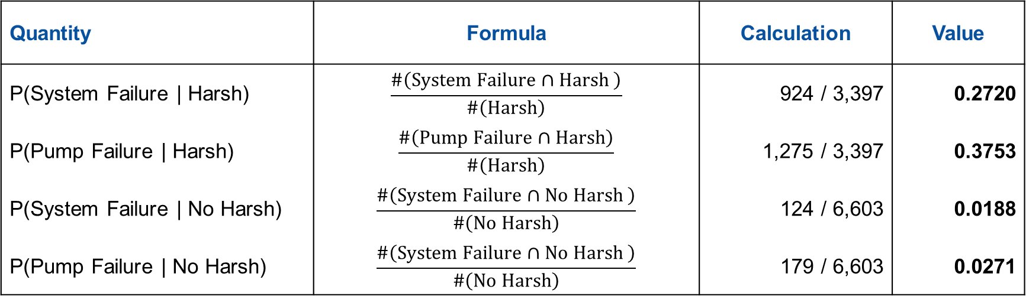
II. How is the Confounding Analysis Calculated?
Harsh Operating Conditions | System Failure | Pump Failure | Total # Observations Dataset
Yes | 924 | 1,275 | 3,397
No | 124 | 179 | 6,603
Total | 1,084 | 1,454 | 10,000
Quantity | Formula | Calculation | Value
P(System Failure | Harsh) | $$\frac{\#\left(\text{System} \text{Failure}∩\text{Harsh} \right)}{\#\left(Harsh\right)}$$ | 924 / 3,397 | 0.2720
P(Pump Failure | Harsh) | $$\frac{\#\left(\text{Pump} \text{Failure}∩\text{Harsh}\right)}{\#\left(\text{Harsh}\right)}$$ | 1,275 / 3,397 | 0.3753
P(System Failure | No Harsh) | $$\frac{\#\left(\text{System} \text{Failure}∩\text{No} \text{Harsh} \right)}{\#\left(\text{No} \text{Harsh}\right)}$$ | 124 / 6,603 | 0.0188
P(Pump Failure | No Harsh) | $$\frac{\#\left(\text{System} \text{Failure}∩\text{No} \text{Harsh} \right)}{\#\left(No Harsh\right)}$$ | 179 / 6,603 | 0.0271

Slide 11
Simulation and Results
Observational Probabilities: system failure occurs in approx. 42% of observations involving pump failure
Quantity | Value
P(System Failure | Pump Failure) | 0.4195 ~ 42%
P(System Failure | No Pump Failure) | 0.0513 ~ 5%
I
Confounding Analysis: where Confounder = Harsh Operating Conditions
Quantity | Harsh Conditions | No Harsh Conditions
P(System Failure) | 0.2720 | 0.0188
P(Pump Failure) | 0.3753 | 0.0271

Slide 12
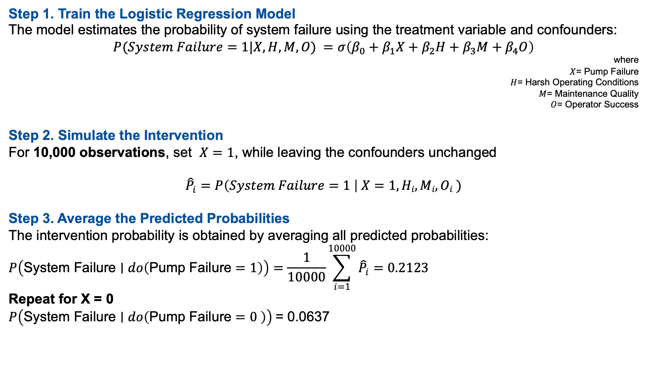
III. How is the Causal Intervention Probability Calculated?
Step 1. Train the Logistic Regression Model
The model estimates the probability of system failure using the treatment variable and confounders:
$$P(System Failure=1|X, H, M, O) =σ\left(β_{0}+β_{1}X+β_{2}H+β_{3}M+β_{4}O\right)$$
where
$X$= Pump Failure
$H$= Harsh Operating Conditions
$M$= Maintenance Quality
$O$= Operator Success
Step 2. Simulate the Intervention
For 10,000 observations, set $X=1$, while leaving the confounders unchanged
$${\hat{P}}_{i}=P\left(System Failure=1 \right| X=1, Hi, Mi, Oi )$$
Step 3. Average the Predicted Probabilities
The intervention probability is obtained by averaging all predicted probabilities:
$$P\left(\text{System} \text{Failure}∣do\left(\text{Pump} \text{Failure}=1\right)\right)=\frac{1}{10000}\sum_{i=1}^{10000}{{\hat{P}}_{i}}=0.2123$$
Repeat for X = 0
$P\left(\text{System} \text{Failure}∣do\left(\text{Pump} \text{Failure}=0 \right)\right)$= 0.0637
A causal effect is the change in an outcome that would occur because an intervention changes a particular variable, while other relevant conditions are held comparable.

Slide 13
Simulation and Results
Observational Probabilities: system failure occurs in approx. 42% of observations involving pump failure
Quantity | Value
P(System Failure | Pump Failure) | 0.4195 ~ 42%
P(System Failure | No Pump Failure) | 0.0513 ~ 5%
I
Confounding Analysis: where Confounder = Harsh Operating Conditions
Quantity | Harsh Conditions | No Harsh Conditions
P(System Failure) | 0.2720 | 0.0188
P(Pump Failure) | 0.3753 | 0.0271
Causal Intervention Analysis: reduces system failure estimate to approx. 21% after accounting for confounding factors
Quantity | Value
P(System Failure | do(Pump Failure = 1) | 0.2123 ~ 21%
P(System Failure | do(Pump Failure = 0) | 0.0637 ~ 6%
Causal Effect = 0.2123 – 0.0637 | 0.1486 ~ 15%
II
III
II – III

Slide 14
What does a PRA analyst do with the estimated causal effect?
After Estimating Causal Effects
Update conditional probabilities in PRA models
Evaluate design or operational interventions
Prioritize risk-significant components
Identify previously unmodeled causal relationships
Support more informed risk-informed decision making

Slide 15
Challenges and Practical Considerations
Limited data
Rare events
Limited failure observations
Model assumptions
Confounding variables
Assumed causal relationships
Verification & Validation
Ensure physically meaningful relationships
Consistency with engineering knowledge
Expert review
Validate causal structure
Determine suitability for PRA integration
These challenges reinforce that causal machine learning should complement and not replace traditional PRA and expert judgment

Slide 16
Summary
How Can Causal ML Help PRA?
  Improve estimation of conditional probabilities
  Identify causal relationships from operational data
  Support intervention and counterfactual analysis
  Complement expert judgment and existing PRA models
Future work
  Validate the framework using realistic PRA case studies

Slide 17
Contact the Authors
Karen D’Souza karen.dsouza@inl.gov
Wen-Chi Cheng wenchi.cheng@inl.gov
Thank You

