Slide 1
Refined Deep Learning-Based Time-Series Surrogate Model for the BRI2-CRIEPI Zone Fire Model with Demonstration
Using Full-Scale Test Data
1
Nuclear Risk Research Center
Central Research Institute of Electric Power Industry
Junghoon JI junghoon@criepi.denken.or.jp
Motomu SUZUKI s-motomu@criepi.denken.or.jp
PSAM18
July 20-24, 2026
PSAM18, July 20-24, 2026

Slide 2
INTRODUCTION
2
Background
In probabilistic risk assessment (PRA) for internal fires in nuclear power plants, scenario-based analysis plays a crucial role in quantitatively evaluating fire progression and equipment damage based on validated fire models
Spreadsheet-based models are primarily used, while zone models are applied only to limited evaluations
Limitations of Existing Models
Spreadsheet models
  Low prediction accuracy under mechanically ventilated conditions
  Limited capability for time-dependent calculations
Zone models
  Restricted applicability to compartment configurations
  Lack of spatial resolution in simulation results
Field models (CFD model)
  High computational cost (limited practicality for routine applications)
PSAM18, July 20-24, 2026

Slide 3
INTRODUCTION
3
Background (Cont.)
Current assessments tend to include a certain level of conservatism
There have been attempts in various engineering fields to develop deep learning-based surrogate models to maintain calculation accuracy while significantly reducing computational costs
Objective
To develop a deep learning-based surrogate model for field models
To reduce computational cost in fire progression analysis while maintaining field-model-level accuracy in fire risk assessment
Project Phases
  Phase 1 (FY2024): Development of a static surrogate model for zone models
  Phase 2 (FY2025): Development of a time-series surrogate model for zone models
  Phase 3 (FY2026): Development of a surrogate model for field models
PSAM18, July 20-24, 2026

Slide 4
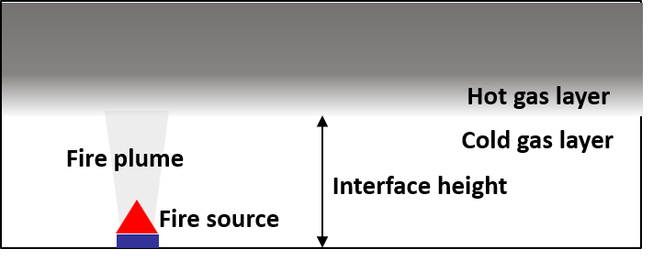
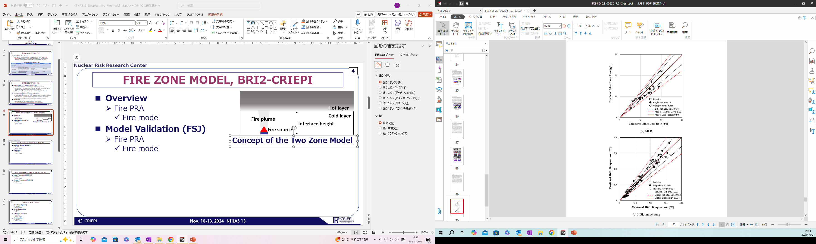
ZONE MODEL, BRI2-CRIEPI
4
BRI2002 & BRI2-CRIEPI
BRI2002
  Developed by Prof. Tanaka
  For architectural fire simulation
BRI2-CRIEPI
  An advanced model incorporating a fan curve approach to better represent mechanically ventilated conditions, enabling enhanced fire analysis for nuclear facilities
Two-zone model
Model Validation
The validation results for mass loss rate & hot gas layer temperature are acceptable
    [1] Shirai, K., Ji, J., Tasaka, K. and Udagawa, T., “Development of two-layer zone model BRI2-CRIEPI applicable to fire PRA for nuclear power plants”, Fire Safety Journal, Vol. 141, 2023, https://doi.org/10.1016/j.firesaf.2023.103948
Validation of BRI2-CRIEPI[1]
PSAM18, July 20-24, 2026

Slide 5
APPROACH
5
Surrogate Model Development Workflow
Sensitive analysis for identifying key model parameters in BRI2-CRIEPI
Dataset generation (100,000 samples)
Model construction, training, and evaluation
BRI2-CRIEPI
BRI2-CRIEPI
Dataset generation
Sensitive analysis
Randomized input
100,000
Simulations
Input 1
Output 1
Input 2
Output 2
,
,
Key Parameters
Output
…
Input 100,000
Output 100,000
LSTM
Training
Surrogate model
New Input
New Output
T
t
PSAM18, July 20-24, 2026

Slide 6
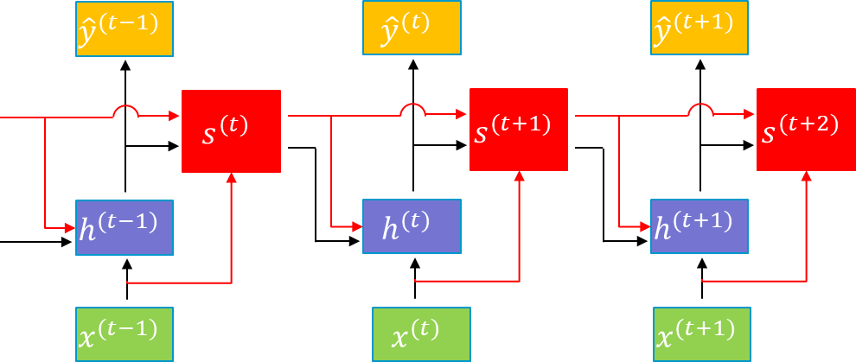

TIME SERIES SURROGATE MODEL
6
Overview & Training Setup
LSTM (Long Short-Term Memory)-based surrogate model
Training/Validation/Test data: 70%/20%/10%
Sampling interval: 10 sec
Batch size: 25
Activation function: $tanh$
Teacher Forcing applied: 0.8 → 0.0
Optimizer: Adam
  Initial learning rate: 0.001
Dropout: 0.1~0.5
Epochs: 100
Loss function: Mean Squared Error
Output
Long-term
memory
Hidden state
Input
Unrolled LSTM structure
PSAM18, July 20-24, 2026

Slide 7
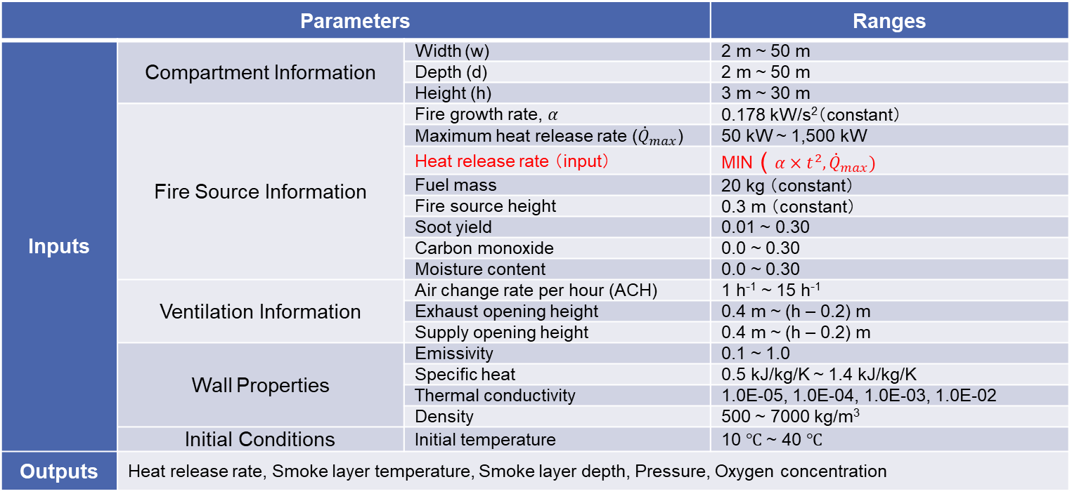
TIME SERIES SURROGATE MODEL
7
Parameters and Ranges
A broad parameter range applicable to typical nuclear facilities
The heat release rate (input) is the only time-dependent input
Parameters |  |  | Ranges
Inputs | Compartment Information | Width (w) | 2 m ~ 50 m
 |  | Depth (d) | 2 m ~ 50 m
 |  | Height (h) | 3 m ~ 30 m
 | Fire Source Information | Fire growth rate, $α$ | 0.178 kW/s²（constant）
 |  | Maximum heat release rate (${\dot{Q}}_{max}$) | 50 kW ~ 1,500 kW
 |  | Heat release rate （input） | MIN ( $α×t^{2}, {\dot{Q}}_{max})$
 |  | Fuel mass | 20 kg （constant）
 |  | Fire source height | 0.3 m （constant）
 |  | Soot yield | 0.01 ~ 0.30
 |  | Carbon monoxide | 0.0 ~ 0.30
 |  | Moisture content | 0.0 ~ 0.30
 | Ventilation Information | Air change rate per hour (ACH) | 1 h⁻¹ ~ 15 h⁻¹
 |  | Exhaust opening height | 0.4 m ~ (h – 0.2) m
 |  | Supply opening height | 0.4 m ~ (h – 0.2) m
 | Wall Properties | Emissivity | 0.1 ~ 1.0
 |  | Specific heat | 0.5 kJ/kg/K ~ 1.4 kJ/kg/K
 |  | Thermal conductivity | 1.0E-05, 1.0E-04, 1.0E-03, 1.0E-02
 |  | Density | 500 ~ 7000 kg/m³
 | Initial Conditions | Initial temperature | 10 ℃ ~ 40 ℃
Outputs | Heat release rate, Smoke layer temperature, Smoke layer depth, Pressure, Oxygen concentration
PSAM18, July 20-24, 2026

Slide 8
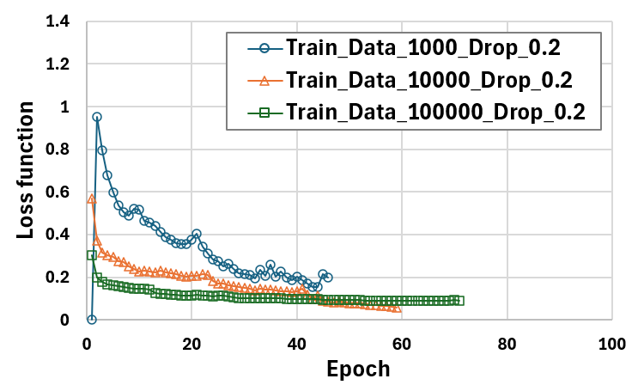
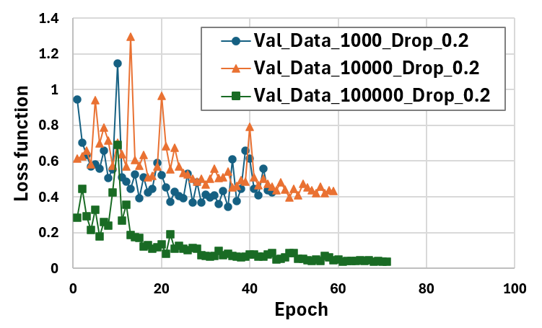
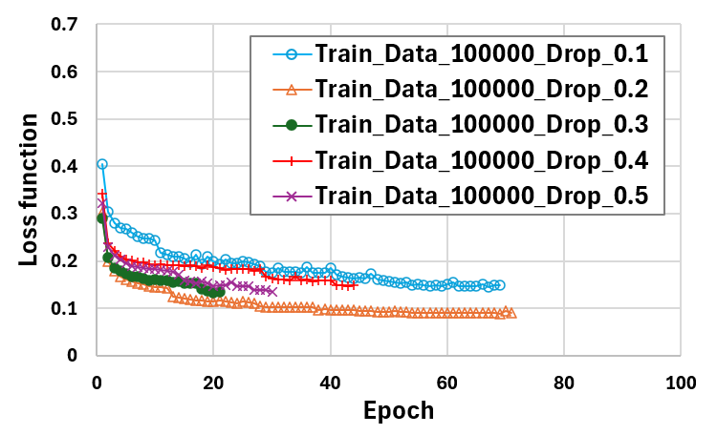
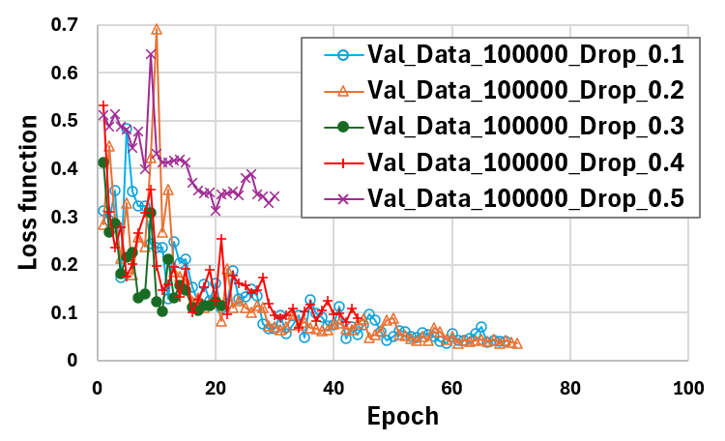
EFFECTS OF DATASET SIZE AND DROPOUT
8
Effects on Training and Validation Stability
Effects of dataset size
  Improved training stability with increasing dataset size
  Improved generalization with 100,000 samples
Effects of dropout
  Moderate dropout improves stability
  Excessive dropout degrades convergence
  Optimal dropout ≈ 0.2
Training
Validation
Effects of dataset size
Training
Validation
Effects of dropout
PSAM18, July 20-24, 2026

Slide 9
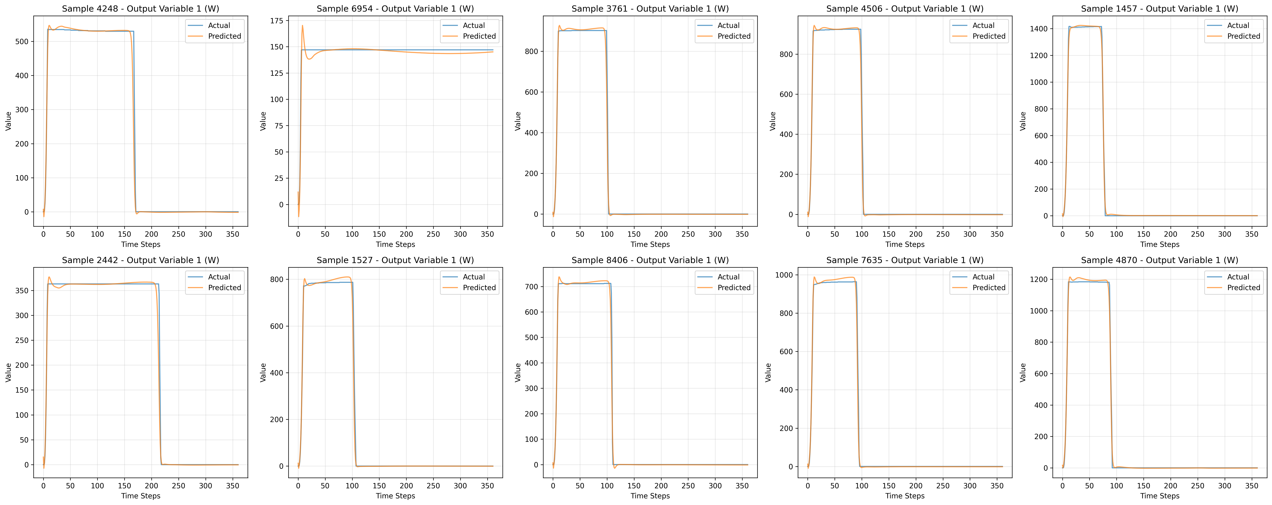
MODEL EVALUATION WITH TEST DATA
9
Predicted Heat Release Rate (HRR)
The time-dependent heat release rate was predicted for 10 simulation cases randomly sampled from the parameter space
The model successfully learned underlying physical patterns in complex fire behavior, enabling time-series prediction
Evaluation results of the time-dependent heat release rate
PSAM18, July 20-24, 2026

Slide 10
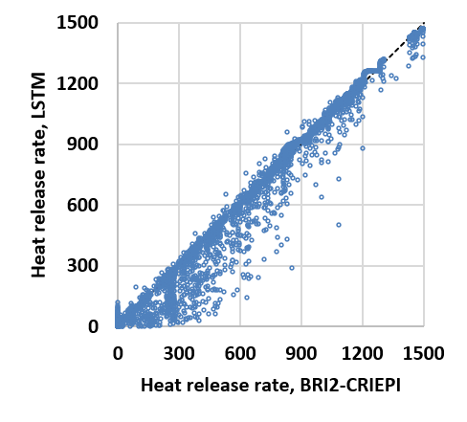
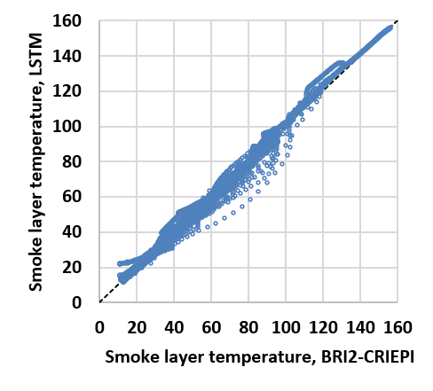
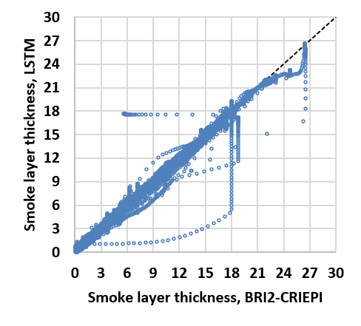
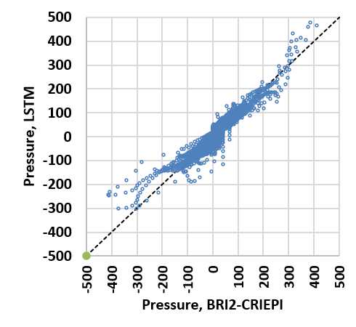
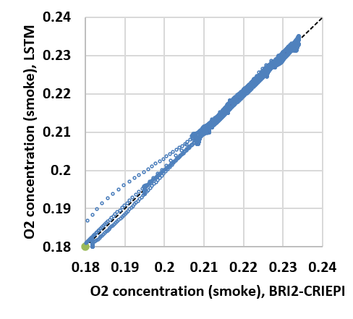
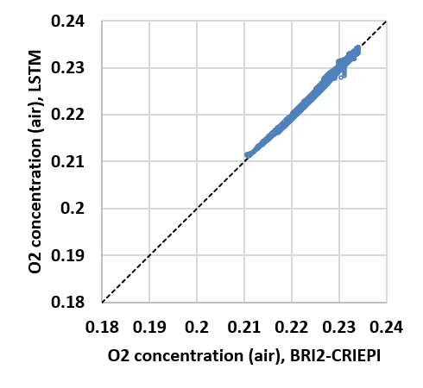
MODEL EVALUATION WITH TEST DATA
10
Evaluation Results for All Output Parameters
Results for 100 cases randomly sampled from the evaluation dataset
Some variability is observed in the predicted results
  It is necessary to introduce constraints based on physical principles (e.g., the heat release rate at time zero should be zero)
  Improvement in the quality of data generated using BRI2-CRIEPI is required
  Hyperparameter tuning is necessary
Heat release rate
Smoke layer
temperature
Smoke layer
thickness
Pressure
O₂ concentration
in the smoke layer
O₂ concentration
in the air layer
Prediction results for all output parameters
PSAM18, July 20-24, 2026

Slide 11
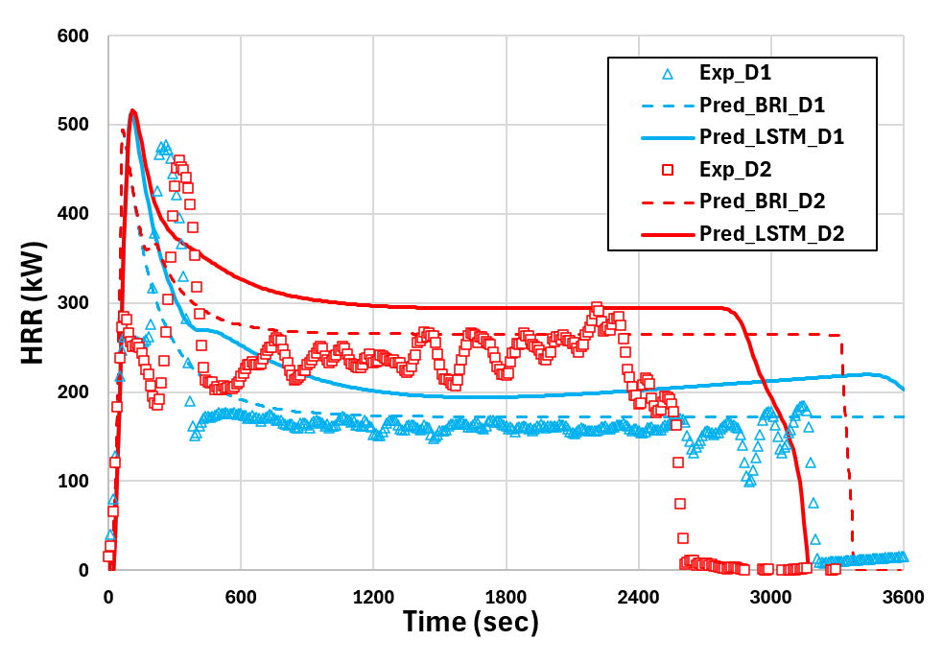
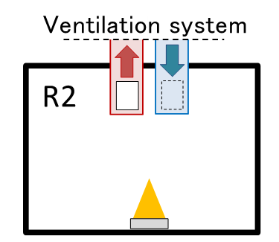
MODEL EVALUATION WITH EXPERIMENTAL DATA
11
Comparison with Full-Scale Experimental Data
Systematic overprediction of HRR in quasi-steady conditions, especially under ventilation-controlled fires
Further learning is needed to capture differences in burning duration due to fuel amount
Experimental overview
Single compartment （ 5 m × 6 m × 4 m ）
Fire source area：0.4m² (TPH pool)
Experimental condition
  D1：Air change rate = 4.7 h⁻¹
  D2：Air change rate = 8.4 h⁻¹
Time-dependent heat release rate
PSAM18, July 20-24, 2026

Slide 12
SUMMARY
12
Key Findings
  A deep learning–based temporal surrogate model for the BRI2-CRIEPI zone model was developed using an LSTM architecture
  The model predicts the full-time histories of key fire variables (e.g., HRR, smoke layer temperature, thickness, pressure, and O₂ concentration) from static inputs
  Comparison with full-scale experiments showed that the model can reproduce overall fire dynamics, including ventilation effects
Limitations
  Systematic overprediction of HRR in quasi-steady conditions, especially under ventilation-controlled fires
  Discrepancies in growth and burnout phases
PSAM18, July 20-24, 2026

