Slide 1
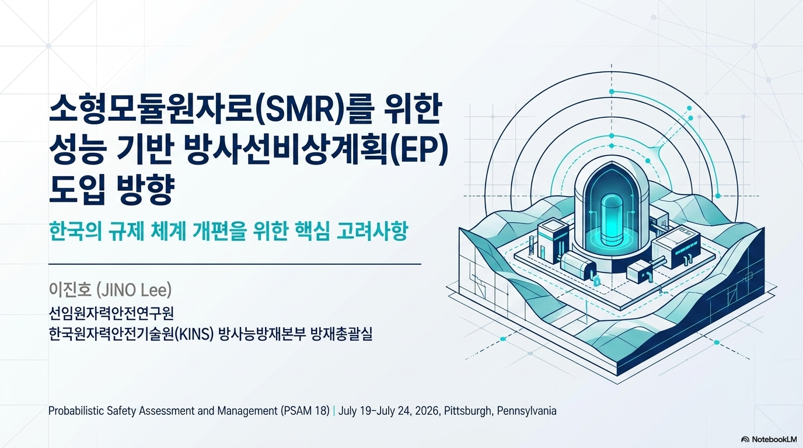

Toward Performance-Based Emergency Planning for Small Modular Reactors:
Regulatory Framework Considerations in Korea
Mr. JINO Lee
Senior Nuclear Safety Inspector
Division of Nuclear Emergency Preparedness
Department of Emergency Preparedness
Korea Institute of Nuclear Safety (KINS)
Probabilistic Safety Assessment and Management PSAM 18,
July 19-July 24, 2026, Pittsburgh, Pennsylvania
Notes:
Good morning. My name is Jino Lee. I am a Senior Nuclear Safety Inspector at the Korea Institute of Nuclear Safety, KINS.
Today I will talk about "Toward Performance-Based Emergency Planning for Small Modular Reactors: Regulatory Framework Considerations in Korea."
My work is on emergency preparedness regulation for SMRs. Today I will share the Korean case.

Slide 2
Disclaimer
The opinions, findings, conclusions, and recommendations expressed in this document are solely those of the authors and do not necessarily represent the official policy or position of the Korea Institute of Nuclear Safety (KINS)
Notes:
Before I start, one note. The views in this presentation are my own. They do not represent the official position of KINS.

Slide 3
Contents
Introduction
Considerations for EP in South Korea's SMR programs
Conclusion
Notes:
Here is the outline. First, an introduction. Second, the considerations for emergency preparedness in Korea's SMR programs. And finally, the conclusion.

Slide 4
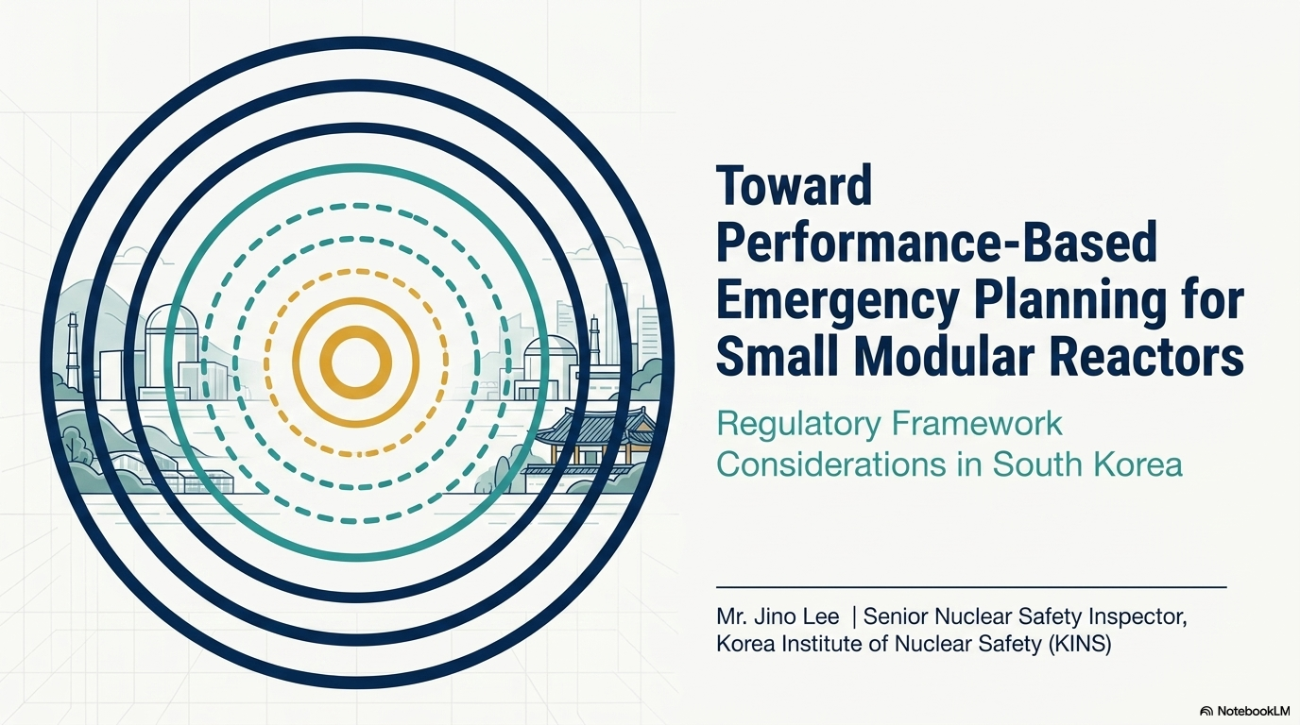
Introduction
Notes:
Let me begin with the background and the objectives of this study.

Slide 5
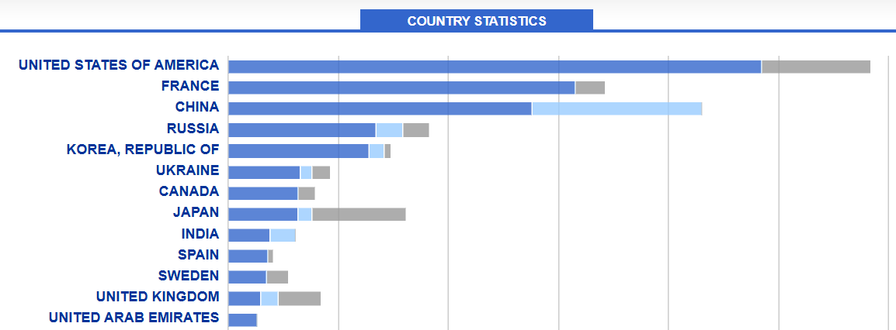
Background
1
2
3
4
5
NPP (Light water reactor, Heavy water reactor)
Permanently shut down power reactors
Research Reactor
Nuclear fuel material processing facilities
Spent fuel processing facilities
Etc.
Source: IAEA. Power Reactor Information System (PRIS): Country Statistics. Available at: https://pris.iaea.org/PRIS/CountryStatistics/CountryStatisticsLandingPage.aspx.
5
Notes:
Korea is the fifth largest country in nuclear power operation. We operate light water reactors and heavy water reactors. We also have research reactors, fuel fabrication facilities, and spent fuel facilities.
So our emergency preparedness regulation already covers many types of facilities.

Slide 6
Status of Reactor Types Expected to Apply for KOREA Licensing
Category | Reactor Type | Model Name | Developer | Purpose
Light Water Reactor | Light Water Small Modular Reactor | i‑SMR | i‑SMR Project Group | Power generation (multi‑purpose)
Non-Light Water Reactors | Molten Salt Reactor (MSR) | MARINA | KAERI | Ship propulsion
 | High Temperature Gas‑cooled Reactor (HTGR) | HECTAR | KAERI | Heat supply
 | Sodium‑cooled Fast Reactor (SFR) | H‑SFR (tentative) | KAERI | Power generation
 | Heat Pipe Reactor (HPR), MMR | NuSpace Power | KAERI | Power generation (extreme environments)
 | High Temperature Gas‑cooled Reactor (HTGR), | BeSMART | Biz | Power generation
 | Sodium‑cooled Fast Reactor (SFR) | Natrium | TerraPower (USA) | Power generation
 | Molten Salt Reactor (MSR) | Sea MSR‑100 | Saltforce Energy (Denmark) | Power generation (marine floating type)
Under review
Source: Korea NSSC. (2026). Roadmap for Establishing a Regulatory Framework for Small Modular Reactors (SMRs) (Draft)
6
Notes:
Now, many advanced reactors are under development in Korea. This table shows the reactor types expected to apply for licensing.
One light water SMR, the i-SMR, is under review now. Several non-light-water designs are expected to apply. These include molten salt reactors, high temperature gas-cooled reactors, sodium-cooled fast reactors, and heat pipe reactors.
So we will soon face reactors that are very different from our existing fleet.

Slide 7
Study Necessity and Objectives
Necessity
Given the introduction or planned deployment of advanced reactors, including SMRs and ONTs, the regulatory authority needs to review the current nuclear power EP regulatory framework and assess the necessity and direction for its revision.
Objectives
To review the appropriateness of South Korea’s current EP regulatory framework as applied to SMRs and ONTs.
To examine the Considerations for EP frameworks for SMRs in South Korea.
7
Notes:
This raises a question for the regulator. Is our current EP framework still appropriate?
So this study has two objectives. First, to review whether Korea's current EP regulatory framework fits SMRs and other new technologies. Second, to identify the key considerations for a future framework.

Slide 8
Considerations for EP in South Korea's SMR programs
Notes:
Now let me move to the main part. What should we consider for EP in Korea's SMR programs?

Slide 9
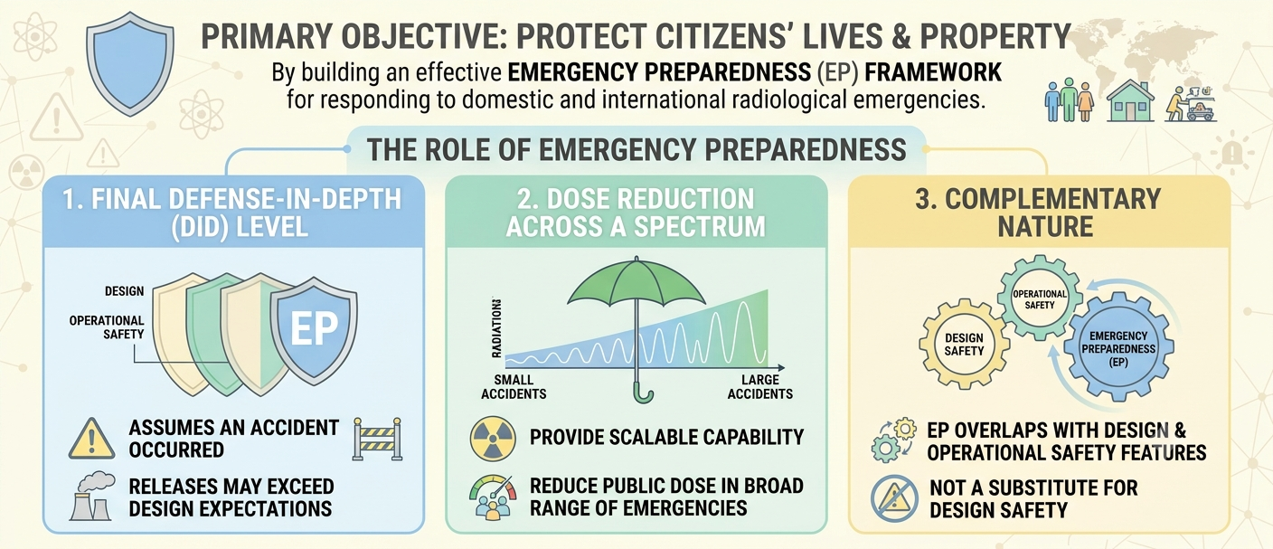
What Should EP Regulation Achieve?
9
Notes:
First, we should ask a basic question. What should EP regulation achieve?
The primary objective is simple. Protect the lives and property of the public.
EP plays three roles. First, it is the final level of defense in depth. It assumes an accident has already occurred, and that the release may exceed design expectations. Second, it provides scalable capability. It must reduce public dose across a wide range of accidents, from small to large. Third, it is complementary. EP overlaps with design and operational safety, but it is not a substitute for design safety.
This last point matters for our discussion today.

Slide 10
Current Status of EP Regulatory Framework in Korea Law
Planning Standard Topic | Korean Act
1. Assignment of Responsibility | Act Art. 18, Art. 19, Art. 20, Art. 21
2. Emergency Response Organization (ERO) | Act Art. 25–32
3. Emergency Response Support & Resources | Act Art. 21, Art. 25–32, Art. 35
4. Emergency Classification System (ECL/EAL) | Act Art. 17
5. Notification Methods & Procedures | Act Art. 21(1), Art. 22–24
6. Emergency Communications | Act Art. 21(1)⑥, Art. 28
7. Public Education & Information | Act Art. 21(1)③, Art. 24, Art. 42
8. Emergency Facilities & Equipment - Establishment of TSC, OSC and EOF | Act Art. 35
Planning Standard Topic | Korean Act
9. Accident Assessment - Facilities for assessing offsite release | Act Art. 29, Art. 32(4), Art. 41
10. Protective Response (Evacuation, KI, etc.) | Act Art. 29, Art. 26, Art. 35-2
11. Radiological Exposure Control | Act Art. 21(1), Art. 29, Art. 42
12. Medical & Public Health Support | Act Art. 32(2), Art. 39
13. Recovery & Reentry | Act Art. 33, Art. 41–42
14. Exercises & Drills | Act Art. 37–38
15. Response Training | Act Art. 36, Art. 21(1)
16. Plan Development, Review, Distribution | Act Art. 18–20, Art. 20-2
10
Notes:
This slide shows the current EP framework in Korea. We have sixteen planning standards, and each one is supported by the Act.
One point to note. Korean law already applies a graded approach. It distinguishes power reactor licensees from other nuclear licensees. Different levels of requirements apply to each.
For other licensees, relaxed requirements can be applied to some elements. For example, emergency response facilities, and accident assessment.
So the idea of grading is not new to us. But the grading is by facility category, not by risk.

Slide 11
EPZ sizing regulation
“Regulatory body shall announce an area that serves as a base for establishment of a EPZ by nuclear facilities” - Act. Art. 20-2
Category | PAZ (radius) | UPZ (radius)
Power reactors | 3–5 km | 20–30 km
Research reactors
– Thermal power ≥ 2 MW and < 10 MW | None | Approx. 0.5 km
– Thermal power ≥ 10 MW and < 50 MW | None | Approx. 1.5 km
– Thermal power ≥ 50 MW and < 100 MW | None | Approx. 5 km
Other nuclear facilities | None | Site boundary
Currently, there is no formal regulatory framework for
requesting exemptions from regulatory requirements or
case-by-case determinations of the EPZ
11
Notes:
Now, EPZ sizing. Here the graded approach is only partial.
For research reactors, the UPZ scales with thermal power. For other facilities, the EPZ is the site boundary.
But for power reactors, the numbers are fixed. PAZ three to five kilometers. UPZ twenty to thirty kilometers.
And this is the key point. Currently there is no formal mechanism to request an exemption, and no mechanism for a case-by-case determination of the EPZ.

Slide 12
Item | IAEA | Korea | USA | Finland | UK | Canada | Japan
EPZ approach | Graded; hazard-assessment based. Obligation to establish only — no fixed distance required | Prescriptive (statutory ranges) | Existing: prescriptive. Alternative: performance-based | Case-by-case (applicant demonstrates safety), 20 km cap | Case-by-case, risk-assessment based, no fixed distance | No zone size in federal requirements; set by provinces | Prescriptive
Distances | (Non-binding guidance) PAZ 3–5 km, UPZ 15–30 km | PAZ 3–5 km, UPZ 20–30 km | 10 mi plume / 50 mi ingestion | ≤20 km (cap) | Operator hazard evaluation → local authority sets DEPZ | Varies by province | PAZ 5 km, UPZ 30 km
SMR response | No amendment needed — current standards applicable | Amendment in progress | Explicit amendment: 10 CFR 50.160 (2023) + RG 1.242; → may shrink to site boundary | Explicit amendment: uniform 20 km abolished → case-by-case. No approvals yet | Not needed — existing case-by-case system accommodates | Not needed; reviewing improvements to SMR EPZ decision process | No amendment identified
12
Notes:
This table compares the EPZ approach across countries.
In short, there are two groups. The United States, Finland, the United Kingdom, and Canada allow case-by-case or performance-based EPZ determination. Korea and Japan remain prescriptive.
Korea is the country with an amendment in progress. That is where we are today.

Slide 13







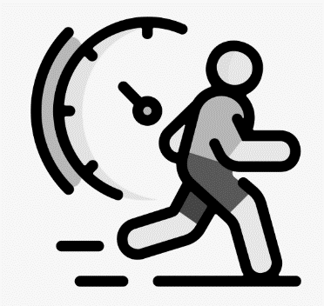
Anticipated Exemptions from Off-Site EP Requirements for Site-Boundary EPZ
Site-Boundary
= EPZ ?
Emergency classification
In the E-Plan, actions and EALs for the ‘General Emergency’ may not be necessary to be included in the E-Plan.
Evacuation Time Estimate (ETE)
Not required to perform an ETE because no predetermined strategy/plan exists for off-site protective actions.
Notifications to external agencies
Off-site
Not required to establish coordination systems with external emergency organizations (e.g., medical, fire services).
Protective actions
Dose Projections
Not required to establish an off-site protective action recommendation and decision-making system for implementing predefined protective actions.
Not required to provide means to evaluate off-site dose (e.g., environmental survey teams, environmental monitoring networks).
Emergency response facilities
Drills/Exercises
Not required for the licensee to operate off-site emergency response facilities used for coordination on off-site response.
Not required to conduct off-site response drills or joint exercises with external emergency response organizations.
13
Notes:
Because of this, SMR vendors are asking for relaxation. Their main goal is to reduce the EPZ to the site boundary.
So we asked a simple question. If the EPZ becomes the site boundary, what happens to the off-site requirements?
This slide shows what we anticipate. A General Emergency classification may not be needed. An evacuation time estimate may not be required. Off-site protective action decision-making may no longer be necessary. Off-site dose projection, off-site emergency facilities, and joint drills with off-site organizations may all be exempted.
So this is not a small change. Reducing the EPZ removes a large part of the off-site EP system. That is why the question deserves careful review.

Slide 14

Prescriptive Regulation vs. Performance‑Based Regulation
Item | Prescriptive Regulation |  | Performance‑Based Regulation
Definition | A regulatory approach that specifies detailed requirements, actions, and procedures to be followed, often referred to as a command‑and‑control model. |  | A regulatory approach that emphasizes the achievement of desired outcomes, allowing flexibility in the methods used to meet performance objectives.
Characteristi-cs | Focuses on specific steps, standards, and predefined criteria (e.g., fixed Emergency Planning Zone (EPZ) size, fixed emergency response facilities). Low flexibility; all procedures are explicitly defined and must be strictly adhered to. |  | Focuses on outcome‑ or performance‑based criteria (e.g., protection of public health, effectiveness of emergency response). High flexibility; regulated entities may choose methods to achieve the specified performance goals.
Pros and Cons | Clarity Ease of Regulation Consistency | Rigidity Check-box Mentality Over-regulation | Flexibility Efficiency Innovation | Uncertainty Verification Difficulty Initial Cost
Examples | Fixed EPZ size. Fixed Emergency facilities. |  | Adjustable EPZ size based on risk assessment. Flexible emergency planning informed by hazard evaluation.
14
Notes:
This brings us to the regulatory approach itself.
Korea has traditionally used prescriptive regulation. It gives clarity, ease of regulation, and consistency. But it is rigid. It can create a check-box mentality, and it can lead to over-regulation
A performance-based approach gives flexibility, efficiency, and room for innovation. But it also brings uncertainty, difficulty in verification, and higher initial cost.
So the question is not which one is better. The question is where the right balance is.

Slide 15
Key Considerations for EP Regulatory Revision
PB approach
Scope
(All type of licensee?)
Will a performance-based approach be more effective than the prescriptive approach?
Regulatory Framework Revising
Integration
Stakeholder engagement?
How to differentiate or integrate “SMRs” or “new technologies” with existing fleets?
Reasonable safety assurance?
15
Notes:
So, what must we decide when we revise the framework?
We identified five key considerations.
First, integration. Should we regulate SMRs and new technologies separately from the existing fleet, or integrate them?
Second, the approach. Will a performance-based approach really work better than the prescriptive one?
Third, reasonable assurance. Can we still demonstrate reasonable assurance of public protection?
Fourth, scope. Does this apply to all licensees, or only to some?
And fifth, stakeholder engagement.
For Korea, I want to focus on the fifth one. Stakeholder engagement is not a procedural formality for us. It is a structural issue. Let me explain why on the next slide.

Slide 16
What specific considerations are needed given Korea's conditions?
Stakeholder engagement
It should be reviewed whether it is reasonable to have the local governments responsible for implementing offsite emergency plans participate in determining the EPZ size.
Effectiveness of Reduced EPZ (Site Boundary) Considering Korea's Population Density
Korea's EPZ (30 km) covers a population of approximately 3 million (Kori NPP), whereas in the U.S. a comparable EPZ covers approximately 300,000 (Limerick NPP).
Given the population density difference, it should be reviewed whether protective actions for the public can be implemented ad hoc, without an EPZ as a formal planning tool.
16
Notes:
Two considerations are specific to Korea.
The first is who conducts. In Korea, off-site protective actions are implemented by local governments, not by the licensee. So if the EPZ size is determined only between the regulator and the licensee, the organization that must actually protect the public has no voice in that decision. We should review whether local governments should participate in determining the EPZ size.
The second is population density. This is the most important slide of my talk.
The thirty kilometer EPZ around the Kori site covers about three million people. For a comparable EPZ in the United States, at Limerick, the number is about three hundred thousand. That is a factor of ten.
So here is the question. If we remove the EPZ as a formal planning tool, can protective actions still be implemented ad hoc? For three hundred thousand people, maybe. For three million people, we are not confident.
This is why Korea cannot simply copy another country's rule. The same EPZ size does not mean the same risk to the public.

Slide 17
Conclusion
Notes:
Let me conclude.

Slide 18
Summary
In this study, we (1) evaluated the adequacy of South Korea’s current EP regulatory framework for SMRs and ONTs, (2) identified key considerations for future revisions.
For regulating SMRs and ONTs, the existing prescriptive framework may need to be revised by introducing an appropriate balance between prescriptive and performance-based approaches.
In this context, it is essential to ensure that the regulatory framework can flexibly accommodate diverse reactor technologies while maintaining stakeholder-supported emergency preparedness capabilities.
18
Notes:
In this study, we did two things. We evaluated whether Korea's current EP framework is adequate for SMRs and other new technologies. And we identified the key considerations for future revision.
Our conclusion is this. The existing prescriptive framework will likely need revision. But the answer is not a full move to performance-based regulation. It is an appropriate balance between the two.
And the framework must do two things at once. It must flexibly accommodate diverse reactor technologies. And it must maintain emergency preparedness capability that stakeholders actually support.

Slide 19


Closing Remark
Closing Remark
GEN.3+
GEN.3 NPP
GEN.2 NPP
GEN 4?
GEN.1 NPP
19
Notes:
One closing thought.
With SMRs and Gen-IV technologies coming, I believe this is a good opportunity to strengthen and optimize our regulatory system.
In the past, whenever a new facility appeared, we tended to add regulation piece by piece. Like stacking stones. An exemption here, a requirement there. It was a patchwork.
Now we have a chance to carve and polish those stones, and build a proper pagoda. In other words, we can turn what we have into a more robust and more coherent regulatory framework.

Slide 20
Thank you
Mr. Jino Lee
Senior Nuclear Safety Inspector
Division of Nuclear Emergency Preparedness
Department of Emergency Preparedness
Korea Institute of Nuclear Safety (KINS)
62 Gwahak-ro, Yuseong-gu, Daejeon 34142. Republic of Korea | www.kins.re.kr
+82-42-603-3200 | jolee@kins.re.kr
20
Notes:
Thank you for your attention. I am happy to take any questions.

