Slide 1
Safety Case Management in the United Kingdom Offshore Industry
Verification of Safety and Environmental Critical Elements, and Risk Management through Predictive Bow Ties
Dr. Ian Stanley
Principal Reliability Engineer
The content of this paper was developed during PhD (University of Aberdeen) and subsequent personal research and work prior to the Author joining Shell International B.V.. The contents therefore do not necessarily reflect the views of Shell International B.V. and the Author asserts their moral right to be identified as Author of this work.

Slide 2
UK Offshore Safety Case framework
Defining Moment - Piper Alpha Disaster (North Sea)
  6th July 1988
  Hydrocarbon fire…..
  167 persons perished
  Lord Cullen’s Inquiry (106 Recommendations)
Introduction of Safety Case
  Transition from Prescriptive to Goal Setting Regime
    Setting out what must be achieved but not prescribing how it is to be accomplished
  Demonstrates the Duty Holder has:
    Identified all major accident hazards (MAH)
    Assessed the risks
    Has in place adequate control measures and management systems to manage these risks
    ALARP Demonstration

Slide 3

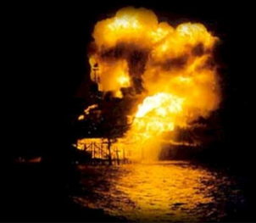
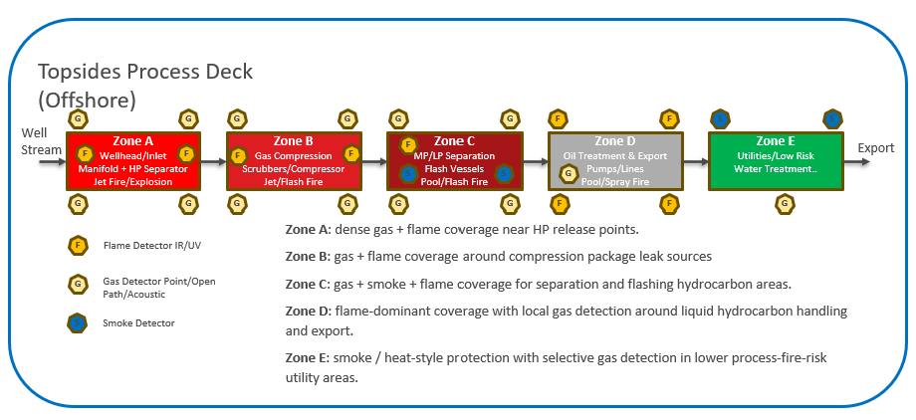
Offshore Environment

Slide 4
Major Accident Hazard
An event that could result in multiple fatalities or serious environmental damage
Identification: HAZID/HAZOP/Bow Ties
Risk Assessment: Quantitative Risk Assessment (QRA)
  Individual and Societal Risk
Control Measures
  Prevention and Mitigation Barriers
  Safety and Environmental Critical Elements (SECE’s)
  Verification
ALARP Demonstration
MAH ID | MAH Category | Scenario Description | Initiating Causes | Potential Consequences | Prevention Barriers | Mitigation Barriers | Key Safety-Critical Elements (SECEs) | Performance Standard (Example) | Owner
MAH-01 | Hydrocarbon Release | High-pressure gas leak from separator piping leading to explosion | Corrosion, gasket failure, overpressure | Explosion, multiple fatalities, structural damage | RBI programme, corrosion monitoring, pressure control systems | Gas detection, ESD, deluge system, blast walls | Gas detectors, ESD valves, firewater pumps, PFP | Gas detection within <5 sec; ESD closure <30 sec | Ops / Technical Authority
MAH-02 | Loss of Containment | Crude oil leak from export pump seal | Mechanical seal failure, poor maintenance | Pool fire, environmental pollution | Preventive maintenance, condition monitoring | Fire detection, bunding, firefighting systems | Fire detectors, pumps, containment systems | Firewater availability >95% uptime | Maintenance Lead

Slide 5
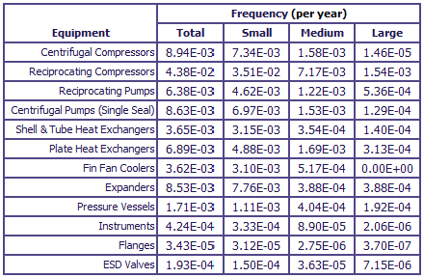
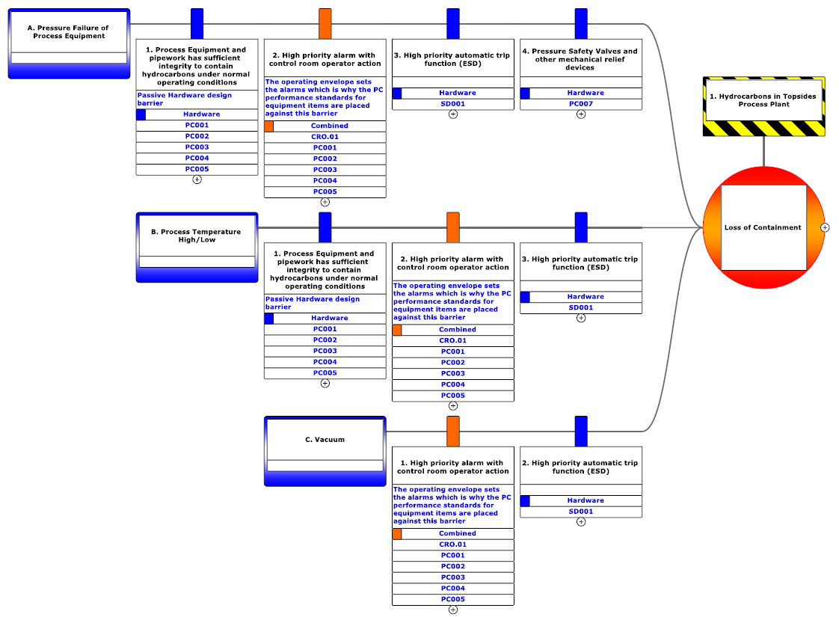
Predictive Bow Ties: Why they matter?
UK Offshore Oil & Gas Safety Cases
  Static “snapshots” in time
  Reviewed/updated every five (5) years
  Large voluminous documents – “thud factor”
QRA
  Generic industry data used
  “Suitable and Sufficient”
Bow Ties
  Barriers assumed to be independent
  Barrier not viewed as a system – series/parallel/zoning configurations
CMMS Systems
  Hierarchy or FLOC Structures
  Missing certain QRA “parts count”
  ~20% FLOCS are SECE

Slide 6
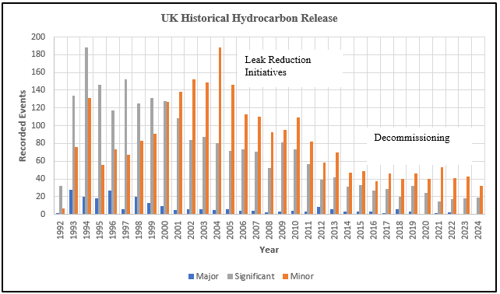
Fundamental Questions
How safe are we today, tomorrow, next week……………..?
How do prioritise SECE verification activities?
If we predict ALARP being compromised, what activities can be scoped sufficiently early?
How do we make the Safety Case “Live” and deliver the “thud factor”

Slide 7
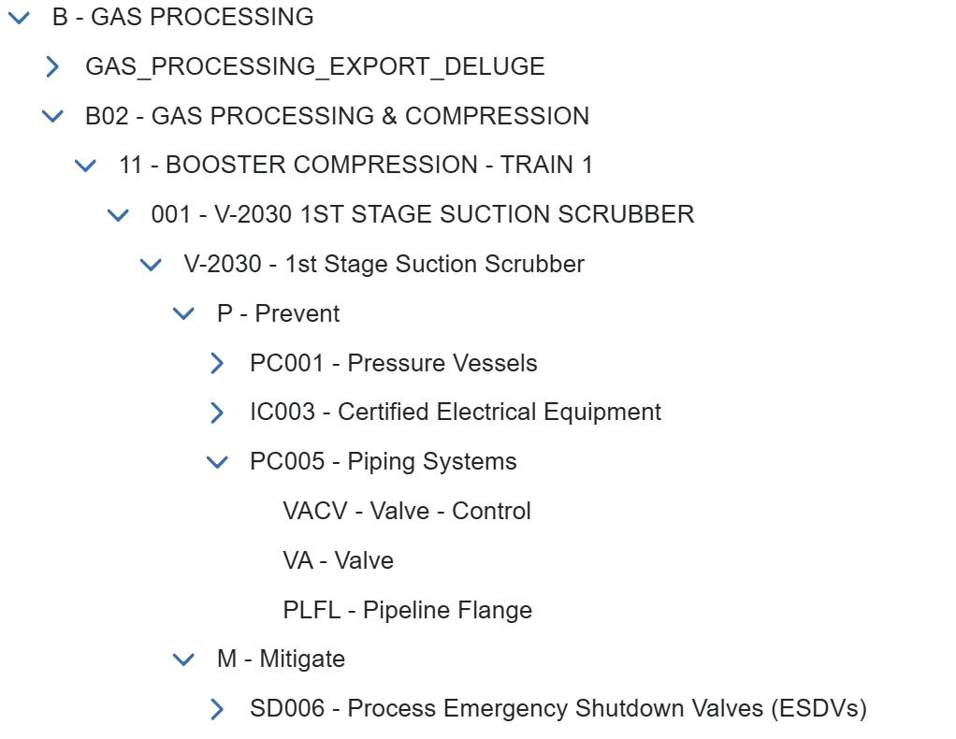
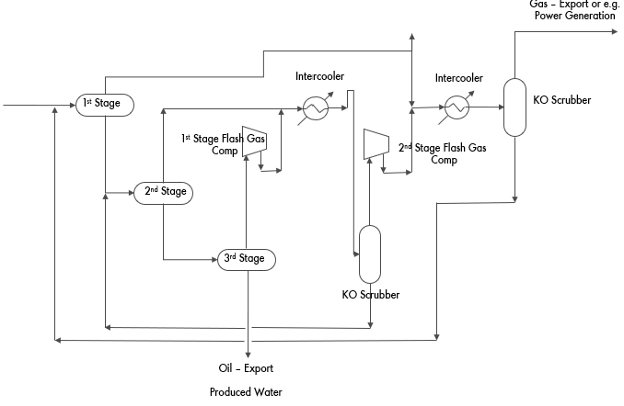
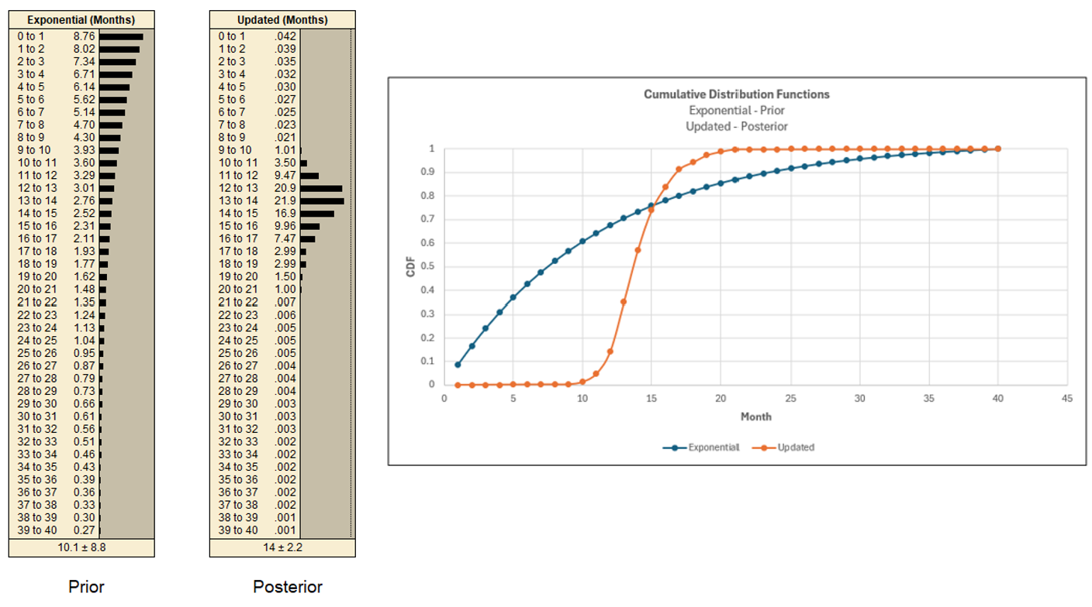
Foundation of Predictive Bow Tie
Condensing LHS and RHS side of Bow tie into a more granular equipment and system focussed alternative
Including
  Inclusion of P and M
  Missing QRA “parts count”
  “zoning” and MooN
  AND/OR Gates
  Time dependent Probabilistic modelling
  Bayesian Learning
Live CMMS and other data

Slide 8
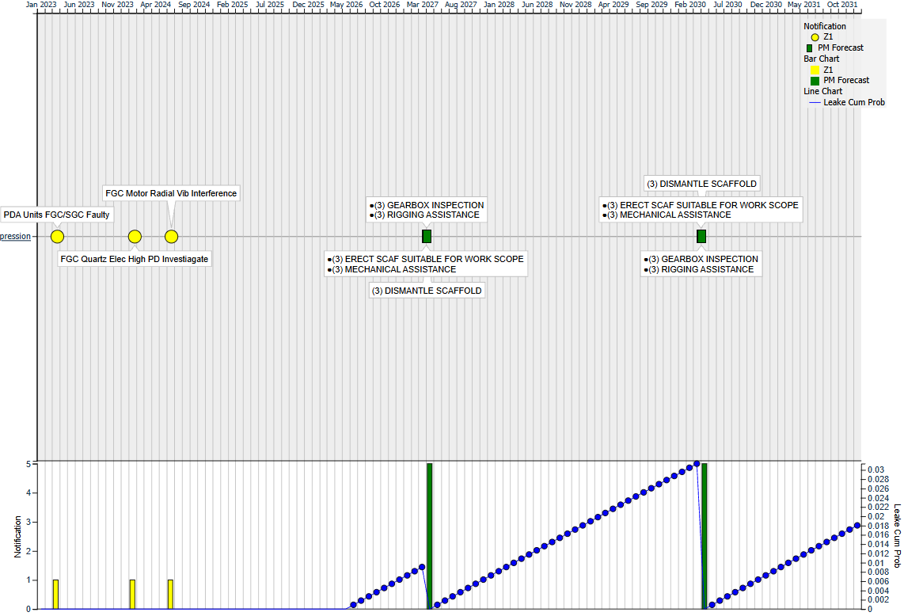
Planned Maintenance and Risk Profile
Probability of Failure at future point in time
CDF asymptotic
Back to time zero on SECE planned maintenance
Simulate changing timing of planned maintenance

Slide 9
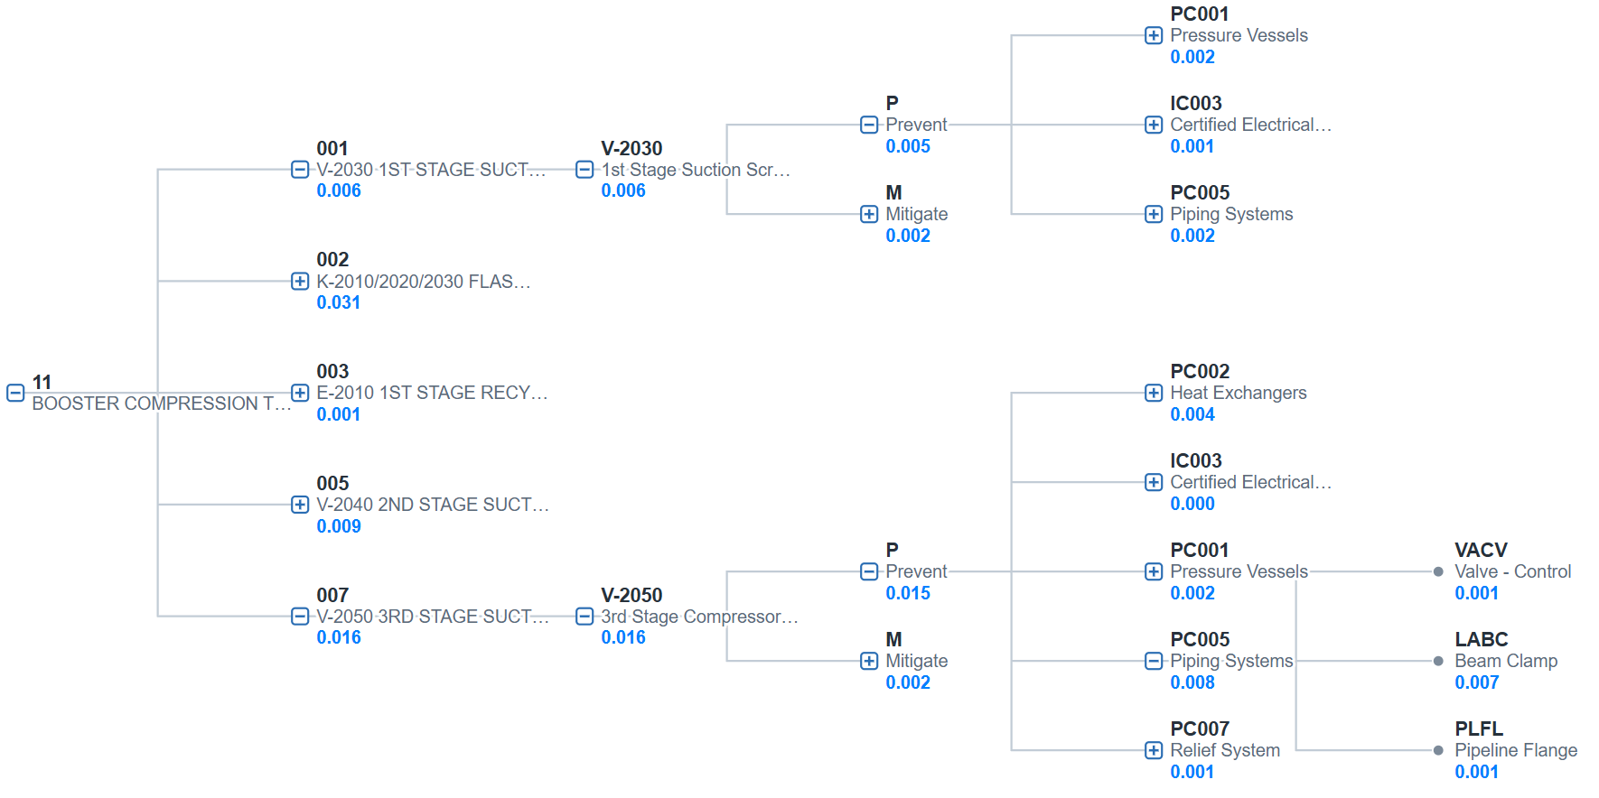
Predictive Capability
Topology of Causal Relationships
Cumulative Risk and “bad actors”
If ALARP compromised, where, what, when????
Scoping actions sufficiently early to mitigate

Slide 10
Conclusions
A live and predictive hybrid Bow Tie has been developed
  Addresses issues associated with QRA, Bow Tie and CMMS
  Allows scoping of interventions when ALARP is predicted to being compromised
  Prioritisation of SECE’s verification activities more rigorous
  Clear evidence to Competent Authority control measures in place to manage risk
  Provides the “thud factor” to Safety Cases

Slide 11
Q&A

Slide 12
THANK YOU

