Slide 1


Probabilistic Safety Assessment and Management (PSAM 18)
A Dynamic Bayesian Network Approach for Modeling
High-Wind Probabilistic Safety Assessment in Nuclear Power Plants
Chaeyeon Go¹, Shinyoung Kwag¹*, Seunghyun Eem², Changuk Mun³, Daegi Hahm³
Ph.D. Student
Civil Engineering
¹ Hanbat National University ² Kyungpook National University ³ Korea Atomic Energy Research Institute

Slide 2

Table of
CONTENTS
1
Introduction
Research Introduction · Research Background
2
Methodology
Proposed intensity-based DBN · Study Area and High Wind Scenarios
3
Case Studies & Extension
Case 1 · Case 2 · Extension to Real-Time Monitoring
4
Conclusion
Conclusion & Future work
2

Slide 3
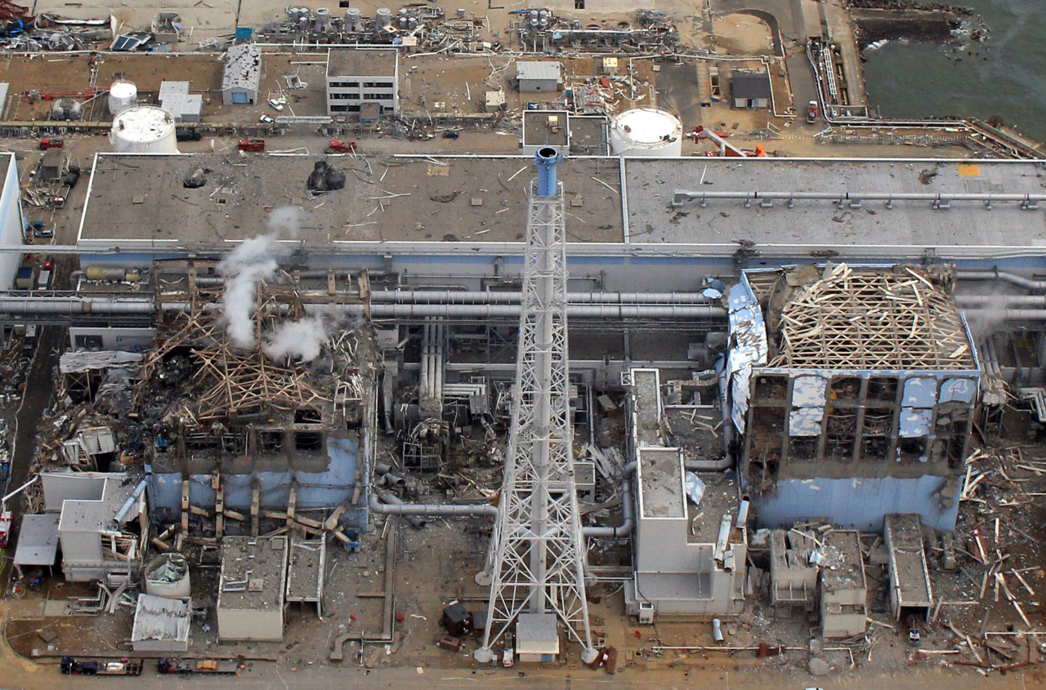
1 · INTRODUCTION
Research Introduction
After the 2011 Fukushima accident, external hazards became a serious concern for NPP safety.
Especially, regulators including the USNRC expanded external-hazard PSA to cover earthquakes, flooding, and high winds.
Among these external hazards, high winds act across the entire site, causing simultaneous SSC(Structures, Systems, and Components) damage and cascading failures.
Typhoons, Tornadoes, etc.
SSCs considered in this study
Auxiliary Building (AUX)
Emergency Diesel Generator Building (EDGB)
Essential Service Water (ESW) Intake Structure
Component Cooling Water (CCW) Heat Exchanger Building
Turbine Building (TB)
Switchyard Structure (SWY)
Figure 1. Fukushima NPP after the 2011 accident
3

Slide 4
1 · INTRODUCTION
Research Background
To assess these hazards, NPPs have traditionally used ET–FT models.
However, ET–FT computes the damage probability independently at each wind speed, so it cannot capture how damage accumulates as wind speed rises.
Bayesian network (BNs) offer an alternative: they can represent complex inter-SSC dependencies, probabilistic inference, and uncertainty propagation.
But a static BN fixes the system state at a single point in time, so it cannot capture how damage states evolve as wind speed changes. A static BN gives only the conditional core damage probability (CCDP) at one wind speed. Core damage frequency (CDF = Σ CCDPᵢ·ΔHᵢ) requires CCDP across the whole intensity range. A static BN therefore cannot produce CDF.
Against this background, this study proposes an intensity-based dynamic BN (DBN) that uses wind intensity as the state-transition axis to model the integrated propagation and dependencies of SSC damage states.
4

Slide 5
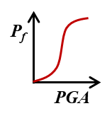
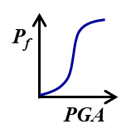
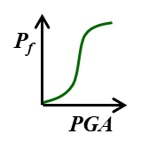
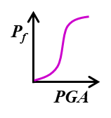

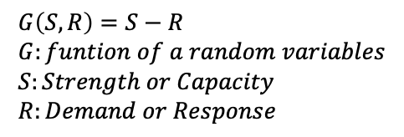

2 · METHODOLOGY
Proposed Intensity-based DBN
Traditional static Bayesian Network (BN)
A static BN captures the system at only a single wind speed. It can only calculate the CCDP.
CDF needs CCDP over the whole intensity range. A static BN cannot produce CDF.
$$CCDP =P_{f|λ}=P(G<0|λ)$$
$$G\left(S,R\right)=S−R \\ G:funtion of a random variables \\ S:Strength or Capacity \\ R:Demand or Response$$
Sys₁
Sys₂
CCDP
CCDP
+
+
Con-
sequence
+
C₁
C₂
C₃
C₄
Seq₁
Seq₂
Seq₁
Seq₂
·
Seq #
Sys₁
Sys₁
Sys₂
+
Sys₁
NSys₁
Sys₂
Sys₁
Sys₂
Seq₃
OK
C₁
C₂
+
+
C₁
C₂
C₃
C₄
C₁
C₂
C₃
C₄
Seq₂
CD
Seq₁
CD
ET-FT
One-top FT
Static BN
5

Slide 6



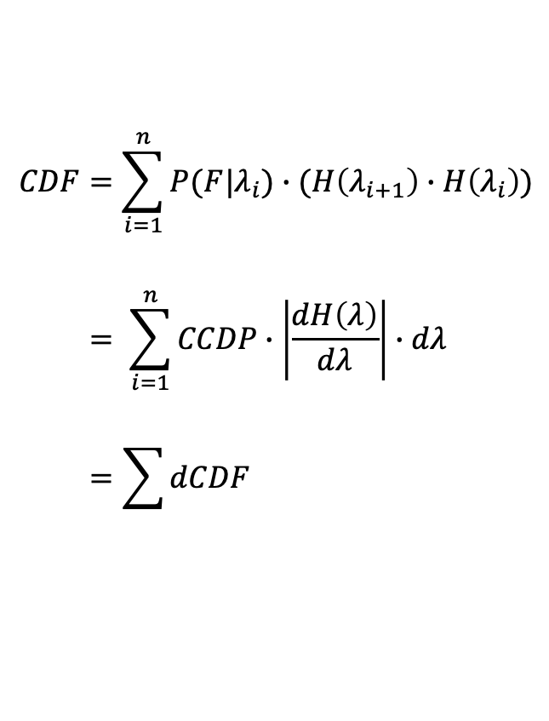


2 · METHODOLOGY
Proposed Intensity-based DBN
Hazard curve Info.
Proposed Dynamic BN (DBN)
AEP
$$y=H(λ)$$
A DBN links intensity slices with inter-slice edges. A state at one slice conditions the next. This models the transition and propagation of damage states.
(Annual Exceedance Probability)
dCDF
$$CCDP =P_{f|λ}=P(G<0|λ)$$
$λ$ = 1
$λ$ = 3
Intensity
CCDP
dH
$λ$ = 2
$$CDF=\sum_{i=1}^{n}{P(F|λ_{i})∙(H\left(λ_{i+1}\right)∙H\left(λ_{i}\right))} \\ = \sum_{i=1}^{n}{CCDP∙\left|\frac{dH\left(λ\right)}{dλ}\right|∙dλ} \\ =\sum{dCDF}$$
Fragility based-
CPTs (conditional probability tables)
Seq₁
Seq₂
Sys₁
NSys₁
Sys₂
n=3 | C₁
Fail
Safe
Fragility info.
Hazard info.
n=2 | C₁
Fail
Safe
C₁
C₂
C₃
C₄
n=1 | C₁
Fail
Safe
6
Figure 2. Intensity-based DBN

Slide 7
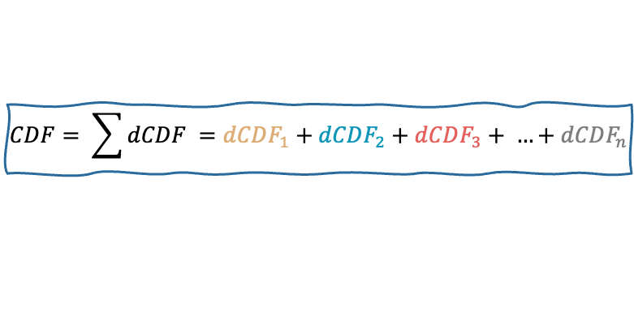
2 · METHODOLOGY
Proposed Intensity-based DBN
3
dCDF3
dH
CCDP
…
Seq₁
Seq₂
dCDF1
1
NSys₁
dH
CCDP
Sys₁
Sys₂
Seq₁
Seq₂
dCDF2
C₁
C₂
C₃
C₄
n
2
dCDFn
NSys₁
dH
CCDP
Sys₁
Sys₂
dH
CCDP
Seq₁
Seq₂
Seq₁
Seq₂
C₁
C₂
C₃
C₄
Sys₁
NSys₁
Sys₂
NSys₁
Sys₂
CPT(N = 1)
Sys₁
n=1 | C₁
Fail | -
Safe | -
C₁
C₂
C₃
C₄
C₁
C₂
C₃
C₄
$$CDF= \sum{dCDF} =dCDF_{1}+dCDF_{2}+dCDF_{3}+ …+dCDF_{n}$$
7
Figure 3. Unrolled Intensity-based DBN

Slide 8
2 · METHODOLOGY
Proposed Intensity-based DBN
CPT(N = 2)
3
dCDF3
n=2 | C₁
 | Fail | Safe
Fail | - | -
Safe | - | -
dH
CCDP
…
Seq₁
Seq₂
dCDF1
1
NSys₁
dH
CCDP
Sys₁
Sys₂
Seq₁
Seq₂
dCDF2
C₁
C₂
C₃
C₄
n
2
dCDFn
NSys₁
dH
CCDP
Sys₁
Sys₂
dH
CCDP
Seq₁
Seq₂
Seq₁
Seq₂
C₁
C₂
C₃
C₄
Sys₁
NSys₁
Sys₂
NSys₁
Sys₂
Sys₁
C₁
C₂
C₃
C₄
C₁
C₂
C₃
C₄
$$CDF= \sum{dCDF} =dCDF_{1}+dCDF_{2}+dCDF_{3}+ …+dCDF_{n}$$
8
Figure 3. Unrolled Intensity-based DBN

Slide 9
2 · METHODOLOGY
Proposed Intensity-based DBN
CPT(N = 3)
3
n=3 | C₁
 | Fail |  | Safe
 | Fail | Safe | Fail | Safe
Fail | - | - | - | -
Safe | - | - | - | -
dCDF3
dH
CCDP
…
Seq₁
Seq₂
dCDF1
1
NSys₁
dH
CCDP
Sys₁
Sys₂
Seq₁
Seq₂
dCDF2
C₁
C₂
C₃
C₄
n
2
dCDFn
NSys₁
dH
CCDP
Sys₁
Sys₂
dH
CCDP
Seq₁
Seq₂
Seq₁
Seq₂
C₁
C₂
C₃
C₄
Sys₁
NSys₁
Sys₂
NSys₁
Sys₂
Sys₁
C₁
C₂
C₃
C₄
C₁
C₂
C₃
C₄
$$CDF= \sum{dCDF} =dCDF_{1}+dCDF_{2}+dCDF_{3}+ …+dCDF_{n}$$
9
Figure 3. Unrolled Intensity-based DBN

Slide 10
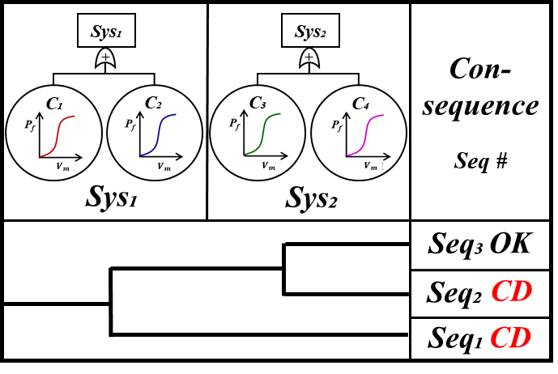
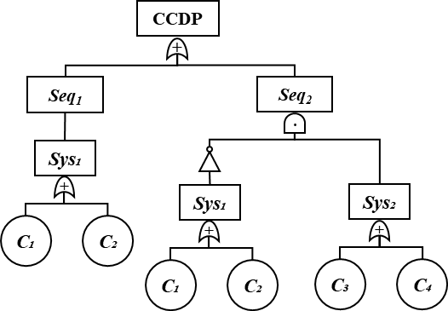
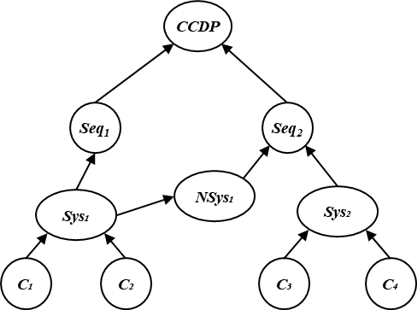

2 · METHODOLOGY
Proposed Intensity-based DBN
ET–FT to DBN conversion
STEP 1
STEP 2
STEP 3
STEP 4
ET-FT Model
One-top FT
Static BN
Intensity-based DBN
ET Branch Structure
FT Gate Logic
Top Event Integration
OR/AND Gates
Node & Edge Conversion
CPT Construction
Inter-slice Transition
$k_{D}$Damage Factor
Accident Scenario & Basic Events
FT Integration & Simplification
CPT-based Probabilistic Structure
Dynamic Intensity Transition
Figure 4. Traditional ET–FT to proposed DBN conversion (4 steps)
10

Slide 11
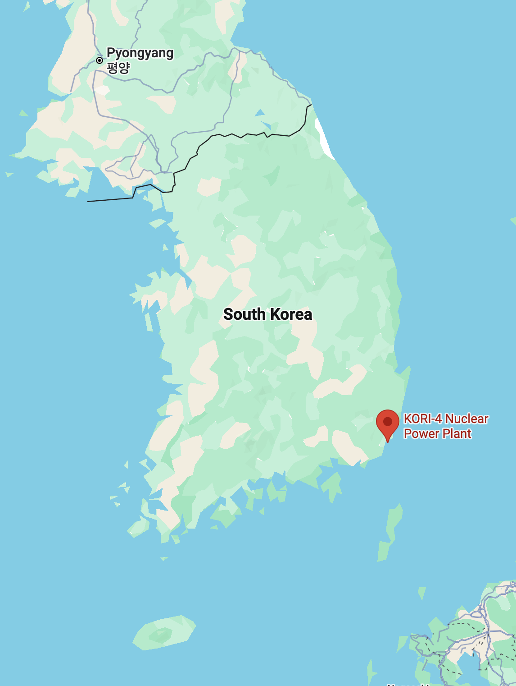
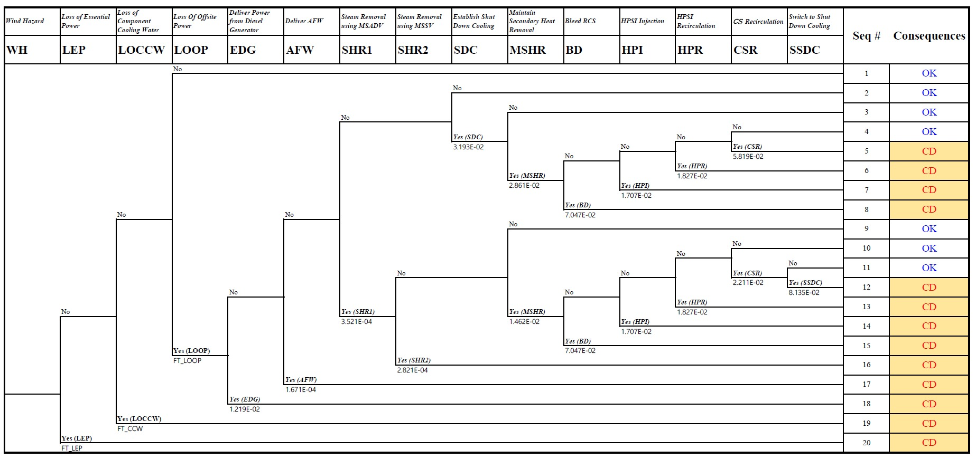
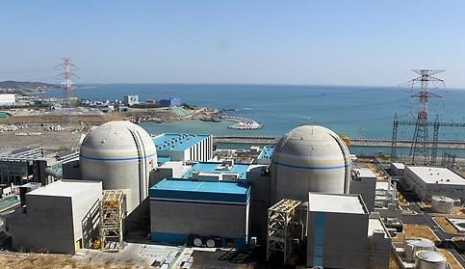
2 · METHODOLOGY
Study Area and High Wind Scenarios: Event Tree
Target plant
Shin-Kori Units 1 & 2 (OPR1000)
16 / 20 accident sequences lead to core damage (CD)
Figure 5. Event tree for high-wind-induced accident scenarios
11

Slide 12
2 · METHODOLOGY
Study Area and High Wind Scenarios: Fault Tree
Each initiating event is defined by which structure fails — this is what links fragility to the event tree.
SSC damage → initiating event → consequence
AUX or EDGB
LEP
ESW or CCW
LOCCW
SWY / TB
LOOP
→ direct core damage
→ direct core damage
→ mitigation tree
The emergency power itself is destroyed — no mitigation remains.
The path to the ultimate heat sink is severed.
In-plant safety systems survive: EDG · AFW · SHR · SDC.
LOOP
(Loss of Offsite Power)
LEP
(Loss of Essential Power)
LOCCW
(Loss of Component Cooling Water)
LOOPWBM
(Failure of Switchyard Structure by WBM caused by TB damage)
SWY
AUX
EDGB
ESW
CCW
TB
WBM
Wind-Borne Missile
12
Figure 6. Fault tree for high-wind-induced accident scenarios

Slide 13

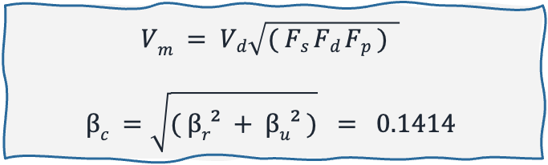
3 · CASE STUDIES & EXTENSION
Case 1: Hazard and Fragility Inputs
Baseline case
No damage factor is applied.
The fragility is not modified by any previous damage.
② SSC fragility — lognormal curves
$$Vm = Vd\sqrt{( Fs Fd Fp ) }$$
$$βc =\sqrt{( βr² + βu² )} = 0.1414$$
① Wind hazard: ΔH_{i}(V)
Data source
Wind-speed return periods, RCP8.5 climate scenario
$$β_{r}=1.0 , β=1.0$$
Hazard curve
Fitted with an extreme-value distribution
Table 2. Fragility parameters (βₑ = 0.1414 for all SSCs)
SSC | v_{d} (m/s) | F_{s} | F_{d} | F_{p} | V_{m} (m/s)
AUX | 40 | 2.0 | 1.25 | 1.3 | 72.11
EDGB | 40 | 2.0 | 1.25 | 1.3 | 72.11
ESW | 40 | 2.0 | 1.25 | 1.3 | 72.11
CCW | 40 | 2.0 | 1.25 | 1.3 | 72.11
TB | 40 | 2.0 | 1.25 | 1.3 | 72.11
SWY | 36.6 | 1.5 | 1 | 1 | 44.83
Table 1. Hazard information: Annual exceedance frequency per wind-speed interval
Interval (m/s) | 35–40 | 40–45 | 45–50 | 50–55 | 55–60
ΔH_{i} (/yr) | 2.130 E-01 | 3.203 E-02 | 5.987 E-03 | 1.451 E-03 | 3.012 E-04
13

Slide 14
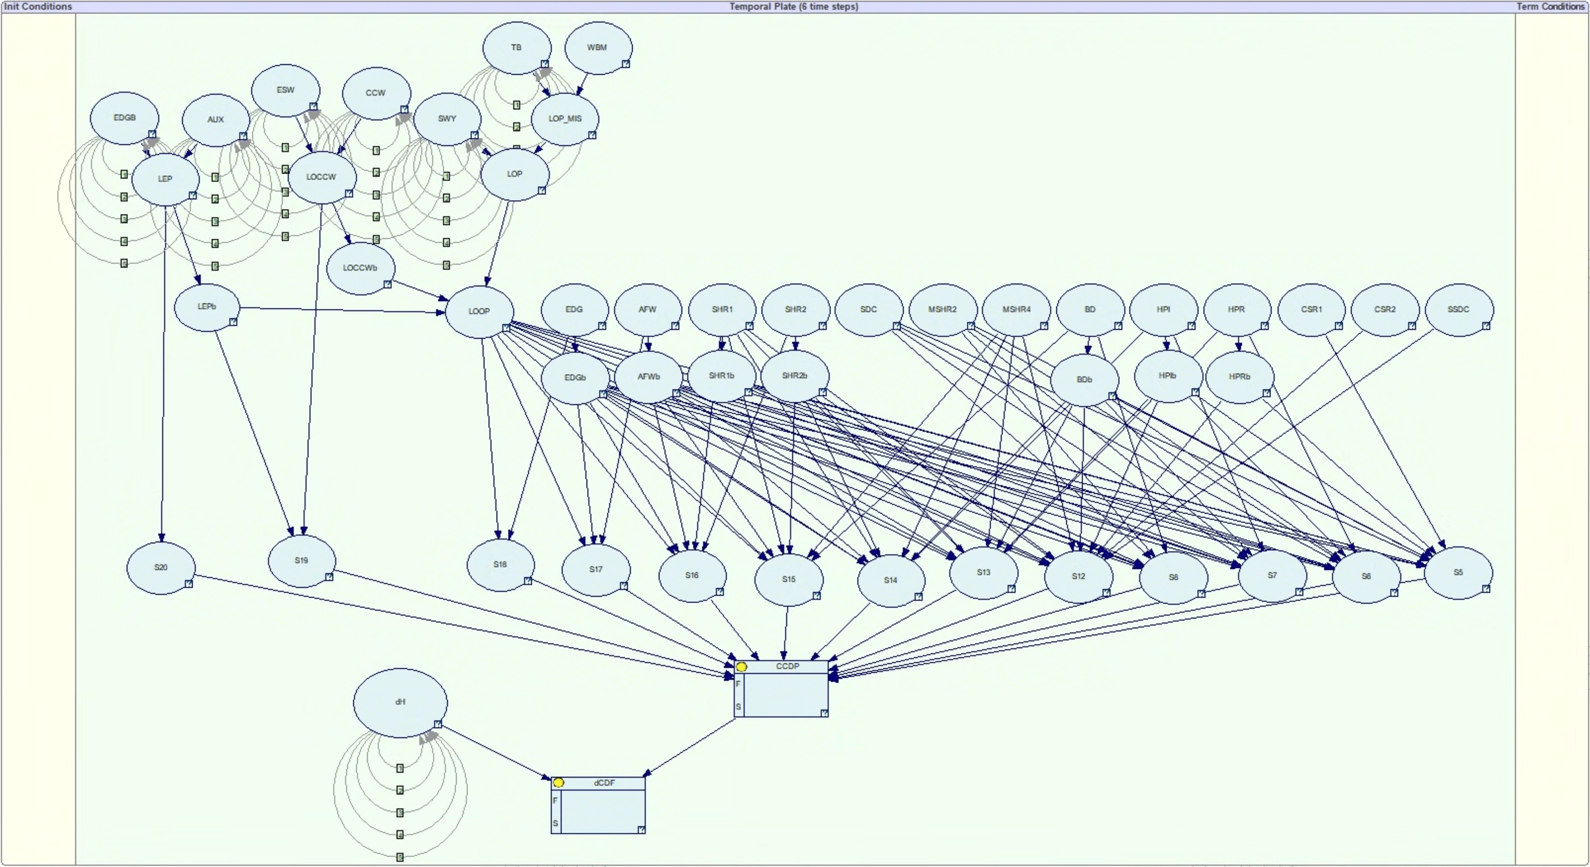
3 · CASE STUDIES & EXTENSION
Case 1: Model Verification
DBN structure built in GeNIe
Table 1. Annual exceedance frequency per wind-speed interval
Interval (m/s) | 35–40 | 40–45 | 45–50 | 50–55 | 55–60
ΔH_{i} (/yr) | 2.130E-01 | 3.203E-02 | 5.987E-03 | 1.451E-03 | 3.012E-04
Figure 7. A DBN built in GeNIe (6 intensity slices)
14

Slide 15
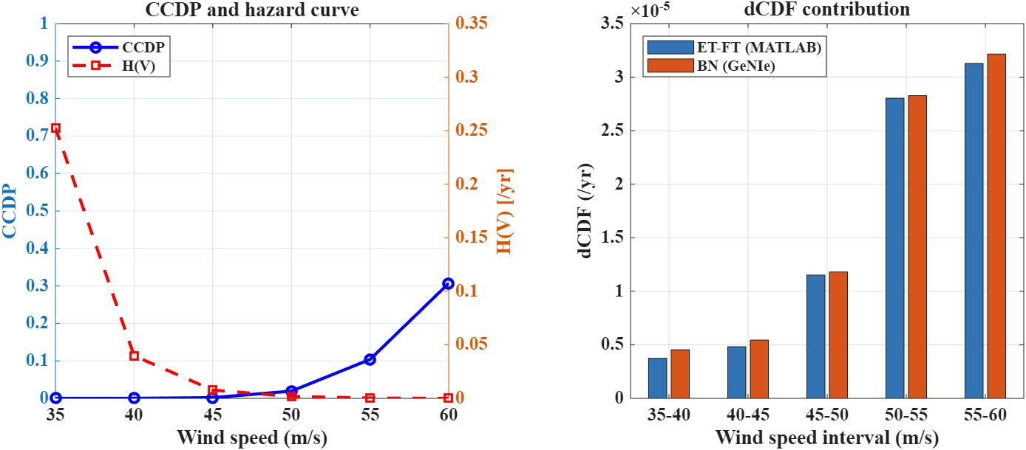
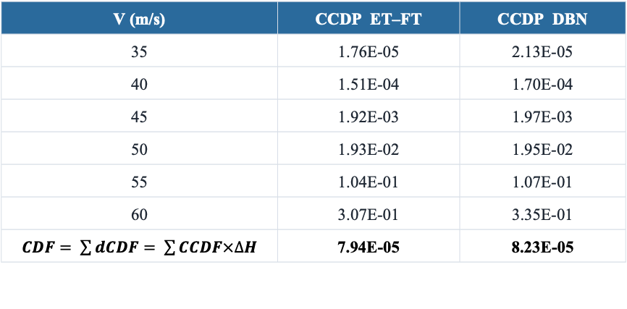
3 · CASE STUDIES & EXTENSION
Case 1: Model Verification
② Verification — DBN reproduces ET–FT
① EDGB fragility → node CPT
LEP
(Loss of Essential Power)
AUX
EDGB
0 1 2 3 4 5
Figure 8. The CCDP and dCDF results for high-wind PSA using DBN
P_{f}(V) = Φ ( ln( V / V_{m} ) / β ) V_{m} = 72.11 m/s, β = 0.1414
Table 4. CCDP and CDF by wind intensity — ET–FT vs. DBN
Table 3. The CPT of the EDGB node, one entry per intensity slice
V (m/s) | CCDP ET–FT | CCDP DBN
35 | 1.76E-05 | 2.13E-05
40 | 1.51E-04 | 1.70E-04
45 | 1.92E-03 | 1.97E-03
50 | 1.93E-02 | 1.95E-02
55 | 1.04E-01 | 1.07E-01
60 | 3.07E-01 | 3.35E-01
$CDF= \sum{dCDF}= \sum{CCDF×∆H}$ | 7.94E-05 | 8.23E-05
Slice | V (m/s) | P_{f}(EDGB)
0 | 35 | 1.59E-07
1 | 40 | 1.54E-05
2 | 45 | 4.27E-04
3 | 50 | 4.80E-03
4 | 55 | 2.77E-02
5 | 60 | 9.68E-02
15
Relative error is 3.7%

Slide 16
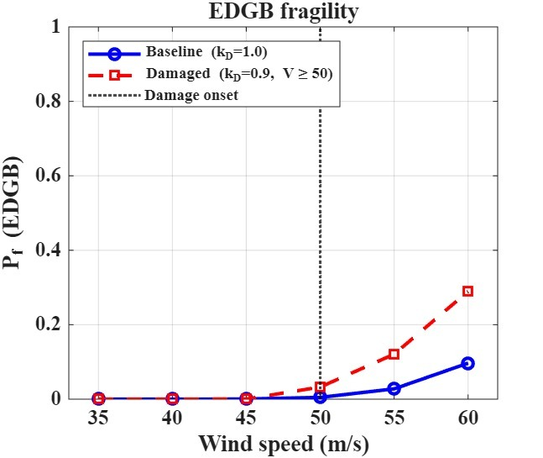
3 · CASE STUDIES & EXTENSION
Case 2: Damage State Factor and CPT Update
A damaged structure is weaker against the next wind. The fragility must carry that history.
① The damage state factor, k_{D}
② EDGB node CPT — before vs. after
Assume EDGB is damaged at V = 50 m/s
Table 5. Updated CPT of the EDGB node
V (m/s) | Case 1 P_{f}(EDGB) | Case 2 P_{f}(EDGB) | ratio
35 | 1.59E-07 | 1.59E-07 | —
40 | 1.54E-05 | 1.54E-05 | —
45 | 4.27E-04 | 4.27E-04 | —
50 | 4.80E-03 | 3.26E-02 | 6.8
55 | 2.77E-02 | 1.21E-01 | 4.4
60 | 9.68E-02 | 2.89E-01 | 3.0
Median capacity is reduced
V_{m}′ = k_{D} × V_{m} = 0.9 × 72.11 = 64.90 m/s
k_{D} ∈ (0, 1]. k_{D} = 1.0 is undamaged. A lower k_{D} means more accumulated damage.
P_{f}′(V) = Φ ( ln( V / V_{m}′ ) / β )
Modified fragility
LEP
(Loss of Essential Power)
At 60 m/s, the P_{f}(EDGB) increases approximately 3 times.
AUX
EDGB
0 1 2 3 4 5
16
Figure 9. Comparison of the baseline vs. damaged EDGB fragility

Slide 17
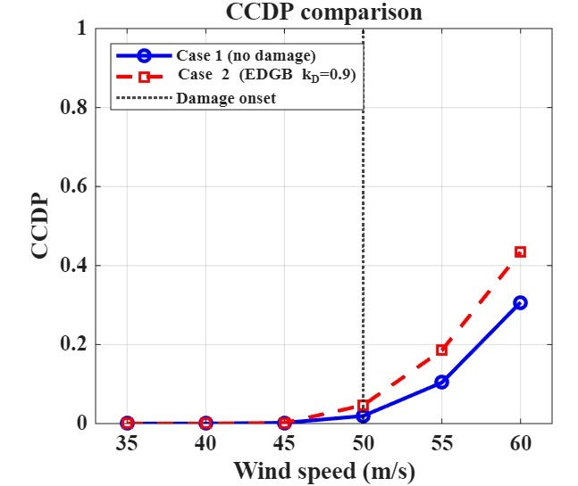
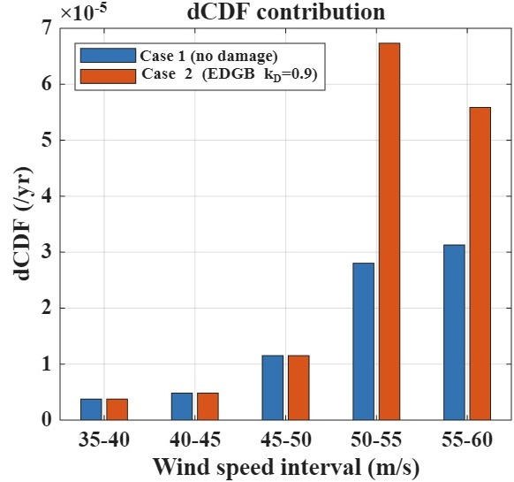
3 · CASE STUDIES & EXTENSION
Results: Effect of Damage Propagation
CCDP by wind speed
dCDF by interval
Table 6. Comparison of CCDP between Case 1 and Case 2
Table 7. Comparison of dCDF and CDF between Case 1 and Case 2
V (m/s) | Case 1 | Case 2 | ratio
35 | 2.13E-05 | 2.13E-05 | —
40 | 1.70E-04 | 1.70E-04 | —
45 | 1.97E-03 | 1.97E-03 | —
50 | 1.95E-02 | 4.68E-02 | 2.4
55 | 1.07E-01 | 1.92E-01 | 1.8
60 | 3.35E-01 | 4.77E-01 | 1.4
Interval | ΔH (/yr) | Case 1 (/yr) | Case 2 (/yr)
35–40 | 2.130E-01 | 4.54E-06 | 4.54E-06
40–45 | 3.203E-02 | 5.44E-06 | 5.44E-06
45–50 | 5.987E-03 | 1.18E-05 | 1.18E-05
50–55 | 1.451E-03 | 2.83E-05 | 6.80E-05
55–60 | 3.012E-04 | 3.22E-05 | 5.79E-05
Total CDF |  | 8.23E-05 | 1.48E-04
The damage factor raises the CCDP about 2.4 times at the 50 to 55 interval.
The total CDF rises about 1.8 times.
Based on this method, once the damage factor is established, it can compute CCDP and CDF from the measured wind speed, in real time.
Figure 10. CCDP comparison · dCDF contribution per interval
17

Slide 18
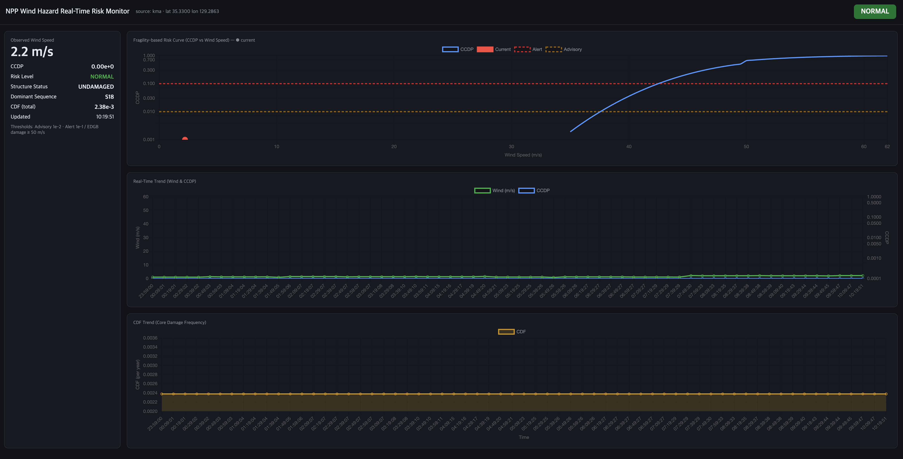
3 · CASE STUDIES & EXTENSION
Extension: Real-Time Wind-Risk Monitoring
Measured wind speed at the NPP site is fed to the DBN. CCDP and CDF are computed for that intensity, in near real time.
What the screen shows
1
Live wind speed
2
Measured at the site and pushed to the model on each refresh.
1
2
Risk curve — CCDP vs. wind speed
The DBN is solved at the measured intensity.
3
3
Wind-speed history
The measured series over time.
4
CDF trend
Risk accumulated from the hazard curve.
4
EDGB is damaged above 50 m/s, so the damage state factor is applied. Its median capacity drops to 64.90 m/s, and the CPT of every later slice is updated. The fragility jumps, so the curve shows a step at that point.
Figure 11. NPP Wind Hazard Real-Time Risk Monitor
18

Slide 19
4 · CONCLUSION
Conclusion
This study proposed an intensity-based DBN for high-wind PSA of NPPs.
For this, the high-wind accident scenario was established for Shin-Kori Units 1 and 2.
The proposed method computes CDF as a function of wind intensity. Damage at one intensity level carries into the next through the damage state factor (k_{D}), so the SSC fragility evolves as the wind grows.
In the baseline case, the DBN results were nearly identical to those of the conventional ET–FT method. In the damaged case, with the damage state factor applied, the total CDF increased about 1.8 times.
Future Work
A more accurate and practical assessment requires further study on the damage state factor of each SSC.
The framework can also be extended to the NPP main control room, where the CDF is checked from real-time measured data.
19

Slide 20

THANK YOU
20

