Slide 1
Recent Insights from the International Common Cause Failure Data Exchange (ICDE) Project
Hayat Chatriª, Muhammad Azharª, Jan Stiller^{b}, Gunnar Johanson^{c}, Mattias Håkansson^{d}
ªCanadian Nuclear Safety Commission (CNSC), Ottawa, Canada
^{b}Gesellschaft für Anlagen- und Reaktorsicherheit (GRS) gGmbH, Köln, Germany
^{c}ÅFRY, Stockholm, Sweden
^{d}Risk Pilot AB, Sweden
The Probabilistic Safety Assessment and Management (PSAM 18)
July 19-24, 2026, Pittsburgh, Pennsylvania

Slide 2
Outline
  Introduction & History
  ICDE Objectives
  ICDE Organization
  Data Exchange
  ICDE Analyses
  Insights from the Analysis of CCF Events
  Conclusion
  References

Slide 3
Introduction & History
International Common Cause Failure Data Exchange (ICDE) Project was initiated in 1994.
Since 1997, it has been successfully operated within the OECD/NEA framework over 8 consecutive phases (9th phase is 2023 to 2026).
ICDE Project allows countries to collaborate and to exchange CCF data with the aim of generating qualitative and quantitative insights into these failures.
Notes:
Common cause failures (CCFs) can significantly impact the availability of safety systems and other items important to safety of NPPs, even though CCF are rare events.
To gain a comprehensive knowledge of CCF phenomena, it is necessary to combine operating experience from multiple countries.
In many cases the national operating experience is insufficient for the quantification of CCF in PSA.

Slide 4
ICDE Objectives
    Collect and analyse Common Cause Failure (CCF) events over the long term.
    Generate qualitative insights into the root causes of CCF events.
    Establish a mechanism for the efficient feedback of experience gained in connection with CCF phenomena.
    Generate quantitative insights and record event attributes to facilitate quantification of CCF frequencies in member countries.
    Use ICDE data to estimate CCF parameters.

Slide 5
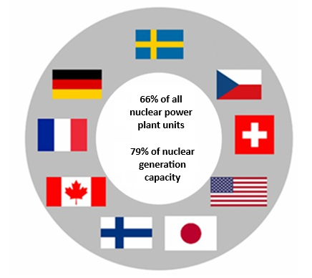
ICDE Organization (1 of 2)
Participants in Phase 9
  CNSC - Canada
  STUK - Finland
  IRSN - France
  GRS - Germany
  NRA - Japan
  SSM - Sweden
  ENSI - Switzerland
  NRC - United States
  UJV - Czech Republic

Slide 6
ICDE Organisation (2 of 2)
Each Member Country is represented by its National Coordinator.
The ICDE Management Board (MB) controls the project, assisted by the:
  NEA Project Secretary
  Operating Agent (OA)
The ICDE MB is responsible for:
  Defining and prioritizing the specific activities and monitoring the development of the project.
  Securing the necessary financial and technical resources.
The OA is responsible for database and consistency analysis.
The NEA Project Secretary provides administrative support.
The Member Countries provide the operating experience data.

Slide 7
Data Exchange (1 of 4): Definitions
Common Cause Failure Event
A dependent failure in which two or more component fault states exist simultaneously, or within a short time interval, and are a direct result of a shared cause.
ICDE Event
Impairment of two or more components (with respect to performing a specific function), which exists over a relevant time interval and is the direct result of a shared cause.
Complete CCF: All components failed completely.
Partial CCF: At least two components failed completely.

Slide 8
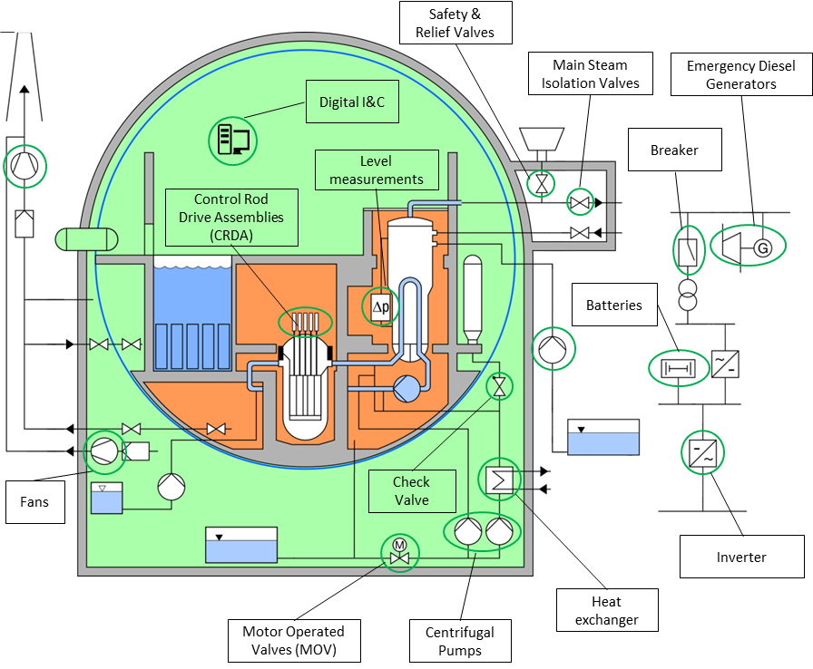
Data Exchange (2 of 4): ICDE Components
Data collection is organized by component types.
Focus on active components.
Components type were added over time:
  Different amount of data for the individual types.
New types are added if necessary.

Slide 9
Data Exchange (3 of 4): Data Collection
  Data collection and analysis has to be organized on national levels.
Prepared OPEX is sent to the Operating Agent (OA) to integrate the new data in the central database.
Preparation of the OPEX is the most time-consuming part when participating in the ICDE project.
New component types may be added in the future if there is a sufficient interest of participating parties. Currently under discussion:
  Mobile equipment (pumps, diesel generators etc.) for emergencies.
  Conventional (not software based) I&C equipment.
Notes:
Based on a generic coding guideline, for each component type an individual coding guideline is developed by the Member Board.
Guidelines are made publicly available as a Committee on the Safety of Nuclear Installations (CSNI) Technical Note.
The data collection concerns two distinct entities:
Events,
Observed Populations. (An Observed Population is a set of similar components in the same system in the same plant that perform the same function.)
The in-kind principle is followed:
Data exchange means that each participant gets the dataset corresponding to its own data sent to ICDE.
Updated copies of the database (“replicas”) containing the amount of data to which the individual participating organization has the right to access are send out by the OA regularly.

Slide 10
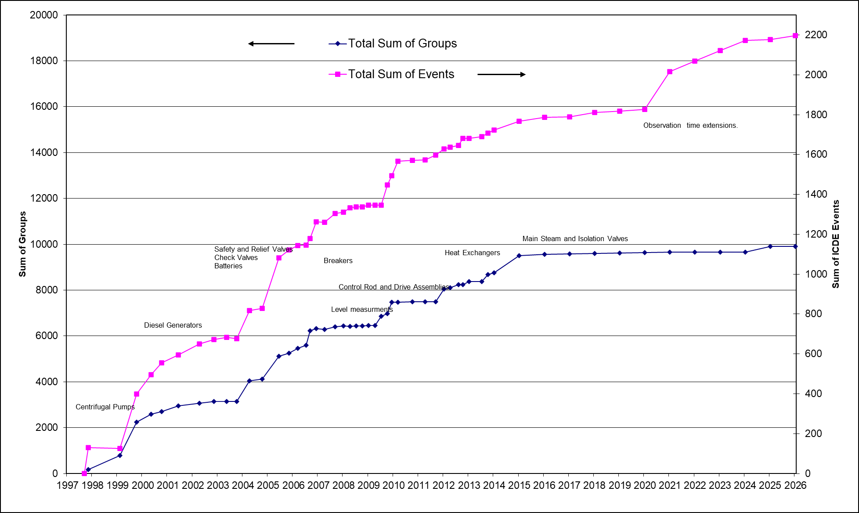
Data Exchange (4 of 4): Data Current Status
Total OPEX in the database: 209 430 group years, 2197 events (May 2026).
Component Type | Total CCF Event | Percentage (%) | Complete CCF | Partial CCF
Centrifugal pumps | 460 | 20.9 | 48 | 44
Diesels | 394 | 17.9 | 36 | 21
Safety and relief valves | 306 | 14.0 | 22 | 44
Motor operated valves | 200 | 9.2 | 10 | 37
Control rod drive assembly | 189 | 8.6 | 4 | 27
Level measurement | 178 | 8.1 | 10 | 32
Check valves | 124 | 5.7 | 15 | 26
Breakers | 121 | 5.6 | 7 | 29
Battery | 94 | 4.3 | 5 | 2
Heat exchanger | 59 | 2.7 | 4 | 1
Fans | 33 | 1.5 | 4 | 0
Main steam isolation valves | 14 | 0.6 | 1 | 4
Digital I&C | 10 | 0.5 | 5 | 0
Cross-component CCF | 9 | 0.4 | 0 | 0
Inverters | 6 | 0.3 | 2 | 0
Grand summaries | 2197 | 100 | 173 | 267

Slide 11
ICDE Analyses
  ICDE carries out detailed operating experience analyses regarding:
CCFs of individual component types.
General topics:
  Intersystem Common Cause Failure Events.
  Common Cause Pre-Initiator Human Failure Events.
  CCF Events caused by Safety Culture Issues.
  CCF Events caused by Aging.
Results are published as OECD/NEA Reports.

Slide 12
Insights (1 of 7): Safety Culture
  Analysis of 142 CCF Events from the observation population of about 2000 events.
A harmonized Safety Culture Model (SCM) was adopted.
The SCM was augmented by certainty codes to account for the analyst’s degree of certainty.
  Explicitly stated
  High
  Medium
  Low
Notes:
Explicitly stated (1): Explicitly stated in the event description and supported by the event coding.
High (1): Indirectly deducible from event description and coding. Not explicitly stated, but the expert is sure from the information in the description and coding that the attribute must have been present. It is not reasonably conceivable how this event could have happened as described (and coded) if the attribute was not present.
Medium (0.5): Very likely, given information in description and coding. The expert rates the presence of the attribute as very likely, given her/his experience and prior knowledge, but another cause cannot be entirely excluded.
Low (0.1): The presence of the attribute is somewhat supported by the event coding and/or description.

Slide 13
Insights (2 of 7): Safety Culture
  Centrifugal pumps represented about one-third of the total events. Indicating that the pumps could be more exposed to deficiencies in the Safety Culture.
  CCF event causes “Human actions, plant staff” and “Procedure inadequacy” contributed to about 77% of the events.
  1990-2000: 7-12% of the reported ICDE events can be attributed to SC issues.
  After 2000, the overall number of ICDE events declined resulting in decrease of SC related events, from zero to a few events per year.

Slide 14
Insights (3 of 7): Safety Culture
  Work planning (WP) dominates, followed by Individual Responsibility (IR) and Questioning Attitude as the most common SCM attributes.
  About 100 events had a SCM weight score above 0.7, indicating a high suitability for the topical report. For 12 events, the event assessment resulted in a SCM weight above 3.2, i.e., the events demonstrate deficiencies in safety culture with high certainty and involve multiple SCM attributes.
Notes:
Work planning (WP) dominates, followed by Individual Responsibility (IR) as the most common SCM attributes. This is true both for the counts and the sum of SCM weights.

Slide 15
Insights (4 of 7): On-going Analyses - Aging
  ICDE Project started the study of ICDE events where aging has been identified as CCF contributor.
  The purpose is to analyze aging aspects that result in CCF events.
  85 events out of a total of about 2000 events are screened.
  An Aging Coding Model (ACM) framework is adopted which is based on IAEA Report.

Slide 16
Insights (5 of 7): On-going Analyses - Aging
  Aging effects are categorized in broader categories: Physical, Mechanical, Thermal, Electrical, Chemical, Irradiation, Biological, Other, and No Aging.
  Basis for the assessment include:
    Aging Classification.
    Failure Mechanism Description.
    Interesting Event Categories.
  Preliminary analysis show that:
    Mechanical ageing dominates the total data set followed by electrical and chemical ageing.
    diesels were the most common component type in the event set, followed by safety relief valves, centrifugal pumps and motor operated valves.

Slide 17
Insights (6 of 7): On-going Analyses - Quantification
  Database contains all necessary information for the quantification of CCF, namely:
    Observation times.
    Number of failed and impaired components in the events.
    Number of independent failures (for Alpha Factor Model).
  Formal “completeness statement” of contributors assures completeness of data.

Slide 18
Insights (7 of 7): On-going Analyses - Quantification
  Aspects to be considered for quantification:
    Component boundaries (ICDE ↔ PSA).
    Inhomogeneity: Technical differences; Different operation; Different maintenance/monitoring.
    Applicability of observed CCF mechanisms to “target” component group.
  Two exemplary applications were conducted: Emergency Diesel Generators (EDGs) and Centrifugal Pumps (CPs).
  ICDE Publication with guidance on quantification is in progress.

Slide 19
Conclusions
  ICDE successfully operating for 30 years.
  Significantly contributed to the knowledge on CCF phenomena.
  Data for various components such as Centrifugal Pumps, Diesel Generators, Motor Operated Valves, Safety Relief Valves, Check Valves, Batteries, Level Measurement, Breakers Control Rod Drive Assemblies, Heat Exchangers, Digital I&C.
  Public reports on components and generic subjects.
  ICDE has been the model for other successful database projects, e.g., Fire Events Record Exchange (FIRE), Component Operational Experience, Degradation and Aging Programme (CODAP).

Slide 20
References:
Publicly available reports:
  https://projectportal.afconsult.com/ProjectPortal/icde
  https://www.oecd-nea.org/jcms/pl_25090/international-common-cause-failure-data-exchange-icde-project

Slide 21
Thank you

