Slide 1

A Bayesian Framework for Estimating Natural Hazard Impacts on Transmission Assets
Federico Sartore, Blazhe Gjorgiev, Giovanni Sansavini
Reliability and Risk Engineering Lab, ETH Zurich, Switzerland

Slide 2


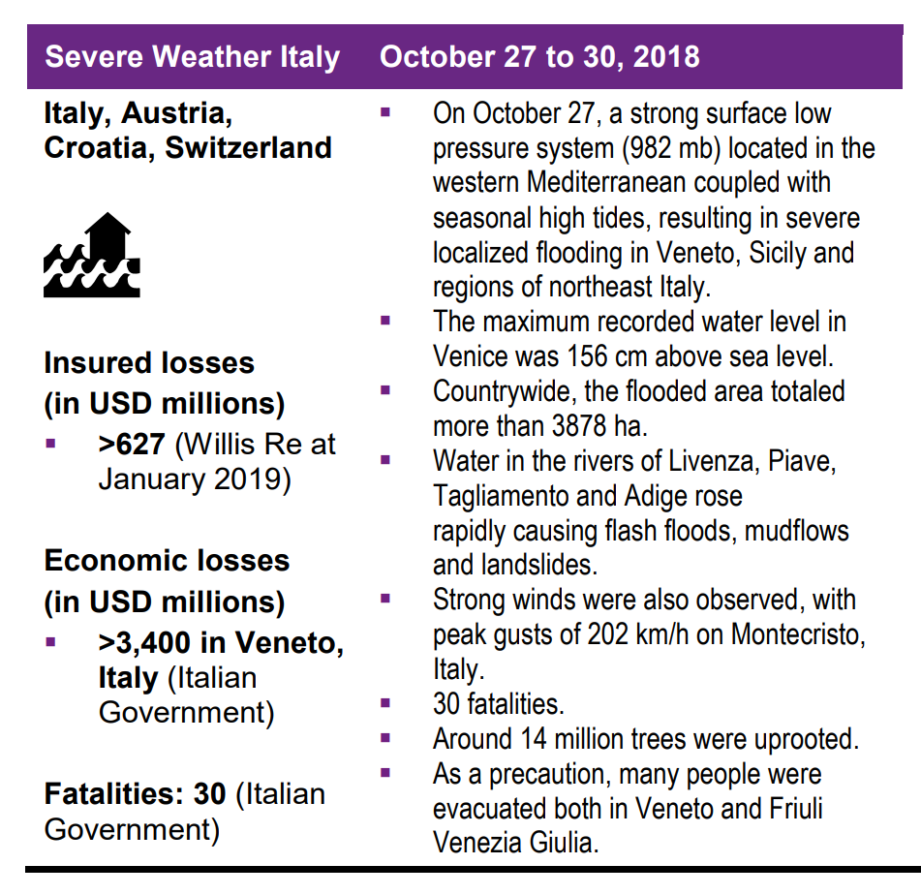
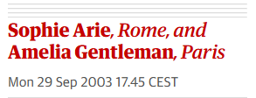
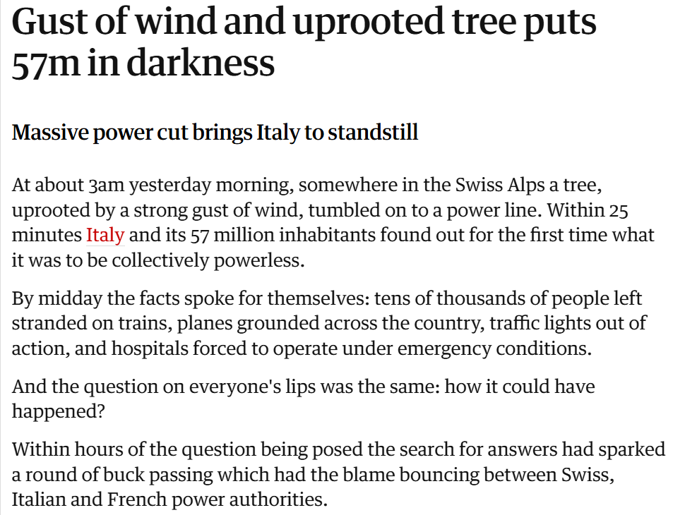


Motivation
Method
Results
Conclusion
Natural Hazards Impacts on Transmission Assets

Slide 3
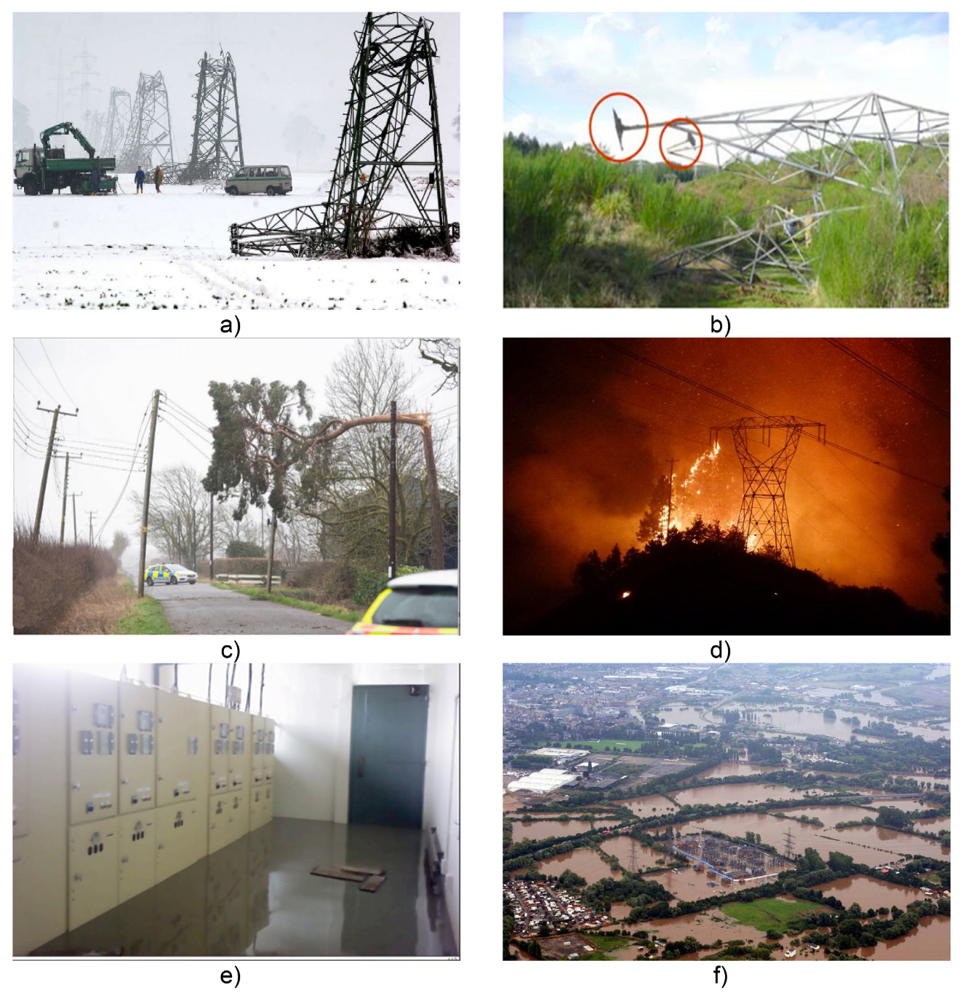
Motivation
Method
Results
Conclusion
Natural Hazards Impacts on Transmission Assets
a) Snow & Windstorms
b & c) Windstorms
b & c) Windstorms
d) Lightning
d) Lightning
e & f) Flooding
Landslides, avalanches ...
Karagiannakis, G., Panteli, M., & Argyroudis, S. (2023). Fragility modeling of power grid infrastructure for addressing climate change risks and adaptation. Reliability Engineering & System Safety, 235, 109198
European Network of Transmission System Operators for Electricity (ENTSO-E). (2025). HVAC Nordic and Baltic Grid Disturbance Statistics 2024. Brussels: ENTSO-E.

Slide 4
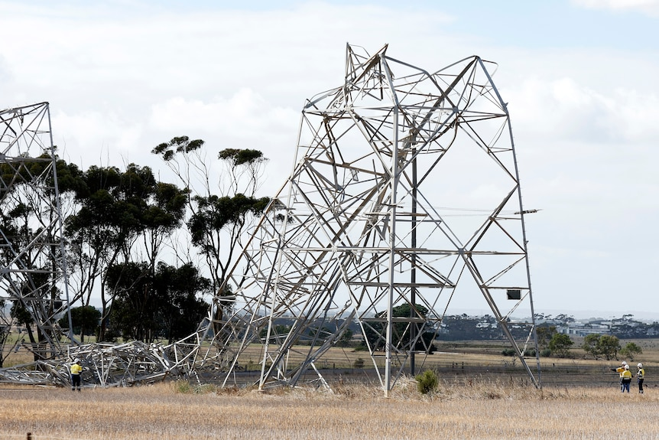
Motivation
Method
Results
Conclusion
Natural Hazards Impacts on Transmission Assets
Challenges
Coarse and incomplete data [1]
Uncertainty
What happened?
TERNA (2024). Quality of the transmission service
Highly specific, non-transferable studies [2]
Research question
Xue, J., Mohammadi, F., Li, X., Sahraei-Ardakani, M., Ou. (2023). Impact of transmission tower-line interaction to the bulk power system during hurricane. Reliability Engineering & System Safety, 233, 109134.
Is it possible to develop a data-driven framework that incorporates hazard-specific knowledge and captures the uncertainty of natural hazard events?
Literature
Fragility curves

Slide 5
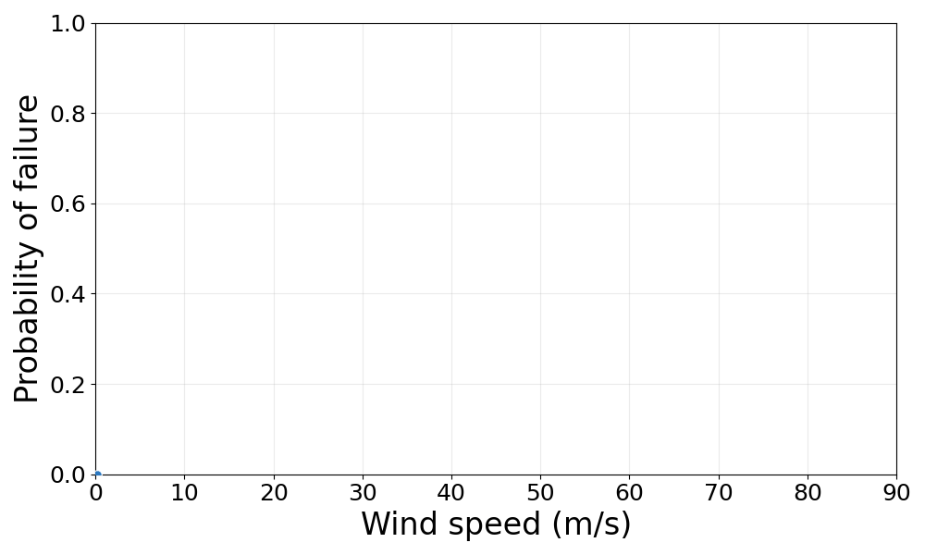
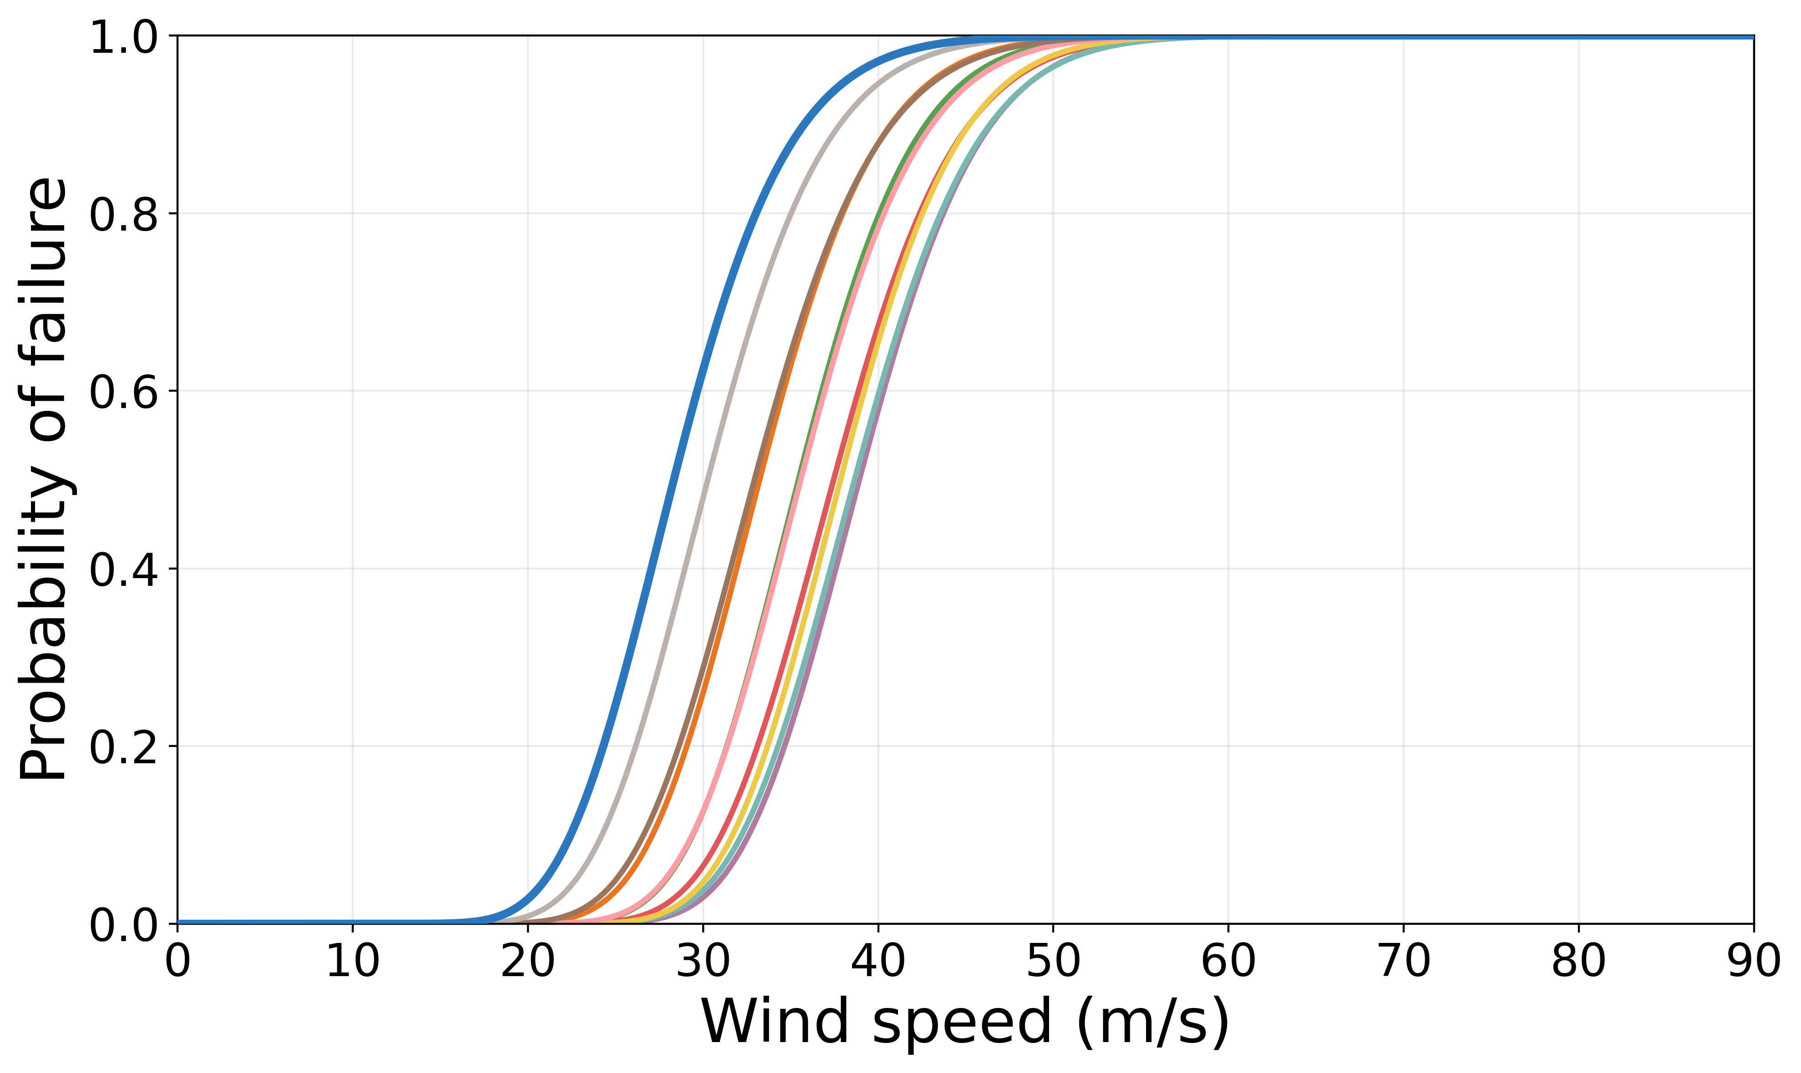
Motivation
Method
Results
Conclusion
Natural Hazards Impacts on Transmission Assets
Challenges
Coarse and incomplete data [1]
Uncertainty
What happened?
TERNA (2024). Quality of the transmission service
Highly specific, non-transferable studies [2]
Research question
Xue, J., Mohammadi, F., Li, X., Sahraei-Ardakani, M., Ou. (2023). Impact of transmission tower-line interaction to the bulk power system during hurricane. Reliability Engineering & System Safety, 233, 109134.
Is it possible to develop a data-driven framework that incorporates hazard-specific knowledge and captures the uncertainty of natural hazard events?
Literature
Finite element-based model [1]
Fragility curves
Dikshit, S., & Alipour, A. (2021). A moment-matching method for fragility analysis of transmission towers under straight line winds. Engineering Structures, 248, 113236.
Data-driven [2]
Solheim ØR, et al. “Vaffel – a tool for forecasting transmission line failures based on Bayesian updating, reanalysis data and medium-range weather forecasts,” IEEE Acess, 2024

Slide 6
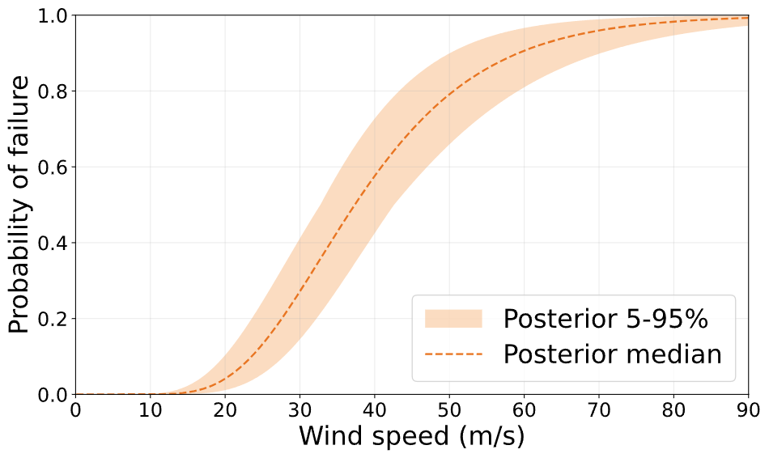
Motivation
Method
Results
Conclusion
Bayesian Approach for Physically Informed Data-Driven Fragility Curves
Prior
Evidence
Posterior

Slide 7
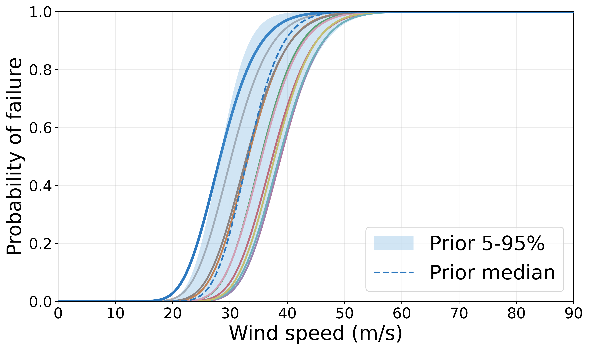
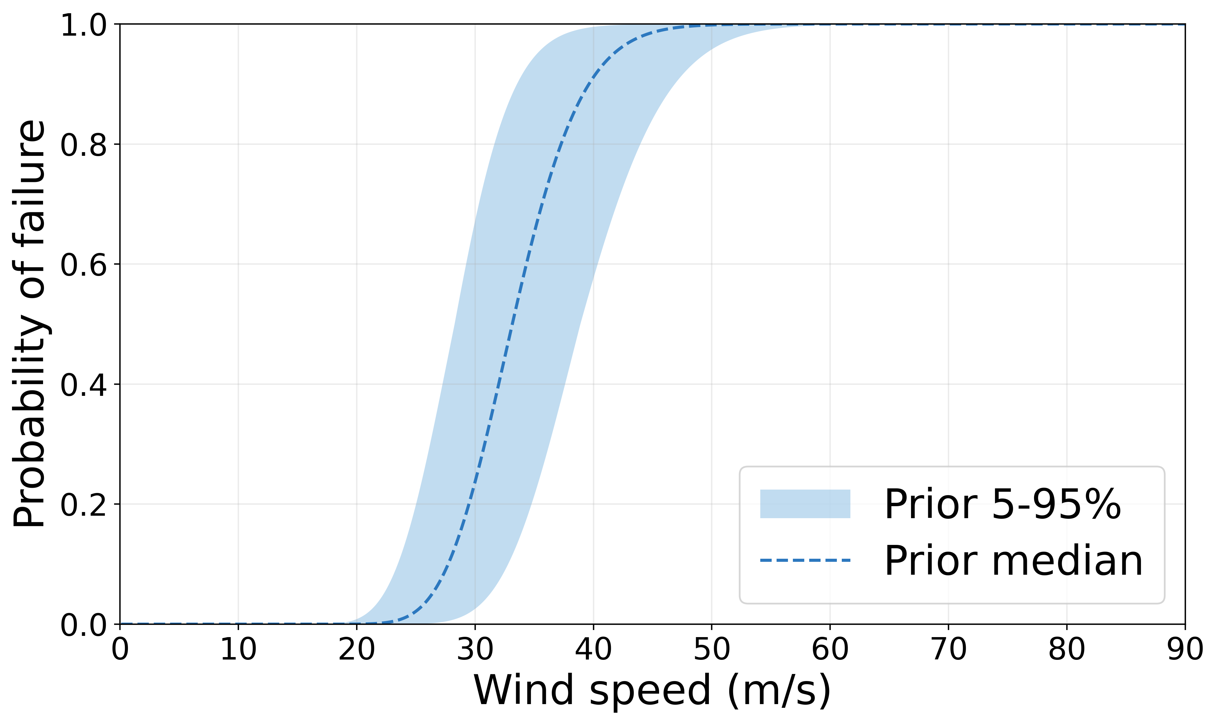
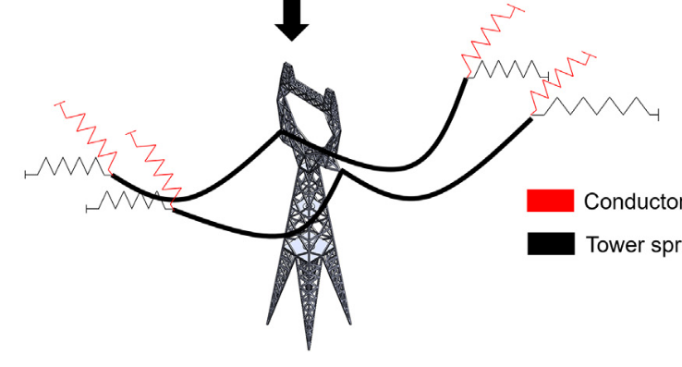
Motivation
Method
Results
Conclusion
Bayesian Approach for Physically Informed Data-Driven Fragility Curves
Prior Manipulation
Prior
Evidence
Posterior
Failure Dataset
From finite element-based modeling [1]
Physically-informed prior
Conductor-conductor flashover
1. Mazaheri, & Alipour. Department of Civil, Structural, and Environmental Engineering at Iowa State University

Slide 8
Motivation
Method
Results
Conclusion
Bayesian Approach for Physically Informed Data-Driven Fragility Curves
Prior
Evidence
Posterior

Slide 9
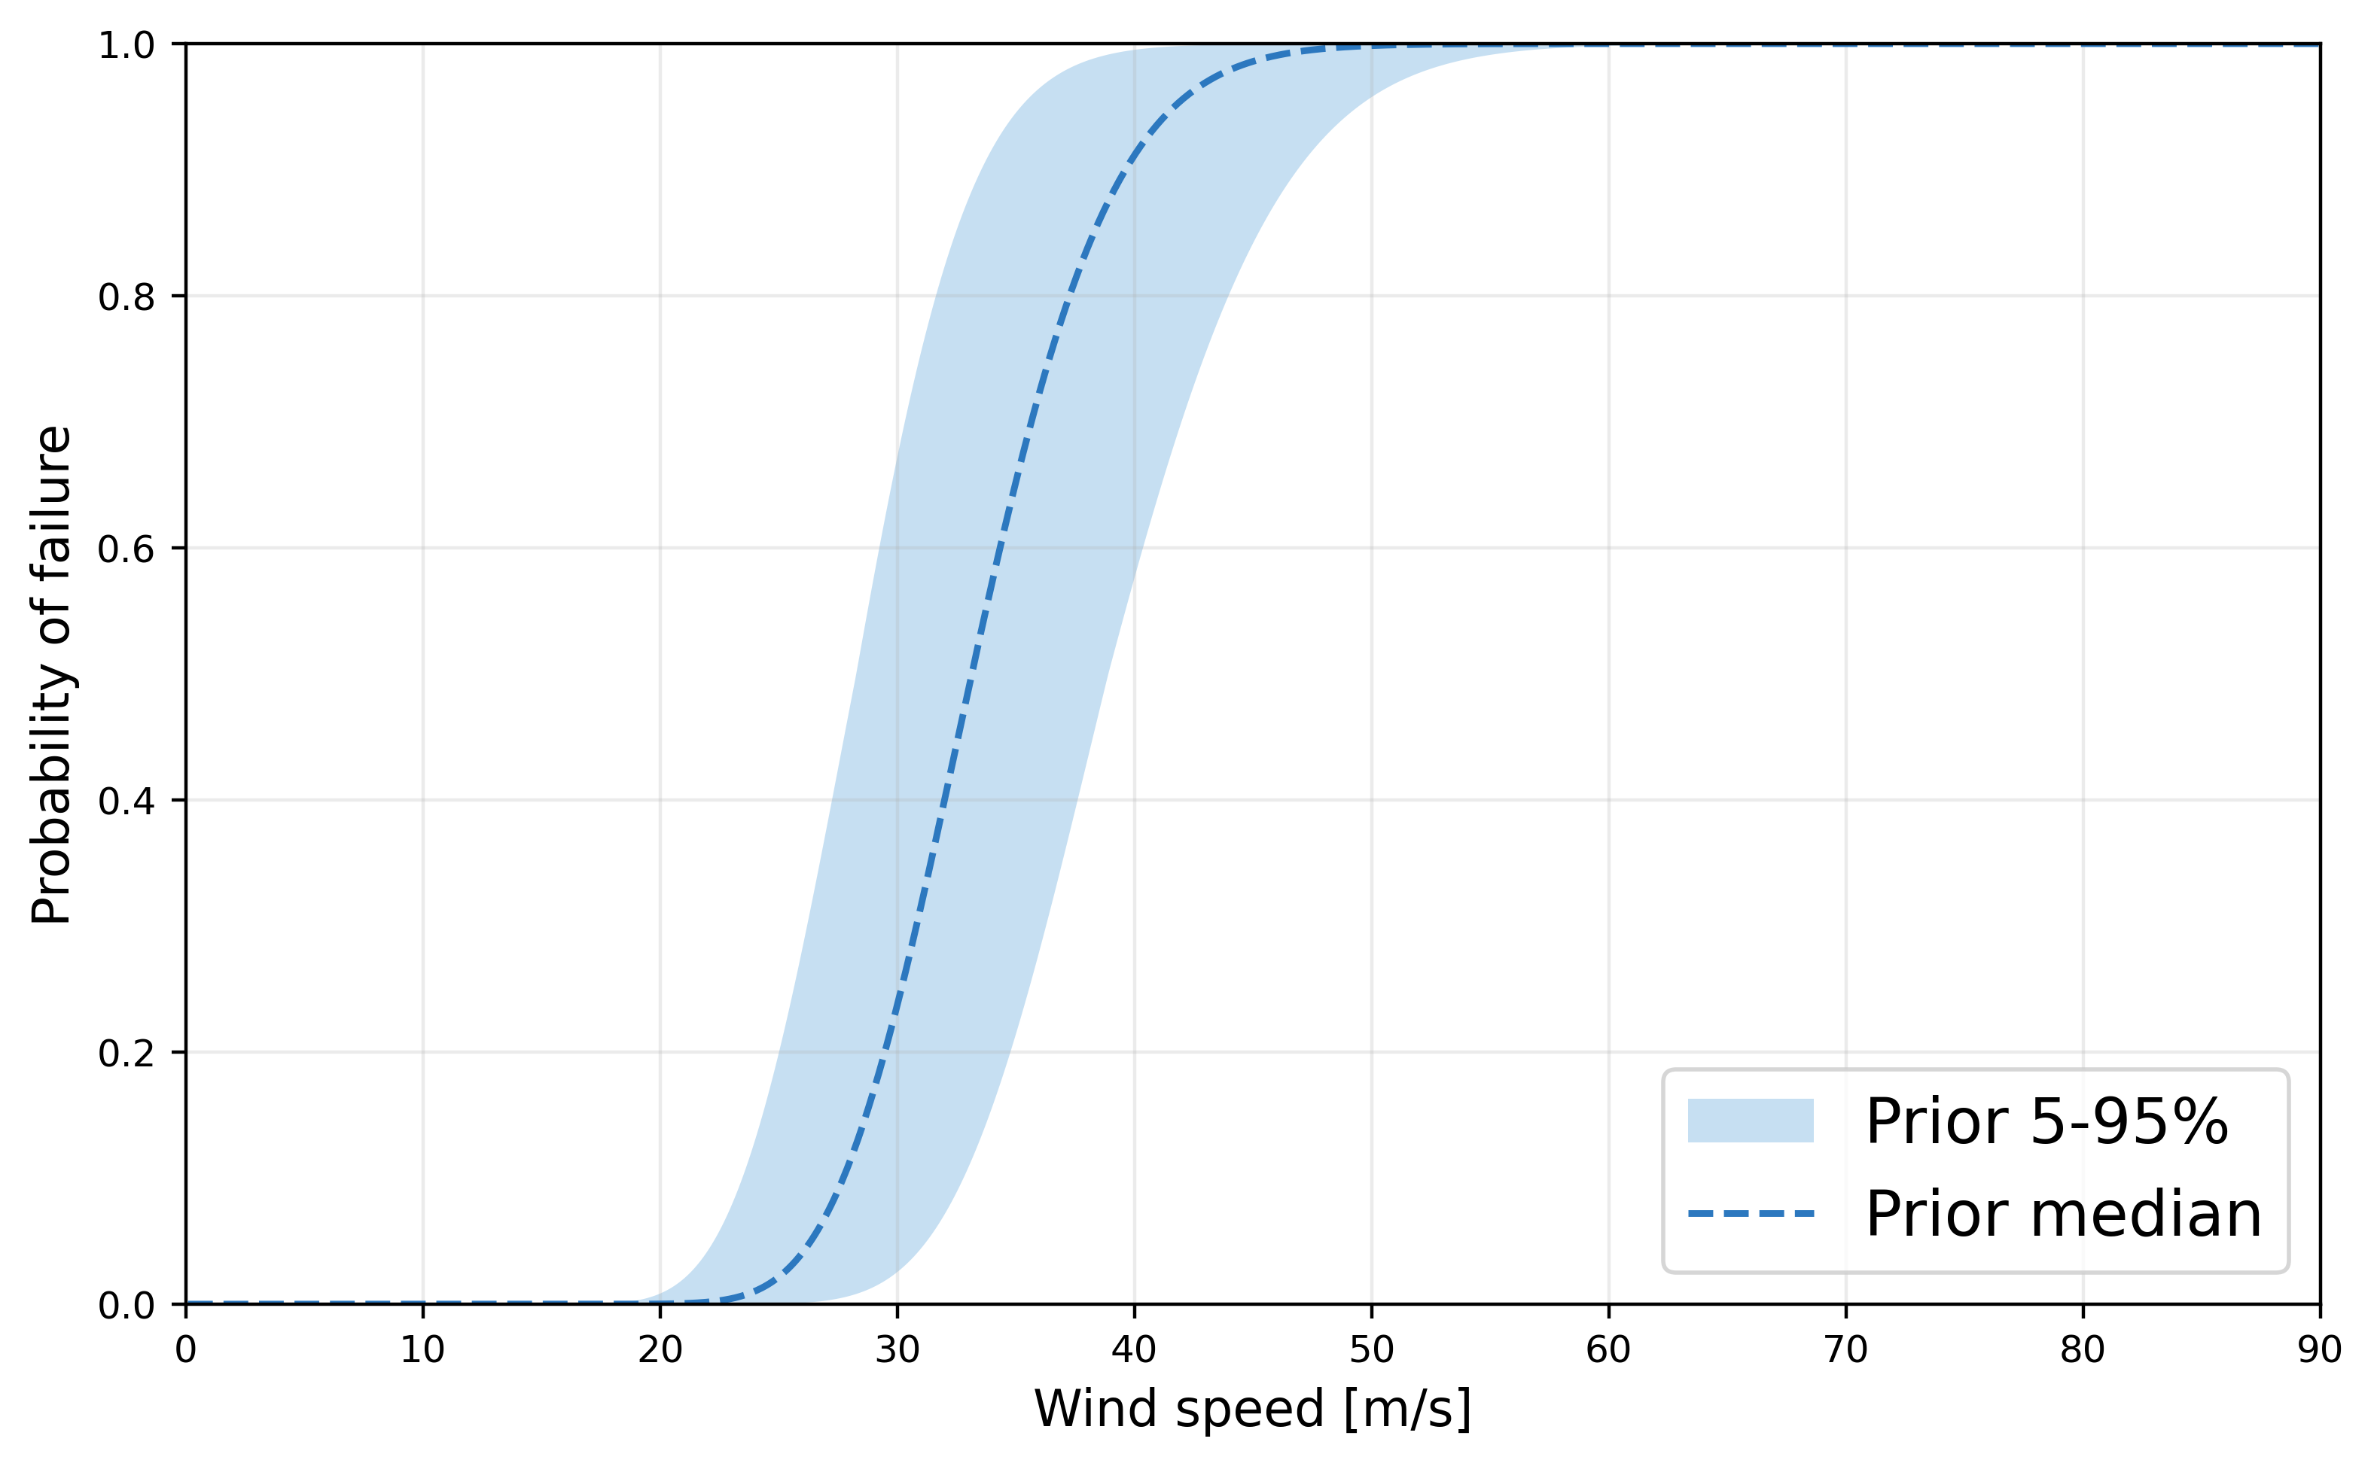
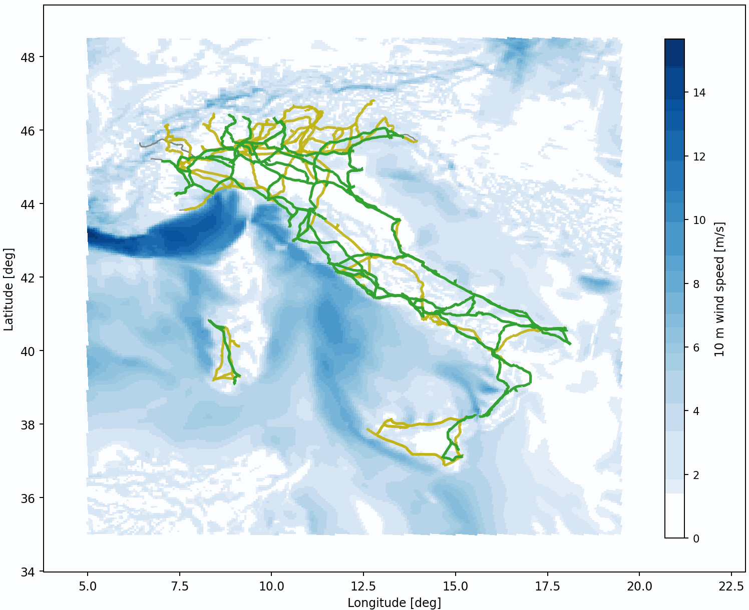
Motivation
Method
Results
Conclusion
Bayesian Approach for Physically Informed Data-Driven Fragility Curves
Dataset
Failure data (TERNA)
Weather data (COPERNICUS)
Posterior
Evidence
Exposure map
Prior
From a finite element-based [1]
From data
Physically-informed prior
Conductor-conductor flashover
9

Slide 10
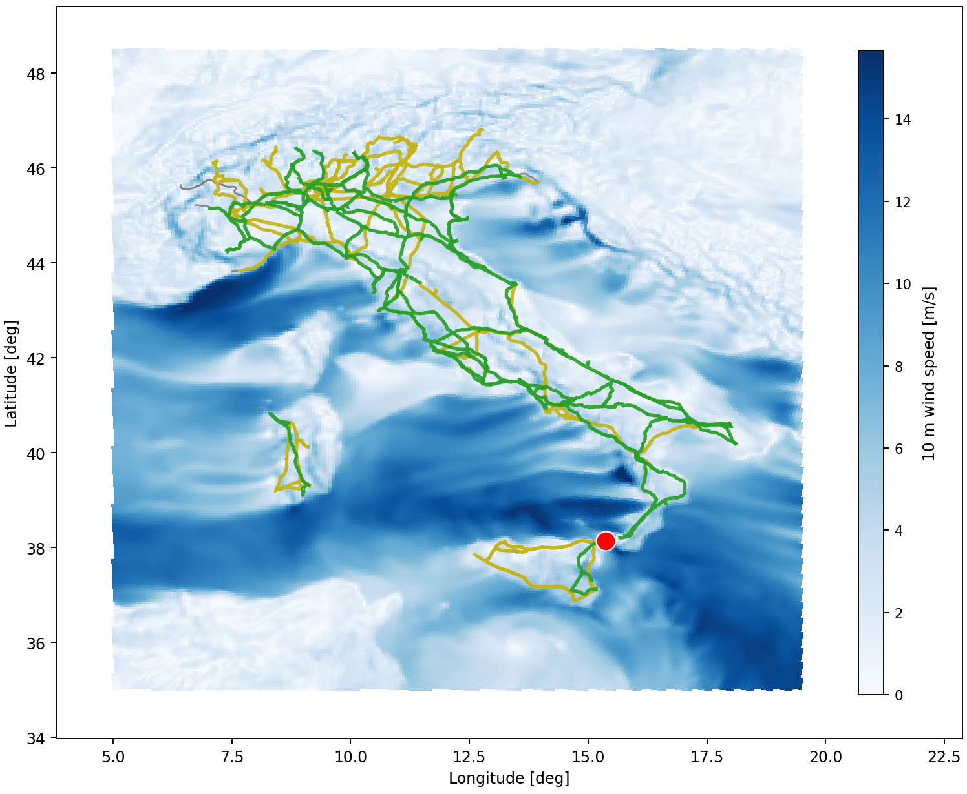
Motivation
Method
Results
Conclusion
Bayesian Approach for Physically Informed Data-Driven Fragility Curves
Prior
Evidence
Posterior

Slide 11
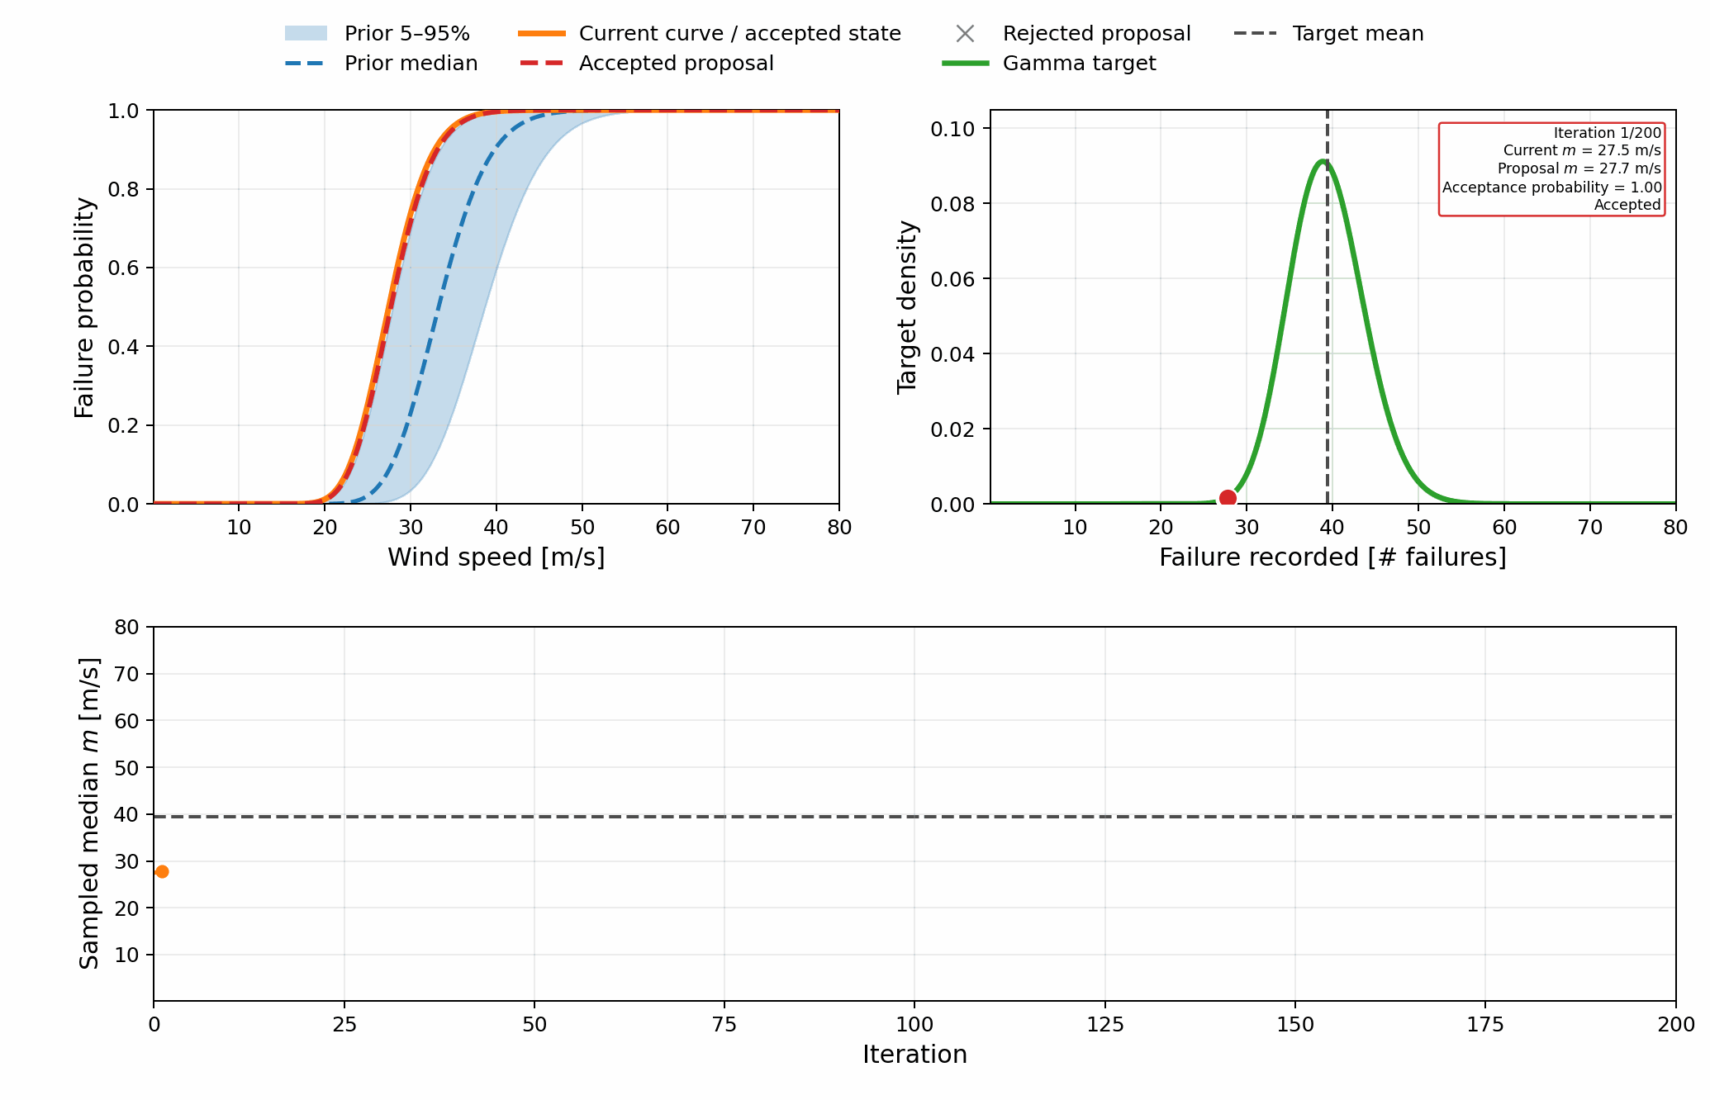
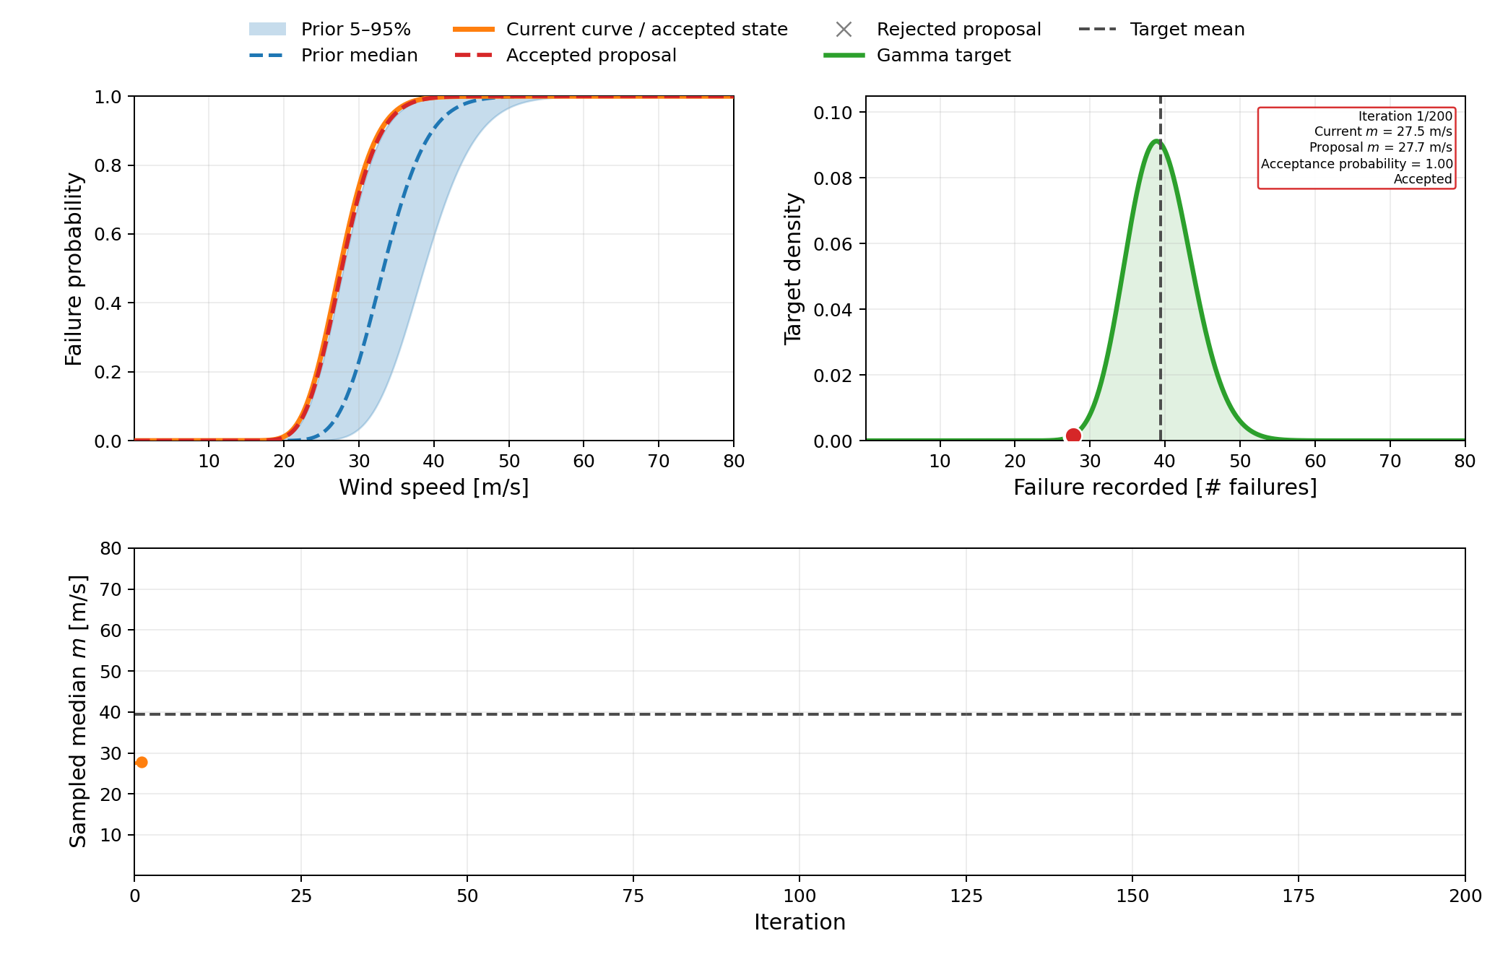
Motivation
Method
Results
Conclusion
Bayesian Approach for Physically Informed Data-Driven Fragility Curves
Markov Chain Monte Carlo
Prior
Evidence

Slide 12
Motivation
Method
Results
Conclusion
Bayesian Approach for Physically Informed Data-Driven Fragility Curves
Markov Chain Monte Carlo
Prior
Evidence

Slide 13
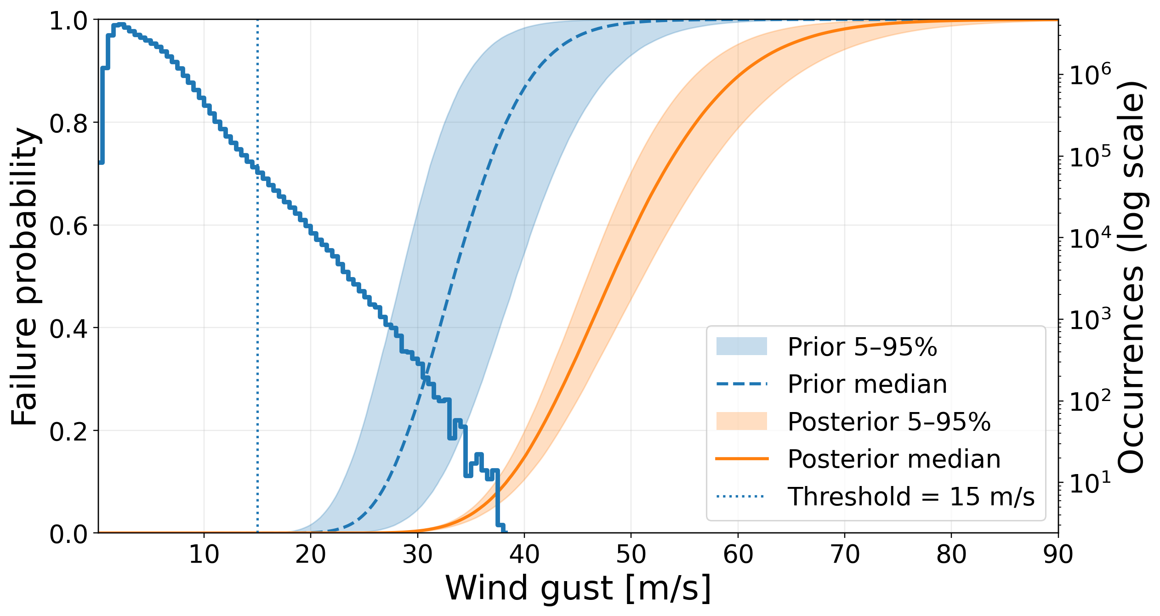
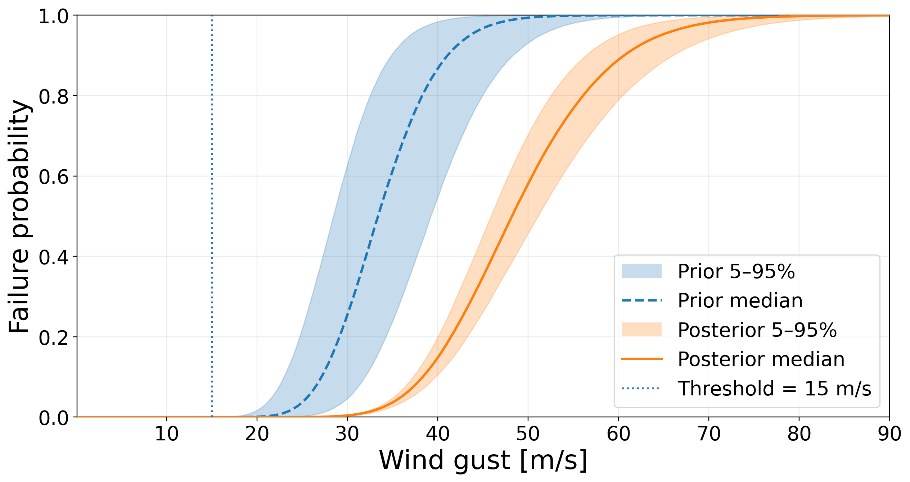
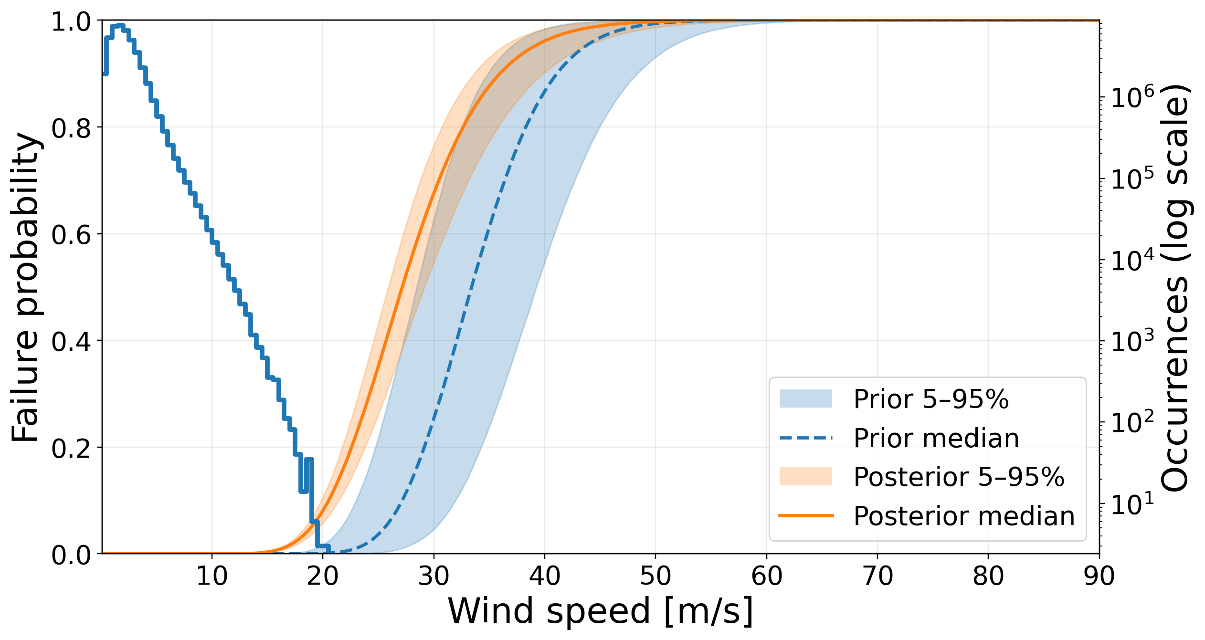
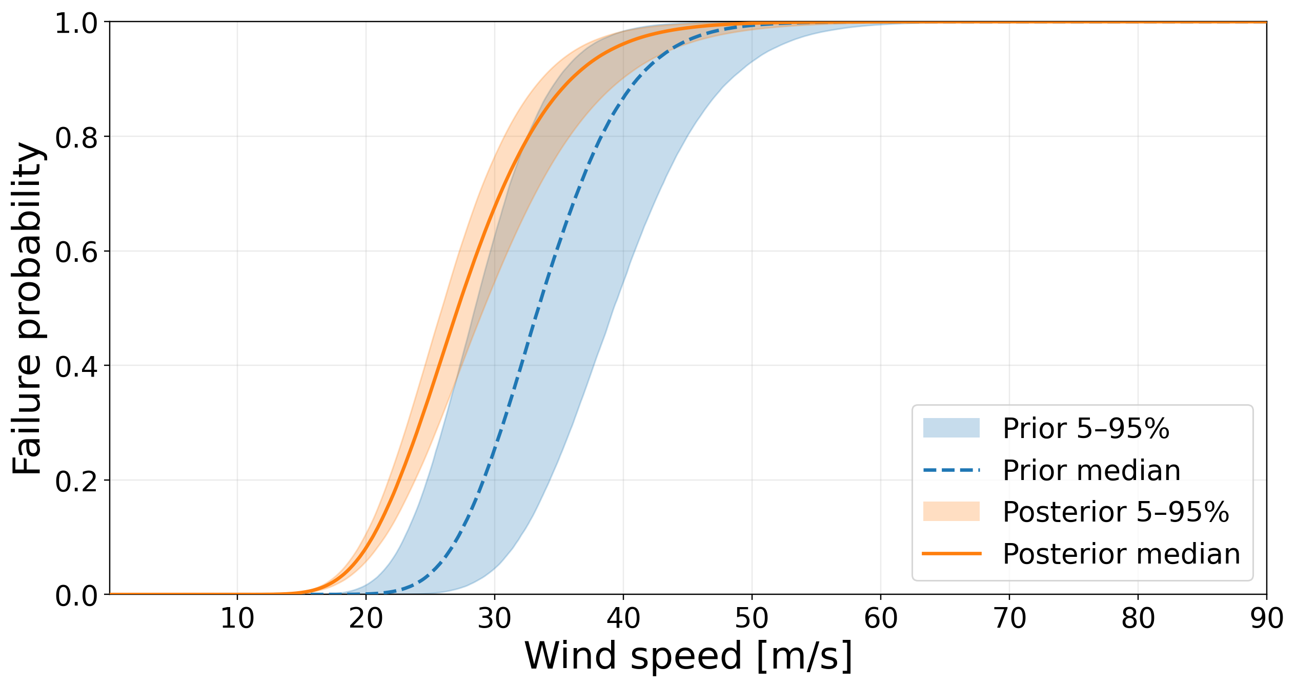
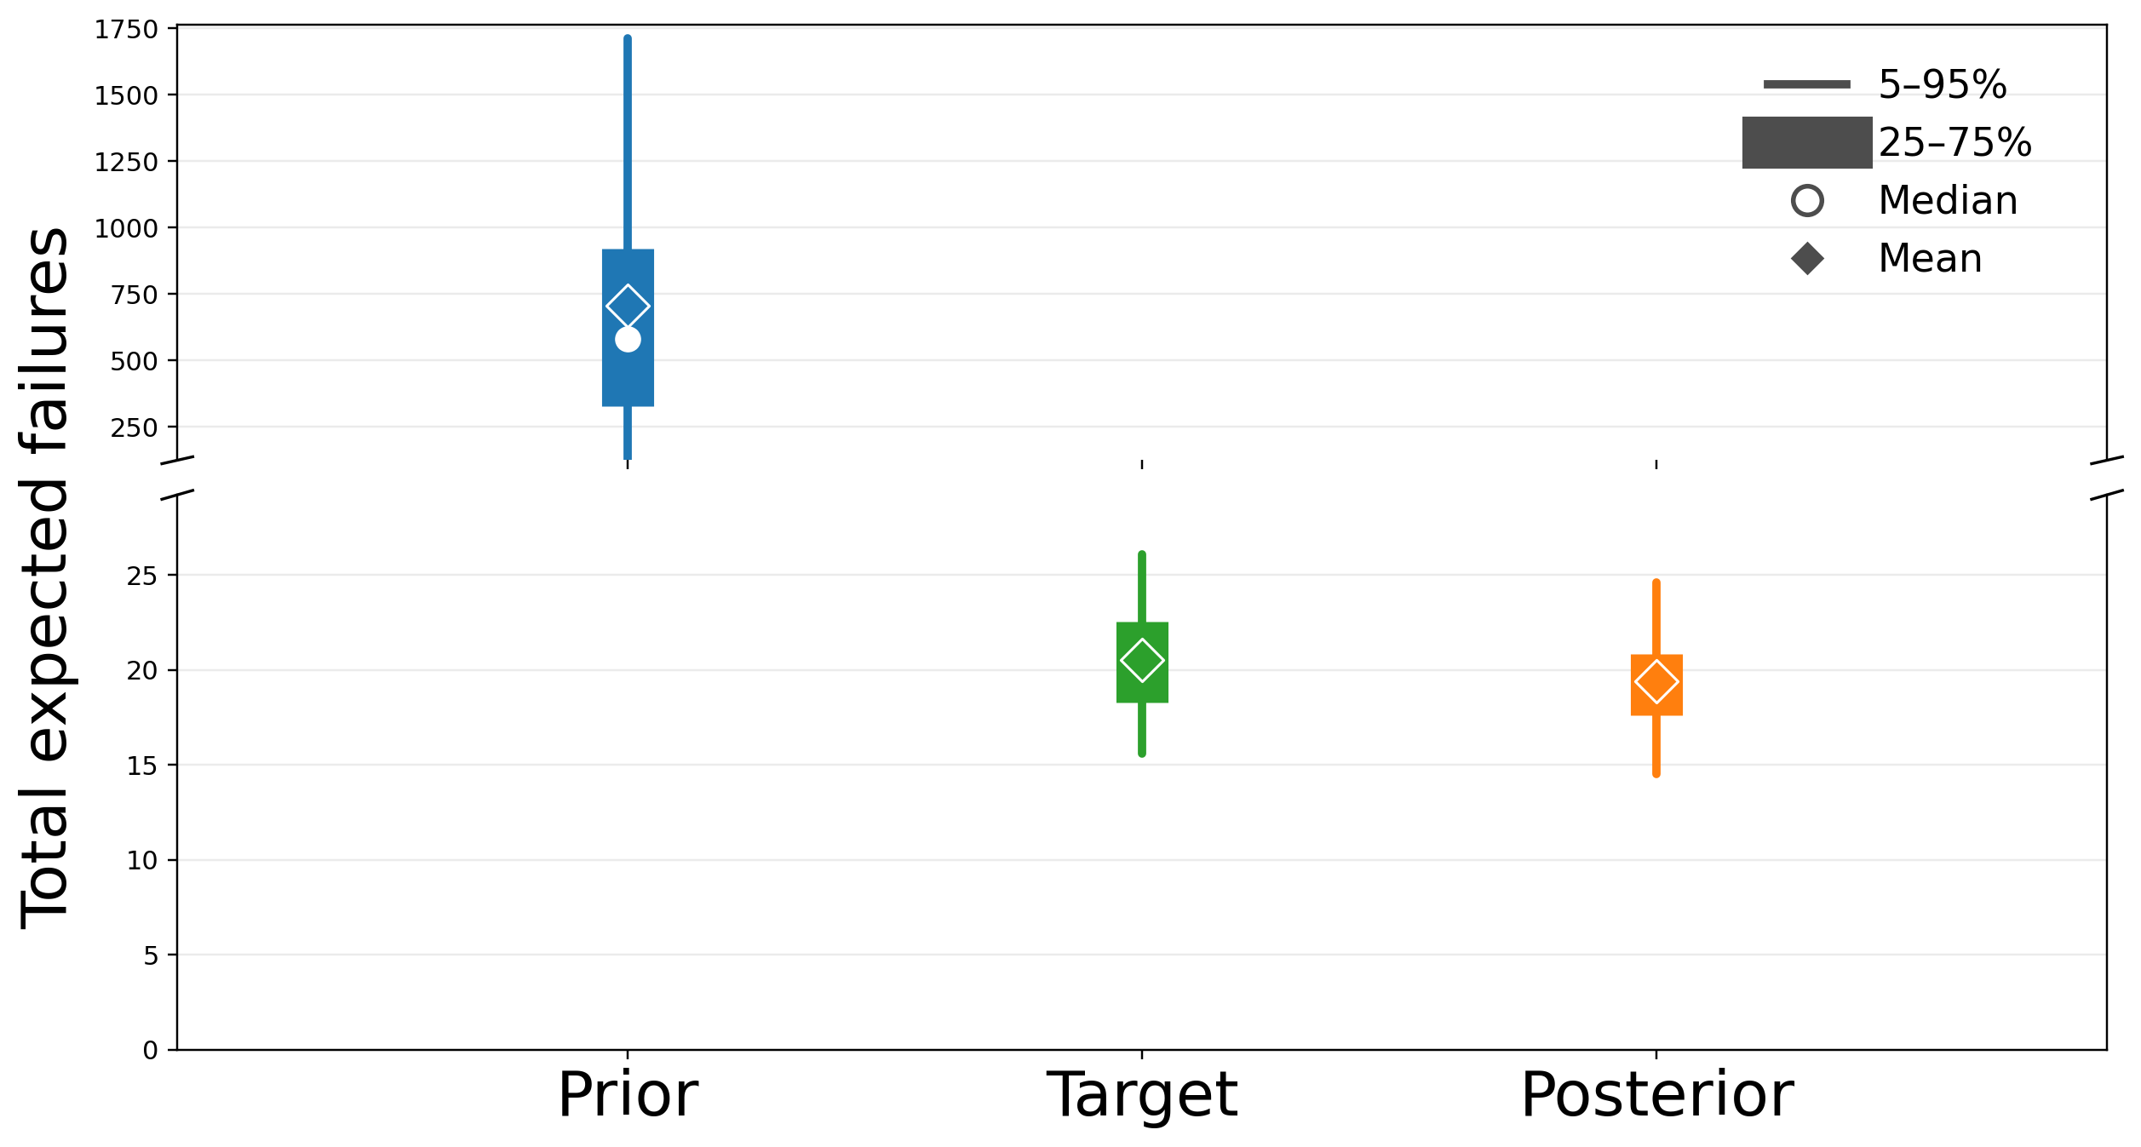
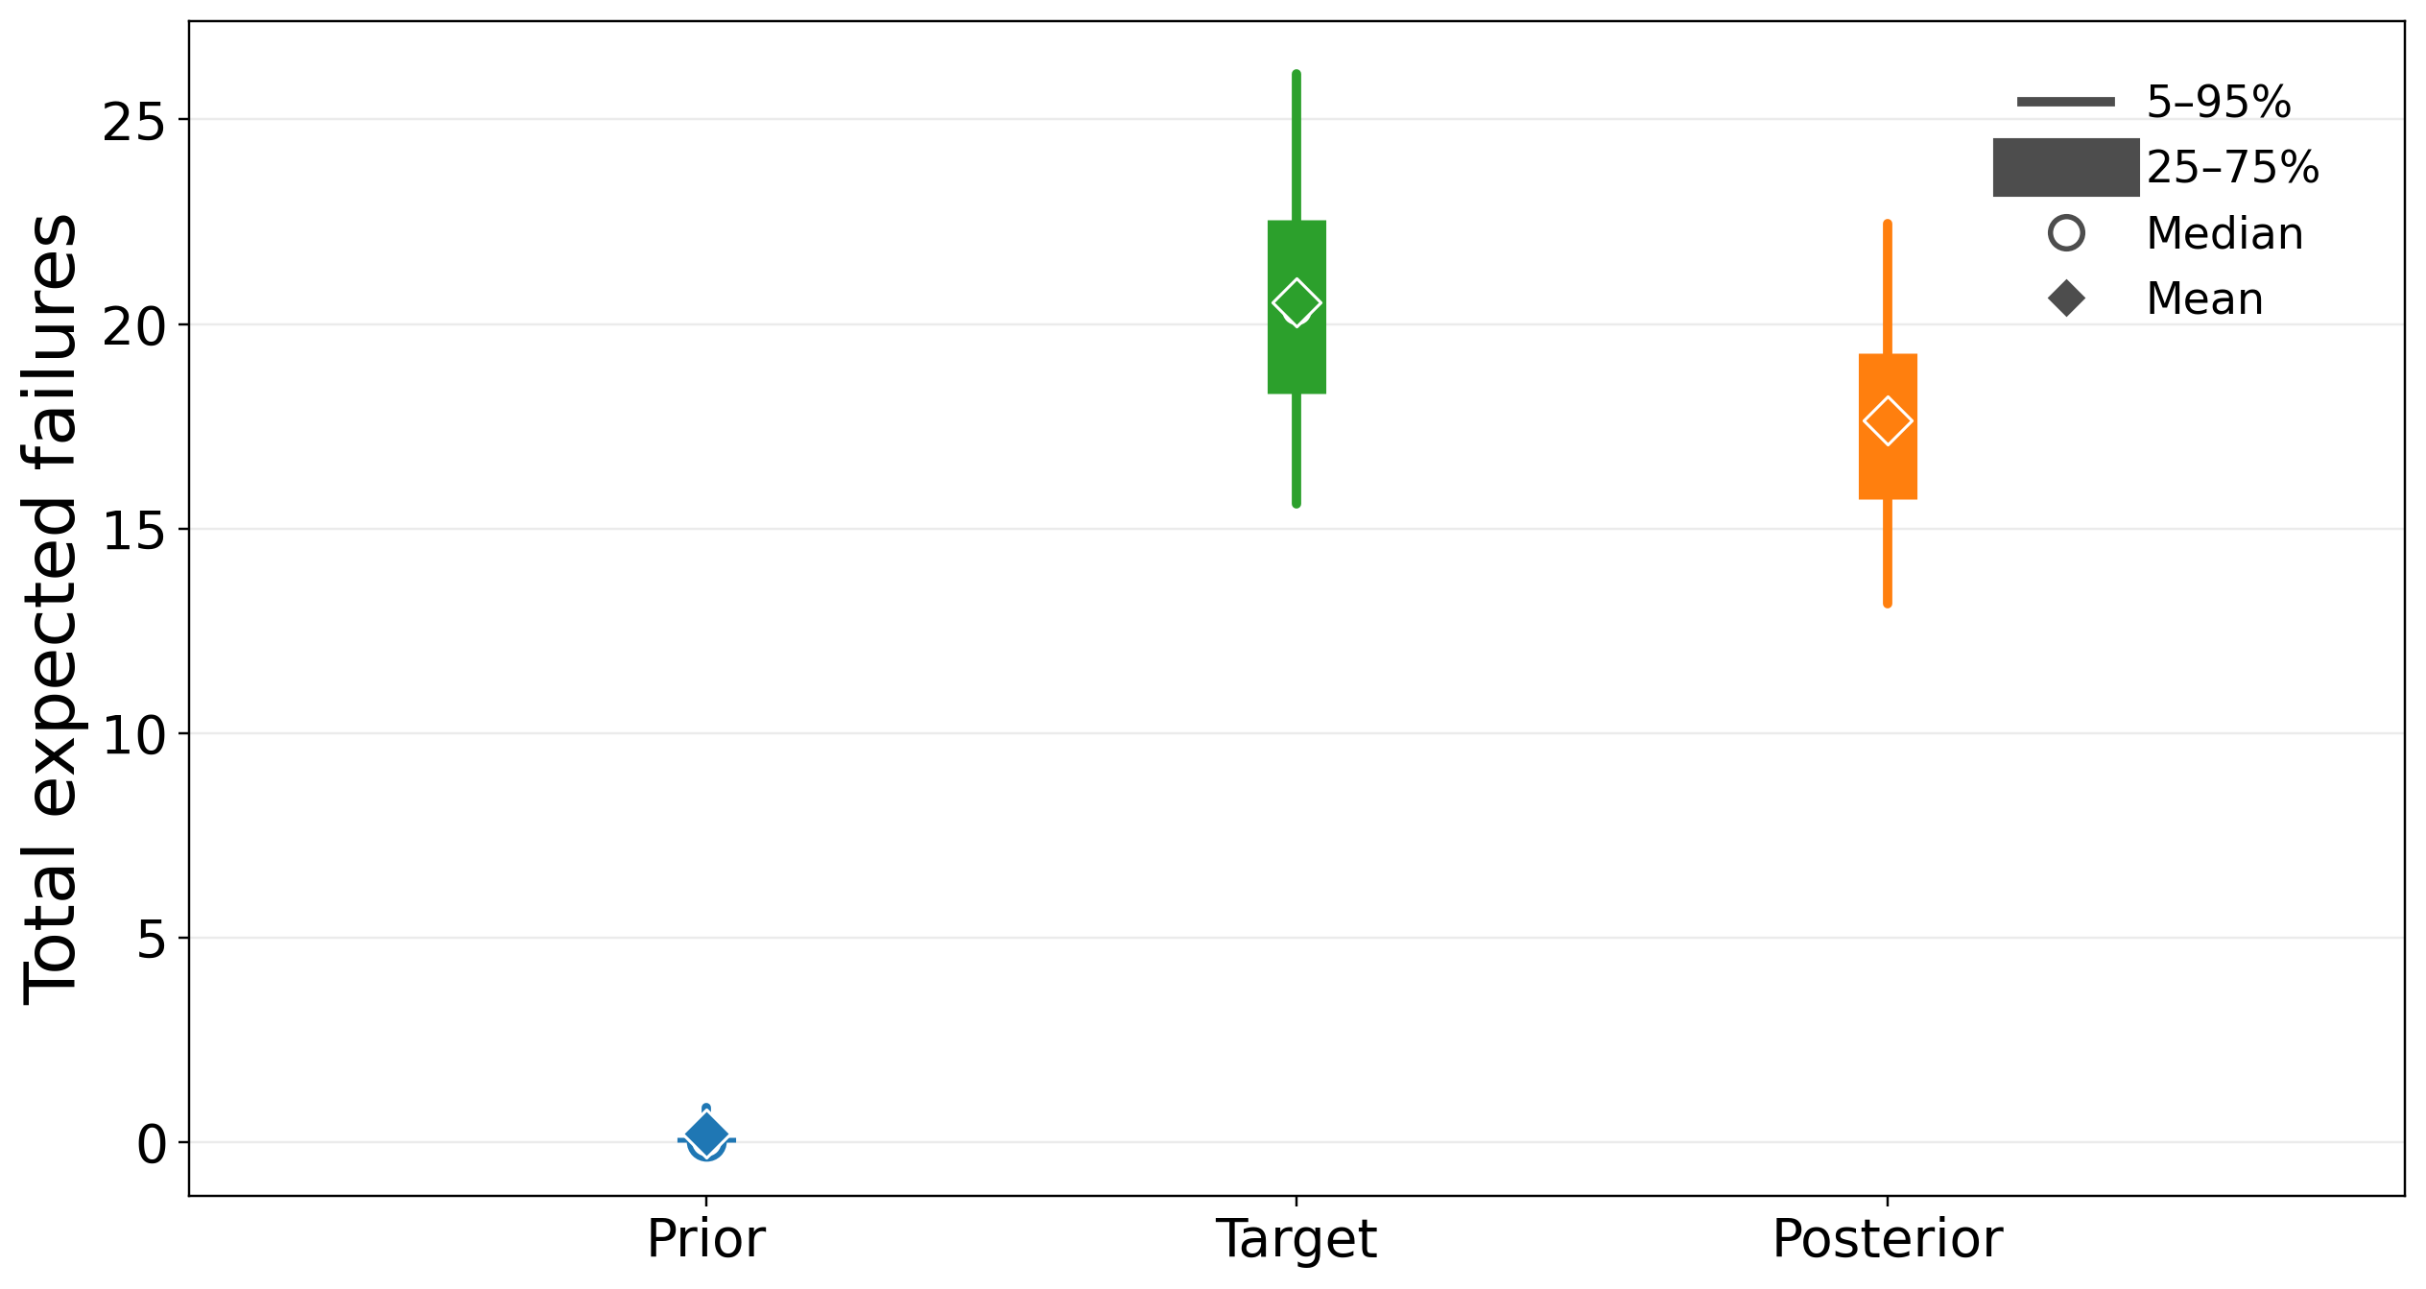
Motivation
Method
Results
Conclusion
Results
Wind gust
Wind average
Prior (5-50-95%) | Target (5-50-95%) | Posterior (5-50-95%)
126.2/582.0/1714.3 | 15.6/20.3/26.1 | 14.5/19.5/24.6
Prior (5-50-95%) | Target (5-50-95%) | Posterior (5-50-95%)
0.0/0.0/0.8 | 15.6/20.3/26.1 | 13.2/17.5/22.5

Slide 14
Motivation
Method
Results
Conclusion
Model Deployment
Short-term weather forecast
Climate projections
Short-term:
Assets likely to fail (Early warning)
Long-term:
Contingency generation
Grid analyses:
Vulnerability assessment
Grid analyses:
Resilience assessment

Slide 15
Conclusion
Motivation
Method
Results
Conclusion
Fragility curves can over/under estimate the failure risk.
Bayesian methods can regularize fragility curves calibration.
Fragility curves can capture uncertainty in natural hazards events.

Slide 16

Thank you for your attention!
Linkedln
Federico Sartore
fsartore@ethz.ch

Slide 17
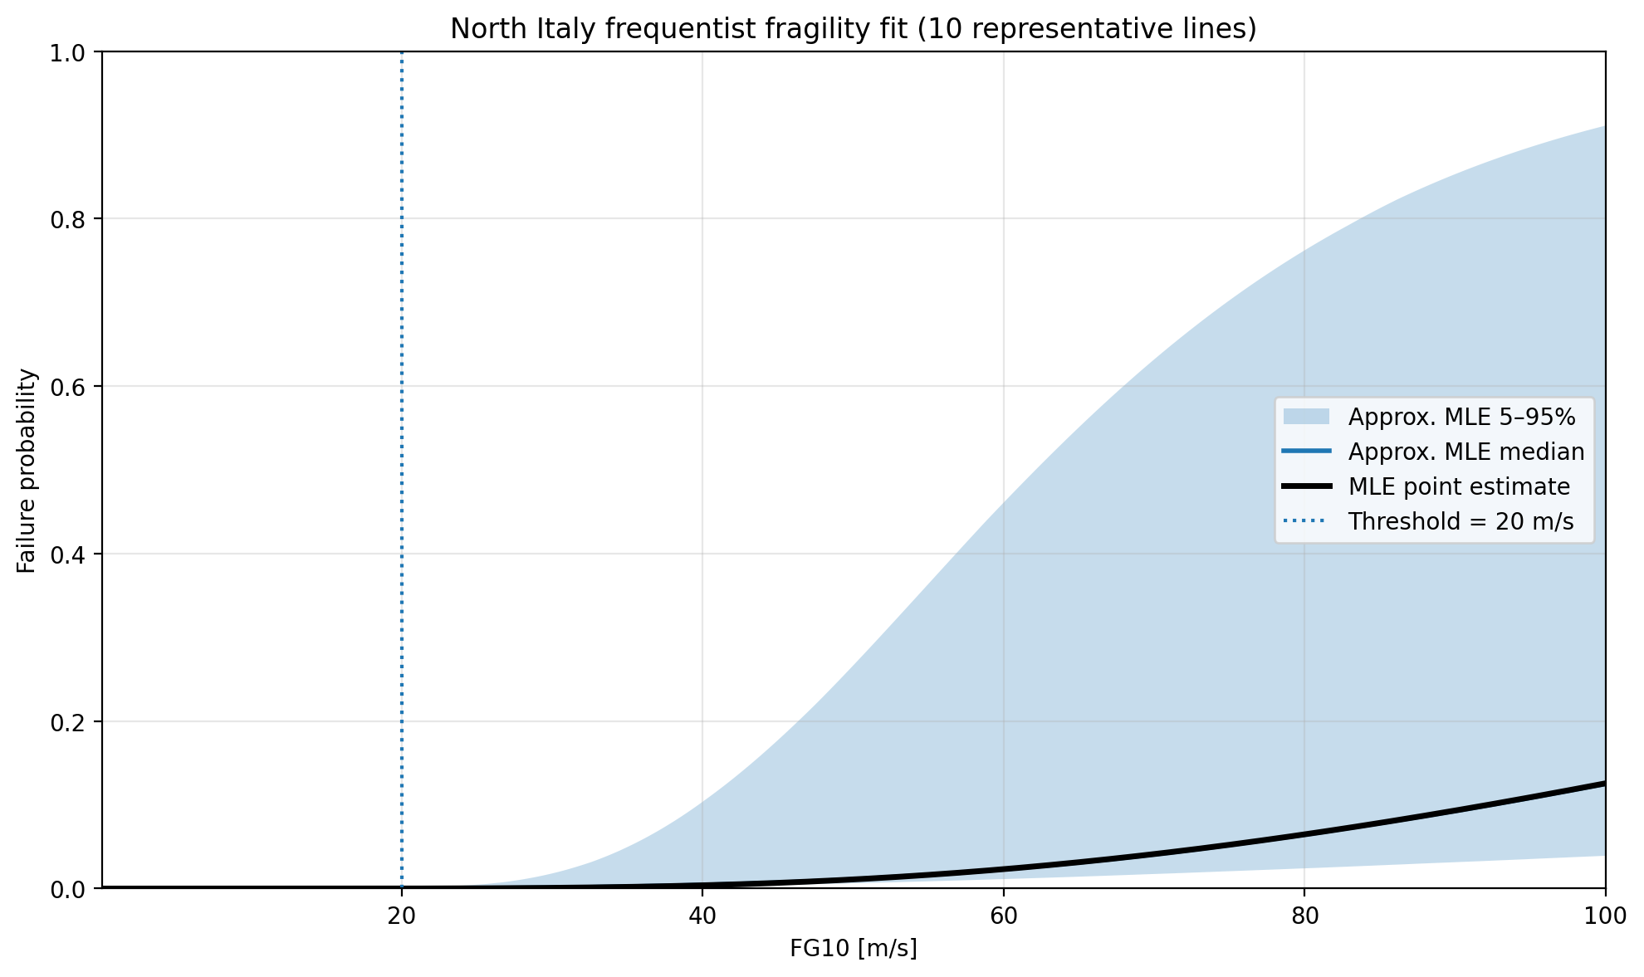
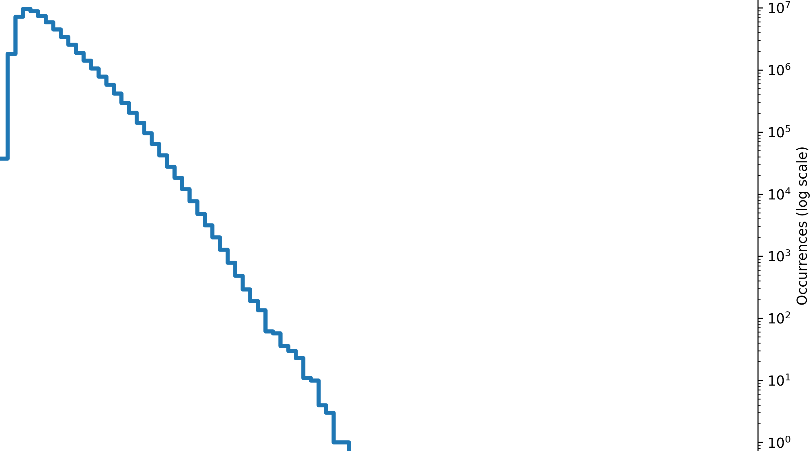
Motivation
Method
Results
Conclusion
Results
Wind gust
Bayesian Approach
MLE Approach

Slide 18
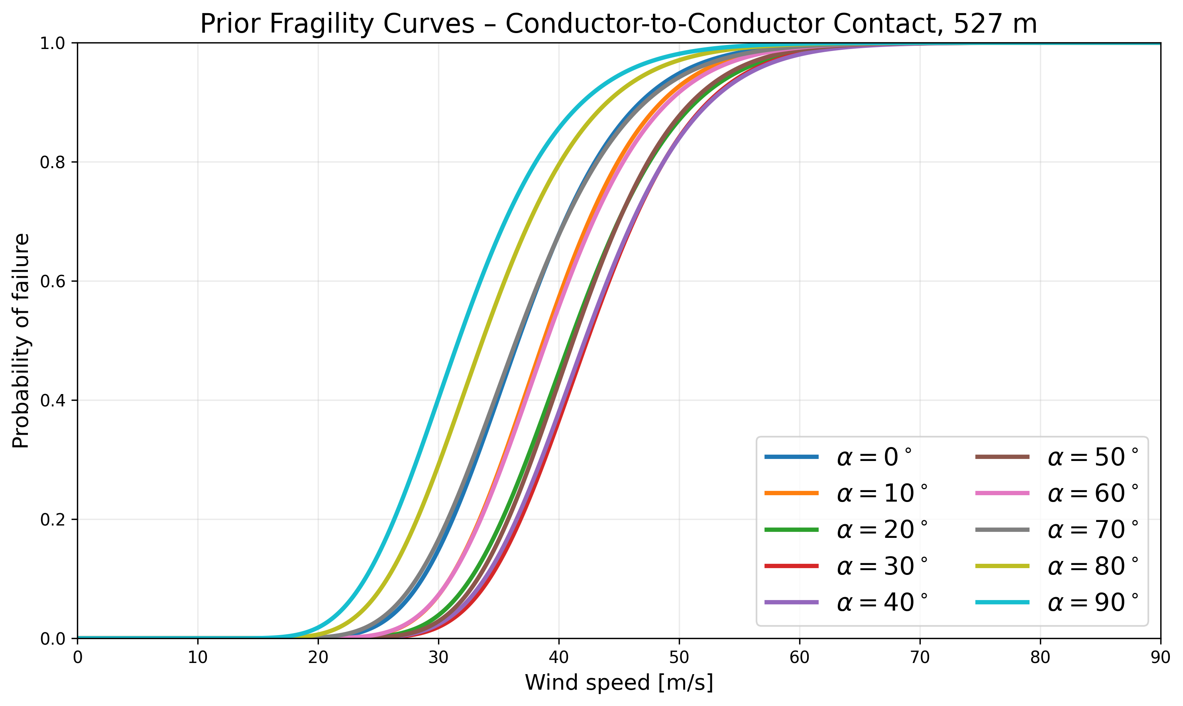
Motivation
Method
Results
Conclusion
Natural Hazards Impacts on Transmission Assets
Fragility Curves
Power Transmission
Finite element-based models [1]
Data-driven studies [2]
Limited research
1. Dikshit, S., & Alipour, A. (2021). A moment-matching method for fragility analysis of transmission towers under straight line winds. Engineering Structures, 248, 113236.
2. Solheim ØR, et al. “Vaffel – a tool for forecasting transmission line failures based on Bayesian updating, reanalysis data and medium-range weather forecasts,” IEEE Acess, 2024.

Slide 19
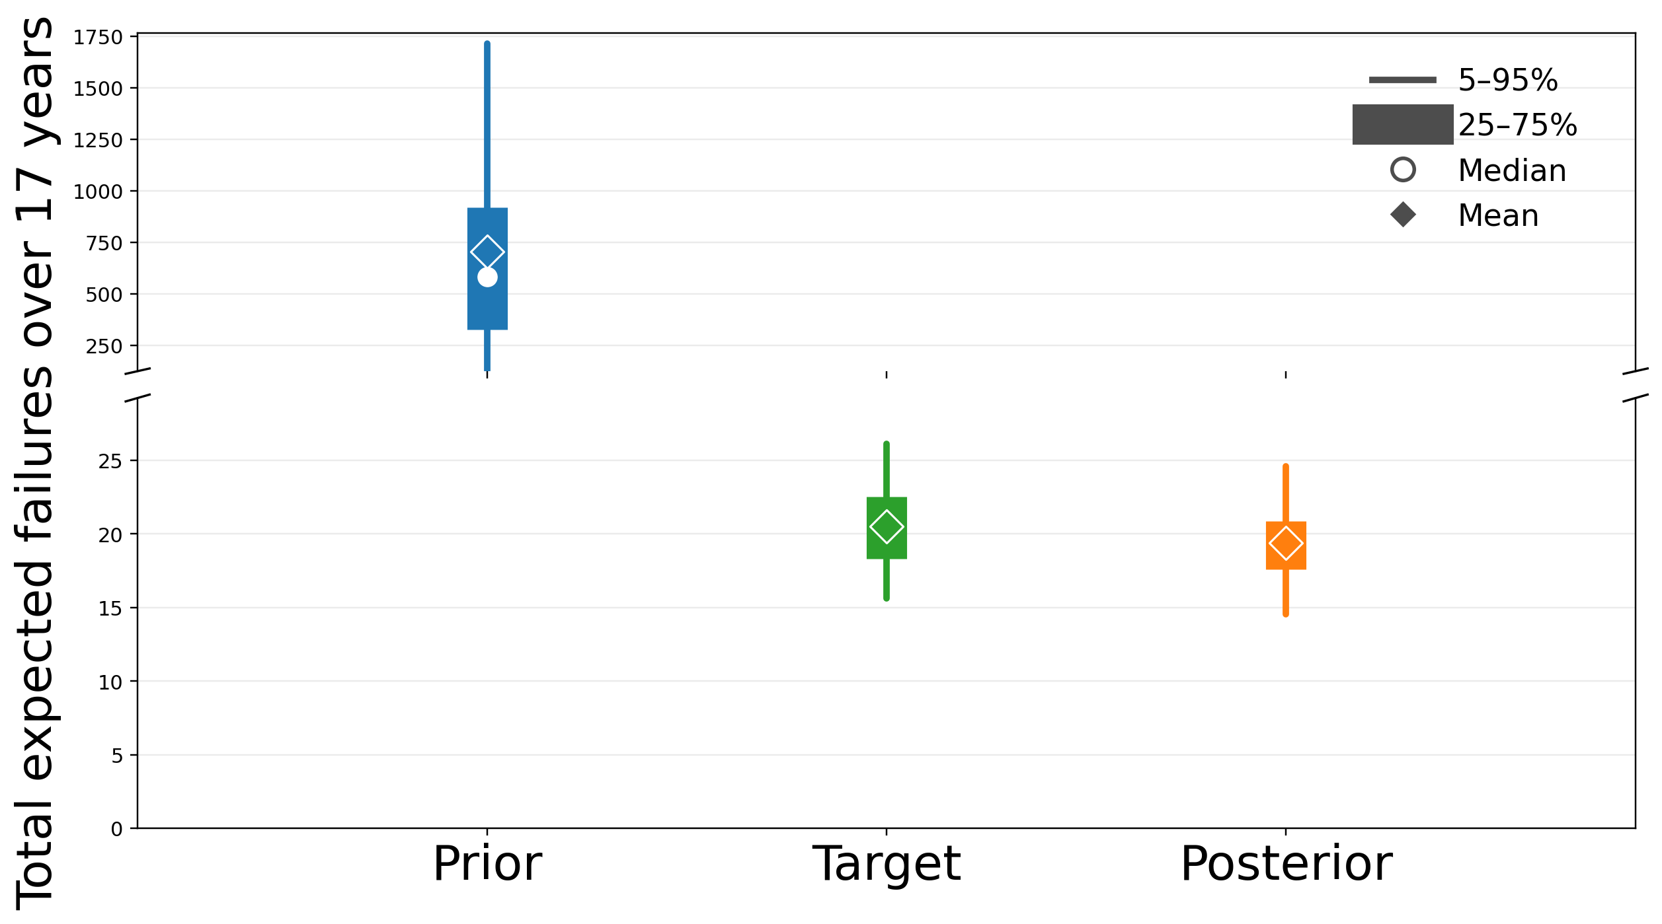
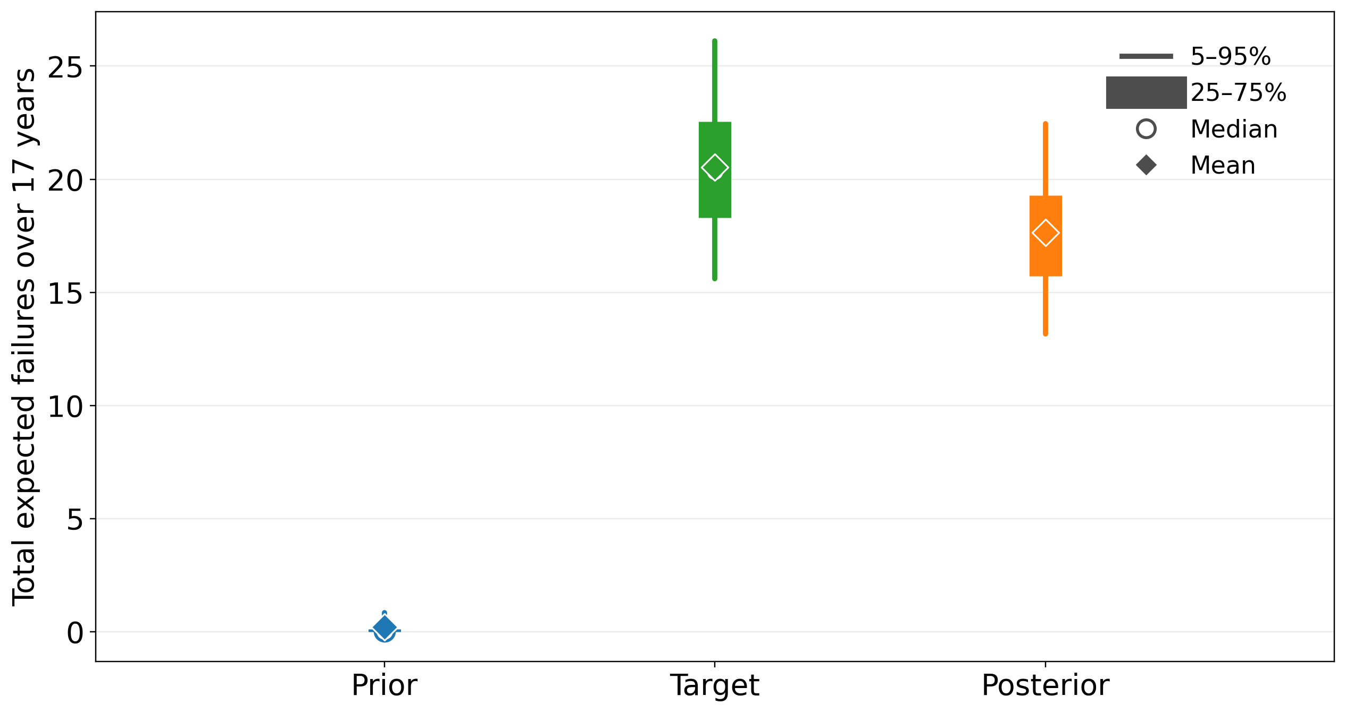
Motivation
Method
Results
Conclusion
Results
Wind gust
Wind average
Prior (5-50-95%) | Target (5-50-95%) | Posterior (5-50-95%)
126.2/582.0/1714.3 | 15.6/20.3/26.1 | 14.5/19.5.5/24.6
Prior (5-50-95%) | Target (5-50-95%) | Posterior (5-50-95%)
0.0/0.0/0.8 | 15.6/20.3/26.1 | 13.2/17.5/22.5

