Slide 1
Evaluation of the Emergency Planning Zone for a Nuclear Power Plant during the Pre-Defueled Stage of Decommissioning under Conservative Meteorological Conditions
July 21, 2026
Speaker: Cheng-Lun Yu

Slide 2
Outline
Introduction
EPZ Evaluation Criteria in Taiwan
Research Method
System Description
Overall Evaluation Framework
Upper-bound Conditions
Results and Discussion
Results for DBA Scenario
Results for SA Scenario
Conclusions

Slide 3
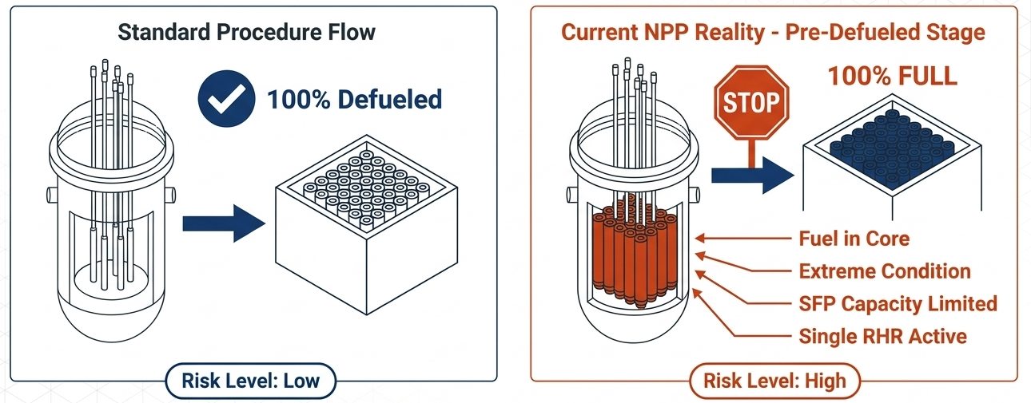
Introduction
SFP
SFP
Standard conditions
Conditions in Taiwan
The extremely conservative meteorological conditions (i.e., a fixed wind blowing toward the south at 0.1 m/s, stability class G and no rainfall) are considered in this work to establish an upper-bound estimation for EPZ evaluation. This study investigates whether the current officially designated 8 km EPZ remains sufficient to cover such severe accident scenarios.

Slide 4
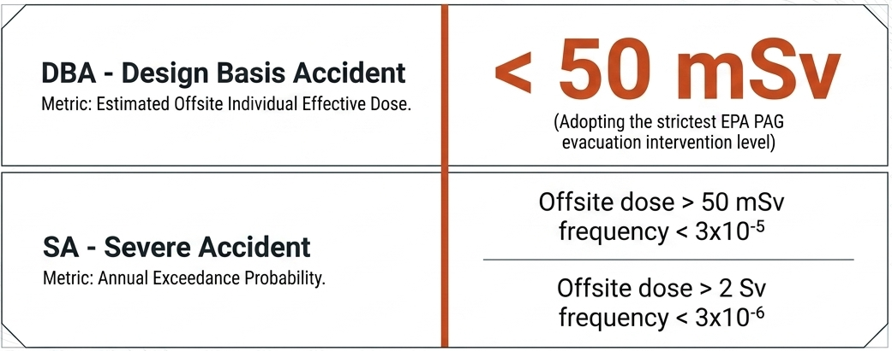
EPZ Evaluation Criteria in Taiwan
(1)
Individual effective dose
(2)
Individual effective dose > 50 mSv
Annual exceedance probability < 3x10⁻⁵
(3)
Individual effective dose > 2 Sv
Annual exceedance probability < 3x10⁻⁶
The evacuation intervention level specified in the Protective Actions Guidelines (PAG) is 50–100 mSv over a 7-day period. In this study, a conservative value of 50 mSv is adopted as the assessment criterion to determine the EPZ.

Slide 5
System Description
The Chinshan NPP is configured with an open reactor vessel head and a hydraulic connection between the Reactor Pressure Vessel (RPV) and the SFP. Due to the lower decay heat and large water inventory in the SFP, the fuel melting in the SFP occurs later than that in the reactor core and beyond the Level 3 emergency phase (i.e., 7 days) in this study. Accordingly, the contribution of the SFP to the individual effective dose is not included in the EPZ evaluation.
Research Method

Slide 6
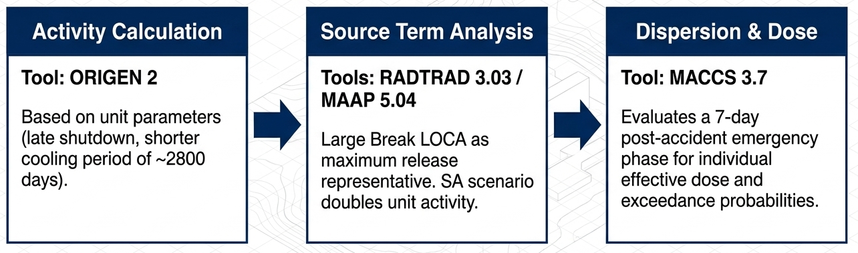
Overall Evaluation Framework
Evaluates a 7-days emergency phase after accident for individual effective dose (DBA) and annual exceedance probabilities (SA)
Based on Unit 2 parameters (late shut down, shorter cooling time period of ~2800 days) to calculate core inventory.
Loss-Of-Coolant Accident (LOCA) as maximum release representative for DBA and SA
This methodology including core inventory, source term and dose evaluation is based on the EPZ review and revision report [4] approved by the Nuclear Safety Commission (NSC) in Taiwan.
[4] Taiwan Power Company. “The Review and Revision of the Emergency Planning Zones for Chinshan, Kuosheng, and Maanshan Nuclear Power Plants,” 2025.
Research Method

Slide 7
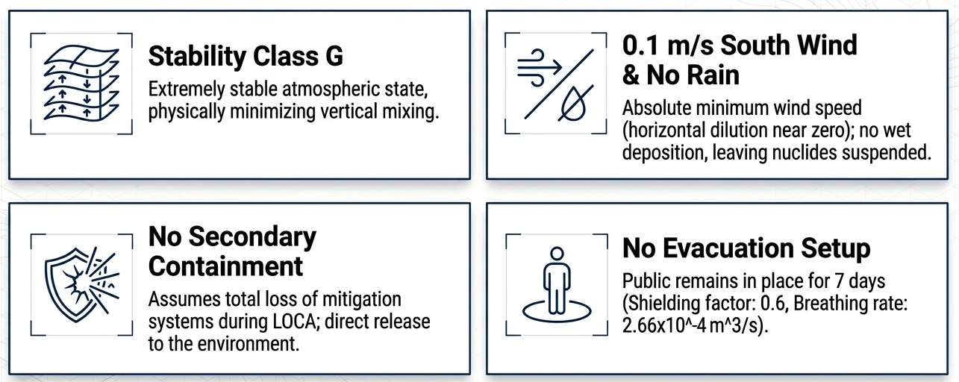
Upper-bound Conditions
(1)
(2)
(3)
(4)
Radionuclides are assumed to be directly released into the environment.
Research Method

Slide 8
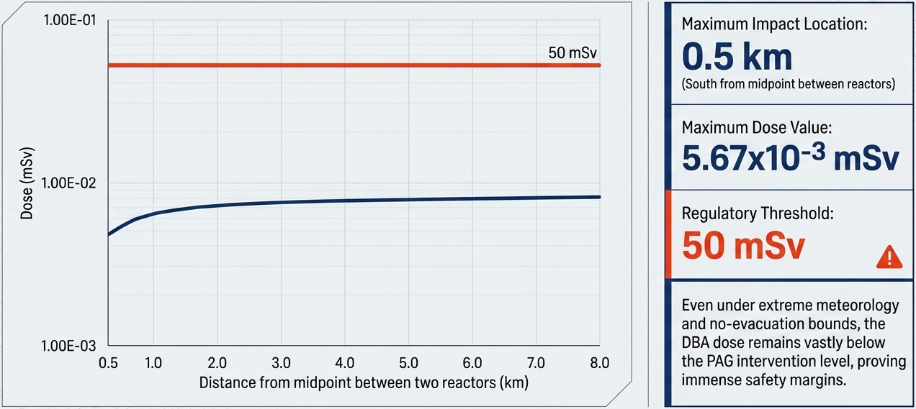
Results for DBA Scenario
The individual effective dose at a distance of 0.5 km to the south of the midpoint between the two reactor units is 5.67×10⁻³ mSv, which is well below 50 mSv.
Results and Discussion

Slide 9
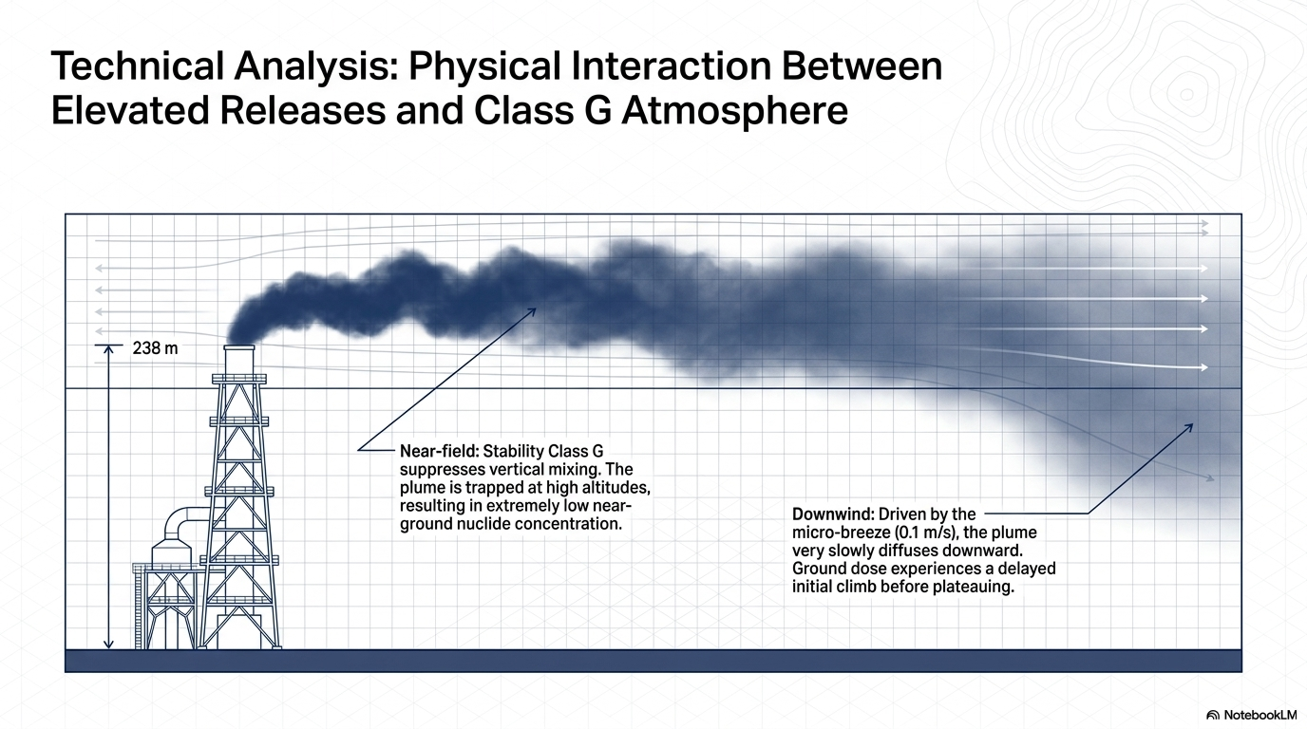
Results for DBA Scenario
Stack height
238 m
In the near-field region, the plume remains aloft, due to the suppressed vertical mixing in such a stable atmosphere leading to lower ground-level concentrations. As the plume travels downwind and disperses toward the ground, the dose increases accordingly.
Results and Discussion

Slide 10
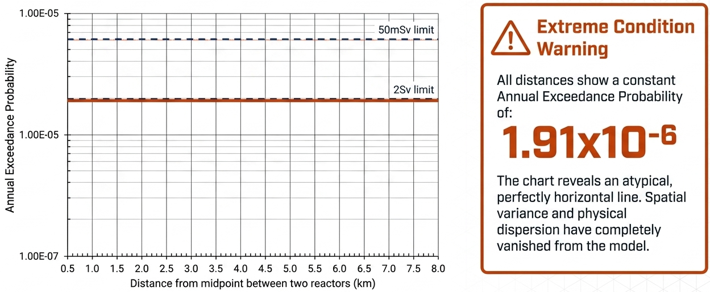
Results for SA Scenario
For 50 mSv and 2Sv, the figure reveals that the probability remains constant at 1.91×10⁻⁶ across all evaluated distances, which reflects the saturation of radiological impact under the extreme meteorological conditions.
Results and Discussion

Slide 11
Results for SA Scenario
Roof height
43.58 m
Due to the low wind speed and highly stable atmospheric conditions, the atmospheric dilution is physically minimized, which results in MACCS-predicted individual effective doses at various downwind distances readily reaching both the 50 mSv and 2 Sv dose thresholds. In other words, the conditional exceedance of 50 mSv and 2 Sv dose thresholds becomes almost certain, resulting in the conditional exceedance probabilities predicted by the MACCS approaching 1.
Results and Discussion

Slide 12
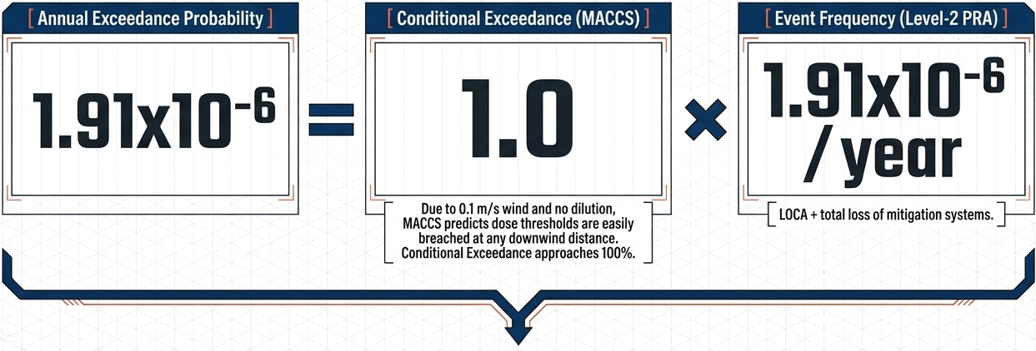
Results for SA Scenario
Note that the annual exceedance probabilities of 50 mSv and 2 Sv (i.e., 1.91×10⁻⁶) are obtained by multiplying the conditional exceedance probabilities from the MACCS code (i.e., 1) by the SA release frequency of 1.91×10⁻⁶ /year from Level 2 PRA [4]; consequently, the risk metric is dominated by the low accident frequency (1.91×10⁻⁶ /year) rather than spatial dispersion.
Results and Discussion

Slide 13
Conclusions
For DBA scenario, the results reveal that the individual effective dose at a distance of 0.5 km to the south of the midpoint between the two reactor units (i.e., 5.67×10⁻³ mSv) is well below 50 mSv (regulatory criterion in Taiwan).
For SA scenario, the results show that the annual exceedance probabilities for both 50 mSv and 2 Sv at a distance of 0.5 km to the south of the midpoint between the two reactor units (i.e., 1.91×10⁻⁶) are lower than the corresponding criteria in Taiwan (3.0×10⁻⁵ and 3.0×10⁻⁶, respectively).
In brief, the EPZ for the Chinshan NPP during the pre-defueled stage of decommissioning is within 0.5 km from the midpoint between the two reactor units. Therefore, the current 8-km EPZ in Taiwan provides sufficient conservatism under the conservative conditions considered in this study.
This study provides a technical basis for future EPZ reviews under similar decommissioning conditions.

Slide 14
Thank you for your attention

