Slide 1
Response Surface Methodologies for Passive Safety System Reliability Analysis
Tom Elicson, Chloe Howard, Stephen Hess, Leo Shanley, Jensen Hughes
Eric Thornsbury, EPRI
PSAM 18
July 19-July 24, 2026, Pittsburgh, Pennsylvania

Slide 2
Overview
Response surface background
Why we use response surfaces
Passive safety system response surface methodology pilot study
Lessons learned

Slide 3
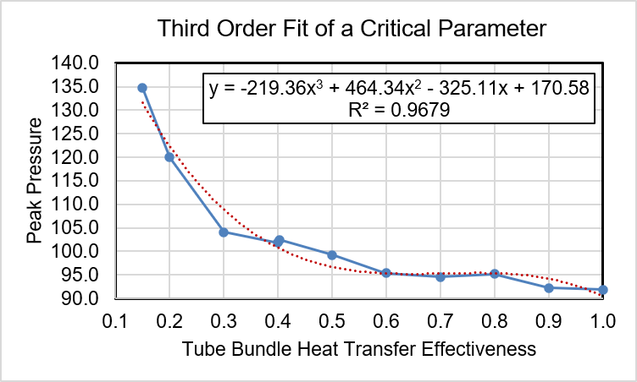
What is a Response Surface?
A response surface is a mathematical model used as a surrogate for a best estimate code
Common response surfaces use a second order or third order polynomial regression of best estimate code results to represent the response of the best estimate code (parametric response surface)
We are familiar with curve fitting of a single variable using a straight line or a higher order polynomial
The response surface involves several variables, so we use multi-variate regression techniques
Notes:
Most people are familiar with TH codes for safety analysis but may not be familiar with response surfaces, so let’s start by explaining what a response surface is and why we use them
Example: Suppose we are doing a sensitivity study and we vary multiple MAAP (or other TH code) parameters to see the effect on timing of core uncovery, onset of core damage, or some other key event. The MAAP results are the data: the independent variables are the values of the MAAP parameters that we are varying. There is a single dependent variable which is the key event; e.g., time to core uncovery. We do a multi-variate regression using the MAAP input parameters and the MAAP result.

Slide 4
What is a Response Surface?
A polynomial regression model is the simplest form of a response surface, but the data may not always be well-represented by polynomials
Alternate response surfaces methods involve variable transformations
There are also more advanced techniques referred to non-parametric response surfaces such as Artificial Neural Networks (ANNs) and Gaussian Process Regressors (GPRs), or using a spline fit of the data
Notes:
Most people are familiar with TH codes for safety analysis but may not be familiar with response surfaces, so let’s start by explaining what a response surface is and why we use them
Example: Suppose we are doing a sensitivity study and we vary multiple MAAP (or other TH code) parameters to see the effect on timing of core uncovery, onset of core damage, or some other key event. The MAAP results are the data: the independent variables are the values of the MAAP parameters that we are varying. There is a single dependent variable which is the key event; e.g., time to core uncovery. We do a multi-variate regression using the MAAP input parameters and the MAAP result.

Slide 5
Why Do We Use Response Surfaces
Often times we need to use best estimate (BE) thermal hydraulic (TH) codes like MAAP or GOTHIC to do uncertainty studies that may require 1000’s or 100’s of thousands of code runs
The uncertainty studies are typically performed by assigning probability distributions to a set of code input parameters and then randomly selecting values of the parameters
  Example: Investigating uncertainty regarding hydrogen combustion and peak containment pressure: the number of cases resulting in containment failure can be used to quantify the containment failure probability
It may be practical to run 1000 MAAP or GOTHIC cases, it is not practical to run 100,000 cases
A response surface can be exercised several hundred thousand times in a matter of a few minutes
Notes:
e.g., investigating uncertainty regarding hydrogen combustion and peak containment pressure
If we can do a regression or a curve fit of the MAAP results as a function of the code input parameters then we can get a fast running tool – the response surface – that can be used to perform the uncertainty study.
The key is to pick a single metric or success criteria for evaluation, such as peak containment pressure. The response surface is also sequence dependent, so we may have to generate separate response surfaces form LOCA’s, SBOs, etc. It may be possible to pick a bounding scenario or a bounding scenario for each initiating event type.

Slide 6
Are Response Surfaces Needed in Nuclear Safety?
Passive safety systems (PSS) found in advanced reactor designs rely on natural physical processes; therefore they are susceptible to uncertainties in the physical processes themselves
Advanced reactors may be licensed within a risk-informed framework which requires that the PSS reliability include an assessment of the phenomenological reliability
The phenomenological failure rate may be on the order of 1E-4 to 1E-6, therefore 100’s of thousands or 100’s of millions of best estimate code runs would be required
An alternative is to build and exercise a response surface
Notes:
e.g., investigating uncertainty regarding hydrogen combustion and peak containment pressure
If we can do a regression or a curve fit of the MAAP results as a function of the code input parameters then we can get a fast running tool – the response surface – that can be used to perform the uncertainty study.
The key is to pick a single metric or success criteria for evaluation, such as peak containment pressure. The response surface is also sequence dependent, so we may have to generate separate response surfaces form LOCA’s, SBOs, etc. It may be possible to pick a bounding scenario or a bounding scenario for each initiating event type.

Slide 7
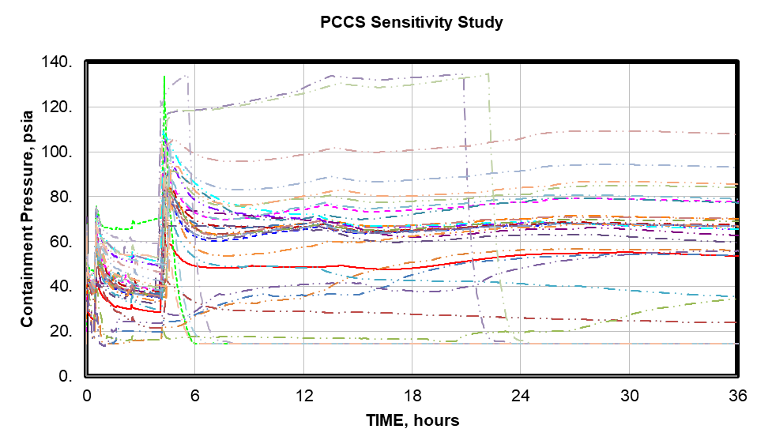
Are Response Surfaces Needed in Nuclear Safety?
In 2025, an EPRI-sponsored project developed guidance for performing PSS reliability analysis which involved the use of MAAP to develop a response surface to characterize the phenomenological reliability
This presentation will focus on the techniques used to build the response surface and will present results and lessons learned for a pilot study
Techniques applicable to other codes
Advanced Nuclear Technology: Guidance for Passive Safey System Analysis. EPRI, Palo Alto, CA: 2025. 3002032223
E. Thornsbury, C. Howard, T. Elicson, S. Hess, and L. Shanley, “EPRI Guidance for Passive System Reliability Analysis,” PSAM-18, Pittsburgh, PA USA, July 19 – 24, 2026.
Notes:
This presentation will be focused on the role of MAAP in characterizing the phenomenological reliability. The plot shows the variation in containment pressure in response to changed in the MAAP input parameter for Hx tube condensation effectiveness. We can get a wide variation in peak containment pressures by changing a single model parameter. Man y cases show containment pressure is controlled, but some cases show early, mid, or late containment failures.

Slide 8
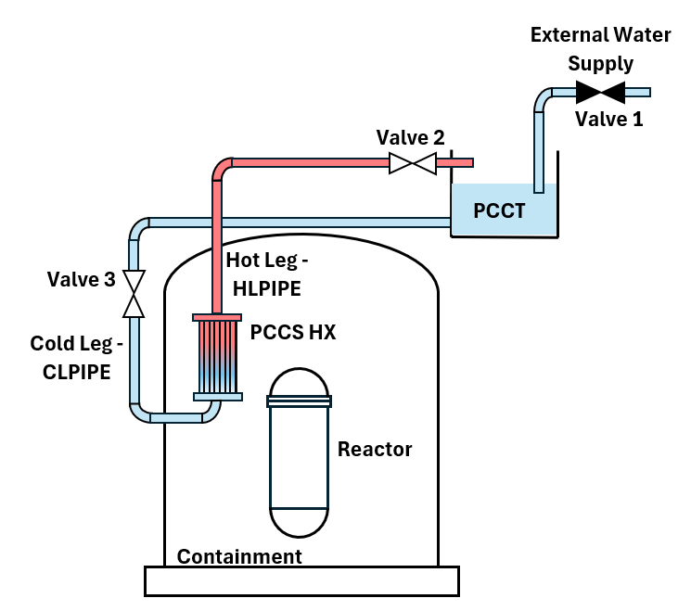
Pilot Study: Passive Containment Cooling System (PCCS)
TH model constructed to represent primary system, containment, and PCCS
The key safety function for the PCCS is to remove heat from the containment structure
  The figure of merit used to assess the PCCS phenomenological reliability is the peak containment pressure
  A limiting case with regard to peak containment pressure, a Loss of Coolant Accident (LOCA) represented by a main steam line break into the containment space, was selected for analysis
  The containment is assumed to fail at 120 psig (134.7 psia, 0.93 MPa). Therefore, the success criteria for this study is containment pressure maintained at less than 120 psig (134.7 psia, 0.93 MPa).
Goal is to quantify the PCCS phenomenological reliability
Notes:
Example of phenomenological failure: Hx in containment relies on natural circulation with steam condensation on tube surface. Suppose the core melts and the containment contains a large quantity of hot airborne aerosols. We typically see CsI aerosols released during the LEU core melt of current generation LWRs. We can also get 1000 kg or more of inert concrete aerosol generated during prolonged core –concrete attack.
Hot aerosols like to plate out on cold surfaces such as heat exchanger tubes. Can enough aerosols plate out on the passive Hx tubes to degrade the Hx performance?

Slide 9
Key Components of the Response Surface Methodology
Identification of critical parameters
Phenomena identification and ranking table (PIRT)
Identify and rank phenomena; match code inputs to phenomena
Parameter range definition
Define operating ranges for normal and off-normal conditions
Limits extend beyond design limits but avoid excessive conservatism
Sensitivity analysis
Each parameter is varied independently across its operating range
TH code results used to determine impact on system performance
Probability distribution assignment
Response surface development
Uncertainty propagation
Probability density function assigned to characterize uncertainty
A limited number of TH code calculations are performed to develop “truth data” for constructing mathematical model (response surface)
Random sampling of critical parameters is used to exercise the response surface to determine PSS phenomenological reliability
Informed by experimental and operational data

Slide 10
Identification of Critical Parameters
A Phenomenon Identification and Ranking Table (PIRT) process identified 25 key physical phenomena affecting the PSS performance and ranked their importance relative to PSS key safety function
    The phenomena were mapped to available TH code inputs
    Code inputs are referred to here as “critical parameters”
Not all phenomena may have detailed representation in the TH code
  Use a surrogate model from the TH code
  Combine multiple phenomena into a single code parameter
Example: Uncertainty in tube inside surface heat transfer coefficient
  No MAAP input for tube inside surface thermal resistance
  Resistance include with uncertainty on tube wall thermal conductivity
Notes:
25 key physical phenomena is a large number of phenomena to consider for a reliability analysis, therefore screening was uwd to reduce the number of phenomena, or more importantly, the critical parameters.
The first level of screening is to combine multiple phenomena into a single TH input parameter or model

Slide 11
Parameter Range Definition
A nominal, minimum, and maximum value for each critical parameter was defined
  Constraints on min and max values may be due to code limitations, design and operational limits, and limits in ambient conditions
    Example: PCCT pool temperature and level are limited by technical specifications
    Cold leg and hot leg ruptures limited by pipe diameter
  Literature review indicates that parameter limits are often assigned based on expert judgement
Pilot study selected parameter ranges that would challenge PSS key safety function success

Slide 12
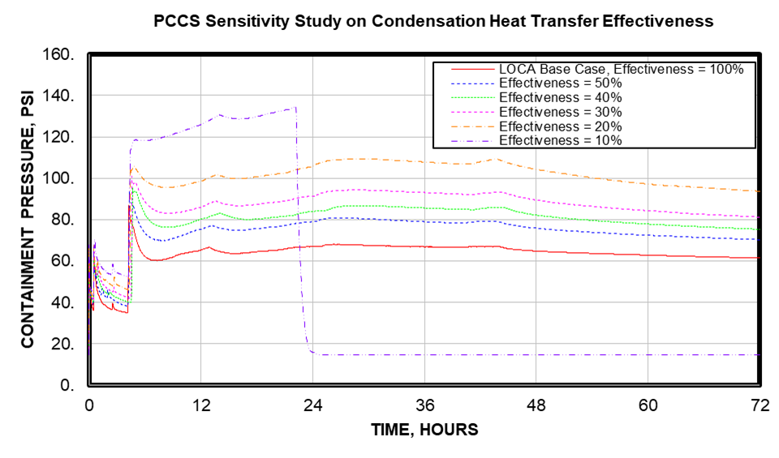
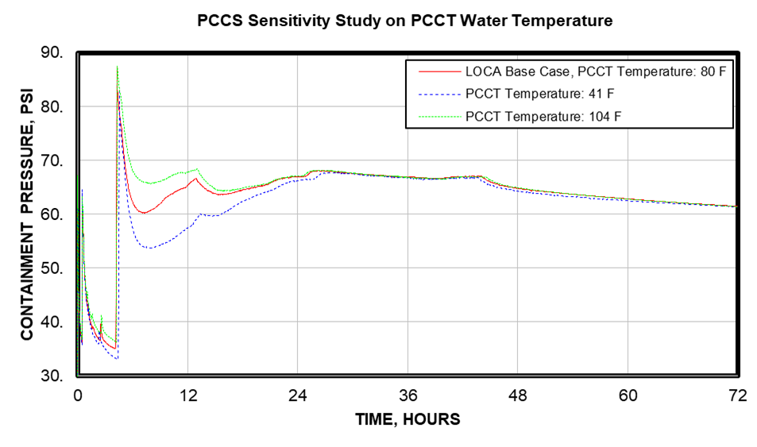
Sensitivity Analysis
TH code calculations performed for each critical parameter across defined ranges
Results of sensitivity analysis used to further screen critical parameters
Notes:
This is the general process for propagating uncertainty.
Due to a lack of data for most modeling parameters, selection of probability distributions and distribution parameters requires expert judgement.
With the lack of data, a nominal value of a parameter can be assumed to be the mean value in a distribution and the extreme values of the distribution can be assigned values that are qualitatively taken to be unlikely or almost impossible to occur; i.e., .001 to .0001. In a normal distribution, the extreme values would be represented by data at 3 to 4 std devs from the mean (i.e., , the nominal value)

Slide 13
Probability Distribution Assignment
After screening and considering code modeling capabilities, 6 critical parameters were selected for final analysis
Phenomena | Distribution Type | Distribution Parameters | MAAP Parameter
PCCS HEX tube blockage (%) (Number of tubes blocked) | Exponential | Min: 0%, Mean: 9.346% (208 tubes blocked) Max: 100%, σ = 9.346 % | NTBPCS(1)
Tube material thermal conductivity (W/mC) | Truncated Normal | Min: 0.3, Mean: 17.35 Max: 24.7, σ = 2.45 W/mC | KHSM(3)
Tube outside surface condensation heat transfer effectiveness | Exponential | Min: 0.005, Mean: 0.1087 Max: 1.0, σ = 0.1087 | FHTBNDPCS(1)
Water droplet entrainment in the break flow (% of total liquid flow appearing as suspended water droplets) | Uniform | Min: 0%, Mean: 5% Max: 10%, σ = N/A | FELOCA
Gas flow at the PCCS Hx inlet (m²) | Truncated Normal | Min: 1 m2, Mean 55 m2 Max 100 m2, σ = 15 m2 | AJUNC0(41)
Core decay heat as a function of time (MW) | Truncated Normal | Min: 1660 MW, Mean: 1850 MW Max: 2040 MW , σ = 63.5 MW | QCR0
Notes:
Could have also used a beta distribution which is preferred by the NRC. But in the absence of data, the more general beta distribution would not provide any advantages.
Due to a lack of data for most modeling parameters, selection of probability distributions and distribution parameters requires expert judgement.
With the lack of data, a nominal value of a parameter can be assumed to be the mean value in a distribution and the extreme values of the distribution can be assigned values that are qualitatively taken to be unlikely or almost impossible to occur; i.e., .001 to .0001. In a normal distribution, the extreme values would be represented by data at 3 to 4 std devs from the mean (i.e., , the nominal value)
Normal distribution - This distribution is often used to represent uncertainty in physical properties and can be used when parameter values are most likely to be close to their mean values with extreme values possible to either side of the mean. Can also use truncated normal. But could have used Beta distribution which is more flexible and is useful for modeling data that is bounded between a minimum and maximum value. This distribution is extensively used by the US NRC in their data collection and analysis supporting Probabilistic Risk Assessment (PRA)..
Exponential distributions are often used to represent degradation as a function of time or for parameters representing systems that are most likely in an intact state with zero degradation. Gamma distributions are often used for positive, continuous, right skewed parameters such as failure rates. The exponential distribution is a special case of the gamma . This distribution is extensively used by the US NRC in their data collection and analysis supporting PRA.
Uniform distributions can be applied when no information is available regarding a parameter uncertainty and the parameter varies between two known limits.

Slide 14
Response Surface Development
A limited number of best-estimate code runs are used to develop “truth data”
The response surface is built to represent the truth data
The response surface exercised to determined the PSS reliability
MAAP 5.06 calculations were used to develop the set of truth data to build a 3rd order polynomial response surface and a cubic spline response surface based on 6 critical parameters
  The 3rd order multivariate regression was performed in Mathcad ® using the polyfitc and regress functions and the response surface was exercised using the interp function
  DAKOTA (Design Analysis Kit for Optimization and Terascale Applications) software from Sandia National Lab was used with its multivariate adaptive regression splines (MARS) options to develop an alternate response surface
Notes:
General steps. Each step discussed in more detail on following slides.

Slide 15
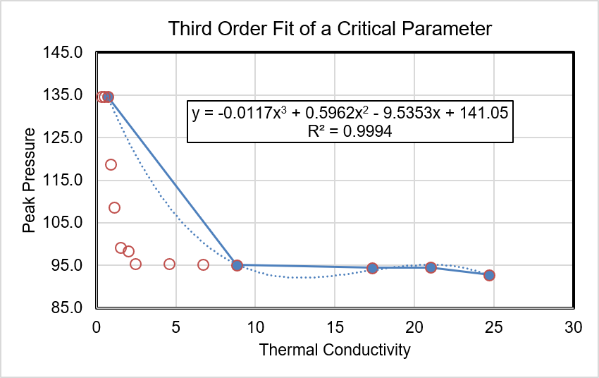
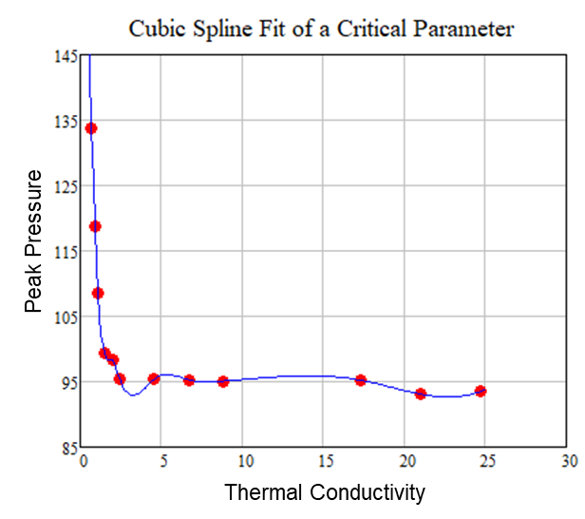
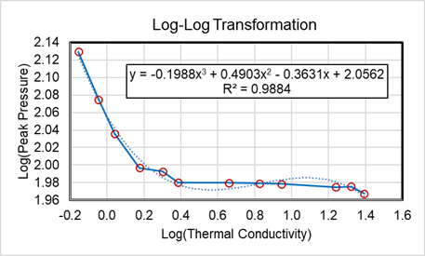
Response Surface Model Selection
A 3rd-order polynomial response surface was selected, but not all critical parameters were well-represented
  Log-log transformation considered
  Alternate response surface considered: Spline (MARS)
Notes:
This example used in the pilot study used a 3rd order polynomial with 6 critical parameters because it was relatively straightforward to develop. And polynomial response surfaces are fairly common.
However, there are more sophisticated non-parametric response surface models that can also be considered. These are highly flexible and can capture complex, non-linear patterns not suitable for polynomial modelling
Non-parametric response surface models are highly flexible and can capture complex, non-linear patterns that do not easily fit into the predefined functional forms often used for parametric response surfaces. Common non-parametric response surface methods include,
Artificial Neural Networks (ANNs):
Gaussian Process Regressors (GPR):
Splines
We also applied a cubic spline model to develop a response surface and will compare results from the cubic spline and third order polynomial.

Slide 16
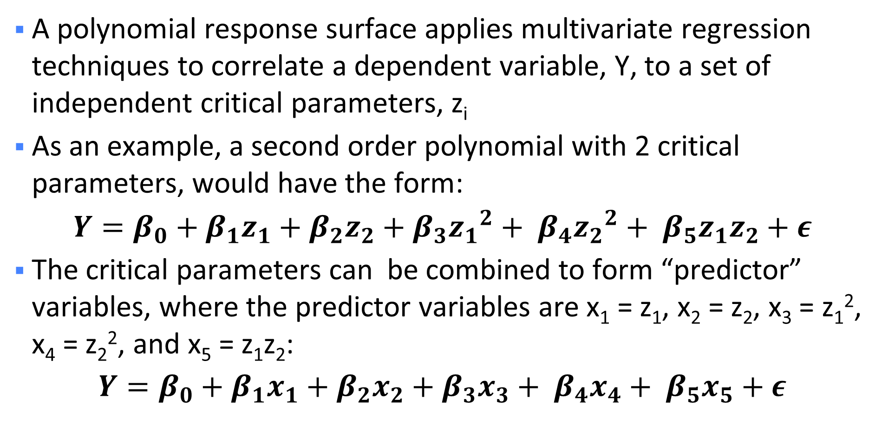
General Form of a Polynomial Model
A polynomial response surface applies multivariate regression techniques to correlate a dependent variable, Y, to a set of independent critical parameters, z_{i}
As an example, a second order polynomial with 2 critical parameters, would have the form:
$$Y=β_{0}+β_{1}z_{1}+β_{2}z_{2}+β_{3}{z_{1}}^{2}+ β_{4}{z_{2}}^{2}+ β_{5}z_{1}z_{2}+ε$$
The critical parameters can be combined to form “predictor” variables, where the predictor variables are x₁ = z₁, x₂ = z₂, x₃ = z₁², x₄ = z₂², and x₅ = z₁z₂:
$$Y=β_{0}+β_{1}x_{1}+β_{2}x_{2}+β_{3}x_{3}+ β_{4}x_{4}+ β_{5}x_{5}+ε$$
Notes:
Response surface models are divided into parametric response surfaces and non-parametric response surfaces. The parametric response surface models are, perhaps, easier to understand, as they apply multivariate regression techniques using a predefined functional form to correlate a dependent variable, Y, to a set of independent predictor variables, x_{i}

Slide 17
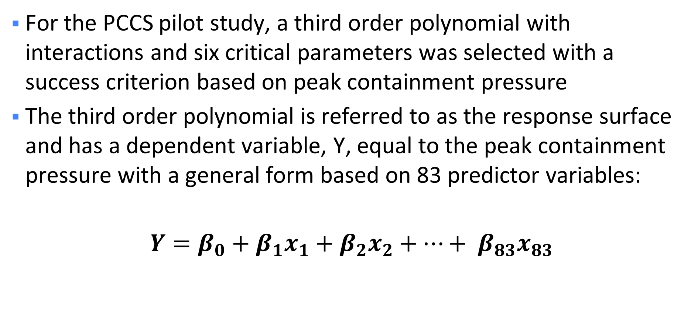
Response Surface Using 3rd Order Polynomial with 6 Critical Parameters
For the PCCS pilot study, a third order polynomial with interactions and six critical parameters was selected with a success criterion based on peak containment pressure
The third order polynomial is referred to as the response surface and has a dependent variable, Y, equal to the peak containment pressure with a general form based on 83 predictor variables:
$$Y=β_{0}+β_{1}x_{1}+β_{2}x_{2}+…+ β_{83}x_{83}$$
Notes:
This example used in the pilot study used a 3rd order polynomial with 6 critical parameters because it was relatively straightforward to develop. And polynomial response surfaces are fairly common.

Slide 18
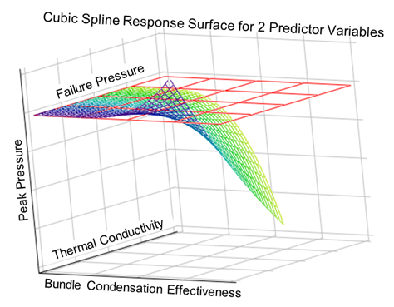
Truth Data
A truth data set was created by making TH code runs (MAAP) with each critical parameter set at its extreme and intermediate values while keeping all other critical parameters at their nominal values
Truth data selected to provide good representation of individual parameters (data values not randomly selected)
Additional cases were created to examine parameter interactions
Examination of parameter interactions
Lesson Learned: Include more data points at intermediate values

Slide 19
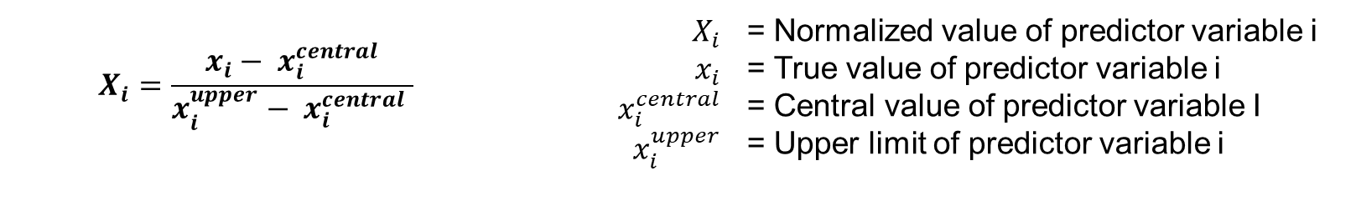
MAAP “Truth Data”
A 3rd order polynomial with six variables, requires a minimum of 84 data points to perform the regression
The number of truth data points is recommended to be 1.5 to 3 times the minimum required: 126 to 252 data points
  This is a manageable number of MAAP runs
Actual number of truth data points used: 108
Data scaled prior to developing response surface
$$X_{i}=\frac{x_{i}− x_{i}^{central}}{x_{i}^{upper}− x_{i}^{central} }$$ | $X_{i}$ $$x_{i}$$ $$x_{i}^{central}$$ $x_{i}^{upper}$ | = Normalized value of predictor variable i = True value of predictor variable i = Central value of predictor variable I = Upper limit of predictor variable i
Lesson Learned: Use a larger set of truth data points

Slide 20
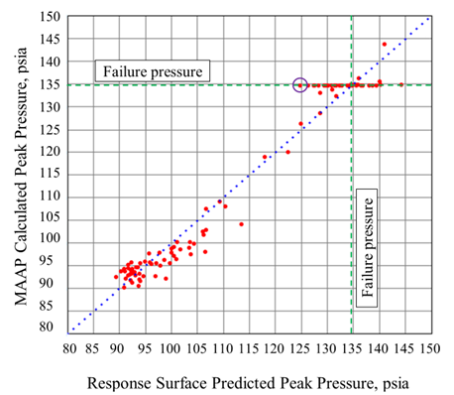
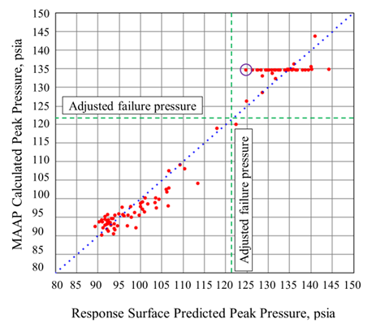
Response Surface Goodness of Fit
Current effort used calibration plots and residual error analysis to test response surface goodness of fit
  3rd order polynomial residual errors show a std dev of 7.707 psi
  MARS spline residual errors show a std dev of 5.798 psi
Errors are expected to be normally distributed around the observed values
Therefore, failure pressure shifted 1.645 std dev to capture 95% of failures
Notes:
Data falling on the horizontal dotted line shows predictions which exactly match the observations.
Data points to the right show predictions which are higher than the observed values
Data points to the left show predictions which are lower than the observed values
Since the response surface is only an approximation of the observed data, there can always be observed failures that are not predicted by the response surface. Example circled data point to left of horizontal line. Observed value is at the failure pressure of 135 psia, but response surface prediction is only 124 psia so a failure is not predicted.
So what do we do?
Due to the nature of the regression analysis, the errors are expected to be approximately normally distributed around observed values. Therefore, the predicted values, or the failure criterion, can be adjusted based on the calculated standard deviation to capture more of the observed failures.
As an example, for normally distributed data, 95% of the data lies within ±1.645 standard deviations of the mean. Thus, to capture 95% of the failures, the failure criterion or the response surface predictions can be shifted by 1.645 x 7.707 = 12.678 psi (0.087 MPa). With this shift, all failures in the limited data set of 108 MAAP calculations are predicted by the response surface, as shown in Figure 7b. This approach also predicts a handful of additional failures where no failure is observed from the MAAP calculation which ensures that the reliability is not overpredicted.

Slide 21
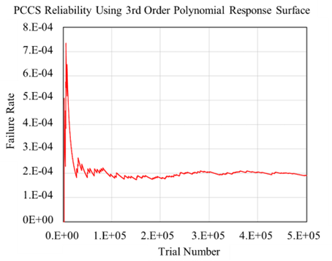
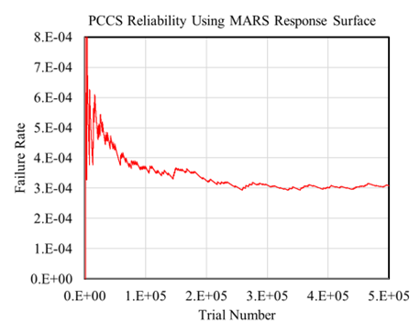
Uncertainty Propagation: Phenomenological Failure Rate
Latin Hypercube Sampling (LHS) techniques were used to generate 500,000 critical parameter data sets for interrogation of the response surfaces
The predicted peak pressures were then compared to the failure pressure to determine the failure rate
Convergence plots used to determine when enough trials have been performed
  Polynomial PCCS failure rate: 1.9E-4 MARS PCCS failure rate: 3.1E-4
Notes:
Convergence plots used to tell us when we have run enough trials. Plot of failure rate vs trial number eventually converges to a solution.
DAKOTA exercised the MARS response surface 500,000 times in 153 CPU seconds. Assuming linear time scaling, 100E6 runs would require 100E6/1E5 = 1000 * 153 = 153,000 seconds = 42 hours of CPU time. 2 days (or running over the weekend) is still a manageable amount of time.

Slide 22
Lessons Learned
Probability distributions focused on normal, log normal, and exponential and did not consider beta and gamma distributions which are extensively used by the US NRC to support PRAs
Consideration of additional phenomena such as two-phase flow instabilities
  May require more detailed code or surrogate models in existing code
Expand truth data set to include more intermediate values
Use a larger truth data set to generate response surfaces

Slide 23
Conclusion
The response surface methodology demonstrates that a manageable number of best-estimate code runs can be used to generate truth data required by the response surface
By developing mathematical models that approximate complex thermal-hydraulic behavior, the response surface methodology allows for uncertainty propagation and reliability assessment that would be impractical with direct best estimate code calculations
An overall PCCS reliability was not calculated since each accident scenario may present different conditions that would result in a different phenomenological reliability
Notes:
Is it practical to develop a response surface to evaluate PSS reliability? Forst 2 bullet points say yes. Last bullet point highlights a limitation/drawback that can complicate the use of an RSM

