Slide 1
EPRI Guidance for Passive System Reliability Analysis
July 2026
Eric Thornsbury, Principal Technical Leader, EPRI

Slide 2
EPRI Passive System Reliability Project
Phase 1 - Evaluation of Passive System Reliability Approaches
  Review literature for state-of-the-art reliability methods
  Summarize efforts developed within the modeling and experimental community to address normal and abnormal operating conditions that can occur in passive systems
  Investigate and consolidate regulatory and licensing landscape for recent passive safety system reliability analysis

Slide 3
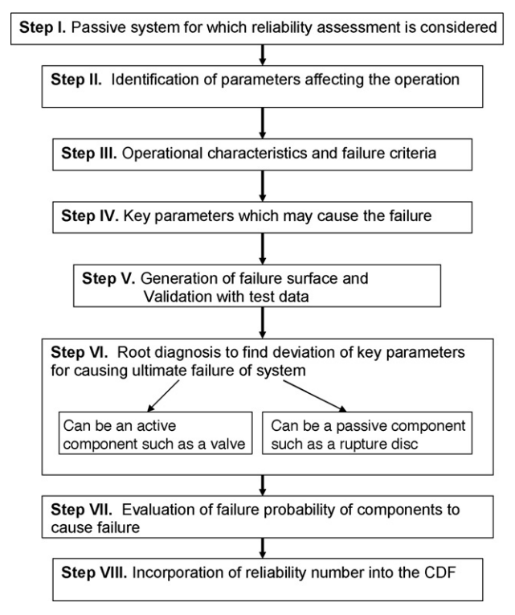
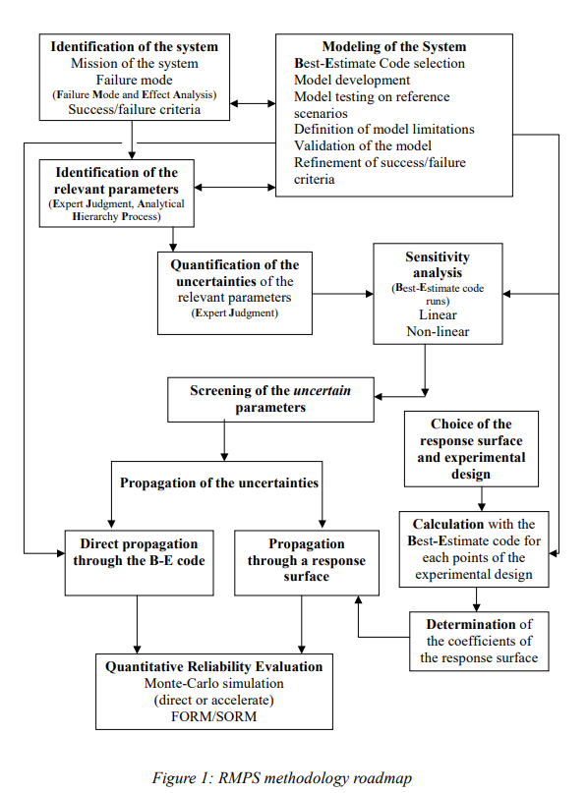
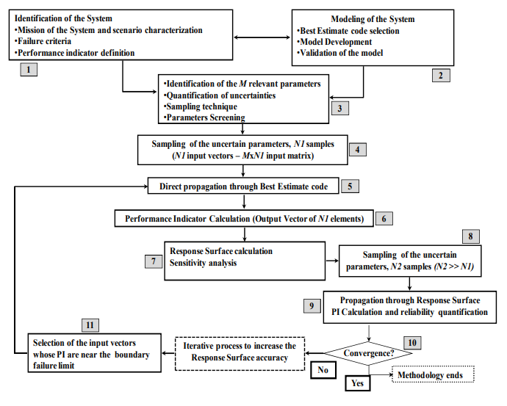
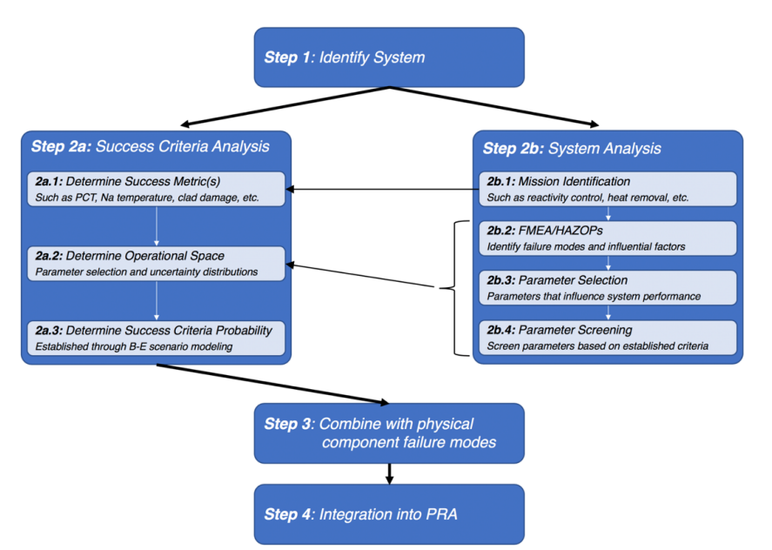
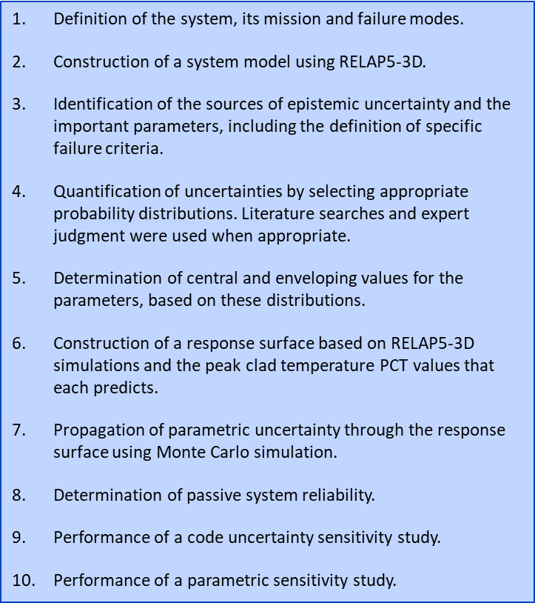
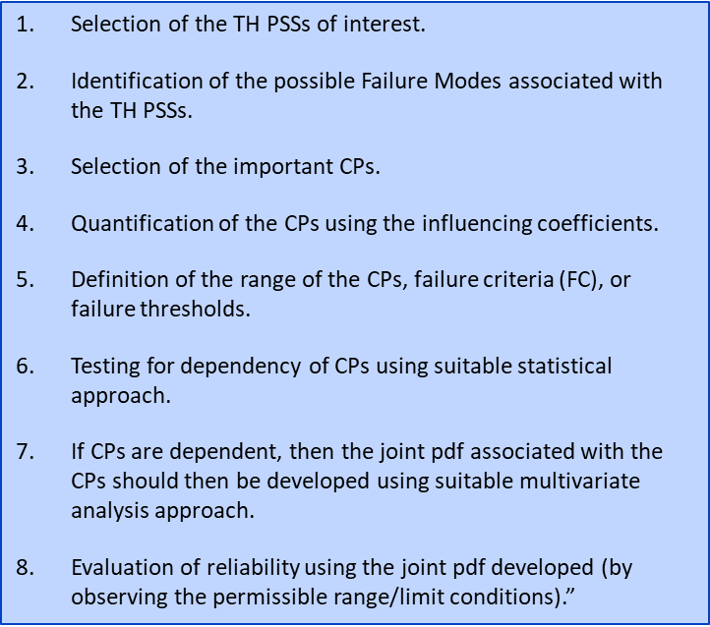
Reliability Frameworks
APSRA (Assessment of Passive System ReliAbility)
  Critical Parameters (CPs) with failure surface via thermal-hydraulic code calculations
APSRA+
  Integrated dynamic reliability method for dynamic failure characteristics
RMPS (Reliability Methods for Passive Systems) & REPAS (Reliability Evaluation of Passive Systems)
  Identifies CPs and their probability distributions, Monte Carlo simulations with thermal-hydraulic codes
RMPS+
  Performance indicator (PI) directly linked to the design failure criteria, response surface sensitivity analysis
MIT (2009)
  Response surface relies on fewer thermal-hydraulic model calculations, uncertainty analysis of the code
GE-Hitachi/Argonne (2015)
  Iteratively develops plant level and system level success criteria, describes how to integrate the framework into an overall PRA
Harbin Engineering University (2018-19)
  CP dependency in more detail, more statistical analysis

Slide 4
Review of Other Research & Licensing Considerations
Phase 1 research includes a review of thermal-hydraulic codes, test facilities, and related research
Licensing considerations and experience were included from an NEA/CSNI survey, WENRA reports, and US licensing experience
  AP600/1000, ABWR, ESBWR, NuScale, APR1400
  USNRC perspectives documented in SECY papers from 1993-1997 and NUREG-0800 Standard Review Plan
  Currently approved designs often have active non-safety systems that reduce reliance on the passive safety systems

Slide 5
Insights from Phase 1
Critical parameter (CP) identification and quantification is a key aspect of all existing frameworks
Expert judgement is still incorporated in the absence of experimental or operational data/experience
Uncertainty analysis and model simplification are key items to address
  Definition of the CP statistical distributions are needed
  Realistic thermal-hydraulic uncertainty computations can be resource intensive
Recent literature is generally academic as opposed to actual implementation that is ready for industrial applications
  Realism in the analysis is a key to turn it into a practical approach

Slide 6


EPRI Passive System Reliability Project
Phase 1 - Evaluation of Passive System Reliability Approaches
  Review literature for state-of-the-art reliability methods
  Summarize efforts developed within the modeling and experimental community to address normal and abnormal operating conditions that can occur in passive systems
  Investigate and consolidate regulatory and licensing landscape for recent passive safety system reliability analysis
  Phase 1 Report published July 2025
Phase 2 - Guidance for Passive System Reliability Analysis
  Developed guidance for a common, consolidated, realistic approach to passive system reliability assessment for use in advanced reactor risk analysis applications
  Performed a realistic demonstration assessment of the common consolidated approach on a simplified passive system
  Engaged stakeholders to identify potential pilot plant applications of the recommended approach on a passive system for an advanced reactor design
  Phase 2 Report published
  November 2025

Slide 7
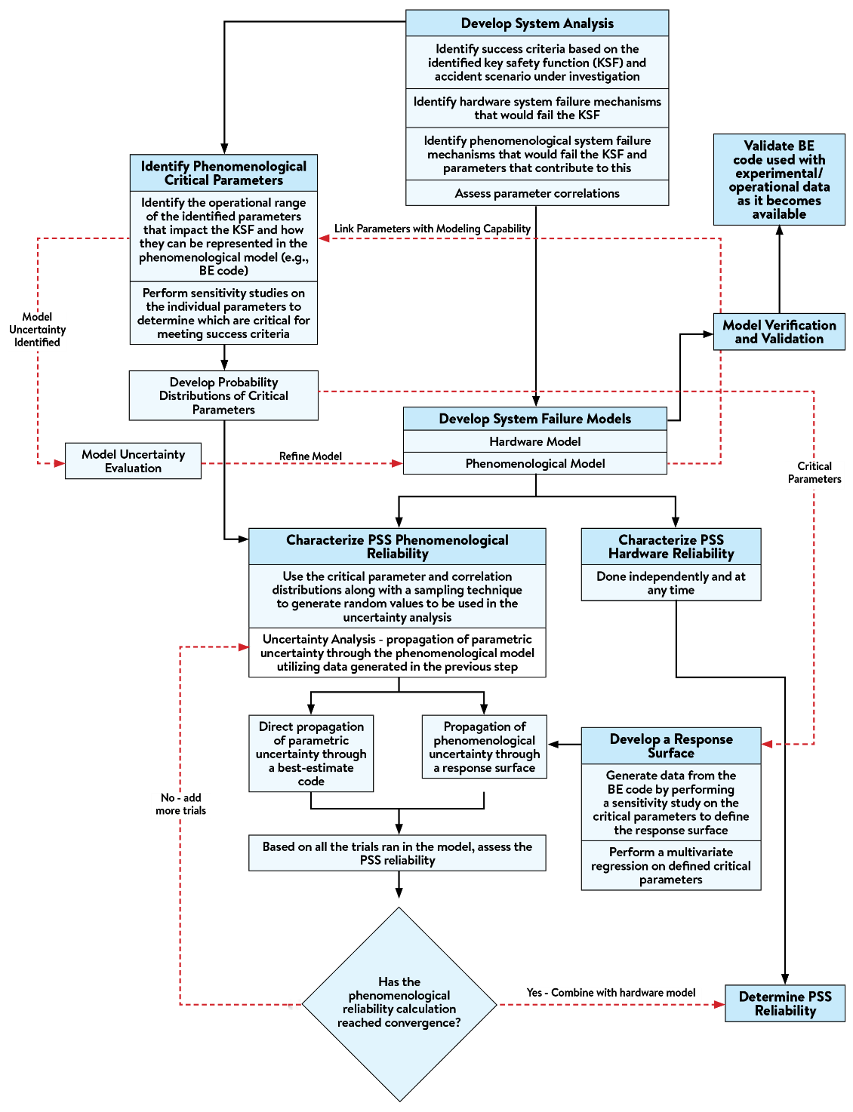
Guidance for PSS Reliability

Slide 8
System Analysis
Identify success criteria
Identify hardware failure mechanisms
Identify phenomenological failure mechanisms
  Typically, FMEA and HAZOP processes have been used for PSS reliability studies with modifications to consider phenomenological failures
  In addition to the FMEA-type approach, we recommended to also apply a structured methodology solely focused on phenomena
  A Phenomenon Identification and Ranking Table (PIRT) study can be used to identify, assess, and prioritize parameters that can affect system reliability
Identify parameter correlations

Slide 9
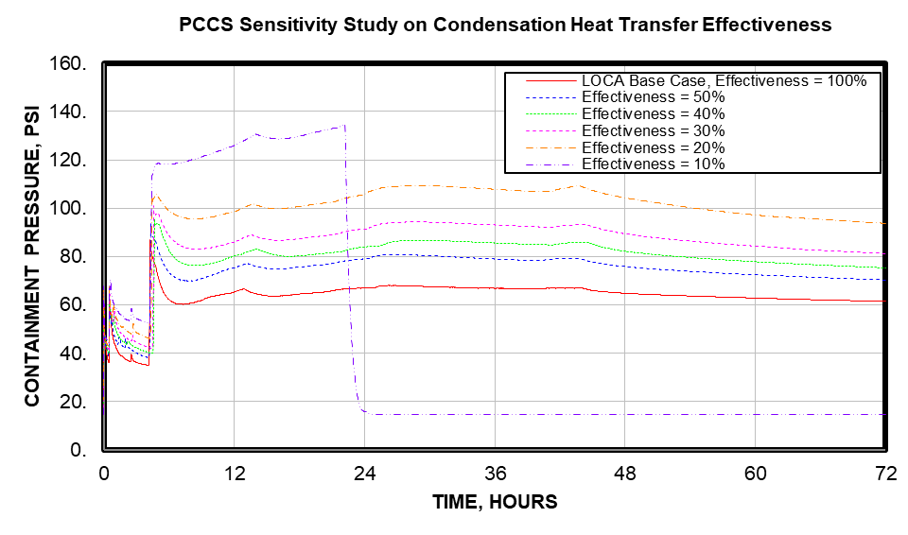
Identify Phenomenological Critical Parameters
Parameter operational range assessment
Sensitivity analysis on parameters
Outside surface tube condensation heat transfer coefficient sensitivity analysis – MAAP Input Variable FHTBNDPCS

Slide 10
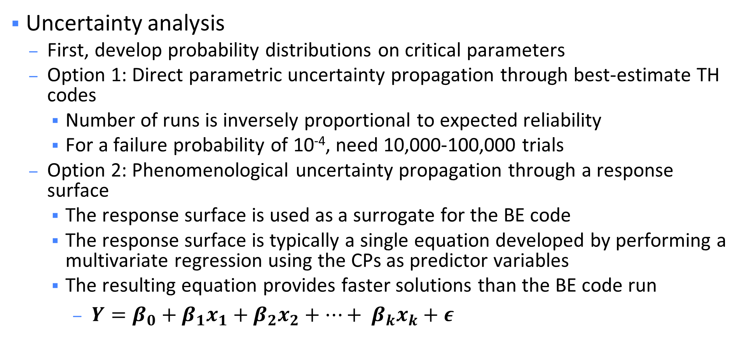
Characterize PSS Phenomenological Reliability
Uncertainty analysis
  First, develop probability distributions on critical parameters
  Option 1: Direct parametric uncertainty propagation through best-estimate TH codes
    Number of runs is inversely proportional to expected reliability
    For a failure probability of 10⁻⁴, need 10,000-100,000 trials
  Option 2: Phenomenological uncertainty propagation through a response surface
    The response surface is used as a surrogate for the BE code
    The response surface is typically a single equation developed by performing a multivariate regression using the CPs as predictor variables
    The resulting equation provides faster solutions than the BE code run
      $Y=β_{0}+β_{1}x_{1}+β_{2}x_{2}+…+ β_{k}x_{k}+ε$

Slide 11
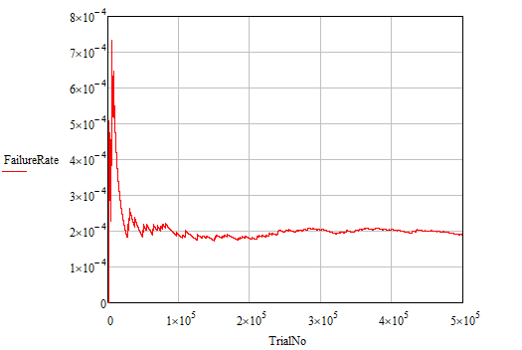
Phenomenological Reliability Convergence
PCCS Phenomenological Failure Rate Predicted from the Response Surface Using 500,000 Trials

Slide 12
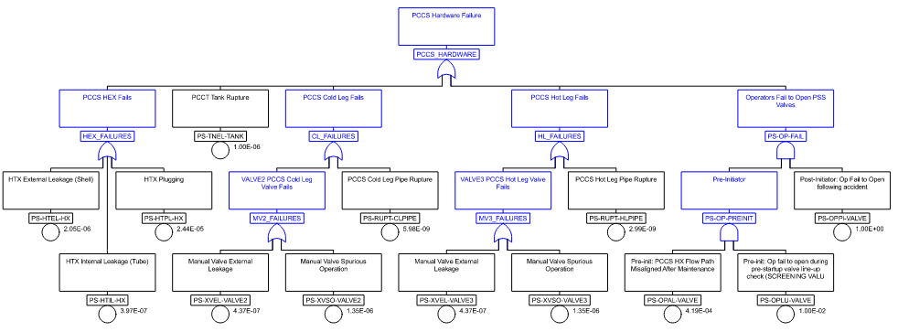
PCCS Hardware Fault Tree
Phenomenological
Failure

Slide 13
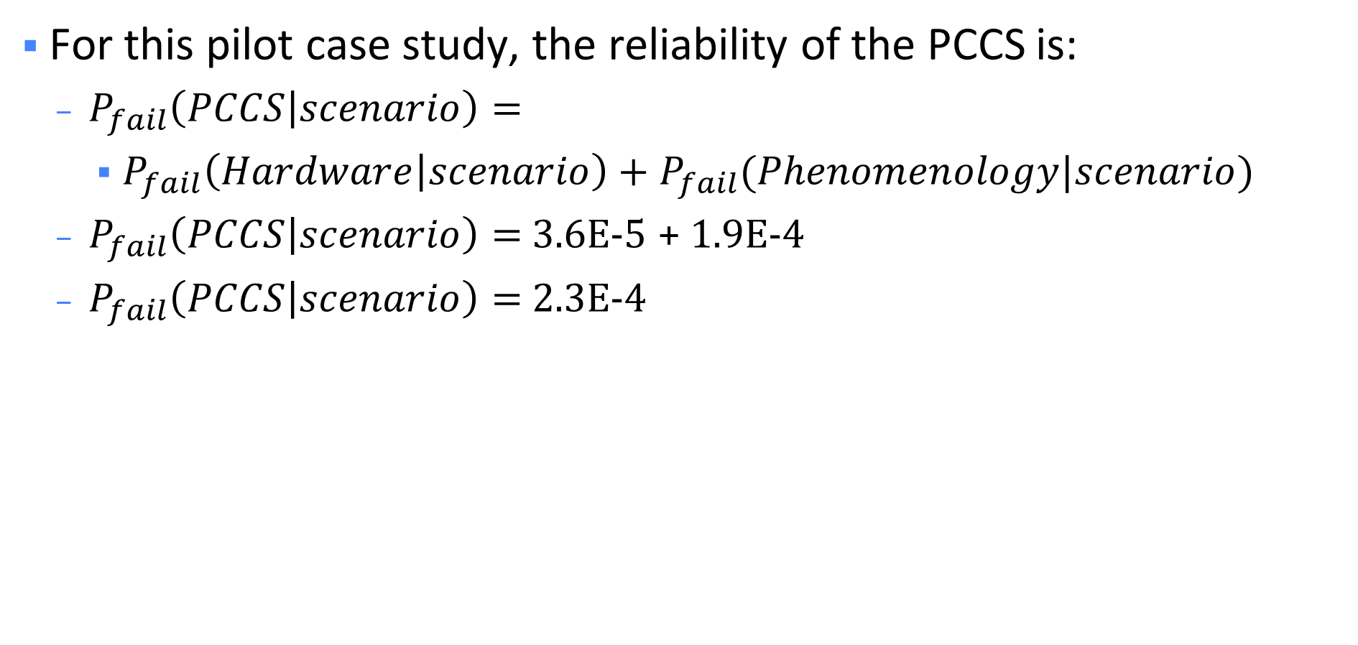
PSS Reliability Example
For this pilot case study, the reliability of the PCCS is:
  $P_{fail}\left(PCCS | scenario\right)=$
    $P_{fail}\left(Hardware | scenario\right)+P_{fail}(Phenomenology|scenario)$
  $P_{fail}\left(PCCS | scenario\right)=$ 3.6E-5 + 1.9E-4
  $P_{fail}\left(PCCS | scenario\right)=$ 2.3E-4

Slide 14
Insights from Phase 2
Overall PSS reliability is not calculated since each scenario may present different conditions that would result in a different phenomenological reliability calculation
  Each scenario may require its own set of calculations
The demonstration provides an example that reflects reasonably low failure rates expected from modern passive systems while avoiding very low results that would not be useful to demonstrate the process
If a PSS supports more than one function, thermal-hydraulic calculations may be able to simultaneously produce results for all figures of merit that support the functions
Design is iterative, and improved reliability results may be obtainable through modifications that impact the accident behavior, success criteria, or other inputs

