Slide 1
Reliability Estimation Method for SMR Passive Safety Systems
Tero Tyrväinen (Steady Energy), Essi Immonen & Atte Helminen (VTT Technical Research Centre of Finland)
PSAM 18, July 19 – July 24, 2026, Pittsburgh, Pennsylvania, USA

Slide 2
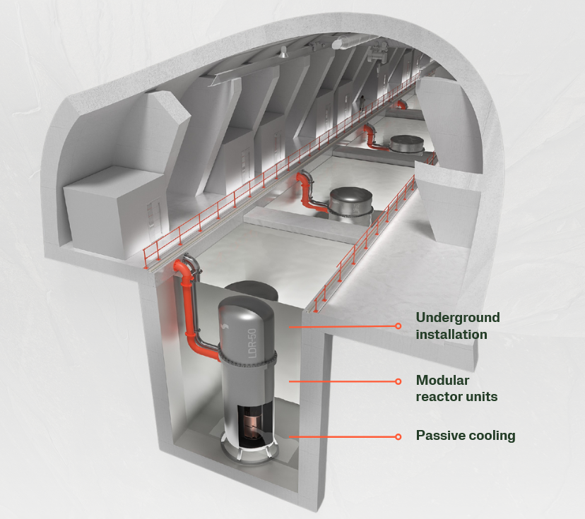
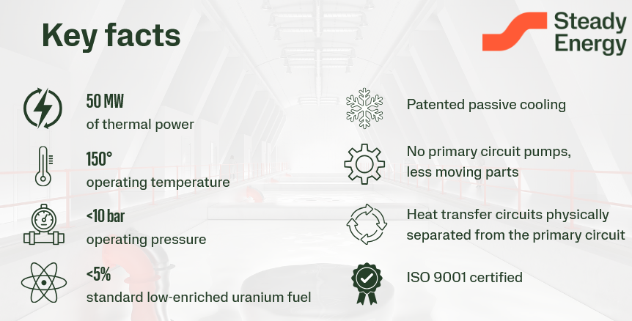
Introduction
2019
Design of LDR-50 started at VTT Technical Research Centre of Finland
2023
Commercialization transferred to VTT spinoff Steady Energy
LDR = Low-temperature District heating Reactor
https://www.steadyenergy.com

Slide 3
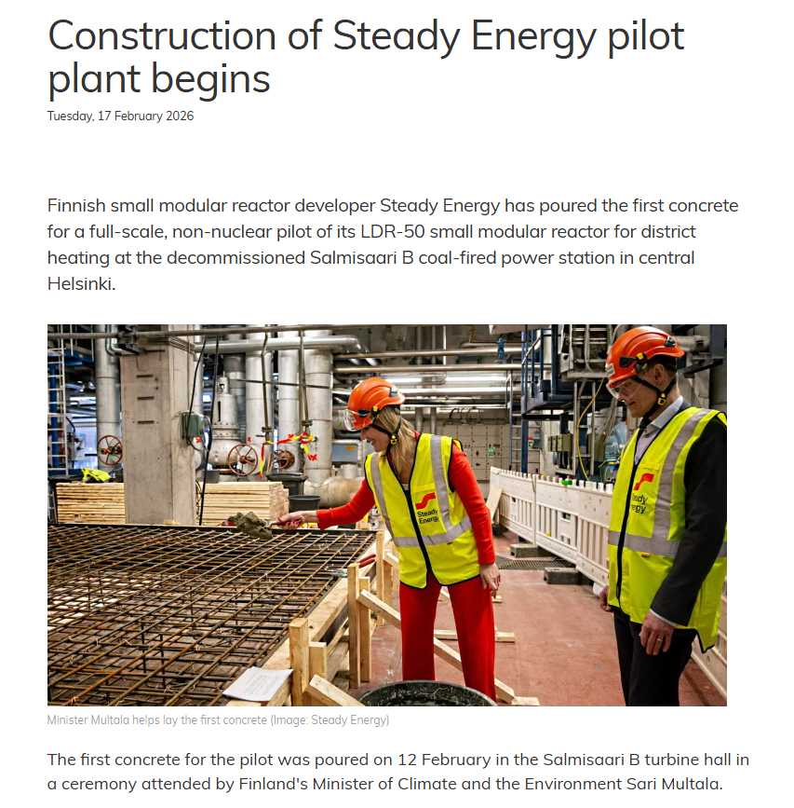
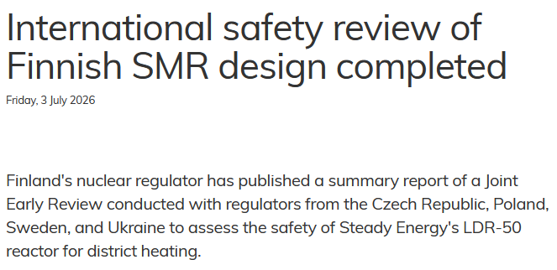
https://world-nuclear-news.org/articles/international-safety-review-of-finnish-smr-design-completed
https://www.world-nuclear-news.org/articles/construction-of-steady-energy-pilot-plant-begins

Slide 4
Background
Passive systems increasingly present in many SMR designs
Many existing reliability analysis methods for passive systems rely on thermal-hydraulic simulation of the system using best-estimate codes
Methods emphasizing integration of the passive system reliability to probabilistic risk assessment are not widely published
A comprehensive expert judgement –based reliability assessment method to support PRA

Slide 5
Problems with uncertainty propagation
Examples of methods include REPAS, RMPS, APSRA…
Some reasons not to use in connection with PSA, especially in early design phase:
  Large number of time-consuming simulations
  If the safety functions doesn’t fail, simulations may not provide an accurate probability distribution
  Input parameters require expert judgement
  …
A comprehensive expert judgement –based reliability assessment method to support PRA

Slide 6
VTT’s approach:
Comprehensive expert judgement-based reliability analysis of passive systems
The main features of the method are to
identify comprehensively different scenarios where the conditions in the passive system are different;
estimate the reliability of the passive system in each identified scenario in a practical way without an extensive number of deterministic simulations.
The main steps:
Characterization of the system
Identification of events and deviations
Identification and selection of accident scenarios
Quantification of mechanical component failures
Quantification of phenomenological failures

Slide 7
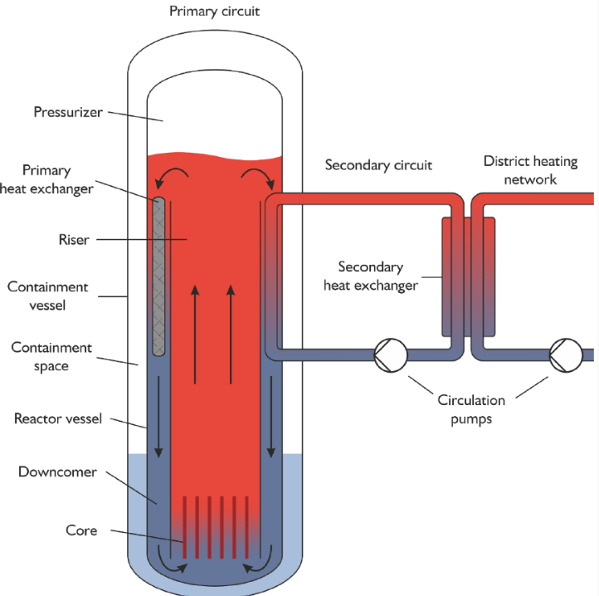
Application to LDR lite passive core cooling system
Step 1: Characterization of the system
The mission of the passive core cooling system (PCCS) is to transfer heat from the reactor core to the reactor pool (RP).
The safety function is considered successful if core damage is avoided.
Interfacing systems:
  primary heat exchangers
  reactor core
  control rod system
  secondary system
  chemical and volume control system
  overpressure protection valve in RV
  overpressure protection valve in CV
Public benchmark description: https://serpent.vtt.fi/kraken/index.php/LDR_lite_benchmark

Slide 8
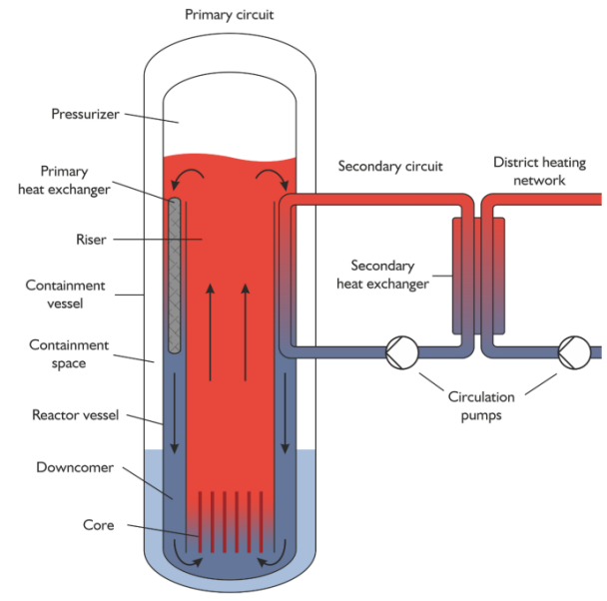
Events and deviations
Step 2: Identification of events and deviations
Events that change the conditions of the passive system
HAZOP to identify physical phenomena related to the PCCS operation + parameters influencing each of them
FMEA from passive safety functions’ point of view
Evaporation of the water inside the CV
Steam condensing on the inner surface of the CV
Natural circulation inside the RV
Natural circulation (both liquid and gas) inside the CV
Natural circulation inside the RP
Flow rate inside the RV
Reactor power
RV wall heat transfer distribution
Flow resistance of the circulation flow inside the RV
RV water level

Slide 9
Accident scenarios
Scenario | Description
General transient | An initiating event that has no impact on the PCCS occurs, and the reactor trip is performed.
Leak at the bottom of the CV | There is a leak at the bottom of the CV. The reactor trip is performed.
Leak from the RV to the CV and CV leak | There is a leak from the RV to the CV. There is also a leak in the CV. The reactor trip is performed. There is no make-up for the RV water.
CVCS LOCA and failure to isolate | There is a leak in the CVCS with a direct path from the RV to outside the system boundary. Isolation fails. The reactor trip is performed. There is no make-up for the RV water.
Loss of CVCS make-up and failure to isolate CVCS | CVCS failures decrease the RV water level below the elevation of the riser barrel. The reactor trip is performed.
Step 3: Identification and selection of accident scenarios
Relevant initiating events (HAZOP, FMEA, PRA model IEs) identified and grouped
Additional failures/events
Final list of scenarios where passive system is demanded to operate includes combinations of the IEs and additional failures

Slide 10
Quantification
Step 4 & 5: Quantification of mechanical and phenomenological failures
Mechanical failures: normal PRA techniques, if model is available
Phenomenological failures:
The conditional failure probability of the passive system is estimated in each scenario by expert judgment supported by information from the FMEA, HAZOP, deterministic simulations and experiments if available.
Deterministic simulations to support expert judgments should mainly focus on scenarios that involve uncertainty. There is no need to perform simulations if the result is known beforehand, i.e. the safety function’s failure probability is clearly 1 or 0.
Qualitative assessment | Conditional failure probability
The passive heat removal system cannot fail in this scenario | 1E-7
The passive heat removal system shouldn’t fail in this scenario, but there is some uncertainty | 1E-4
The passive heat removal system could possibly fail, but it is unlikely | 0.01 or 0.1
The passive heat removal system is assumed to fail | 1

Slide 11
Results
Scenario | Description | Conditional failure probability
General transient | An initiating event that has no impact on the PCCS occurs, and the reactor trip is performed. | 1E-7
Leak at the bottom of the CV | There is a leak at the bottom of the CV. The reactor trip is performed. | 0.01
Leak from the RV to the CV and CV leak | There is a leak from the RV to the CV. There is also a leak in the CV. The reactor trip is performed. There is no make-up for the RV water. | 1
CVCS LOCA and failure to isolate | There is a leak in the CVCS with a direct path from the RV to outside the system boundary. Isolation fails. The reactor trip is performed. There is no make-up for the RV water. | 1
Loss of CVCS make-up and failure to isolate CVCS | CVCS failures decrease the RV water level below the elevation of the riser barrel. The reactor trip is performed. | 1E-4
In practice, the PCCS fails only if enough water is lost either from the RV, CV or RP. Otherwise, the PCCS is expected to function.
For full results, simultaneous development of PRA (+ quantification of mechanical failures) is needed

Slide 12
Discussion
Reliability assessment of passive systems is iterative
  Tentative reliability estimates needed already in conceptual design
  Updates made with evidence from simulations and experiments
Combining PRA and passive system reliability assessment supports selection of simulated T-H scenarios to reduce uncertainty in risk-significant scenarios
The presented method gives flexibility to include multiple separate scenarios in the analysis
Useful for preliminary assessment

Slide 13
Thank you!
Contact: essi.immonen@vtt.fi
vttresearch.com

