Slide 1
Allocating Reliability Goals for SMR Passive Safety Systems
Atte Helminen & Essi Immonen
VTT Technical Research Centre of Finland
PSAM 18, July 19 – July 24, 2026, Pittsburgh, Pennsylvania, USA

Slide 2
Passive safety systems in SMR
Passive systems are extensively applied in the safety design of small modular reactors (SMR)
Passive systems are particularly convenient for scenarios involving loss or reduction of heat removal
Some system examples and applications in current SMR designs:
  Passive emergency core cooling systems (LDR-50, NuScale, Rolls-Royce SMR)
  Passive isolation condenser systems (BWRX-300)
  Passive containment cooling systems (Calogena, BWRX-300)
  Passive gravity drive valves (Calogena)
  Passive temperature regulation via low power density and material thermal absorption (JIMMY)
The simplified safety design of SMR impose high expectations for the reliability of passive safety systems

Slide 3
Challenges with reliability estimation of passive systems in SMR
Natural driving forces are normally small
Counter-forces and other adverse effects can be of comparable magnitude
Failure modes are phenomenological depending on dynamic physical processes rather than discrete component failures
Typical parameters causing passive system’s failure:
  Presence of non-condensable gases
  Undetected leaks
  Excessive heat losses
  Suboptimal piping layout
  Limited valve opening area in discharge lines
  Fouling, corrosion or plugging in heat exchangers

Slide 4
Challenges with reliability estimation of passive systems in SMR
Passive systems in SMR are almost without exception unique in design, and therefore their operational experience is sparse
The reliability data for estimation is typically generated from experimental testing or thermal-hydraulic simulations, both of which are either expensive or time-consuming to perform
Since the failure of a passive system depends strongly on the plant conditions, the system reliability can also be different in different plant conditions
The uncertainties created by different plant conditions can easily explode the amount of analysis work required in the reliability estimation
To manage the workload, a graded approach is needed where more detailed analysis is performed in situations where the reliability of the passive system has a greater impact on plant safety

Slide 5
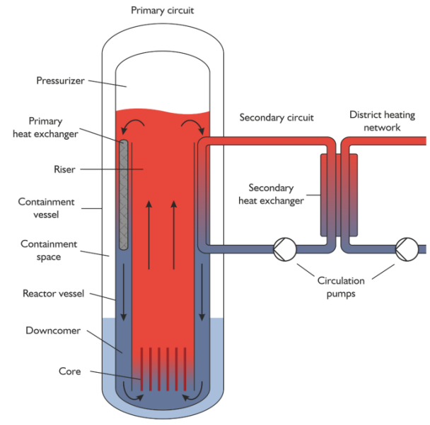
Example study: Allocating reliability goals for SMR passive safety system
Aim of study is to demonstrate the idea of supporting the reliability estimation of passive systems with the reliability goal definition and allocation by PRA
LDR lite is used for the study, it is a public research study version of the LDR-50 SMR design
From PRA viewpoint there are several shortcomings in LDR lite specifications (only some frontline safety systems are included in the specifications)

Slide 6
Example study: Allocating reliability goals for SMR passive safety system
LDR lite design specifications extended with following systems:
  Diverse reactivity control system with boron injection systems (BIS)
  Shutdown cooling systems (SDCS)

Slide 7
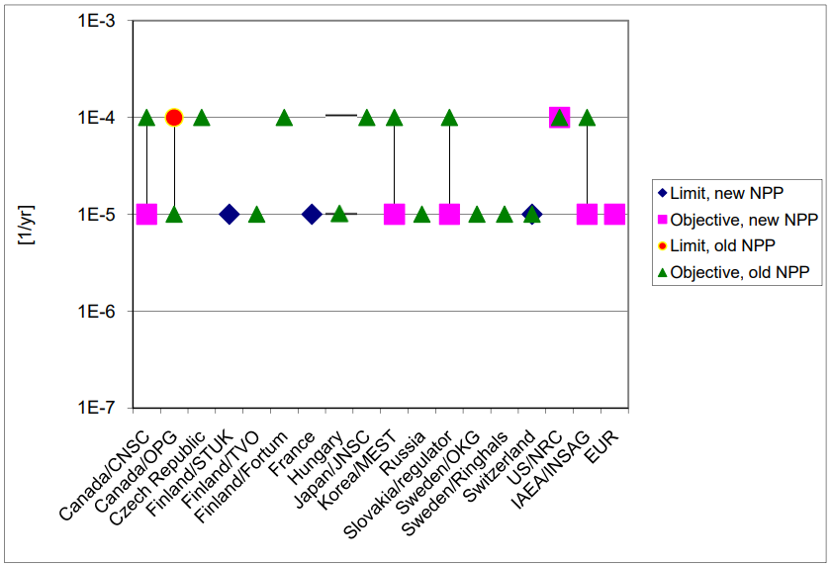
Example study: Allocating reliability goals for SMR passive safety systems
Probabilistic risk model consists of an event tree for the loss of district heating network transient
Typical core damage frequency target (CDF) values for new plants are of the order of 1E-5 per reactor-year -> Setting CDF target value for the single event of the study to 1E-7 per reactor-year (1% of overall CDF)
NKS report 227 by J.-E. Holmberg and M. Knochenhauer, 2011

Slide 8
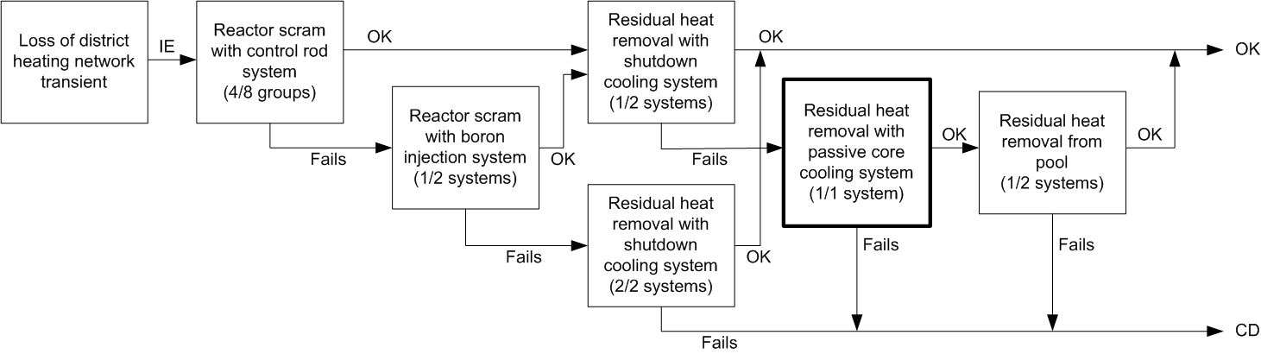
Example study: Allocating reliability goals for SMR passive safety systems
Different sequences of the risk model are illustrated in the logical diagram below
  Two diverse systems for reactor scram: Control rod system (CRS) and boron injection system (BIS)
  Two diverse systems for residual heat removal: Active shutdown cooling system (SDCS) and passive core cooling system (PCCS)

Slide 9
Example study: Allocating reliability goals for SMR passive safety systems
For loss of district heating network transient the sufficient failure probability of PCCS would be somewhere in magnitude of 1E-5
PCCS failure probability | CDF (MCA) | PCCS Fussell-Vesely
1,00E-07 | 5,86E-08 | 0,004
1,00E-06 | 6,06E-08 | 0,037
1,00E-05 | 8,08E-08 | 0,278
1,00E-04 | 2,83E-07 | 0,793
1,00E-03 | 2,30E-06 | 0,975

Slide 10
Conclusions
Although the PRA model presented is not very realistic (lacks e.g. the supporting systems and other system dependencies), it serves the purpose of the study.
To manage the uncertainties created by different plant conditions and to support expert judgements in reliability estimations, it is beneficial to use PRA modelling for the defining and allocating reliability goals for the SMR passive safety systems.
Reliability estimation of SMR passive systems shouldn’t be considered as one-way process where the reliability estimation serves the risk modelling, but an iterative process, where the PRA model is created simultaneously providing feedback for the reliability estimation process.

Slide 11


Acknowledgements
The paper has been created in EASI-SMR and SANE projects co-funded by the European Commission and performed as part of Euratom Research and Training Programme, under contracts 101164810 (EASI-SMR) and 101163929 (SANE).
EASI-SMR – Ensuring Assessment of Safety Innovations for SMR
https://www.easi-smr.eu/
SANE – Safety Assessment of Non-Electric uses of nuclear energy
https://www.sane-euratom.eu/

