Slide 1
Slide Title for Accessibility 01
Probabilistic Risk Assessment for Multi-Network Integrated Energy Systems: Gap Analysis and Preliminary Results
Emelia Stouffer, Amir Shahriar Kalantari Oskoui, and Tatsuya Sakurahara
Risk Analysis and Reliability Engineering (RARE) Laboratory, Department of Mechanical Engineering and Materials Science, Swanson School of Engineering, University of Pittsburgh, Pittsburgh, PA, United States
July 22, 2026

Slide 2
Overview
Background
Summary of Literature Review
IES Risk Analysis Framework
Gas Network Case Study
Conclusion

Slide 3
Background
An integrated energy system (IES) combines multiple energy sources to produce diverse energy products through coordination of subsystems.
IES have various benefits such as enhanced efficiency, environmental sustainability, economic productivity, etc.
Integrating various energy technologies introduces operational and maintenance complexity requiring systematic risk assessment to ensure dependability.
This research aims to develop methods to advance probabilistic risk assessment (PRA) for IES.
Risk Analysis and Reliability Engineering (RARE) Lab

Slide 4
Literature Review: Scope
A literature review was conducted to identify the state-of-the-art methodologies and gaps within risk assessment of integrated energy systems (IES).
The literature search was limited to publications between 2015 to July 2025 and contained both of the following criteria
  Conducting risk assessment for IES
  Characterizing risk at the entire IES level
Risk Analysis and Reliability Engineering (RARE) Lab

Slide 5
Literature Review: Summary of Insights
The gaps identified by the literature review can be summarized in three main points
  Most publications assume the component failure rate is constant.
  Transient analyses are not conducted on electrical networks due to the assumption that electrical networks reach steady state in a negligible amount of time
  The dependency of uncertain input parameters is modeled using a stationary correlation matrix, while the dynamic evolution of their correlations is not considered.
The goal of this research is to create an IES risk assessment framework that addresses these gaps.
Risk Analysis and Reliability Engineering (RARE) Lab
Notes:
is

Slide 6
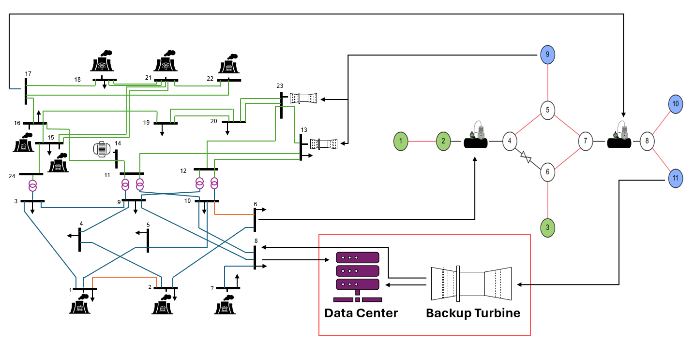
IES PRA Framework
Risk Analysis and Reliability Engineering (RARE) Lab

Slide 7
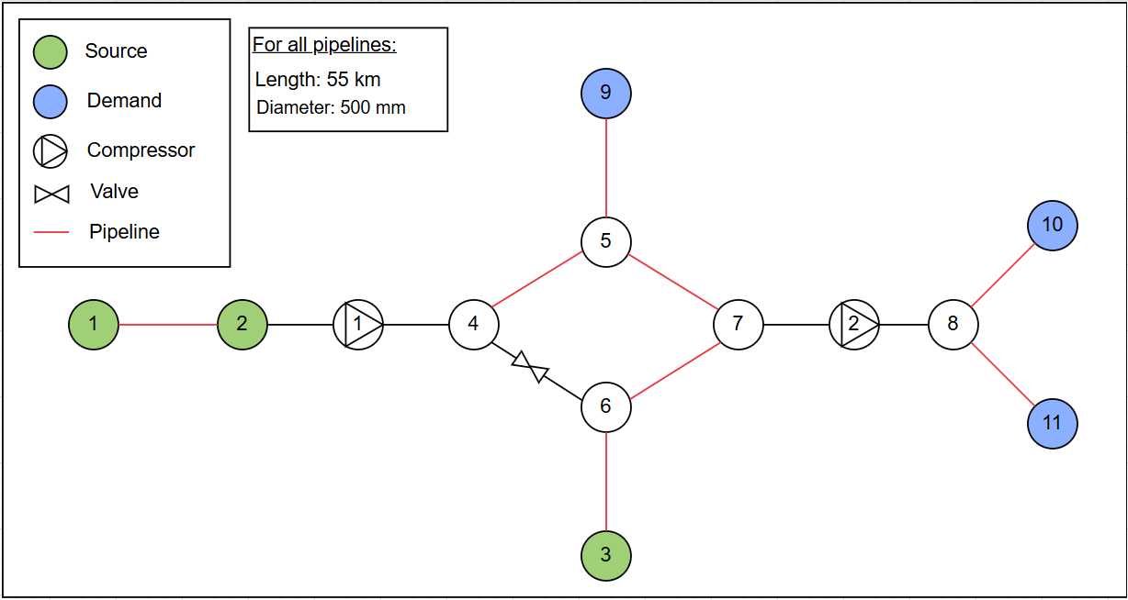
Gas Network Case Study
This is a diagram of GasLib-11*
GasLib provides boundaries for the pressures and flow rates within all pipelines and nodes
*M. Schmidt et al., "GasLib—A Library of Gas Network Instances," Data, vol. 2, no. 4, p. 40, 2017. [Online]. Available: https://www.mdpi.com/2306-5729/2/4/40.
Risk Analysis and Reliability Engineering (RARE) Lab

Slide 8
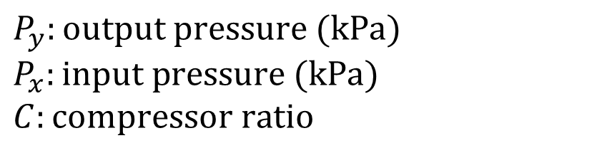

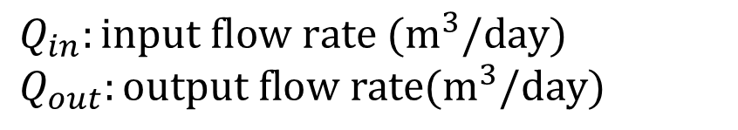
Governing Equations
Node mass balance:
$$Q_{in}−Q_{out}=0$$
Compressor ratios:
$$P_{y}=CP_{x}$$
$$Q_{in}:input flow rate (m^{3}/day)$$
$$Q_{out}:output flow rate(m^{3}/day)$$
$P_{y}:output pressure (kPa)$
$$P_{x}:input pressure (kPa)$$
$$C:compressor ratio$$
Risk Analysis and Reliability Engineering (RARE) Lab

Slide 9
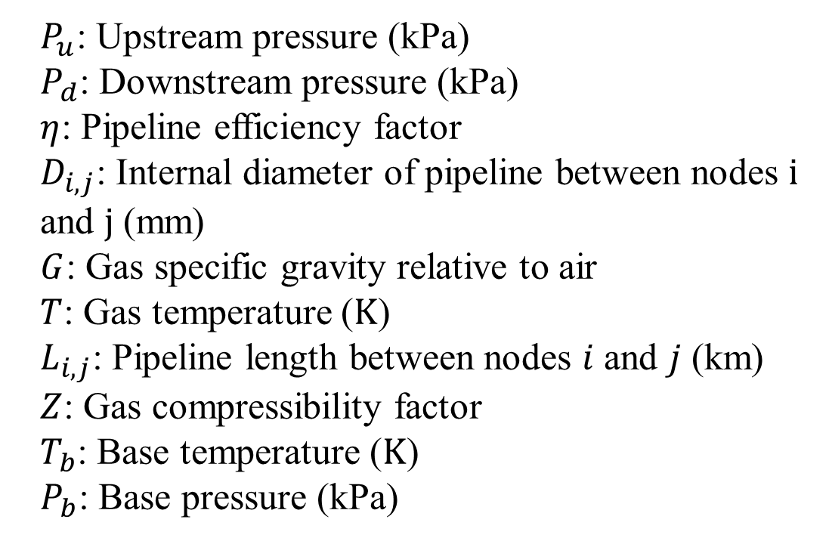
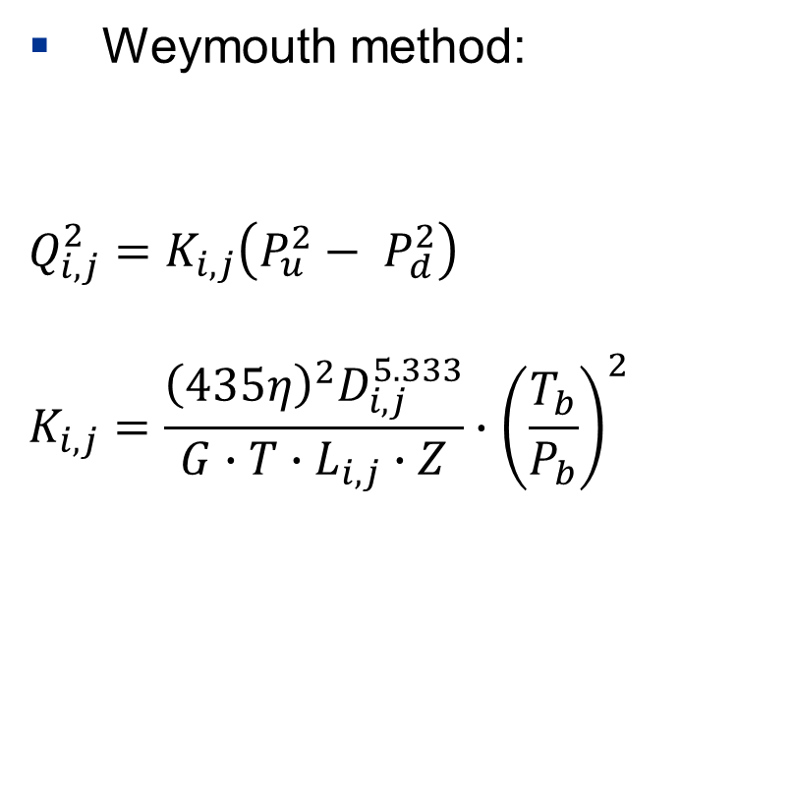
Governing Equations (Cont.)
Weymouth method:
$$Q_{i,j}^{2}=K_{i,j}\left(P_{u}^{2}− P_{d}^{2}\right)$$
$$K_{i,j}=\frac{{\left(435η\right)}^{2}D_{i,j}^{5.333}}{G∙T∙L_{i,j}∙Z}∙{\left(\frac{T_{b}}{P_{b}}\right)}^{2}$$
$P_{u}$: Upstream pressure (kPa)
$P_{d}$: Downstream pressure (kPa)
$η$: Pipeline efficiency factor
$D_{i,j}$: Internal diameter of pipeline between nodes $i$ and $j$ (mm)
$G$: Gas specific gravity relative to air
$T$: Gas temperature ($K$)
$L_{i,j}$: Pipeline length between nodes $i$ and $j$ (km)
$Z$: Gas compressibility factor
$T_{b}$: Base temperature ($K$)
$P_{b}$: Base pressure (kPa)
Risk Analysis and Reliability Engineering (RARE) Lab

Slide 10
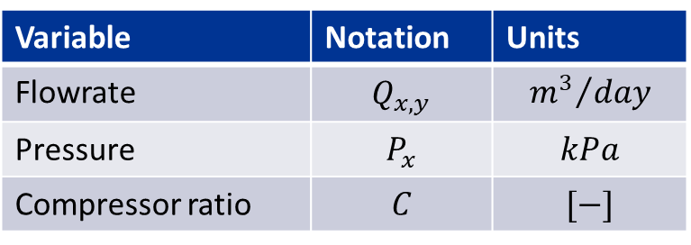
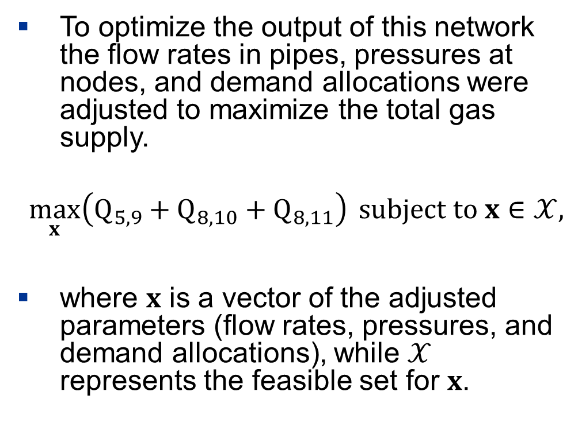
Optimization
To optimize the output of this network the flow rates in pipes, pressures at nodes, and demand allocations were adjusted to maximize the total gas supply.
$$\max_{x}\left(Q_{5,9}+Q_{8,10}+Q_{8,11}\right) subject to x∈𝒳,$$
where $x$ is a vector of the adjusted parameters (flow rates, pressures, and demand allocations), while $𝒳$ represents the feasible set for $x$.
Variable | Notation | Units
Flowrate | $$Q_{x,y}$$ | $${m^{3}}/{day}$$
Pressure | $$P_{x}$$ | $$kPa$$
Compressor ratio | $$C$$ | $$[−]$$
Risk Analysis and Reliability Engineering (RARE) Lab

Slide 11
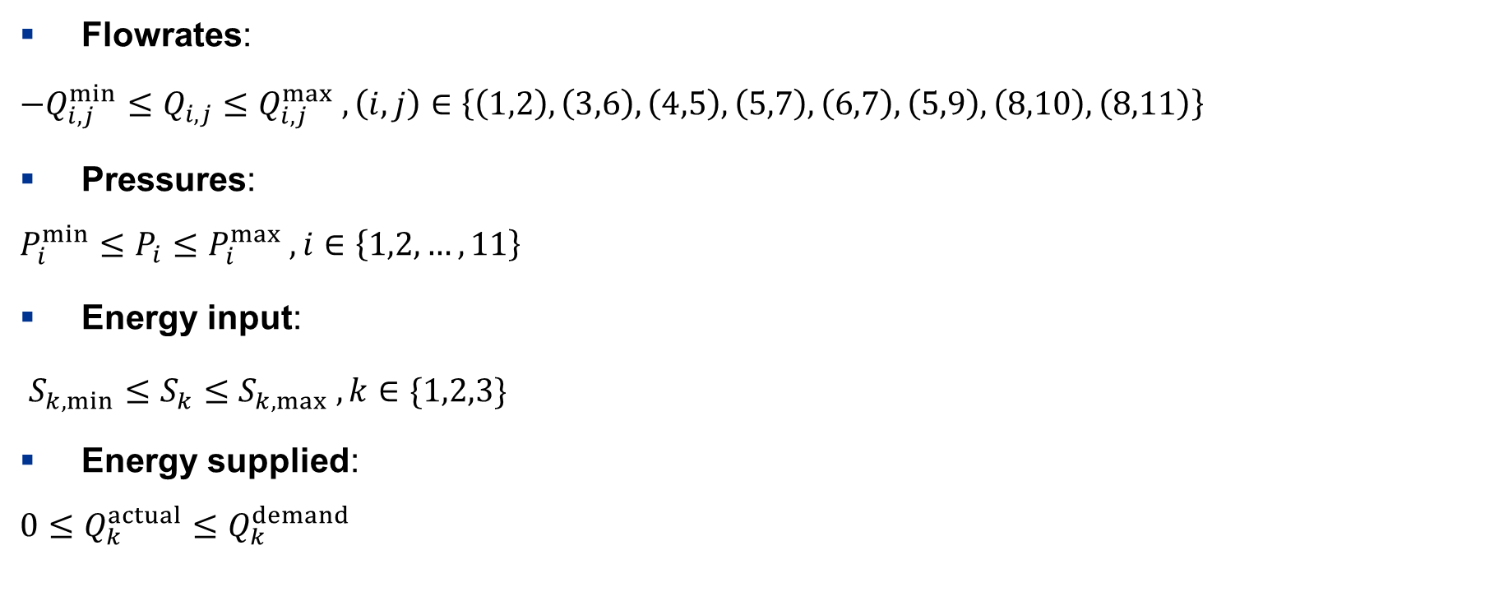
Constraints
Flowrates:
$$−Q_{i,j}^{min}≤Q_{i,j}≤Q_{i,j}^{max} , \left(i,j\right)∈\left\{\left(1,2\right), \left(3,6\right),\left(4,5\right), \left(5,7\right), \left(6,7\right),\left(5,9\right),\left(8,10\right),\left(8,11\right)\right\}$$
Pressures:
$$P_{i}^{min}≤P_{i}≤P_{i}^{max} , i∈\left\{1,2,…,11\right\}$$
Energy input:
$S_{k,min}≤S_{k}≤S_{k,max} , k∈\{1,2,3\}$
Energy supplied:
$$0≤Q_{k}^{actual}≤Q_{k}^{demand}$$
Risk Analysis and Reliability Engineering (RARE) Lab

Slide 12
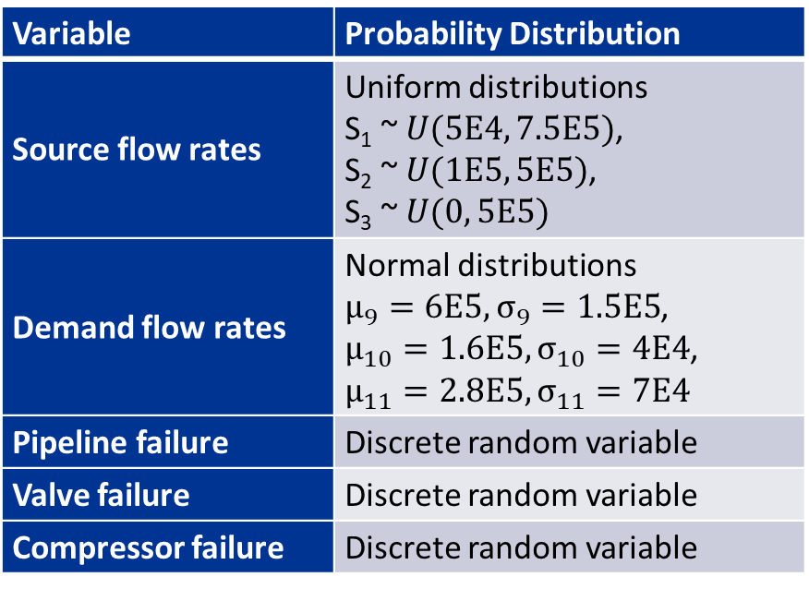
Uncertain Input Variables and Distributions
To incorporate uncertainty in the model various probability distributions were used for input parameters
Variable | Probability Distribution
Source flow rates | Uniform distributions S₁ ~ $U(5E4, 7.5E5)$, S₂ ~ $U(1E5, 5E5)$, S₃ ~ $U(0, 5E5)$
Demand flow rates | Normal distributions $μ_{9}=6E5, σ_{9}=1.5E5$, $μ_{10}=1.6E5, σ_{10}=4E4$, $$μ_{11}=2.8E5, σ_{11}=7E4$$
Pipeline failure | Discrete random variable
Valve failure | Discrete random variable
Compressor failure | Discrete random variable
Component | Failure Probability
Pipelines | 0.002
Valve | 0.01
Compressors | 0.02
Risk Analysis and Reliability Engineering (RARE) Lab

Slide 13
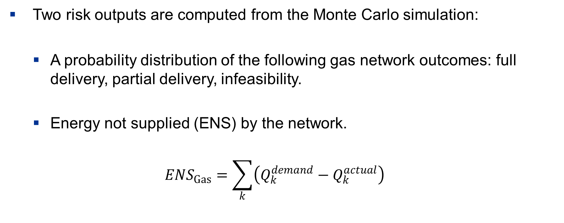
Monte Carlo Risk Outputs
Two risk outputs are computed from the Monte Carlo simulation:
  A probability distribution of the following gas network outcomes: full delivery, partial delivery, infeasibility.
  Energy not supplied (ENS) by the network.
  $${ENS}_{Gas}=\sum_{k}{\left(Q_{k}^{demand}−Q_{k}^{actual}\right)}$$
Risk Analysis and Reliability Engineering (RARE) Lab

Slide 14
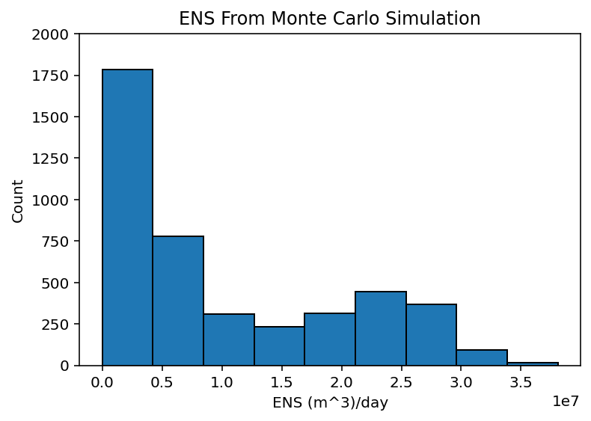
Monte Carlo Simulation Results
A sample size of 100,000 was selected for the simulation and produced the following results:
 | Point Estimate | 95% Confidence Intervals
Partial Delivery | 0.03123 | (0.03019, 0.03227)
Infeasibility | 0.01210 | (0.01093, 0.01327)
Risk Analysis and Reliability Engineering (RARE) Lab

Slide 15
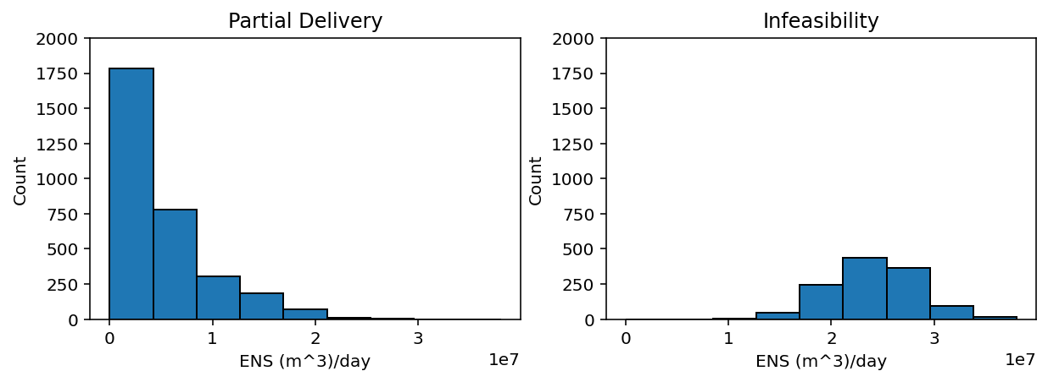
Monte Carlo Simulation Results
A sample size of 100,000 was selected for the simulation and produced the following results:
Risk Analysis and Reliability Engineering (RARE) Lab

Slide 16
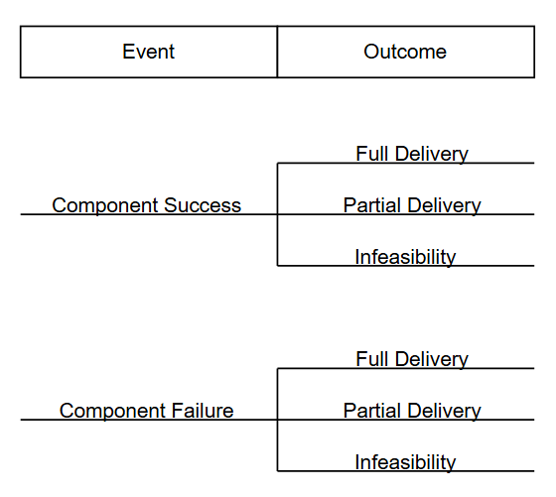
Scenario-Based Event Tree Model
Sampling all the uncertain variables simultaneously in a probabilistic simulation obscures the interpretability of the results
To address this issue, the probabilistic simulation was combined with a scenario-based PRA method, event tree analysis.
The valve between nodes 4 and 6 was determined to be the most important component through an importance study and was selected as the component for event tree analysis
Risk Analysis and Reliability Engineering (RARE) Lab

Slide 17
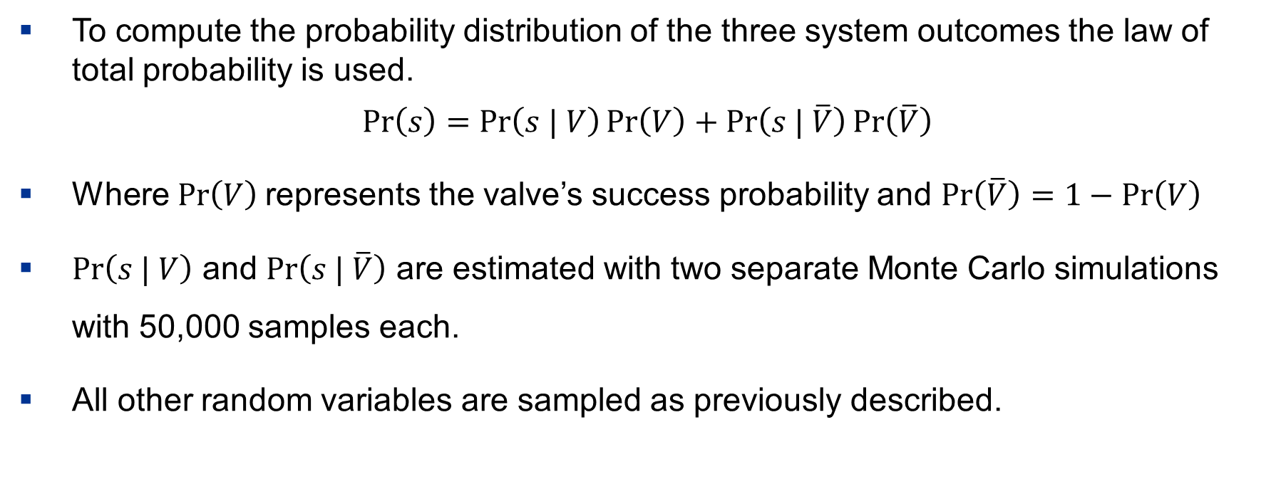
Scenario-Based Event Tree Model
To compute the probability distribution of the three system outcomes the law of total probability is used.
$$\operatorname{Pr}\left(s\right)=\operatorname{Pr}\left(s | V\right)\operatorname{Pr}\left(V\right)+\operatorname{Pr}\left(s | \overline{V}\right)\operatorname{Pr}\left(\overline{V}\right)$$
Where $\operatorname{Pr}\left(V\right)$represents the valve’s success probability and $\operatorname{Pr}\left(\overline{V}\right)=1−\operatorname{Pr}\left(V\right)$
$\operatorname{Pr}\left(s | V\right)$ and $\operatorname{Pr}\left(s | \overline{V}\right)$ are estimated with two separate Monte Carlo simulations with 50,000 samples each.
All other random variables are sampled as previously described.
Risk Analysis and Reliability Engineering (RARE) Lab

Slide 18
Event Tree Model Results
95% confidence intervals were calculated for the partial delivery and infeasibility probabilities.
These results are in good agreement with the full Monte Carlo simulation approach verifying it as an accurate approach.
Full Monte Carlo Simulation
 | Point Estimate | 95% Confidence Intervals
Partial Delivery | 0.03182 | (0.03012, 0.03352)
Infeasibility | 0.01253 | (0.01170, 0.01336)
Event Tree Analysis
 | Point Estimate | 95% Confidence Intervals
Partial Delivery | 0.03123 | (0.03019, 0.03227)
Infeasibility | 0.01210 | (0.01093, 0.01327)
Risk Analysis and Reliability Engineering (RARE) Lab

Slide 19
Summary
A literature review identified research gaps in existing IES risk analysis studies, motivating the development of a probabilistic IES simulation framework.
The gas network risk model was developed, using Monte Carlo simulation to compute two risk outputs, probabilities and energy not supplied (ENS), across three network outcomes: full delivery, partial delivery, and infeasibility.
Event tree analysis was demonstrated to produce results consistent with Monte Carlo simulation and increases the interpretability of the results.
Risk Analysis and Reliability Engineering (RARE) Lab

Slide 20
Future Work
The gas network simulation will be coupled with an electric power model to advance the multi-network IES simulation platform.
Develop an energy consumption prediction model for hyperscale data centers to support risk assessment of large-scale data center loads connected to IES.
Risk Analysis and Reliability Engineering (RARE) Lab

Slide 21
Slide Title for Accessibility 21
Risk Analysis and Reliability Engineering (RARE) Lab
Questions?
Emelia Stouffer, Amir Shahriar Kalantari Oskoui, and Tatsuya Sakurahara
July 22, 2026

