Slide 1
July 21, 2026
Real-Time Data-Driven Signal Denoising for Operational Monitoring in Hydrogen Stack Testing
Dr. Elvan Sahin
Postdoctoral Researcher
Idaho National Laboratory | Hydrogen & Electrochemistry
• PSAM18 • Pittsburgh, PA

Slide 2
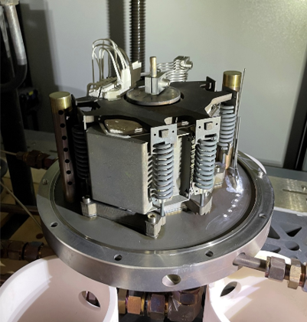
The Introduction: SOEC Stack Experiments
What is a SOEC Stack?
Solid Oxide Electrolysis Cell – converts electricity + steam into hydrogen and oxygen at ~700 ℃.
Multi-cell stack architecture: cathode | YSZ electrolyte | anode layers separated by metallic interconnects.
Nuclear-compatible – integrates with reactor heat & power for clean hydrogen production.
INL tests stack modules from multiple industry partners under real operating conditions.
SOEC Stack System

Slide 3
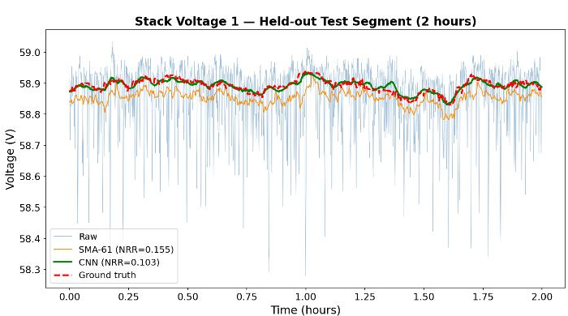
The Problem: Noise Masks SOEC Degradation
SOEC stacks degrade at ~millivolts per 1,000 hours
Raw voltage σ is 10–100× larger than that drift over a single 24-hour window
Noise sources: power supply electronics, furnace transients, instrumentation drift
Classical filters (Simple Moving Average, Savitzky–Golay, Butterworth) hit a spectral-overlap ceiling — aggressive smoothing biases the very trend being measured
Raw trace + slow trend of interest
Goal: reduce residual noise without distorting the slow trend.

Slide 4
Data & Noise Characterization
Operating Regime Selection
Red/Brown noise (Voltage)
PSD slope ≈ −1.3 → correlated, structured
Exploitable by CNN
Group | Current | Temp. | Duration | Role
A | 48.6 A | 709 °C | 1,263 h | Future validation
B ★ | 48.6 A | 716 °C | 836 h | Dev + Eval
C | 56.7 A | 722 °C | 601 h | Future validation
Pink (1/f) noise (Thermal)
PSD slope ≈ −0.4 → weaker structure
Smaller CNN gain
Group B selected: tightest current control → cleanest noise isolation
Leave-one-file-out: train SEP 6 + SEP 29 → test SEP 16 (fully withheld)
3–6 s correlation time
Hard floor on denoiser resolution
Sets minimum feature timescale
r > 0.93 cross-channel
All 7 voltage signals share noise source
Only Stack Voltage 1 retained as representative

Slide 5
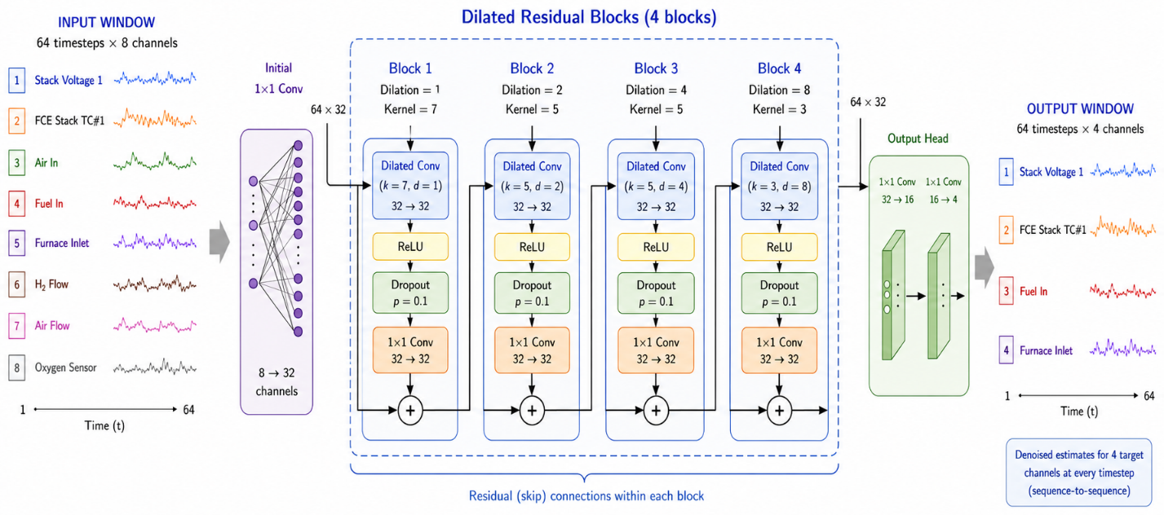
The Model: Compact Dilated CNN Denoiser
Three Design Choices Enabling Cross-File Generalization:
① Per-window normalization
② 16× overlap averaging
③ Held-out file evaluation
Zero-centers each 64-step input window. Stores the mean and adds it back at output.
An earlier LSTM variant without this memorized file-level mean voltages and failed on the held-out file.
Each timestep predicted 16 times from 16 different contexts (stride = 4).
Averages diverse non-linear views — smoother than a single pass at zero parameter cost.
SEP 16 withheld from training and validation. Time-block splits prevent receptive-field leakage.
Results reflect genuine cross-file generalization, not memorization.

Slide 6
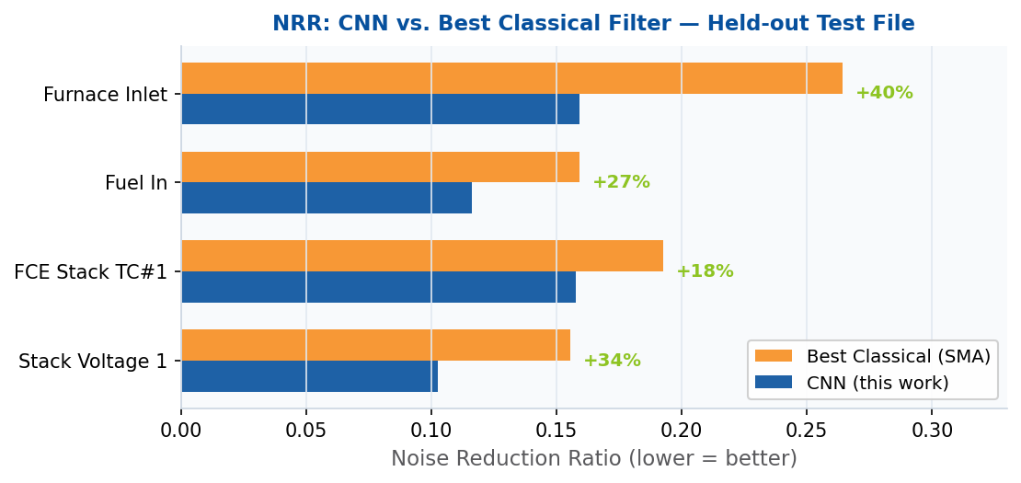
Results: CNN Outperforms Classical Filters on All Channels
Noise Reduction Ratio (NRR) — lower is better | Evaluated on fully withheld SEP 16 test file | Fidelity constraint: r ≥ 0.95
Key Findings
+40%
Furnace Inlet
Most structured noise (slope −1.35)
Spike excursions effectively removed
+34%
Stack Voltage 1
Red/brown noise (slope −1.32)
CNN learns correlated structure
+27%
Fuel In
Moderate pink noise (slope −0.50)
CNN still improves consistently
+18%
FCE Stack TC#1
High SNR channel (31.0 dB)
Less structure to exploit
CNN Pearson r ≥ 0.9979 on all channels — slow trend fully preserved

Slide 7
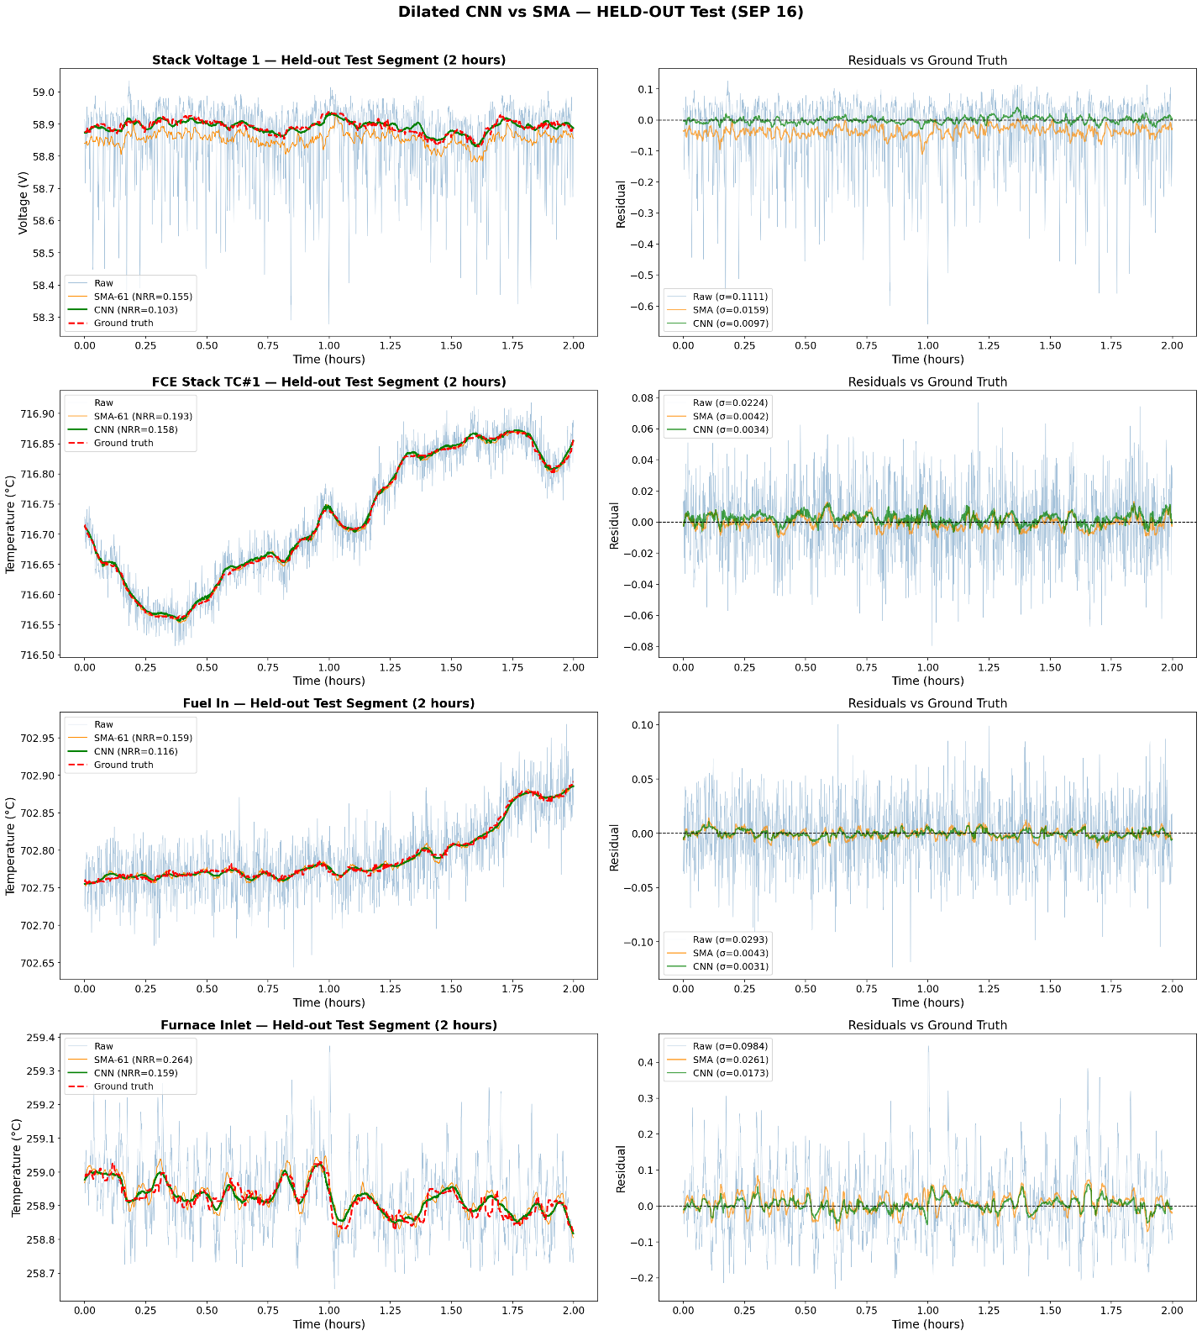
Results: Visualizing the Impact
1
Spike Suppression:
2
Drift Tracking:
The CNN suppresses downward spikes instantly, returning to the trend within seconds. SMA spreads the disturbance, creating a prolonged false dip.
CNN tracks genuine thermal drift (-0.3 C on TC#1) while eliminating high-frequency noise.

Slide 8
Results: Visualizing the Impact
3
Zero-Mean Residuals:
CNN residuals remain tightly centered on zero with no low-frequency bias, essential for accurate degradation rate estimation.

Slide 9
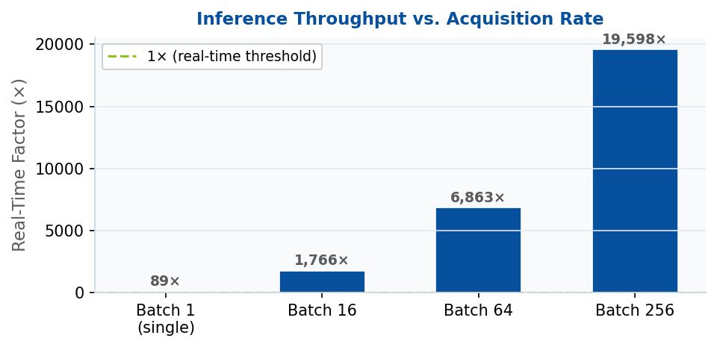
Real-Time Deployment: 88× Faster Than Acquisition Rate
96.2%
88×
0.12 MB
Computational headroom
Faster than real-time
Runtime memory
Single-window inference: 113 ms
3-second stride budget: 12,000 ms
Single-window streaming mode
20,000 windows processed in 679 s
25,716-parameter model
Suitable for embedded deployment
Startup & Deployment Notes
▶ 252-second buildup to reach full 16× overlap averaging
▶ Start model during thermal ramp-up — full capacity before on-load begins
▶ At batch size 256: 19,598× real-time factor
▶ Ready for live integration into INL pipeline

Slide 10
Conclusions & Future Work
A 25,716-parameter dilated CNN reduces SOEC signal noise by 18–40% over the best classical filter — on a fully held-out file, at 88× real-time speed
Three Generalizable Lessons:
Future Work
① Per-window normalization is essential
① Extend to Groups A & C — validate with long-term degradation and current-regime variation
Without it, the model memorizes file-level mean voltages and fails on cross-file deployment. This is the single most important implementation detail.
② Quantify CNN impact on degradation-rate estimator variance and bias
② Overlap averaging is free regularization
16 overlapping non-linear context views averaged at zero parameter cost. Visibly smoother output than a single forward pass.
③ Add MC-Dropout uncertainty intervals for per-sample confidence bounds
③ Held-out file splits give honest results
Random window splits across a 64-step receptive field leak future data. Time-block splits and a withheld file are the correct evaluation standard.
④ Integrate into live INL DAQ pipeline for online monitoring

Slide 11
Q & A and Acknowledgements
Thanks for listening to me and for your great questions☺
• Nick Kane • Jeremy Hartvigsen • Temitayo Olowu • Micah Casteel
U.S. Department of Energy, Office of Nuclear Energy under DOE Idaho Operations Office Contract DE-AC07-05ID14517.

