Slide 1
Revisiting maximum magnitude assumptions within the development of Loviisa’s seismic hazard assessment
PSAM 18
19 – 24 July 2026, Pittsburgh, Pennsylvania, United States of America
Eeli Asikainen, Juhana Vehmas, Jukka Koskenranta, and Päivi Mäntyniemi (University of Helsinki)

Slide 2
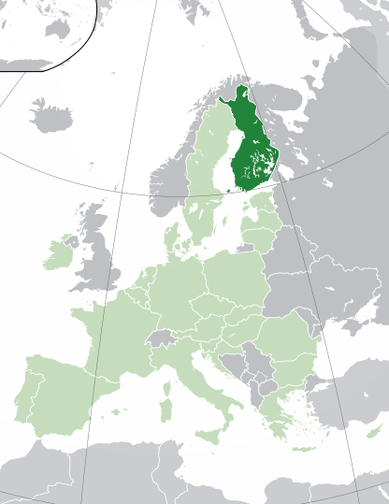
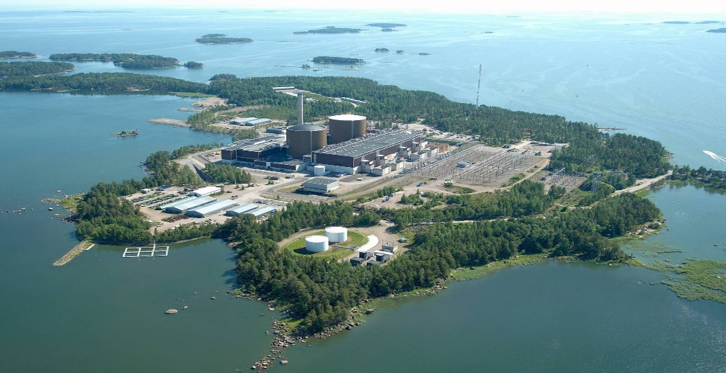
Loviisa Nuclear Power Plant
Located on the southern coast of Finland
2 x 500 MWe VVER-440 units (1977/1980)
Operating license until the end of 2050

Slide 3
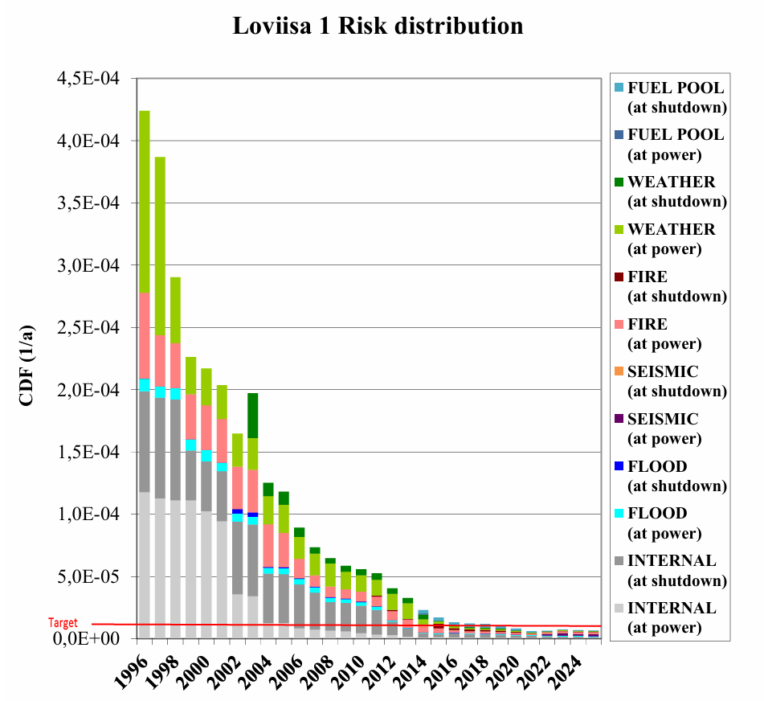
Loviisa PRA
Includes
  Level 1 and 2 PRA
  All operating and shutdown states
  All types of initiating events
Significant plant upgrades to reduce risks
Seismic events contribute ~25 % of the CDF and ~50 % of the LRF (2025 PRA results)

Slide 4
Loviisa PSHA
Estimates the annual frequency of exceedance for a given level of ground motion intensity
PSHA2021
Full-scale PSHA update by Slate Geotechnical Consultants
2022 Master’s thesis
Sensitivity study on recurrence parameters
2023 Special assignment
Verification of an alternative recurrence parameter computation method
2024 Master’s thesis and PSHA2024
Updated PSHA2021 with a new earthquake catalogue and recurrence parameters
2026 Master’s thesis and PSHA2026
Updated PSHA2024 with new seismic source zones and maximum magnitude distribution
+ Independent sensitivity studies and reviews done by external parties such as the Radiation and Nuclear Safety Authority (STUK) and the Technical Research Centre of Finland (VTT)

Slide 5
Maximum Magnitude ($m_{max}$)
Defines the largest earthquake considered physically possible within a given seismic source
Can be assessed using either deterministic or probabilistic approaches
Common probabilistic methods:
  Kijko method
  Bayesian method

Slide 6
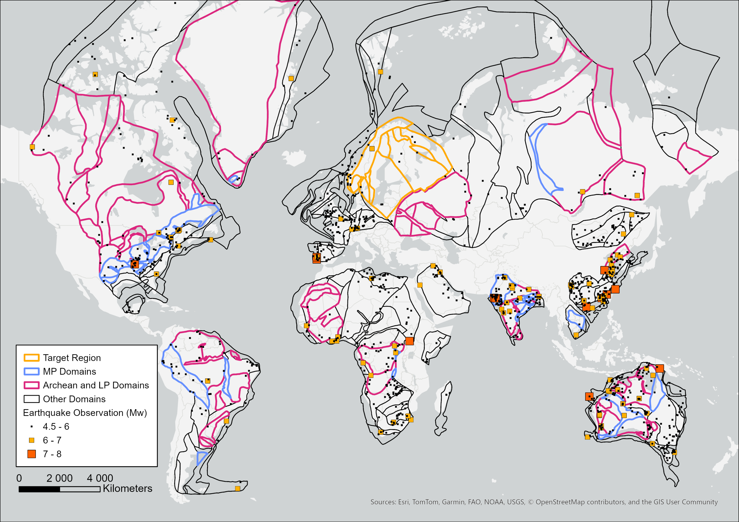
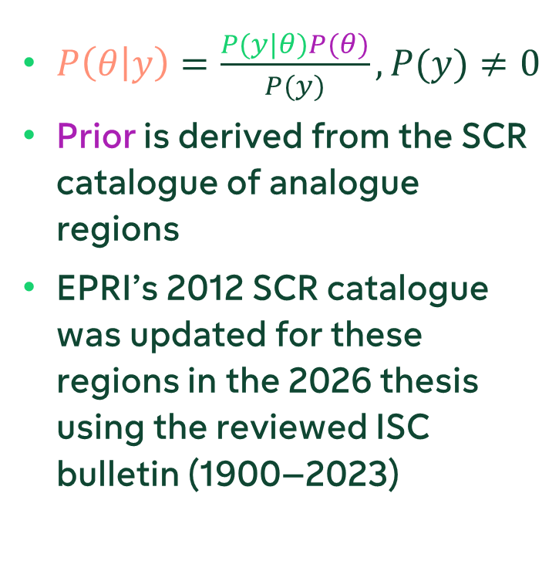
Bayesian Approach to Maximum Magnitudes
$P\left(θ | y\right)=\frac{P(y|θ)P(θ)}{P(y)}, P(y)≠0$
Prior is derived from the SCR catalogue of analogue regions
EPRI’s 2012 SCR catalogue was updated for these regions in the 2026 thesis using the reviewed ISC bulletin (1900–2023)

Slide 7
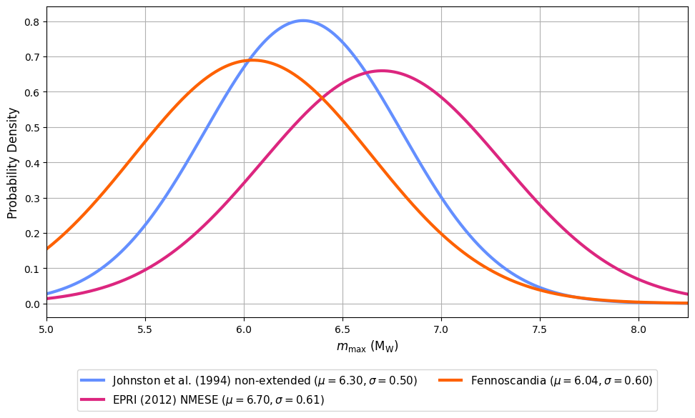
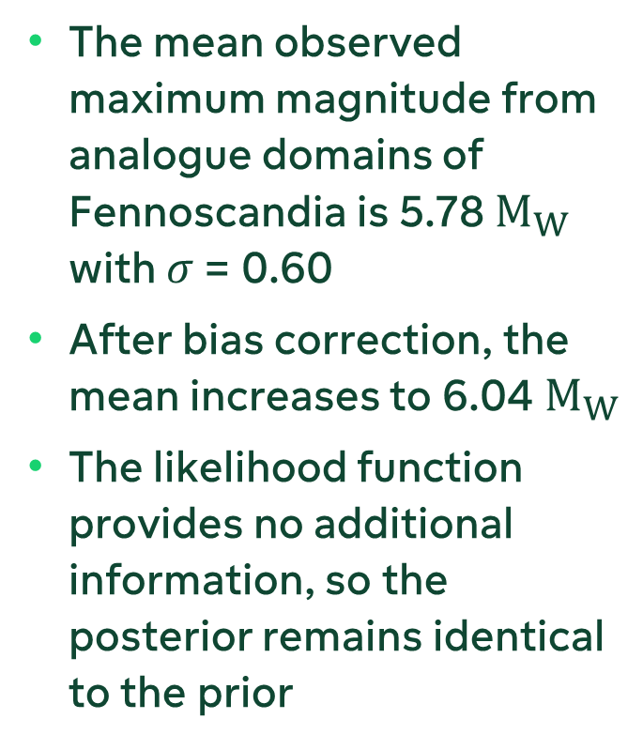
Bayesian Prior Distribution for Fennoscandia
The mean observed maximum magnitude from analogue domains of Fennoscandia is 5.78 $M_{W}$ with $σ$ = 0.60
After bias correction, the mean increases to 6.04 $M_{W}$
The likelihood function provides no additional information, so the posterior remains identical to the prior

Slide 8
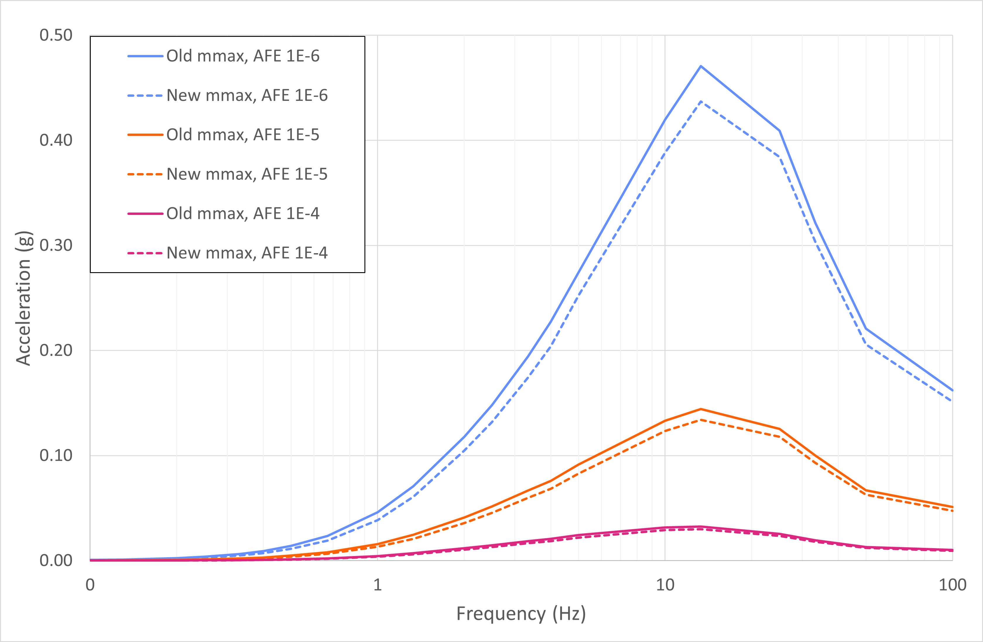
Loviisa Seismic Hazard Estimate Sensitivity

Slide 9
Discussion and Conclusion
The scarcity of large earthquake observations in low-seismicity regions complicates PSHA development
Observed maximum magnitudes in regions analogous to Fennoscandia suggest that the region's largest credible earthquakes may be smaller than the global SCR average
  However, ongoing work by Mäntyniemi et al. suggests that results are highly sensitive to data grouping and a single approach may not robustly resolve differences between SCR regions
The presented workflow is potentially applicable to other low-seismicity SCRs, provided analogue selection reflects regional tectonic conditions
Contact: eeli.asikainen@fortum.com

Slide 10
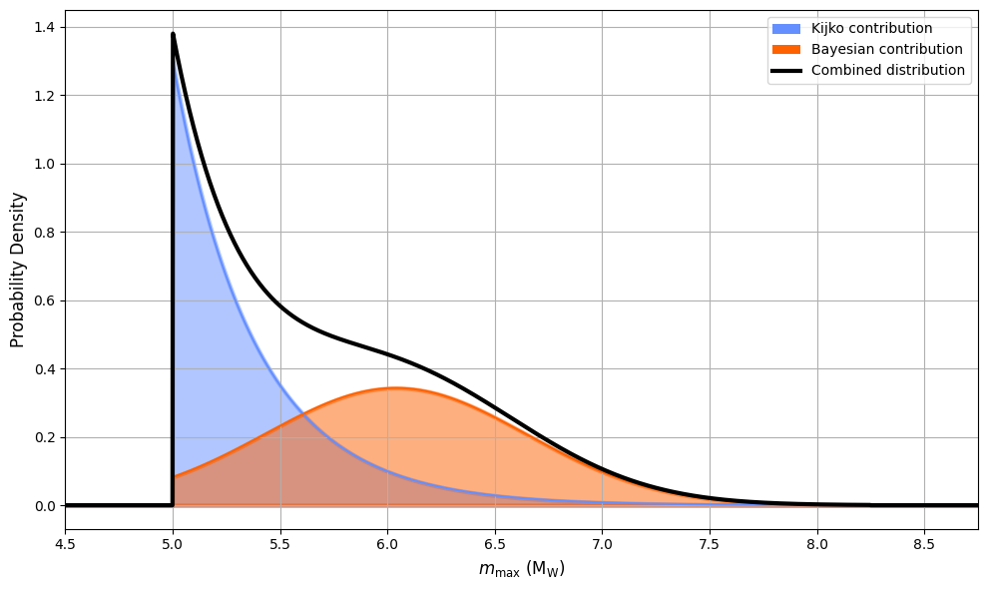

Additional Information (1/4)
Combined $m_{max}$ Distribution
Continuous probability distribution
Discrete weight distribution
Weight | m_{max}
0.101 | 5.03
0.244 | 5.19
0.310 | 5.61
0.244 | 6.25
0.101 | 6.98

Slide 11
Additional Information (2/4)
Maximum Magnitude Distributions in PSHA2021
Kijko
Bayesian
Weight | m_{max}
0.726 | 5.5
0.201 | 6.0
0.057 | 6.5
0.016 | 7.0
Weight | m_{max}
0.01 | 5.25
0.08 | 5.75
0.23 | 6.25
0.36 | 6.75
0.32 | 7.00

Slide 12
Additional Information (3/4)
Miller and Rice Discrete Approximation of Continuous Distributions
Cumulative Probability of a Continuous Distribution | Miller and Rice Probability Weight | Modified Weight for PSHA
0.034893 | 0.10108 | 0.101
0.211702 | 0.24429 | 0.244
0.500000 | 0.30926 | 0.310
0.788298 | 0.24429 | 0.244
0.965107 | 0.10108 | 0.101

Slide 13
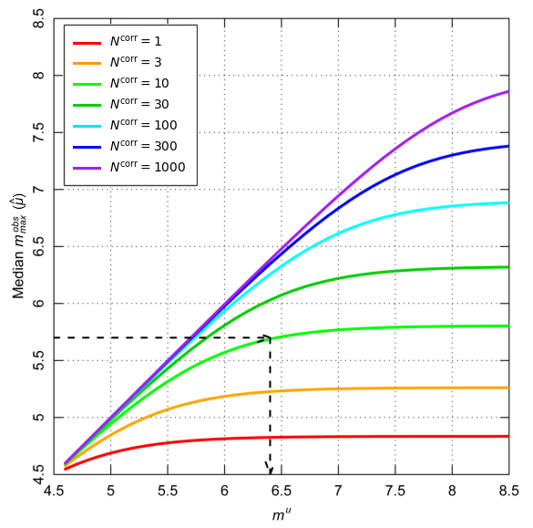
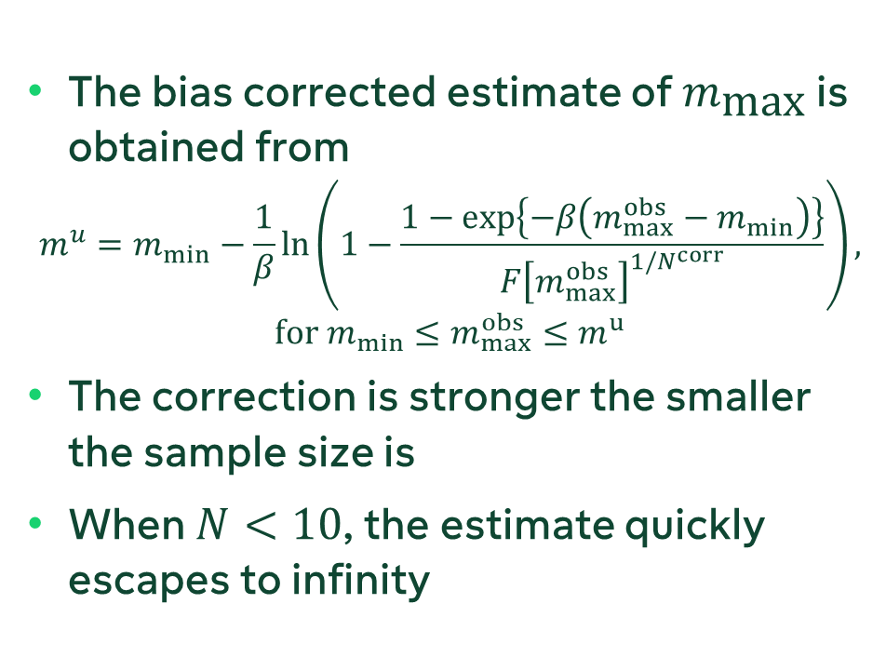
Additional Information (4/4)
Maximum Magnitude Bias Correction
The bias corrected estimate of $m_{\text{max}}$ is obtained from
$$m^{u}=m_{min}−\frac{1}{β}ln\left(1−\frac{1−exp\left\{−β\left(m_{max}^{obs}−m_{min}\right)\right\}}{{F\left[m_{max}^{obs}\right]}^{1/N^{corr}}}\right),$$
$$for m_{min}≤m_{max}^{obs}≤m^{u}$$
The correction is stronger the smaller the sample size is
When $N<10$, the estimate quickly escapes to infinity

