Slide 1

PSAM 18 - 2026
Steven Prescott
Steven.Prescott@inl.gov
Daniel Nevius
Coauthor
Enabling Dynamic Probabilistic Risk Assessment of Physical Security Using EMRALD and MAAP

Slide 2
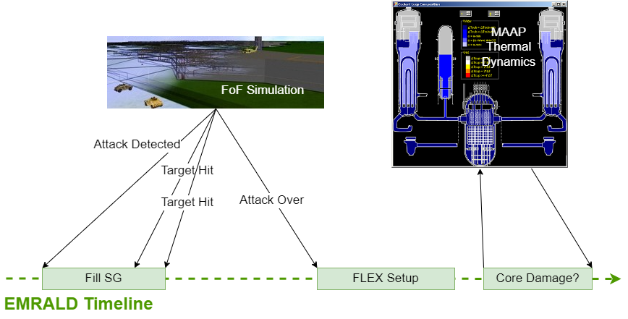

MASS-DEF (Modeling and Analysis of Safety and Security - Dynamic Evaluation Framework)

Slide 3
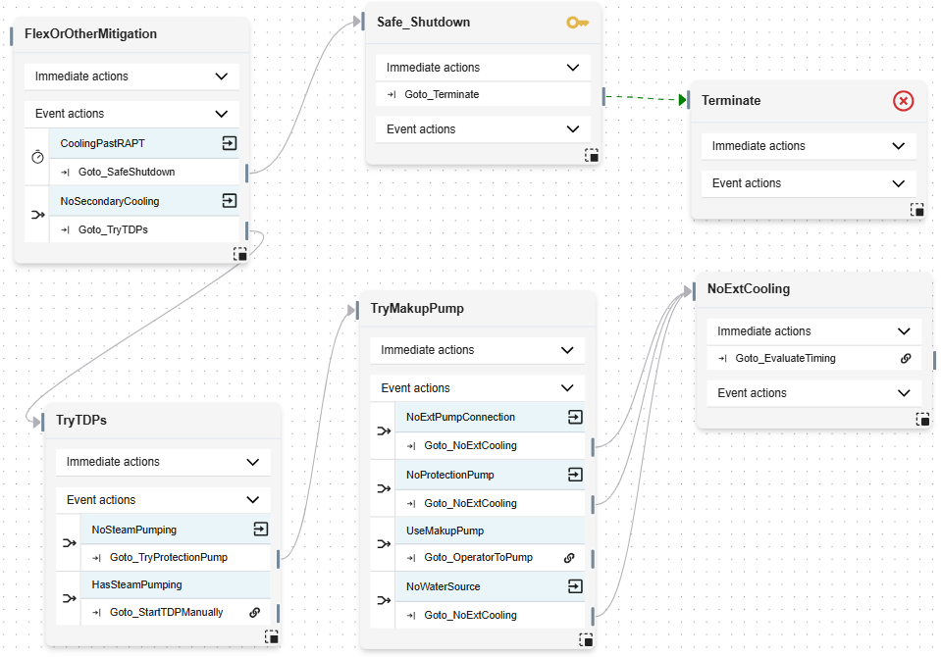
EMRALD (Event Modeling Risk Assessment using Linked Diagrams)
Dynamic probabilistic risk assessment (PRA), state modeling based on a three-phased discrete event simulation.
  No time steps
  Jumps to next thing that happens in time
  Monte Carlo sampling
  Good for long and/or short time jumps
Condition-driven events
Sampled time-driven events

Slide 4
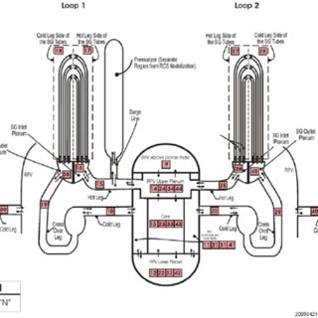
Modular Accident Analysis Program (MAAP)
MAAP is:
Commonly used by industry to evaluate pressurized
water reactors (PWR) and boiling water reactors (BWR)
Faster than other thermohydraulic codes, but still slow
when running thousands of simulations
Inaccessible to PRA analyst so sensitive data
can only be used in secure environments.
Need a way to get MAAP results faster to use in
dynamic PRA
Nuclear Engineering and Technology, 10.1016/j.net.2015.06.010
Notes:
Input files reminiscent of Fortran code. Typical runs take from 5-20 min.

Slide 5
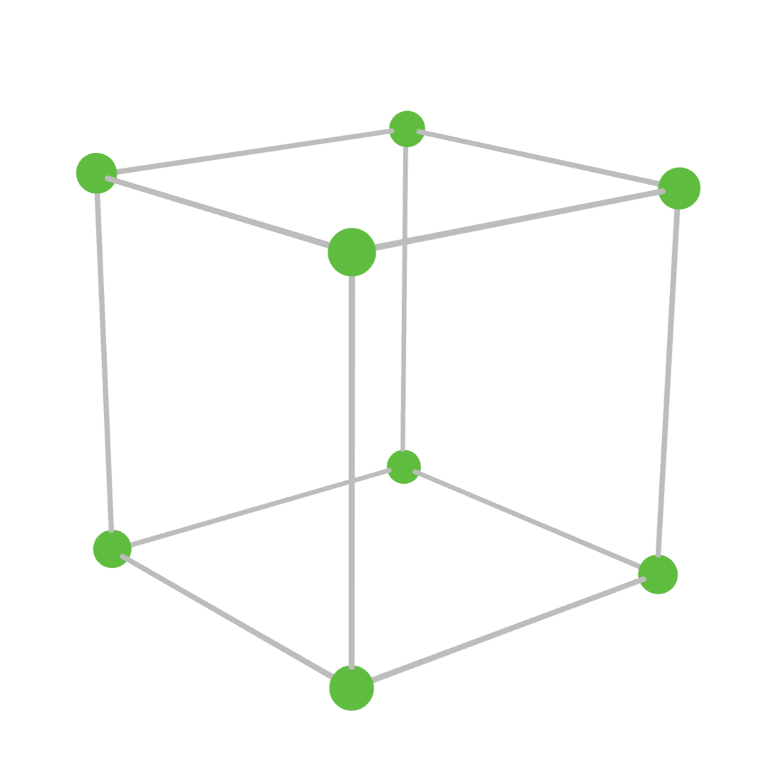
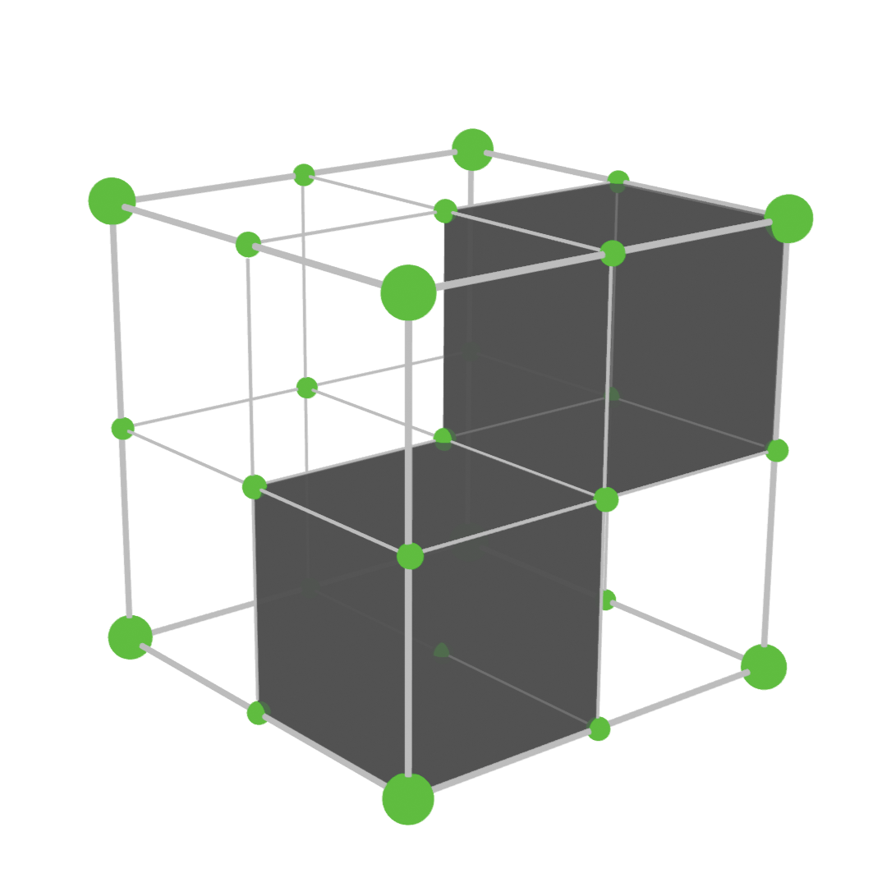
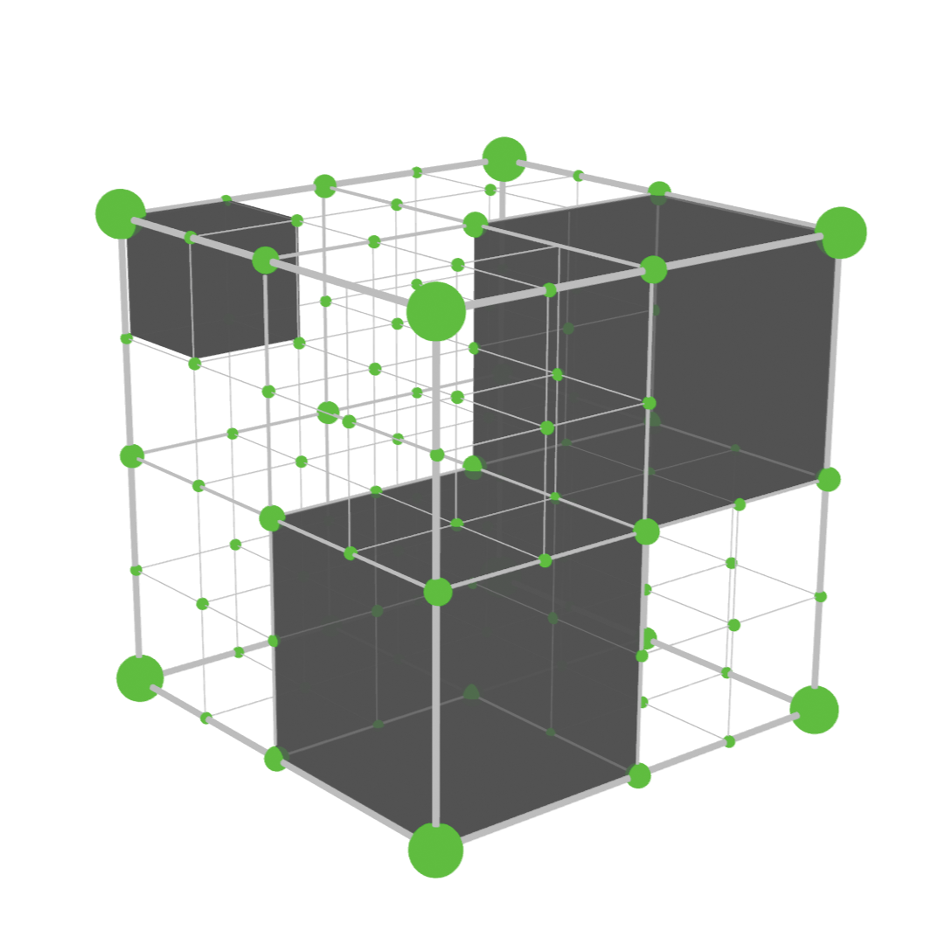
Solution: Reduced Order Model (ROM) of MAAP Results
Only three or four parameters are relevant to the EMRALD simulation
Can gather data using thousands of runs to interpolate for millions of runs
Create n-dimensional space representing the parameters of interest
Eliminate subspaces below user-set tolerance
Notes:
Images show a 3-dimensional space for 3 parameters of interest. Each green point is a MAAP run for a unique set of parameter values. After the runs, the number of points is doubled and MAAP is run again. The grey boxes represent subspaces that have been eliminated and no further points will be evaluated within them. The user specifies a maximum “depth”, or number of times to subdivide the points, to prevent the program from running infinitely.

Slide 6
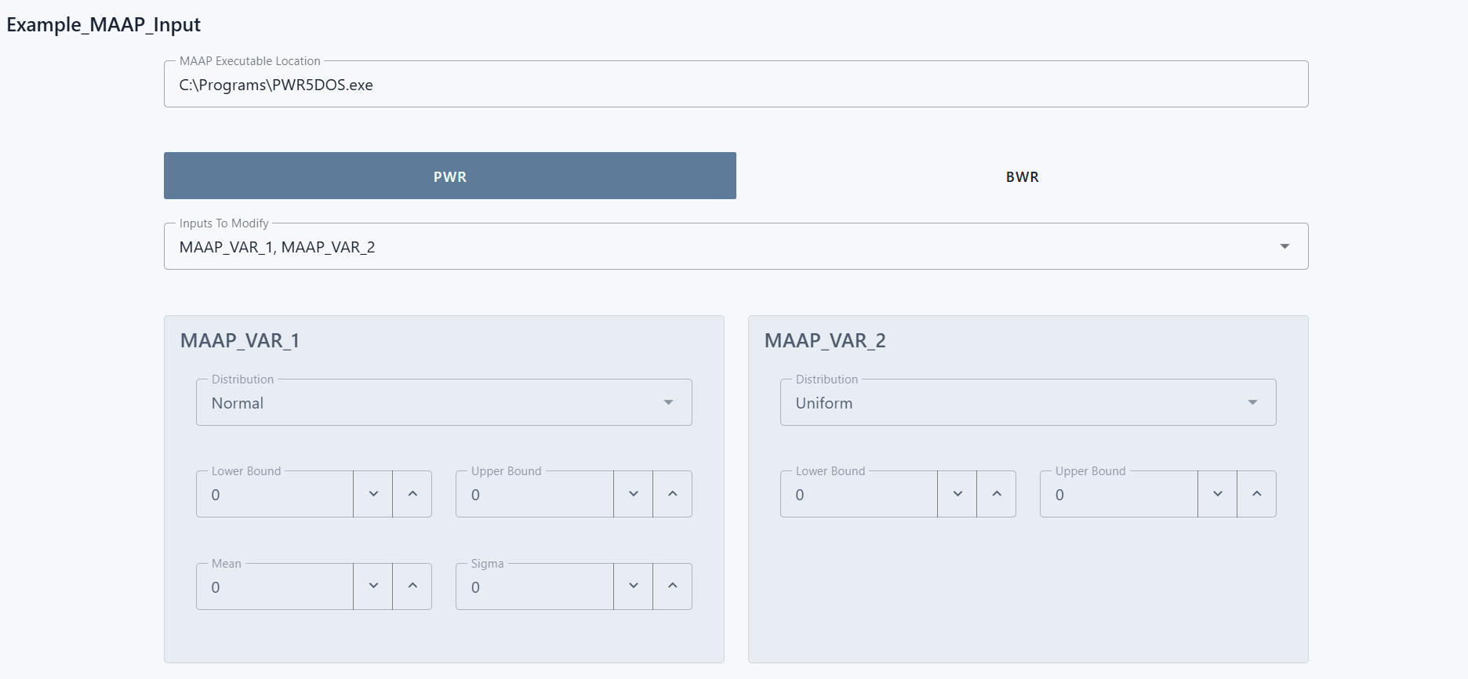
ROM Generator Tool
Software tool to automate the sampling process
Upload existing MAAP input files & select parameters of interest
Notes:
The user selects from a list of parameters retrieved from the MAAP INP file, then enters the distribution and corresponding distribution parameters for each of the selected MAAP parameters. Then, the user simply clicks “Run” and the sampling process described in the previous slide automatically beings. The result of the run is the collected data in the form of X and n Y values, where n is the number of parameters selected. The MAAP model may need to be modified so that variables are used in condition statements that need sampling.

Slide 7
Results
~3 days on 2.8ghz with 30 threads to produce the ROM
Collected samples can be used to train the user’s choice of regressor – KNN and Random Forest built-in
Our selection: Random Forest with 300 trees, three features, and 28,000 samples predicts values within 5.3 +/- 0.3 minutes of the true value produced by a full MAAP run
100 simulations using the ROM model run in less than a minute – compared with 3 days running MAAP each time
Notes:
KNN is “K nearest neighbors”, a supervised learning method that can be used as a regressor. The values it predicts are the average of the k nearest neighboring points. It is the more basic of the regressors and is very fast to train, but the predicted values were not very accurate for our case.
Random Forest is an “ensemble learning” method that creates x decision trees (300 trees in our case) and can also be used as a regressor. The values it predicts are the average of the predictions of all its trees. The number of trees and number of features are parameters for the regressor that can be adjusted depending on the model to get better predictions.
In our case, the random forest model is trained on the data and then encoded into a binary file. The calls from EMRALD load this binary file, containing the trained regression model, and use it to return the predicted values.

Slide 8
ROM Validation
The regression model is trained on 90% of the collected samples, chosen randomly
The remaining 10% are used as known values to check how close the regression predicted values are
This process is repeated 30 times, and the Root Mean Square Error (RMSE) is calculated for each run
Reports mean RMSE, standard deviation, and margin of error of the RMSE
Notes:
Root Mean Square Error measures the distances between actual and predicted values. A random 10% of the samples are set aside to serve as the actual values, and the other 90% used to train a new random forest regression model. The actual values that were set aside contain a X values with each of the parameters that were passed to MAAP, and Y values of the result of the MAAP run with those parameters. The X values are then passed to the new regression model trained on the other 90%, which predicts a new value. Because we know what the true value is for those parameters, we can calculate the RMSE using the difference between the known value and the predicted value. Doing this for every set of known values in the 10% set aside gives a RMSE value for the entire model.
This process is repeated 30 times, each time randomly choosing a different 90% and 10%. This gives a normal distribution of the calculates RMSE themselves, so we can calculate a margin of error *of the RMSE* at a 95% confidence interval, which produces the 5.3 +/- 0.3 minutes value in the results slide. What this really means is that for a particular call to the ROM from EMRALD, we are 95% confident the value the ROM returns a value within the time. For our application it was at worst 5.6 minutes different than if we had spent the time to actually run MAAP with those same parameters.

Slide 9
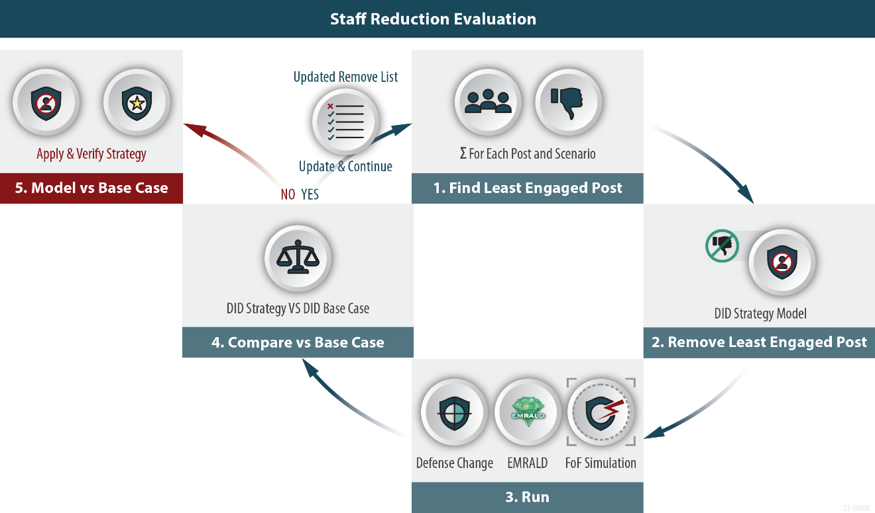
Use Case – Site Alternative Protection Evaluation
Site protection strategy
Operator actions on attack
Protection pump inside protected area
Escorted operator actions after attack
MAAP
ROM Use

Slide 10
Notes:
Possible questions:
Q: What ROM is it / what type of ROM is it? A: Bayesian process optimization
Q: Why did you not use RAVEN? A: RAVEN did not support the MAAP integration we needed (the MAAP link in RAVEN was outdated and essentially unsupported)
Q: What regression model / hyperparameters are used to predict values? A: This is up to the user to determine the correct regressor and hyperparameters for the shape of their model. Our selections for both of these are in the results slide.
Q: What are the disadvantages to this approach? A: The sample collection strategy has the potential to miss very rough areas in the MAAP output as it checks (potentially) comparatively large planes in the sample space (compared to the size of spikes in the output).

