Slide 1

Obtaining System- and Component-Level Insights from Importance Measures Using an Efficient Data-Driven Simulation Approach
Prof. Curtis Lee Smith
Prof. Emanuele Borgonovo
Massachusetts Institute of Technology
Bocconi University
Image Created by Gemini

Slide 2

Summary
▶ Motivation
▶ Background
▶ Approach
▶ Conclusions
Gemini 3
Notes:
BY THE END OF THIS PRESENTATION
YOU WILL UNDERSTAND RISK and RELIABILITY CONCEPTS AND KNOW WHY THEY ARE IMPORTANT

Slide 3

“Risk” can describe different contexts
Risk can represent a performance shortfall
– Risk Analysis – science-driven way to make things better
3

Slide 4

Risk as an impact to safety
Computer simulation to evaluate complex systems
– Computational Risk Analysis (CRA)

Slide 5

Background

Slide 6

Off-normal scenarios = Initiating Events + Enabling Conditions
Gemini 3

Slide 7

    Components that contribute to system and
    plant performance need to be evaluated
Gemini 3

Slide 8

Importance Measures (Ims) are a central tool supporting engineering decision making
Allow us to identify important components in a system under a variety of settings
Over the years several Reliability-focused IMs developed
Mainly focused on Boolean-logic based models
What challenges and insights are to be found when performing computational simulation?
Gemini 3

Slide 9

Boolean-based IMs have understood calculations
For example, Birnbaum
B_{i} = P[θ(1)] – P[θ(0)]
and RAW
RAW = P[θ(1)] / P[θ(nominal)]
But what about simulation?
Gemini 3

Slide 10
Approach

Slide 11

Event Model Risk Assessment using Linked Diagrams EMRALD (github.com/idaholab/EMRALD)
Gemini 3

Slide 12

Event Simulation
Time interval [0,mission time]
Simulates system and component states as function of time
Allows mixing physical and logical considerations
Potentially no restrictions on # of components and systems and the “type” of failure
Gemini 3

Slide 13
EMRALD
A modeling approach using states
A browser- based editor
Simulation of detailed time-based
systems & components evolution
Calculation of state probabilities

Slide 14
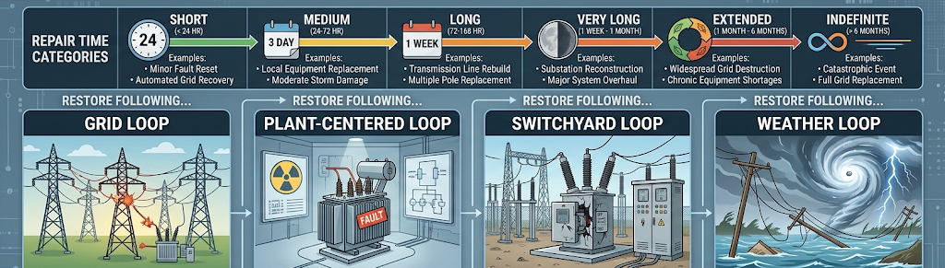
Example: Component restoration times
  When component fails, the time-to-restore is represented
  Key components cause the facility to lose power production

Slide 15
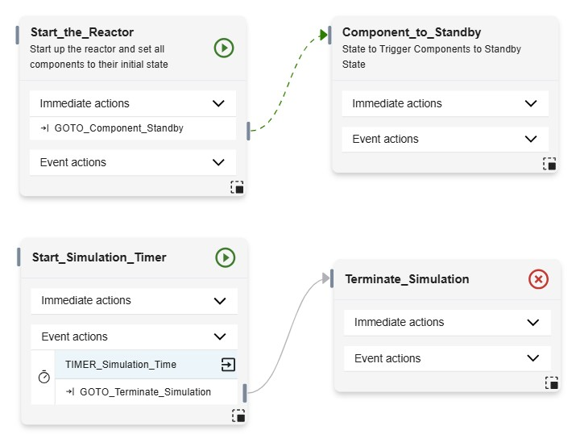
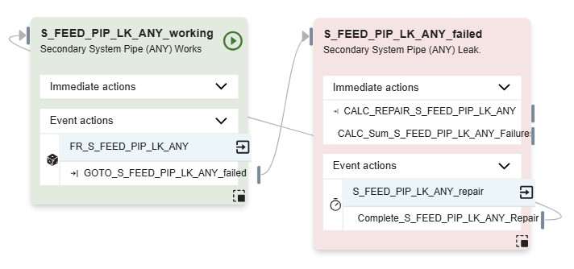
EMRALD diagram
Trigger the Components
Example Component Model
One year mission time

Slide 16
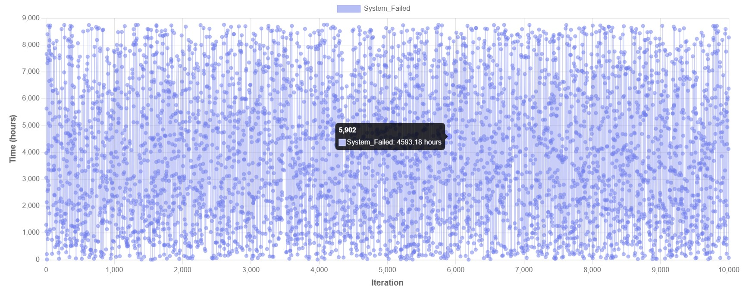
Simulating reliability

Slide 17

Monte Carlo Simulations are expensive, N replicates
Computing Ims based on conditioning state of each component yields Cost = s*C*N (s # states, C # components)
2 states, 10 components, 500,000 replicates yields 10 million simulations
Gemini 3

Slide 18

Our Goal
Calculate Ims from the simulation without adding additional cost
«Given already calculated data» approach
Avoid having to run calculations specific to IM calculations in the simulation engine

Slide 19

Example: Birnbaum
Estimate 𝐏[θ(𝟏)] and 𝐏[θ(0)] from simulation results
𝒏_{𝒊} = #-times component i fails in all simulations
𝒇_{𝒊}^{𝟏} = number of times in which system fails in this set
𝑵−𝒏_{𝒊} = #-times component i does not fail
𝑵 = total number of simulations
𝒇_{𝒊}^{𝟎} = number of times in which system works in this set
An estimate of the Birnbaum importance is
𝑩_{𝒊} = 𝒇_{𝒊}^{𝟏} / 𝒏_{𝒊} − 𝒇_{𝒊}^{𝟎} / (𝑵−𝒏_{𝒊})
This can be extracted directly from the system simulation
Law of large numbers ensures asymptotic consistency
Gemini 3

Slide 20
What is important in the system?
Importance measures from simulation…
Borgonovo, E. and C. Smith (2025), “Importance
measures from complex reliability simulations,”
In 35th European Safety and Reliability Conference
(ESREL 2025) and the 33rd Society for Risk Analysis Europe Conference (SRA-E 2025), pp. 330–337.
https://rpsonline.com.sg/proceedings/esrel-sra-e2025/pdf/ESREL-SRA-E2025-P8909.pdf
Gemini 3

Slide 21
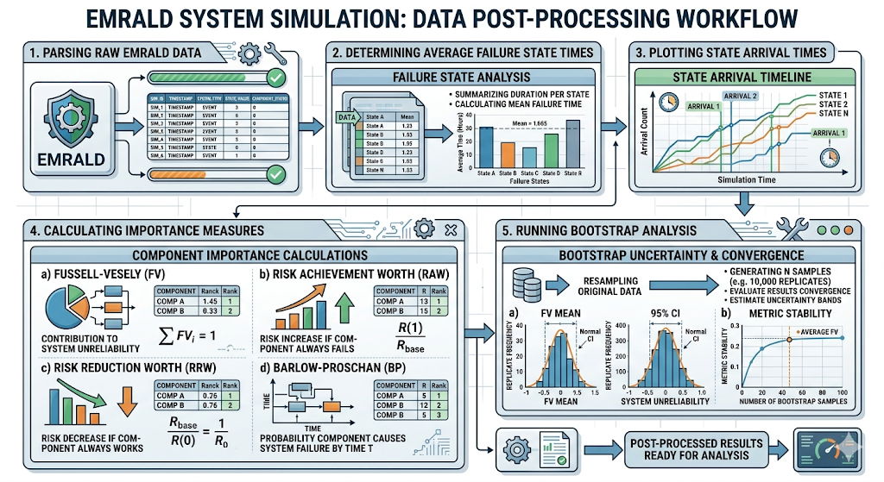

Slide 22
Conclusions

Slide 23
In Summary
We have proposed a way to compute reliability importance measures from complex computer simulations
  No need to run conditional simulations yields a notable reduction in computational burden
We find asymptotically consistent IM estimates
Results show applicability of the method to match traditional IMs
Approach allows estimation and paves the way to chose the proper importance measure for the application at hand
  Safety significance, resilience, performance, maintenance...
Got Files?
  https://github.com/emanueleborgonovo/ReliabilityImportanceMeasures

Slide 24

Gemini 3

