Slide 1
Risk Assessment of a Known Capacitor Defect in the Artemis II Orion ECLSS Motor Controller Circuits
Probabilistic Safety Assessment and Management 18 Conference
Authors: Colton Brehm (NASA, Johnson Space Center), Jason Sturgis (Science Applications International Corporation, Johnson Space Center)

Slide 2

Nomenclature
Artemis – Moon exploration program led by NASA
Orion – Artemis II Crewed Vehicle
      Vehicle subject of this presentation
ECLSS – Environmental Control and Life Support System
          Subsystem subject of this presentation
DMC – Digital Motor Controller
              Component subject of this presentation
PRA – Probabilistic Risk Assessment
SAPHIRE – Systems Analysis Programs for Hands-on Integrated Reliability
      Probabilistic risk and reliability assessment tool used in this study that was originally developed by Idaho National Laboratory in support of the U.S. Nuclear Regulatory Commission
ISS – International Space Station
UWMS – Universal Waste Management System (space toilet)

Slide 3
Background
In 2024, the International Space Station (ISS) experienced a failure to start of its Universal Waste Management System (UWMS).
The failure was traced to the Digital Motor Controller (DMC) and was caused by excessive current leakage to ground in one of the critical capacitors. The source of leakage was from a delamination in the capacitor introduced during the manufacturing process.
The Probabilistic Risk Assessment (PRA) team for Orion was interested in determining the incremental risk to the Artemis II mission due to the presence of capacitors from the same manufacturing lot in Orion’s Environmental Control and Life Support System (ECLSS) DMCs.

Slide 4
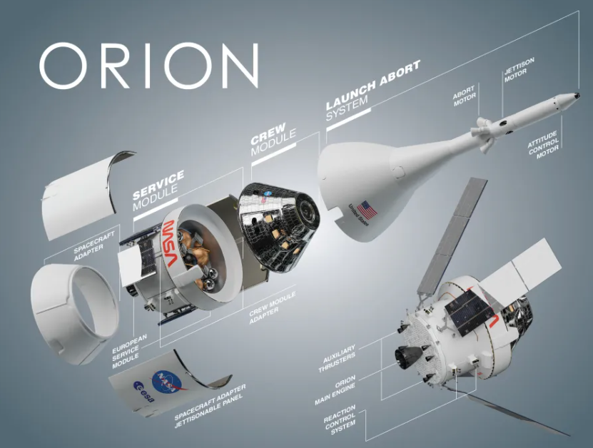
Orion Overview

Slide 5
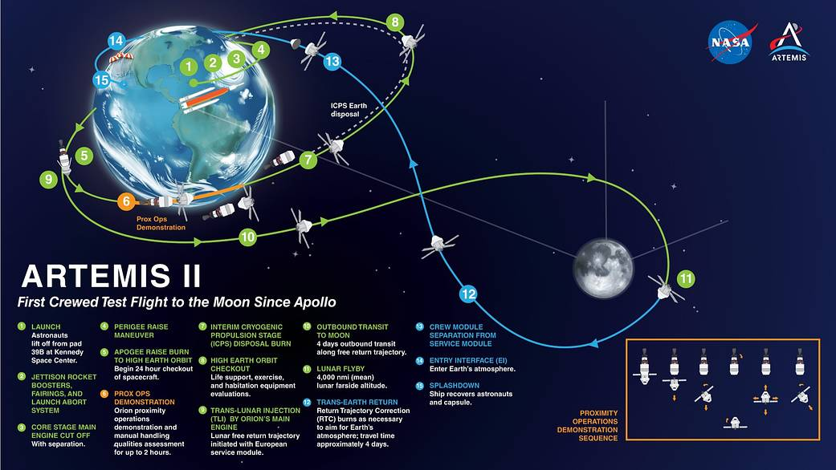
Mission Overview

Slide 6
Problem Scope
Artemis programs including Orion have PRA models in SAPHIRE to quantify Loss of Crew and Loss of Mission.
These SAPHIRE models track risks at the component-level, meaning each of the DMC cards are explicitly modeled with a failure rate and uncertainty distribution for that failure rate, but not to the capacitor level. This degree of fidelity is chosen for feasibility of modeling; there are more than 28,000 unique events in the Artemis II PRA.
How can NASA leverage capacitor defect data, accelerated testing of the suspect lot, and the existing PRA models to quantify incremental risk to the Artemis II mission of flying the DMC cards already present on the vehicle?
Notes:
Blue text is a specific statement for solving a more general problem. How can I track a defect from below my current modeling fidelity to an undesirable end state?

Slide 7
Strategy
Determine which DMC cards have suspect capacitor lot installed and how many on each card
Estimate the number of defective capacitors for each DMC card (22 Cards) given the defect rate of uninstalled capacitors from suspect lot (X-Ray Examination)
Calculate probability of a general resistance failure given a defect
Calculate incremental risk from defective capacitors using weighted populations
Update the total failure rate per controller board and solve SAPHIRE model for Loss of Crew and Loss of Mission to determine effect to mission risk

Slide 8
Strategy
Determine which DMC cards have suspect capacitor lot installed and how many on each card
  Cabin ventilation, liquid water cooling, oxygen regulator assembly, and flow control assembly (service module)
Estimate defective capacitor rate for each DMC card (22 Cards) given the defect rate from uninstalled capacitors from suspect lot (X-Ray Examination)
  Count reflects High, Medium, and Low impedance groups
  *These steps taken as data inputs to our statistical analysis using experts from other NASA teams

Slide 9

3. Calculate probability of a general resistance failure given a defect
Weibayes
Determine failure distribution of a general current leak. ➔ Weibayes (distribution of shape parameter, β, of similar lot)
$$η={\left[\sum_{i=1}^{N}{\frac{t_{i}^{β}}{r}}\right]}^{1/β}$$
η is the Weibull distribution characteristic life
  Similar lot testing used to estimate a distribution of β
  N is the number of installed boards
  t_{i} total number of defect hours per board
  r is the number of failures per board in t_{i}
    1 failure on ISS UWMS (r=1) and 0 failures for the others (r=0.693 assumed)
Notes:
WeiBayes is a statistical reliability method used to analyze product lifespans and predict failure rates. It is useful for making accurate engineering predictions when you have limited failure data

Slide 10
3. Calculate probability of a general resistance failure given a defect
Monte Carlo Simulation (10,000 runs)
Use binomial distribution (given defect rate and trials = number of capacitors on the board) to estimate number of defective capacitors on each board
  could be 0; could be up to 4+
Find the total tested hours of defective capacitors, t_{i} , by multiplying the number of defects by the test hours.
Sample β for the run from the prior β distribution (uniform distribution between 5th and 95th percentiles)
Calculate Weibayes scale parameter (η) for the populated boards given the above estimates of r, t_{i} and sampled β.
Calculate the conditional probability of capacitor leakage of each board given no failures at launch
Equation from previous chart
Notes:
Monte Carlo Simuation builds 10,000 cards (done for each type of card on the vehicle that has suspect capacitors) and does the weibayes method within each trial

Slide 11
4. Incremental risk from defective capacitors using weighted populations
Assessing Current Leakage Severity vs. Failure
Performed circuit analysis indicating which capacitors were critical to overall function
  3 categories of leakage established for failure (high, medium, and low)
Determine the weights of high, medium and low resistance susceptible capacitors on each board
  Fractions of the total critical capacitors
Calculated the incremental risk for each affected board:
  Multiplied mean probability of a capacitor leak by probability of leak exceeding category threshold for failure by fraction of critical capacitors – repeated for each of the 3 sensitivity categories
  Added the weighted incremental risks to obtain incremental risk for each of the 22 boards
Notes:
Purpose: Probability of current leakage➔Incremental Risk due to defect. A current leakage does not necessarily mean failure. NASA engineers and board analysis ga

Slide 12
4. Incremental risk from defective capacitors using weighted populations
Monte Carlo Results
(Step 3)
NASA Engineering Assessment
Monte Carlo Results
(Step 3)
NASA Engineering Assessment
P(Reduced IR | Defect) * P(<High Impedance IR Criteria) * Average Defect Count * High Impedance Fraction of Capacitors
Average Failure Probability of High Impedance Capacitors
… + Medium + Low
DMC Card Failure Probability from Defective Capacitors Only
+ Previously modeled DMC Card Failure Probability
Failure Probability of DMC
/ Mission Duration
Arrows denote flow of information.
Green denotes pre-existing SAPHIRE data
Incrementally Increased DMC Card Failure Rate
Notes:
This process is repeated for each type of DMC card on the vehicle. (22 cards with varying numbers of “suspect lot” capacitors on them)

Slide 13
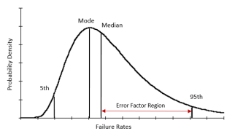
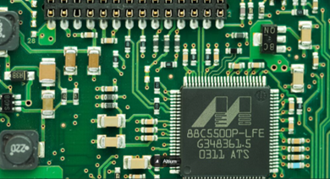
5. SAPHIRE Updates for Loss of Crew and Loss of Mission
LEGEND
Loss of Crew
Transfer to another fault tree
Incrementally increased DMC Card Failure Rate
Loss of ECLSS
Loss of Avionics
Loss of…
AND Gate
OR Gate
Loss of Cabin Pressure
Loss of O2RA
Basic Event containing failure rate, lognormal uncertainty distribution, and mission duration
O2RA Logic Gate 1
O2RA Logic Gate 2
Failure of DMC Card
Basic Event 1…
*Figure is for illustrative purposes. There are thousands of basic events and gates and hundreds of fault trees in the Orion SAPHIRE model.

Slide 14
Conclusion
NASA able to make an informed decision as part of its risk-informed decision-making process.
Accounted for:
Similar lot test data to get a β (shape parameter)
Sample lot defect fraction, powered hours, and known failures
Actual lot test data
Effective powered-on time of cards during the mission and capacitor counts per card
SAPHIRE fault tree logic for ECLSS system redundancy (criteria for both Loss of Crew and Loss of Mission)
The resulting increase to Loss of Crew and Loss of Mission was quantified given the full breadth of data available. Accelerated testing results of unused capacitors from the lot in question represented the final piece of the data to this analysis. This quantitative result of the incremental risk posed by capacitor defects was necessary for proper risk-informed decision making by NASA.

Slide 15
Reference
For information regarding the analysis conducted largely before the Orion PRA in this presentation, please refer to the following NASA publication:
McKinley, M.K, Borrego, M., Et al. “NASA Exploration Toilet Hardware Technical Challenges and Accomplishments” 54th International Conference on Environmental Systems, ICES-2025-094, July 13-17, 2025.

