Slide 1
PSAM 18
Development of a Multi-Unit Tsunami PSA Model for the Hanul Nuclear Power Plant Site
Min-Sik Cha
2026. 07. 20

Slide 2
1
2
3
4
Introduction
Single-Unit Tsunami PSA Modeling
Multi-Unit Integration (One-Top Fault Tree)
Quantification Results & Insights

Slide 3
Introduction
1

Slide 4
Introduction
1
Background
Current Status in Korea:
  Seismic and typhoon hazards are explicitly modeled or incorporated in single-unit PSAs.
  Tsunamis have traditionally been screened out, resulting in a lack of independent multi-unit tsunami PSA frameworks.
The Fukushima Lesson:
  Tsunami-induced simultaneous damage can occur across multiple units and critically impacts site-wide risk.
Multi-Unit PSA (MUPSA):
  A systematic approach to evaluate site risk by considering inter-unit dependencies and shared systems.

Slide 5
Introduction
1
Overall Methodology & Framework
1. Tsunami Hazard Analysis
  Site-Specific Hazard Curve Evaluation
2. Tsunami Fragility Evaluation
  Log-normal Capacities of Key SSCs(Breakwater, CST, ESW)
3. Initiating Event & Single-Unit PSA
  Wave Height Classification(<10m, 10~13m, ≥13) & ET/FT Modeling
4. Site Walkdown & Realism Refinement
  Reflecting Indoor AFST, Submerged Intakes & Watertight doors
5. One-Top Multi-Unit Model Configuration
  Logic Integration, Shared AAC DG Priorities, and Inter-Unit CCFs
6. Site-Wide Quantification & Insights
  Dominant Cutset Generation & Risk-Informed Engineering Actions

Slide 6
Single-Unit Tsunami PSA Modeling
2

Slide 7
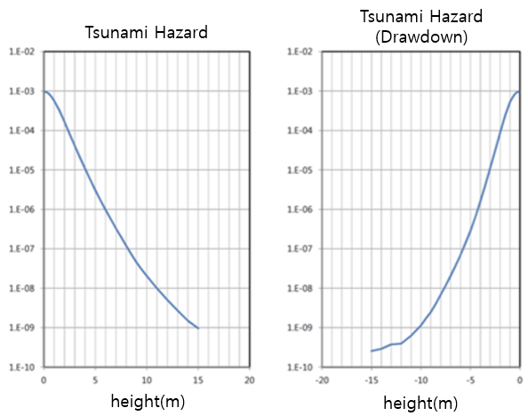
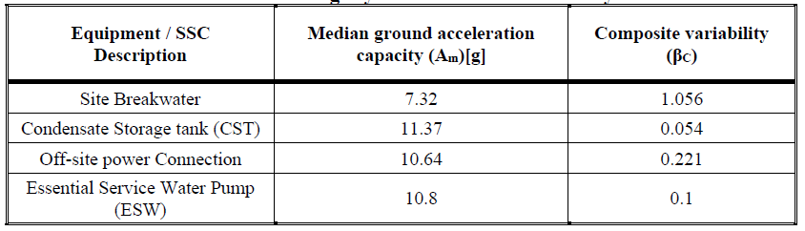
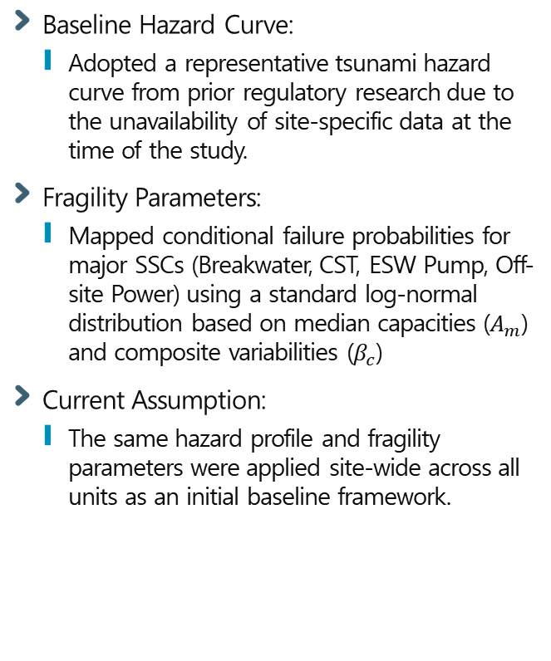
Single-Unit Tsunami PSA Modeling
2
Tsunami Hazard & Fragility Evaluation
Baseline Hazard Curve:
  Adopted a representative tsunami hazard curve from prior regulatory research due to the unavailability of site-specific data at the time of the study.
Fragility Parameters:
  Mapped conditional failure probabilities for major SSCs (Breakwater, CST, ESW Pump, Off-site Power) using a standard log-normal distribution based on median capacities ($A_{m}$) and composite variabilities ($β_{c}$)
Current Assumption:
  The same hazard profile and fragility parameters were applied site-wide across all units as an initial baseline framework.

Slide 8
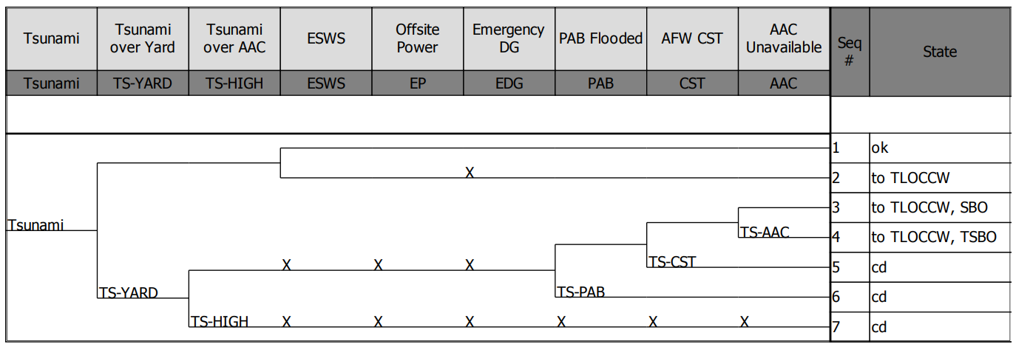
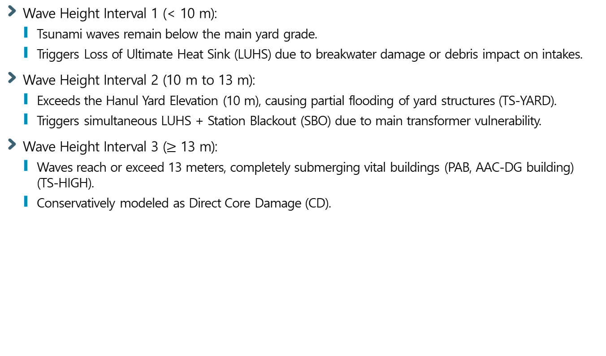
Single-Unit Tsunami PSA Modeling
2
Development of Initiating Events
Wave Height Interval 1 (< 10 m):
  Tsunami waves remain below the main yard grade.
  Triggers Loss of Ultimate Heat Sink (LUHS) due to breakwater damage or debris impact on intakes.
Wave Height Interval 2 (10 m to 13 m):
  Exceeds the Hanul Yard Elevation (10 m), causing partial flooding of yard structures (TS-YARD).
  Triggers simultaneous LUHS + Station Blackout (SBO) due to main transformer vulnerability.
Wave Height Interval 3 ($≥$ 13 m):
  Waves reach or exceed 13 meters, completely submerging vital buildings (PAB, AAC-DG building) (TS-HIGH).
  Conservatively modeled as Direct Core Damage (CD).

Slide 9
Single-Unit Tsunami PSA Modeling
2
Incorporating Site Walkdown Realities
Walkdown Scope:
  Conducted extensive site walkdowns for Hanul Units 1–6 and Shin-Hanul Units 1–2 to enhance model realism.
Indoor AFST (Hanul Units 1 & 2):
  Confirmed that Auxiliary Feedwater Storage Tanks (AFST) are safely located indoors within robust auxiliary buildings.
  Modeled as immune to direct external tsunami wave impacts (not susceptible to flooding damage).
Submerged Intakes (Shin-Hanul Units 1–4):
  Employs a submerged intake structure without an offshore breakwater, unlike older Hanul units.
  Debris impact from breakwater failure is not applicable; intake-specific fragility parameters were directly mapped to the LUHS frequency.
Post-Fukushima Flood Protection:
  Verified full implementation of seismically qualified watertight doors and modular flood barriers at major building openings.
  Credited for mitigation up to the evaluated inundation conditions.

Slide 10
Multi-Unit Integration
3

Slide 11
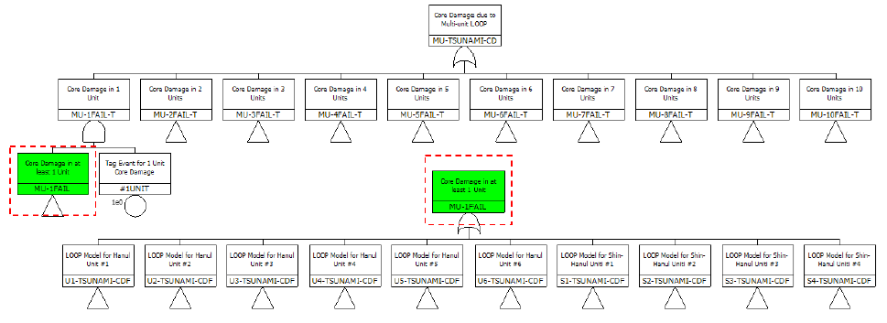
Multi-Unit Integration
3
One-Top Multi-Unit Model Configuration
Unified Site Risk (MU-TSUNAMI-CD):
  An integrated master fault tree capturing all combinatorial accident sequences across 10 co-located units.
Automated Classification (Dummy Events):
  Embedded dummy events (#1UNIT to #10UNIT) into the logic branches with a probability of 1.0.
  Used to seamlessly filter and count the exact number of damaged units within quantified minimal cutsets.

Slide 12
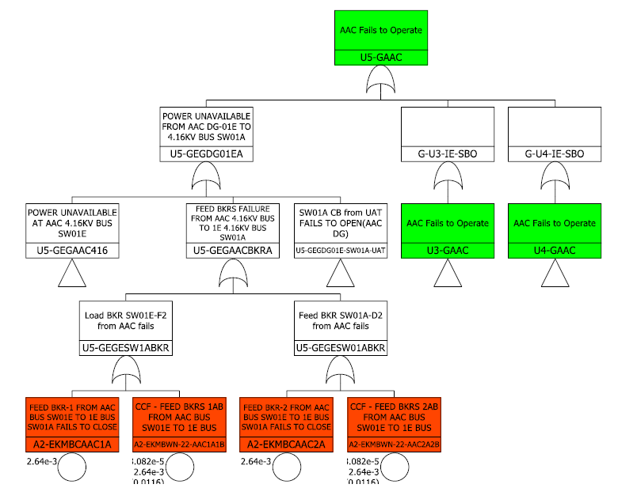

Multi-Unit Integration
3
Shared Systems & Operational Priority Logic
Resource Contention:
  A single shared Alternate AC DG cannot be double-credited to multiple units at the same time during a site-wide SBO.
Operational Priority Logic:
  Applied strict sequential allocation to prevent double-counting of mitigation credits.
  Example: Unit 3 $→$Unit 4 $→$Unit 5 $→$Unit 6 sequence.

Slide 13

Multi-Unit Integration
3
Multi-Unit CCF & Dependencies
Active Components (AFW, AAC DG):
  Screened by $F\text{−}V≥0.005$ from single-unit runs.
  Partitioned CCF groups strictly by reactor types using NUREG/CR-5497 parameters.
Passive Outdoor Structures (TS-DWST):
  Modeled with perfect logical dependency (1.0) due to uniform site-wide tsunami wave loads.

Slide 14
Quantification Results & Insights
4

Slide 15
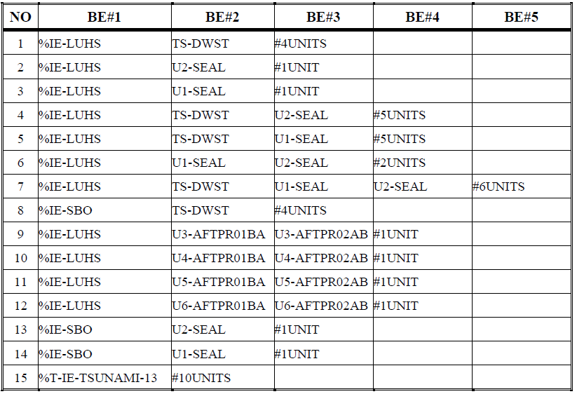
Quantification Results & Insights
4
Dominant Accident Sequences
Top Risk Driver (TS-DWST):
  Tsunami-induced LUHS paired with the simultaneous failure of outdoor water storage tanks (TS-DWST) at 10–13 m wave heights is the most dominant contributor to site risk.
  Leads to concurrent core damage across 4 separate units simultaneously (#4UNITS state).
Secondary Risk Driver (RCP Seals):
  Loss of component cooling water triggers RCP seal degradation.
  Hanul Units 1 & 2 exhibit a higher conditional frequency for seal-related core damage sequences.

Slide 16
Quantification Results & Insights
4
TS-DWST Conservatism
Current Assumption:
  Identical outdoor structures (TS-DWST) are assumed to experience a perfect, simultaneous failure under uniform wave impacts.
  This driving assumption significantly increases multi-unit risk estimates.
Future Refinement:
  In reality, tsunami effects vary across the site due to local topography, plant layout, and structural shielding.
  Need to re-evaluate site-specific hazard curves and limit co-failures to localized boundaries (e.g., twin-unit pairs).
Plant Hardening Strategies
RCP Seal Upgrades:
  Replace existing legacy seals in Hanul Units 1 & 2 with advanced, high-temperature-resistant seal packages.
  Effectively reduces the probability of Seal LOCAs under extreme flooding conditions.
Mobile Equipment Credit:
  Evaluate the practical applicability of mobile mitigation systems (FLEX equipment) as an effective risk reduction measure.

Slide 17
Quantification Results & Insights
4
Conclusions & Future Work
Conclusions
  Methodology Established: Successfully developed a full-scale, site-specific Multi-Unit Tsunami PSA model for the 10-unit Hanul site.
  Realism Enhanced: Incorporated physical site layout, actual yard elevations (10m, 13m), and extensive walkdown results (indoor AFST, submerged intakes).
  Dependency Captured: Explicitly modeled cross-unit shared system constraints using a strict operational priority logic and reactor-type CCF grouping.
Future Work
  Refinement of Conservatism: Perform detailed site-specific hazard and fragility re-evaluations to mitigate excessive conservatism in outdoor structure failures (TS-DWST).
  Mitigation Strategy Credit: Incorporate and quantify the practical risk-reduction effects of mobile mitigation equipment.
  Regulatory Reference: Expect this framework to serve as an important technical reference for establishing future MUPSA regulatory review guidance.

Slide 18

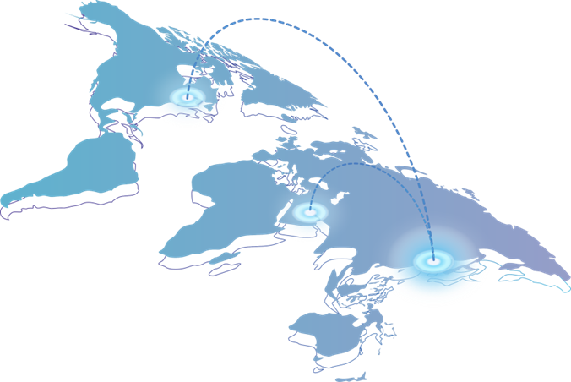

ABOUT
Headquarters
UAE Abu Dhabi Branch
Heungdeok IT Valley Bldg. 32F, 13, Heungdeok 1-ro, Giheung-gu , Yongin-si , Gyeonggi-do, 16954, Korea
+82-31-8065-5114
Office 904, Capital Tower, Al Rawhah,
PO Box 95133, Abu Dhabi, UAE
+971-2-643-5144
USA Maryland Branch
Daejeon Branch
11140 Rockville Pike, Suite 380A,
Rockville, MD 20852, USA
+1-202-577-5537
Daeduk Tech Business Center, 1004-2, 593,
Daeduk-daero, Yusung-gu, Daejeon, 34112, Korea
+82-42-867-5114
Institute of Future Energy Technology
46, Tapsil-ro, Giheung-gu, Yongin-si, Gyeonggi-do, 17084, Korea
+82-31-8005-5618
Facility & Equipment Development Research
46, Tapsil-ro, Giheung-gu, Yongin-si, Gyeonggi-do, 17084, Korea
+82-31-8065-5114

Slide 19
THANK YOU

