Slide 1


Toward Standardizing Probabilistic Risk Assessment Procedures for Combined External Hazards
: A Focus on Screening Procedures
July 21, 2026
Pittsburgh, Pennsylvania, USA
Byunghyun Choi*¹, Tatsuya Itoi*¹, Akemi Nishida*¹ and Tsuyoshi Takada*²
*¹Japan Atomic Energy Agency (JAEA)
*²Formerly JAEA and the University of Tokyo
This study was performed under a contract research entrusted by the Secretariat of Nuclear Regulation Authority of Japan.

Slide 2
Contents
Background and Objectives
Conceptual Framework for Combined Hazard PRA
Standardized Procedures for Combined Hazard PRA
Screening Procedures for Combined Hazard PRA
Conclusions

Slide 3
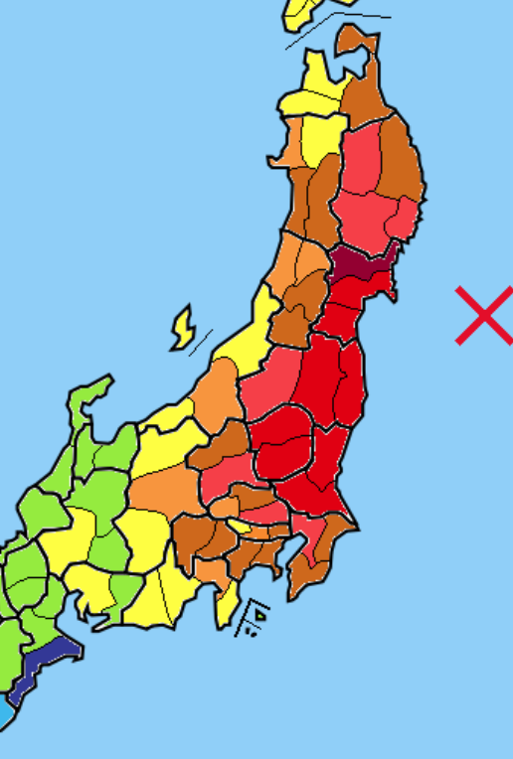
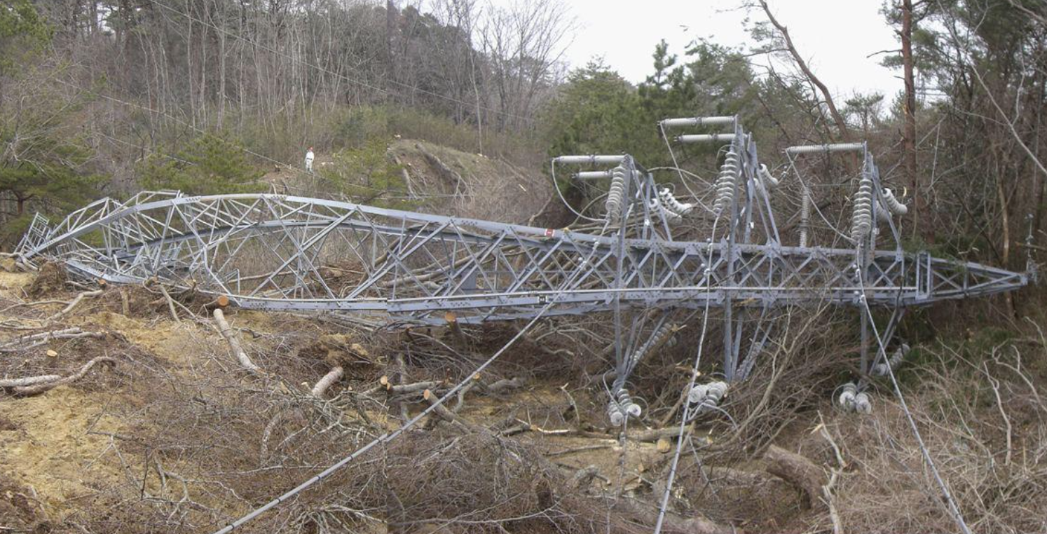
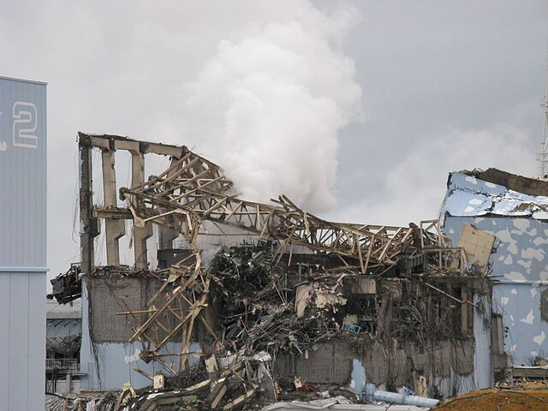
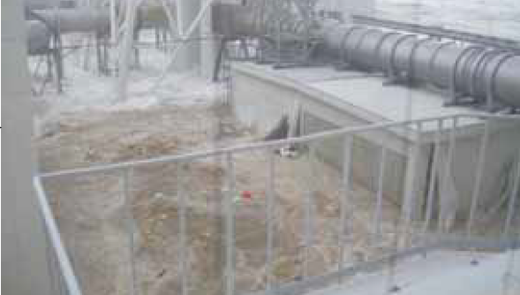
Background
  The Fukushima Daiichi Nuclear Power Plant accident in 2011 highlighted the vulnerability of nuclear facilities to combined earthquake and tsunami hazards.
  Although various methodologies for combined hazard assessment have been developed [1,2], standardized procedures for implementing combined hazard PRA have not yet been established.
  The large number of possible hazard combinations requires a systematic screening framework.
Epicenter(M9.0)
Earthquake Damage
Fukushima NPP site
2011 Tohoku Earthquake (JMA)
Tsunami-Induced Flooding
Hydrogen explosion at Fukushima NPP
[1] ASAMPSA_E (2017): List of external hazards to be considered in ASAMPSA_E.
[2] IAEA (2026): Safety Assessment of Nuclear Installations Against Combinations of Hazards Induced by External Events, TECDOC-2129, Vienna, Austria.

Slide 4
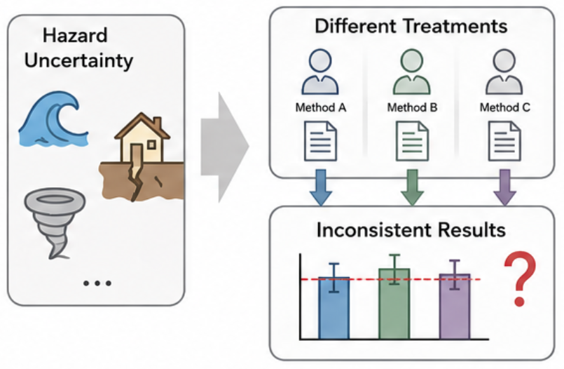
Objectives
  Challenges
  Large number of possible hazard combinations.
  Complex hazard dependencies, temporal relationships, and interactions among hazards, fragilities and plant systems.
  Lack of standardized procedures for implementing combined hazard PRA.
Objectives
  Develop a systematic screening framework and a preliminary screening matrix.
  Establish a conceptual framework for combined hazard PRA.
  Propose standardized procedures for combined hazard PRA.

Slide 5
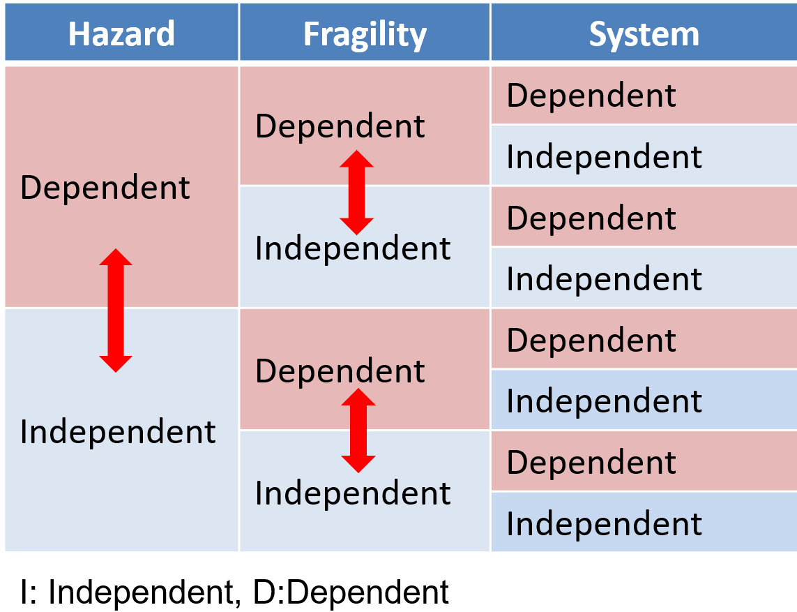
Conceptual Framework for Combined Hazard PRA
Challenges in Combined Hazard PRA
  Existing studies mainly classify combined hazards based on hazard dependency (consequential, associated and independent hazards) and temporal relationships [1, 2].
  However, hazard classification alone is not sufficient for PRA because interactions may also occur at the fragility and system levels.
Proposed Concept
  Extend the framework to include hazard, fragility, and system dependencies.
Classification of combined hazard PRA
Example of combined hazard PRA
Phase |  | Example
Hazard | Dependent (consequential) | EQ (shaking) → Tsunami (pressure), Mainshock (shaking) → Aftershocks (shaking)
 | Dependent (associated) | (EQ) Tsunami + Liquefaction, (Typhoon) Heavy rainfall + strong wind
 | Independent | EQ (shaking) + Tornado (pressure)
Fragility | Dependent | Accumulated damage due to mainshock and aftershocks
 | Independent | Damage due to EQ and Tsunami
System | Dependent | Reduced availability of operators due to EQ
 | Independent | No shared support systems
[1] ASAMPSA_E (2017): List of external hazards to be considered in ASAMPSA_E.
[2] IAEA (2026): Safety Assessment of Nuclear Installations Against Combinations of Hazards Induced by External Events, TECDOC-2129, Vienna, Austria.
・Consequential hazards: One hazard triggers another
・Associated hazards: Hazards originate from a common source
・Independent hazards: No causal or common-source relationship

Slide 6
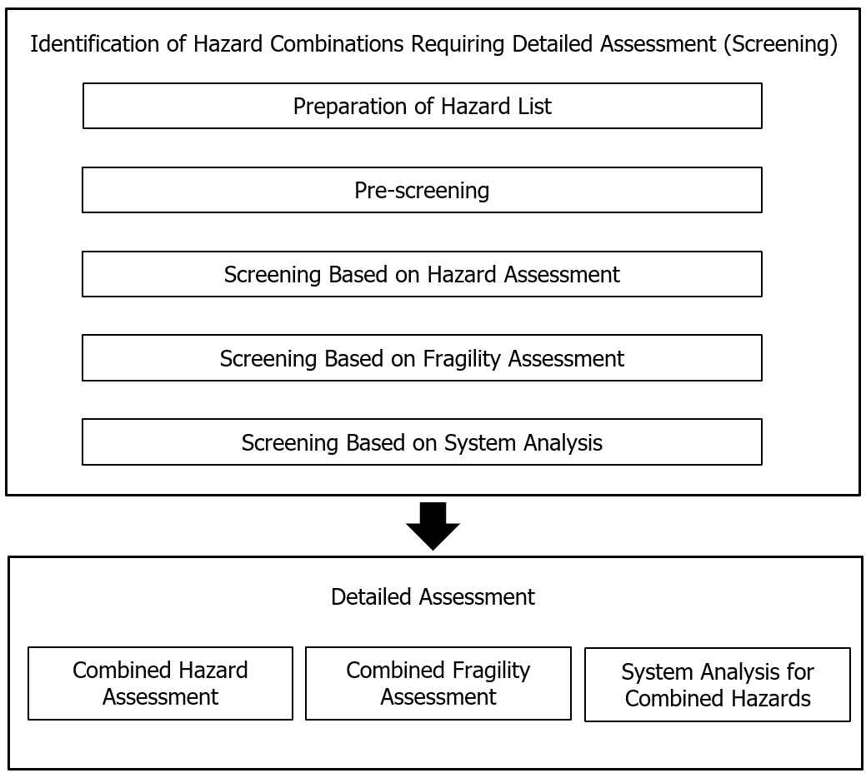
Conceptual Framework for Combined Hazard PRA
Screening Process for Combined Hazard PRA
The proposed assessment flow starts with hazard identification, followed by a four-stage screening process.
After screening, the remaining combinations are evaluated through hazard assessment, fragility assessment, and system analysis.
This stepwise approach improves assessment efficiency while maintaining sufficient completeness.
Assessment flow for combined hazard PRA

Slide 7
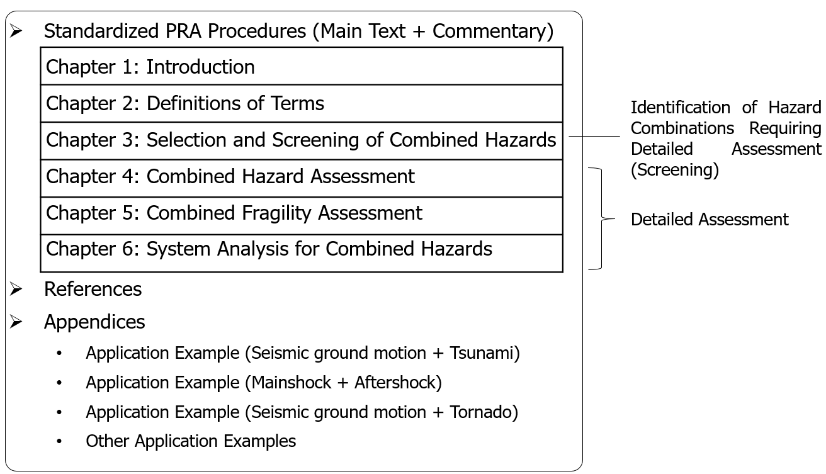
Standardized Procedures for Combined Hazard PRA
Purpose
Provide a consistent and systematic framework for implementing combined hazard PRA.
Proposed structure of standardized procedures for combined hazard PRA

Slide 8
Screening Procedures for Combined Hazard PRA
Why Screening?
Large number of possible hazard combinations.
Detailed PRA for all combinations is impractical.
Pre-screening
Screening Principles
Completeness
  Ensure all risk-significant combinations are retained
Practical Feasibility
  Reduce unnecessary assessment effort
Four Screening Stages
Prescreening
  Engineering judgment, operational experience
Hazard Screening
  Hazard intensity, frequency, and temporal relationship
Fragility Screening
  SSC behavior, residual damage, damage interaction
System Screening
  Plant response, accident management, Human intervention
Hazard screening
Fragility screening
System screening
Four Screening Stages
Through these four stages, hazard combinations can be systematically reduced while maintaining sufficient completeness.

Slide 9
Screening Criteria
The objective of screening is to retain risk-significant combinations while screening out insignificant ones.
Screening Criteria [1,3]
Screening method | Example
Mutually exclusive | High temperature + Snow
Hazard Inclusion | Aircraft accident + Fog (already included)
Enveloping | No additional impact
Progression rate | Sufficient mitigation time
Hazard frequency | < 10⁻⁵/year [3]
CDF / LERF | CDF < 10⁻⁶/year or LERF <10⁻⁷/year [3]
These screening criteria provide practical guidance for systematically reducing the number of hazard combinations before detailed combined hazard PRA.
[1] ASAMPSA_E (2017): List of external hazards to be considered in ASAMPSA_E.
[3] EPRI (2015): Identification of External Hazards for Analysis in Probabilistic Risk Assessment.

Slide 10
Hazard Grouping
Direct evaluation of all possible hazard combinations is impractical.
Hazard groups after prescreening
101 Candidate External Hazards [1]
77 Natural hazards
24 Human-induced hazards
Preliminary Screening
Applicability to Japanese NPP sites
Potential impact on plant safety
Relevance to combined hazard assessment
25 Individual Hazards
17 Natural hazards
8 Human-induced hazards
Hazard Grouping
Based on hazard source and characteristics
16 Hazard Groups
12 Natural hazard groups
4 Human-induced hazard groups
Benefits
  Reduces the number of combinations
  Improves practical feasibility
  Maintains sufficient completeness
[1] ASAMPSA_E (2017): List of external hazards to be considered in ASAMPSA_E.

Slide 11
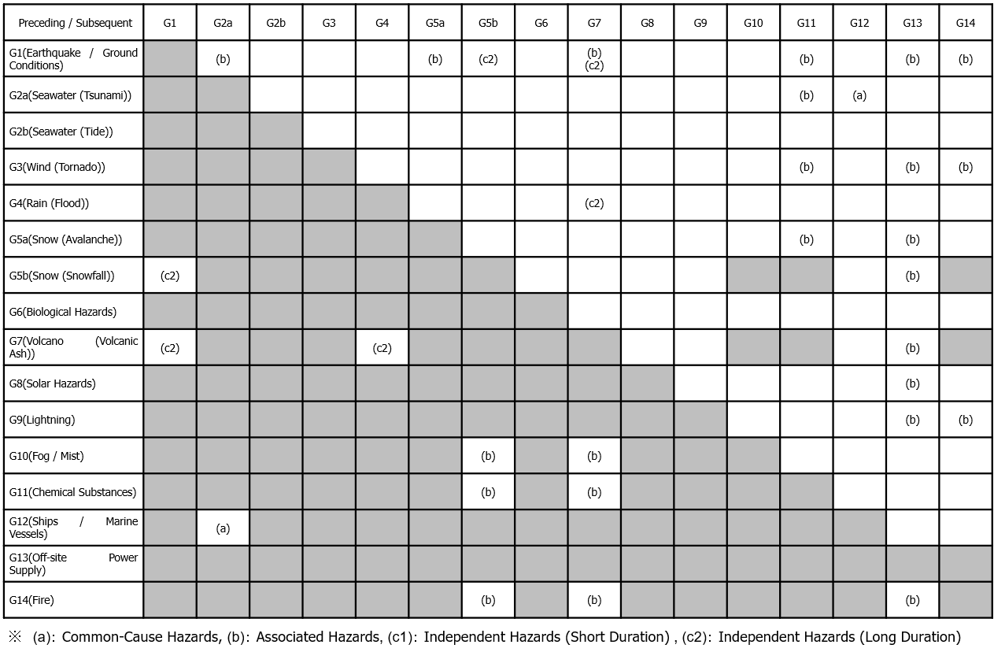
Preliminary Screening Matrix
Preliminary Screening Matrix for Combined Hazards
The rows and columns represent the 16 hazard groups identified through hazard grouping.
Each cell represents a potential combination of two hazard groups.
Hazard combinations are classified as associated, consequential, or independent based on their dependency characteristics.
This matrix is a conceptual framework rather than a site-specific evaluation.
Preliminary screening matrix for Japanese nuclear power plant sites
Example of Prescreening for G1 (Earthquake / Ground)
Combination with G1 (Earthquake / Ground) | Prescreening Decision
G2a Seawater (Tsunami) | 🔴Candidate for detailed evaluation (Screened in)
G7 Volcanic | 🟡Site-specific evaluation required
G14 Fire | 🟡Requires further evaluation
G3 Wind (Tornado) | 🟢Candidate for screening out
・・・ | ・・・
※ (a) Associated hazards, (b): Consequential hazards, (c1) Independent hazards (Short duration), (c2) Independent hazards (Long duration)

Slide 12
Conclusions
In summary, this study established a conceptual framework, proposed standardized PRA procedures, and developed a screening framework and preliminary screening matrix for combined hazards. These results provide a foundation for future standardization and practical implementation of combined hazard PRA.
A conceptual framework for combined hazard PRA was established by considering hazard, fragility, and system dependencies.
A standardized structure for implementing combined hazard PRA was proposed.
A multi-phase screening framework consisting of prescreening, hazard screening, fragility screening, and system screening was organized.
A preliminary screening matrix applicable to Japanese nuclear power plants was developed.
Future Work
Development of detailed screening criteria.
Standardization of hazard, fragility, and system screening procedures.
Application to practical combined hazard PRA studies
Extension of the framework toward Level 3 PRA, including off-site consequence and public health impacts.

Slide 13
References
[1] Kurt Decker, Hans Brinkman. List of external hazards to be considered in ASAMPSA_E, Technical report ASAMPSA_E, (2017).
[2] IAEA, Safety Assessment of Nuclear Installations Against Combinations of Hazards Induced by External Events, TECDOC-2129, Vienna, Austria, (2026).
[3] EPRI, Identification of External Hazards for Analysis in Probabilistic Risk Assessment. (2015).
[4] Byunghyun Choi, Akemi Nishida, Hideaki Tsutsumi, Tsuyoshi Takada. “Development of a probabilistic risk assessment method for combined hazards: A classification and modeling framework for multihazard events”, In Proceedings of the International Conference on Probabilistic Safety Assessment and Management & Asian Symposium on risk Assessment and Management (PSAM 17& ASRAM2024), Miyagi, Japan, (2024).
[5] Strack, C., et al., “Hazard Screening Tool”, Gesellschaft fur Anlagen-und Reaktorsicherheit (GRS) gGmbH, Koeln, (2020).
[6] Eujeong Choi, Jeong-gon Ha, Daegi Hahm, Minkyu Kim. “A Review of Multihazard Risk Assessment: Progress, Potential, and Challenges in the Application to Nuclear Power Plants”, International Journal of Disaster Risk Reduction, Volume 53, (2021).
[7] de Ruiter et al.: Why we can no longer ignore consecutive disasters, Earth’s future 8, (2020).
[8] Tamas Siklossy et al. : Assessing the impact of combined external events on the safety of npp paks, PSAM16, 2022.
[9] Attila BAREITH et. al., Combinations of External Hazards – A Survey on Hazard and Impact Assessment and Probabilistic Safety Analysis (PSA) for Nuclear Installations, (2021).
[10] Alois Tilloy, Bruce D. Malamud, Hugo Winter, Amelie Joly-Laugel, A review of quantification methodologies for multi-hazard interrelationships, Earth-Science Reviews, Volume 196, September 2019, 102881, (2019).
[11] Baoyin Liu, Yim Ling Siu, and Gordon Mitchell, Hazard interaction analysis for multi-hazard risk assessment: a systematic classification based on hazard-forming environment, Nat. Hazards Earth Syst. Sci., (2016).
[12] R. Ba, Q. Deng, Y. Liu, R. Yang, H. Zhang, “Multi-hazard disaster scenario method and emergency management for urban resilience by integrating experiment-simulation-field data”, J. of Safety Science and Resilience, (2021).
[13] M. A. Jaimes, E. Reinoso and L. Esteva, Risk Analysis for Structures Exposed to Several Multi-Hazard Source, J. of Earthquake Engineering, 19, (2015).
[14] Atomic Energy Society of Japan, “Fundamental Concepts of Nuclear Safety for External Events, Technical Report of the Standards Committee”, AESJ-SC-TR018:2021, (2022), (Japanese)
[15] Atomic Energy Society of Japan, “A Standard for Selection Procedures of Risk Assessment Methods for External Hazards: 2024”, AESJ-SC-RK008:2024, (2025), (Japanese)
[16] Egemen M. Aras, Mihai A. Diaconeasa, A Critical Look at the Need for Performing Multi-Hazard Probabilistic Risk Assessment for Nuclear Power Plants, Eng, 2(4), 454-467, (2021).

Slide 14
Thank you
ACKNOWLEDGMENTS
This study was performed under the contract research entrusted by the Secretariat of the Nuclear Regulation Authority of Japan. We would like to express our sincere gratitude to all the people concerned for their cooperation.

