Slide 1
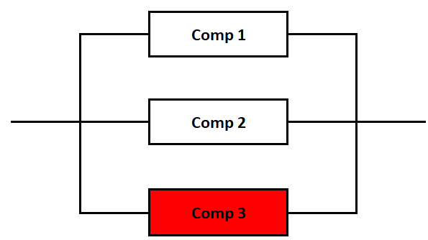
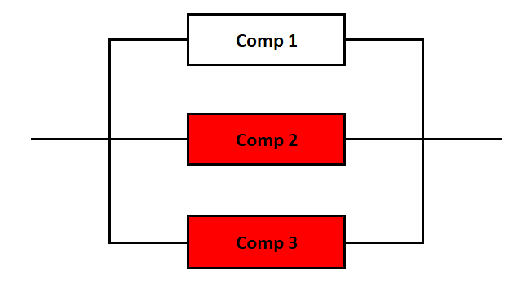
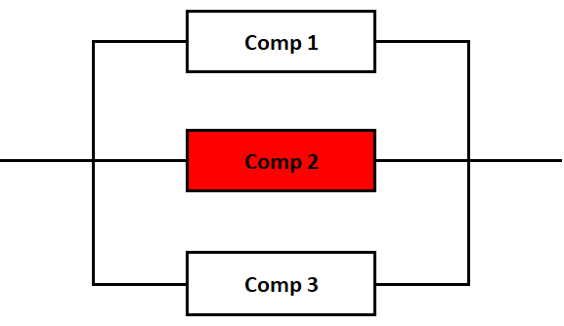
Modeling of Radiation Effects on Spacecraft Hardware
Bruce Reistle NASA JSC
Teri Hamlin NASA JSC
System OK
System OK
System OK
July 23, 2026

Slide 2
Introduction
In a space environment, electronic components are subject to radiation induced upsets
Unavailable until it recovers
Upset time is generally brief
Could experience multiple upsets (and recoveries) during a mission
System failure occurs when multiple components are unavailable at the same time
Mission time could be long (years)
Standard fault trees are not designed for this type of model
Simplest Case
State Space Diagram
2λ_{Upset}
λ_{Upset}
2 Available
1 Available
0 Available
λ_{Recover}
This would be easy to simulate in Excel or possibly using a Markov Model.

Slide 3
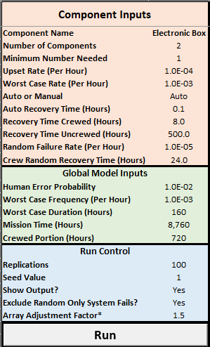
Complications
System complications:
System size of two or more items
  Mostly two or three
Radiation upsets and random failures
  Random failures are likely not recoverable
Auto reset or manual reset
  Reset from ground or on board if crewed
  Human error possible on ground-based manual resets
Radiation complications:
Regular radiation environment and solar particle events
  Higher upset rates during solar particle events (“worst case”)
Model complications:
Vehicle crewed part of the time
Crew can manually do resets
Crew might be able to fix random failures
Human error
Note: All values in this presentation are for demonstration purposes and are not actual data.

Slide 4
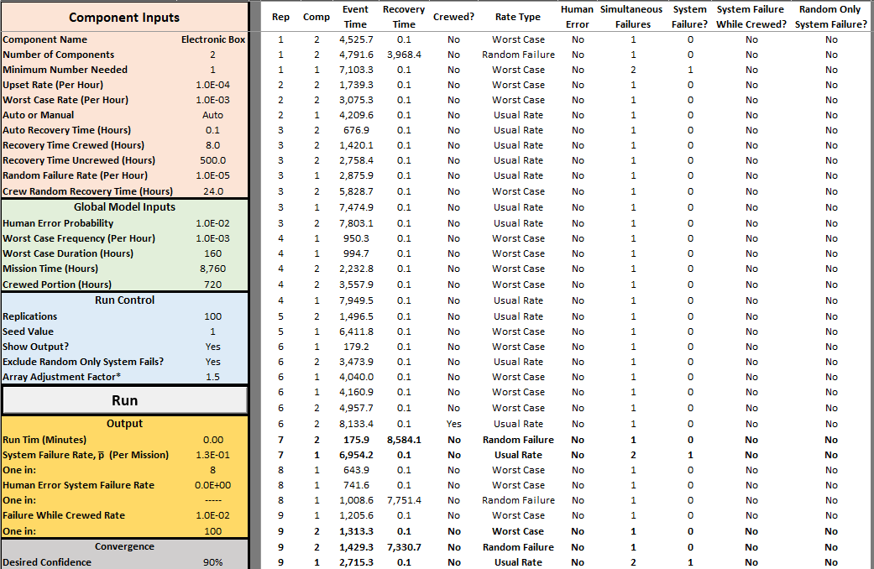
The Model
Excel front shows inputs and outputs.
The simulation is done in Visual Basic using the Excel random number generator (Mersenne Twister since 2010).
Turn off output to save run time, run 1,000,000 reps.

Slide 5




Methodology
Suppose there are two components and the system needs at least one component to function at all times.
Step
One Model Replication
Notes
Start with the base timeline:
Same for every replication
Simulate solar particle event arrival intervals (the upset rate is higher in these intervals):
Exponentially distributed time between SPE arrivals
Simulate upset and random failure times:
Comp 2 Fail
Comp 1 Fail
Comp 1 Fail
Comp 2 Fail
Exponentially distributed time between upsets and random failures
Use the recovery time to determine the downtime intervals:
No system failures since failures did not overlap
This is what needs to be done for each of the 1,000,000 or so replications.
Exponential failure times use this: FailTime = -Log(U) / GapRate(Gap)

Slide 6
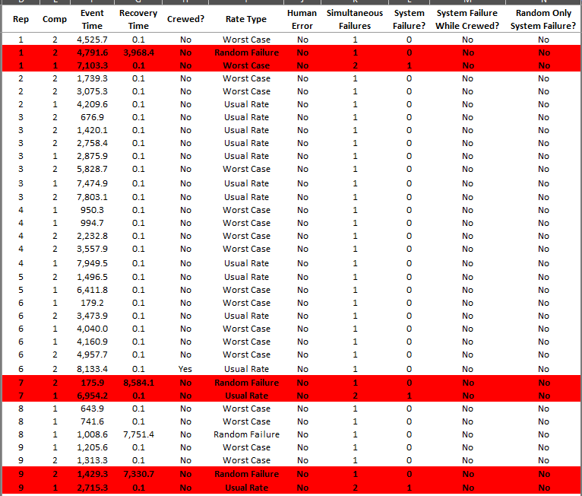
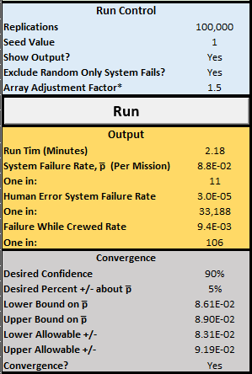
Output
Note: “Worst Case” indicates the solar particle environment.
Output in the table is shown for 9 replications
Zero-failure replications are not shown
The replication ends if there is a system failure
Random + Upset combinations are most likely

Slide 7
Pros and Cons
Pros
Good for non-standard models with several complications
Shows intermediate result (failures and times) not just summary data
Anyone with Excel can run it
It is easy to make changes to the inputs—sensitivity analyses
Cons
“Hard” to build
Hard to change the model structure to add additional features
Key Takeaway
Random failures followed by upsets are the primary risk driver (unless the random failure rate is very low).

