Slide 1
Time to Failure of a Parallel System
(Should You Use T/2 For Cold Standby?)
Bruce Reistle NASA JSC
Colton Brehm NASA JSC
July 19, 2026

Slide 2
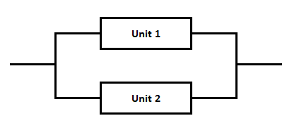

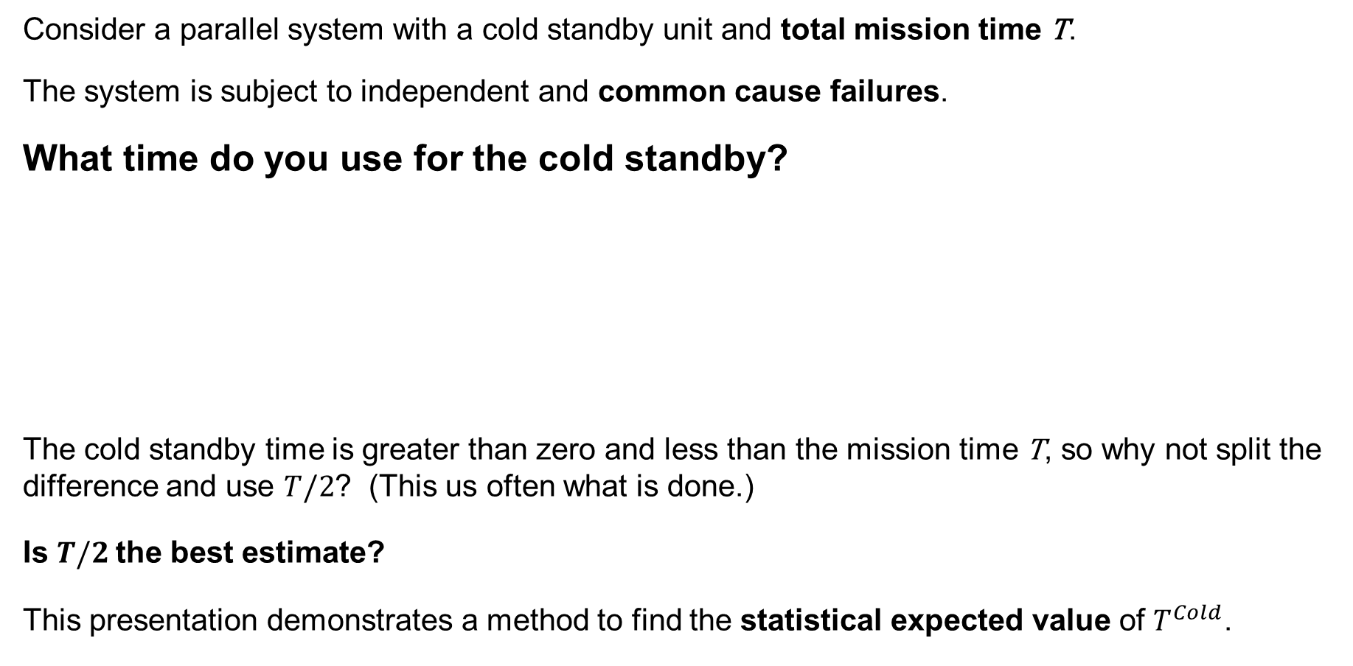
Parallel System with Cold Standby
Consider a parallel system with a cold standby unit and total mission time T.
The system is subject to independent and common cause failures.
What time do you use for the cold standby?
The cold standby time is greater than zero and less than the mission time T, so why not split the difference and use $T/2$? (This us often what is done.)
Is $T/2$the best estimate?
This presentation demonstrates a method to find the statistical expected value of $T^{Cold}$.

Slide 3
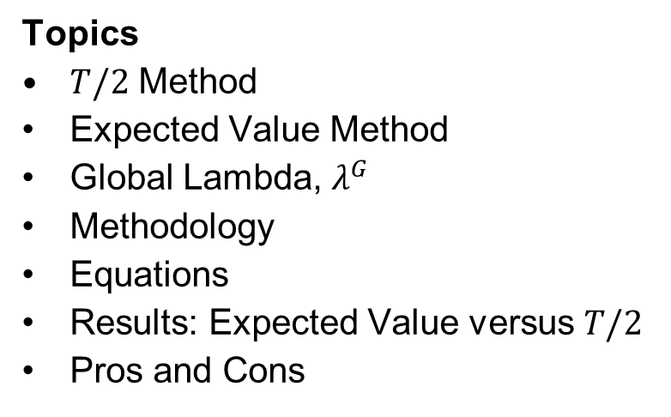
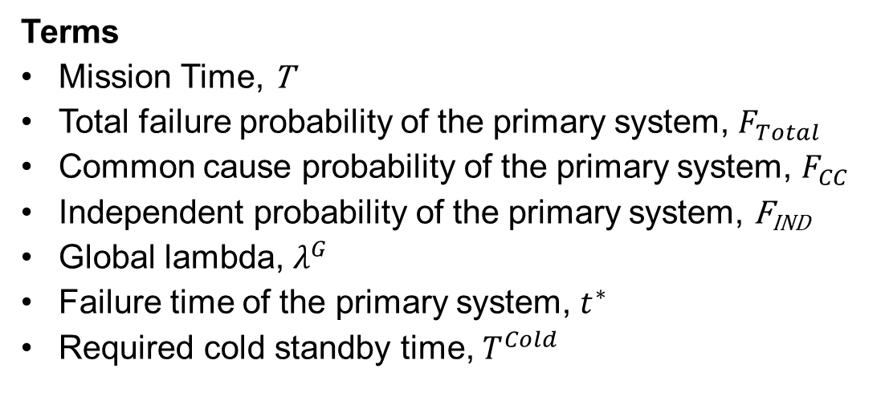
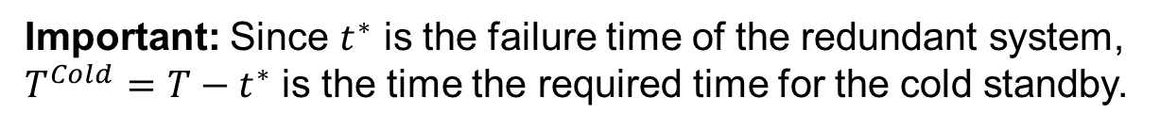
Overview
Topics
$T/2$ Method
Expected Value Method
Global Lambda, $λ^{G}$
Methodology
Equations
Results: Expected Value versus $T/2$
Pros and Cons
Important: Since $t^{∗}$ is the failure time of the redundant system, $T^{Cold}=T−t^{∗}$ is the time the required time for the cold standby.
A parallel system of size two will be used for demonstration purposes but results will be presented for systems of sizes one through four.
Terms
Mission Time, T
Total failure probability of the primary system, $F_{Total}$
Common cause probability of the primary system, $F_{CC}$
Independent probability of the primary system, F_{IND}
Global lambda, $λ^{G}$
Failure time of the primary system, $t^{∗}$
Required cold standby time, $T^{Cold}$

Slide 4

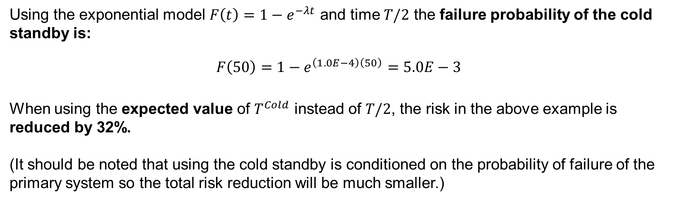
The T/2 Method
T/2 Example
Suppose the failure rate of the cold standby is $λ=1.0E−4$ and the mission time $\text{T}\text{=100}$.
$$T^{Cold}=T/2=50$$
(easy)
Using the exponential model $F\left(t\right)=1−e^{−λt}$ and time $T/2$ the failure probability of the cold standby is:
$$F\left(50\right)=1−e^{\left(1.0E−4\right)\left(50\right)}=5.0E−3$$
When using the expected value of $T^{Cold}$ instead of $T/2$, the risk in the above example is reduced by 32%.
(It should be noted that using the cold standby is conditioned on the probability of failure of the primary system so the total risk reduction will be much smaller.)

Slide 5
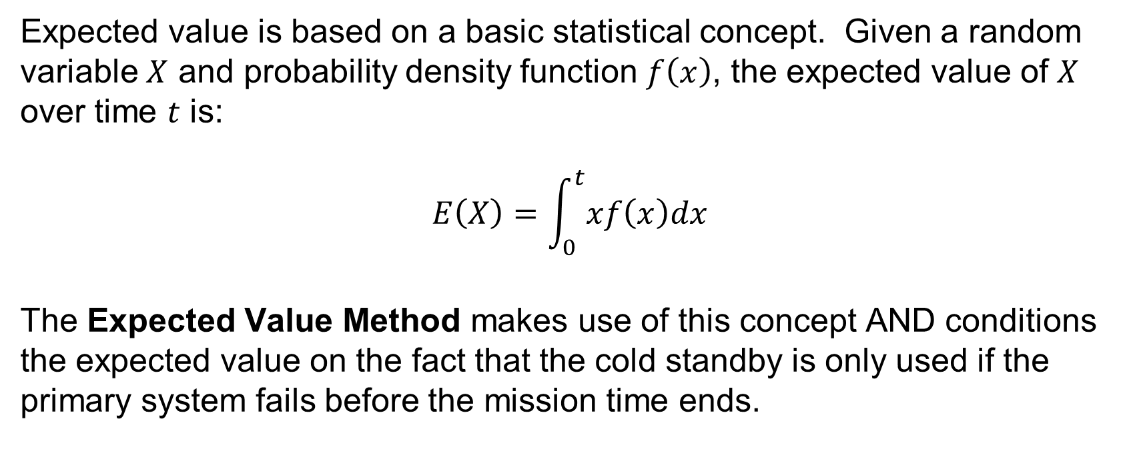
The Expected Value Method
Expected value is based on a basic statistical concept. Given a random variable $X$ and probability density function $f\left(x\right)$, the expected value of $X$ over time $t$ is:
$$E\left(X\right)=\int_{0}^{t}{xf\left(x\right)dx}$$
The Expected Value Method makes use of this concept AND conditions the expected value on the fact that the cold standby is only used if the primary system fails before the mission time ends.

Slide 6
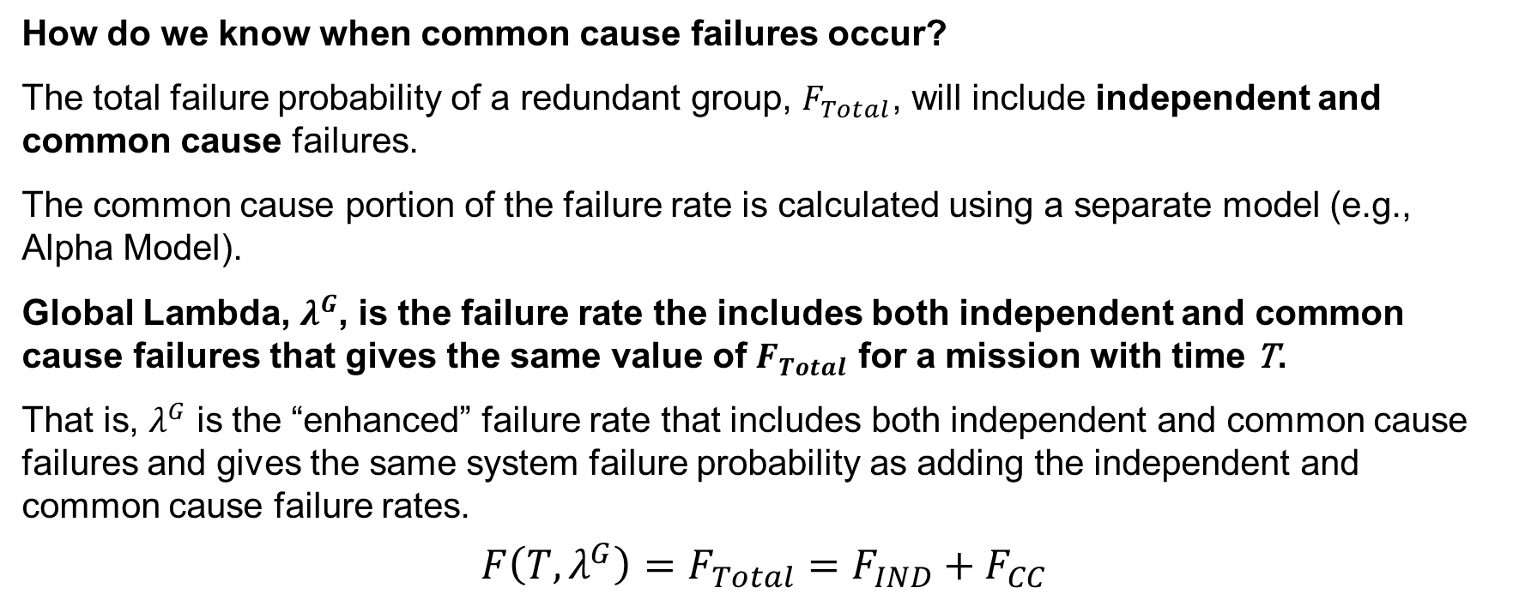
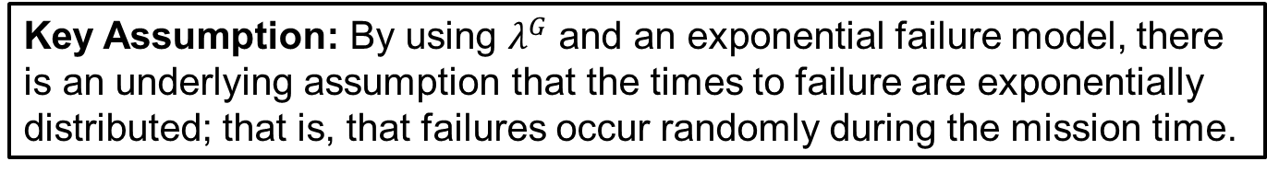
Global Lambda*, λ^{G} and Common Cause
How do we know when common cause failures occur?
The total failure probability of a redundant group, $F_{Total}$, will include independent and common cause failures.
The common cause portion of the failure rate is calculated using a separate model (e.g., Alpha Model).
Global Lambda, $λ^{G}$, is the failure rate the includes both independent and common cause failures that gives the same value of $F_{Total}$ for a mission with time T.
That is, $λ^{G}$ is the “enhanced” failure rate that includes both independent and common cause failures and gives the same system failure probability as adding the independent and common cause failure rates.
$$F\left({T,λ}^{G}\right)=F_{Total}=F_{IND}+F_{CC}$$
Key Assumption: By using $λ^{G}$ and an exponential failure model, there is an underlying assumption that the times to failure are exponentially distributed; that is, that failures occur randomly during the mission time.
*Disclaimer: “Global Lambda” is a term coined for the purposes of writing this paper.

Slide 7
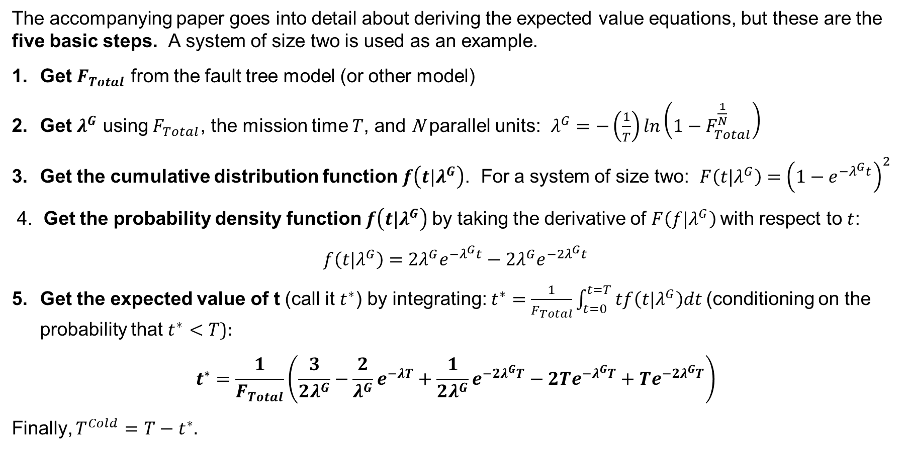
Methodology
The accompanying paper goes into detail about deriving the expected value equations, but these are the five basic steps. A system of size two is used as an example.
Get $F_{Total}$ from the fault tree model (or other model)
Get $λ^{G}$ using $F_{Total}$, the mission time $T$, and N parallel units: $λ^{G}=−\left(\frac{1}{T}\right)ln\left(1−F_{Total}^{\frac{1}{N}}\right)$
Get the cumulative distribution function $f\left(t|λ^{G}\right)$. For a system of size two: $F\left(t|λ^{G}\right)={\left(1−e^{−λ^{G}t}\right)}^{2}$
4. Get the probability density function $f\left(t|λ^{G}\right)$ by taking the derivative of $F\left(f|λ^{G}\right)$ with respect to $t$:
$$f\left(t|λ^{G}\right)=2λ^{G}e^{−λ^{G}t}−2λ^{G}e^{−{2λ}^{G}t}$$
Get the expected value of t (call it $t^{∗}$) by integrating: $t^{∗}=\frac{1}{F_{Total}}\int_{t=0}^{t=T}{tf\left(t|λ^{G}\right)dt}$ (conditioning on the probability that $t^{∗}<T$):
$$t^{∗}=\frac{1}{F_{Total}}\left(\frac{3}{2λ^{G}}−\frac{2}{λ^{G}}e^{−λT}+\frac{1}{2λ^{G}}e^{−2λ^{G}T}−2Te^{−λ^{G}T}+Te^{−2λ^{G}T}\right)$$
Finally, $T^{Cold}=T−t^{∗}$.

Slide 8

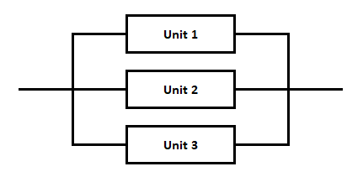
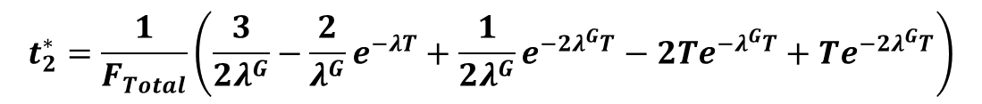
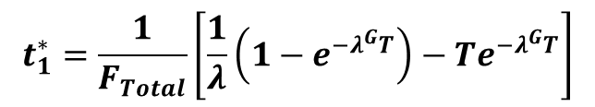
Equations
Below are the equations for the system failure time, $t^{∗}$, for systems sizes one through four.
Recall the required cold standby time $T_{Cold}=T−t^{∗}$, where $T$ is the mission time.
$$t_{1}^{∗}=\frac{1}{F_{Total}}\left[\frac{1}{λ}\left(1−e^{−λ^{G}T}\right)−Te^{−λ^{G}T}\right]$$
$$t_{2}^{∗}=\frac{1}{F_{Total}}\left(\frac{3}{2λ^{G}}−\frac{2}{λ^{G}}e^{−λT}+\frac{1}{2λ^{G}}e^{−2λ^{G}T}−2Te^{−λ^{G}T}+Te^{−2λ^{G}T}\right)$$
$$t_{3}^{∗}=\frac{1}{F_{Total}}\left(−3Te^{−λ^{G}T}−\frac{3}{λ^{G}}e^{−λ^{G}T}+\frac{3}{λ^{G}}+3Te^{−2λ^{G}T}+\frac{3}{2λ^{G}}e^{−{2λ}^{G}T}−\frac{3}{2λ^{G}}−Te^{−3λ^{G}T}−\frac{1}{3λ^{G}}e^{−3λ^{G}T}+\frac{1}{3λ^{G}}\right)$$
$$t_{4}^{∗}=\frac{−T\left[{1−\left(1−e^{−λ^{G}T}\right)}^{4}\right]+\frac{1}{λ^{G}}\left[\left(1−e^{−λ^{G}T}\right)+\frac{1}{2}{\left(1−e^{−λ^{G}T}\right)}^{2}+\frac{1}{3}{\left(1−e^{−λ^{G}T}\right)}^{3}+\frac{1}{4}{\left(1−e^{−λ^{G}T}\right)}^{4}\right]}{F_{Total}}$$

Slide 9
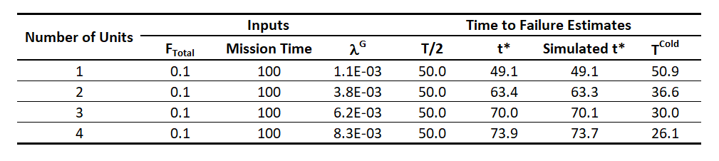
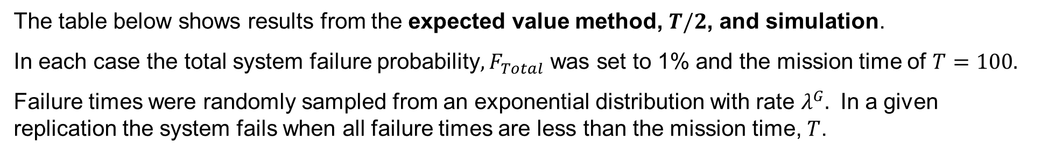
Results
The table below shows results from the expected value method, $T/2$, and simulation.
In each case the total system failure probability, $F_{Total}$ was set to 1% and the mission time of $T=100$.
Failure times were randomly sampled from an exponential distribution with rate $λ^{G}$. In a given replication the system fails when all failure times are less than the mission time, $T$.

Slide 10
Results—Continued
The following plot shows how the values of $T^{Cold}$ change with $λ^{G}$ in a system of size two.
Notice that T/2 overpredicts the cold standby time except when the failure rate is high.
This additional time will result in a higher risk estimate.

Slide 11
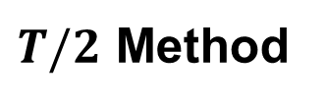
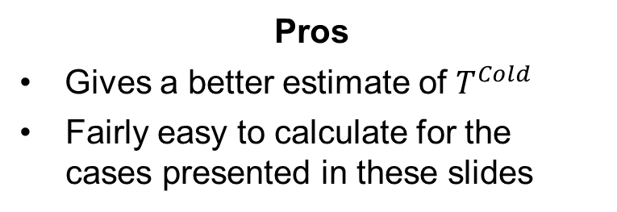
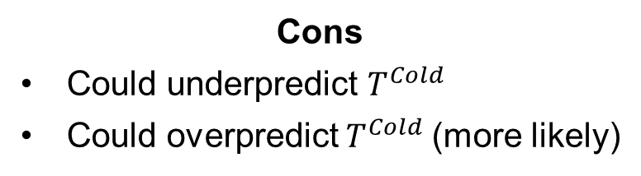
Pros and Cons
$T/2$ Method
Pros
Intuitive
Has the appearance of being objective
Easy to calculate
Works with all group sizes
Cons
Could underpredict $T^{Cold}$
Could overpredict $T^{Cold}$ (more likely)
Expected Time Method
Pros
Gives a better estimate of $T^{Cold}$
Fairly easy to calculate for the cases presented in these slides
Cons
Equations are somewhat complicated
Only derived for the cases shown here
Math gets complicated for larger systems
Conclusion: If you encounter a scenario where you can use the expected time method, then you might produce a more accurate, less conservative risk estimate.

