Slide 1



Developing Eye Movement-based Situation Awareness Measurement in Multi-Module Operation
PSAM 18 | July 19–24, 2026, Pittsburgh, Pennsylvania
Tae Ryoun Kim, Jonghyun Kim*
Ph.D Candidate, Department of Nuclear and Quantum Engineering
Korea Advanced Institute of Science and Technology (KAIST), Republic of Korea
Nuclear I&C and Autonomous Operation Lab

Slide 2
Contents
Introduction
Quantification of Multi-Module Gaze Metric
Experiment Design
Results and Discussion
Conclusion

Slide 3
1. Introduction
1.1 Background
What is Situation Awareness (SA) ?
The degree to which the operator's perception and understanding of the current process state corresponds to the plant's actual condition, supporting projection of future states for plant control [1,3].
Failures in maintaining accurate SA may propagate to human errors safety-critical operation [1,4].
Achieved through three levels of cognitive process [2].
  Level 1 Perception: detect parameter deviations
  Level 2 Comprehension: integrate symptoms into plant condition
  Level 3 Projection: anticipate process trends
Table. Summary of Survey Questionnaires in Assessing SA
Method | Category | Survey Timing | Definition | SA Properties of Interest
SAGAT (SA Global Assessment Technique) | Objective | During Scenario ("Freeze-probes") | Query of system state and parametric trends at freeze-probe moment | Level 1: Perception Level 2: Comprehension Level 3: Projection
SACRI (SA Control Room Inventory)
SART (SA Rating Technique) | Subjective | Post-scenario | Self-rating of subjective level of demand, supply, and understanding of scenario | Demand Supply Understanding
Notes:
Situation awareness is the degree to which the operator's perception and understanding of the current process state corresponds to the plant's actual condition, supporting the projection of future states. It is achieved through three levels: Level 1 perception, to detect parameter deviations; Level 2 comprehension, to integrate symptoms into the plant condition; and Level 3 projection, to anticipate process trends. Since failures in maintaining accurate situation awareness may propagate to human errors, it is conventionally assessed through survey questionnaires, such as the objective SAGAT and SACRI, or the subjective SART.

Slide 4
1. Introduction
1.1 Background
Human Performance Issues in Multi-Module SMR Operation
New safety features and design characteristics of SMRs introduced new challenges in maintaining degree of situation awareness.
Thus, verifying that operators maintain adequate SA under these novel concepts is required for multi-module validation [3,5]
Table. SMR Concepts of Operation, Design Features, and Corresponding SA Issues
Concept of Operation | SMR Design | Potential Human Performance Issues
Agents' roles & responsibilities | Multi-unit operation | SA loss of unattended modules — attention neglect and change blindness
Staffing, qualifications & training | Reduced staffing per module | Unverified SA maintenance capability of smaller crews across all assigned units
Management of normal and off-normal operations | Modules in different operating states | Uneven SA demand for each module state (cross-state confusion)
 | High automation of normal and safety operations | Out-of-the-loop: degraded SA of multiple highly automated system states
 | Passive safety systems | Weak awareness of their status and active–passive interactions
Notes:
This becomes more challenging in small modular reactors, whose new safety features and design characteristics introduce new challenges in maintaining situation awareness. Multi-unit operation can cause a loss of situation awareness for unattended modules through attention neglect and change blindness, and reduced staffing leaves the capability of smaller crews unverified. In addition, high automation places the operator out of the loop, while passive safety systems produce a weak awareness of their status. Verifying that operators maintain adequate situation awareness under these novel concepts is therefore required for multi-module validation.

Slide 5
1. Introduction
1.2 Problem Statement
Limitation of Current Measures of SA for Multi-Module Operation
Memory Reliance
  Response depends on Operator's recall on survey-probe within limited working memory [2,6–8]
  In multi-module operation, attention is divided across modules, resulting in inter-module confusion from less per-module memory encoding – thus, undermining accuracy of SA measures [5,14].
  Therefore, a recall-free, continuous measure capturing SA of multiple modules is required.
Previous Studies on Gaze-based SA Quantification
Gaze(eye-movement) is a potential quantification metric of SA, providing continuous and quantitative information of operator’s attention across task performance [10,12,13].
Table. Summary of Gaze features and Relation to SA
Gaze feature | Definition | Unit | Correlation with Direction of SA Changes | Levels of SA
Fixation count | Number of gaze stabilizations landing on the areas of interest (AOIs) during the task | Number of Counts | Increase in count → Poorer SA Intensive, effortful search under task complexity | L1 Acquisition
Dwell time | Cumulative fixation duration within an AOI before the gaze moves to another area | Time (ms) | Longer dwell → Lower-SA tendency greater processing difficulty / extraction demand | L1 and L2
Stationary (Shannon) entropy Hₛ | Spatial spread of the fixation distribution across the AOIs | Bits | Higher Hₛ (broad, undiscriminating spread) → Lower SA / Lower Hₛ (focused allocation) → Higher SA | L1 and L2
Gaze transition entropy (GTE, Hₜ) | Unpredictability of AOI-to-AOI transitions, modelled as a first-order Markov chain | Bits | ↑ Hₜ (disordered scanning) → SA low · ↓ Hₜ (systematic scanning) → SA high | L2 Comprehension
Notes:
However, current measures of situation awareness face a key limitation for multi-module operation: their reliance on memory. The response depends on the operator's recall within limited working memory, and since attention is divided across modules, the resulting inter-module confusion undermines accuracy. A recall-free and continuous measure of the situation awareness of multiple modules is therefore required. Gaze provides such continuous and quantitative information on the operator's attention, through features such as fixation count, dwell time, Shannon entropy, and gaze transition entropy.

Slide 6
1. Introduction
1.2 Problem Statement
Insufficiency of Current Adaptation of Gaze Metrics for Multi-Module SA
Limited Implementation of Single-unit Gaze Situation Model
  Existing metrics borrow their SA interpretation from a single-unit situation task model [10,11].
  Since multi-module supervision demands attention distributed across concurrently evolving modules, the multi-module gaze metric must derive its semantics from a multi-module task structure and recalibrate the gaze-to-SA mapping empirically under multi-module conditions.
Module-blind computation
  Existing metrics aggregate over a single attention space with no representation of module identity, leaving per-module awareness and attention allocation unquantified [5,14]
Notes:
Even so, the current adaptation of these gaze metrics remains insufficient for multi-module situation awareness, for two reasons. First, existing metrics borrow their interpretation from a single-unit task model; but since multi-module supervision demands attention distributed across concurrently evolving modules, the metric must derive its semantics from a multi-module task structure and recalibrate the gaze-to-situation-awareness mapping empirically. Second, existing metrics are module-blind, aggregating over a single attention space with no representation of module identity, leaving per-module awareness unquantified.

Slide 7
1. Introduction
1.3 Objective of This Study
Main Objective
Develop a Eye-Movement (Gaze) based SA quantification measure for objective assessment in multi-module operation
Research Steps
Quantification of Multi-Module Gaze Metric
Experiment Design to Collect Empirical Eye-Movement Data and Situation Awareness Survey Data
Results and Discussion of Verifying the Feasibility of the Proposed Metric
Notes:
This leads to the main objective of this study: to develop an eye-movement, or gaze-based, situation awareness quantification measure for objective assessment in multi-module operation. The study proceeds in three steps: quantification of the multi-module gaze metric; an experiment design to collect empirical eye-movement and situation awareness survey data; and results that verify the feasibility of the proposed metric. I will now follow these three steps in order.

Slide 8
2. Quantification of Multi-Module Gaze Metric

Slide 9
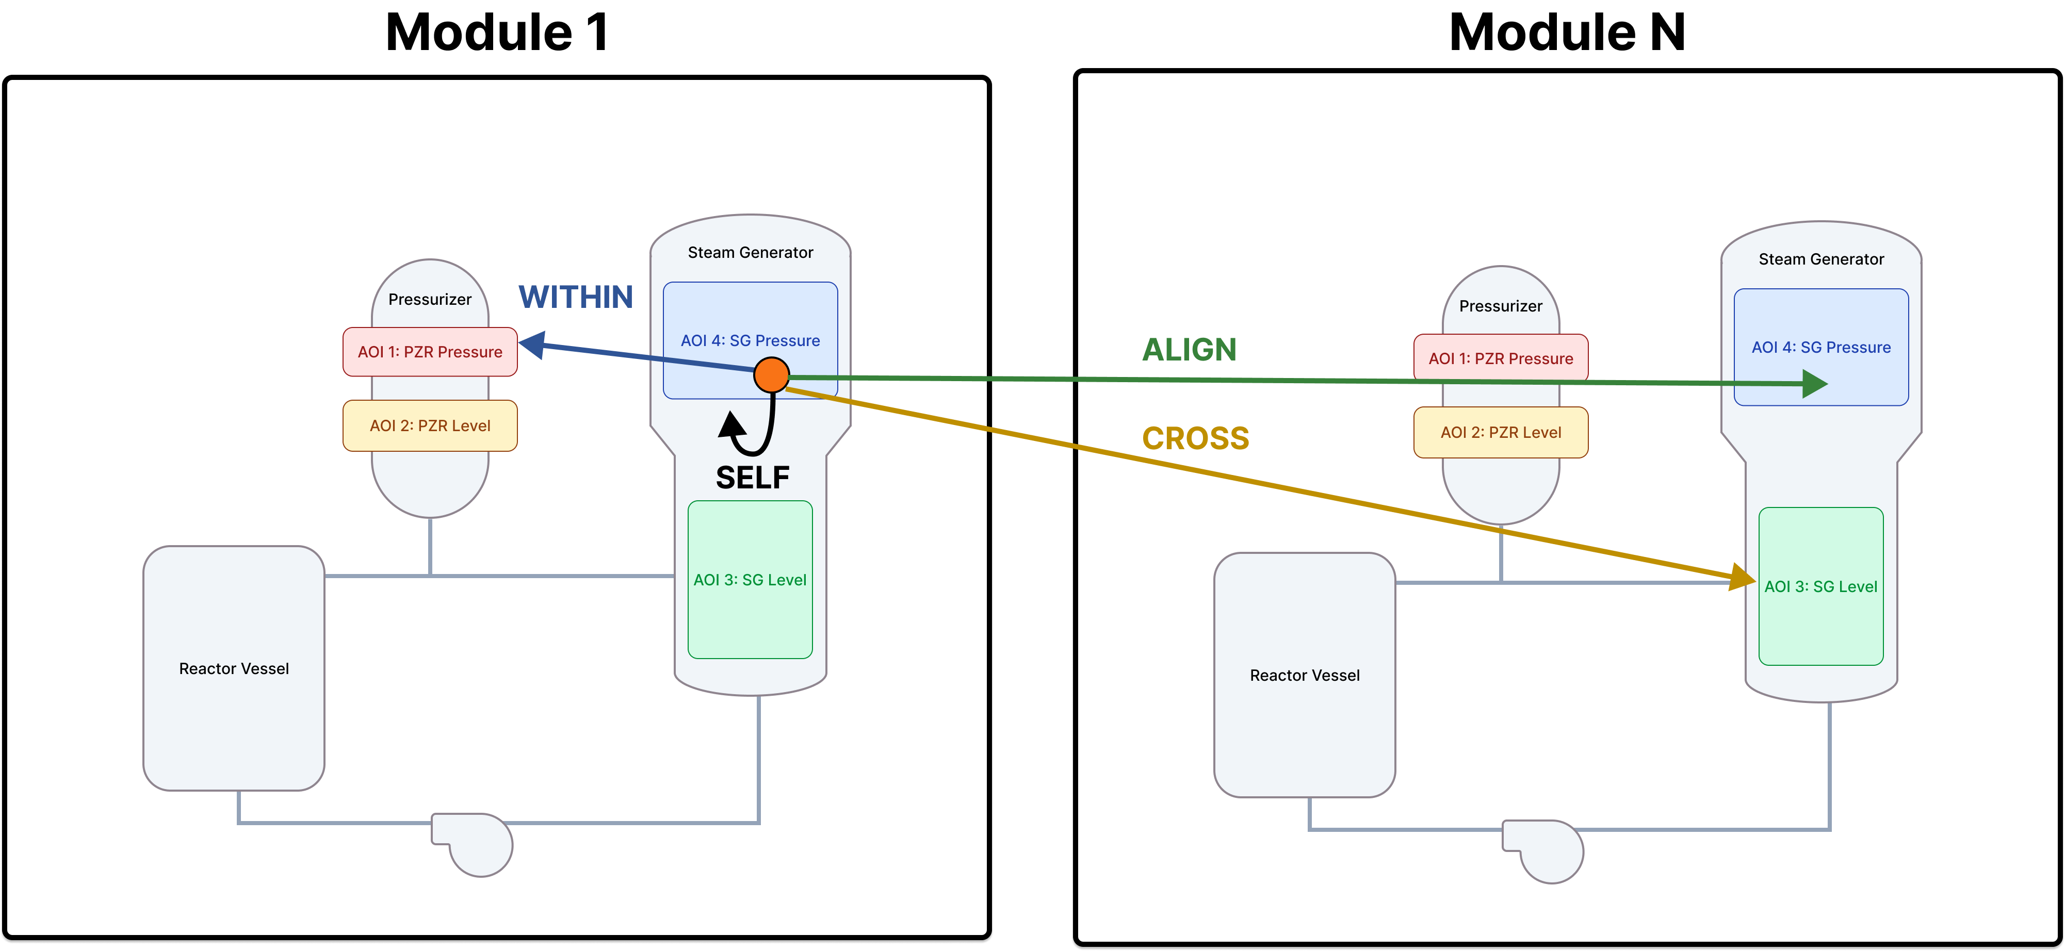
2. Quantification of Multi-Module Gaze Metric
2.1 Taxonomy of Gaze States in Multi-Module Operation
Gaze States in Multi-Module Operation
Xₜ = (mₜ, aₜ): At fixation index t the operator fixates at parameter Area of Interest (AOI) aₜ of module mₜ.
  mₜ ∈ {1, …, N} — module index
  aₜ ∈ {1, …, Kₐ} — parameter index (Kₐ = number of monitored parameters per module)
In multi-module operation, the transitional sequence of Xₜ → Xₜ₊₁ for scanning is characterized by one of the four move types of (ΔM, ΔA) (module changed, parameter changed)
Table. Four move types of Gaze State
Move | (ΔM, ΔA) | Transition | Behavioural meaning
SELF | (0, 0) | same module, same parameter | refixation
WITHIN | (0, 1) | same module, different parameter | elaborate the unit’s picture
ALIGN | (1, 0) | different module, same (homologous) parameter | cross-check the units
CROSS | (1, 1) | different module, different parameter | reorientation on the partner
Fig. The four gaze-transition types on the Reactor Coolant System mimic of N modules (N = 2)
Notes:
The first step is to build a module-aware taxonomy of gaze states. At each fixation index t, I define the gaze state as the pair of the module m-t and the parameter area of interest a-t that the operator fixates. Each transition to the next state is then characterized by one of four move types, defined by whether the module and the parameter changed: SELF, a refixation; WITHIN, a different parameter of the same module, to elaborate the unit's picture; ALIGN, the homologous parameter of a different module, to cross-check the units; and CROSS, a different parameter of a different module, to reorient onto the partner.

Slide 10
2. Quantification of Multi-Module Gaze Metric
2.2 Gaze State Transition Model in Multi-Module Operation
Mathematical Representation of the Multi-Module Gaze State Transition Model(Tree)
Each node of the gaze transition model(tree) corresponds to a decision
  Decision 1. Module Selection (Allocation): Stay vs Leave
  Decision 2.1. Parameter Selection (Stay): Which Parameter
  Decision 2.2. Target-module Selection(Coverage): Which Different Module
  Decision 3. Parameter Selection of Partner (Integration)
Current gaze state Xₜ = (mₜ, aₜ)
Decision 1 — Module selection
stay (σ) · leave (1−σ)
Term: Allocation
stay · σ
leave · 1−σ
Leaf | Decisions along the path | Path probability
SELF | D1 stay → D2 same parameter | σ · ρₛ
WITHIN | D1 stay → D2 different | σ · (1−ρₛ) · W(a′)
ALIGN | D1 leave → D2 target m′ → D3 homologous | (1−σ) · ρℓ · Q(m′)
CROSS | D1 leave → D2 target m′ → D3 different | (1−σ) · (1−ρℓ) · Q(m′) · R(a′)
Decision 2.1 — Parameter selection
(current module)
Term: Stay
Decision 2.2 — Target-module selection
(N−1 candidate modules)
Term: Coverage
different · 1−ρₛ
q(m′)
SELF
P = ρₛ
WITHIN
P = (1−ρₛ)·W
Decision 3 — Parameter selection
Term: Integration
homologous · ρℓ
different · 1−ρℓ
ALIGN
P = ρℓ
CROSS
Term: Reorientation
P = (1−ρℓ)·R
P( (m′,a′) | (m,a) ) = σρₛ·SELF + σ(1−ρₛ)W·WITHIN + (1−σ)ρℓ Q·ALIGN + (1−σ)(1−ρℓ)Q R·CROSS
σ = stay probability, ρₛ = self-refixation probability, ρℓ = align probability
· W, Q, R = landing distributions of WITHIN / partner-choice / CROSS moves
Notes:
These four moves are organized into a gaze state transition model, a decision tree in which every node corresponds to a decision. Decision one is module selection, or allocation: the operator stays in the current module with probability sigma, or leaves. If the operator stays, decision two selects the parameter within that module; if the operator leaves, decision two selects the target module, which we term coverage, and decision three selects the parameter on the partner, which we term integration. Each path gives the transition probability to the four leaves, governed by the stay probability sigma, the self-refixation probability rho-s, and the align probability rho-l.

Slide 11
2. Methodology
2.3 Model Quantification: Multi-module Gaze Metric($Ψ(N))$
Quantification of Kernel to derive Multi-Module Gaze Metric
1) Quantify kernel nodes via information (Shannon) entropy($\text{H}\text{(}\text{X}\text{) = }\text{−}\text{Σ}\text{ᵢ }\text{p}\text{(}\text{x}\text{ᵢ)·}\text{log}\text{₂ }\text{p}\text{(}\text{x}\text{ᵢ))}$
P( (m′,a′) | (m,a) ) = σρₛ·SELF + σ(1−ρₛ)W·WITHIN + (1−σ)ρℓ Q·ALIGN + (1−σ)(1−ρℓ)Q R·CROSS
2) Assign valence(cognitive direction) of each term with respect to their correlation to the changes in situation awareness and simplify the terms with only clear correlative direction with the SA.
H(Xₜ₊₁ | Xₜ) = H_b(σ) + σ·H_stay + (1−σ)H(Q) + (1−σ)H_b(ρℓ) + (1−σ)(1−ρℓ)H(R)
Allocation term(D1) + stay term(D2.1) (negatively correlated) + coverage term(D2.2)(positively correlated) + integration term(D3)(symmetric => replaced with cross-check index) + reorientation term
H(Xₜ₊₁ | Xₜ) = − σ·H_stay + (1−σ)·[ H(Q) + cci(ρℓ) ]
*cross-check index(𝝆ℓ) = sgn⁡(𝝆ℓ − 𝟏/𝑲ₐ) · 𝑫𝑲𝑳( 𝑩𝒆𝒓(𝝆ℓ) ‖ 𝑩𝒆𝒓(𝟏/𝑲ₐ) ) (signed divergence)
Notes:
From this transition kernel, the conditional entropy of the next look decomposes, by the chain rule, into one exact term per decision node: allocation, stay, coverage, integration, and reorientation. I then assign a cognitive valence to each term by its correlation with situation awareness, keeping only the clearly signed terms: the stay term is negatively correlated, since erratic within-module search lowers situation awareness; the coverage term is positively correlated; and the symmetric integration term is replaced by a signed cross-check index. This yields a signed numerator: minus sigma times the stay entropy, plus one minus sigma times the coverage entropy and cross-check index.

Slide 12
2. Methodology
2.3 Model Quantification: Multi-module Gaze Metric($Ψ(N))$
Quantification of Kernel to derive Multi-Module Gaze Metric
3) Normalize the signed numerator by the transition capacity log₂(Kₐ·N) — the most bits one next-look can carry.
$Ψ_{raw}\left(N\right)={\left[ −σ·H_{stay}+ \left(1−σ\right)\left( H\left(Q\right)+ cci\left(ρℓ\right)\right)\right]}/{\log_{2}\left(Kₐ·N\right)}$ , $Ψ_{0}\left(N\right)=$ uniform random scanning baseline
Ψ = 0 aimless scanning · Ψ > 0 ordered & directed
4) Subtract closed-form uniform-random-scanning baseline from $Ψ_{raw}\left(N\right)$ to derive multi-module gaze metric
$$Ψ\left(N\right)= Ψraw\left(N\right)− Ψ_{0}\left(N\right)$$
Ψ(N) = degree of operator’s scanning is structural and purposeful compared to uniformly random scanning in multi-module operation
Notes:
In the final step, I normalize this signed numerator by the transition capacity, the logarithm base two of K-a times N, which is the most bits a single next look can carry. The resulting metric, Psi of N, quantifies the degree to which the operator's scanning is structural and purposeful, compared with uniformly random scanning. A higher Psi of N therefore indicates more ordered and directed attention, whereas a value near zero indicates near-random scanning.

Slide 13
3. Experiment Design

Slide 14
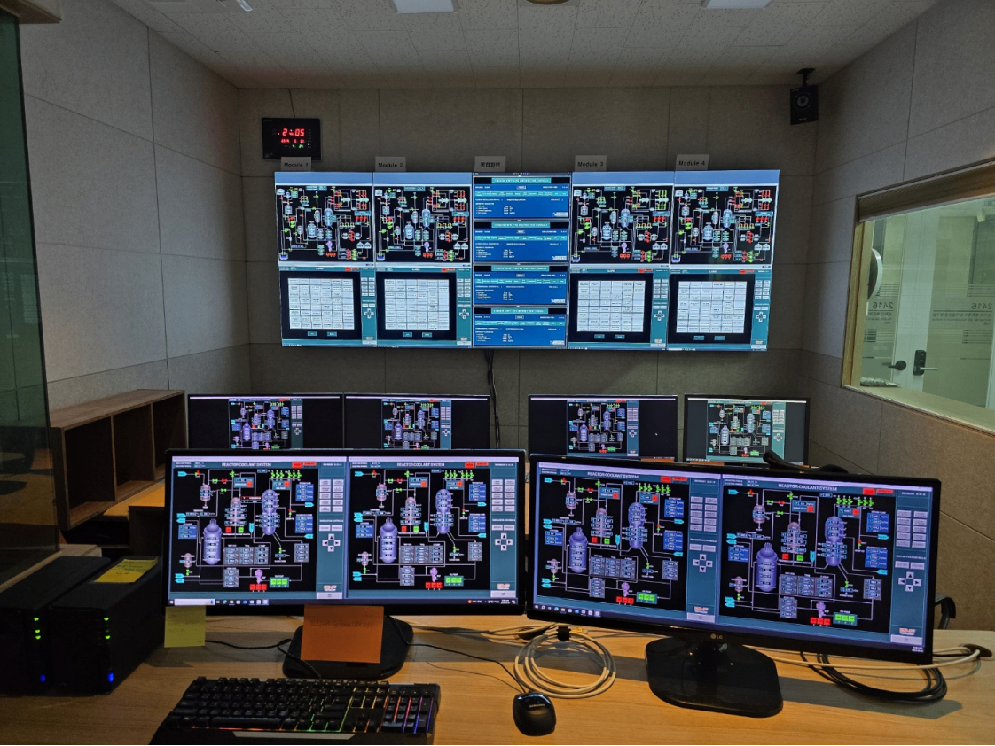
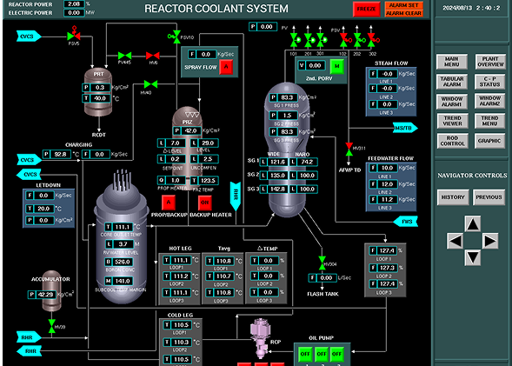
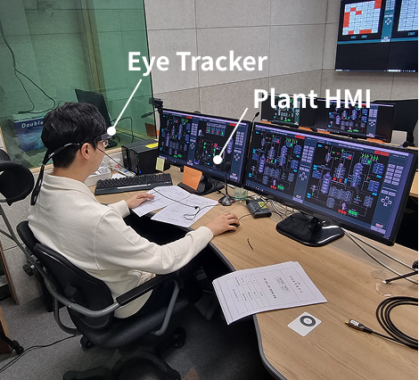
3. Experiment Design
3.1 Multi-Module Operating Environment
Simulated 4-Module Operational Environment
  Large Display Panel: Alarm Support
  Screen per module: Maximum 2 screens assigned per operator
Operation Crew
  3 Operating Personnel: 2 Reactor Operators (RO) (Target Gaze Collection), 1 Shift Supervisor (SS)
Experiment Apparatus
  Compact Nuclear Simulator(CNS): Three-loop Westinghouse PWR 993 MWe Simulator
  Tobii Pro Glasses 2: Collect Gaze Data
Fig. Multi-module Operation Environment
Fig. CNS User Interface (Left) and Experiment Recording Layout
Large Display Panel
Module 1
Module 2
Module 3
Module 4
Shift Supervisor
Notes:
To verify the metric, we designed a simulated four-module operating environment, supported by a large display panel for alarms, with a maximum of two module screens per operator. Each operating crew consisted of three personnel: two reactor operators, from whom the target gaze data was collected, and one shift supervisor. The apparatus was the Compact Nuclear Simulator, a three-loop Westinghouse pressurized water reactor simulator, and the operators' gaze data was collected using Tobii Pro Glasses 2.

Slide 15

3. Experiment Design
3.2 Ground-Truth SA Measurement: SACRI
Detailed assessment of operator’s SA for each accident module
  Total 9 Questions on past/normal/future trend of 9 safety function related plant parameters
  Each answer scored as hit/miss/false-alarm/correct-acceptance vs. the simulator ground truth.
Evaluation Criteria:
  A’ : Operator’s ability to discriminate stable parameters from those which are fluctuating
Endsley Levels Mapped to SACRI Items:
  L1/2 (Perception & Comprehension) – Past and normal-referenced items (Q1-Q6)
  L3 (Projection) – Full inventory (Q1-Q9)
Table. Monitored Plant Parameters
Fig. A’ Derivation Formula
SACRI Plant Parameters
1 | Pressurizer Pressure | 6 | Containment Radiation
2 | Pressurizer Level | 7 | RCS Average Temperature
3 | Steam Generator Pressure | 8 | Safety Injection Flow
4 | Steam Generator | 9 | Secondary Radiation
5 | Containment Pressure
$$A’ = 1 – 0.25\left[\left(\frac{pFA}{pH}\right)+ \left(\frac{pM}{pCA}\right)\right]$$
 | Meaning
pCA | Probability to correctly accept stable parameters
pFA | Probability of false alarm for stable parameters as fluctuating
pH | Probability of operators to correctly hit the fluctuating parameter
pM | Probability of operators to miss the fluctuating parameters
Notes:
For the ground-truth measurement, we used SACRI, which assesses situation awareness for each accident module through nine questions on the past, normal, and future trends of nine safety-function-related parameters. Each answer is scored as a hit, miss, false alarm, or correct acceptance against the simulator ground truth, and combined into A-prime, the operator's ability to discriminate stable parameters from fluctuating ones. The Endsley levels are mapped onto the items, so that A-prime for Levels one and two uses the past and normal-referenced items, while A-prime for Level three uses the full inventory.

Slide 16
3. Experiment Design
3.3 Experiment Scenarios & Participants
Experiment Scenarios
Scenarios based on the operational conditions specific to multi-module operation
Total 51 valid samples of extractable operator recordings were pre-processed and analyzed
Table. Scenario Conditions
Table. Valid Scenario Samples Analyzed
Accident Modules per Reactor Operator (N) | Accident Homogeneity (Multi-Module operation) | Off-normal Conditions (one for each module)
1 | Homogenous (Same Accidents) | LOCA
 |  | ESDE
2 | Heterogenous (Different Accidents)
 |  | SGTR
Accident Modules per Operator | Accident Homogeneity (Multi-Module operation) | Samples
1 | - | 25
2 | Homogenous (Same Accidents) | 14
 | Heterogenous (Different Accidents) | 12
 | Total | 51
Participants
Total 30 Participants (20 RO, 10 SS): Each operational crew performed 4 scenario cases
Eye-tracking data collected from reactor operators
Training:
  Familiarize operational tasks and simulator interface
  Perform 2 cases of single-module operation in off-normal conditions
Notes:
The scenarios were based on the operational conditions specific to multi-module operation. We varied the number of accident modules per reactor operator, and, for two modules, the accident homogeneity between homogeneous and heterogeneous scenarios, using the LOCA, ESDE, and SGTR off-normal conditions. Thirty participants took part, twenty reactor operators and ten shift supervisors, and after training, each crew performed four scenario cases, producing fifty-one valid samples: twenty-five for single-module and twenty-six for two-module operation.

Slide 17
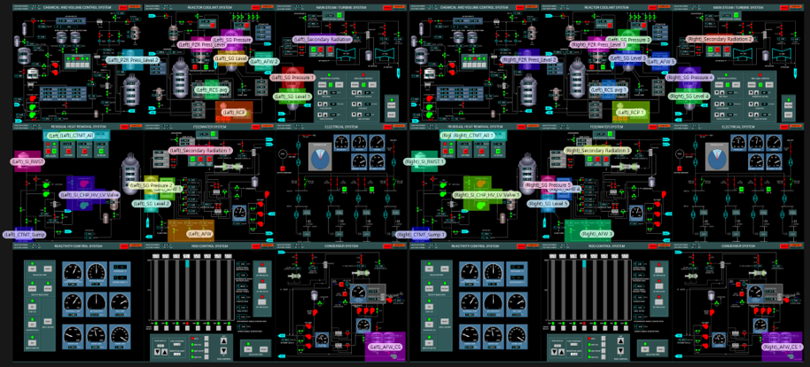
3. Experiment Design
3.4 Areas of Interest (AOI)
Region of attentional-resource allocation based on significant diagnostic parameters of each accident condition
Total 7 Parameters per accident module; therefore, gaze states for each accident module per operator is 7 for N = 1, 14 for N=2
Table. Monitored Plant Parameters(AOI)
Fig. AOI Layout for N=2 Operation
Scenario | AOI List (7 Parameters)
LOCA | PZR Pressure PZR Level Containment Pressure Containment Radiation Feedwater Flow SG Pressure SG Level
SGTR | PZR Pressure PZR Level Containment Pressure Feedwater Flow SG Pressure SG Level Secondary Radiation
ESDE | PZR Pressure PZR Level Containment Pressure Feedwater Flow SG Pressure SG Level Secondary Radiation
Notes:
Within each module, the areas of interest were defined as the regions of attentional-resource allocation, based on the significant diagnostic parameters of each accident condition. There are seven parameters per accident module, so the number of gaze states per operator is seven for single-module operation and fourteen for two-module operation. These seven parameters were selected for each of the LOCA, SGTR, and ESDE scenarios.

Slide 18
3. Experiment Design
3.5 Experiment Procedure & Analysis
Data Collection Experiment Scenario
Gaze data collected from onset to SACRI free-probe was collected for correlative analysis with A’ values
Fig. Experiment Scenario Flow
Preparation
Insert Malfunction
Eye-tracker Calibration
Onset
Start Simulator
Accident Diagnosis
Perform diagnosis procedural tasks
SACRI (freeze-probe)
Accident response
Perform response procedural tasks
Termination
Gaze data collected up to the diagnosis step
Pre-processing & Statistical Analysis
Pre-processing conditions
  Gaze sample rate ≥ 80 % & Mapping similarity ≥ 70 % (Tobii Pro Lab)
  Out-of bound / Ambiguous / Sub-threshold fixations included; Only in-AOI fixation counted
Statistical Analysis
  Descriptive Statistics on the SA changes in multi-module operation (Mann-Whitney U test)
  Correlation Analysis between A’ and Multi-module Gaze Metrics (Ψ(N)) via Spearman Correlation
  Linear Regression & Trend between A’ and Multi-module Gaze Metrics (Ψ(N))
Notes:
During each scenario, gaze data was collected from the onset up to the SACRI freeze-probe, for analysis against the A-prime values. The recordings were pre-processed in Tobii Pro Lab, retaining only samples with a gaze sample rate of at least eighty percent and a mapping similarity of at least seventy percent, and counting only in-AOI fixations. We then applied the Mann-Whitney U test to the situation awareness changes across module counts, and Spearman correlation and linear regression between A-prime and the gaze metric, Psi of N.

Slide 19
4. Results/Discussion

Slide 20
4. Results and Discussion
4.1 Statistical Analysis of Overview on Situation Awareness
Significant Decrease in Situation Awareness with Increased Number of Modules
For SACRI,
  A’(L1/2) and A’(L3) reduced significantly from 0.847 to 0.731 (A’(L1/2)) and from 0.700 to 0.465 (A’(L3))
  Compared to A’(L1/2), A’(L3) reduced in greater degree as number of modules operated increased
For Multi-Module Gaze Metric,
  Ψ(N) decreased significantly from 0.308 to 0.081, which is near random scan behavior, as number of modules operated increased.
  Same directional tendencies with the change in number of operation modules.
Table. Mann-Whitney U Test Results of A’ and Gaze Metric between Modules
Measure | Pooled (51) | N = 1 (25) | N = 2 (26) | U | p | R(coefficient)
Ψ(N) (Mean (Std Dev)) | 0.192 (0.143) | 0.308 (0.093) | 0.081 (0.079) | 642 | <0.001 | −0.975
A′(L1/2) (Mean (Std Dev)) | 0.788 (0.190) | 0.847 (0.162) | 0.731 (0.201) | 486 | 0.0024 | −0.495
A′(L3) (Mean (Std Dev)) | 0.580 (0.347) | 0.700 (0.292) | 0.465 (0.361) | 496 | 0.0013 | −0.525
Notes:
Turning to the results, we first observed a significant decrease in situation awareness as the number of modules increased. For SACRI, A-prime for Levels one and two fell significantly from 0.847 to 0.731, and A-prime for Level three fell from 0.700 to 0.465, so the projection level degraded to a greater degree. The gaze metric showed the same directional tendency, with Psi of N decreasing significantly from 0.308 to 0.081, close to random scanning behavior.

Slide 21
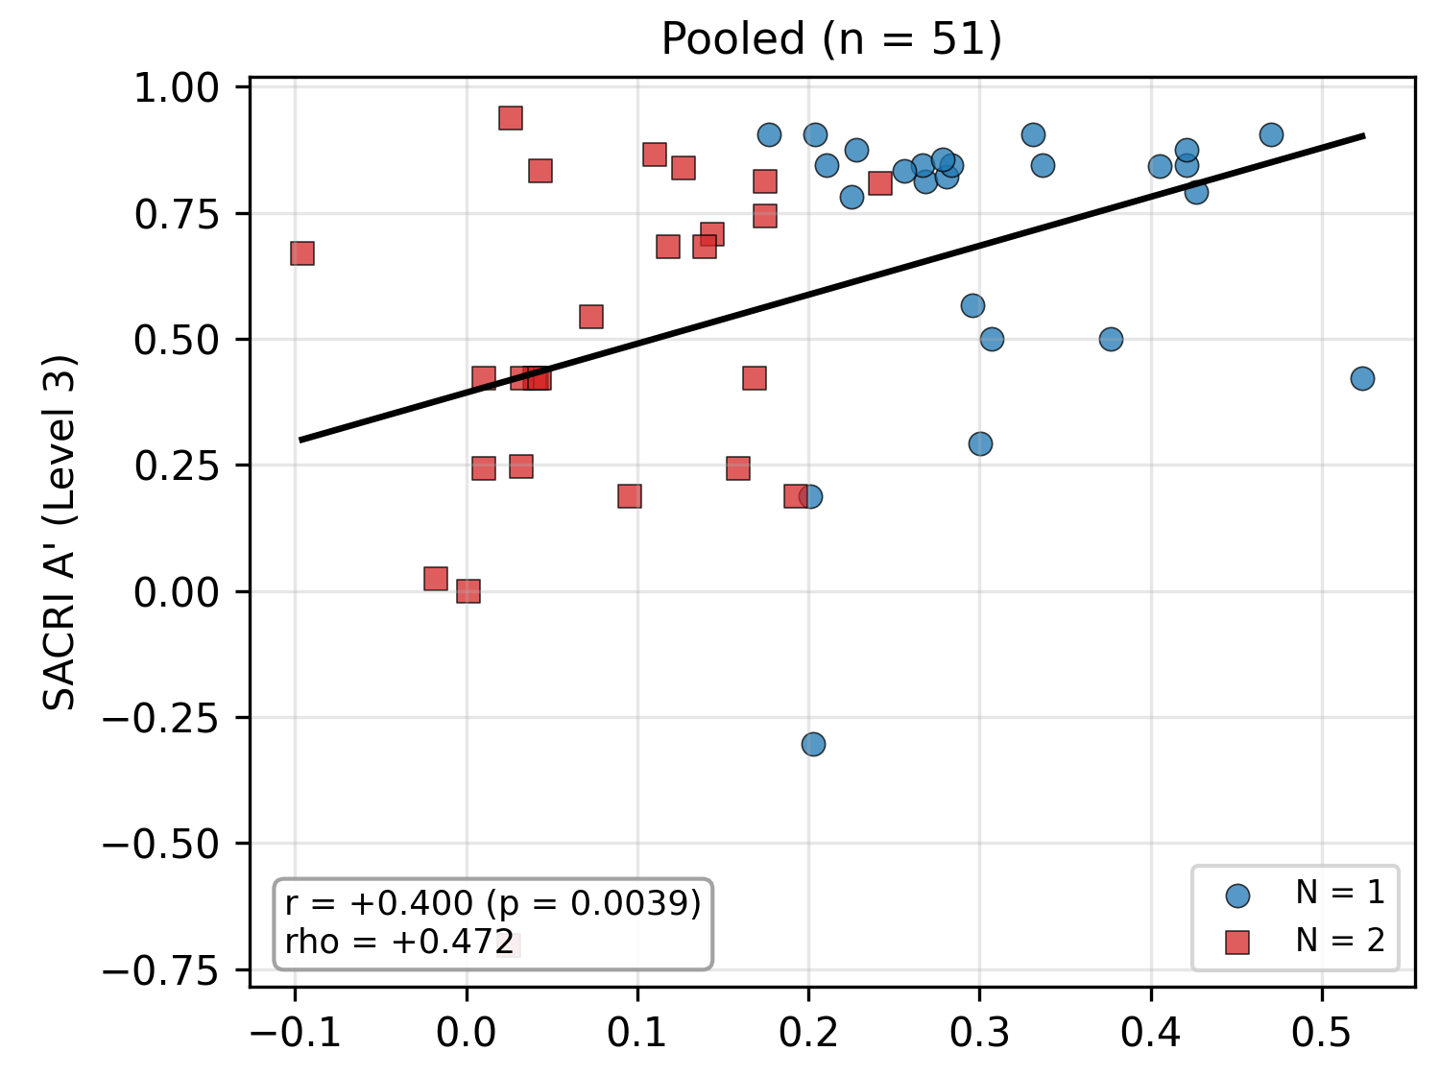
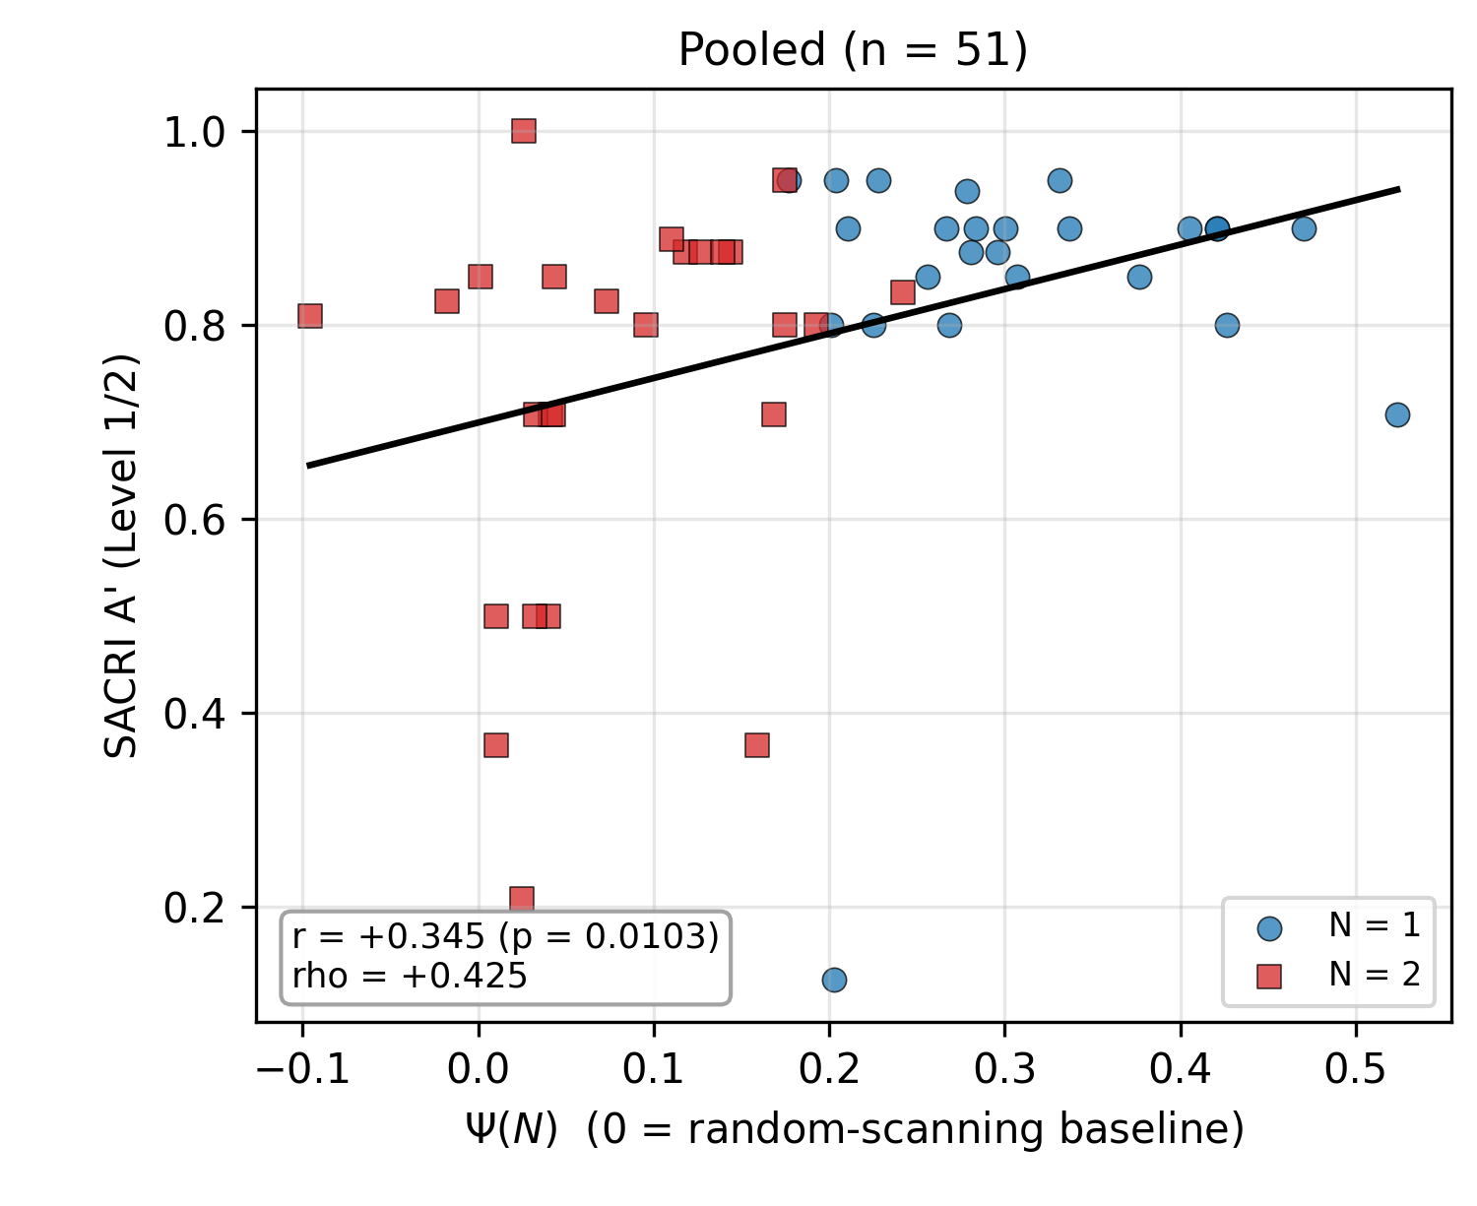
4. Results and Discussion
4.2 Correlation and Trend: Survey-based A’ and Ψ(N)
Positive Correlation between Multi-module Gaze Metric and A’ in both between and within multi-module condition (N=2)
The gaze metric co-varies sensitively with A′ at both SA levels (ρ = +.47 / +.43; τ_b = +.33 / +.31)
Co-variation also persists at fixed module count (N=2), significant for A′(L3) (τ_b = +.28, p = .048)
Saturation of SA from training explains the single-module null: A′ at ceiling, range restricted
Table. Correlations of SACRI A’ and Ψ(N)
Fig. Pooled trend — A′(L3) (left), A′(L1/2) (right)
 | Data | Spearman ρ (p-value) | Kendall τ_b (p-value)
A′(L3) | Pooled | +0.472 (.0005) | +0.333 (.0007)
 | N = 1 | −0.003 (.990) | −0.028 (.851)
 | N = 2 | +0.382 (.054) | +0.282 (.048)
A′(L1/2) | Pooled | +0.425 (.0019) | +0.306 (.0022)
 | N = 1 | −0.084 (.690) | −0.066 (.664)
 | N = 2 | +0.285 (.158) | +0.235 (.101)
Notes:
Beyond this shared direction, the gaze metric co-varies sensitively and positively with A-prime at both situation awareness levels, with a Spearman rho of plus 0.47 and plus 0.43 in the pooled data. This co-variation also persists at a fixed module count of two, remaining significant for A-prime at Level three, which shows that the metric tracks situation awareness within the multi-module condition, not merely across module counts. The single-module case shows a null result, which we attribute to a saturation of situation awareness from training, where A-prime is at ceiling and its range is restricted.

Slide 22
4. Results and Discussion
4.3 Comparison with Existing Gaze Metrics
Ψ(N) is the only measure significantly pooled for both A′ levels and for within multi-module condition (N = 2) at A’(L3)
Shannon entropy stays significantly negative pooled (both levels)
Fixation count only within N = 2 by Kendall
GTE loses significance in the rank families and dwell time is null throughout
Table. Correlations of SACRI A’ and Existing Gaze Metric
Gaze Metrics | A′ | Pooled — Spearman | Pooled — Kendall | N = 1 — Spearman | N = 1 — Kendall | N = 2 — Spearman | N = 2 — Kendall
Ψ(N) | L3 | +.472 (.0005) | +.333 (.0007) | −.003 (.9897) | −.028 (.8507) | +.382 (.0539) | +.282 (.0481)
 | L1/2 | +.425 (.0019) | +.306 (.0022) | −.084 (.6901) | −.066 (.6642) | +.285 (.1583) | +.235 (.1006)
Fixation count | L3 | −.176 (.2172) | −.124 (.2070) | +.160 (.4435) | +.121 (.4099) | −.375 (.0592) | −.293 (.0409)
 | L1/2 | −.133 (.3522) | −.103 (.3064) | +.134 (.5230) | +.088 (.5625) | −.297 (.1400) | −.227 (.1149)
Dwell time | L3 | −.109 (.4466) | −.053 (.5912) | −.026 (.9035) | +.014 (.9250) | −.087 (.6736) | −.054 (.7057)
 | L1/2 | −.100 (.4848) | −.067 (.5024) | +.066 (.7521) | +.066 (.6642) | −.210 (.3040) | −.165 (.2485)
Shannon entropy Hₛ | L3 | −.386 (.0052) | −.279 (.0044) | +.046 (.8270) | +.021 (.8877) | −.106 (.6063) | −.079 (.5787)
 | L1/2 | −.338 (.0154) | −.227 (.0230) | +.058 (.7838) | +.037 (.8094) | +.102 (.6197) | +.089 (.5344)
Gaze Transition Entropy (GTE, Hₜ ) | L3 | −.193 (.1783) | −.130 (.1882) | +.218 (.2946) | +.165 (.2587) | −.297 (.1498) | −.223 (.1258)
 | L1/2 | −.194 (.1769) | −.135 (.1804) | +.116 (.5822) | +.095 (.5306) | −.222 (.2857) | −.165 (.2593)
Notes:
Compared with existing gaze metrics, Psi of N is the only measure significantly correlated in the pooled data for both A-prime levels, and also within the two-module condition at Level three. Shannon entropy stays significantly negative in the pooled data; fixation count is significant only within two modules, by Kendall's tau; gaze transition entropy loses significance in the rank families; and dwell time is null throughout. This indicates that the proposed metric explains the changes in situation awareness with the largest effect size and sensitivity among the compared gaze metrics.

Slide 23
5. Conclusion

Slide 24
5. Conclusion
Summary
Proposed a gaze-based situation awareness quantification measure for multi-module operation through gaze state transition model
Performed multi-module operation experiment to verify the gaze metric’s correlation with situation awareness in multi-module conditions
Results indicate that the proposed metric is significantly correlated to all levels of situation awareness (L1/2 and L3); and explains the changes in SA under multi-module conditions with largest effect size and sensitivity amongst existing gaze metrics.
Future Work
Extension to N ≥ 3 module operation scenarios to fully analyze the effects of the nodal terms in the proposed equation; thus verifying the N-module implementation of the suggested metric
Larger samples to strengthen the explanatory power of the suggested metric
Notes:
To conclude, this study proposed a gaze-based situation awareness quantification measure for multi-module operation, derived through a gaze state transition model, and verified it with a multi-module operation experiment. The results indicate that the proposed metric is significantly correlated with all levels of situation awareness, both Levels one and two and Level three, and explains the changes under multi-module conditions with the largest effect size and sensitivity among existing gaze metrics. For future work, we plan to extend the metric to three or more modules, in order to analyze the nodal terms and verify its N-module implementation, and to use larger samples to strengthen its explanatory power. Thank you for your attention.

Slide 25
Thank You

Slide 26
Reference
Endsley, M. R., Toward a theory of situation awareness in dynamic systems. Human Factors, 37(1), 32-64. (1995).
Kim, S. K., & Seong, P. H., Development of a tool for measuring situation awareness of operators in a nuclear power plant. IEEE Transactions on Nuclear Science, 53(5), 3045-3053., 2006.
Hogg, D. N., et al. Development of a situation awareness measure to evaluate advanced alarm systems in nuclear power plant control rooms. Ergonomics, 38(11), 2394-2413., 1995.
Salmon, P. M., et al. Situation awareness measurement: A review of applicability for training. Applied Ergonomics, 40(2), 225-233.(2009).
Ha, J. S., & Seong, P. H. A human error analysis method based on the cognitive process of nuclear power plant operators. Nuclear Engineering and Technology. (2014).
Goldberg, J. H., & Kotval, X. P. Computer interface evaluation using eye movements: methods and instrumentation. International Journal of Industrial Ergonomics.(1999).
Reingold, E. M., et al. Gaze-contingent multiresolutional displays: An eye-movement study. Human Factors.(2001).
Y. Lee, K. T. Jung, and H. C. Lee, "Use of gaze entropy to evaluate situation awareness in emergency accident situations of nuclear power plant," Nuclear Engineering and Technology, vol. 54, no. 4, pp. 1261–1270, 2022.
A. Bhavsar, B. Srinivasan, and R. Srinivasan, "Quantifying situation awareness of control room operators using eye-gaze behavior," Computers & Chemical Engineering, vol. 106, pp. 191–201, 2017.
X. Zhang et al., "A Comprehensive Situation Awareness Measurement Method for Analyzing the Operators’ Situation Awareness of Multi-Module High Temperature Gas-Cooled Reactor Plants," Energies, vol. 16, no. 14, p. 5601, 2023.

Slide 27
Appendix
Appendix 2.A. From Path Products to Decision-Node Entropies
The kernel groups the transition’s information by leaf (row-wise); the decomposition groups the same pieces by decision node (column-wise). Each path’s surprisal, −log₂(path probability), is the sum of the surprisals of the decisions along it:
Path (leaf) | D1 — module | D2 — parameter (stay) | D2 — target module | D3 — align/cross | Landing
SELF | −log₂ σ | −log₂ ρₛ | — | — | —
WITHIN | −log₂ σ | −log₂ (1−ρₛ) | — | — | −log₂ W(a′)
ALIGN | −log₂ (1−σ) | — | −log₂ Q(m′) | −log₂ ρℓ | —
CROSS | −log₂ (1−σ) | — | −log₂ Q(m′) | −log₂ (1−ρℓ) | −log₂ R(a′)
Column sum (weighted) | H_b(σ) | σ·H_stay | (1−σ)·H(Q) | (1−σ)·H_b(ρℓ) | (1−σ)(1−ρℓ)·H(R)
Table 2.A Leaf-by-decision surprisal map: kernel = row totals · entropy decomposition = weighted column totals
Row-wise totals = the kernel: one product per destination; its −log₂ is the row sum — e.g., σ = 0.8, ρₛ = 0.5, W uniform: −log₂(0.8·0.5·⅙) = 0.32 + 1.00 + 2.59 = 3.91 bits
Column-wise totals = the decomposition: expectation is order-free, so collecting by decision assembles H_b(σ) from all four leaves, σ·H_stay from SELF + WITHIN, (1−σ)·H(Q) and (1−σ)·H_b(ρℓ) from ALIGN + CROSS, and (1−σ)(1−ρℓ)·H(R) from CROSS alone
Why 4 leaves become 5 terms: forks are shared between destinations — the stay/leave fork lies on every path; a leaf does not own its whole surprisal
Why group by node: only the column pieces are entropies of a decision — the objects to which an SA valence can attach (2.4); both groupings share the same exact total (the identity)

Slide 28
Appendix
Appendix 2.B. The Chain-Rule Entropy Decomposition
The kernel’s uncertainty is quantified via information (Shannon) entropy, H(X) = −Σᵢ p(xᵢ)·log₂ p(xᵢ) (bits) [29]. Applying the chain rule along the tree decomposes the total next-look uncertainty into one exact term per decision node:
H(Xₜ₊₁ | Xₜ) = H_b(σ) + σ·Hstay + (1−σ)H(Q) + (1−σ)H_b(ρℓ) + (1−σ)(1−ρℓ)H(R)
allocation + within term + coverage term + integration term + reorientation term
$$\text{H}\text{_}\text{b}\text{(}\text{p}\text{) = }\text{−}\text{p}\text{·}\text{log}\text{₂}\text{p} \text{− }\text{(}\text{1}\text{−}\text{p}\text{)·}\text{log}\text{₂}\text{(}\text{1}\text{−}\text{p}\text{), }\text{the} \text{binary} \text{entropy} \text{of} \text{a} \text{two}\text{-}\text{outcome} \text{decision}$$
$\text{H}\text{_}\text{stay}\text{ = }\text{H}\text{_}\text{b}\text{(}\text{ρ}\text{ₛ) + (}\text{1}\text{−}\text{ρ}\text{ₛ)·}\text{H}\text{(}\text{W}\text{), }\text{the} \text{within}\text{-}\text{module} \text{decision} \text{entropy}$
Property. The decomposition is an exact identity — no bit of scanning information appears in two terms. Gaze transition entropy corresponds to its unsigned sum, in which SA-beneficial and SA-detrimental structure cancel.
Entropy term | Decision node (Fig. 2) — scanning meaning | Enters Ψ(N) as | Basis
H_b(σ) allocation | Decision 1, module selection — stay ↔ leave split | — (weight only) | σ sets the reach weights
σ·H_stay within | Decision 2, parameter (current unit) — within-unit disorder | − detrimental | erratic search lowers SA [19,22]
(1−σ)·H(Q) coverage | Decision 2, target-module selection — breadth across modules | + beneficial | attention spread is the demand [20]
(1−σ)·H_b(ρℓ) integration | Decision 3, parameter (partner) — align ↔ cross-check | cci(ρℓ) signed | a direction, not a spread (below)
(1−σ)(1−ρℓ)·H(R) reorient | CROSS landing — spread after a cross-move (reorientation) | — (unscored) | ambiguous / empirically null

Slide 29
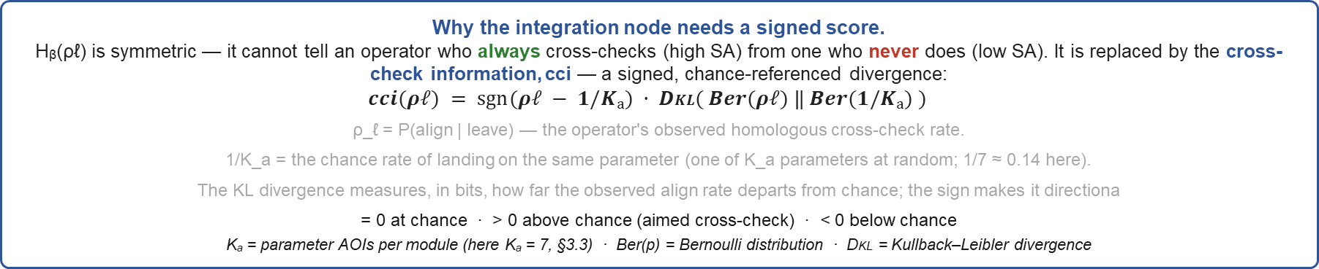
Appendix
Appendix 2.C. Valence Assignment & Simplification
Entropy measures how much information the scan carries — not whether it helps SA. GTE sums every piece unsigned, so SA-good and SA-bad structure cancel.
Rule: score only what theory can sign. Within-module disorder enters −, coverage +; allocation is unscored (σ becomes the weight); the integration and reorientation nodes require care:
Why the integration node needs a signed score.
Hᵦ(ρℓ) is symmetric — it cannot tell an operator who always cross-checks (high SA) from one who never does (low SA). It is replaced by the cross-check information, cci — a signed, chance-referenced divergence:
$$cci(ρℓ) = sgn⁡(ρℓ − 1/Kₐ) · DKL( Ber(ρℓ) ‖ Ber(1/Kₐ) )$$
ρ_ℓ = P(align | leave) — the operator's observed homologous cross-check rate.
1/K_a = the chance rate of landing on the same parameter (one of K_a parameters at random; 1/7 ≈ 0.14 here).
The KL divergence measures, in bits, how far the observed align rate departs from chance; the sign makes it directiona
= 0 at chance · > 0 above chance (aimed cross-check) · < 0 below chance
Kₐ = parameter AOIs per module (here Kₐ = 7, §3.3) · Ber(p) = Bernoulli distribution · DKL = Kullback–Leibler divergence
Reorientation H(R) → unscored
No theory-fixed direction: broad spread after a cross-move reads equally as healthy survey of the newly engaged unit or as aimless wandering; narrow spread as purposeful targeting or as tunneling
Empirically null in this data — and the rarest node (reach (1−σ)(1−ρℓ)), hence the noisiest estimate
It remains in the exact identity — only its valence is withheld
signed numerator = − σ·H_stay + (1−σ)·[ H(Q) + cci(ρℓ) ]

Slide 30

Appendix
Appendix 2.C. Valence Assignment & Simplification
Ψraw(N) = [ −σ·H_stay + (1−σ)( H(Q) + cci(ρℓ) ) ] ⁄ log₂(Kₐ·N)
log₂(Kₐ·N) = the most bits one next-look can carry over K = Kₐ·N AOI states → dimensionless (bits realized per bit available)
② Subtract the random-scanning baseline so single- and multi-module scores are commensurable
Uniform random scanner — the zero-skill policy
draws every next fixation uniformly over all K = Kₐ·N states; its parameters follow by counting states:
σ₀ = 1/N · H_stay⁰ = log₂Kₐ · H(Q)⁰ = log₂(N−1) · ρℓ⁰ = 1/Kₐ ⇒ cci = 0
Closed-form baseline Ψ₀(N)
Ψ₀(1) = −1 Ψ₀(2) = −0.369 Ψ₀(3) = −0.061
a design constant per module count — no fitting
$$\text{Ψ}\text{₀}(N)=\frac{\left[−\left(\frac{1}{N}\right)\log_{2}K_{a},+\left(1−\frac{1}{N}\right)\log_{2}\left(N−1\right)\right]}{\log_{2}\left(K_{a}N\right)}$$
Ψ(N) = Ψraw(N) − Ψ₀(N)
the scan's departure from random scanning
Ψ = 0 aimless · Ψ > 0 ordered & directed
N = 1: Ψ = 1 − H_stay ⁄ log₂Kₐ ∈ [0,1] — one formula spans single→N-module
12

