Slide 1
Surrogate Models for Sensitivity Analysis of Quantitative Risk Assessments of Hydrogen Systems
Dusty Brooks, Ben Schroeder,
Brian Ehrhart
Probabilistic Safety Assessment & Management Conference (PSAM) 18
July 19-24, 2026

Slide 2
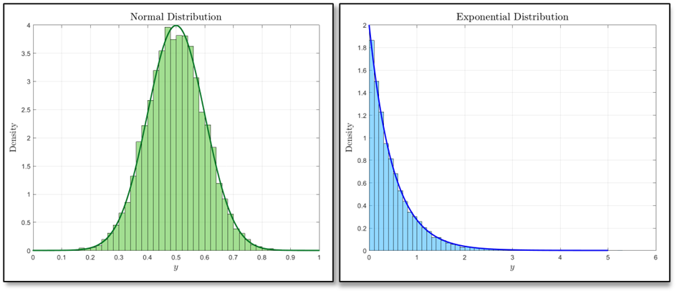
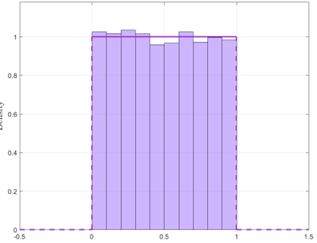
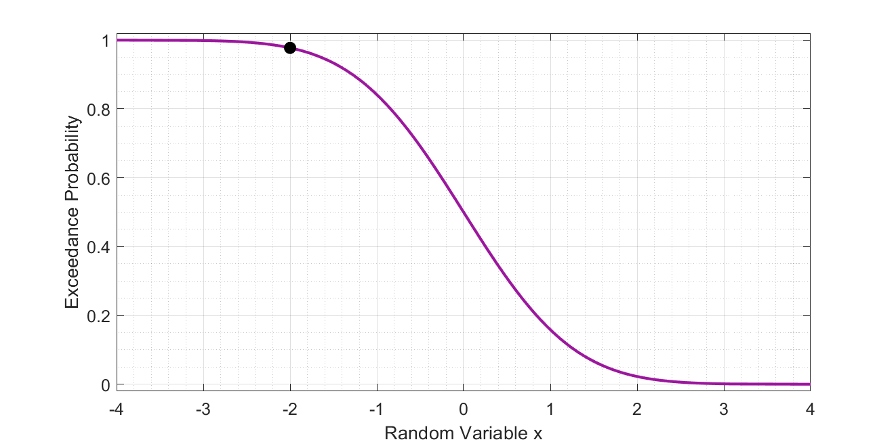

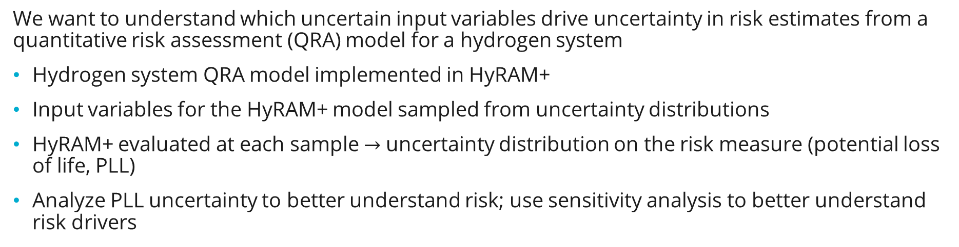

Uncertainty Propagation through a Risk Model
We want to understand which uncertain input variables drive uncertainty in risk estimates from a quantitative risk assessment (QRA) model for a hydrogen system
Hydrogen system QRA model implemented in HyRAM+
Input variables for the HyRAM+ model sampled from uncertainty distributions
HyRAM+ evaluated at each sample $→$ uncertainty distribution on the risk measure (potential loss of life, PLL)
Analyze PLL uncertainty to better understand risk; use sensitivity analysis to better understand risk drivers
Risk Model
Uncertainty Quantification
Input
Sampling
HyRAM+
Risk Uncertainty
Sensitivity Analysis
$$x=x_{1}, x_{2},…,x_{d}$$
$$f(x)$$

Slide 3
Demonstration System:
Gaseous H₂ Forklift Fueling Facility
Demonstration system used for this analysis is an indoor gaseous hydrogen forklift fueling facility*
  Hydrogen at 287.7 K and 35 MPa
  Ambient conditions: 288 K and 0.101325 MPa with 89% relative humidity
  System composed of 5 valves, 3 instruments, 35 joints, 1 hose, 20 meters of pipe (each meter treated as an individual component)
  Piping outer diameter 9.525 mm, 1.651 mm thick walls
  Refuels 20 vehicles, 2 fueling operations per vehicle per day, over 250 days per year
    10,000 fueling operations annually
  9 occupants assumed, randomly distributed 1 to 20 meters away from a leak in the x-direction (leak direction) and 1 to 12 meters in the z-direction (tangential to leak)
  Probability of leak detection and mitigation before ignition assumed to be 0.9
* K. Groth, J. LaChance and A. P. Harris, “Early-Stage Quantitative Risk Assessment to Support Development of Codes and Standard Requirements for Indoor Fueling of Hydrogen Vehicles,” Sandia National Laboratories, SAND2012-10150, Albuquerque, New Mexico, 2012

Slide 4
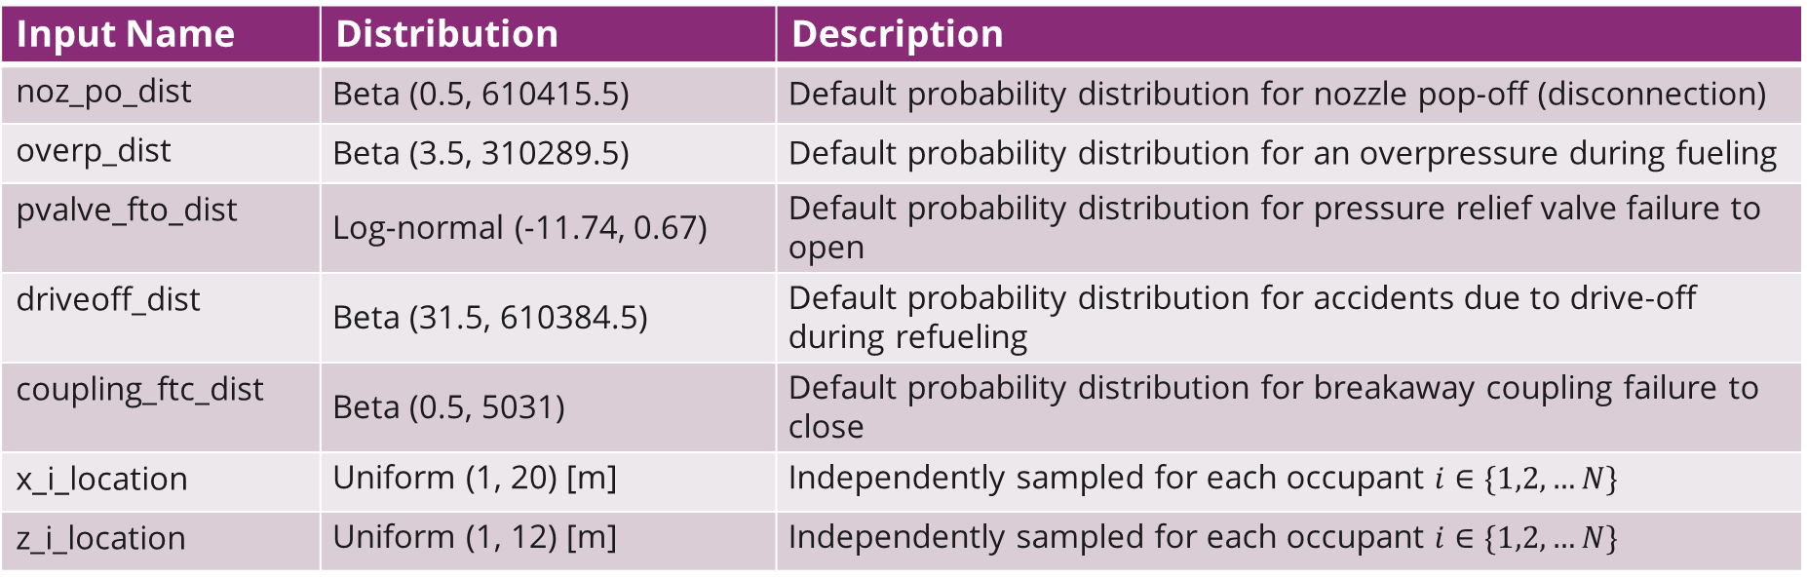
Input Uncertainty Distributions
Annual leak frequencies for valves, instruments, joints, hoses, and pipes for leaks that are 0.01%, 0.1%, 1%, 10%, and 100% of the flow area (very small leaks to ruptures)
  Lognormal distributions*
Additional input uncertainty definitions:
Input Name | Distribution | Description
noz_po_dist | Beta (0.5, 610415.5) | Default probability distribution for nozzle pop-off (disconnection)
overp_dist | Beta (3.5, 310289.5) | Default probability distribution for an overpressure during fueling
pvalve_fto_dist | Log-normal (-11.74, 0.67) | Default probability distribution for pressure relief valve failure to open
driveoff_dist | Beta (31.5, 610384.5) | Default probability distribution for accidents due to drive-off during refueling
coupling_ftc_dist | Beta (0.5, 5031) | Default probability distribution for breakaway coupling failure to close
x_i_location | Uniform (1, 20) [m] | Independently sampled for each occupant $i∈\{1,2,…N\}$
z_i_location | Uniform (1, 12) [m] | Independently sampled for each occupant $i∈\{1,2,…N\}$
* Benjamin Schroeder and Dusty Brooks, Uncertainty Quantification and Sensitivity Analysis for Quantitative Risk Assessments of Hydrogen Infrastructure, SAND2024-09878, August 2024, Sandia National Laboratories, https://doi.org/10.2172/2463031.

Slide 5
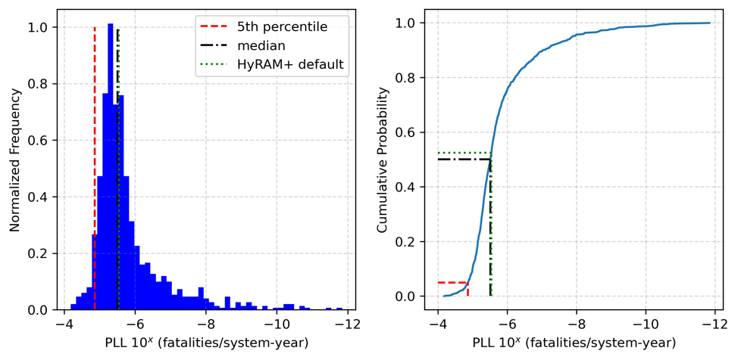
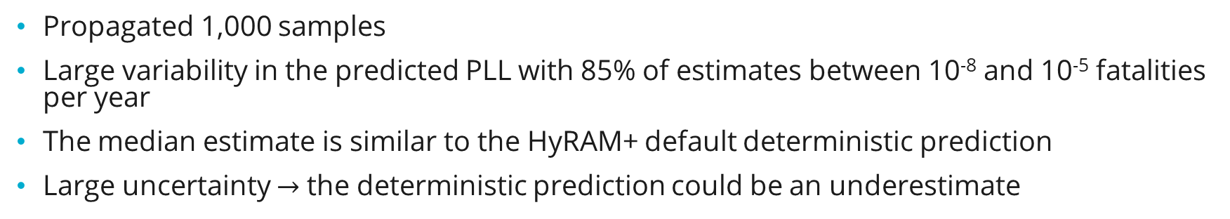
UNCERTAINTY Quantification
Propagated 1,000 samples
Large variability in the predicted PLL with 85% of estimates between 10⁻⁸ and 10⁻⁵ fatalities per year
The median estimate is similar to the HyRAM+ default deterministic prediction
Large uncertainty $→$ the deterministic prediction could be an underestimate

Slide 6
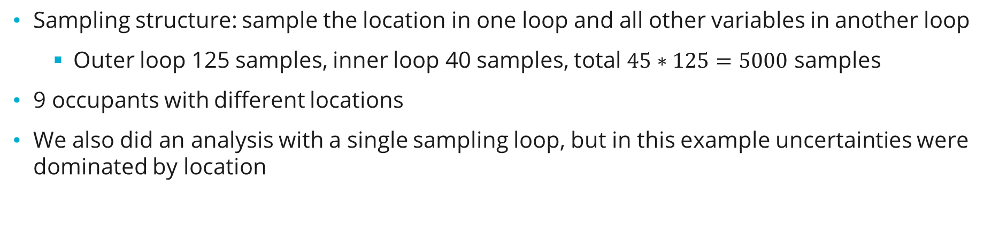
Sensitivity Analysis: Multiple Cases
Sampling structure: sample the location in one loop and all other variables in another loop
  Outer loop 125 samples, inner loop 40 samples, total $45∗125=5000$ samples
9 occupants with different locations
We also did an analysis with a single sampling loop, but in this example uncertainties were dominated by location
Base Case
Input | Case 1 | Case 2 | Case 3 | Case 4
x Location - uniform (m) | 1-20 | 0.01-1 | 1-20 | 0.01-1
z Location - uniform (m) | 1-12 | 0.01-0.02 | 1-12 | 0.01-0.02
Pressure (Pa) | 3.5×10⁷ | 3.5×10⁷ | 7×10⁷ | 7×10⁷

Slide 7
Sensitivity Analysis: Multiple Cases
Sampling structure: sample the location in one loop and all other variables in another loop
  Outer loop 125 samples, inner loop 40 samples, total $45∗125=5000$ samples
9 occupants with different locations
We also did an analysis with a single sampling loop, but in this example uncertainties were dominated by location
What if the occupants are closer to the leaks?
Input | Case 1 | Case 2 | Case 3 | Case 4
x Location - uniform (m) | 1-20 | 0.01-1 | 1-20 | 0.01-1
z Location - uniform (m) | 1-12 | 0.01-0.02 | 1-12 | 0.01-0.02
Pressure (Pa) | 3.5×10⁷ | 3.5×10⁷ | 7×10⁷ | 7×10⁷

Slide 8
Sensitivity Analysis: Multiple Cases
Sampling structure: sample the location in one loop and all other variables in another loop
  Outer loop 125 samples, inner loop 40 samples, total $45∗125=5000$ samples
9 occupants with different locations
We also did an analysis with a single sampling loop, but in this example uncertainties were dominated by location
What if the system pressure was higher?
Input | Case 1 | Case 2 | Case 3 | Case 4
x Location - uniform (m) | 1-20 | 0.01-1 | 1-20 | 0.01-1
z Location - uniform (m) | 1-12 | 0.01-0.02 | 1-12 | 0.01-0.02
Pressure (Pa) | 3.5×10⁷ | 3.5×10⁷ | 7×10⁷ | 7×10⁷

Slide 9
Sensitivity Analysis: Multiple Cases
Sampling structure: sample the location in one loop and all other variables in another loop
  Outer loop 125 samples, inner loop 40 samples, total $45∗125=5000$ samples
9 occupants with different locations
We also did an analysis with a single sampling loop, but in this example uncertainties were dominated by location
What if the occupants were closer to the leaks and the system pressure was higher?
Input | Case 1 | Case 2 | Case 3 | Case 4
x Location - uniform (m) | 1-20 | 0.01-1 | 1-20 | 0.01-1
z Location - uniform (m) | 1-12 | 0.01-0.02 | 1-12 | 0.01-0.02
Pressure (Pa) | 3.5×10⁷ | 3.5×10⁷ | 7×10⁷ | 7×10⁷

Slide 10
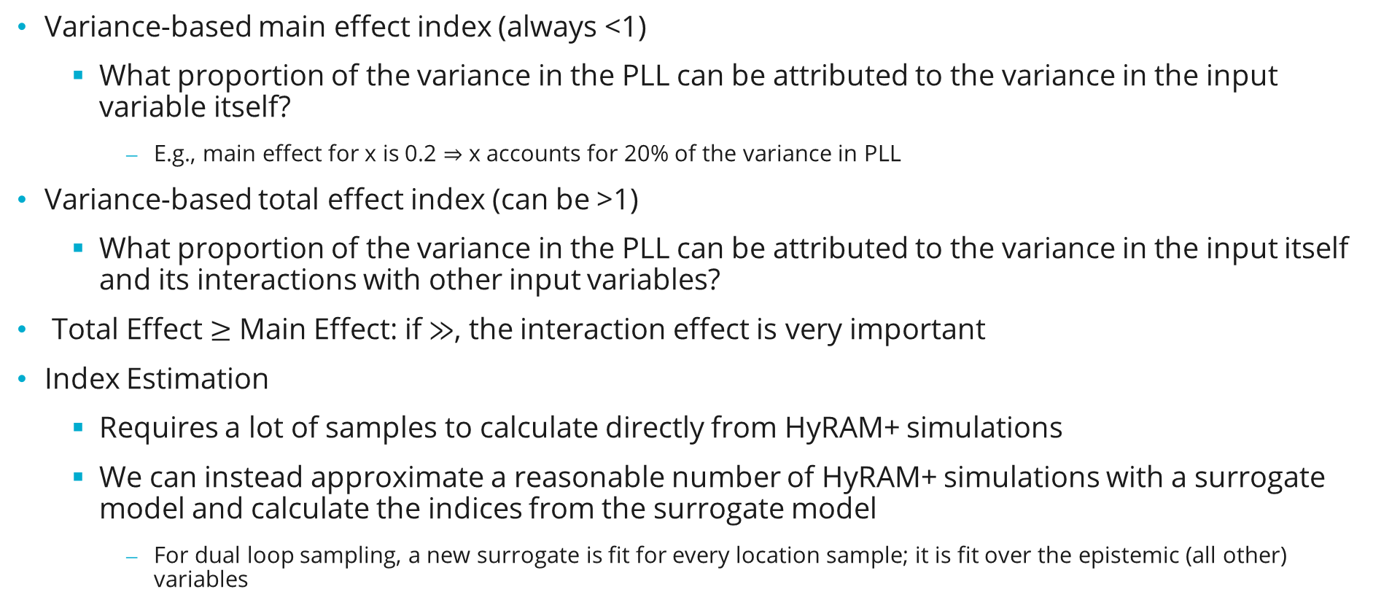
Variance-Based Sensitivity Analysis with Surrogate Models
Variance-based main effect index (always <1)
  What proportion of the variance in the PLL can be attributed to the variance in the input variable itself?
    E.g., main effect for x is 0.2 $⇒$ x accounts for 20% of the variance in PLL
Variance-based total effect index (can be >1)
  What proportion of the variance in the PLL can be attributed to the variance in the input itself and its interactions with other input variables?
Total Effect $≥$ Main Effect: if $≫$, the interaction effect is very important
Index Estimation
  Requires a lot of samples to calculate directly from HyRAM+ simulations
  We can instead approximate a reasonable number of HyRAM+ simulations with a surrogate model and calculate the indices from the surrogate model
    For dual loop sampling, a new surrogate is fit for every location sample; it is fit over the epistemic (all other) variables

Slide 11
Surrogate Models
Polynomial Chaos Expansion (PCE)
Gaussian Process (GP)
The output is modeled as a sum of polynomials where the coefficients of the polynomials are random variables
Allows you to estimate sensitivity indices directly from the expansion coefficients
Model fit in Dakota*
Great for modeling non-constant output variance over the input space
Introduces fitting error to sensitivity analysis
Think of this as a Gaussian distribution over functions, each of which approximates the input/output relationship
Allows you to estimate sensitivity indices by evaluating the GP at many sample points
Model fit in Dakota*
Great for fitting non-monotonic and non-linear relationships in data
Introduces fitting and sample size error to sensitivity analysis
PCE performed better (fit the trends in the input/output data better) for Case 1; GP performed better for Cases 2-4.
*Brian Adams et al., “Dakota, A Multilevel Parallel Object-Oriented Framework for Design Optimization, Parameter Estimation, Uncertainty Quantification, and Sensitivity Analysis: Version 6.16 User’s Manual,” SAND2022-6171, 2022, dakota.sandia.gov.

Slide 12
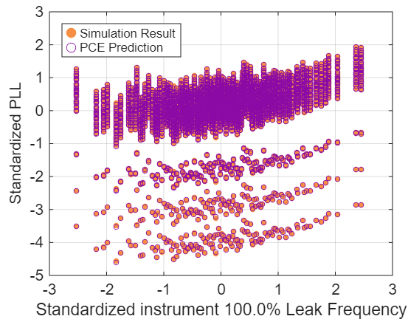
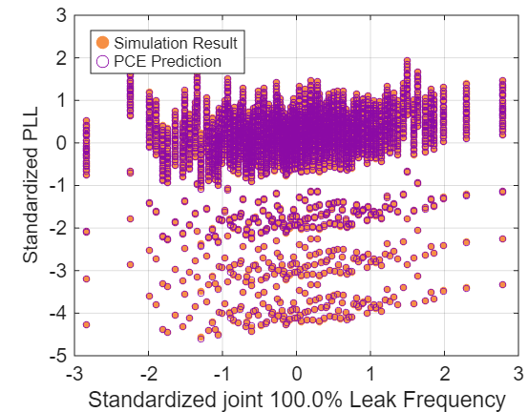
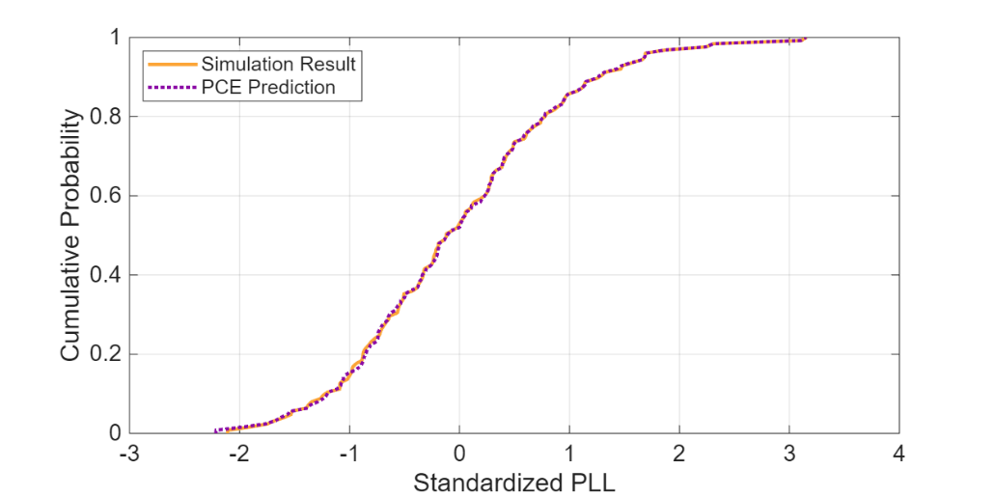
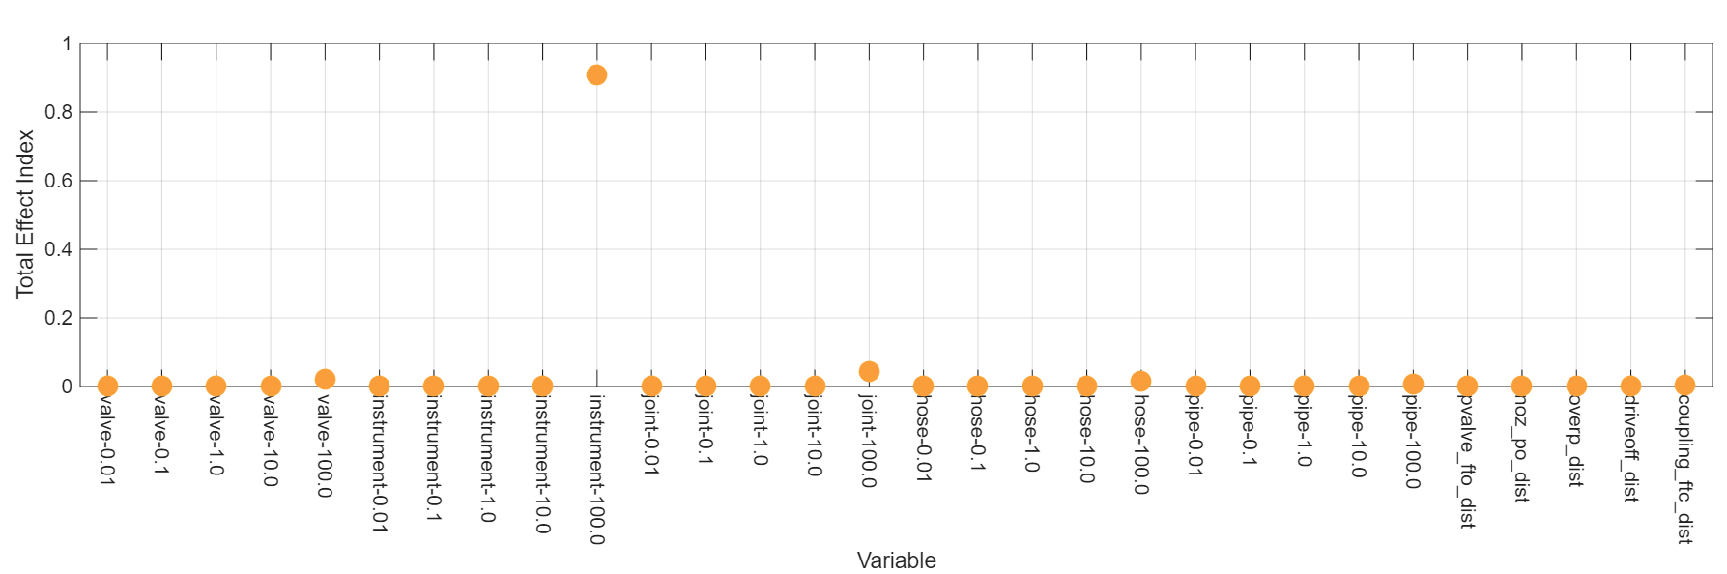
Case 1: Base Case
PCE approximates the input/output relationship very well
Total (and main, not shown) effect indices indicate the instrument rupture frequency is the most influential input uncertainty.
PCE estimates the output distribution very well
Sensitivity indices calculated for all spatial realizations, but results are so similar they cannot be distinguished in the plot.

Slide 13
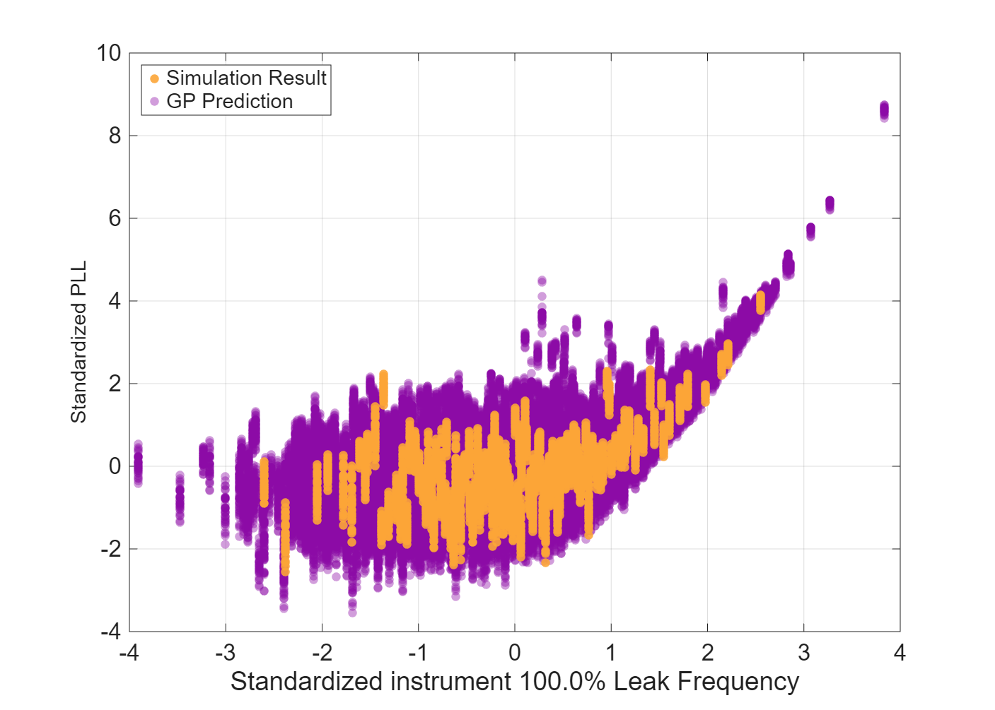
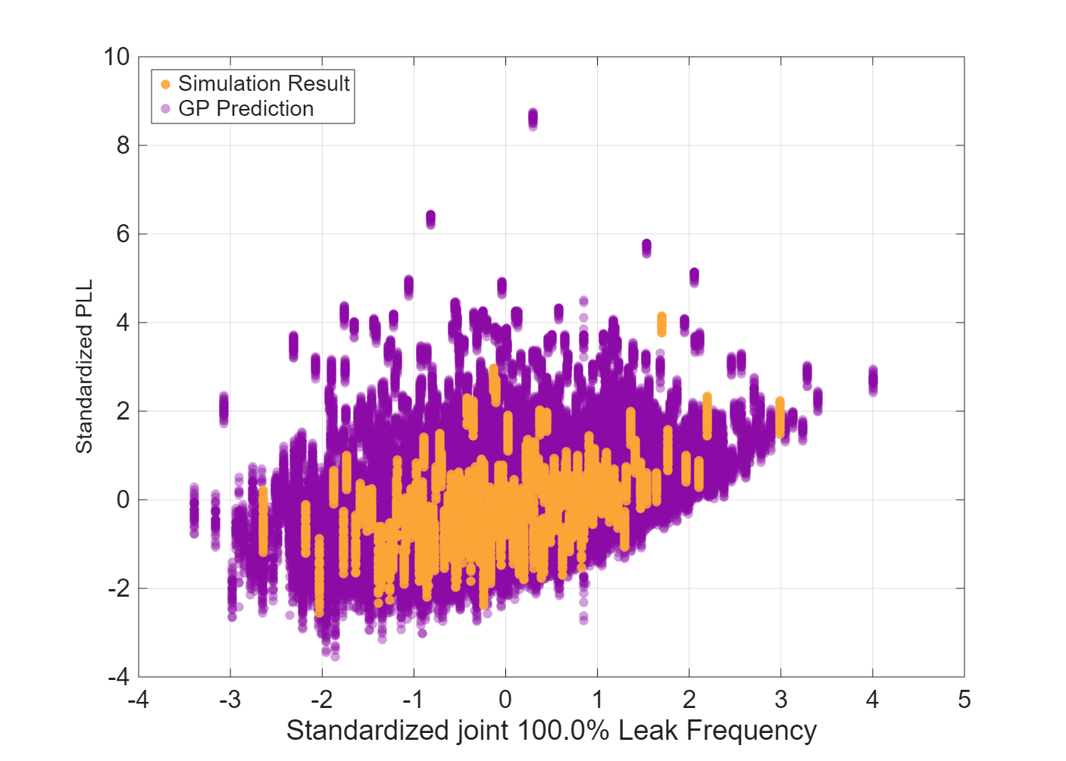
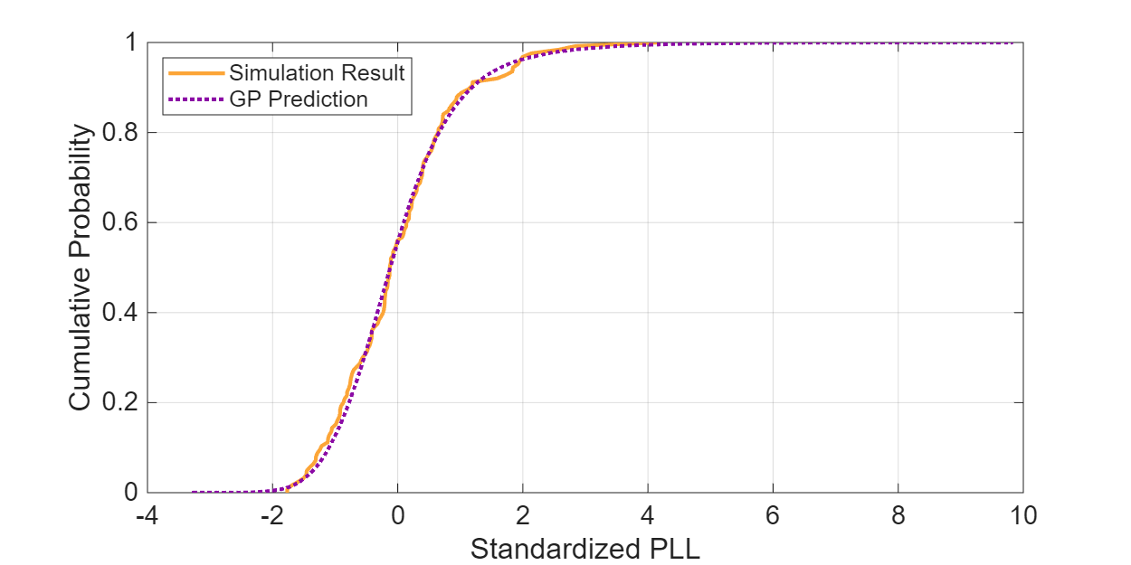
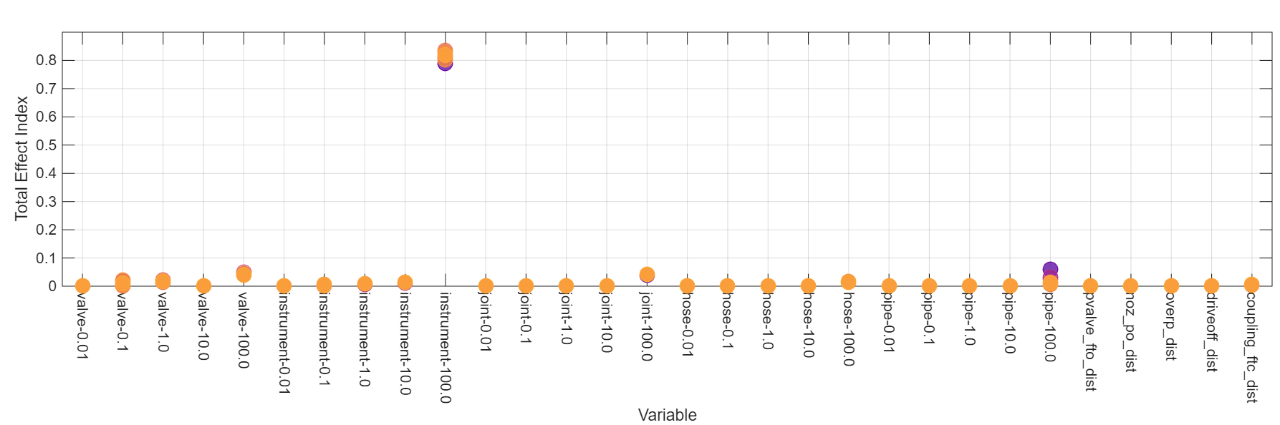
Case 3: Higher Pressure
GP approximates the input/output relationship well
Conclusions mostly the same as Case 1; we do see slightly different sensitivity index values for different spatial realizations (different colors)
GP estimates the output distribution well
Notes:
Note for Brian: The reason the PCE dots from the surrogate are basically exactly on the HyRAM+ points and this isn’t the case for the GP comes down to the output Dakota gives for cross validation for each model. For PCEs, it gives you the PCE estimates for the points you built the model on. For GPs, it gives you the GP estimates at a new sample of points. It was way out of scope for this to work with the Dakota folks to get a unified approach implemented.

Slide 14
Conclusions
Sensitivity Analysis Conclusions
  We did not present the results of all four cases because they are very similar
    Moving occupants closer and/or increasing system pressure did not change sensitivity conclusions
  Regardless of system pressure or occupant location relative to the leaks, instrument rupture frequency is the driving uncertainty
  Pipe rupture frequency also has an influence, but it is a much weaker influence
Overall Conclusions
  QRA is a valuable tool for understanding the risks associated with specific system configurations and operating conditions of hydrogen systems
  Incorporation of uncertainty quantification and sensitivity analysis methods will improve the effectiveness of QRA to inform safety decisions
  Such methods can be readily incorporated into QRA problems being solved using HyRAM+
  These methods are a significant advancement towards better informing risk decisions
  This was a first step; the treatment of uncertainty with HyRAM+ can be improved

Slide 15
Thank You!
Questions?
This material is based upon work supported by the U.S. Department of Energy, Office of Critical Minerals and Energy Innovation (CMEI), specifically the Alternative Fuels and Feedstocks Office (AFFO)

