Slide 1
Hydrogen Contribution to Risk in Post-Crash Outcomes for Rail Locomotives
Brian Ehrhart, Dusty Brooks,
Ben Schroeder
Probabilistic Safety Assessment & Management Conference (PSAM) 18
July 19-24, 2026
SAND2026-23501C

Slide 2
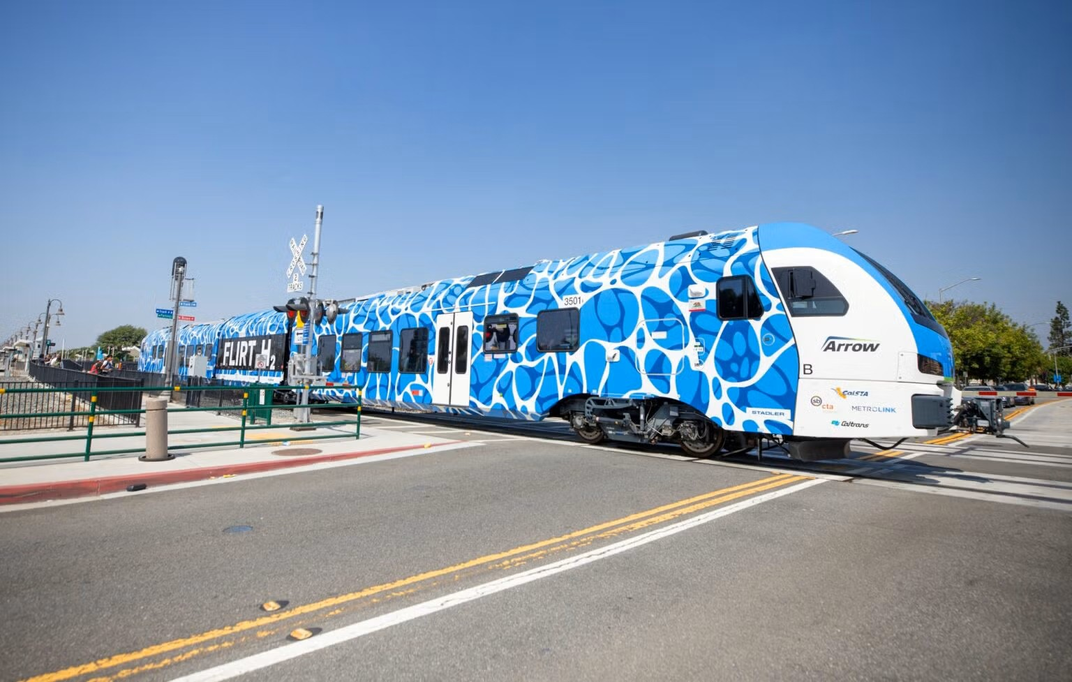
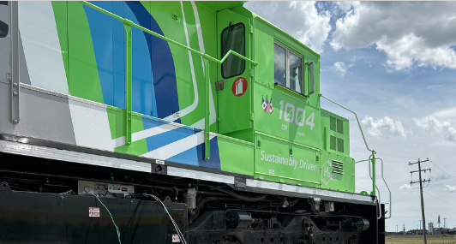
Hydrogen in Rail Applications
Hydrogen is being used as fuel for in-service freight and passenger rail
  SBCTA: entered service in 2025
  CPKC: multiple locomotives entered service in 2025
Prioritizing uncertainties in hydrogen hazards for rail applications
  Not attempting to quantify absolute risk or harm
  E.g., train collisions can be damaging without fuel release
Data on FRA and PHMSA incidents consistently showed a decreasing trend over time
  Using all of the data since 1976 would be highly conservative
  Data from 2000 to 2020 was used
Images:
https://www.gosbcta.com/project/zero-emission-multiple-unit-zemu/
https://www.cpkcr.com/en/sustainability/Hydrogen-locomotive-program

Slide 3
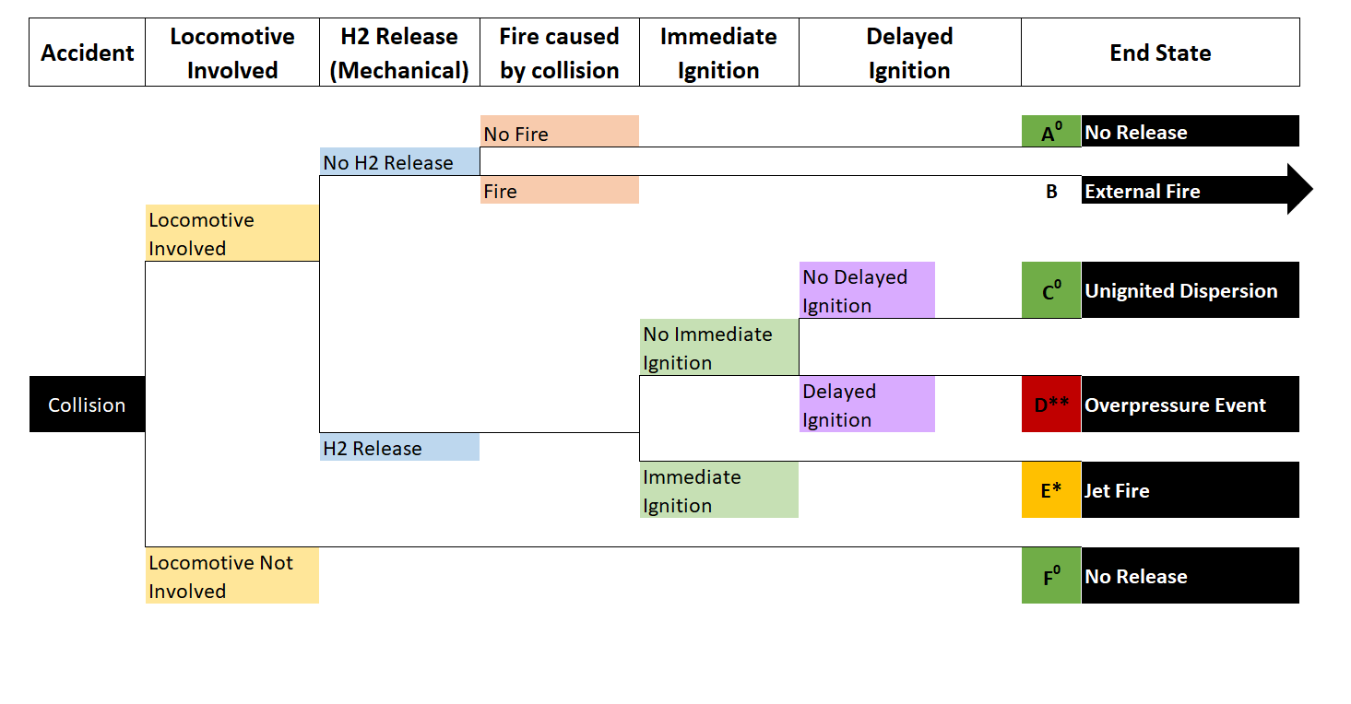
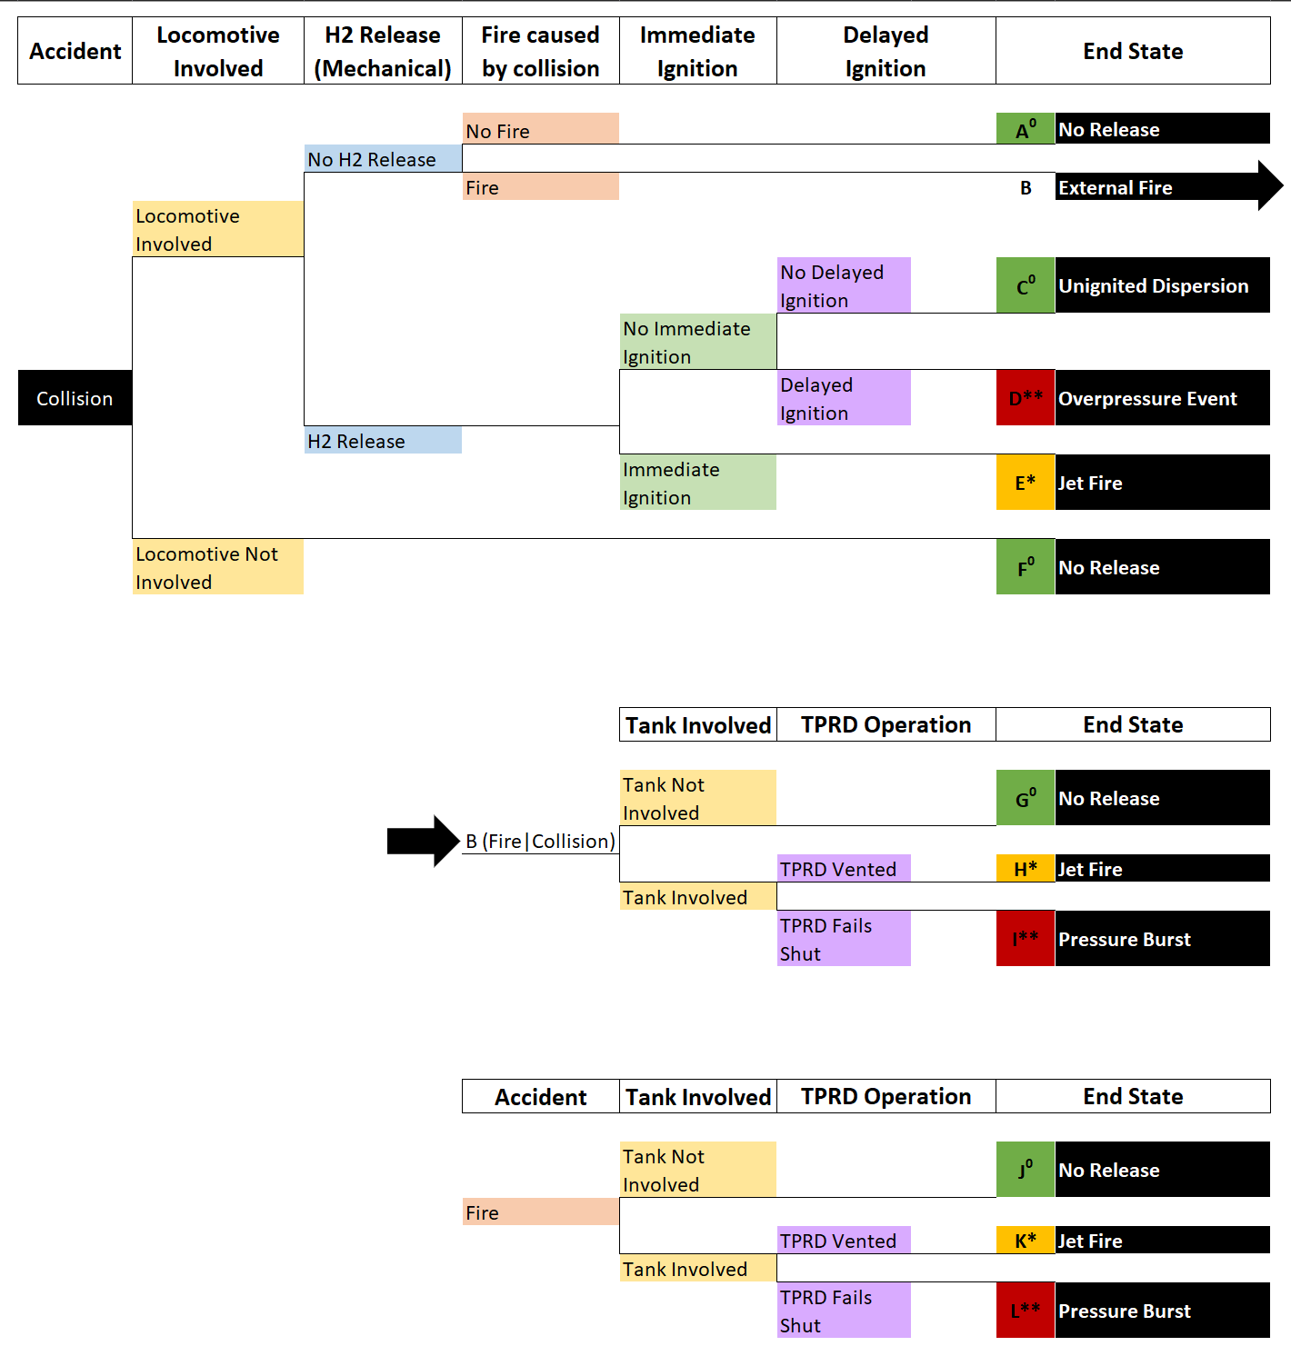
Model Structure: Accidents Initiating with a Collision*

Slide 4
Uncertainty Quantification/Distribution Sampling
Objective: Assess possible post-crash outcomes for rail accidents involving hydrogen-fueled trains
Risk Model
Risk Analysis Results
Data Analysis
Uncertainty Quantification
Uncertainty distributions are sampled many times for each event in the risk model
  The risk model is evaluated on each sample
Results in a distribution of possible risk values that are supported by data
Risk analysis results are presented as uncertainty distributions (using cumulative distribution functions) on the frequency (or probability) of each accident scenario
Notes:
If people want to know why we used CDFs, it’s because the risks vary by so many orders of magnitude that everything needs to be on a log scale. Histograms are generally more easily interpreted, but not necessarily when they have to be on the log of the QoI.

Slide 5
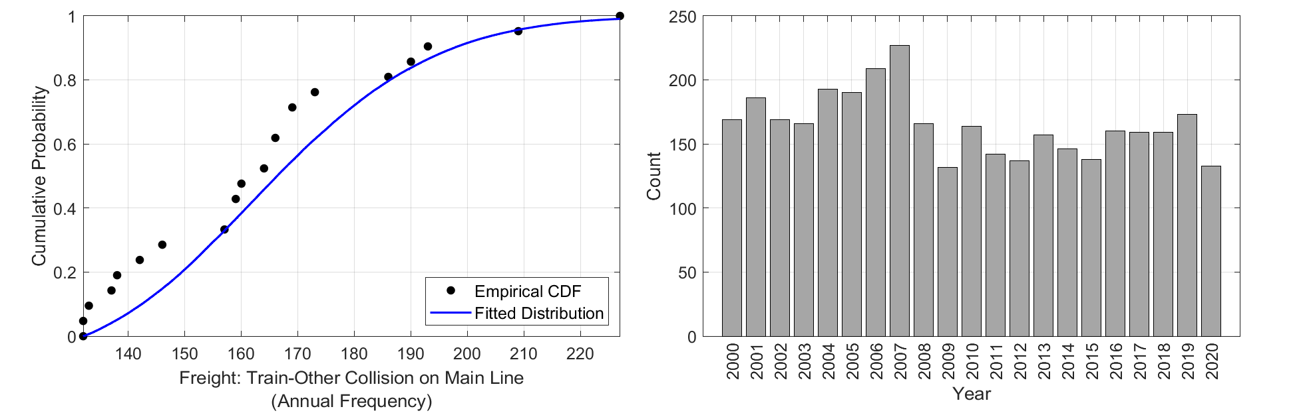
Initiating events
Treated each year of data as a single data point
  Frequency is estimated as the number of incidents per year
  Estimated per train type (passenger or freight) and collision type:
  freight/passenger, derailment, train-train, train-other, fire-explosion
Only showing “Freight: Train-Other” data in this presentation
  Other collision types included in full report:
  Brooks et al. SAND2026-22699, https://doi.org/10.2172/3376522

Slide 6
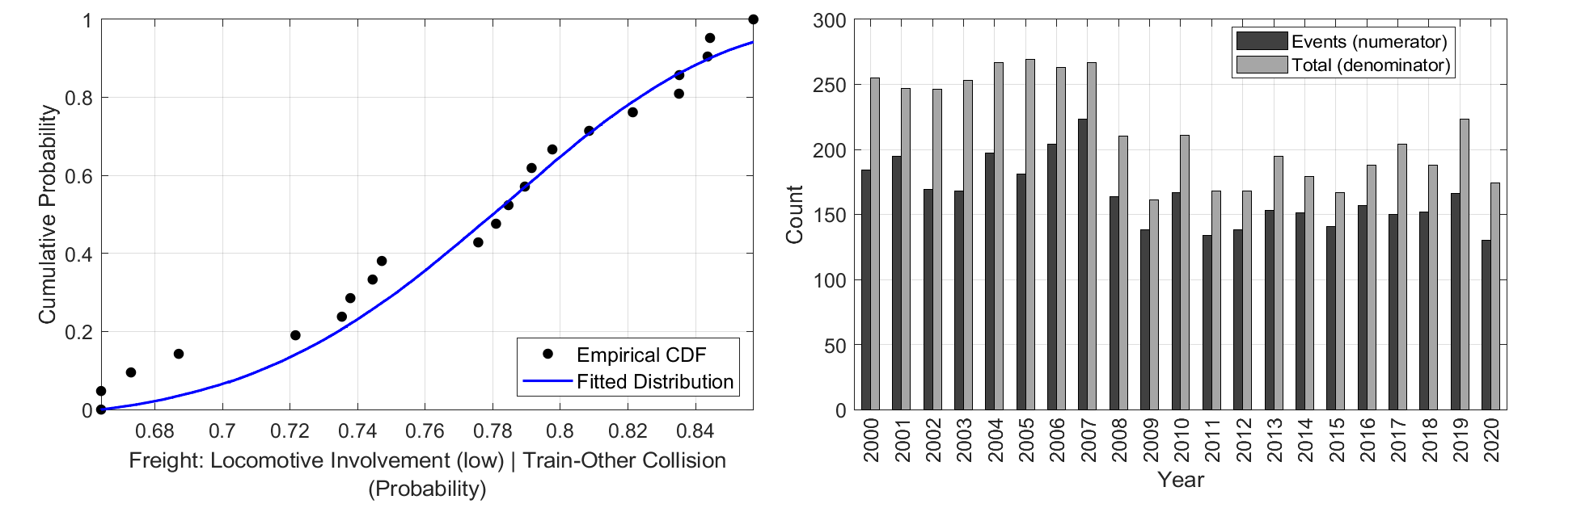
Locomotive Involved/H₂ Mechanical Release
FRA database provides position of first car involved and number of head-end (front) locomotives
  If position is less than number of head-end locomotives:
  assumed a locomotive was involved
  Do not know if a mid/rear-end locomotive was involved
    This was considered in a sensitivity analysis
Mechanical insult – physical damage leading to H₂ release (from DOT PHMSA database)
  Used rail collisions and where quantity released (of anything) was greater than zero
  Conservative estimate – studied in sensitivity analysis (on later slide)
Locomotive Involved
The numerator is the number of train-other freight collisions that year that involved a locomotive
The denominator is the total number of train-other freight collisions that year

Slide 7
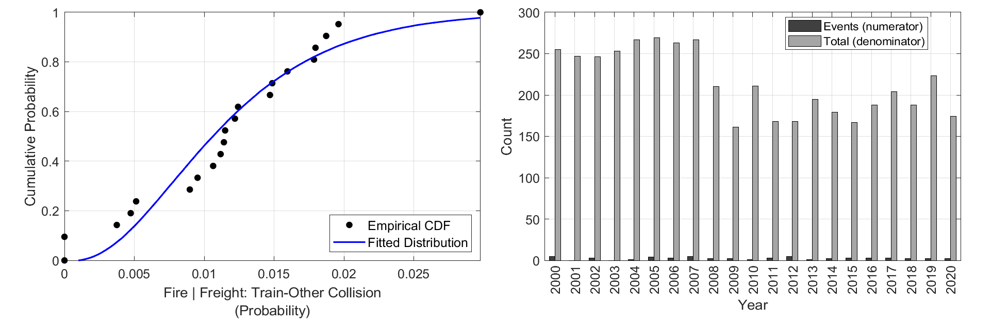
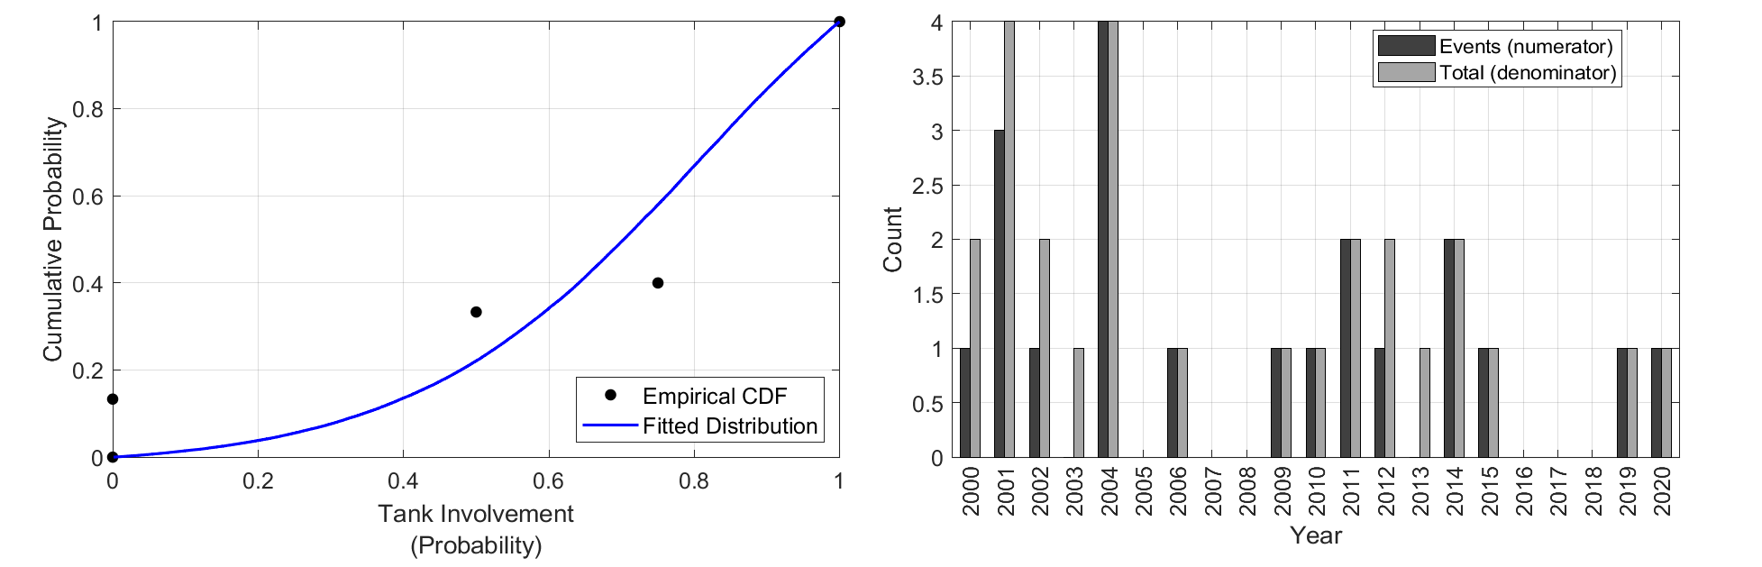
Fire Caused by Collision/Fire without Collision
Fire Caused by Collision
Tank Involvement in Fire
FRA database distinguishes between incidents initiating with fire/explosion or initiating with collision
Incidents were counted as collision-induced fire if:
  They were categorized as initiating with a collision
  Had narrative that included “fire” outside of “fireman”, “firemen”, or “fire department”
PHMSA database tracked incidents
initiated by fire/heat and indicates
whether hazardous release occurred or not
  If a release occurred, assumed the tank was involved
  If a release did not occur, assumed the tank was not involved
    Due to high reliability of relief devices

Slide 8
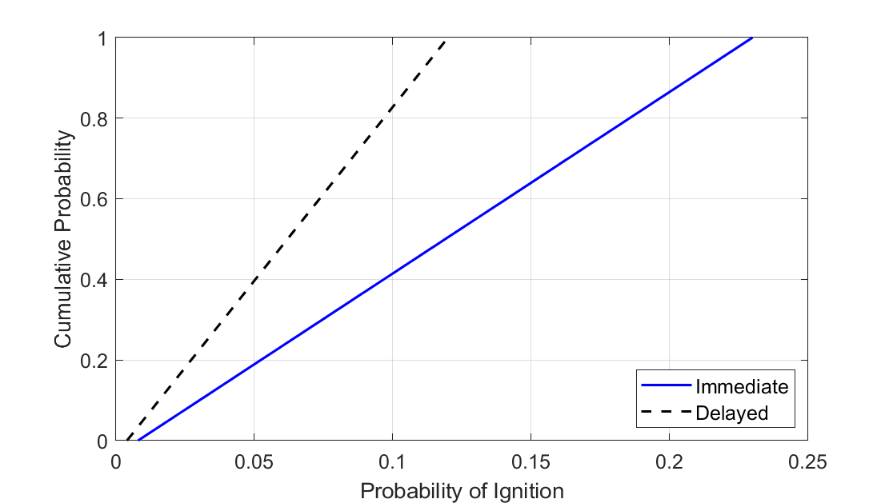
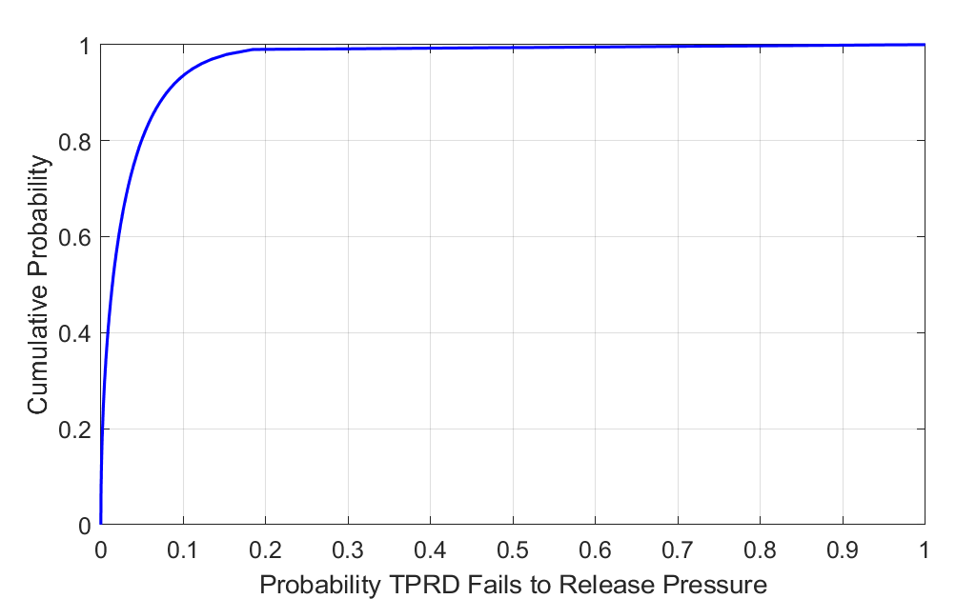
Ignition Probabilities/TPRD Operation
Immediate/Delayed Ignition
TPRD Operation
Probabilities were derived in previous work and are known to be highly uncertain
  No strong evidence due to lack of data
Uniform distributions between probability point estimates in the literature
Probabilities were derived in previous work, likely conservative
  No strong evidence due to lack of data
Beta distribution using Jeffreys prior
Notes:
You may get a question about why we used a uniform in one case and a beta in the other; this is because the data we do have for TPRD operation is trial data (success/failure binary data). The probability of a success (or failure) is naturally modeled by a beta distribution. For the immediate/delayed ignition case, the data we have is in the form of probability estimates, so we really just have to fit a distribution directly.

Slide 9
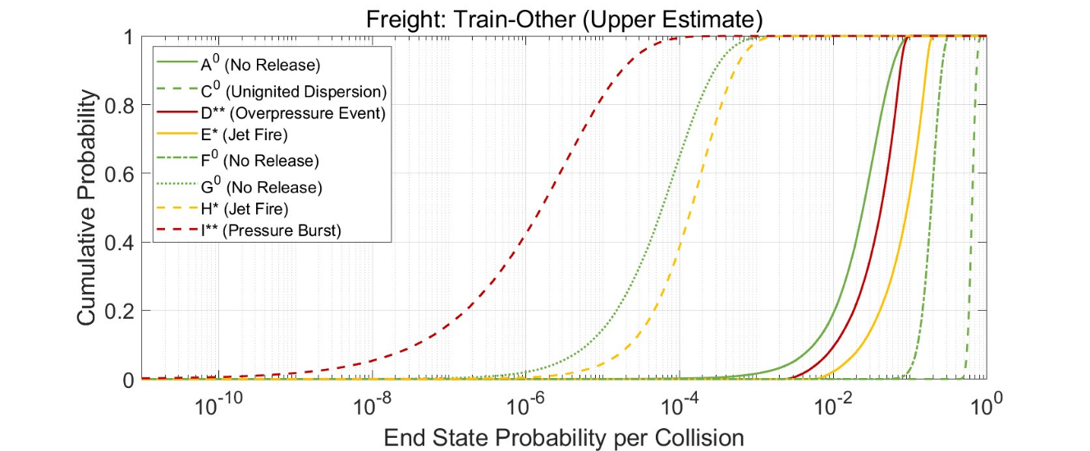
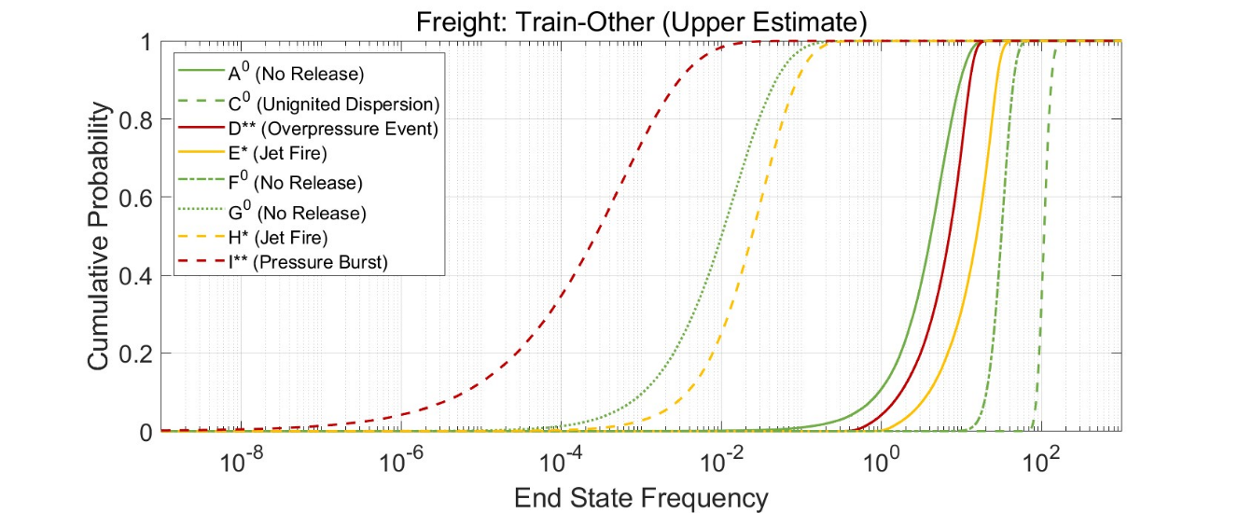
Risk Results
End-State Probability
End-State Frequency

Slide 10
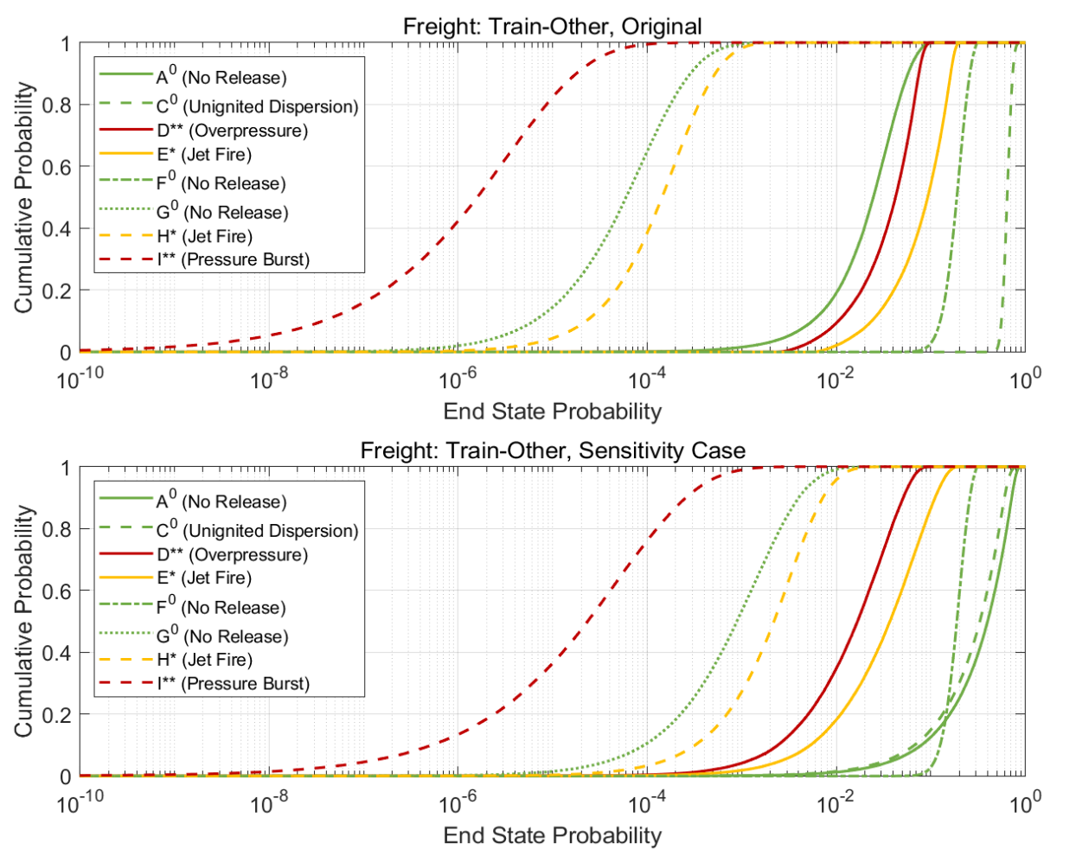
Mechanical Impact Sensitivity
Beta distribution derived from data was replaced with a uniform distribution between 0 and 1
  Maximum uncertainty
  This change shifts (lowers) median values and increases uncertainty (distribution width)
Original distribution likely conservative, due to generic (not hydrogen-specific) data
  Does not account for the more robust design of a hydrogen vessel to withstand mechanical insult
A distribution fit to hydrogen-specific data would also be expected to narrow the distributions on end state probabilities (i.e., reduce uncertainty)

Slide 11
Summary/Conclusions
Most likely end-states do not have significant contributions to consequences from hydrogen
Release due to mechanical insult is highly uncertain and significantly affects the estimated likelihood of end states
  Reducing uncertainty may change these conclusions
Ignition probabilities are highly uncertain and significantly affects the estimated likelihood of end states
  Reducing uncertainty may change these conclusions
Scenario frequencies are highly conservative compared to what would be expected during early adoption of the technology
  Initially, only a small proportion of operating trains would be hydrogen trains
End state descriptions are potential hazards
  Actual consequences would depend on many factors (e.g., orientation of the leak, proximity to people, etc.)

Slide 12
Thank You!
Questions?
This work was supported by the U.S. Department of Transportation Federal Railroad Administration, under the direction of Melissa Shurland

Slide 13
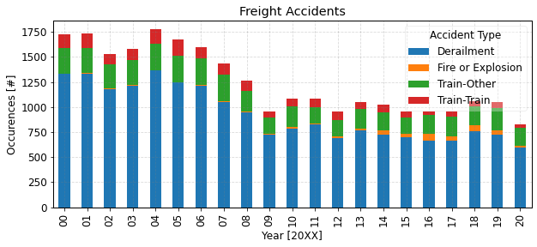
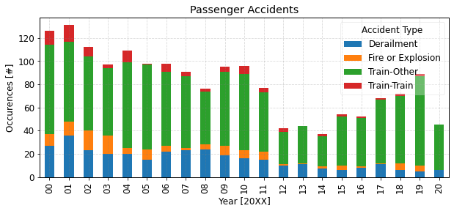
Freight and Passenger Accidents from FRA Database

Slide 14
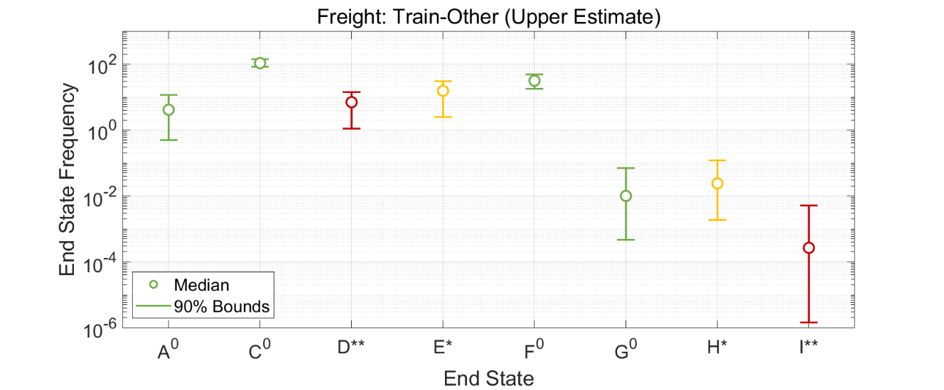
CDF vs. Box-and-Whisker

