Slide 1


In collaboration with

Slide 2

Overview
Background:
Each outage is planned according to operational readiness requirements laid out in the Technical Specifications
  Tech Specifications are mainly based on Deterministic Safety Assessment (DSA) with a significant amount of inherent conservatism
Goal:
Enable outage plans to be evaluated not only from a safety perspective (radiological release) but also from economic perspectives in terms of prolonged outage leading to loss of production
Create an interface with the Probabilistic Safety Assessment (PSA) model that can be used by non-PSA experts, i.e. the outage planner
The two big questions:
How to define economic consequences in a way that can be incorporated into the PSA?
What refinements are needed in the baseline PSA for outages?
  Current outage PSA evaluates safety for a typical outage with few variations (e.g. partly unloaded core vs fully unloaded)

Slide 3
Defining economic consequences
Definition:
Economic consequences are those deemed acceptable from a safety perspective (i.e. do not lead to a release of radionuclides) but will have a negative impact on the facility’s ability to produce electricity, i.e. loss of production. Such production loss can be cased by:
  Failures (damages) on SSCs (Structure, Systems and Components) which may require repair, or
  Exceedance of highest permissible limit (e.g. pressure, temperature) as defined in the Technical Specifications
Example from the spent fuel pool at Oskarshamn 3:
If the temperature in the Spent Fuel Pool (SFP) would reach 60°C (140°F) this is not a problem from a safety perspective in terms of the ability to prevent core or fuel damage
However, 60°C is the first temperature limit which indicates that the plant has not been within the boundaries of the Operational Limits and Conditions (OLC) which in turn will give rise to various types of investigation and documentation which in turn will prolong the outage time ➔ production loss.
  Other temperature limits are 80°C (176°F) and 100°C (212°F)

Slide 4
Expanding the consequence analysis
Acceptable from a safety perspective
Unacceptable from a safety perspective
  ED - Economic Damage, all fuel elements intact ➔ Loss of production.
  FD - Fuel Damage, mechanical damage or thermal overheating of fuel elements outside the reactor core
  Further subdivided into:
  EFD - Economic Fuel Damage, mechanical damage of fuel elements
  TFD - Thermal Fuel Damage, overheating of fuel elements
OK
CD
Adjustment of screening criteria
OK
ED
FD
CD
Consequence assessment
OK
ED
EFD
TFD
CD
A method for including economic consequences in your PSA model – In collaboration with
Notes:
In the baseline PSA for outage, there are only two type of consequences defined – CD and “no CD”, i.e. OK. A “CD sequence” are those that lead to a radioactive release which give rise to public doses exceeding the acceptance criteria. The are the sequences in the PSA which compose the core damage frequency (CDF) in PSA Level 1.
It was recognized in this project though that there are some initiating events that will have an impact on the integrity of fuel elements (assemblies) which will give rise to a radioactive release, but the initiating event has been screened out as it can be shown with deterministic assessment (DSA) that this release will not exceed the acceptance criteria for doses to the public. An example of such initiating events are various types of load drops. This is why the bar for FD in the middle section overlap the OK bar in the top section.
It shall also be noted that CD is a mixture of sequences which are related to fuel elements located either in the reactor core (CD) or fuel elements located in the Spent Fuel Pool. To distinguish between these, CD in the baseline PSA can be subdivided into CD and FD.
It was also concluded that those sequences that are evaluated in the baseline PSA are only those related to overheating of fuel elements.
The conclusion from this new definition of consequences is that if you are to evaluate economic consequences (prolonged outage / loss of production) one need to look closer into the sequences that are defined as OK in the baseline PSA.

Slide 5
Screening of Initiating Events
As shown in previous slide, sequences assigned with end state “OK” in the baseline PSA can lead to economic consequences (prolonged outage ➔ loss of production)
In the baseline PSA, several initiating events have been screened out:
  Cannot cause “CD” (radiological release that exceeds acceptance criteria) within the time frame of the PSA*)
  The frequency can be show to below screening frequency **)
The initiating event analysis for the baseline PSA must be revisited to determine which screened out initiating events need to be screened in when scope is expanded to economic consequences
*⁾ Mission time for Level 2 is 48 hours ➔ a screening time on 50 hours have conservatively been chosen for initiating events
**⁾ 1E-07/year

Slide 6
*⁾ Heavy loads (≥1000 kg); Not heavy loads (<1000 kg)
Screening of Initiating Events – Examples
Load drops
Screened out in baseline PSA for core damage
Screening in for economic damages
  Consequence depends on when the load is being dropped and kind of load is being lifted *⁾
  Economic consequence from expected delay, based on engineering judgement
Loss of residual heat removal (LRHR)
Screened in in baseline PSA as LRHR can lead to uncovery of fuel elements in the spent fuel pool or reactor vessel
  Assumed to lead to overheating of fuel elements (CD)
Need to be screened in also for economic consequences
  Events “OK sequences” in baseline PSA can that lead economic consequences due to high temperature in Spent Fuel Pool (> 60°C / 140°F)
CONCLUSION: More initiating events are screened in, and “OK sequences” need to be further developed when assessing economic consequences (loss of production due to prolonged outage)

Slide 7
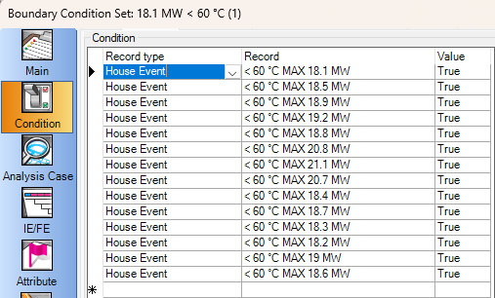
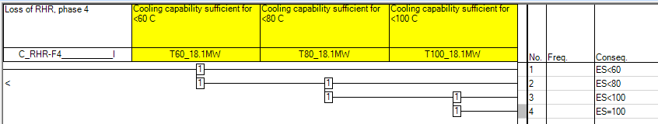
Example of event tree for economic consequences
For each phase, there is a fixed amount of residual heat in the SFP that needs to be cooled (18.1 MW in phase 4)
All function events are using the same input
  Generic fault tree structure representing all possible combinations of system functions and their cooling capability
Boundary conditions are used to select all combinations that have a capacity equal to, or greater, than the residual heat.
The event tree is able to determine the frequency for SFP temperature:
  T<60°C (OK)
  60°C <T<80°C (ED8)
  80°C <T<100°C (ED6)
  T=100°C (ED4)
A method for including economic consequences in your PSA model – In collaboration with

Slide 8
Production delay divided by a year
Weighting of economic consequence
Consequence Code | Description | Production Delay (estimate) | Weighting
CD | Uncovering of fuel in reactor core with reactor vessel head on | Permanent (5000 days) | 13,7
TFD1 | Uncovering of fuel in reactor core with reactor vessel head off | 1000 – 5000 days (average 3000 days) | 8,22
TFD2 | Uncovering of fuel in spent fuel pool | 50 days | 0,14
EFD1 | Drop of moderator vessel cap or fuel handling bridge on fuel | Permanent (5000 days) | 13,7
EFD2 | Drop of component on fuel inside reactor core | 0,5-3 years (1,75 years) | 1,75
EFD3 | Drop of fuel | 30 days | 0,08
ED1 | Drop of reactor vessel head on flange | Permanent (5000 days) | 13,7
ED2 | Non-isolated LOCA | 1000 – 5000 days (average 3000 days) | 8,22
ED3 | Independent Core Cooling System activation | 1000 days | 2,74
ED4 | Temperature in spent fuel pool > 100°C | 1000 days | 2,74
ED5 | Drop of equipment that lead to medium duration process delays | 0,5-3 years (average 1,75 years) | 1,75
ED6 | Temperature in spent fuel pool > 80°C | 100 days | 0,27
ED7 | Drop of equipment that lead to short duration process delays | 30 days | 0,08
ED8 | Temperature in spent fuel pool > 60°C | 10 days | 0,03
OK | No ED, EFD, TFD or CD. | N/A | 0,00
A method for including economic consequences in your PSA model – In collaboration with

Slide 9
User interface
Based upon system configuration (bottom) defined, the results displayed in the interface are:
  Total contribution from each consequence
  Relative contribution from each consequence
  Hourly and accumulated risk as percentage of total acceptance criteria
Configuration
Import script
Refuelling outage plan
User Interface
PSA-model
Results
Risk informed decisions

Slide 10
Summary of additional activities for inclusion of economic consequences
Definition of economic consequences (production loss in terms of delayed start-up after outage)
Revisit initiating event analysis (screened out ➔ screened in)
Development of “OK sequences” in the baseline PSA so that economic consequences can be assigned
  Similar process as when expanding Level 1 to Level 2
  Grouping of sequences depending on “plant damage state” when baseline PSA reach OK
Revisit of system requirements for “OK sequences” depending on success criteria as defined by the economic consequences
Identification of system function that have not been credited in the baseline PSA but may have an impact on economic consequences
Refinement of the PSA model
  “Hour by hour” analysis instead of “yearly”
  Modelling of system functions for success criteria as defined by the economic consequences
  Development of “OK sequencies”
Development of user interface

Slide 11
Sebastian Jovancic
Consultant
+46 70 05 800 31
Sebastian.Jovancic@vysusgroup.com

Slide 12
Appendix A - Residual heat removal system combinations
Steady-state calculations
Use:
  Specify which phase during shutdown
  Specify temperature limit
  Shows in green or red which combinations are OK or NOT OK

