Slide 1
AI and Operational Boundaries:
A Basis for Analyzing Safety of Human-AI Teams
PSAM 18, Pittsburgh, July 19-24, 2026
Andreas Bye
Chief Scientist
Programme Manager
OECD NEA Halden HTO Project

Slide 2
Outline
AI in nuclear: where and for what?
Challenges
Dimensions in human-AI teaming
  Explainability, trust, trustworthiness
  Automation – remote
  Role of humans
What are the questions that need to be addressed before and during deployment of AI in nuclear?

Slide 3
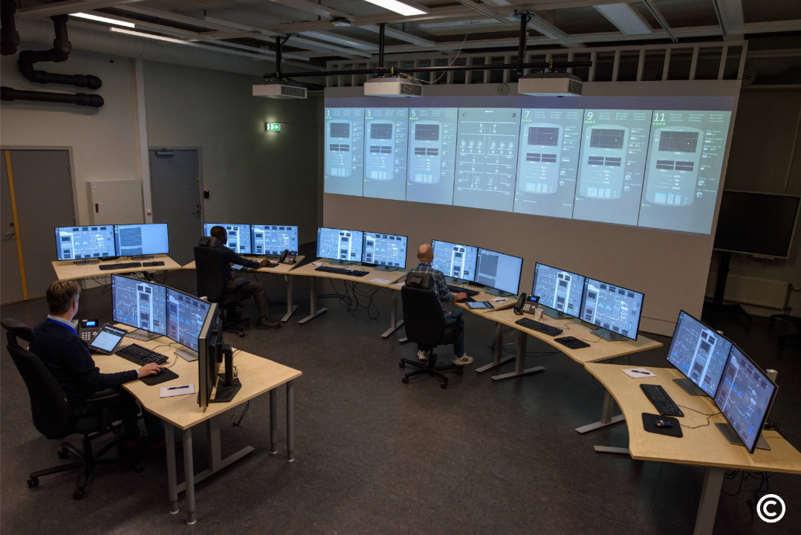
HAMMLAB, SMR simulator
Foto: Gyrd Skråning / © IFE

Slide 4
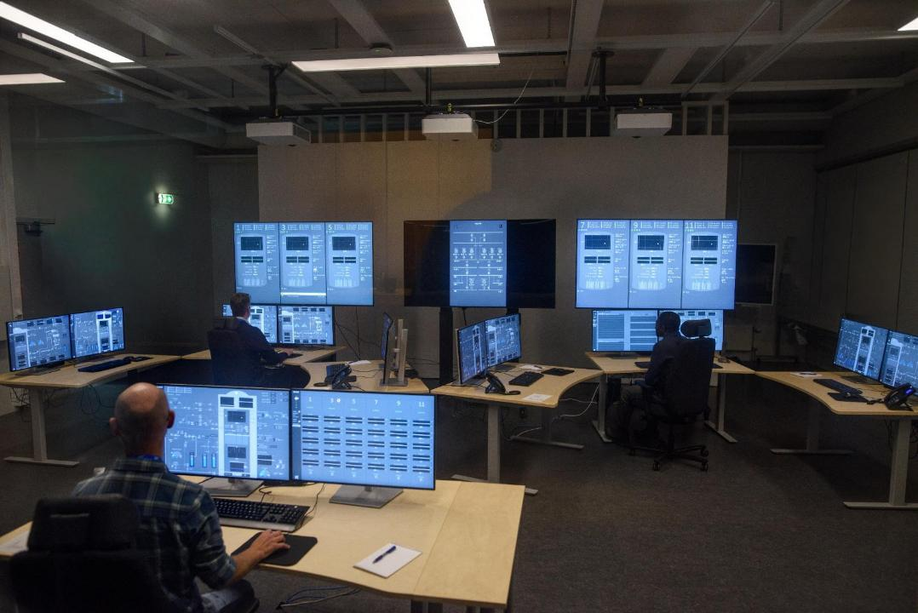
HAMMLAB, SMR simulator
Foto: Gyrd Skråning / © IFE

Slide 5
AI and Operational Boundaries
Three years ago: AI and nuclear? NO
Two years ago, RIC: Skeptical HF people, enthusiastic tech guys
Now: We embrace the technology, and begin to ask the right questions: «AI and autonomous technologies redefine operational boundaries»
  What are these boundaries?
  Are the same questions and challenges relevant for all of them?
AI in the loop?

Slide 6
AI in the control loop?
HS
I
Action
AI ?
Control room
AI?
AI?
SCR
Safety loop
Auto
AI
Process, plant
Notes:
Plant modernization
Flexible use of nuclear, non-electrical. New inflation reduction act will have impact.

Slide 7
AI in the loop?
www
AI
SOC
AI
HS
I
Action
OPEX
Lessons learned
Safety analysis
AI ?
Control room
AI?
AI?
AI
Maintenance
System engineers
Optimization
Robotics
SCR
Safety loop
Auto
AI
Process, plant
Notes:
Plant modernization
Flexible use of nuclear, non-electrical. New inflation reduction act will have impact.

Slide 8
AI in the loop?
www
AI
SOC
AI
HS
I
Action
OPEX
Lessons learned
Safety analysis
AI ?
Control room
AI?
AI?
AI
Maintenance
System engineers
Optimization
Robotics
SCR
Safety loop
Trust
Performance
Explainability
From within AI
Or for the user?
Auto
AI
Process, plant
Notes:
Plant modernization
Flexible use of nuclear, non-electrical. New inflation reduction act will have impact.

Slide 9
AI and Operational Boundaries, Qs
AI is not AI, technologies are different:
  Large Language Models (LLMs) vs Machine Learning (ML)
When are we «in the loop»?
  Are there hidden links?
  What about confinement?
What are the dimensions to look into for the various loops?
  Explainability
  Performance
  Risk
  Human oversight
  Trust vs trustworthiness
    From within AI: Trustworthiness (e.g., objective hallusination rate for LLMs, accuracy for ML)
    For the user collaborating with AI: Trust (this may be miscalibrated)

Slide 10
Reimagining Human-AI teaming
Many ways to succeed
  Passive monitoring with active AI?
  Active monitoring with passive AI?
  Active monitoring with active AI?
Link to automation
  Advanced automation?
  More transparent automation?
  Finally a possibility to make automation collaborative and exchange views and strategies?
Different requirements in the various operational boundaries
  In the control loop and outside the control loop
  Safety systems vs non-safety
  Support for detection vs support for diagnosis
Different technologies – different requirements?
  Machine learning (ML) can be used if well confined?
  Large Language Models (LLM) can be used if human oversight, to take care of halluzinations?

Slide 11
Safety analysis of human-AI systems
Design and off-line use of AI is different from on-line use
  However, it may have safety implications to do wrong safety analysis
Use of AI in safety analysis may support the safety analyst, not replace her/him
  Many possibilities of active and interactive support
Are there other scenarios to be aware of if there is AI involved in the plant?
  Like cyber security: similar to intention-based failures?
Are there other failure modes?
  Situation awareness (SA) over time
  Human-AI dependencies
    Relations over time, building trust or dis-trust

Slide 12
Conclusions
AI has so much potential, great opportunities
AI cannot be let loose on safety systems or in the control loop without human oversight and control
The way to include AI is then to design good human-AI teaming solutions
Good Human Factors Engineering, V&V. These do not change, neither does PRA
«AI and autonomous technologies redefine operational boundaries»
  Operational boundaries and envelopes do not change with AI
  They should be defined up front
  Treat based on risk, in risk-informed and performance-based processes.

Slide 13

Thank you!
Andreas.Bye@ife.no

