Slide 1
Integration of Physical Simulation with PRA
for Nuclear Energy Systems:
Literature Review and Conceptual Framework
Amir Shahriar Kalantari Oskouiª, Wen-Chi Cheng^{b}, and Tatsuya Sakuraharaª
ª Risk Analysis and Reliability Engineering (RARE) Laboratory, Department of Mechanical Engineering and Materials Science,
Swanson School of Engineering, University of Pittsburgh, Pittsburgh, PA, USA
^{b} Department of Integrated Systems & Thermal Analysis, Energy & Environment Science & Technology Directory,
Idaho National Laboratory, Idaho Falls, ID, USA
The 18th Probabilistic Safety Assessment & Management conference (PSAM 18)
July 2026

Slide 2
Integration of PRA and Physical Simulations
Physical simulations are increasingly used in PRA of nuclear energy systems
Advances in computational power enable the execution of physical simulations within timeframes consistent with PRA implementation
Growing recognition of the value of integrating physical simulations with PRA
Advantages
New reactor designs
  Compensate for limited operational data and provide a mechanistic understanding
Existing plants
  Producing more detailed risk insights, facilitating the risk-informed application, such as lifetime extension, power uprate, and operational and maintenance efficiency
MEMS Department, Risk Analysis and Reliability Engineering (RARE) Laboratory
Notes:
Recently, physical simulation has increasingly been used to support PRA in nuclear energy systems. This increase is a result of two driving forces: "advances in computational power enable the execution of physical simulations within timeframes consistent with PRA implementation", and second, the value of integrating physical simulation PRA is better recognized.
The advantages of the integration of PRA physical simulation for new reactor designs is “compensating for limited operational data and providing a mechanistic understanding”, while” existing plants take advantage of producing more detailed risk insights, facilitating the risk-informed application, such as lifetime extension, power uprate, and operational and maintenance efficiency”

Slide 3
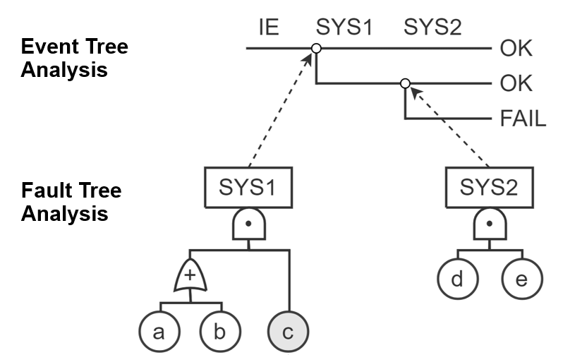
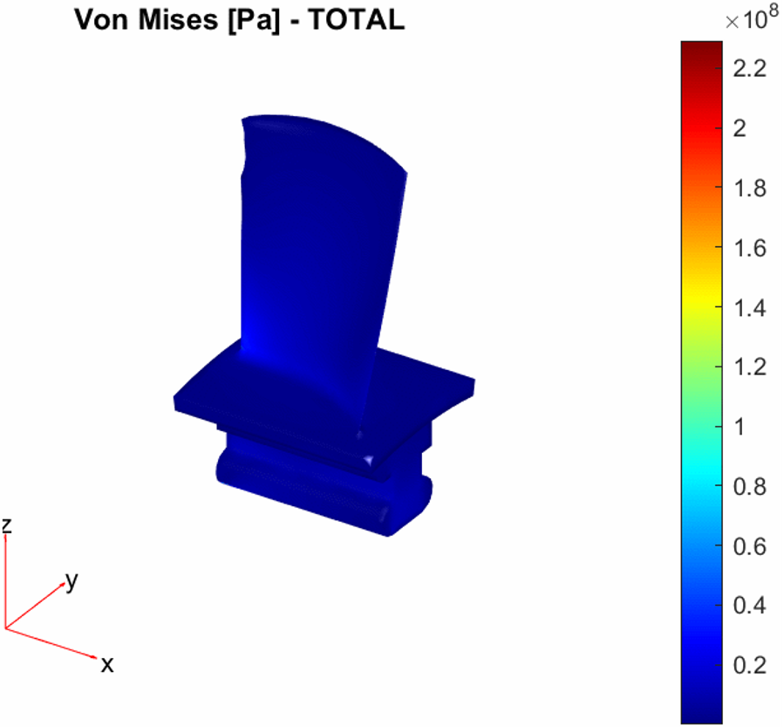
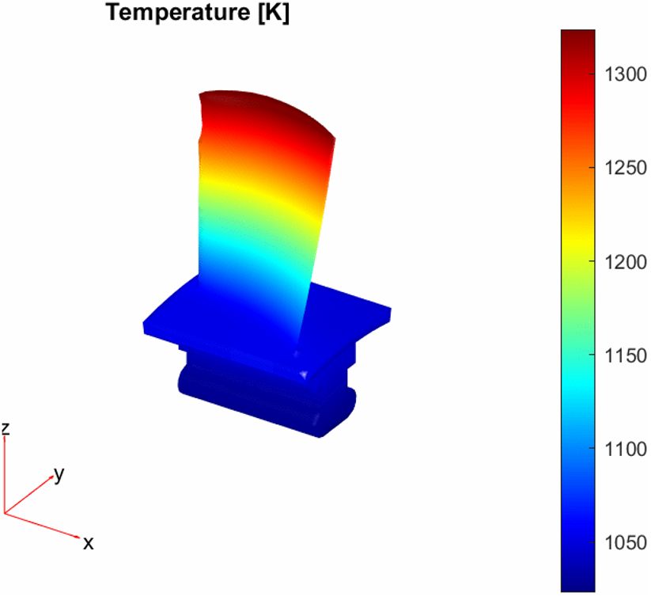
PRA-Physics Simulation Interface
PRA
Existing PRA models for nuclear systems (event trees, fault trees)
Physical simulations
  Physics-based computational models that numerically solve governing equations (e.g., conservation of mass, momentum, and energy) to predict the progression of physical phenomena and system behavior under specified conditions
Interface
  The structural and methodological connection between PRA logic and physical simulations, specifically, how their input-output exchange is operationalized
Interface
Finite Element Analysis
Physical Simulation
MEMS Department, Risk Analysis and Reliability Engineering (RARE) Laboratory
Notes:
In this research, by PRA we refer to PRA models, including event tree and fault tree analyses.
By Physical simulation, we refer to “physics-based computational models that numerically solve governing equations (e.g., conservation of mass, momentum, and energy). They are used for “predicting the progression of physical phenomena and system behavior under specified conditions”. An example can be a finite element analysis, or a thermal-hydraulic code
By the interface, we are referring to “the structural and methodological connection between PRA logic and physical simulations, specifically, how their input-output exchange is operationalized “

Slide 4
Research Contributions
Goal
  Establish a generic technical basis, applicable across reactor types and simulation codes, for guiding the development and improvement of PRA-physical simulation interfaces
01
02
03
Literature Review
Conceptual Framework
Practical Use of Conceptual Framework
Characterize the state of the art in PRA-physical simulation integration and to identify research gaps that require further investigation.
Propose a conceptual framework to analyze PRA–physical simulation interfaces, serving as the theoretical basis for evaluating adequate and viable approaches.
Discussion on the Benefits and Practical Implementation of the Proposed Conceptual Framework Using a Case Study
MEMS Department, Risk Analysis and Reliability Engineering (RARE) Laboratory
Notes:
The research goal is “establish a generic technical basis, applicable across reactor types and simulation codes, for guiding the development and improvement of PRA-physical simulation interfaces”
To achieve this research goal, this paper covers three main sections: literature review, computational framework, and practical use of the conceptual framework.
Let’s start with the literature review.

Slide 5
Literature Review: Preliminary Scope
Preliminary selective review has been conducted focusing on
  References from the authors’ prior research on an integrated PRA (I-PRA) methodology [1, 2]
  Studies by Idaho National Laboratory (INL), primarily on the Grizzly application for probabilistic fracture mechanics analysis of reactor pressure vessels (RPVs) [3-14]
MEMS Department, Risk Analysis and Reliability Engineering (RARE) Laboratory
Notes:
The preliminary scope of this literature review is based on a selective review focusing on “references from the authors’ prior research on an integrated PRA methodology”
and
“Studies by Idaho National Laboratory, primarily focusing on Grizzly application for probabilistic fracture mechanics analysis of reactor pressure vessels (RPVs) ”.
In continuation, I am reporting the preliminary insight from the literature review, so this is an ongoing effort, but the content of this presentation is based on a limited number of references

Slide 6
Location of PRA-Physical
Simulation Interface
PRA
Systems
Components
Physical failure modes
Parts
Physical failure mechanisms
Part or component level
  Physical simulations are used to analyze the progression of
  failure mechanisms that initiate and accumulate damage in parts and components [1-13]
System level
  A dynamic PRA study that uses a thermal-hydraulic simulation code (e.g., RELAP5-3D) to model reactor system responses [14]
Interface
Finite Element Analysis
Physical Simulation
MEMS Department, Risk Analysis and Reliability Engineering (RARE) Laboratory
Notes:
First, in most studies, the location of the interface is located at the component or part levels, in these studies, “physical simulation analyzes the progression of failure mechanisms that initiate and accumulate damage in parts and components”
In contrast, the interface is located at the system level in a dynamic PRA study. In this study physical simulation “uses a thermal-hydraulic simulation code (e.g., RELAP5-3D) to model reactor system responses”

Slide 7
PRA
Key Features and Functionalities of the PRA-Physical Simulation Interface
Uncertainty quantification
  Sampling-based propagation makes deterministic simulations probabilistic [1-14]
Stochastic models
  e.g., multi-phase Markov process [2], semi-Markov process [13]
Component dependency
  Dependencies among multiple components that arise from shared causes and failure mechanisms using physical simulations [1]
Reduced order models (ROM) or surrogate models
  To mitigate the computational burden associated with full-physics simulations and the large number of repetitions required in sampling-based analyses [3-12, 15]
Verification and Validation (V&V)
  The interface introduces its own potential uncertainty sources [1, 2]
Interface
A
B
C
D
V&V
Stochastic Process
ROM or Surrogate Models
Finite Element Analysis
Physical Simulation
MEMS Department, Risk Analysis and Reliability Engineering (RARE) Laboratory
Inputs
Notes:
The other key insights were the features and functionalities of the PRA physical simulation interface,
One of the most common functionalities was the “uncertainty quantification” .
it uses “sampling-based uncertainty propagation, to make deterministic physical simulations probabilistic.”
Another feature is incorporating stochastic process models into the interface, for instance, “multi-phase Markov process or semi-Markov process”
Third:
In most of the studies, the computational interface was connected to a single component. However, when two or more components are involved, we need to address the component dependency.
Another feature from the literature review was “Reduced order models (ROM) or surrogate models “
The physical simulation can be computationally expensive. Therefore, some studies introduce ROM or surrogate models to reduce the computational time of physical simulations and a large number of repetitions for the uncertainty propagation.
Another feature of the interface is verification and validation.
Verification and validation (V&V) of the computational interface has received less attention than V&V of physical simulations. “The interface introduces its own potential uncertainty sources”, this can be including specific models, numerical methods, and associated parameters (e.g., state transition rates, sample sizes).

Slide 8
Conceptual Framework
There is no theoretical framework currently existing for the PRA-physical simulation interface.
An initial framework is proposed focuses on cross-layer mapping across the hierarchical structure of PRA modeling.
This mapping has direct implications for the treatment of component dependencies, computational burden, and ROM/surrogate modeling in the PRA-Physical Simulation interface.
MEMS Department, Risk Analysis and Reliability Engineering (RARE) Laboratory
Notes:
Now going to the second section of the research, which is the conceptual framework
From the authors’ research experience and reviewed literature, it is found that “there is no theoretical framework currently existing for the PRA-physical simulation interface”
In this section,” an initial framework is proposed focuses on cross-layer mapping across the hierarchical structure of PRA modeling.“,
“This mapping has direct implications for the treatment of component dependencies, computational burden, and ROM/surrogate modeling in the PRA-Physical Simulation interface.“

Slide 9





















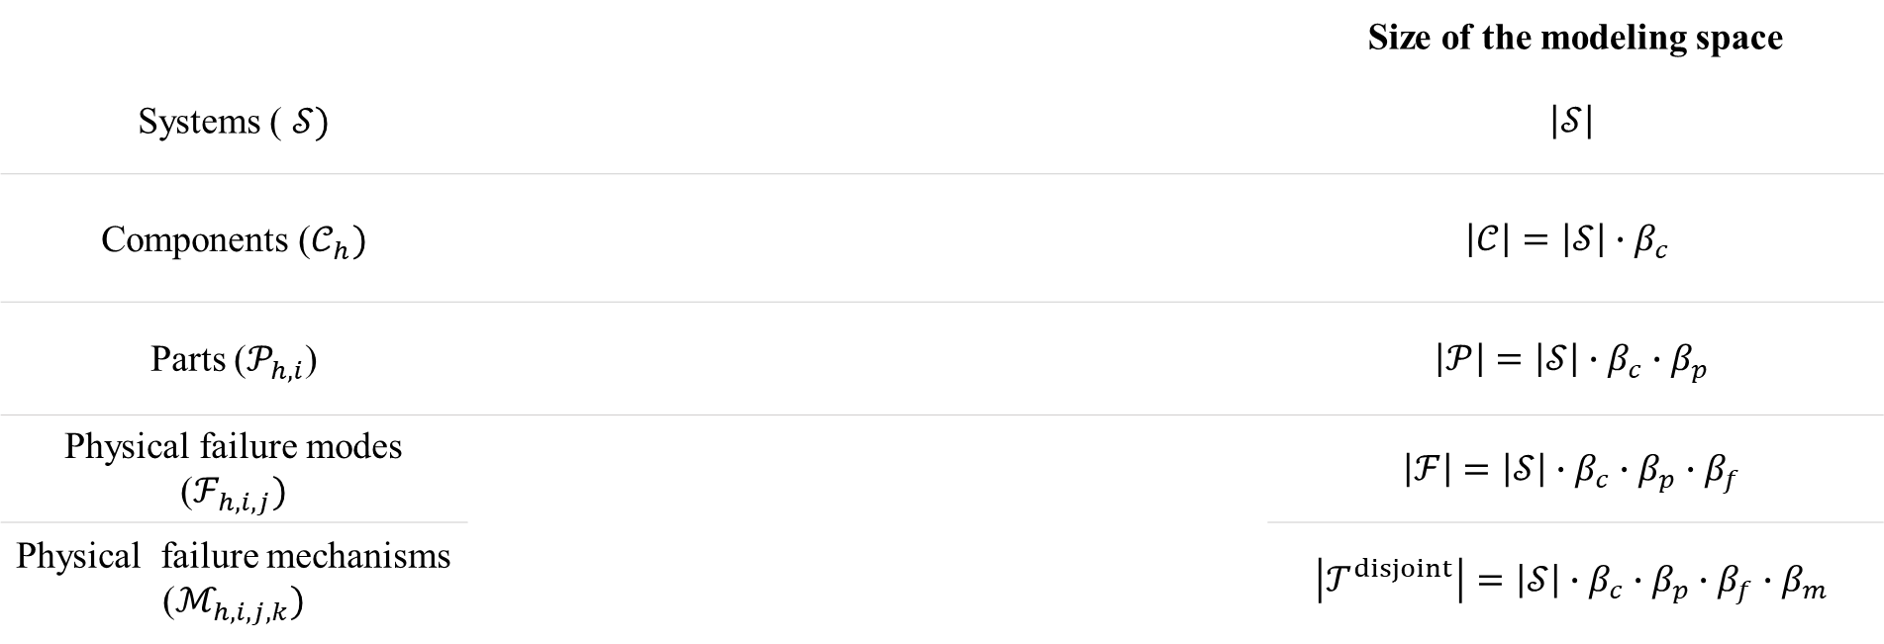




Hierarchical Structure of PRA-Physical Simulation Integration
 |  | Size of the modeling space
Systems ) $𝒮)$ |  | $$\left|𝒮\right|$$
Components ($𝒞_{h})$ |  | $$\left|𝒞\right|=\left|𝒮\right|∙β_{c}$$
Parts ($𝒫_{h,i}$) |  | $$\left|𝒫\right|=\left|𝒮\right|∙β_{c}∙β_{p}$$
Physical failure modes ($ℱ_{h,i,j})$ |  | $$\left|ℱ\right|=\left|𝒮\right|∙β_{c}∙β_{p}∙β_{f}$$
Physical failure mechanisms ($ℳ_{h,i,j,k})$ |  | $$\left|𝒯^{disjoint}\right|=\left|𝒮\right|∙β_{c}∙β_{p}∙β_{f}∙β_{m}$$
$$s_{1}$$
$$…$$
$$s_{h}$$
$$…$$
$$s_{H}$$
$$c_{h,1}$$
$$…$$
$$c_{h,i}$$
$$…$$
$$c_{h,I}$$
$$p_{h,i,1}$$
$$…$$
$$p_{h,i,j}$$
$$…$$
$$p_{h,i,J}$$
$$f_{h,i,j,1}$$
$$…$$
$$f_{h,i,j,k}$$
$$…$$
$$f_{h,i,j,K}$$
$$m_{h,i,j,k,1}$$
$$…$$
$$m_{h,i,j,k,l}$$
$$…$$
$$m_{h,i,j,k,L}$$
$β_{c}$, $β_{p}$, $β_{f}$, and $β_{m}$ as the average branching factors at the system-to-component, component-to-part, part-to-failure-mode, and failure-mode-to-failure-mechanism transitions
MEMS Department, Risk Analysis and Reliability Engineering (RARE) Laboratory
Notes:
Hierarchical Structure of PRA-Physical Simulation Integration can be depicted in the figure.
The hierarchical structure consists of the system layer, the component layer, the part layer, the physical failure mode layer, and the physical failure mechanisms layer.
At the highest level, there is a system layer with S systems. Next is the component layer, where each component is connected to a system in the upper layer.
The average branching factor from the system level to the component level, denoted by beta c​, is defined as the average number of components associated with each system. Accordingly, the total number of components in the model is given by multiplying S in beta c
Going down to the next layer. each part is connected to one component, and we define the average branching factor of a component to a part (beta p) . The size of the modeling space in this layer can be defined as the product of S and the corresponding average branching factors.
similarly average branching of part to failure modes (or beta f ) and average branching of physical failure mode to failure mechanisms (beta m) are introduced
So, the size of the simulation instance, meaning distinct simulation models with their own mesh and boundary conditions, is computed by multiplying the number of systems and corresponding average branching factors.

Slide 10
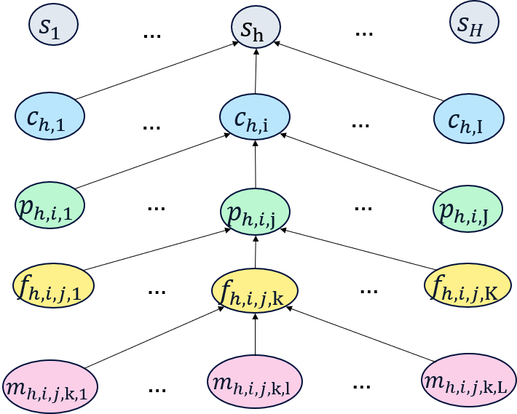
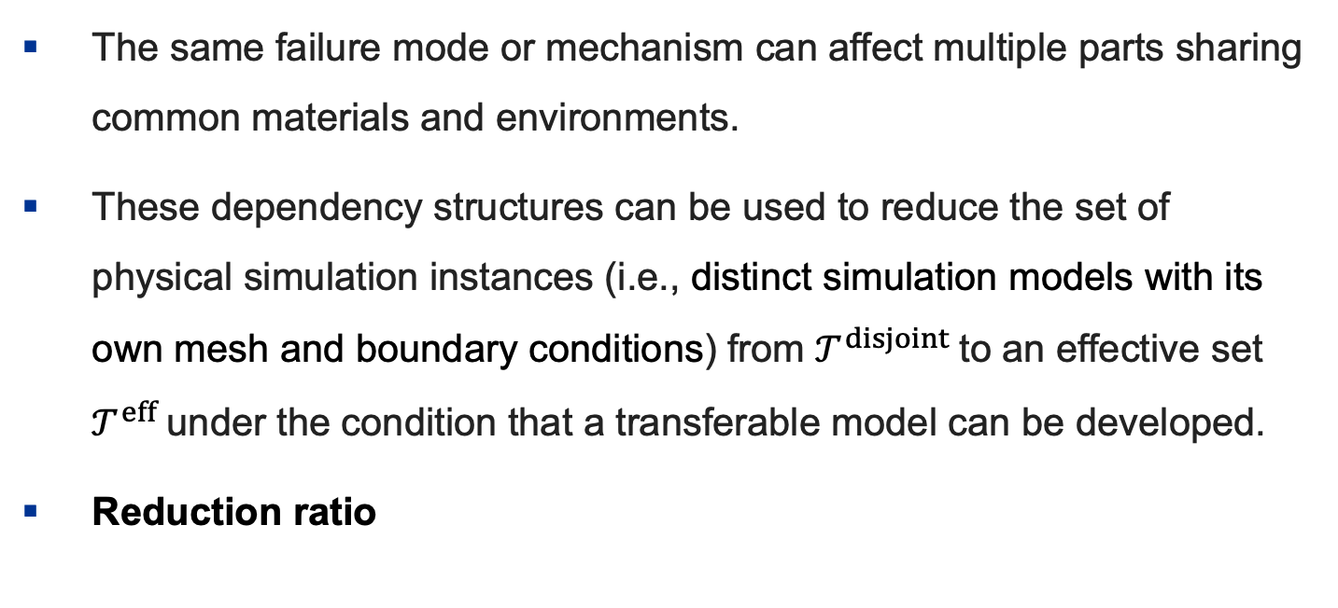
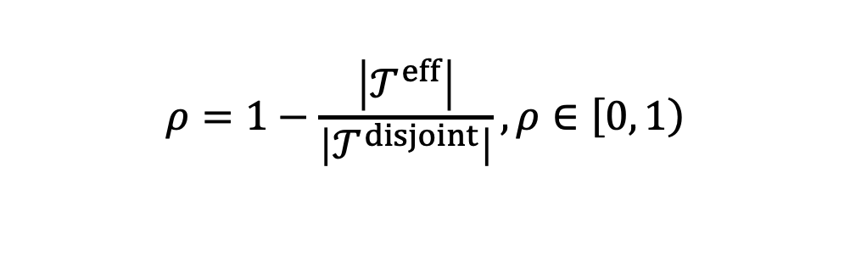
Hierarchical Structure: Exploiting Dependencies
The same failure mode or mechanism can affect multiple parts sharing common materials and environments.
These dependency structures can be used to reduce the set of physical simulation instances (i.e., distinct simulation models with its own mesh and boundary conditions) from $𝒯^{disjoint}$to an effective set $𝒯^{eff}$under the condition that a transferable model can be developed.
Reduction ratio
$$ρ=1−\frac{\left|𝒯^{eff}\right|}{\left|𝒯^{disjoint}\right|}, ρ∈\left[0\right., \left.1\right)$$
MEMS Department, Risk Analysis and Reliability Engineering (RARE) Laboratory
Notes:
In the previous figure, we assumed that each failure mechanism is only connected to one of the failure modes and each failure mode is only connected to one of the parts, but in reality, “The same failure mode or mechanisms can affect multiple parts sharing common materials and environments,”
“These dependency structures can be used to reduce the set of physical simulation instances from $𝒯^{disjoint}$to an effective set $𝒯^{eff}$under the condition that a transferable model can be developed.”
By the transferable model, we mean a model in which a set of similar components or parts is subject to the same operating and boundary conditions and has the same material properties. Under this assumption, shared pairs of physical failure mechanisms and physical failure modes can exist among a set of parts or components.
So the reduction ratio can be defined with this equation.

Slide 11
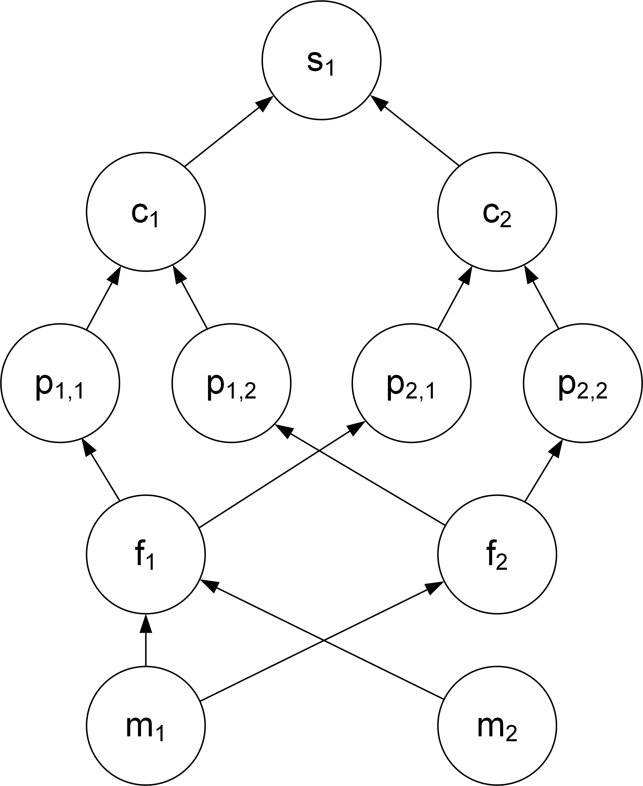

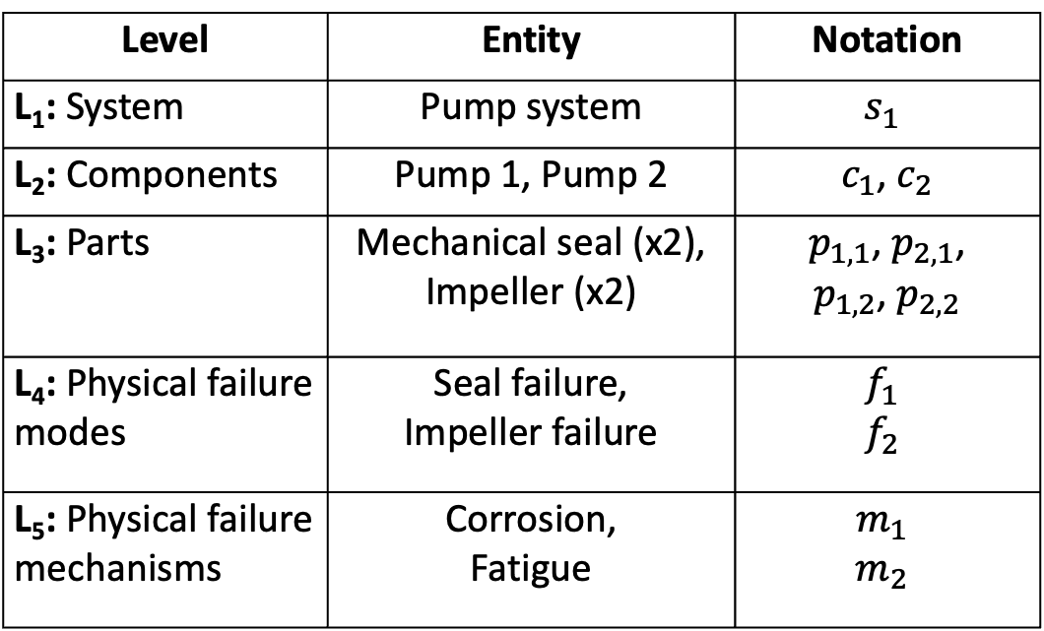
Illustrative Example
Consider a system ($s_{1}$) consisting of two pumps ($c_{1}$ and $c_{2}$) in a parallel configuration
Level | Entity | Notation
L₁: System | Pump system | $$s_{1}$$
L₂: Components | Pump 1, Pump 2 | $c_{1}$, $c_{2}$
L₃: Parts | Mechanical seal (x2), Impeller (x2) | $p_{1,1}$, $p_{2,1}$, $p_{1,2}$, $p_{2,2}$
L₄: Physical failure modes | Seal failure, Impeller failure | $$f_{1}$$ $$f_{2}$$
L₅: Physical failure mechanisms | Corrosion, Fatigue | $$m_{1}$$ $$m_{2}$$
MEMS Department, Risk Analysis and Reliability Engineering (RARE) Laboratory
Notes:
To better understand the conceptual framework, an example can clarify its application.
Let’s consider a pump system consisting of two pumps working in parallel. Each pump consists of two parts, including a mechanical seal and an impeller, resulting in four parts in total . The generic failure modes are seal failure and impeller failure, which are shared by both pumps.
There are two failure mechanisms: corrosion, which underlies both failure modes, and fatigue, which underlies seal failure. So, the question is how many simulation instances exist across all elements?

Slide 12
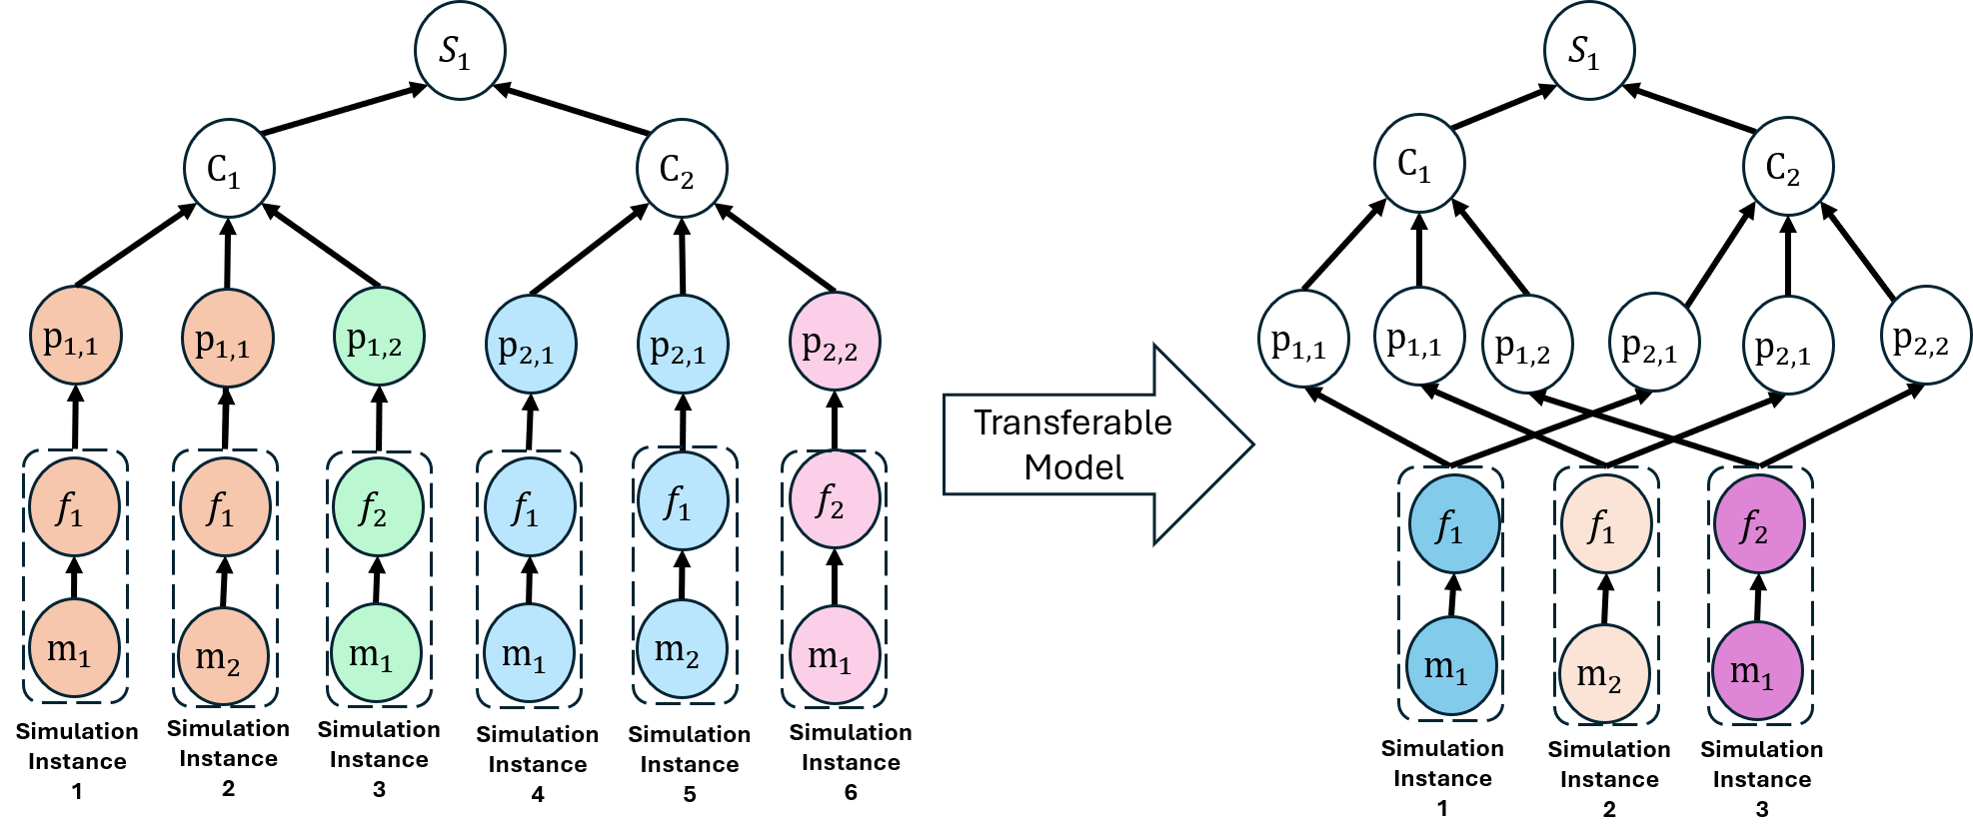
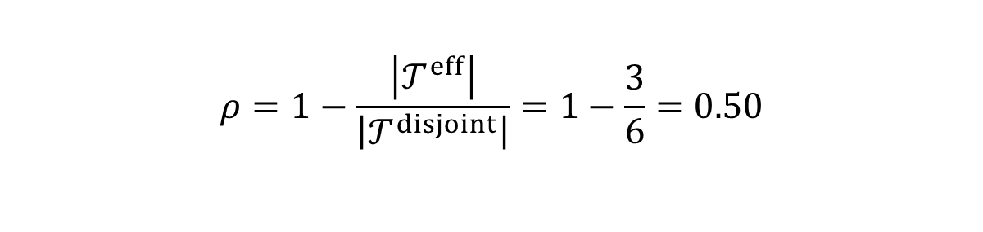
Illustrative Example
$$ρ=1−\frac{\left|𝒯^{eff}\right|}{\left|𝒯^{disjoint}\right|}=1−\frac{3}{6}=0.50$$
MEMS Department, Risk Analysis and Reliability Engineering (RARE) Laboratory
Slide 12
Notes:
On the leftside we need to have one combination of f1 and m1. The paths of p1,1 and p2,1 are influenced by this combination. However, because of the different boundary conditions, usually we have to develop two different simulation instances as depicted in the picture.
However, considering the transferable model that may be applicable to the combination of f1 and m, we can reduce the simulation instances from 2 to 1 for the pair.
similarly we can reduce the number of simulation instances for other combination .
So relying on the transferable model, the 50 % reduction of the simulation instances can observed.

Slide 13
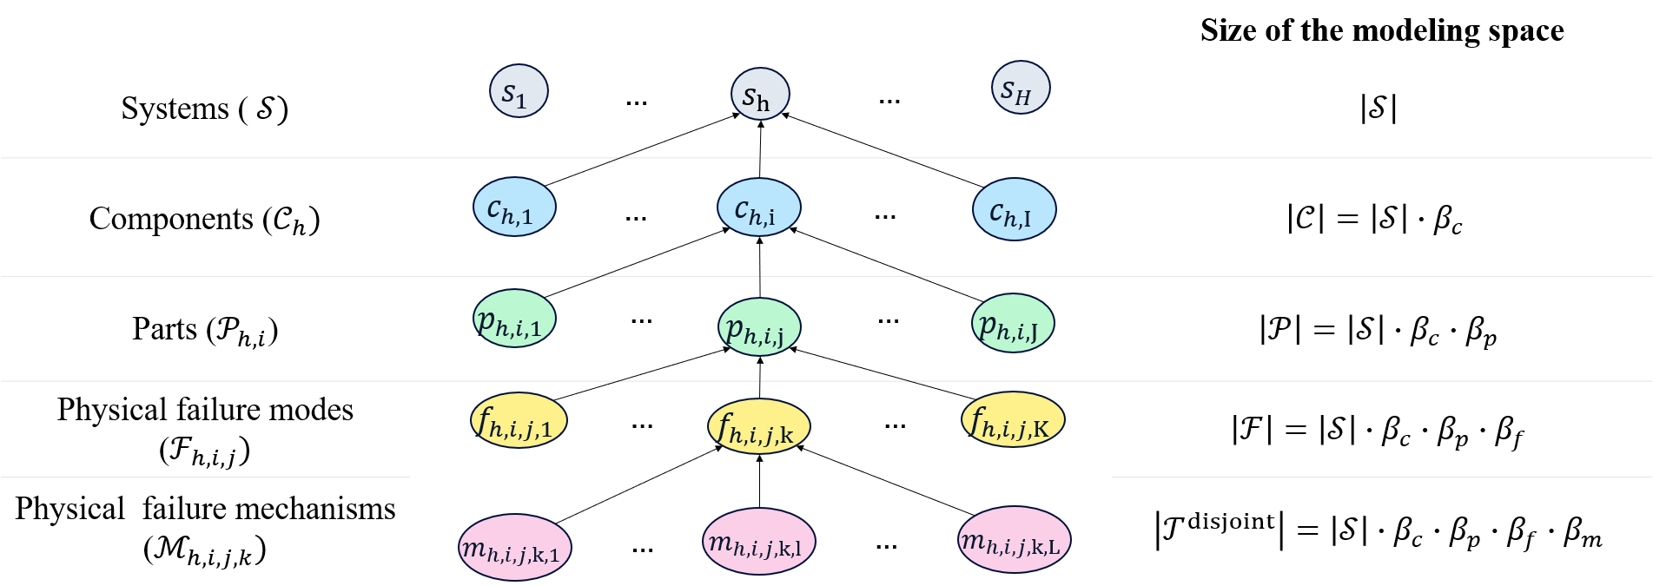
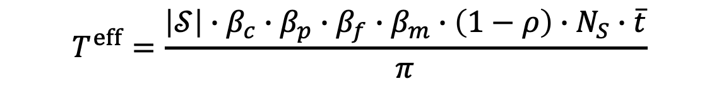
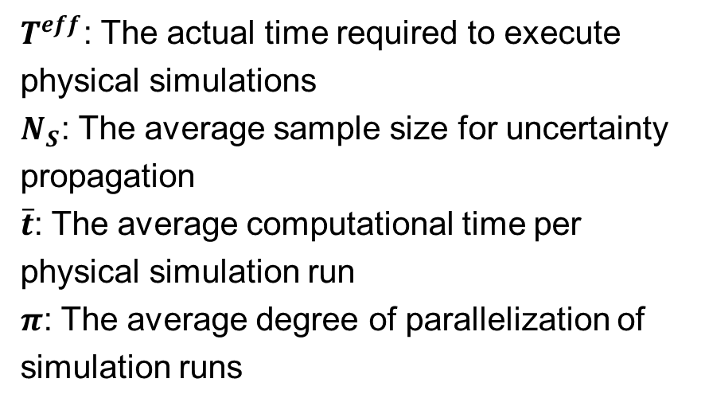
Practical Use of Conceptual Framework
Example: Derive Insights into Computational Challenges
$$T^{eff}=\frac{\left|𝒮\right|∙β_{c}∙β_{p}∙β_{f}∙β_{m}∙\left(1−ρ\right)∙N_{S}∙\overline{t}}{π}$$
$T^{eff}$: The actual time required to execute physical simulations
$N_{S}$: The average sample size for uncertainty propagation
$\overline{t}$: The average computational time per physical simulation run
$π$: The average degree of parallelization of simulation runs
MEMS Department, Risk Analysis and Reliability Engineering (RARE) Laboratory
Notes:
Now going to section 3 of the research, which is the practical use of the conceptual framework
k
We are aiming to derive insight into computational challenges of PRA-physical simulation integration
Using the conceptual framework, the actual time required to execute physical simulation across all elements is a function of the size of the modeling space, reduction factor, the average sample size for uncertainty propagation determined by user preference, average computational time per physical simulation, and the average degree of parallelization of the simulation run.

Slide 14
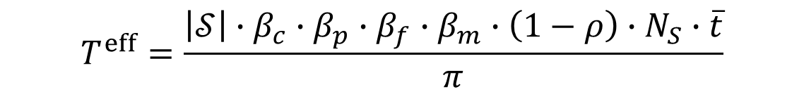
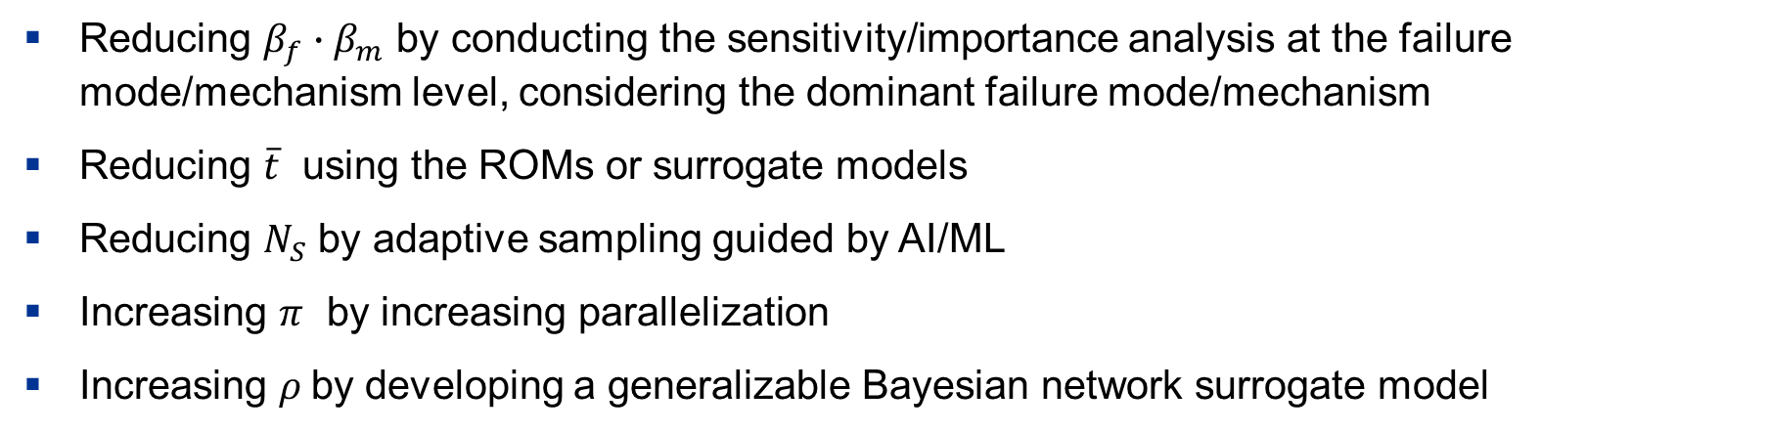
Practical Use of Conceptual Framework
Systematically Mapping Research Directions
$$T^{eff}=\frac{\left|𝒮\right|∙β_{c}∙β_{p}∙β_{f}∙β_{m}∙\left(1−ρ\right)∙N_{S}∙\overline{t}}{π}$$
Reducing $β_{f}∙β_{m}$ by conducting the sensitivity/importance analysis at the failure mode/mechanism level, considering the dominant failure mode/mechanism
Reducing $\overline{t}$ using the ROMs or surrogate models
Reducing $N_{S}$ by adaptive sampling guided by AI/ML
Increasing $π$ by increasing parallelization
Increasing $ρ$by developing a generalizable Bayesian network surrogate model
MEMS Department, Risk Analysis and Reliability Engineering (RARE) Laboratory
Notes:
Practical Use of Conceptual Framework to systematically map research direction is
The researchers may narrow the scope of explicit physical modeling, for instance, reducing the branching factor by “Sensitivity/importance analysis at the failure mode/mechanism level, considering the dominant failure mode/mechanism”.
They may reduce the average simulation time by replacing physical models with reduced-order or surrogate models.
The total number of simulations can also be reduced through AI/ML-guided adaptive sampling
Increasing the degree of parallelization and “Increasing the physical simulation reduction ratio by developing a generalizable Bayesian network surrogate model” are other actions from the researchers

Slide 15
Conclusion
This project aims to develop a generalizable technical basis for computational interfaces between nuclear plant PRA and physical simulations.
A systematic literature review is being conducted to provide a structured understanding of the requirements and considerations for PRA-physical simulation interfaces.
This research develops a conceptual framework to analyze the multi-layer relationships between PRA model elements and the physical simulation scope.
Ongoing work involves continuing a systematic literature review to update our insights and refining the conceptual framework.
MEMS Department, Risk Analysis and Reliability Engineering (RARE) Laboratory

Slide 16
MEMS Department, Risk Analysis and Reliability Engineering (RARE) Laboratory
Questions?
Thank You

Slide 17
References
[1] T. Sakurahara, G. Schumock, S. Reihani, E. Kee, and Z. Mohaghegh, "Simulation-Informed Probabilistic Methodology for Common Cause Failure Analysis," Reliability Engineering & System Safety, vol. 185, pp. 84-99, 2019, doi: 10.1016/j.ress.2018.12.007.
[2] W.-C. Cheng, J. Beal, T. Sakurahara, S. Reihani, E. Kee, and Z. Mohaghegh, "Modeling interconnections of safety and financial performance of nuclear power plants, part 3: Spatiotemporal probabilistic physics-of-failure analysis and its connection to safety and financial performance," Progress in Nuclear Energy, vol. 153, 2022, Art no. 104382, doi: 10.1016/j.pnucene.2022.104382.
[3] B. W. Spencer, Y. Yu, W. M. Hoffman, D. R. Shaver, and E. Merzari, "3D probabilistic fracture mechanics / computational fluid dynamics simulation of a reactor pressure vessel under transient conditions," Nuclear Engineering and Design, vol. 451, 2026, Art no. 114845, doi: 10.1016/j.nucengdes.2026.114845.
[4] B. W. Spencer, W. M. Hoffman, and A. Dahal, "Coupling Thermal-Hydraulics with Reactor Pressure Vessel Fracture Models," Idaho National Laboratory, Idaho Falls, ID, INL/RPT-23-75169, 2023.
[5] B. W. Spencer, W. M. Hoffman, S. Biswas, and A. Jain, "Assessment of Grizzly Capabilities for Reactor Pressure Vessels and Reinforced Concrete Structures," Idaho National Laboratory, Idaho Falls, Idaho,ID, INL/EXT-20-59941 2020.
[6] B. W. Spencer, W. M. Hoffman, and M. A. Backman, "Modular system for probabilistic fracture mechanics analysis of embrittled reactor pressure vessels in the Grizzly code," Nuclear Engineering and Design, vol. 341, pp. 25-37, 2019, doi: 10.1016/j.nucengdes.2018.10.015.
[7 ] B. W. Spencer, W. M. Hoffman, and W. Jiang, "Enhancements to Engineering-scale Reactor Pressure Vessel Fracture Capabilities in Grizzly," Idaho National Laboratory, Idaho Falls, Idaho, ID, INL/EXT-17-43427, 2017.
[8]B. W. Spencer, W. M. Hoffman, A. Jain, S. Biswas, and S. L. Dhulipala, "Reactor Pressure Vessel Fracture Mechanics Development and Concrete Application Testing for Grizzly," Idaho National Laboratory, Idaho Falls, Idaho, ID, INL/EXT-21-64522, 2021.
[9] B. Spencer, W. Hoffman, S. Sen, C. Rabiti, T. Dickson, and R. Bass, "Initial Probabilistic Evaluation of Reactor Pressure Vessel Fracture with Grizzly and Raven," Idaho National Laboratory Idaho Falls, Idaho, ID, INL/EXT-15-37121, 2015.
[10] B. Spencer et al., "Probabilistic Fracture Mechanics of Reactor Pressure Vessels with Populations of Flaws," Idaho National Laboratory, Idaho Falls, Idaho, ID, INL/EXT-16-40050, 2016.
[11] W. M. Hoffman and B. W. Spencer, "Benchmarking of Probabilistic Fracture Mechanics Models in Grizzly," Idaho National Laboratory, Idaho Falls, Idaho, ID, INL/EXT-15-37121, 2021.
[12] B. W. Spencer, W. M. Hoffman, D. Schwen, and S. Biswas, "Progress on Grizzly Development for Reactor Pressure Vessels and Reinforced Concrete Structures," Idaho National Laboratory, Idaho Falls, Idaho, ID, INL/EXT-19-56012, 2019.
[13] A. Guler, D. Mandelli, A. Alfonsi, J. Cogliati, C. Rabiti, and T. Aldemir, "Methodology for the Incorporation of Passive Component Aging Modeling into the RAVEN/ RELAP-7 Environment," presented at the Transactions of the American Nuclear Society, Anaheim, California,, November 9–13, 2014.
[14] D. Mandelli et al., "BWR Station Blackout: A RISMC Analysis Using RAVEN and RELAP5-3D," Nuclear Technology, vol. 193, no. 1, pp. 161-174, 2016, doi: 10.13182/NT14-142.
[15] W. Hoffman, M. Riley, and B. Spencer, "Surrogate Model Development and Validation for Reliability Analysis of Reactor Pressure Vessels," presented at the ASME 2016 Pressure Vessels and Piping Conference, Vancouver, British Columbia, Canada, July 17–21, 2016.
MEMS Department, Risk Analysis and Reliability Engineering (RARE) Laboratory

Slide 18
Hierarchical Viewpoint of PRA-Physical Simulation Integration
Systems
Critical functions and the systems required to fulfill them (e.g., emergency core cooling, reactor protection)
Components
Individual hardware elements constituting each system, such as pumps, valves, and pipes (e.g., pumps, valves, pipes)
Physical failure modes
Underlying physical processes that can result in each physical failure mode (e.g., fatigue crack growth, corrosion, or creep)
Parts
Sub-elements of each component necessary to perform its designed function (e.g., a pump shaft or motor)
Observable manifestations of component/part failure (e.g., leak, rupture, or excessive vibration)
Physical failure mechanisms
MEMS Department, Risk Analysis and Reliability Engineering (RARE) Laboratory

