Slide 1



Safety Improvement of a Tritium Removal System
Through a Gas Expansion Turbine
Presenter: Allan Ghaforian
Department of Energy and Nuclear Engineering
Ontario Tech University, Canada

Slide 2
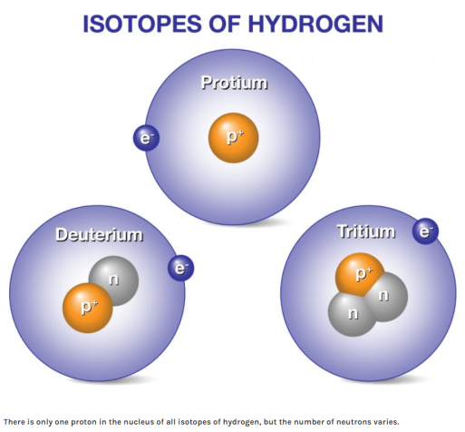
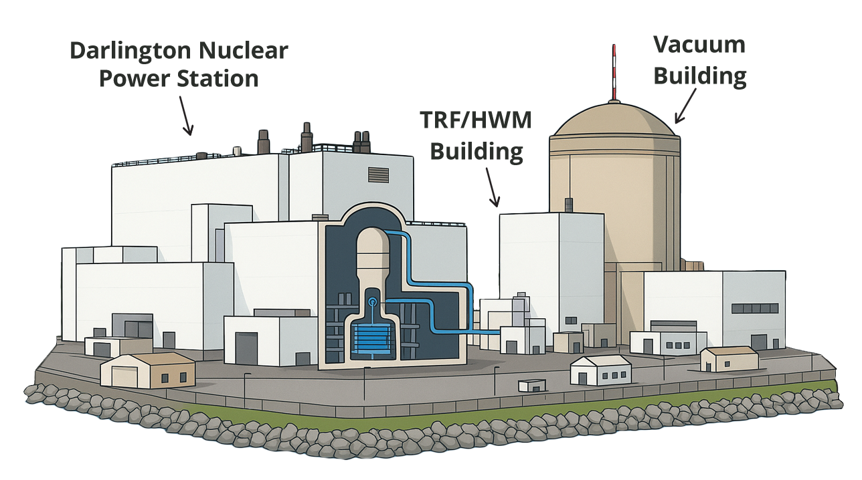
Tritium and its Importance
What is Tritium?
  A radioactive isotope of hydrogen (H-3)
  Produced in heavy water during CANDU operations
Why is it Important?
  It must be removed to protect workers, public, and the environment
  Ensures reactor safety and regulatory compliance
Applications
  Fuel for nuclear fusion research
  Source for medical isotopes and self-powered lighting
Notes:
Tritium is a radioactive isotope of hydrogen, produced in heavy water during CANDU operation. Tritium is both valuable and unforgiving. In heavy-water systems, it accumulates, so our task is to extract, contain, and minimize exposure, while enabling safe use. Beyond risk management, tritium has important applications. It is used in important settings, such as self-powered lighting; it is a critical fuel for nuclear fusion; and it supports medical and scientific research, — always under stringent regulatory control. The real risk is not about how radioactive tritium is, but about how stable our systems are when something goes wrong. This presentation focuses on reliability and improvement of Cryogenic and Auxiliary safety systems—because that’s what keeps doses low and emissions negligible.

Slide 3
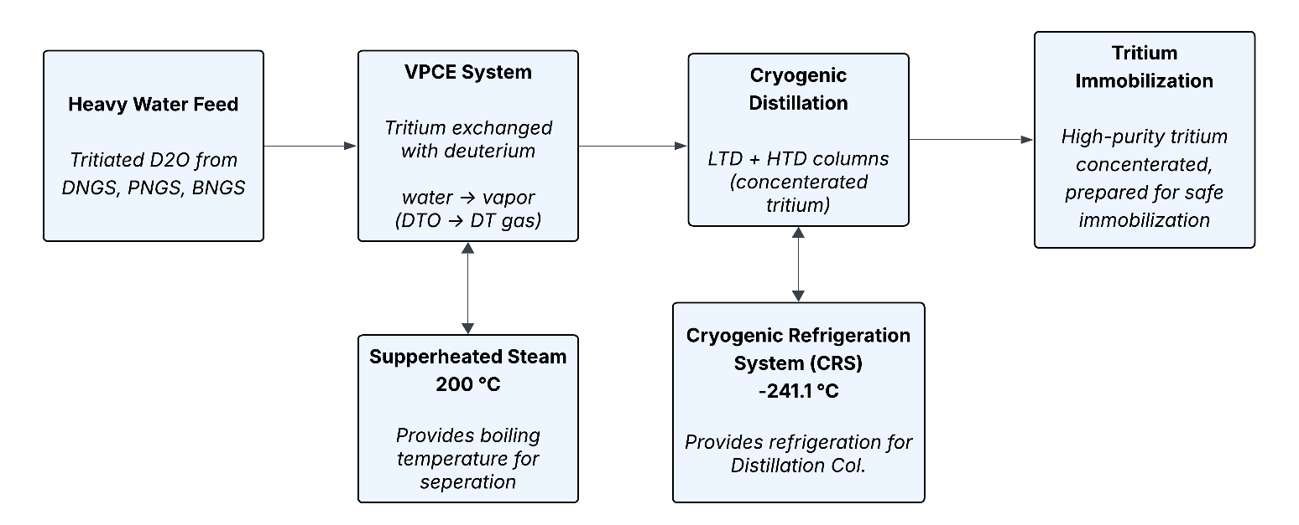
DTRF at a Glance
  Commissioned in 1989, the world’s largest tritium removal facility
  Processes approximately 2000 Mg of heavy water annually
  Uses Vapor Phase Catalytic Exchange (VPCE) + Cryogenic Distillation
  Continuously extracts tritium and concentrates it for immobilization
  Reduces dose to workers and minimizes emissions to the environment
(32 °K)
Notes:
Darlington’s Tritium Removal Facility has operated since 1989. It processes about 2000 megagrams of heavy water each year, using a combination of vapour phase catalytic exchange and cryogenic distillation. Its role is to continuously extract and concentrate tritium, which both lowers radiation risks and supports safe reactor operation. At this scale, even small disruptions could translate into major operational and regulatory consequences.

Slide 4
Cryogenic Refrigeration System (CRS)
  Provides refrigeration for the LTD & HTD cryogenic distillation columns.
  Operates with two 50% oil-free labyrinth piston hydrogen compressors (CP01 & CP02) and an expansion turbine.
  Uses super cooled liquid hydrogen as the working fluid in a closed loop to circulate and transfer cooling.
  Critical sub-systems: LTD / HTD Cold-boxes, Recombiner, TIS, and ACS, that can destabilize distillation, cause outages, or lead to a tritium release .
Notes:
The CRS includes two 50% hydrogen compressors, an expansion turbine, and a closed hydrogen loop, which cools the distillation columns, providing the ultra-low temperatures that the distillation columns need. Because it’s so central, failures or contamination in this loop can shut down the columns. Supporting subsystems—Low Tritium Distillation (LTD) and High Tritium Distillation (HTD) Cold boxes, the Recombiner system, the Tritium Immobilization System (TIS), and the Air Clean-Up System (ACS)—are equally critical system, in that each of them could lead to a tritium release. For example leak in Tritium Immobilization System (TIS), combined with air clean-up system failure, could lead to a tritium release. That’s why we are focusing on the subjects of risk and reliability assessment.

Slide 5
Notes:
This flow sheet is a simplified overview of the Darlington Tritium Removal Facility (DTRF) processes. I am not going to go into detail, in order to stay within the time limit. But the highlighted areas in red show the main equipment associated with the Cryogenic Refrigeration System (CRS), with respect to the TRF systems.

Slide 6
Hazards & Initiating Events
  Internal hazards: Compressor/turbine failure, cryogenic burns, H₂/D₂ explosion, T₂/T₂O exposure
  External hazards: Seismic events, floods, high winds, off-site accidents
  Initiators: Compressor trips, turbine oil system faults, impurity ingress (O₂, N₂, He) destabilizing LTD/HTD
  Top event of concern: CRS Out-of-Service → Long Outage Duration and Emission Increase
Notes:
Key internal hazards include compressor and turbine failure, cryogenic burns, hydrogen explosions, and tritium exposure. External hazards include seismic, flood, and high wind events. Frequent initiators are compressor trips, turbine anomalies, distillation columns instability and impurity ingress. The top event is simple but severe: refrigeration system outage leading long outage and elevated tritium risk. These are the chains we must break.

Slide 7
Event Tree Sequence
Initiating Event | HTD Condenser Level Unstable | Operation Action to Alarm NOT Correct | Turbine Speed Control NOT Function | Turbine Oil Supply System (TOSS) NOT Function | Outcome (TRF Operation)
 |  |  |  | TRUE | CRS Out-of-Service Oil Supply Pump Damage AND Turbine Damage
 |  |  | TRUE
 |  | TRUE
 |  |  |  | FALSE | CRS Out-of-Service Turbine Blade Damage
 | TRUE
 |  | FALSE |  | TRUE | CRS Out-of-Service Oil Supply Pump Damage
 |  |  | FALSE
HTD Loss of Cooling |  |  |  | FALSE | Process Line Blockage
 | FALSE |  |  |  | No Outage
Notes:
This is the Event Tree sequence diagram. It forces clarity - on the left is event initiator, and on the right are consequences, including the top event (CRS / TRF out of service).

Slide 8
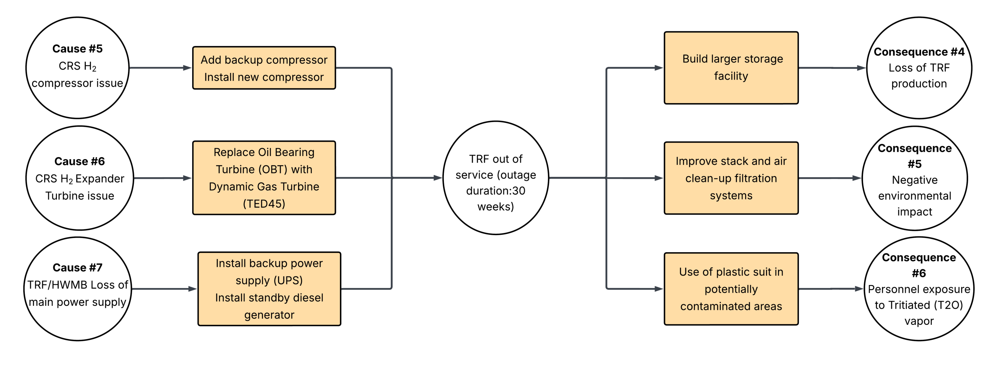
Controls & Barriers to Mitigate CRS
Out-of-Service Risks
Consequences
Initiating Events
Preventative control measures
Mitigative control measures
Notes:
This Bow-Tie diagram shows the barriers that can be introduced to reduce CRS risks. On the left are hardware improvements: adding a backup compressor, replacing the oil-bearing turbine with the gas cool bearing or TED45, and more reliable backup power. On the right are measures to mitigate consequences, such as larger storage facilities, enhanced filtration, protective equipment and trained operators. Together, these controls strengthen reliability and reduce both outage and release risk. The aim is layered, diverse defenses—not redundant versions of the same mechanism.

Slide 9
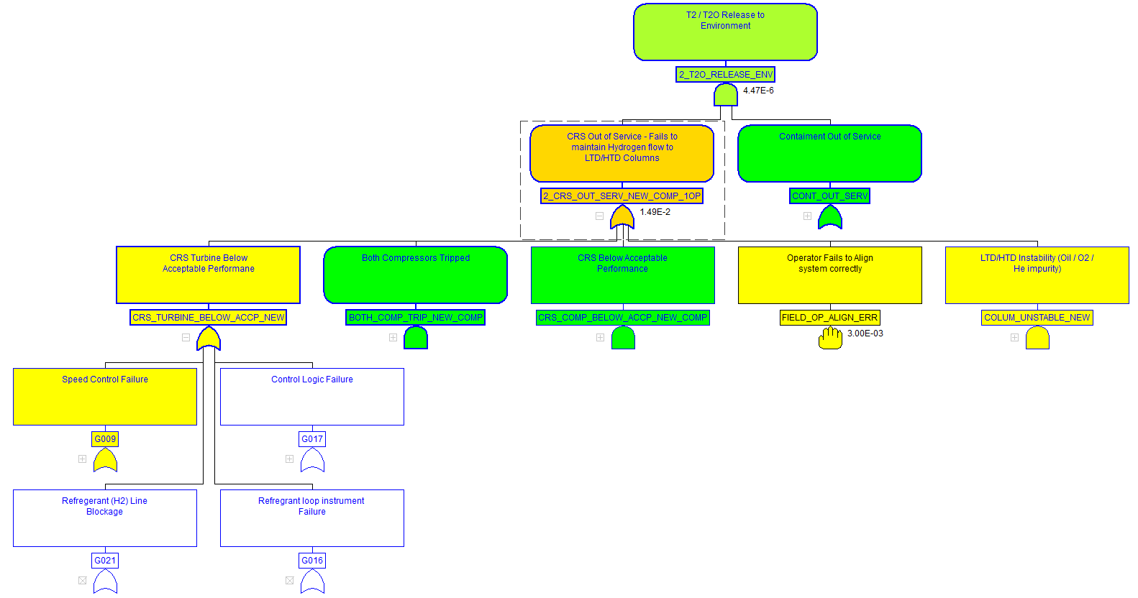
Fault Tree Basic Events
B4
B2
B1
B3
Notes:
The baseline CAFTA, is modelled based on four basic events. B1: HTD Column unstable, B2: Operator erroror delay response, B3: Turbine speed control not function, and B4: Hydrogen compressor not function.

Slide 10
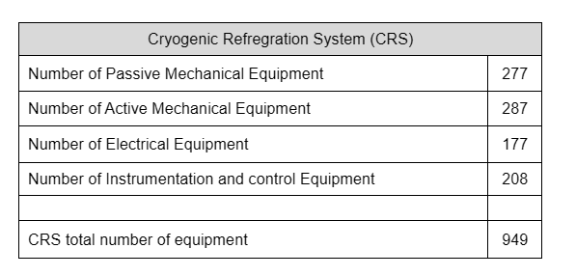
Baseline Fault Tree (Oil-Bearing Turbine)
  Modeled in CAFTA: 2×50% compressors + oil-bearing turbine (OBT), 1 operator (Total 949 equipment analyzed)
  Top event probability (Emission release due to containment leaks): 4.46×10⁻⁶
  CRS Out-of-Service probability: 1.48×10⁻²
  Dominant contributors: turbine oil/brake pumps, H₂ compressor motor faults
  CRS can operate at ½ capacity for 1–4 weeks after one compressor trip, but major failure causes CRS or full gas outage
Notes:
The table on the right shows the breakdown of 949 pieces of equipment that were categorized into passive and active mechanical equipment, as well as electrical, instrumentation and control equipment. Two numbers matter: tritiated-vapour probability at ~4.46×10⁻⁶ and CRS outage probability at ~1.48×10⁻². The main contributors are turbine oil and brake systems, plus compressor motor faults.

Slide 11
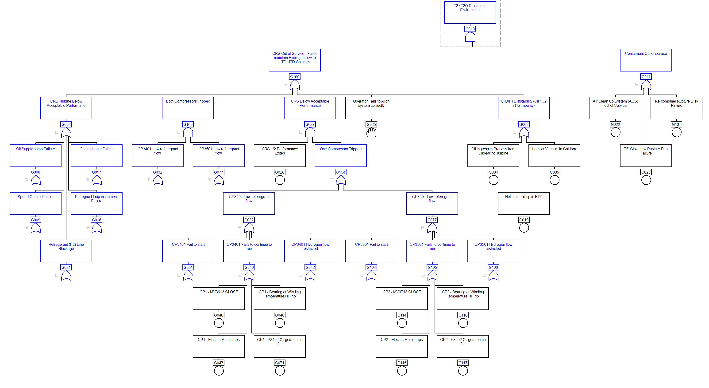
Fault tree
Top event probability: 4.46×10⁻⁶
  CRS Out-of-Service probability: 1.48×10⁻²
Turbine oil/brake pumps
Compressor motor faults
Notes:
The baseline CAFTA, is modelled based on two compressors, an oil-bearing turbine and associated control systems. The chance of tritium release is about 4 in a million, but the chance of CRS going out of service is over 1%. The dominant contributors are turbine oil system faults and compressor motors. After one compressor trip, the system can sustain limited operation for a few days, but a major failure risks total outage.

Slide 12
The Top Five Dominant Cut sets - Fault Tree Analysis-01
T2O_RELEASE_ENV = 4.46E-06 (Probability)
# | Cut set Prob. | BE Prob | Inputs | Description
1 | 4.68E-07 | 1.00E-04 | ACS_OUT_OF_SERVICE | Air Clean Up System (ACS) out of Service
 |  | 4.68E-03 | TU_OIL_PUMP_P3202_FAIL | Turbine main oil supply Pump P3202 failure
2 | 4.68E-07 | 1.00E-04 | GB_RUPTURE_DISK_FAIL | TIS Glove box Rupture Disk Failure
 |  | 4.68E-03 | TU_OIL_PUMP_P3202_FAIL | Turbine main oil supply Pump P3202 failure
3 | 4.68E-07 | 1.00E-04 | RE_COMBINER_RUPTURE_DISK_FAIL | Re-combiner Rupture Disk Failure
 |  | 4.68E-03 | TU_OIL_PUMP_P3202_FAIL | Turbine main oil supply Pump P3202 failure
4 | 4.30E-07 | 1.00E-04 | ACS_OUT_OF_SERVICE | Air Clean Up System (ACS) out of Service
 |  | 4.30E-03 | TU_OIL_PUMP_P3201_FAIL | Turbine brake Oil pump P3201 failure
5 | 4.30E-07 | 1.00E-04 | GB_RUPTURE_DISK_FAIL | TIS Glove box Rupture Disk Failure
 |  | 4.30E-03 | TU_OIL_PUMP_P3201_FAIL | Turbine brake Oil pump P3201 failure
Notes:
The top 5 dominant Cut sets are shown in this table. The main contributor to CRS Out of Service events is failure of expansion turbine main oil and brake pumps

Slide 13
Process Disruptions Events
Tritium 2025 – Ottawa, Canada – September 2025
Notes:
The dominant contributors to top event probability are shown here: on the right you have the highest, which is the turbine oil brake pump failure; and on the left, you have the lowest operator error, causing process disruptions events.

Slide 14
Baseline Risk Scoring
  Risk score = L × C_{f} (Likelihood × Consequence)
  Outage consequence factors: C_{f}=450 (90-day outage), C_{f}=1000 (200-day outage)
  Baseline scores: 6.165 (Medium, 90-day) and 13.70 (High, 200-day)
  Outage cost: $ Value/day; require hydrogen burn-down, helium purge, full restart
Outage Duration | Consequence factor (C_{f}) | Risk Score (CRS Out of Service) | Risk Band
90 days | 450 | 6.165 | Medium
200 days | 1000 | 13.70 | High
Notes:
When we multiply likelihood by consequence, baseline risk falls into the Medium to High range, depending on outage length. A 200-day outage produces a risk score of nearly 14. These outages are expensive and operationally disruptive, since hydrogen must be burned down, replaced with helium, and the CRS process restarted.

Slide 15
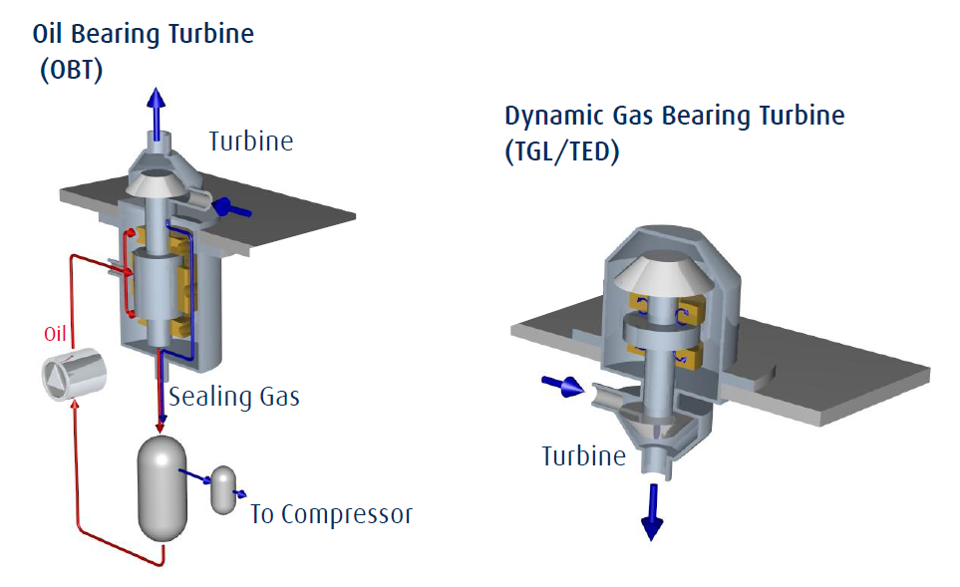

Hardware Mitigation: TED45 Gas-Bearing Turbine
  Gas-bearing, oil-free design → eliminates lube-oil and seal-gas systems
  Removes oil ingress risk to cryogenic loop
  Simpler operation: uses bypass valve for control
  Modeled configuration: 2×50% compressors + TED45 turbine
Notes:
When we multiply likelihood by consequence, baseline risk falls into the Medium to High range, depending on outage length. A 200-day outage produces a risk score of nearly 14. These outages are expensive and operationally disruptive, since hydrogen must be burned down, replaced with helium, and the CRS process restarted.

Slide 16
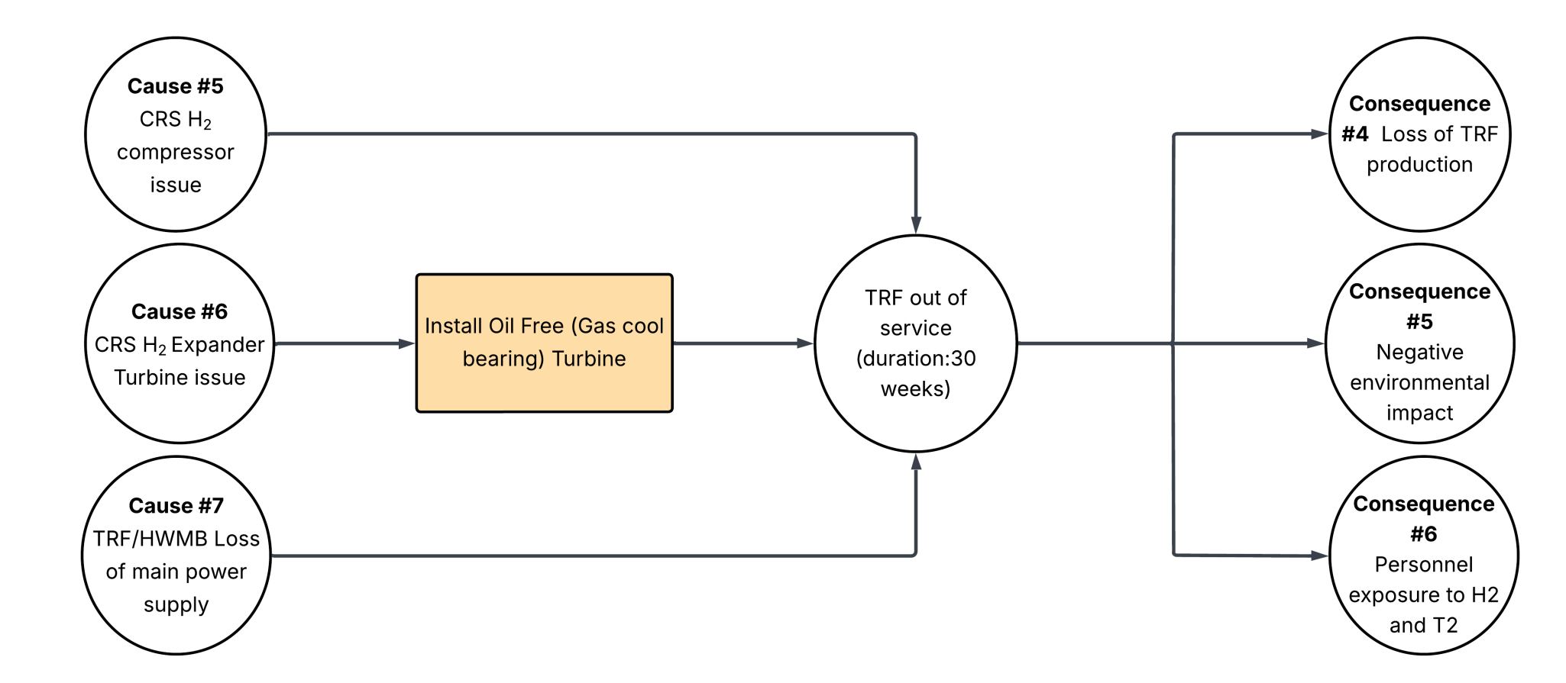
Results with TED45 Retrofit
  CRS Out-of-Service probability: 5.52×10⁻³ (from 1.48×10⁻²)
  Risk scores: 2.48 (90-day, Low) and 5.52 (200-day, Medium)
  New main contributor: Hydrogen (H₂) compressors failures due to aging (mechanical, electrical I&C failures and obsolescence parts)
Notes:
The risk score shifts firmly into the Low band. With oil ingress eliminated, the dominant contributor becomes an instrumentation fault in the hydrogen compressor temperature measurement, “Stator Winding High Temp Trip”.

Slide 17
Risk Score
Notes:
The chart shows movement from Medium/High to Low/Medium. TED45 alone pays for itself in risk reduction and operational simplicity, and it reveals the compressors as the next logical focus for improvement.

Slide 18
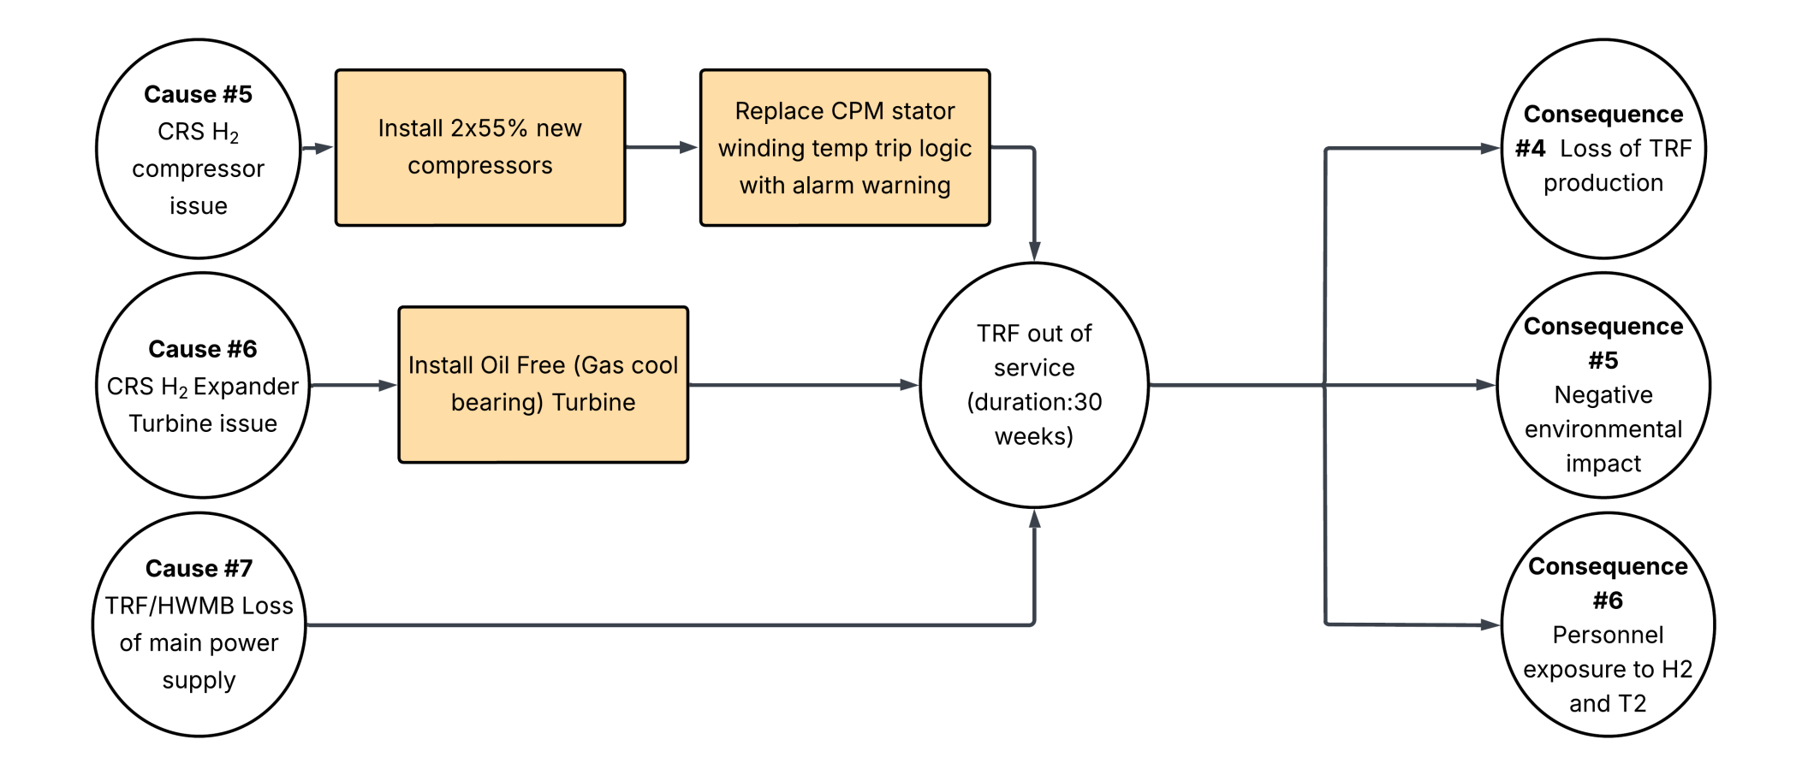
Results with TED45 Retrofit &
Replacing Old H₂ Comp. with Two New H₂ Comp.
  CRS Out-of-Service probability: 4.45×10⁻³ (from 1.48×10⁻²)
  Risk scores: 2.00 (90-day, Low) and 4.45 (200-day, Low)
  New main contributor: Helium-3 build-up in HTD and Loss of Vacuum in LTD/HTD Cold-boxes
Notes:
Upgrading compressors further reduces tritiated-vapour probability to ~1.33×10⁻⁶ and outage probability to ~4.45×10⁻³. Risk scores drop to ~2.00 (90-day, Low) and ~4.45 (200-day, Low). The main risks now are process-related, like helium build-up, rather than chronic mechanical fragility.

Slide 19
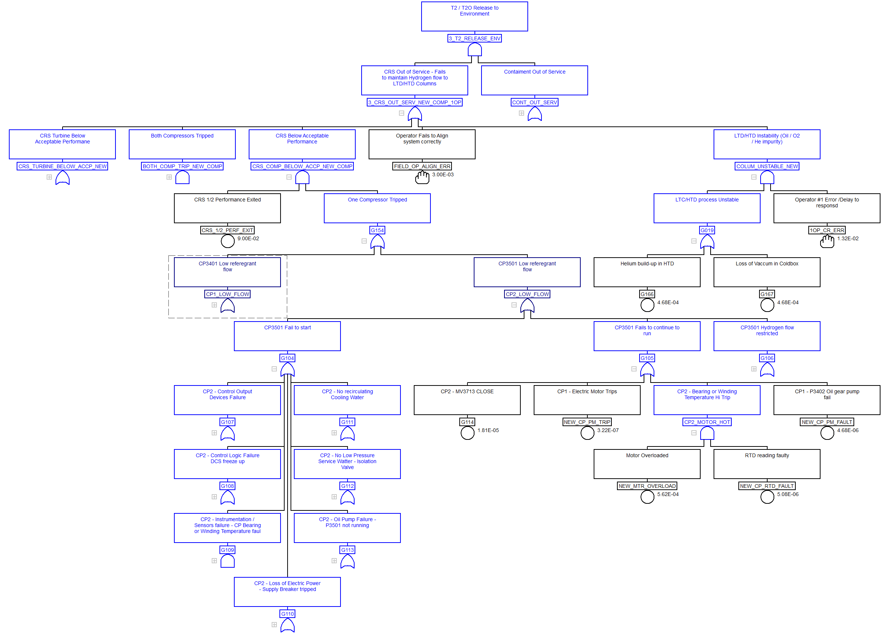
Fault Tree
Top event probability
1.33×10⁻⁶
  CRS Out-of-Service probability: 4.45×10⁻³
  FTA Model configuration:
  TED45 turbine + 2× H₂ compressors (new) + One Panel Operator (TRF Main Control Room)
Replace CPM stator winding Temp “Instant Trip” Logic to “Warning” Alarm to prevent spurious trips
Notes:
With TED45 and two new compressors, tritium release probability drops by about 75% and CRS outage probability drops by about 70% from the baseline.

Slide 20
Layered Defense: TED45 + New H2 Compressors + One Panel Operator
  TED45 retrofit + 2x 50% New H2 Compressors
  Hardware removes oil ingress; Install new compressors with higher reliability
  Net effect: sustained low risk band (both 90-day and 200-day horizons)
Configuration | 90-day Outage (C_{f}=450) | Risk Band | 200-DAY Outage (C_{f}=1000) | Risk Band
1) Baseline: OBT + 2x50% Old H₂ COMP. + 1 Op | 6.66 | Medium | 14.80 | High
2) TED45 + 2x50% Old H₂ COMP. + 1 Op | 2.48 | Low | 5.52 | Medium
3) TED 45 + 2x50% New H₂ COMP. + 1 Op | 2.00 | Low | 4.45 | Low
Notes:
When we combine TED45 and two new compressors with one panel operator, we address both equipment issues. Oil ingress disappears, and spurious trips, due to the H2 compressor, are eliminated. The combined result keeps risk in the Low category across both outage horizons.

Slide 21



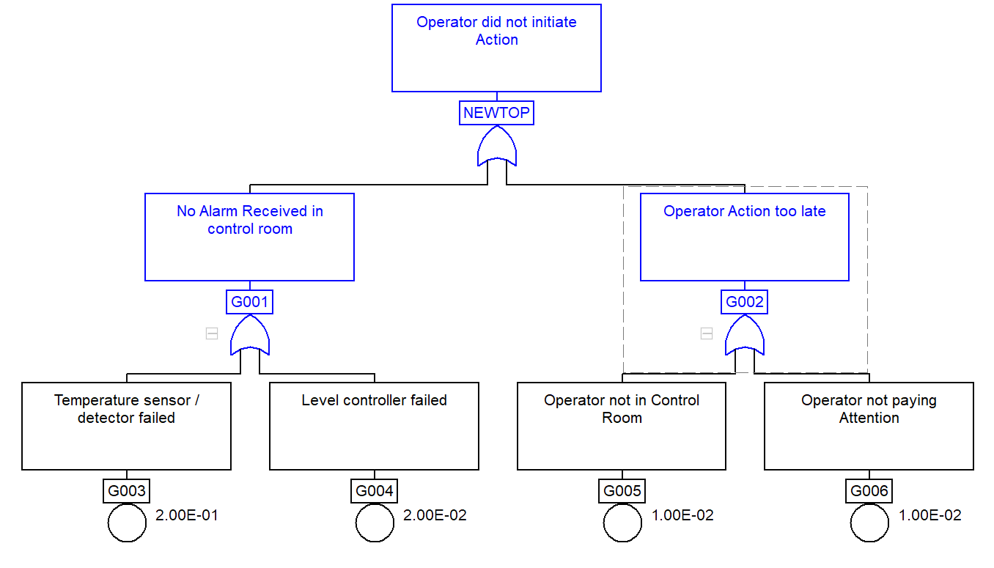
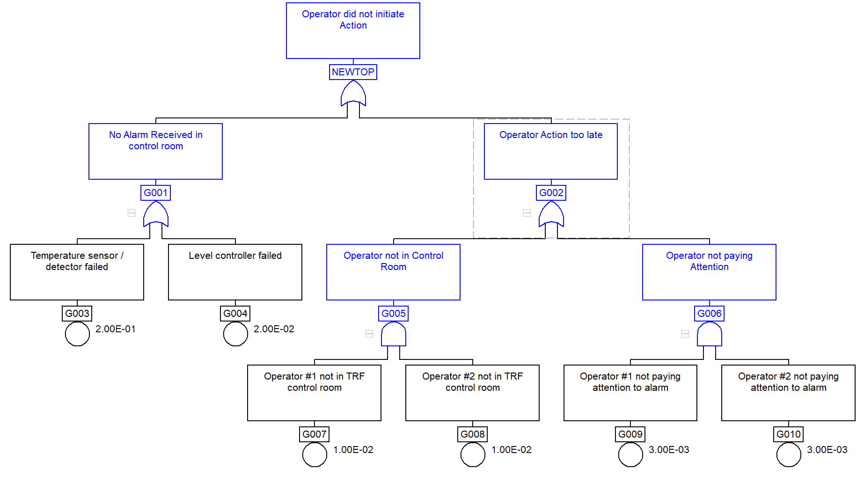
Human Reliability
  2 control room panel operators
  HEP: P(z) = 3.29×10⁻⁴
  1 control room panel operator
  HEP: P(z) = 1.32×10⁻²
Notes:
The human factor is powerful. With one operator, the chance of missing an alarm or sequence is about 1 in 75. With two operators, redundancy cuts that to 1 in 3,000.

Slide 22
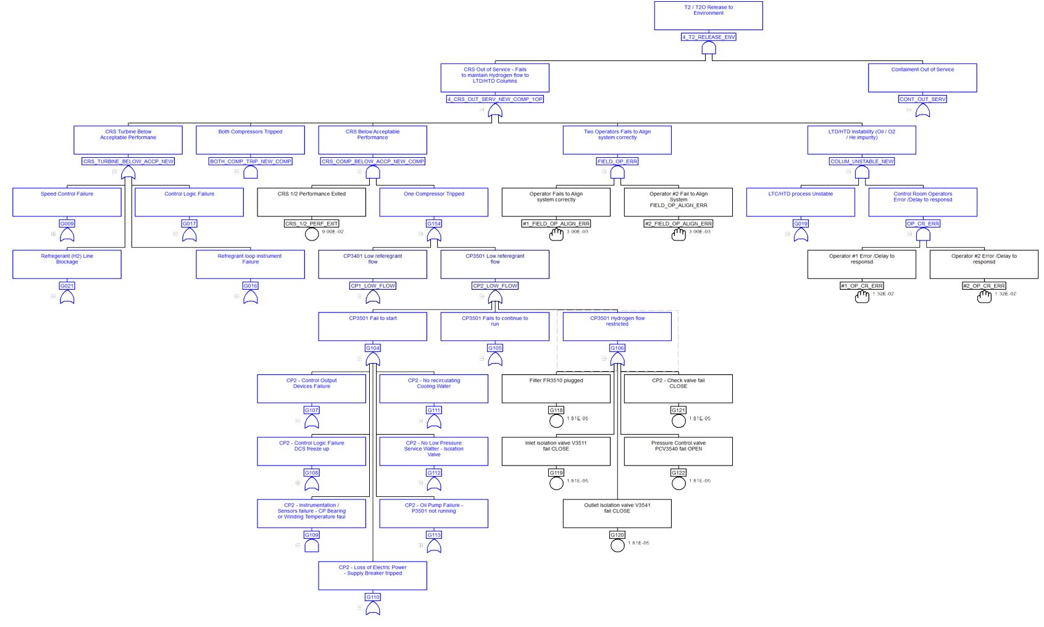
Final Fault Tree
Top event probability : 4.32×10⁻⁷
  CRS Out-of-Service probability: 1.45×10⁻³
  FTA Model configuration:
  TED45 turbine + 2× H₂ compressors (new) + Two Panel Operators (TRF Main Control Room)
Adding Two Operators to Monitor the Process in TRF MCR
Notes:
The final CAFTA model is with TED45, two new 55% compressors and an additional control room operator (two panel operators), tritium release and CRS outage probabilities drops by about 90%.

Slide 23
Layered Defense: TED45 + New H2 Compressors + Two Control Room Operator
  TED45 retrofit + 2x New H₂ Compressors
  Hardware removes oil ingress; Install new compressors with higher reliability
  Net effect: sustained low risk band (both 90-day and 200-day horizons)
Configuration | 90-day Outage (C_{f}=450) | Risk Band | 200-DAY Outage (C_{f}=1000) | Risk Band
1) Baseline: OBT + 2x50% Old H₂ COMP. + 1 Op | 6.66 | Medium | 14.80 | High
2) TED45 + 2x50% Old H₂ COMP. + 1 Op | 2.48 | Low | 5.52 | Medium
3) TED 45 + 2x50% New H₂ COMP. + 1 Op | 2.00 | Low | 4.45 | Low
4) TED 45 + 2x50% New H₂ COMP. + 2 Op | 0.65 | Low | 1.45 | Low
Notes:
When we combine TED45 and two new H2 compressors and two operators, we address both hardware and human vulnerabilities. Oil ingress disappears, and human error drops. The combined result keeps risk in the Low category across both outage horizons.

Slide 24
Likelihood Estimate of CRS Out-of-Service in DTRF
Notes:
This is the final Event Tree sequence diagram, including each event probability and the top event -CRS out of service due to oil supply pump and turbine damage.

Slide 25
Risk Score
Notes:
Final scores confirm the improvement: from Medium/High at baseline to consistently Low across both horizons. Operationally, this means fewer outages, faster restarts, reduced dose, and predictable schedules. For finance, it means reduced forced downtime and cost stability.

Slide 26
Implementation & Feasibility
  Avoids hydrogen burn-down for turbine maintenance; reduces outage exposure
  Scope: Remove Turbine Oil Supply System (TOSS), install TED45 + bypass piping; tie into controls (DCS/CMS); install two new hydrogen compressors, verify cooling water & power connections
  Future Option: Evaluate adding third compressor (100%) + auxiliaries (CAPEX, ROI study)
Criteria | TED45 Retrofit (Now) | Add Compressor (Later)
Cost | Moderate CAPEX (turbine replacement + bypass piping, removal of oil supply system). Avoids recurring oil system maintenance costs. | High CAPEX (new compressor, auxiliaries, building space, controls). Requires ROI analysis.
Outage Risk Reduction | Eliminates oil ingress failure path; lowers OOS probability from 1.37×10⁻² → 4.40×10⁻³. Shifts risk band from High → Low. | Provides redundancy (2x55%+1x100% configuration). Further reduces outage exposure but does not eliminate oil supply system risks (if OBT still in use).
Complexity | Straightforward: replace OBT with TED45; integrate bypass valve; tie into controls, power, cooling. | Complex: additional compressor requires new auxiliaries, building mods, power/cooling tie-ins. Higher integration risk.
Schedule/Feasibility | Achievable in planned outage window; avoids hydrogen burn-down for turbine maintenance. | Longer lead time; likely multi-outage phased project; feasibility depends on ROI and long-term strategy.
Notes:
The new gas cooled turbine TED45 can be installed during a planned outage. Once the system is installed and successfully commissioned, the compressor replacements and upgrades will be planned during another outage. The Turbine replacement project removes the turbine oil supply systems (TOSS), requires bypass valve integration for CRS accurate temperature control. The compressor replacement projects need to be tied into controls (DCU and CMS) and cooling water systems. A future option is to add a new compressor, although that requires significant capital and ROI analysis. Scheduling should align with planned outages to minimize disruption to TRF production and commitment to other CANDU stations.

Slide 27
Conclusions
  CRS reliability governs DTRF stability and tritium process outage risk
  Baseline (OBT + 2×50% H₂ Comp.) → risk scores in Medium/High band
  TED45 retrofit → risk scores drop to Low and Medium band
  Replacing old compressors with 2 x new H₂ Comp. → Improves reliability, risk scores drop to Low band
  Recommended path: implement TED45 and 2 x new H₂ Compressor during upcoming outages; develop FTA for other critical TRF systems (i.e. VPCE, LTD/HTD Cold boxes, TIS, Recombiner and ACS), study ROI adding two panel operators
Notes:
In summary, CRS reliability drives DTRF performance. CRS reliability defines DTRF stability and tritium risks. Baseline systems placed us in the Medium/High risk areas. TED45 reduced this to Low/Medium, new compressors pushed both horizons into Low, and combined with dual operators, produces an overall tenfold improvement. The recommended path forward is to implement TED45 and new compressors installation, extend fault tree analysis to other critical systems, and assess operator strategy and optional future capacity.

Slide 29
Questions & Discussion
Thank you. Questions are welcome
Contact: allan.ghaforian@ontariotech.net

