Slide 1
Identifying Human Failure Events (HFEs) in the Context of Aviation Incidents Using Cognitive-based Human Reliability Analysis (HRA) Methods
Farid Jafarli¹, Ahmad Al-Douri¹*
¹ School of Sustainable Chemical, Biological, and Materials Engineering, University of Oklahoma
* aaldouri1@ou.edu
Probabilistic Safety Assessment and Management
PSAM 18 Conference
July 19-24, 2026 Pittsburgh, PA

Slide 2
Content
Introduction
  HRA in aviation
Methodology
  Phoenix HRA Framework
Results
  Crew failure modes (CFMs) for Runway Stabilizer Checklist
  Preliminary human error probability (HEP) estimates
Conclusions

Slide 3
Introduction

Slide 4
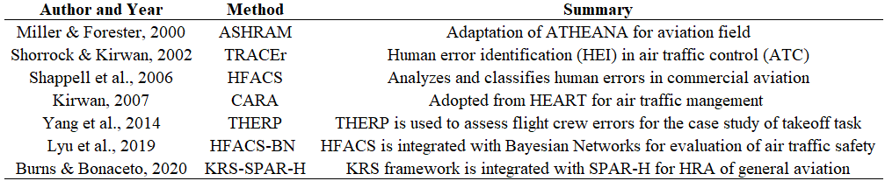
HRA in Aviation
TRACEr
2002
CARA
2007
HFACS-BN
2019
The main limitation of the first- and second-generation methods is the lack of a cognitive model that shows the causal mechanisms linking human responses to performance influencing/shaping factors.
ASHRAM
2000
HFACS
2006
THERP
2014
KRS-SPAR-H
2020

Slide 5
Methodology

Slide 6
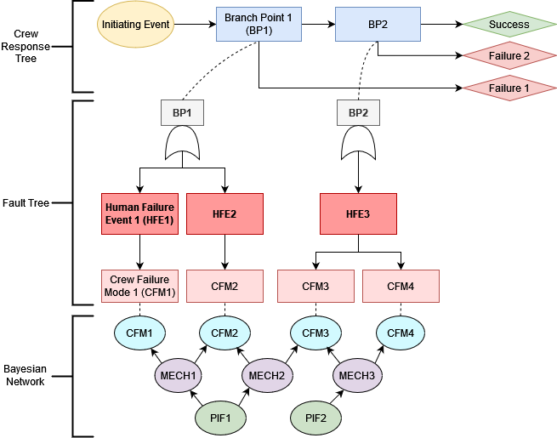
Methodology: Phoenix Model
Phoenix is a cognitive-based HRA method for identifying human failure events (HFEs) and their root causes. The framework is integrated by human failure mechanisms.
Paglioni et al., 2023
Ekanem, N. J., Mosleh, A., & Shen, S. H. (2016). Phoenix–a model-based human reliability analysis methodology:
qualitative analysis procedure. Reliability Engineering & System Safety, 145, 301-315.
Paglioni, V. P., Levine, C. S., Al-Douri, A., & Groth, K. M. (2023). Why Do Human-Machine Teams Fail:
Investigating Failure Mechanisms in Human Reliability Analysis.

Slide 7
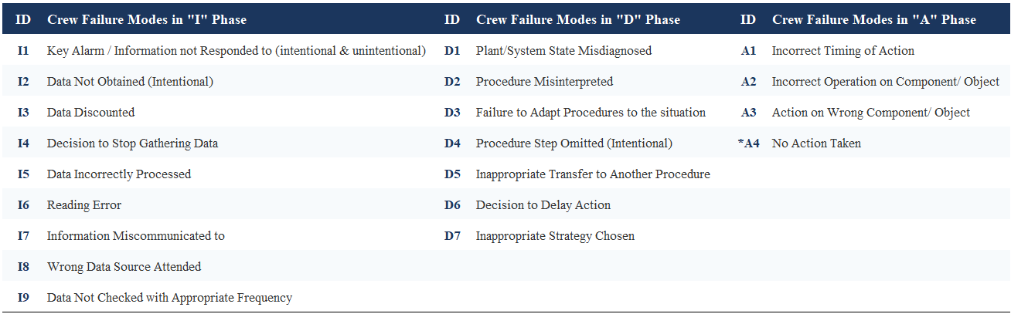
Crew Failure Modes (CFMs)
CFMs determine crew failure forms for Information, Decision, and Action (IDA) phases.
Relevant CFMs are identified for each failure event through Fault Trees (FTs).
*A fourth action-taking CFM is proposed: A4, “No Action Taken ”
Ekanem, N. J., Mosleh, A., & Shen, S. H. (2016). Phoenix–a model-based human reliability analysis methodology:
qualitative analysis procedure. Reliability Engineering & System Safety, 145, 301-315.
Levine, C. S. (2025). Expanding the Causal Logic Foundations of Human Reliability Analysis
(Doctoral dissertation, University of Maryland, College Park).

Slide 8
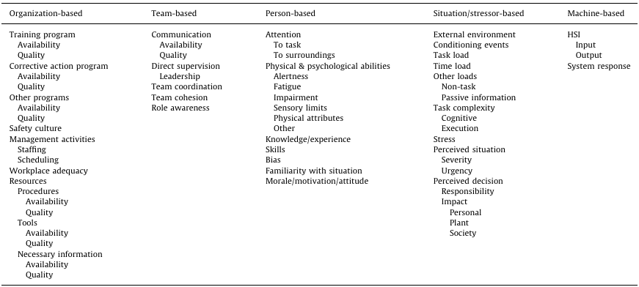
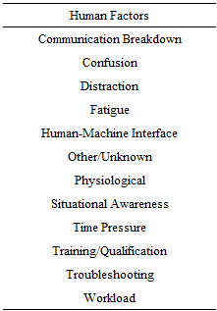
Performance Influencing Factor (PIF) Hierarchy
Groth et al., 2012
ASRS, NASA
The top level consists of five categories: organization-based, team-based, person-based, situation/stressor-based, and machine-based.
PIFs and their impact on the individual/team are clearly defined.
The hierarchy is analogous to a smaller set of human factors derived from the Aviation Safety Reporting System (ASRS) database.
Groth, K. M., & Mosleh, A. (2012). A data-informed PIF hierarchy for model-based human reliability analysis. Reliability Engineering & System Safety, 108, 154-174.
National Aeronautics and Space Administration. (2026). Aviation Safety Reporting System database. https://asrs.arc.nasa.gov/

Slide 9
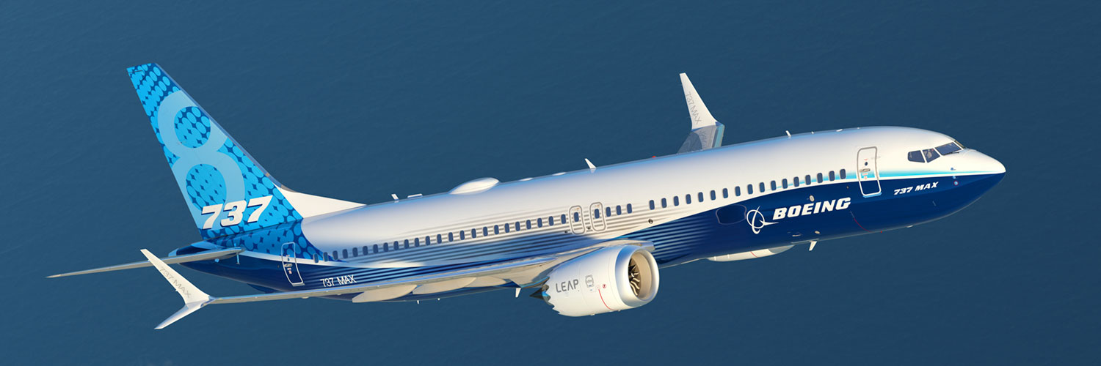
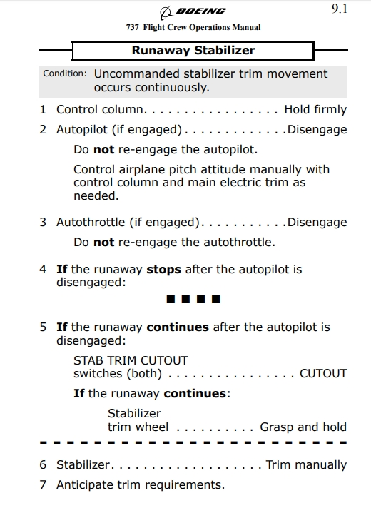
Case Study: Boeing 737 MAX
Boeing implemented the Maneuvering Characteristic Augmentation System (MCAS) to adjust the aircraft’s pitch as needed.
The conflict between the software and the pilots led to two major accidents: Lion Air Flight 610 (189 fatality) and Ethiopian Airlines Flight 302 (157 fatality).
In this work, we apply the Phoenix HRA framework to analyze human errors in the context of crew-system interaction.

Slide 10
Results

Slide 11
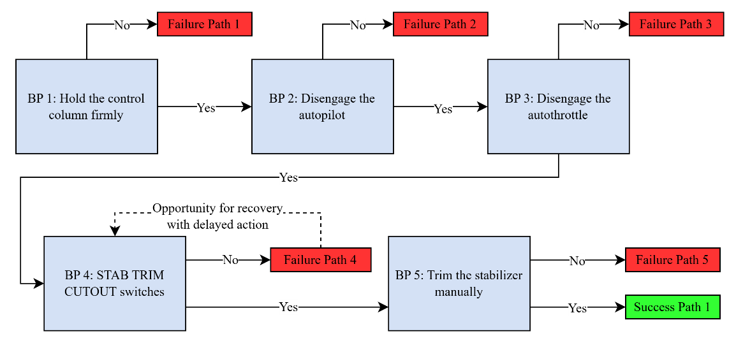
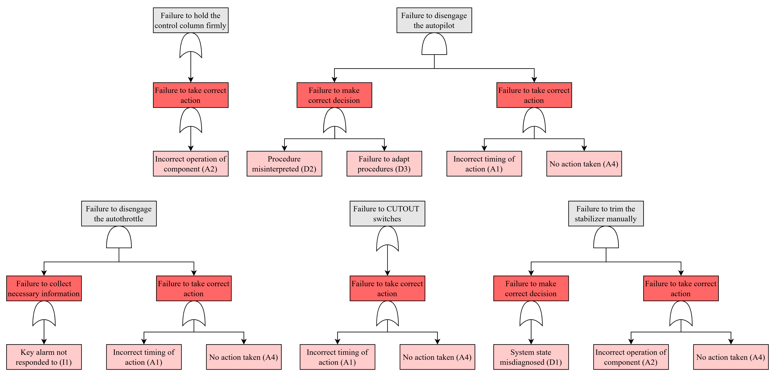
Crew Response Tree (CRT) and Fault Trees (FTs)
We constructed the CRT based on the 5 tasks from the Runaway Stabilizer Checklist:
1. Hold the control column firmly
2. Disengage the autopilot
3. Disengage the autothrottle
4. STAB TRIM CUTOUT switches
5. Trim the stabilizer manually
We developed FTs for each branch and identified its relevant CFMs and HFEs.

Slide 12
Identified CFMs
Phase | Code | Crew Failure Mode (CFM) | Description
Information | I1 | Key alarm not responded to | Failure to respond to a critical alarm, whether intentional or unintentional.
Decision | D1 | Plant/system state misdiagnosed | The crew incorrectly identifies the current state of the plant or its systems.
 | D2 | Procedure misinterpreted | The crew fails to correctly understand or apply the instructions in a procedure.
 | D3 | Failure to adapt procedures | Failure to modify or adjust procedural steps to fit the actual situation.
Action | A1 | Incorrect timing of action | An action is performed, but at the wrong time (e.g., too early or too late).
 | A2 | Incorrect operation of component | The crew operates the correct component but performs the operation incorrectly.
 | A4 | No action taken | The crew initiates the correct action but fails to complete all the necessary steps.
We identified 13 occurrences of 7 unique CFMs.
The majority of the CFMs identified are in the action-execution phase, and the most repeated CFM is “A4*” (No action taken).
Using the Phoenix model, we conducted a causal analysis of CFMs via Bayesian Networks (BNs).

Slide 13
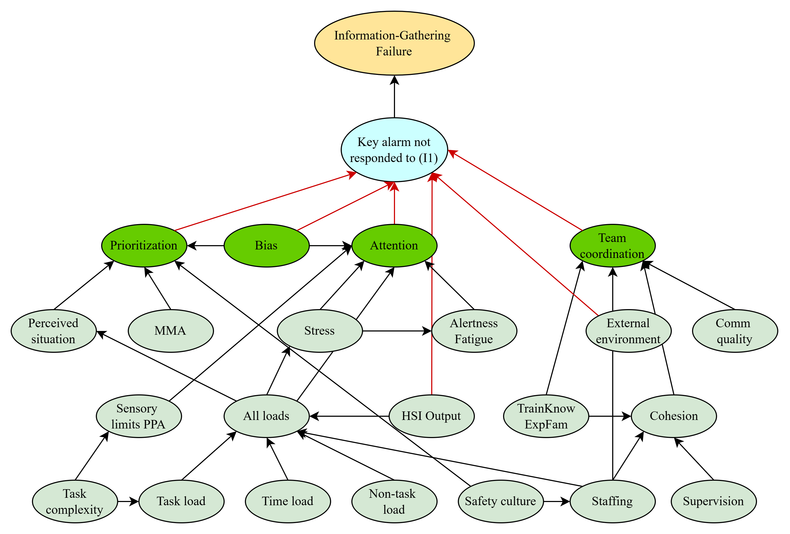
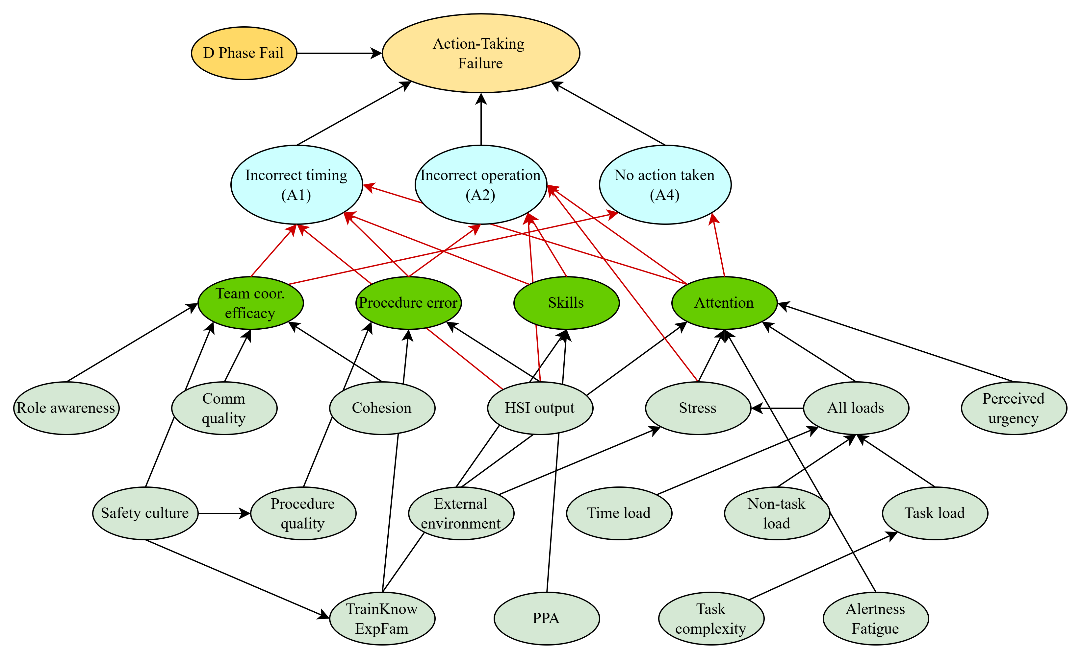
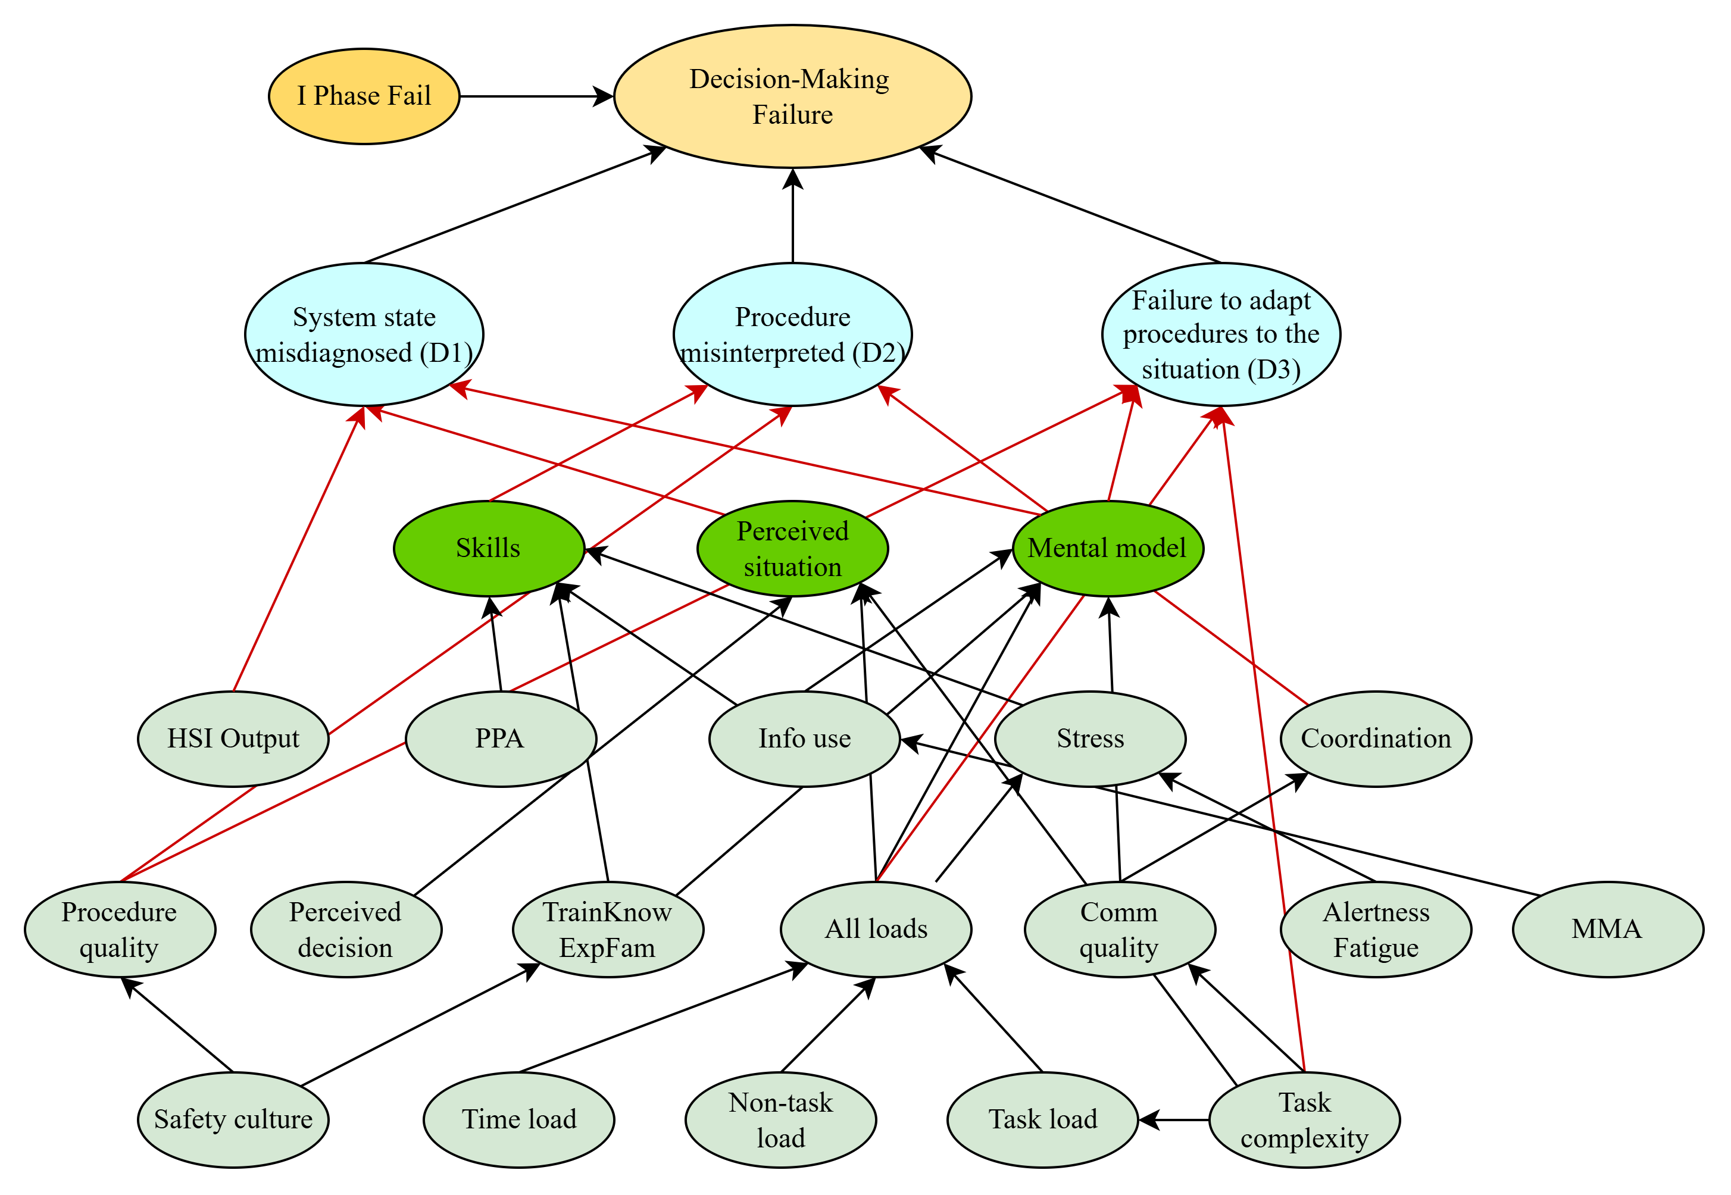
Bayesian Networks (BNs)
Information-gathering phase CFM:
Key alarm not responded to (I1)
Decision-making phase CFMs:
System state misdiagnosed (D1)
Procedure misinterpreted (D2)
Failure to adapt procedure to the situation (D3)
Action-taking phase CFMs:
Incorrect timing of action (A1)
Incorrect operation of component (A2)
No action taken (A4)
Levine, C. S. (2025). Expanding the Causal Logic Foundations of Human Reliability Analysis (Doctoral dissertation, University of Maryland, College Park).

Slide 14
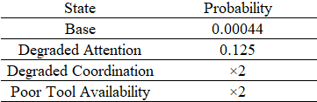
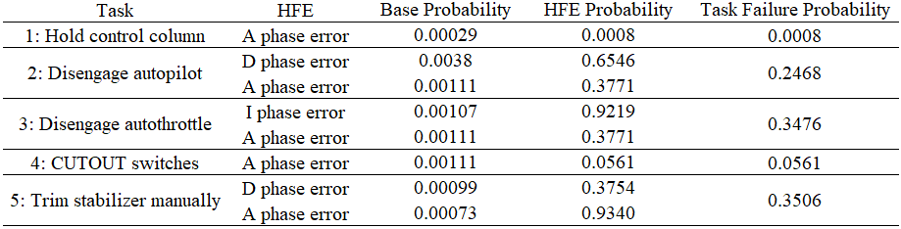
Quantitative Analysis
The base probability of “A4” (No action taken) CFM is 4.4×10⁻⁴. Degraded attention increases the value to 0.125, whereas both degraded coordination and poor tool availability double the probability.
We computed the human error probability (HEP) for each CFM and CRT task.
The highest HEP calculated was for Task 5 due to action execution errors.
The lowest values are observed for Tasks 1 and 4, which the crew successfully performs.
A4. No Action Taken Conditional Multipliers
HFE Probabilities for each Phase and Total HEP for each Task
Levine, Camille, and Katrina Groth. "Causal Human Reliability Operator-Centered Models (Chromo) For Identifying and Quantifying Errors In Information-Gathering, Decision Making, And Action Execution." ASCE-ASME J Risk and Uncert in Engrg Sys Part B Mech Engrg (2026): 1-38.
Notes:
The occurrence probability of CFM depends on the state of PIFs and on failure mechanisms directly affecting CFM. For example, the lowest probability is calculated for Task 1, where the relevant CFM is A2 (Incorrect operation of component). CFM A2 is directly affected by tool quality, HSI, stress, skills, procedure error, and attention. Tool quality and HSI are irrelevant for holding the column task, and we assume the crew doesn’t need high skill or procedure quality to hold the column firmly. Stress and attention may be relevant for this CFM, as the crew was working in a stressful environment, and the pilot’s attention was distracted by several shaking alarms or alerts. Therefore, high stress and degraded attention may lead to incorrect operation, such as applying too much force to the control column.

Slide 15
Conclusion

Slide 16
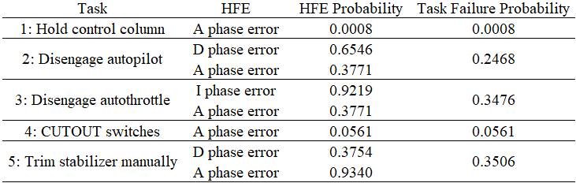
Conclusion
Qualitative analysis
Quantitative analysis
This work demonstrates the application of causal HRA methods to the aviation domain using the Ethiopian Airlines Flight 302 accident as a case study.
The action-execution phase was dominant in the CFMs that occurred.
The future focus should be on developing aviation-specific data sources to quantify crew failure probabilities and to study the effects of automation on human performance.

Slide 17
References
Miller, D. P., & Forester, J. A. (2000). Aviation Safety Human Reliability Analysis Method (No. SAND2000-2955). Sandia National Labs., Albuquerque, NM (US); Sandia National Labs., Livermore, CA (US).
Shorrock, S. T., & Kirwan, B. (2002). Development and application of a human error identification tool for air traffic control. Applied ergonomics, 33(4), 319-336.
Shappell, S. A., Detwiler, C. A., Holcomb, K. A., Hackworth, C. A., Boquet, A. J., & Wiegmann, D. A. (2006). Human error and commercial aviation accidents: A comprehensive, fine-grained analysis using HFACS (No. DOTFAAAM0618).
KIRWAN, B. (2007). Technical basis for a human reliability assessment capability for air traffic safety management. Complexity (EPC), 1, 7.
Yang, K., Tao, L., & Bai, J. (2014). Assessment of flight crew errors based on THERP. Procedia engineering, 80, 49-58.
Lyu, T., Song, W., & Du, K. (2019). Human factors analysis of air traffic safety based on HFACS-BN model. Applied Sciences, 9(23), 5049.
Burns, K., & Bonaceto, C. (2020). An empirically benchmarked human reliability analysis of general aviation. Reliability Engineering & System Safety, 194, 106227.

Slide 18


Email: aaldouri1@ou.edu
Email: Farid.Jafarli-1@ou.edu

