Slide 1



Development of the Plant Fuel Reload Optimization Platform
Y. Heo, E. So, M. Abdo, C. Parisi, Y-J. Choi (Idaho National Laboratory)
J. Valeri, C. Gosdin, G. Palamone, C. Frepoli (FploliSolutions LLC)
K Ogujiuba, N. Rollins, G. Deplipei, J. Hou (North Carolina State Univ)
A. Alfonsi (Formerly at INL)

Slide 2
Background and Objective
Cost summary ($/MWh) in 2019
Type | Sites | Fuel | Capital | O&M | Total
All U.S. | 58 | $6.15 | $5.71 | $18.55 | $30.41
BWR | 22 | $6.07 | $5.83 | $19.62 | $31.52
PWR | 37 | $6.20 | $5.65 | $18.00 | $29.85
Source: NEI, Nuclear Cost in Context, Oct. 2020
The fuel is ~20% of the total generating cost
  Costs ~$50M for a typical LWR fuel reload
Traditional methods is labor-intensive and time-consuming
  >10e30 combinations of 17x17 PWR core
  Need automatized simulation based generic fuel reloading analysis platform
Development of innovative plant fuel reload optimization platform
  Aims 5-10% reduction in fuel reload costs ($2.5−5M per reload)
  Applicable to load follow and flexible operations, ATF, high burn-up and longer cycle

Slide 3
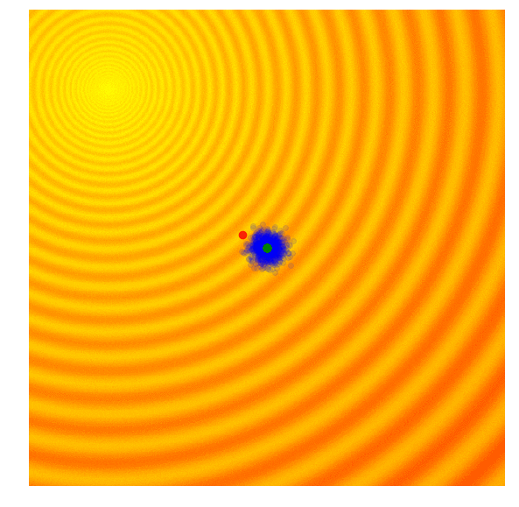
Optimization of Reactor Core Design
Converging
Balance between economics and safety
  Searching for equilibrium fuel cycle core
  Multiple parameters to be considered
  Flexible for computational tools
AI based optimization methodology
  Genetic Algorithm (GA)
  Based on Darwin’s theory of evolution
  Select best results from potential solutions
LWRS Risk-Informed Systems Analysis (RISA)
  Plant fuel reload optimization framework
  Multi-physics/Uncertainty analysis
  LEU+, ATF, HBU, flexible operation
Source: A Visual Guide to Evolutionary Strategies. https://blog.otoro.net/2017/10/29/visual-evolution-strategies.
More details at session Th25

Slide 4
Technology Roadmap
Phase 3 (FY22-23)
Application of risk-informed method
Phase 1 (FY19-20)
Methodology development
Phase 2 (FY21-22)
Framework Improvement
Phase 3 (FY22-23)
Demonstration of benefits
Phase 4 (FY24-25)
Improvement and expansion
Phase 1 (FY19-20)
Framework development
Setup tools and methods
Set plant based scenarios
Simulate DBA with deterministic method
Use fixed core loading pattern
Evaluate recoverable margin
Update tools and methods
Optimization method for fuel reloading pattern
Analyze uncertainties
Assess constraints and issues of tools
Apply risk-informed approach
Improve of optimization method (ML/AI)
Demonstrate generic optimization framework
Maximize capability of framework
Initiation BWR and ATF core optimization
Assess economic benefits
Demonstration with ATFs
Demonstration for BWRs
Demonstrate with equilibrium scenarios
Finalize framework for the use in license applications
Planning & development
Early demonstration
Industry engagement
Industry deployment
Reaching higher maturity for industry (utilities/vendors) engagement from 2021

Slide 5
Schematic of Optimization Platform
Optimization Platform
RAVEN
GA operation
Simulation control
Input and output
Uncertainty propagation
Risk-informed analysis
System Analysis
Core Design
Fuel Performance
RELAP5-3D
SIMULATE
PARCS
VERA
TRANSURANUS
BISON
More details at session Th25

Slide 6
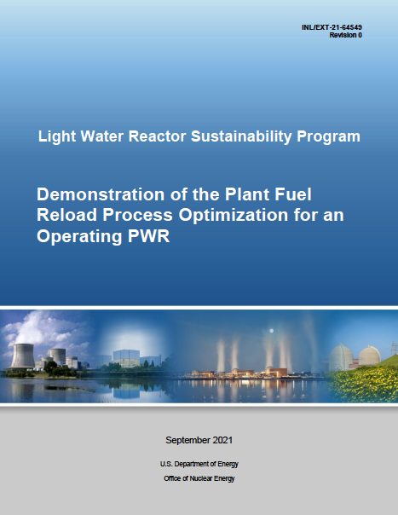
Limiting DBA Analysis
Analysis of ten scenarios from the Standard Review Plan (NUREG-0800)
RELAP5-3D multi-D vessel model for realistic LB-LOCA event simulation
Consider risk-informed multi-physics best estimate plus uncertainties (BEPU)
Limiting Events in Chapter 15 (NUREG-0800)
EVENT | Sec.
Steam System Piping Failure | 15.1.5
Turbine Trip | 15.2.3
Loss of Nonemergency Ac Power to The Plant Auxiliaries | 15.2.6
Reactor Coolant Pump Shaft Seizure (Locked Rotor) | 15.3.3
Chemical and Volume Control System Malfunction That Results in A Decrease in The Boron Concentration in The Reactor Coolant | 15.4.6
Spectrum of Rod Cluster Control Assembly Ejection Accidents | 15.4.8
Inadvertent Operation of the Emergency Core Cooling System During Power Operation | 15.5.1
Steam Generator Tube Failure | 15.6.3
Loss-Of-Coolant Accidents | 15.6.5
Feedwater System Malfunctions that Result in an Increase in Feedwater Flow | 15.3.2
FY21 Project Report
6

Slide 7
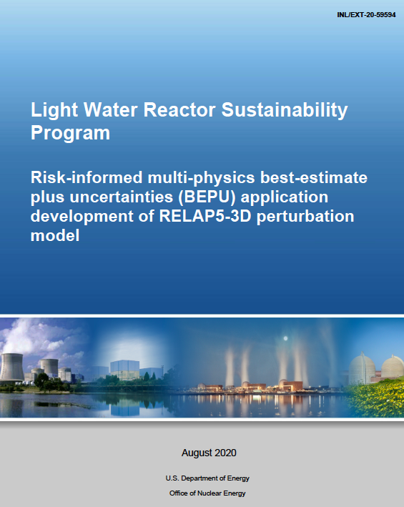
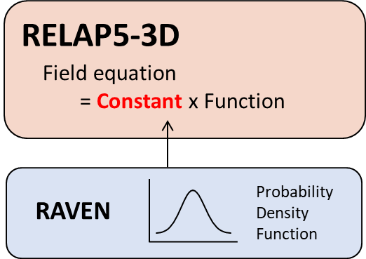
RELAP5-3D for Uncertainty Analysis
Upgrade of RELAP5-3D for uncertainty analysis
User can directly perturb field equation
  Need external stochastic tool (i.e., RAVEN)
  Applicable to multi-physics (2-phase)
  Report in LWRS webpage (Link)

Slide 8
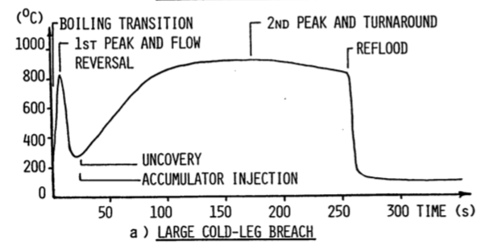
Uncertainties in Reflood of LOCA
Discrepancy due to uncertainty

Slide 9
Conclusion and Future Works
Genetic Algorithm based optimization platform is promising
  Reduces M&O cost, maximize fuel usage, minimize fuel cost
Selection of appropriate computation tools is important
  Need faster, reliable and fully developed computational tools
Facilitate innovative fuel cycle development with ATF
  Higher enriched, extended burn-up and power uprate operation
On-going and future works
  Complete multi-objective model development
  Full scale demonstration (P/BWR, LEU+, ATF, HBU)
  Risk-informed approach
  Economics analysis
More details at session Th25

