Slide 1
TripMonitor Software for quantitative Assessment of shutdown risk in Nuclear Power Plant
Johan Sörman

Slide 2
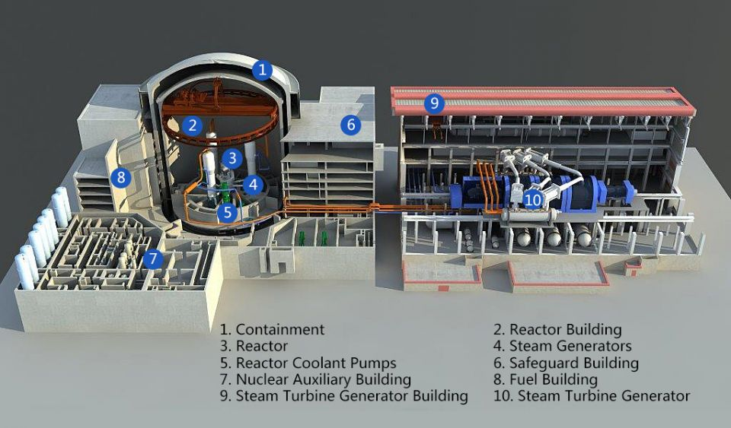
Power loss at nuclear power plants
Reactor trip
Power loss:
nuclear island-reactor shutdown
conventional island-turbine trip
Shutdown means the loss of steam supply, so reactor shutdown will inevitably lead to turbine trip.

Slide 3
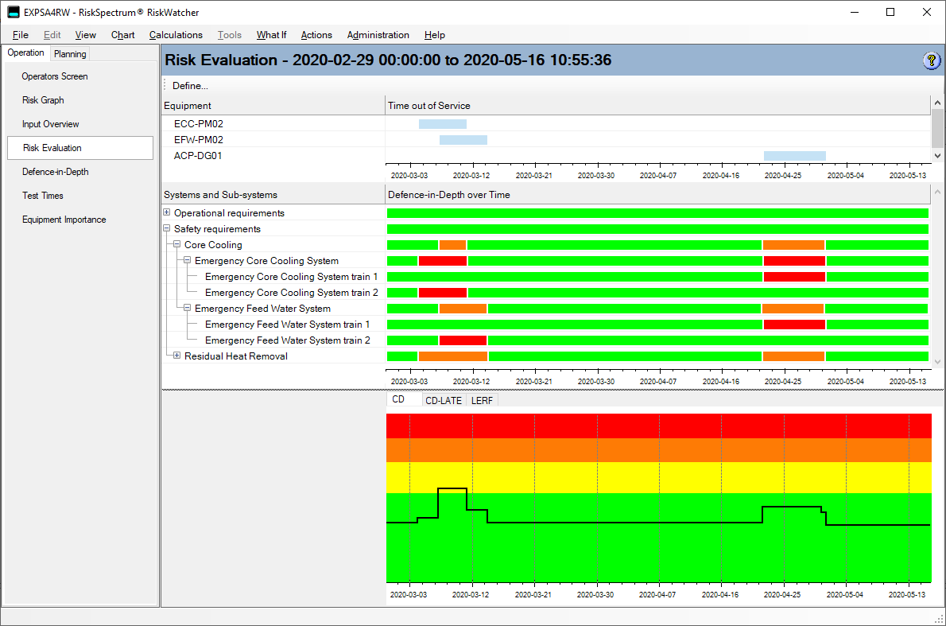
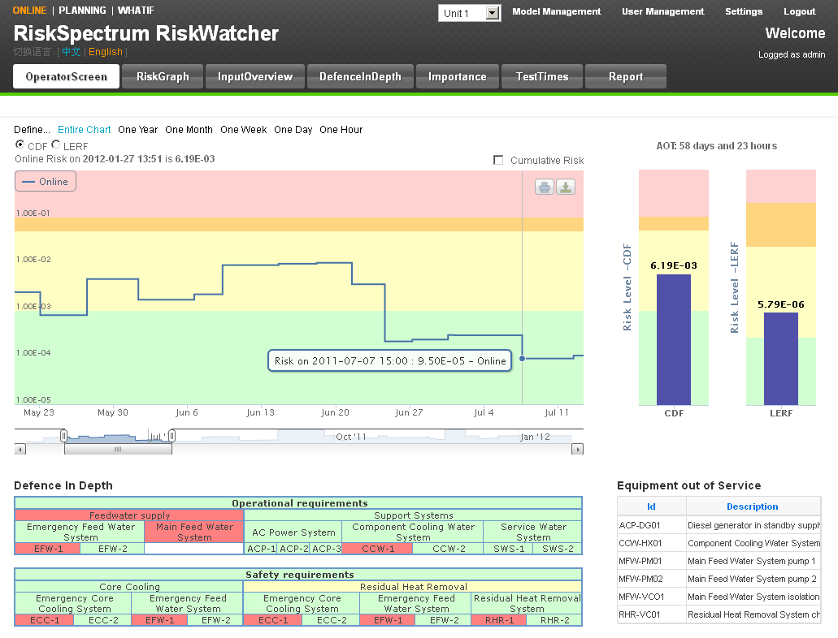
RiskSpectrum Software
RiskWatcher
RiskWatcher Risk Monitor
Monitor risk for e.g. core damage
Manage plant operational safety
Notes:
Ola: Can we show results from both in the same interface?
RiskWatcher uses the PSA model in RiskSpectrum PSA for evaluating risk based on current operation regime and current status of plant and its equipment.

Slide 4
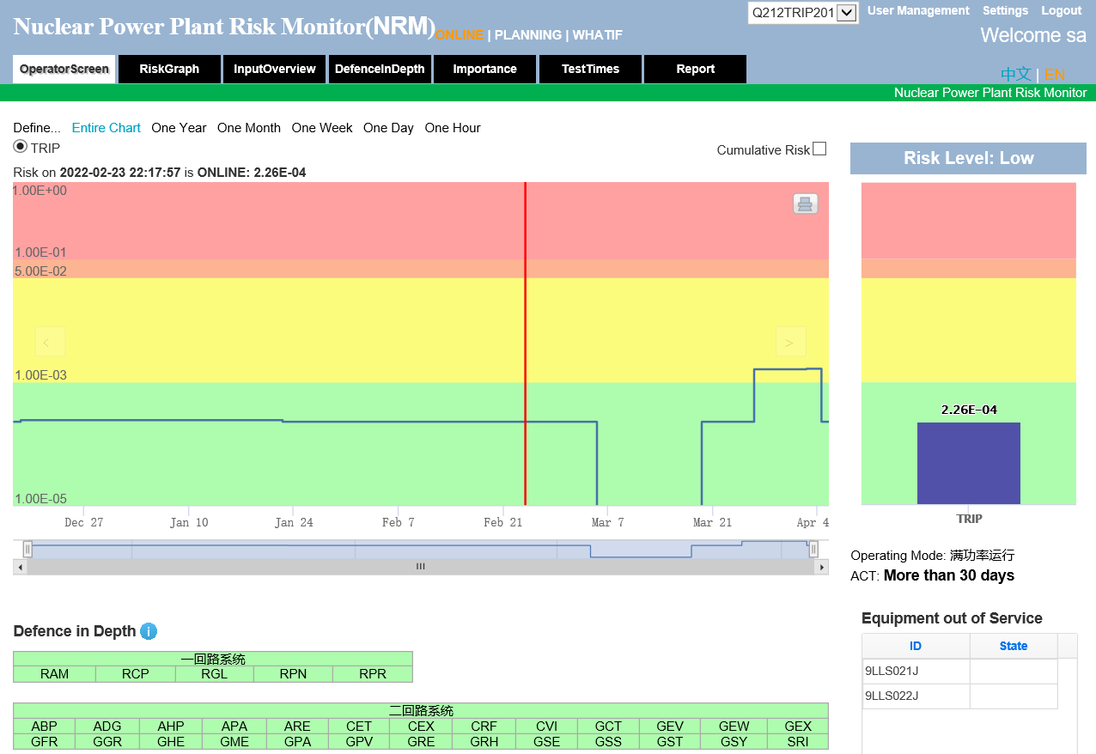
RiskSpectrum Software
RiskWatcher
RiskWatcher Risk Monitor
Monitor risk for e.g. core damage
Manage plant operational safety
RiskWatcher Trip Monitor
Monitor risk for reactor trip
Identify critical equipment
Notes:
Ola: Can we show results from both in the same interface?
RiskWatcher uses the PSA model in RiskSpectrum PSA for evaluating risk based on current operation regime and current status of plant and its equipment.

Slide 5
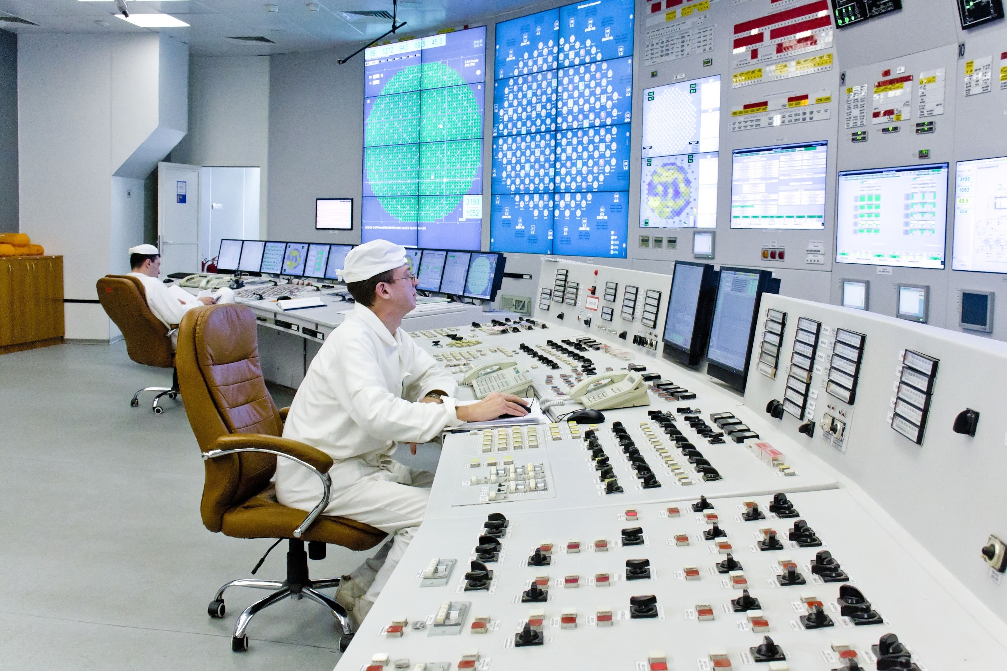
RiskSpectrum Software
Trip Monitor
Added value
Reduce risk for events leading to loss of production
Support decisions on mitigating actions
Increase staff awareness to correctly identify and assess operational risk relating to degradations of plant

Slide 6
RiskSpectrum Software
Trip Monitor
Benefits
Identify Single Points of Vulnerability (SPV) in general and temporary SPVs in particular
SPV: E.g. Reactor cooling pump (typical PWR design)
Temporary SPVs: E.g. one feedwater pump is unavailable (for a 3 pumps, 50% design) the other two are temporary SPVs.
Manage and follow-up frequency of risk for trip
Assess equipment importance based on current configuration

Slide 7
RiskSpectrum Software
RiskWatcher Trip Monitor
RiskWatcher uses a trip model for evaluating risk for trip (or derate)
The Trip model:
represents combinations of key plant systems whose failure can result in a plant trip or derate
is built in RiskSpectrum PSA software

Slide 8
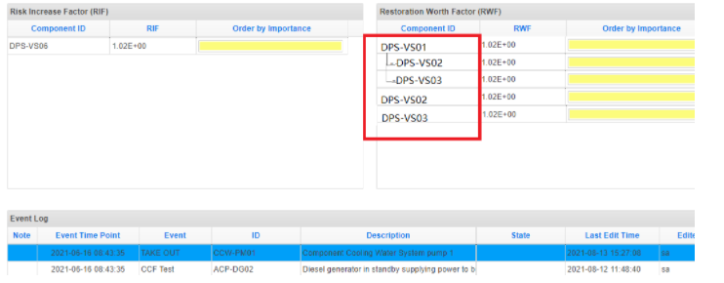
RiskSpectrum RiskWatcher Trip Monitor
Risk vs Trip Monitor
A trip monitor is essentially the same as a risk monitor but requires:
Update of the calculation engine, mainly for the frequency calculation algorithm
Modification of the display of equipment importance:
create a hierarchy in the importance view
filtering of SPVs

Slide 9
RiskSpectrum RiskWatcher Trip Monitor
Calculations
Calculation
Based on an approach “repair as mission time”
Implementation based on:
All components in operation are modelled as repairable events, with the Enabler type setting to Initiator.
Stand-by components are either modelled as probability events (probability, tested, mission time) or as repairable events with Enabler type set to Enabler.
All other events are modelled using reliability model probability, tested or mission time.
No event is represented using frequency event reliability model.

Slide 10
Trip Monitor Application at CNNC Qinshan NPP

Slide 11
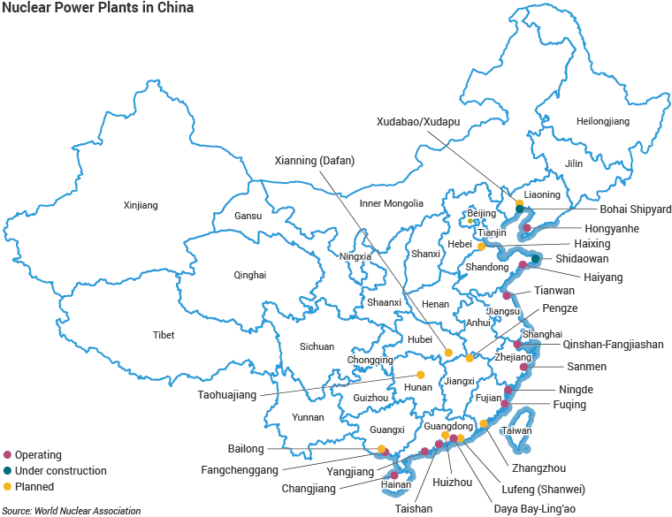
CNNO Qinshan Nuclear Station
About the client
The client “CNNP Nuclear Power Operations Management Co., Ltd (CNNO Qinshan)” is a subsidiary of CNNC group
CNNC (China National Nuclear Cooperation) is the one of the two main nuclear utility companies in China with 24 nuclear units in operation and 9 under construction
RiskSpectrum RiskWatcher is used for risk monitoring at 14 nuclear units of CNNC

Slide 12
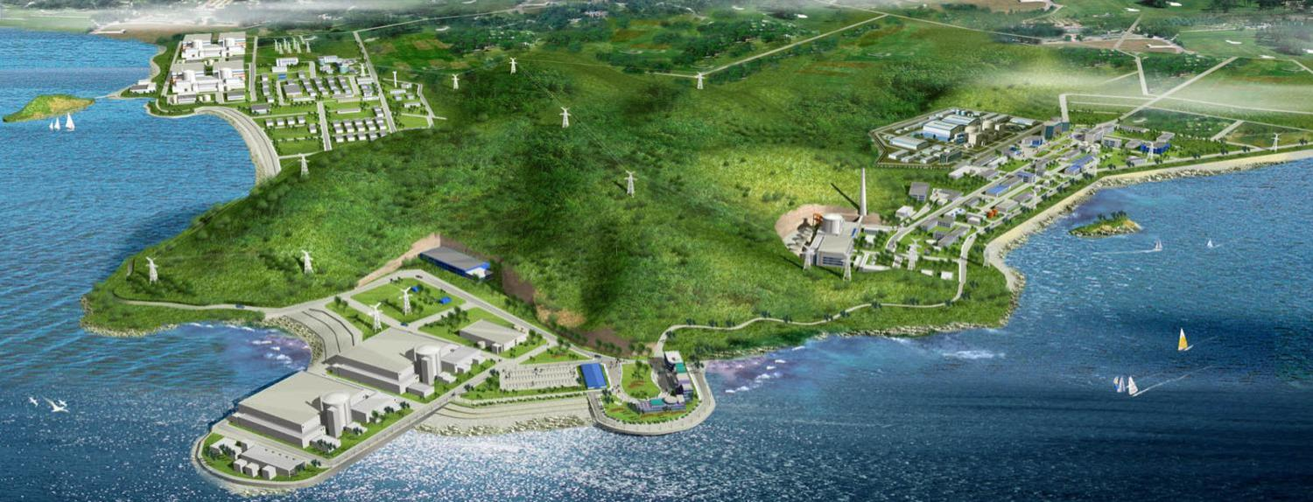
CNNO Qinshan Nuclear Station
Qinshan nuclear site
2*700MWe PHWR
4*650MWe PWR
2*1000MWe PWR
1*300MWe PWR
Qinshan Nuclear Power site is located in east of China (100km from Shanghai), with 9 units in operation and a total installed capacity of 6300 MWe.
Notes:
i

Slide 13
CNNO Qinshan Nuclear Station
Pilot Trip monitor project
Qinshan started a pilot project in 2017 to implement RiskWatcher Trip Monitor to 2 units. Successfully finalised in 2019.
RiskWatcher Trip Monitor is used for:
quantitative trip risk monitoring
identification of critical equipment: “Temporary Single Point Vulnerability (Temporary SPV)”.
SPV: components whose failure will lead to direct or indirectly power loss under standard plant configuration
Temporary SPV: the SPV under temporary plant configuration (typically with components out of service)

Slide 14
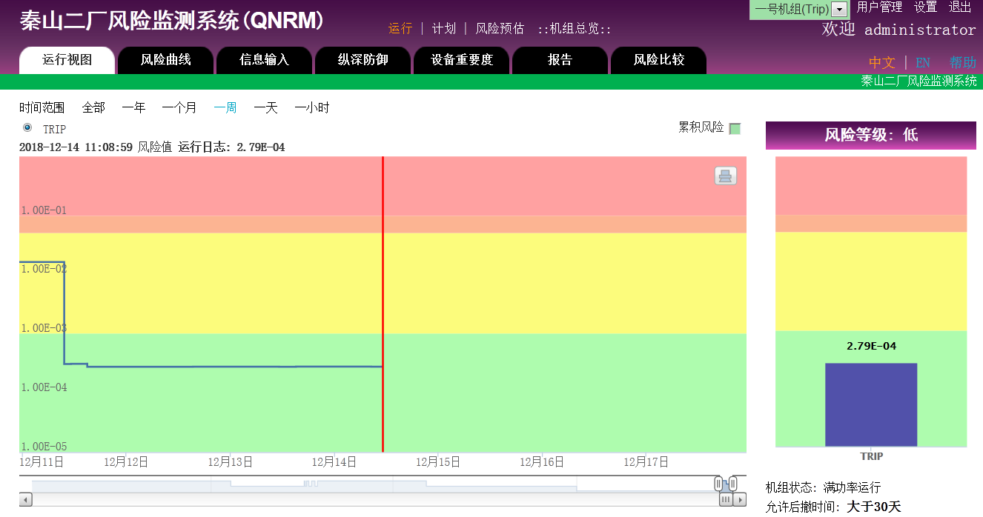
RiskWatcher Trip Monitor interface
Trip risk evaluation for online and planning
Trip risk quantification and risk profile
Current Trip risk frequency with some sensors unavailable in Turbine island
Information from the presentation of CNNO Qinshan in 2019 China RSUM, copyright reserved
Notes:
1: Shutdown/trip risk. In this case, the shutdown/Trip risk is 1.72E-04, its unit is times per hour. If converted into a year, it is 1.507 times per year, that is, under the current unit system configuration, the risk of shutdown/trip in one year is 1.507 times.
2: In this field the current level of Trip risk is indicated. In this case, the risk is medium. The risk level of Trip Monitor is divided into three levels, high, medium and low, corresponding to red, yellow and green respectively. For different risk levels, power plants have different countermeasures and management requirements.
3: Identify the changing trend of unit risk over a period of time.

Slide 15
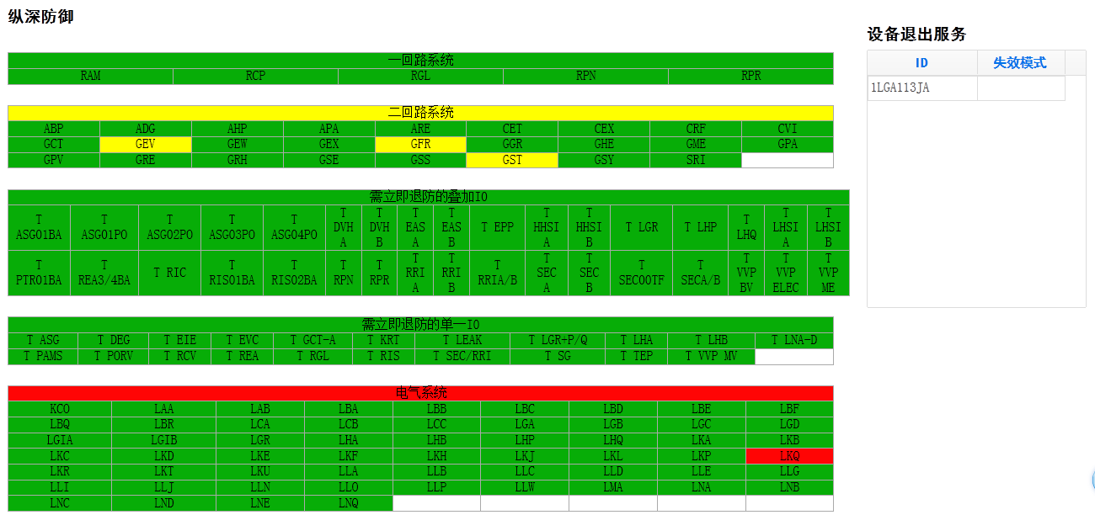
RiskWatcher Trip Monitor interface
Display of status of systems critical for production
Component out of service
Information from the presentation of CNNO Qinshan in 2019 China RSUM, copyright reserved
Notes:
The system state diagram shows the state of systems related to shut down indicated by the colours red, yellow and green. The state diagram includes a primary loop (nuclear island) and a second loop (conventional island) and an electrical system. In addition, it also contains the requirements in the operation technical specification for the operation of the nuclear power plant.

Slide 16
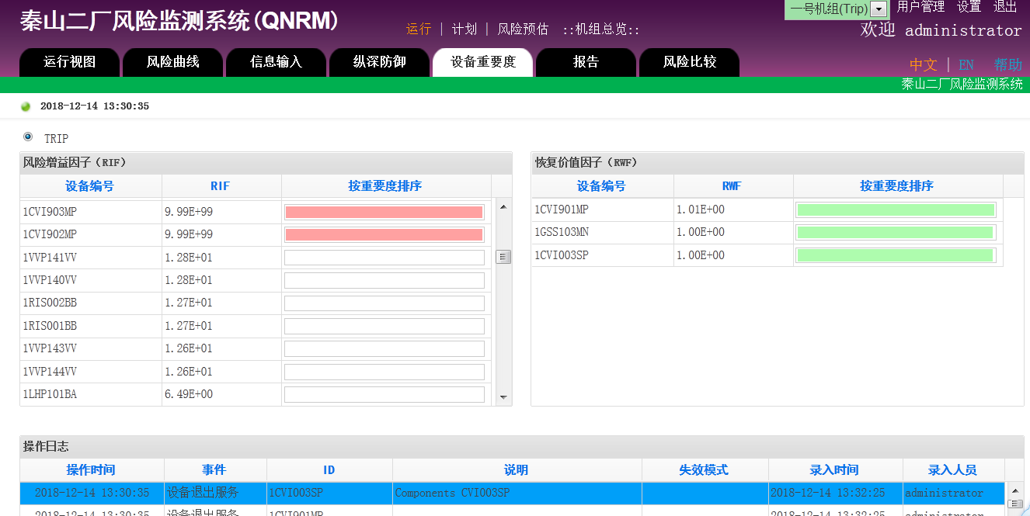
RiskWatcher Trip Monitor interface
Temporary SPVs
Equipment to be restored in priority
Information from the presentation of CNNO Qinshan in 2019 China RSUM, copyright reserved
Notes:
The equipment importance view includes two parts: "Risk Increase Factor (RIF)" and " Restoration Worth Factor (RWF)". The "RIF" indicates, in the current configuration and equipment availability/unavailability, the factor with which the available equipment would increase the risk for shut down if they were made unavailable. The "RWF" indicates which of the equipment that are out of service, at the moment, should be restored first.

Slide 17
Trip monitor application at CNNO Qinshan Nuclear Station
Pilot Trip monitor project
Verification of results:
Trip frequency: frequency matches the operating feedback
Importance ranking: reasonable results
Benchmarking with operating feedback on 53 trip events on similar design:
29 events are included in the model
5 events are not relevant because of design change and improvement
11 events are not in modelling scope (e.g. pipe break, software failure, human error, design flaws, etc.)
8 events are not represented in the model, which lead to later model update
Information from the presentation of CNNO Qinshan in 2019 China RSUM, copyright reserved

Slide 18
Trip monitor application at CNNO Qinshan Nuclear Station
Use of Trip monitor in plant management
Safety analysis team
Management and update of Trip model
Operation planning team
Regular evaluation of upcoming operating plan
Adjustment of operating plan if trip risk is above acceptance criteria
Operation team
Input of equipment unavailability information (due to failure, maintenance, testing etc.)
Identification of risk and critical equipment based on trip calculation
Putting into place risk management measures in operation
Information from the presentation of CNNO Qinshan in 2019 China RSUM, copyright reserved

Slide 19
Trip monitor application at CNNO Qinshan Nuclear Station
Extend Trip monitor to all units
CNNO Qinshan continued in 2021 to provide and implement RiskWatcher Trip Monitor tool for all 9 units at the Qinshan site.
The project also includes an interface with the plant management systems (based on RiskWatcher Connector software):
Automatic import of equipment availability information from Work Order/LOTO system to online risk
Automatic import of upcoming plan information
Import of plan information from planning system
Currently, the client is testing the Trip models, and the implementation will be finished in 2022
Notes:
Lock-Out-Tag-Out System

Slide 20
Conclusion

Slide 21
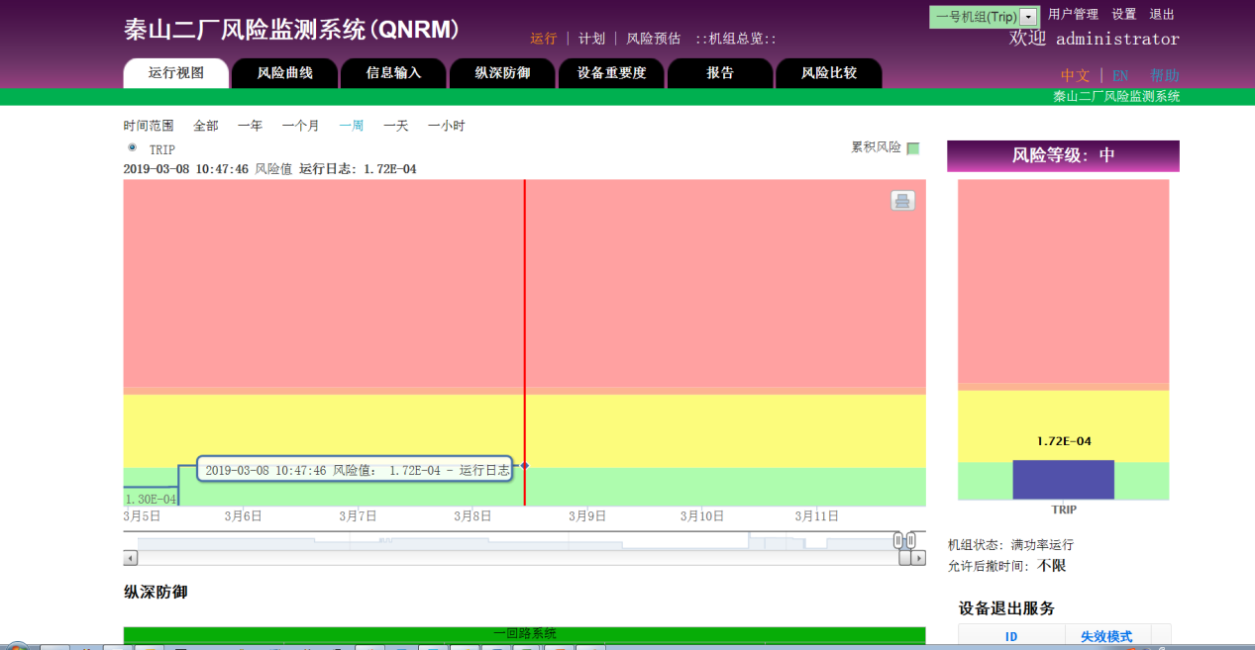
RiskSpectrum RiskWatcher Trip Monitor
In summary
Trip Monitor can provide useful insights and recommendations to eliminate trip
Validation of the trip monitor results at Qinshan NPP show that
The trip frequency matches the operating feedback
Importance ranking show reasonable results
Notes:
MCR operators:
Through the Trip Monitor it is possible to intuitively understand the downtime risk caused by the current equipment failure and maintaining equipment of the power plant.
Input equipment defects in Trip Monitor, quantify the risk, and identify the devices that need to be paid attention.
Daily production planner
Input the daily plan (three-day upcoming plan), assess the shutdown/trip risk of the planned work, and the equipment to focus on.
Adjust the plan according to the analysis results.
Other employees of the power plant. Browse the Trip Monitor web pages to understand the risk of the units.

Slide 22
Thank you
Please contact
Johan Sörman
johan.sorman@lr.org
Wenjie Qin wenjie.qin@vysusgroup.com

