Slide 1
Balanced Fault Tree Modelling of Alternating Operation Systems in Probabilistic Safety Assessment
Woo Sik Jung Sejong University
Probabilistic Safety Assessment & Management conference (PSAM 16)
June 26 – July 1, 2022

Slide 2
Contents
1. Introduction
2. Exclusive Modelling of Partitioning Events by Conditional Events
3. Application to CCW System
4. Conclusions
W.S. Jung, A Method to Avoid Underestimated Risks in Seismic SUPSA and MUPSA for Nuclear Power Plants Caused by Partitioning Events, Energies, 14, 2150, 2021

Slide 3
Nuclear power plants (NPPs) have alternating operation systems
Component cooling water system (CCWS)
Essential service water system (ESWS)
Essential chilled water system (ECWS)
Chemical and volume control system (CVCS)
Single-unit Probabilistic safety assessment (SUPSA) models for nuclear power plants (NPPs) have many failures of alternating systems.
Furthermore, since NPPs undergo alternating operations between full power and low power and shutdown (LPSD), multi-unit PSA (MUPSA) models have failures of NPPs that undergo alternating operations between full power and LPSD.

Slide 4
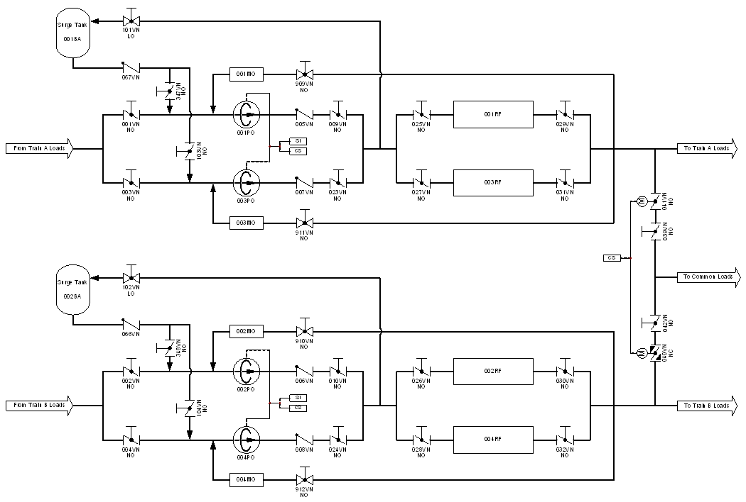
1. Introduction
Alternating train operation of CCW
Alternating operation trains of ① and ②
Alternating operation trains of ③ and ④
Success criteria
① + ② for f
③ + ④ for g
① + ② + ③ + ④ for h
Failure combination
① ② for f
③ ④ for g
① ② ③ ④ for h
f
①
②
h
g
③
④

Slide 5
1. Introduction
Failure combination
① ② for f
CCW failure by partitioning events
$f=X_{1}f_{1}+X_{2}f_{2} (X_{1}+X_{2}=1,X_{1}X_{2}=∅)$
f
①
②
h
$$X_{1}$$ | $$f_{1}=①_{r}×\left(②_{s}+②_{r}\right)$$
$$X_{2}$$ | $$f_{2}=\left(①_{s}+①_{r}\right)×②_{r}$$
g
③
④
Model | Fault tree | Partitioning events | Problem
Usual | $f=f_{1}$ | $p(X_{1})=1.0$ | Biased importance measures
Partitioning events | $$f=X_{1}f_{1}+X_{2}f_{2}$$ | $p(X_{1})=p(X_{2})=0.5$ | Underestimated MCUB of $f$ since $X_{1}X_{2}=∅$
$p{\left(f\right)}_{SUM}=p(X_{1}f_{1})+p(X_{2}f_{2})$
$p{\left(f\right)}_{IEP}=p(X_{1}f_{1})+p(X_{2}f_{2})−p\left(X_{1}X_{2}f_{1}f_{2}\right)$
$p{\left(f\right)}_{MUCB}=p(X_{1}f_{1})+p(X_{2}f_{2})−p(X_{1}f_{1})p(X_{2}f_{2})$
$p{\left(f\right)}_{SDP}=$…
$p{\left(f\right)}_{BDD}=$…

Slide 6
1. Introduction
Failure combination
③ ④ for g
CCW failure by partitioning events
$g=Y_{1}g_{1}+Y_{2}g_{2} (Y_{1}+Y_{2}=1,Y_{1}Y_{2}=∅)$
f
①
②
h
$$Y_{1}$$ | $$g_{1}=③_{r}×\left(④_{s}+④_{r}\right)$$
$$Y_{2}$$ | $$g_{2}=\left(③_{s}+③_{r}\right)×④_{r}$$
g
③
④
Model | Fault tree | Partitioning events | Problem
Usual | $$g=g_{1}$$ | $$p(Y_{1})=1.0$$ | Biased importance measures
Partitioning events | $$g=X_{1}g_{1}+X_{2}g_{2}$$ | $$p(Y_{1})=p(Y_{2})=0.5$$ | Underestimated MCUB of $g$ since $Y_{1}Y_{2}=∅$

Slide 7
1. Introduction
Failure combination
① ② ③ ④ for h
CCW failure by partitioning events
$h=X_{1}h_{1}+X_{2}h_{2}+X_{3}h_{3}+X_{4}h_{4}$
$(X_{1}+X_{2}+X_{3}+X_{4}=1,X_{i}X_{j}=∅)$
Three cases for the fault tree
f
①
②
h
g
$$X_{1}$$ | $h_{1}=①_{r}×\left(②_{s}+②_{r}\right)×③_{r}×\left(④_{s}+④_{r}\right)$
$$X_{2}$$ | $h_{2}=①_{r}×\left(②_{s}+②_{r}\right)×\left(③_{s}+③_{r}\right)×④_{r}$
$$X_{3}$$ | $h_{3}=\left(①_{s}+①_{r}\right)×②_{r}×③_{r}×\left(④_{s}+④_{r}\right)$
$$X_{4}$$ | $h_{4}=\left(①_{s}+①_{r}\right)×②_{r}×\left(③_{s}+③_{r}\right)×④_{r}$
③
④
Model | Fault tree | Partitioning events | Problem
Usual | $$h=h_{1}$$ | $$p(X_{1})=1.0$$ | Biased importance measures
Partitioning events | $$h=X_{1}h_{1}+X_{2}h_{2}+X_{3}h_{3}+X_{4}h_{4}$$ | $$p(X_{1})=p(X_{2})=p(X_{3})=p(X_{4})=0.25$$ | Underestimated MCUB of $h$ since $X_{i}X_{j}=∅$

Slide 8
1. Introduction
How to avoid CDF underestimation
Method 1 : Revise fault tree solvers to reflect $X_{i}X_{j}=∅$
Method 2 : Develop Boolean model for the fault tree modeling to reflect $X_{i}X_{j}=∅$
Objective of this study
Develop Method 2

Slide 9
2. Exclusive Modelling of Partitioning Events by Conditional Events
X1
X2
X3
p(X1) = p(X2) = p(X3) = 1/3
X1 + X2 + X3 = 1
$p(X_{1})=\frac{p\left(X_{1}\right)}{p\left(X_{1}\right)+p\left(X_{2}\right)+p\left(X_{3}\right)}$
$p(X_{2}|/X_{1})=\frac{p\left(X_{2}\right)}{p\left(X_{2}\right)+p\left(X_{3}\right)}$
$p({ X}_{3}|/X_{1}/X_{2})=\frac{p\left(X_{3}\right)}{p\left(X_{3}\right)}=1$
X1
X2
X3
①
/X1
X1
X2
X3
/X1/X2

Slide 10
2. Exclusive Modelling of Partitioning Events by Conditional Events
X1
X2
X3
p(X1) = p(X2) = p(X3) = 1/3
X1 + X2 + X3 = 1
X1
X2
X3
X2
X1
X2
X3
/X1
X2=/X1 X2
X1
X2
X3
X3
X1
X2
X3
/X1/X2
X3=/X1/X2 X3
②
$X_{1}=X_{1}$
$X_{2}=/X_{1}X_{2}$
$X_{3}=/X_{1}/X_{2}X_{3}$

Slide 11
2. Exclusive Modelling of Partitioning Events by Conditional Events
X1
X2
X3
…
Xn
p(X1) = p(X2) = p(X3) = … = p(Xn) = 1/n
X1 + X2 + X3 + ... + Xn = 1
X1
X2
X3
…
Xn
X2
X1
X2
X3
…
Xn
/X1
X2 = /X1X2
X1
X2
X3
…
Xn
X3
X1
X2
X3
…
Xn
/X1/X2
X3 = /X1/X2 X3
$p(X_{1})=\frac{p\left(X_{1}\right)}{p\left(X_{1}\right)+p\left(X_{2}\right)+…}$
$P(X_{2}|/X_{1})=\frac{p\left(X_{2}\right)}{p\left(X_{2}\right)+p\left(X_{3}\right)+…}$
$p({ X}_{3}|/X_{1}/X_{2})=\frac{p\left(X_{3}\right)}{p\left(X_{3}\right)+p\left(X_{4}\right)+…}$
$p({ X}_{n}|/X_{1}/X_{2}…/X_{n−1})=\frac{p\left(X_{n}\right)}{p\left(X_{n}\right)}=1$
②
①
$X_{2}=/X_{1}X_{2}$
$X_{3}=/X_{1}/X_{2}X_{3}$
$X_{n}=/X_{1}/X_{2}…/X_{n−1}X_{n}$

Slide 12
2. Exclusive Modelling of Partitioning Events by Conditional Events
$$X_{n}=/X_{1}/X_{2}…/X_{n−1}X_{n}$$
②
$p\left(X_{n}\right)=p\left(/X_{1}/X_{2}…/X_{n−1}X_{n}\right)$
$p\left(X_{n}\right)=p(/X_{1})p(/X_{2}|/X_{1})p(/X_{3}|/X_{1}/X_{2})…p(X_{n}|/X_{1}/X_{2}…/X_{n−1})$
③
$/X_{1}=/X_{1}^{c}$
$/X_{2}|/X_{1}=/X_{2}^{c}$
$/X_{3}|/X_{1}/X_{2}=/X_{3}^{c}$
$X_{1}^{c}≡X_{1}$
$X_{2}^{c}≡X_{2}|/X_{1}$
$X_{3}^{c}≡X_{3}|/X_{1}/X_{2}$
$X_{n}^{c}≡X_{n}|/X_{1}/X_{2}…/X_{n−1}$
$p\left(X_{1}\right)=p\left(X_{2}\right)=p\left(X_{3}\right)=p\left(X_{n}\right)=1/n$
${p(X}_{1}^{c})=p(X_{1})=\frac{p\left(X_{1}\right)}{p\left(X_{1}\right)+p\left(X_{2}\right)+…}$
$p\left(X_{2}^{c}\right)=P(X_{2}|/X_{1})=\frac{p\left(X_{2}\right)}{p\left(X_{2}\right)+p\left(X_{3}\right)+…}$
$p\left(X_{3}^{c}\right)=p({ X}_{3}|/X_{1}/X_{2})=\frac{p\left(X_{3}\right)}{p\left(X_{3}\right)+p\left(X_{4}\right)+…}$
$p\left(X_{n}^{c}\right)=p({ X}_{n}|/X_{1}/X_{2}…/X_{n−1})=\frac{p\left(X_{n}\right)}{p\left(X_{n}\right)}=1$
①
$p\left(X_{n}\right)$ $=p(/X_{1}^{c})p(/X_{2}^{c})p( /X_{3}^{c})…p(/X_{n−1}^{c})p(X_{n}^{c})$
$X_{n}=/X_{1}^{c}/X_{2}^{c}/X_{3}^{c}…/X_{n−1}^{c}X_{n}^{c}$
$X_{1}=X_{1}^{c}$
$X_{2}=/X_{1}^{c}X_{2}^{c}$
$X_{3}=/X_{1}^{c}/X_{2}^{c}X_{3}^{c}$
$X_{n}=/X_{1}^{c}/X_{2}^{c}/X_{3}^{c}…/X_{n−1}^{c}X_{n}^{c}$
$X_{i}X_{j}=∅$
④
Notes:
*******

Slide 13
2. Exclusive Modelling of Partitioning Events by Conditional Events
$X_{1}^{c}≡X_{1}$
$X_{2}^{c}≡X_{2}|/X_{1}$
$X_{3}^{c}≡X_{3}|/X_{1}/X_{2}$
$X_{4}^{c}≡X_{4}|/X_{1}/X_{2}/X_{3}$
$X_{1}=X_{1}^{c}$
$X_{2}=/X_{1}^{c}X_{2}^{c}$
$X_{3}=/X_{1}^{c}/X_{2}^{c}X_{3}^{c}$
$X_{4}=/X_{1}^{c}/X_{2}^{c}/X_{3}^{c}X_{4}^{c}$
$X_{i}X_{j}=∅$
${p(X}_{1}^{c})=p\left(X_{1}\right)=\frac{p\left(X_{1}\right)}{p\left(X_{1}\right)+p\left(X_{2}\right)+…}=1/4$
$p\left(X_{2}^{c}\right)=P(X_{2}|/X_{1})=\frac{p\left(X_{2}\right)}{p\left(X_{2}\right)+p\left(X_{3}\right)+…}=1/3$
$p\left(X_{3}^{c}\right)=p({ X}_{3}|/X_{1}/X_{2})=\frac{p\left(X_{3}\right)}{p\left(X_{3}\right)+p\left(X_{4}\right)}=1/2$
$p\left(X_{4}^{c}\right)=p({ X}_{4}|/X_{1}/X_{2}/X_{3})=\frac{p\left(X_{4}\right)}{p\left(X_{4}\right)}=1$
$p\left(X_{1}\right)=p(X_{1}^{c})=\frac{1}{4}$
$p\left(X_{2}\right)=p(/X_{1}^{c})p(X_{2}^{c})=\left(1−\frac{1}{4}\right)×\frac{1}{3}=\frac{1}{4}$
$p\left(X_{3}\right)=p(/X_{1}^{c})p(/X_{2}^{c})p(X_{3}^{c})=\left(1−\frac{1}{4}\right)×\frac{1}{3}=\frac{1}{4}$
$p\left(X_{4}\right)=p(/X_{1}^{c})p(/X_{2}^{c})p(/X_{3}^{c})p(X_{4}^{c})=\left(1−\frac{1}{4}\right)\left(1−\frac{1}{3}\right)×\left(1−\frac{1}{2}\right)×1=\frac{1}{4}$

Slide 14
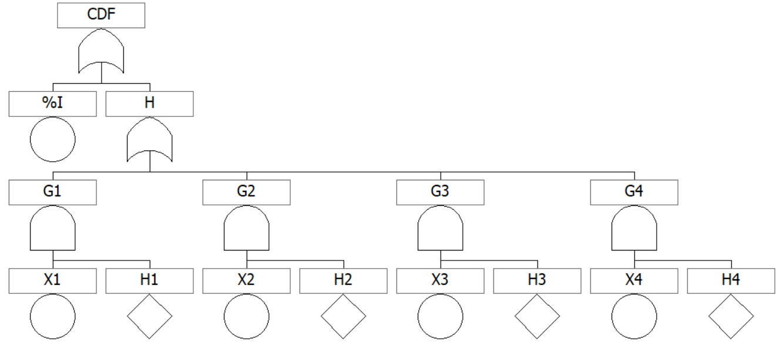
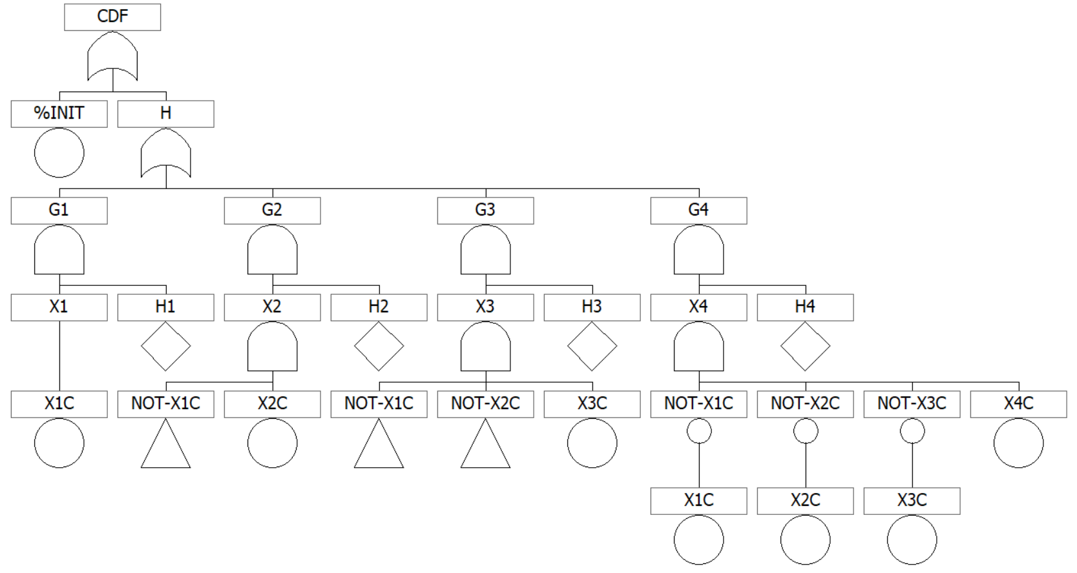
2. Exclusive Modelling of Partitioning Events by Conditional Events
$X_{1}=X_{1}^{c}$
$X_{2}=/X_{1}^{c}X_{2}^{c}$
$X_{3}=/X_{1}^{c}/X_{2}^{c}X_{3}^{c}$
$X_{4}=/X_{1}^{c}/X_{2}^{c}/X_{3}^{c}X_{4}^{c}$
$X_{i}X_{j}=∅$

Slide 15
3. Application to CCW System
CCW failure in SUPSA
Train A failure $f=X_{1}f_{1}+X_{2}f_{2} (X_{1}+X_{2}=1)$
Train B failure $g=Y_{1}g_{1}+Y_{2}g_{2} (Y_{1}+Y_{2}=1)$
f
①
②
h
$$X_{1}$$ | $$f_{1}=①_{r}×\left(②_{s}+②_{r}\right)$$
$$X_{2}$$ | $$f_{2}=\left(①_{s}+①_{r}\right)×②_{r}$$
$$Y_{1}$$ | $$g_{1}=③_{r}×\left(④_{s}+④_{r}\right)$$
$$Y_{2}$$ | $$g_{2}=\left(③_{s}+③_{r}\right)×④_{r}$$
g
③
④
SUPSA-1 (Usual) | $f=f_{1}$ | $p(X_{1})=1.0,p(X_{2})=0.0$
SUPSA-2 (Partitioning events) | $$f=X_{1}f_{1}+X_{2}f_{2}$$ | $p(X_{1})=p(X_{2})=1/2$
SUPSA-3 (Conditional events) | $$f=X_{1}^{c}f_{1}+/X_{1}^{c}X_{2}^{c}f_{2}$$ | $p\left(X_{1}^{c}\right)=p\left(X_{1}\right)=1/2$ $p\left(X_{2}^{c}\right)=1$

Slide 16
3. Application to CCW System
Internal SUPSA (CDF = %Init * CCW failure)
Seismic SUPSA (CDF = %Seis * CCW failure)
CCW failure $h=X_{1}h_{1}+X_{2}h_{2}+X_{3}h_{3}+X_{4}h_{4}$
Three cases for the fault tree
f
①
②
$$X_{1}$$ | $h_{1}=①_{r}×\left(②_{s}+②_{r}\right)×③_{r}×\left(④_{s}+④_{r}\right)$
$$X_{2}$$ | $h_{2}=①_{r}×\left(②_{s}+②_{r}\right)×\left(③_{s}+③_{r}\right)×④_{r}$
$$X_{3}$$ | $h_{3}=\left(①_{s}+①_{r}\right)×②_{r}×③_{r}×\left(④_{s}+④_{r}\right)$
$$X_{4}$$ | $h_{4}=\left(①_{s}+①_{r}\right)×②_{r}×\left(③_{s}+③_{r}\right)×④_{r}$
h
g
③
④
SUPSA-1 (Usual) | $f=f_{1}$ | $p(X_{1})=1.0$
SUPSA-2 (Partitioning events) | $$f=X_{1}f_{1}+X_{2}f_{2}+X_{3}f_{3}+X_{4}f_{4}$$ | $p(X_{1})=p(X_{2})=p(X_{3})=p(X_{4})=1/4$
SUPSA-3 (Conditional events) | $f=X_{1}^{c}f_{1}+/X_{1}^{c}X_{2}^{c}f_{2}+/X_{1}^{c}/X_{2}^{c}X_{3}^{c}f_{3}$ $+/X_{1}^{c}/X_{2}^{c}X_{3}^{c}X_{4}^{c}f_{4}$ | $p\left(X_{1}^{c}\right)=p\left(X_{1}\right)=1/4$, $p\left(X_{2}^{c}\right)=\frac{p\left(X_{2}\right)}{p\left(X_{2}\right)+p\left(X_{3}\right)+p\left(X_{4}\right)}=1/3$ $p\left(X_{3}^{c}\right)=\frac{p\left(X_{3}\right)}{p\left(X_{3}\right)+p\left(X_{4}\right)}=1/2$ $p\left(X_{4}^{c}\right)=\frac{0.25}{0.25}=1$

Slide 17
3. Application to CCW System
$Internal CDF = \%I_{int} ×h$
$Seismic CDF = \%I_{seis} ×h$
Basic Events | Data | Description
%I-INT | 1.00E-02 | Internal event initiator
%I-SEIS | 1.00E-04 | Seismic event initiator
X1 | 2.50E-01
X1C | 2.50E-01
X2 | 2.50E-01
X2C | 3.33E-01
X3 | 2.50E-01
X3C | 5.00E-01
X4 | 2.50E-01
X4C | 1.00E+00
SIF-CC-HXS | 2.50E-01 | Seismic induced failure of CCW heat exchangers
SIF-CC-PPS | 3.33E-01 | Seismic induced failure of CCW pumps

Slide 18
3. Application to CCW System
Internal SUPSA (CDF = %Init * CCW failure)
Seismic SUPSA (CDF = %Seis * CCW failure)
Cases | No of MCSs | CDF by REA | CDF by MCUB | CDF by BDD
SUPSA-1 | 246 | 4.751E-10 | 4.751E-10 | 4.751E-10
SUPSA-2 | 981 | 4.751E-10 | 4.751E-10 | 4.751E-10
SUPSA-3 | 981 | 4.751E-10 | 4.751E-10 | 4.751E-10
Overestimation
Modern seismic SUPSA (EPRI Surry, 2007)
Cases | No of MCSs | CDF by REA | CDF by MCUB | CDF by BDD
SUPSA-1 | 248 | 5.830E-5 | 5.830E-5 | 4.998E-5
SUPSA-2 | 986 | 5.830E-5 | 5.830E-5 | 4.207E-5
SUPSA-3 | 986 | 5.830E-5 | 5.830E-5 | 4.998E-5
Seismic SUPSA Model
Underestimation
MCSs (FTREX)
BDD (ACUBE)
SUPSA-1 (Usual) | $f=f_{1}$ | $p(X_{1})=1.0$
SUPSA-2 (Partitioning events) | $$f=X_{1}f_{1}+X_{2}f_{2}+X_{3}f_{3}+X_{4}f_{4}$$ | $p(X_{1})=p(X_{2})=p(X_{3})=p(X_{4})=1/4$
SUPSA-3 (Conditional events) | $f=X_{1}^{c}f_{1}+/X_{1}^{c}X_{2}^{c}f_{2}+/X_{1}^{c}/X_{2}^{c}X_{3}^{c}f_{3}$ $+/X_{1}^{c}/X_{2}^{c}X_{3}^{c}X_{4}^{c}f_{4}$ | $p\left(X_{1}^{c}\right)=p\left(X_{1}\right)=1/4$, $p\left(X_{2}^{c}\right)=\frac{p\left(X_{2}\right)}{p\left(X_{2}\right)+p\left(X_{3}\right)+p\left(X_{4}\right)}=1/3$ $p\left(X_{3}^{c}\right)=\frac{p\left(X_{3}\right)}{p\left(X_{3}\right)+p\left(X_{4}\right)}=1/2$ $p\left(X_{4}^{c}\right)=\frac{0.25}{0.25}=1$

Slide 19
4. Conclusions
There is a great need to explicitly model the partitioning events in fault trees instead of revising PSA tools.
If the partitioning events are modeled with conditional events in the seismic PSA with the method in this paper, accurate CDF calculation is possible using the existing PSA tools.
The use of the method in this paper is strongly recommended for avoiding CDF underestimation in seismic PSA.
Please take a note “if we don’t pay attention to partitioning events, it frequently results in underestimated CDFs without perception”.
W.S. Jung, A Method to Avoid Underestimated Risks in Seismic SUPSA and MUPSA for Nuclear Power Plants Caused by Partitioning Events, Energies, 14, 2150, 2021

