Slide 1
Performance Testing of Person Passable Openings to Evaluate Accepted Risk
W. Gary Rivera, PhD
Emily Sandt
Sandia National Laboratories
June 2022
SAND2022-8138C

Slide 2
The Unattended Openings Project Charter
History
The current guidelines for determining the minimum passible opening size are based on historical work of the SNL Access Delay department that are in need of update and clarification.
Objective
Inform decision makers to the risk associated with current and future unattended openings as associated with the current accepted risk.
A simple question:
How small of an opening can someone crawl through?
How small of an opening needs to be protected?
A complicated answer:
What size of person?
Is there a person’s critical dimension that dictates passage ability?
What shape of opening?
What length of opening?
What is the surface condition of the opening?
How long does it take?
The primary impact of this effort is to define the scenarios in which an adversary could successfully pass through a potentially complex opening, as well as define the scenarios in which a defined adversary would not be expected to successfully traverse a complex opening. This scientifically based data would then be used for Risk-Informed decision making.

Slide 3
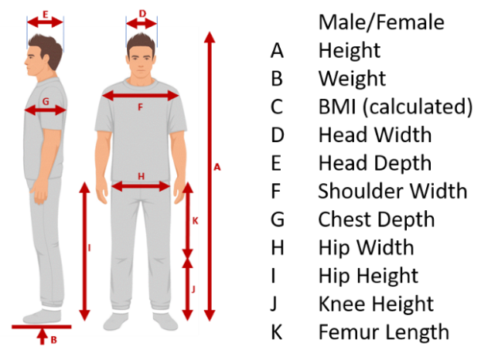
Volunteer Participants
(NM) Study participants needed
Access Delay Dept. 6626 needs volunteers for a study involving physical movement through tight spaces that will take place indoors within a controlled environment. The time commitment is two-three sessions of roughly two hours each.
2D testing: 44 Participants
Tactical Testing: 4 Participants
3D testing: 36 participants
3D “Slippery” testing: 33 participants
Subjects ages range from late teens to ~60s
BMIs range from 19.26 to 34.04
12 Primary body attributes measured or calculated, then compared to ANSUR2 military database

Slide 4
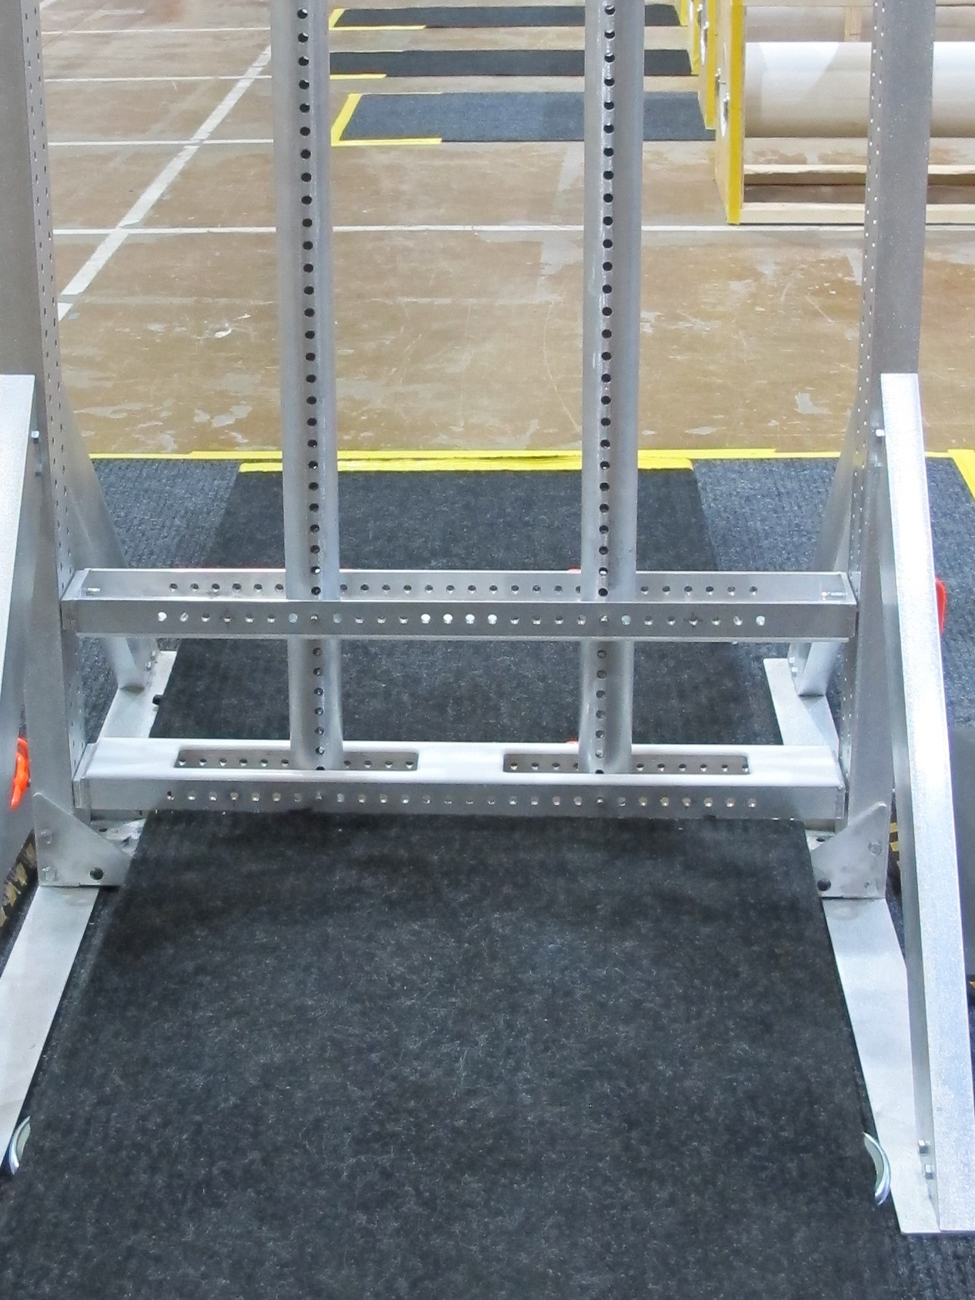
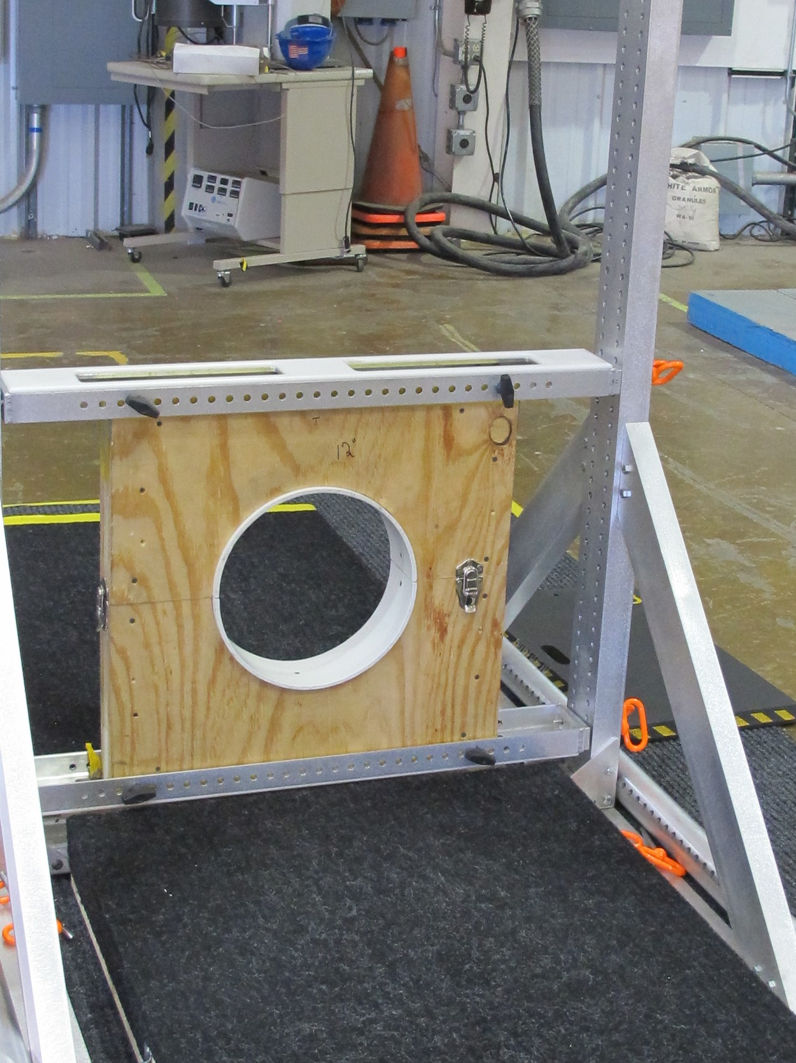
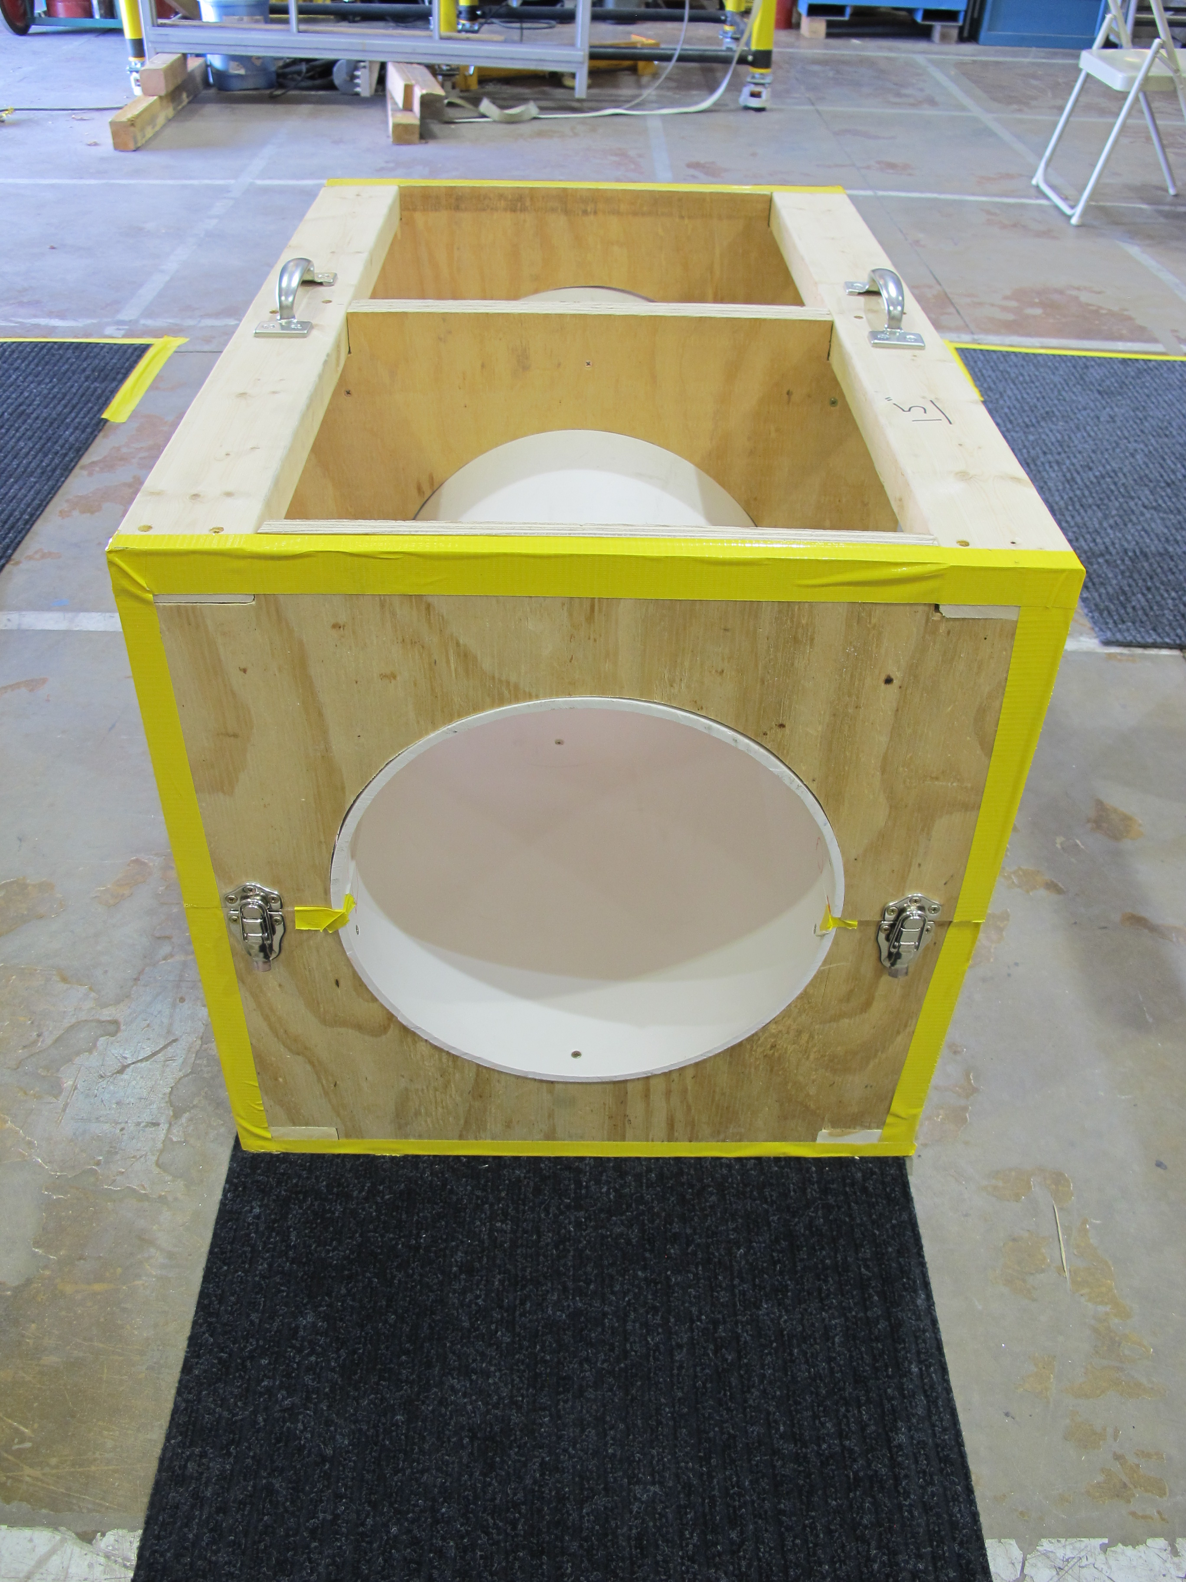
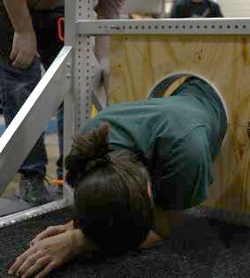
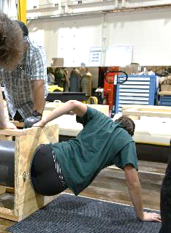
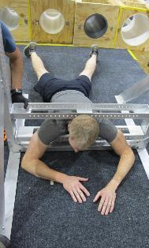
2D Testing
Rectangular frame – 4” depth
Horizontal opening 36” by Y”
Vertical opening X” by 52”
Square opening Y” by Y”
rectangular opening X” by Y”
Circular frame – 4” depth
Circular openings 24”, 18”, 15”, 11”, 10”
Circular short pipe section – 36” depth
Pipe sections 24”, 18”, 15”, 11”, 10”
Retesting sections 14”, 13”

Slide 5
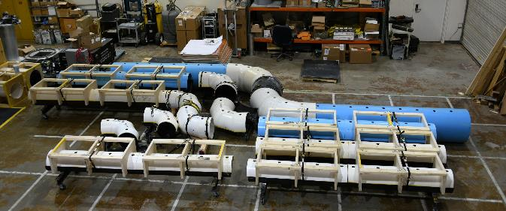
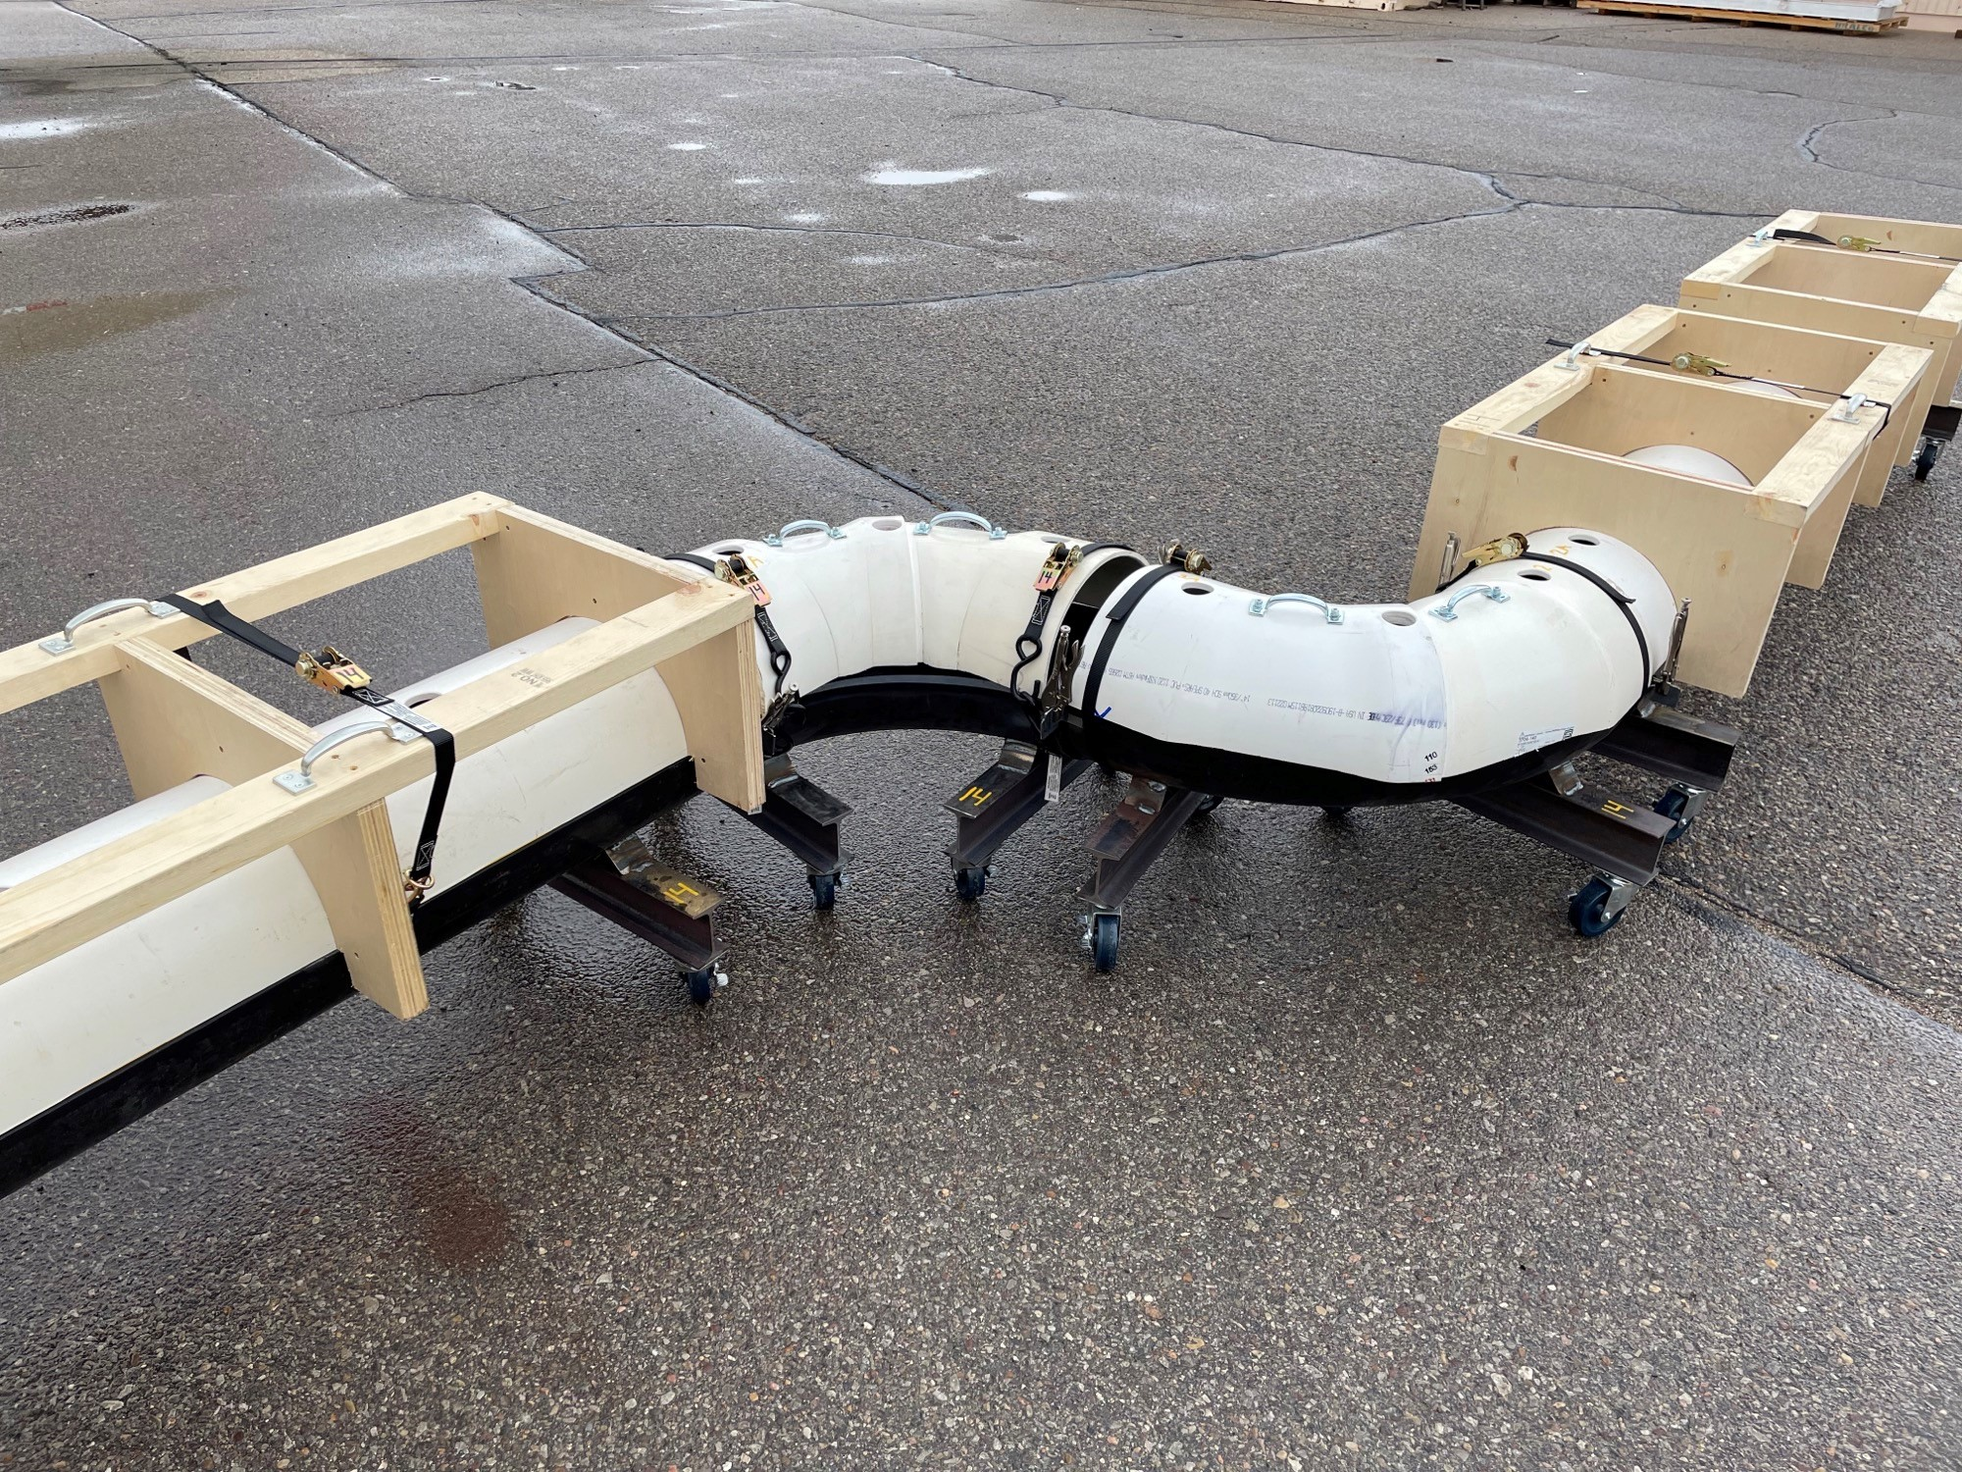
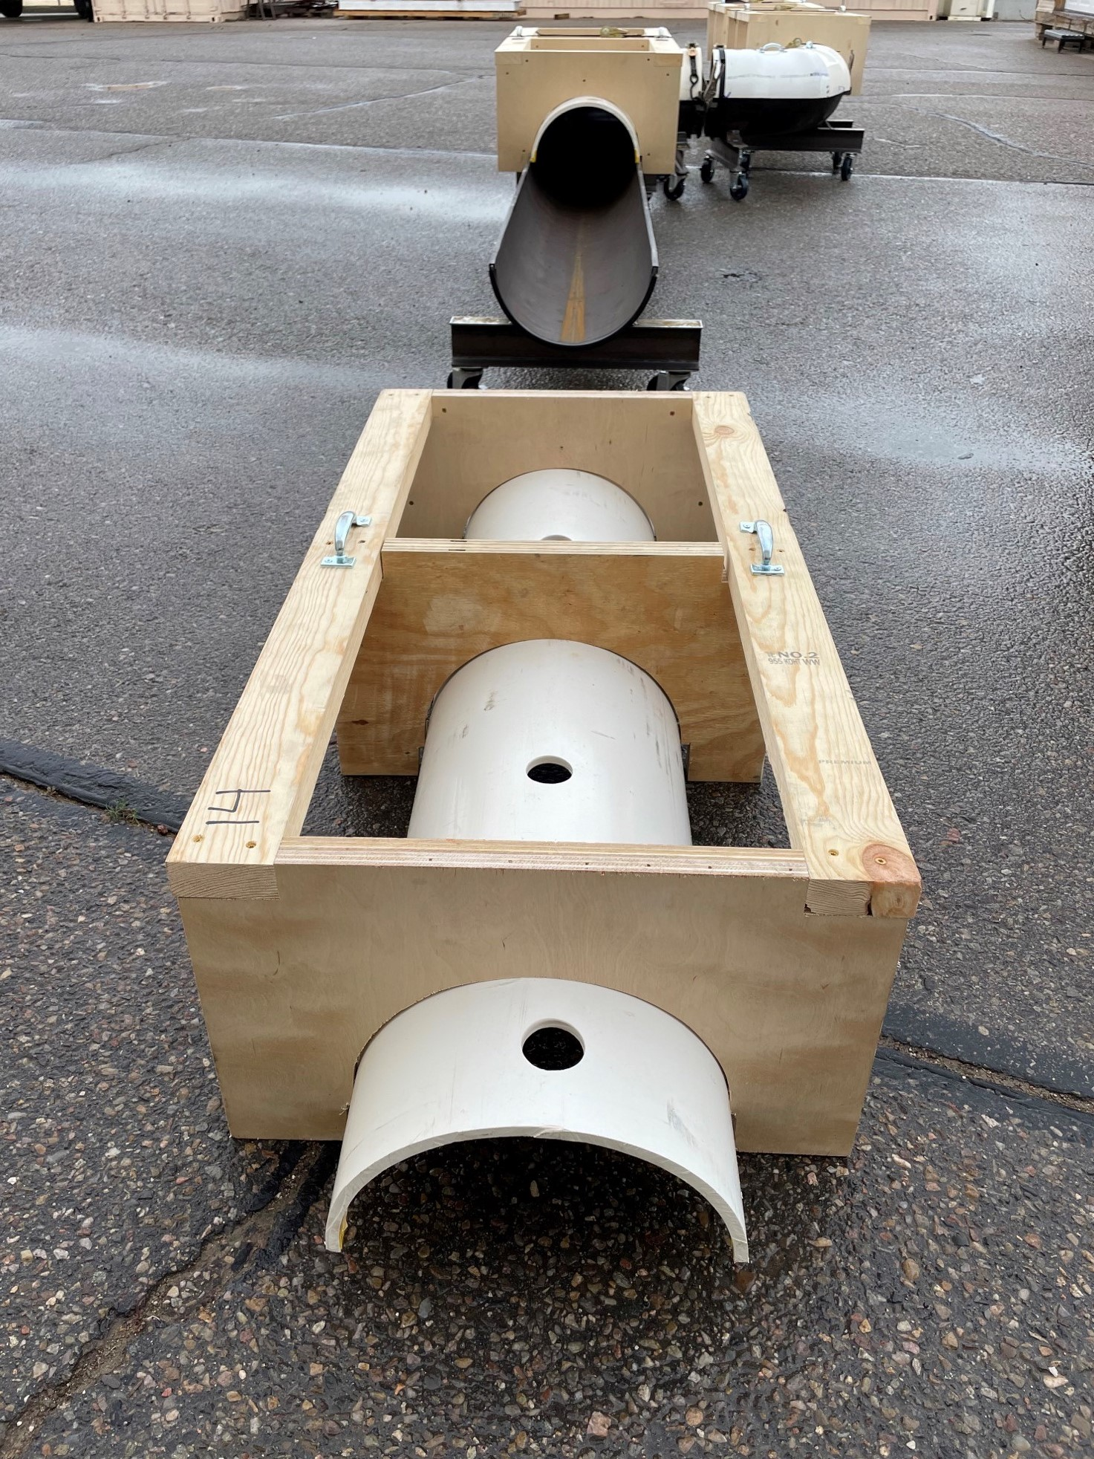
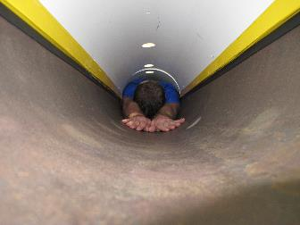
3D Dry Testing
Reconfigurable pipe sections
24”, 18”, 15”, 14”
2 each 10’ straight sections
2 each 90 degree elbow sections
Bottom half steel
Top half PVC
Safety
2” diameter holes drilled in tops for air and light
Top half wood and PVC structure for quick removal
Top halves secured with quick release straps
Safety observers

Slide 6
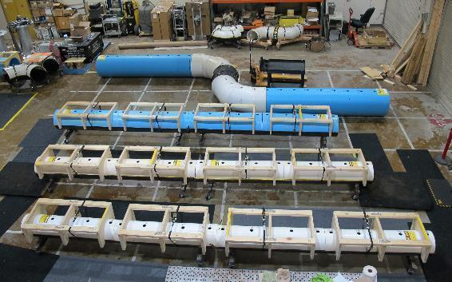
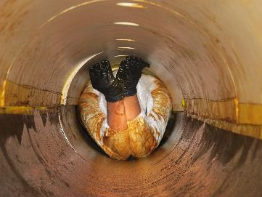
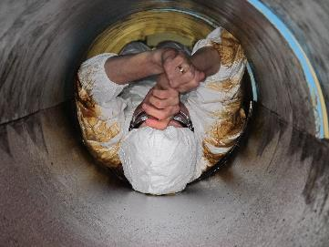
3D “Slippery” Tests
Objective: Decrease the coefficient of friction to determine traversal rate
Commercial dish soap “painted” onto the lower steel half of pipe section.
20’ straight sections only
Each participant given a Tyvek coverall and PPE.
Significantly more difficult than dry testing.

Slide 7
Testing Observations
Overall Testing
Passage success/failure at a nearly minimum size opening was dependent on participant’s willingness to put themselves in discomfort.
Each participant related that passage through their minimum openings resulted in bruising and soreness.
Many participants suggested that claustrophobia was a greater reaction to being in an enclosed pipe section than they had expected.
Body measurements and feature dimensions varied widely, and were not necessarily consistent between test subjects.
Everyone had a different combination of body measurements
Many people were able to out perform some of their critical body dimensions
2D Testing
Hip width, shoulder width, chest depth, and head width were the primary “critical” dimensions.
Head width was a limiting dimension.
Breathing techniques were important to minimize chest depth dimension.
Rectangular aspect ratio openings produced the minimum passable openings in area.
Square and circular cross sections resulted in “free” area that was not usable by the participant.
3D Testing
Leg length and body flexibility were limiting dimension in “L” and “S” turning sections.
Most participants indicated extreme exhaustion after passing through their smallest successful pipe section (20’-26’)
Very few participants could match their performance in the slippery tube, in either successful passage or traversal rate in the dry pipe sections

Slide 8
First-of-a-Kind Risk-Informed Analysis
Objective:
Develop a technique to transfer the accepted risk associated with a generic rectangular 2D opening to other aspect ratios and lengths.
Physical Testing project constraints only allowed for a limited number of volunteer participants.
A virtual population of 10,000 individuals was created to expand the database of participants.
The virtual population was created using a Monte Carlo sampling based on actual test participant measurements.
A statistical model of to determine the percentage of the virtual population would successfully pass an obstacle shape and size.
Using the 10,000 virtual population, an analysis to yield predictions of minimum area passed was created for the various obstacle attributes.

Slide 9
Determining the Risk Associated with the Accepted Opening Dimension
The vertical dash line at 100% of the accepted opening dimension is plotted against the modeled successful passage rates for the rectangular opening.
The percentage of males able to traverse the 100% accepted risk area was determined to be 28.5%
The percentage of females able to traverse the 100% accepted risk area was found to be 45.9%
Using the more conservative female success rate of 45.9%, the area at which the equivalent passage risk is achieved for other aspect ratio and length obstacles is calculated.
Percent of Successful Passage for Rectangular Shaped Areas of 4 in. Depth by Gender for Artificial Population

Slide 10
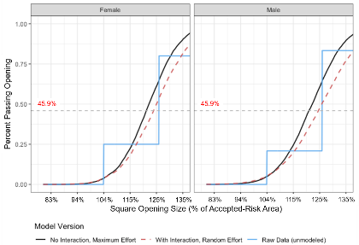
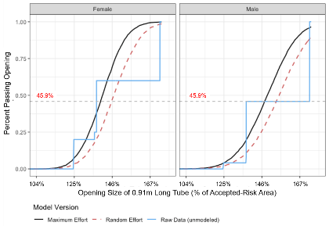
Transferring the Accepted Risk to Other Obstacles
Square Openings
Equivalent risk equates to a square opening of 123% of the accepted risk rectangular opening
Short (36 in) Pipe Openings
Equivalent Risk equates to a 36” long circular opening that is 145% of the accepted risk rectangular opening.
The circular opening results in cross sectional area that cannot be utilized by the actual or virtual participant

Slide 11
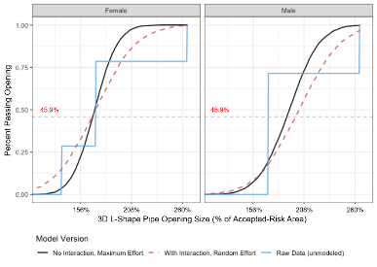
Transferring the Accepted Risk to Other Obstacles
Straight Pipe
153% area
“L” Shape Pipe
168% area
“S” Shape Pipe
209% area

Slide 12
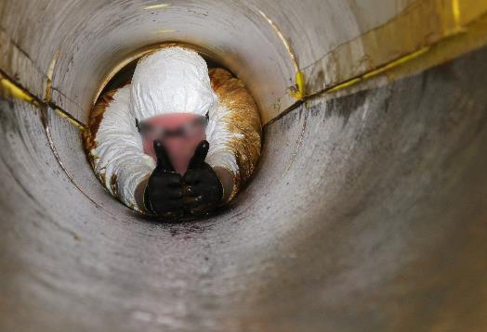
Conclusions
Almost any single area or dimension is insufficient to describe the overall ability of an adversary to pass through an opening
2D vs 3D vs Cross sectional aspect ratio matters
Of the actual test subjects (male and female), 36% were able to pass the accepted rectangular minimum cross sectional area.
The smallest area passed was 80% of the accepted minimum area (one participant)
No single body dimension dictates the ability to traverse or limit traversal of an opening.
Shoulder width
Hip width
Head width
Chest depth.
Thumbs up: Some people will volunteer for just about anything and enjoy it.

