Slide 1

A tool for transferring plant logs to a risk monitor
Johan Sörman

Slide 2
Risk Monitor use World-Wide

Slide 3
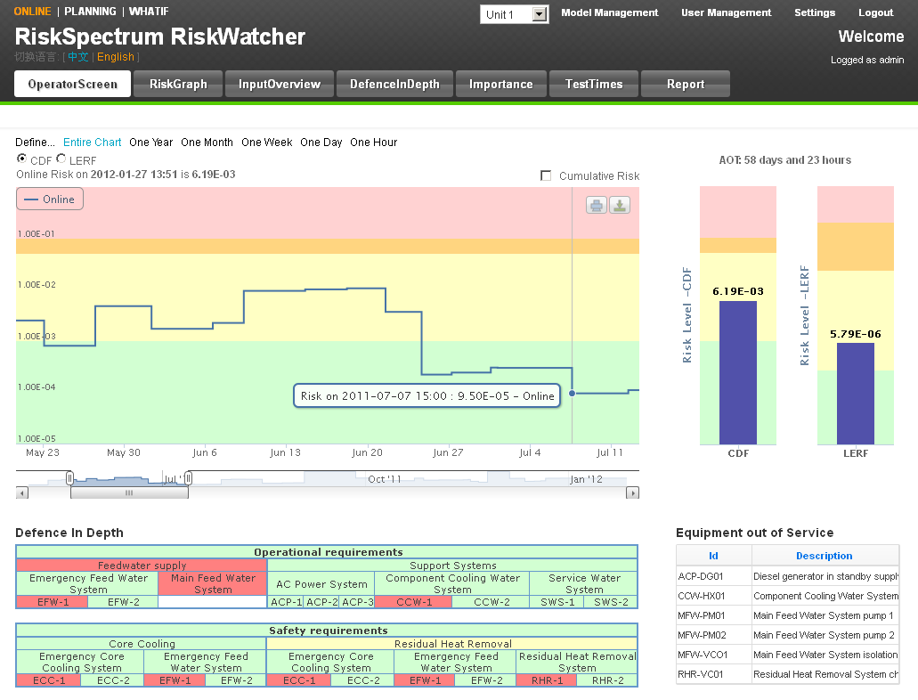
Risk Monitor Use World-Wide
Why a Risk Monitor?
Manage plant operational safety
Support scheduling activities
Achieve greater flexibility in plant operations
Provide justifications for carrying out maintenance on-line
Provide information on the risk importance of Equipment that is in service as well as out of service

Slide 4
Risk Monitor Use World-Wide
Who uses the risk monitor?
Shift Operators:
    Assess risk before any changes in plant configuration (alignments, tests, equipment out of service, etc.)
    Not enter high risk configuration voluntarily or implement compensatory measures
Maintenance Department:
    Outage planning
    Risk profile is assessed one week before the activities
    For high-risk configurations, the schedule can be modified
PSA Department:
    Supports Operators and Maintenance staff

Slide 5
Risk Monitor interface with plant information

Slide 6
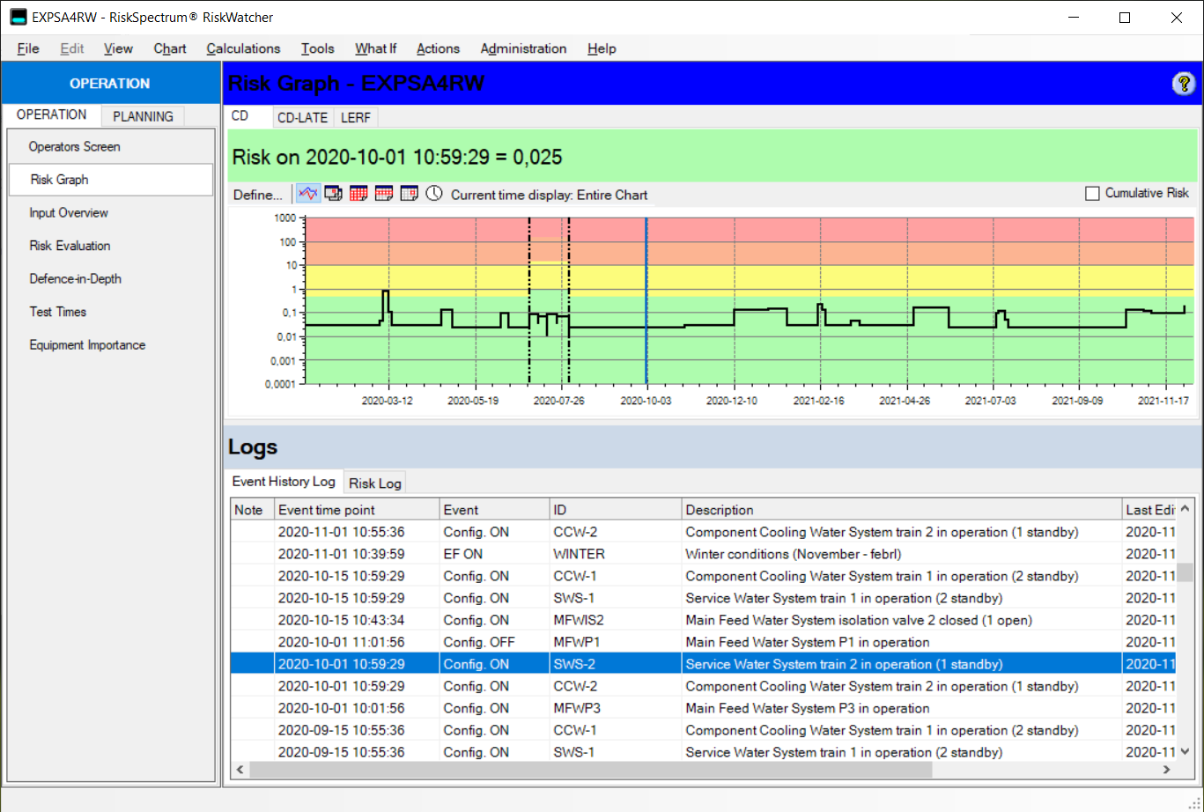
Risk Monitor Event History
Notes:
The RiskSpectrum RiskWatcher model comprise two parts, the model database and the event history database. The model database corresponds directly to the PSA model and represents the safety barriers etc. The conversion from the PSA model to the RiskSpectrum RiskWatcher model is performed automatically via the RiskSpectrum RiskWatcher Model Compiler. In the event history are stored all relevant plant configurations, component unavailabilities etc.
All data is edited in the PSA model in RiskSpectrum PSA and no changes need to be introduced in the risk monitor model. This principle simplifies the process of going from a living PSA baseline model (through the compiler) to a functional risk monitor model and will greatly simplify continuous update work - i.e. maintaining a true living PSA model.

Slide 7
Risk Monitor Event History
Linking the RM Event History to external sources
The Event History is a ”simple” database
Is coupled with the Model database – the complex part
Necessary information for import
  Event logs
  Event type
  Event ID
  Date for the event
PSA Model
RiskWatcher
Compiler
RiskWatcher Model
Event History

Slide 8
The tool

Slide 9
RiskSpectrum RiskWatcher
RiskWatcher Connector
Configurable to read your data sources
Import functionality from your defined input sources, e.g.
  Planning tools
  Autolog etc.
  Real time systems

Slide 10

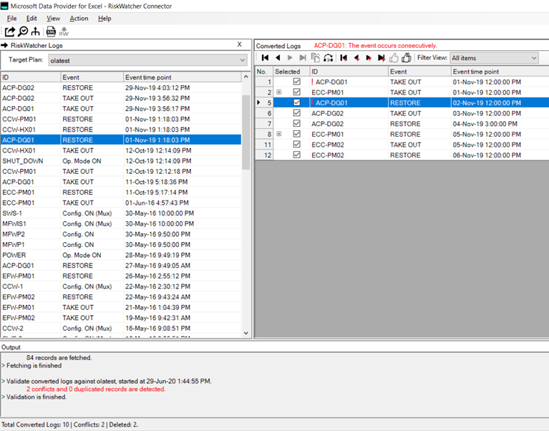
RiskSpectrum RiskWatcher
Plannning tools
RiskWatcher Connector

Slide 11
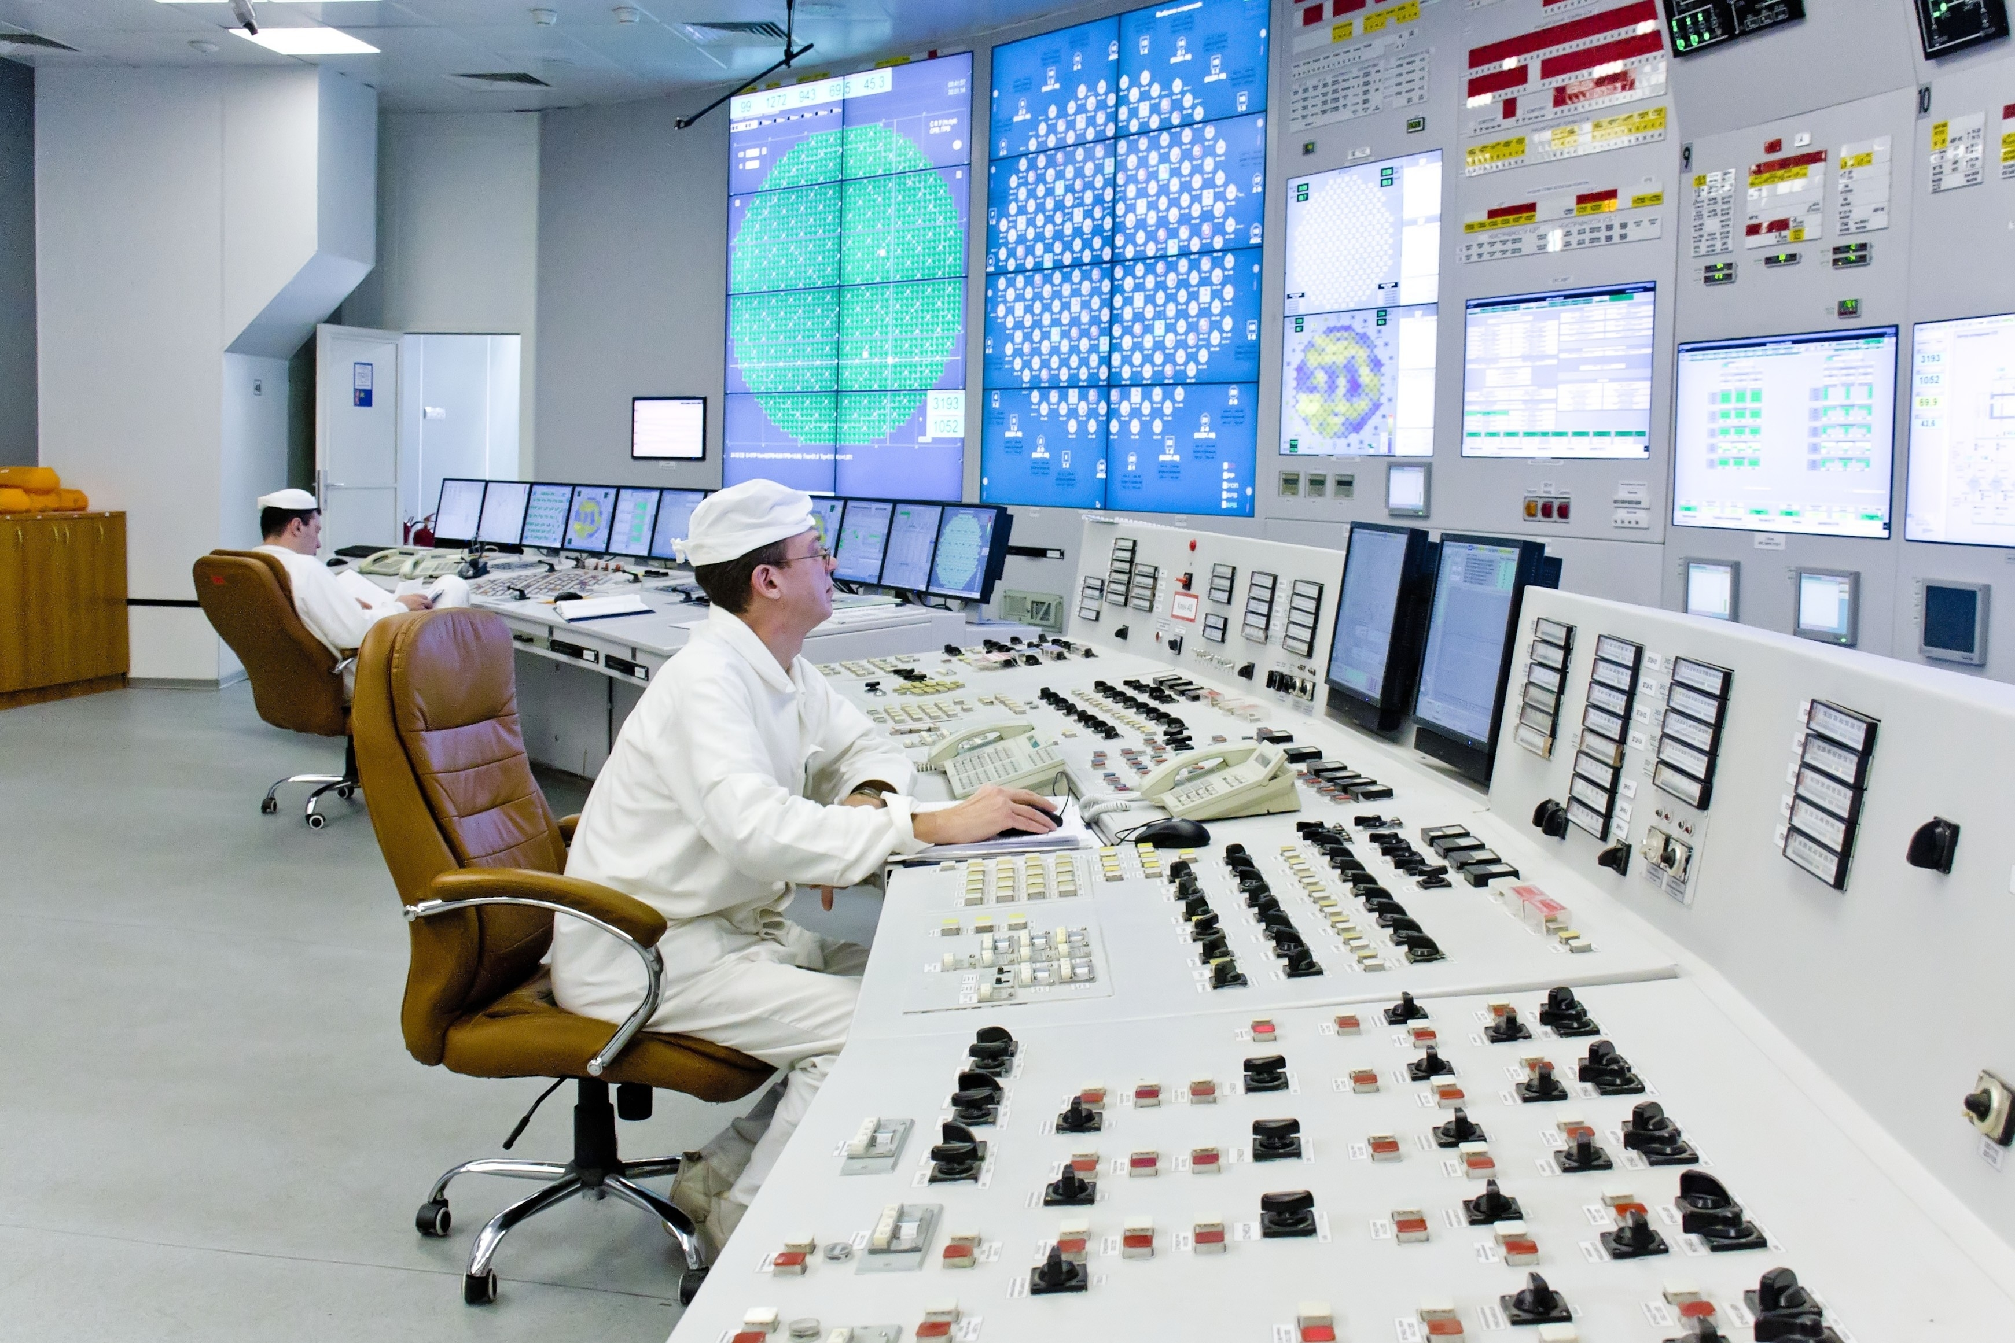
RiskSpectrum RiskWatcher
Plannning tools
RiskWatcher Connector
Plant log

Slide 12
RiskSpectrum RiskWatcher
Plannning tools
RiskWatcher Connector
Plant log

Slide 13
Implementation at Sanmen NPP

Slide 14
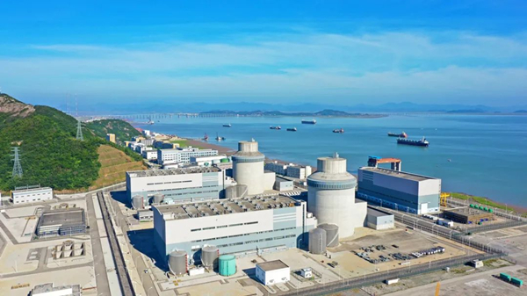
RiskWatcher Connector
Requirements on the import tool for Sanmen Nuclear Power Station
Support multiple data source types: Excel, SQL Server, Oracle, and customized data sources (e.g., online logs from other systems)
Automatically detect conflicts between data source logs and existing risk monitor event logs
Automatically resolve conflicts
Automatic importing with a predefined frequency

Slide 15
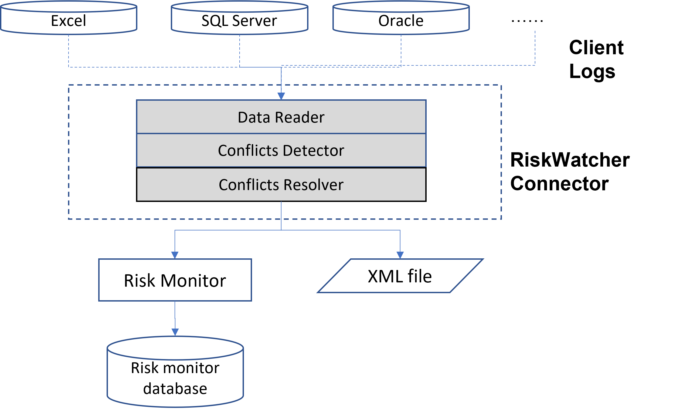
RiskWatcher Connector
Architecture
The Data Reader reads logs from different data sources

Slide 16
RiskWatcher Connector
Architecture
The Data Reader reads logs from different data sources
The Conflicts Detector handles conflicts/overlapping when configuration is changed.
  e.g., a component is taken out by multiple work orders, that happens to be in different time range, which is overlapping.

Slide 17
RiskWatcher Connector
Architecture
The Data Reader reads logs from different data sources
The Conflicts Detector handles conflicts/overlapping when configuration is changed.
  e.g., a component is taken out by multiple work orders, that happens to be in different time range, which is overlapping.
The Conflicts Resolver solves conflicts with the risk monitor event history

Slide 18
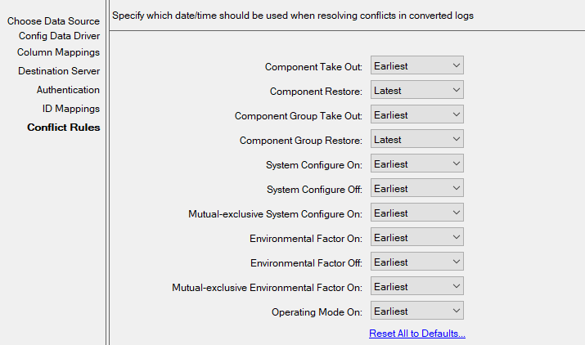
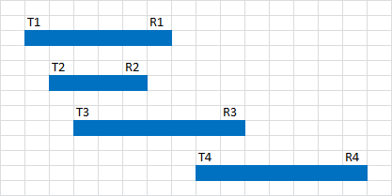
RiskWatcher Connector
Architecture
The Conflicts Detector comes with two algorithms:
The Original Algorithm
  if it detects more than one consecutive take out event of a certain component, keep the first one.
  if it detects more than one restore event of a certain component, keep the last one.

Slide 19
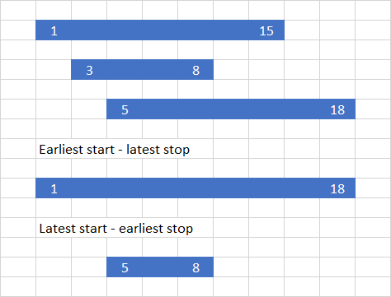
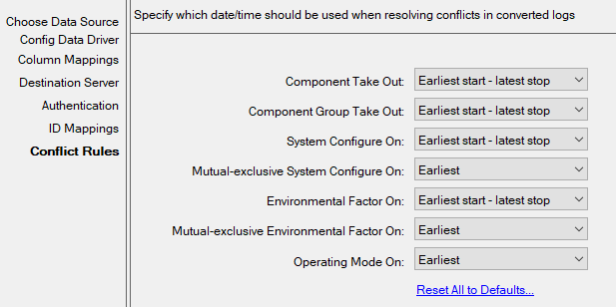
RiskWatcher Connector
Architecture
The Conflicts Detector comes with two algorithms:
The Original Algorithm
The Time Period Algorithm

Slide 20
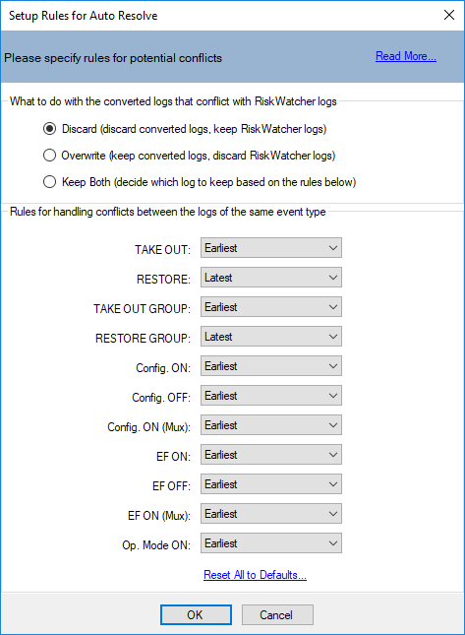
RiskWatcher Connector
Architecture
The Conflicts Resolver solves conflicts with the risk monitor event history
Auto resolve rules
  Discard: discard data source logs, keep existing logs in risk monitor
  Overwrite: overwrite logs in risk monitor
  Keep Both: keep both and resolve conflicts by event type.

Slide 21
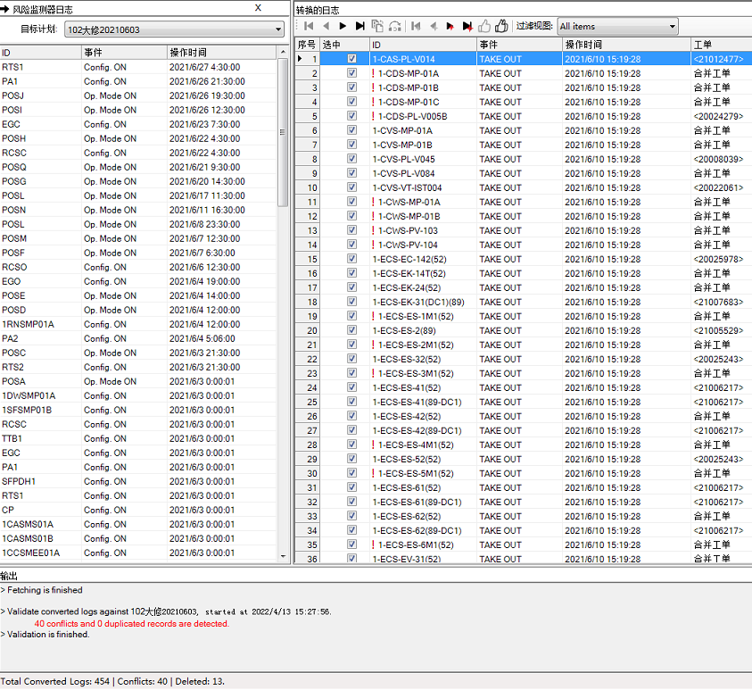
RiskWatcher Connector
Results
Example from Sanmen:
  40 conflicts detected
  13 duplicates deleted

Slide 22
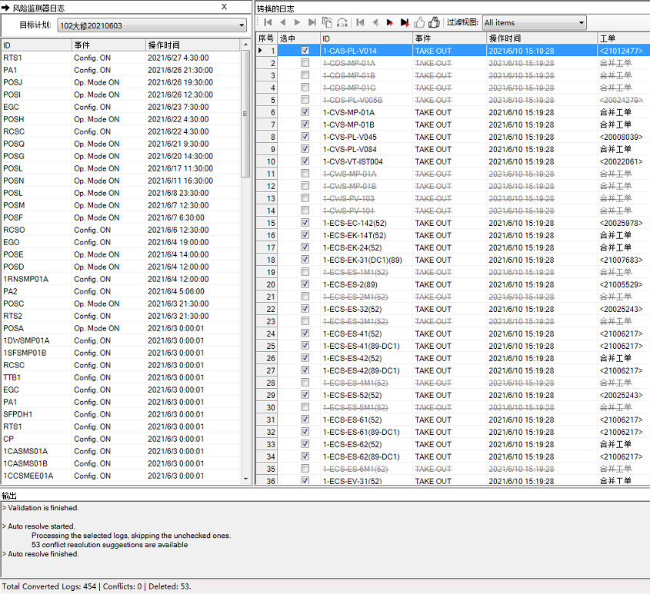
RiskWatcher Connector
Results
Example from Sanmen:
  53 conflicts deleted

Slide 23
RiskWatcher Connector
Implementation at Sanmen Nuclear Power Station
The RiskWatcher Connector implementation at Sanmen has proven to be a very efficient way of reducing manual efforts when importing logs from existing systems and databases to the risk monitor

Slide 24
Thank you
Please contact:
Johan Sörman
+46 70 773 04 04
Johan.sorman@lr.org

