Slide 1


July 1, 2022
Vaibhav Yadav
Senior Scientist
Nuclear Safety and Regulatory Research Division
Risk-Informed Physical Security Assessment for Nuclear Power Plants
2022 PSAM 16 - Honolulu, HI

Slide 2
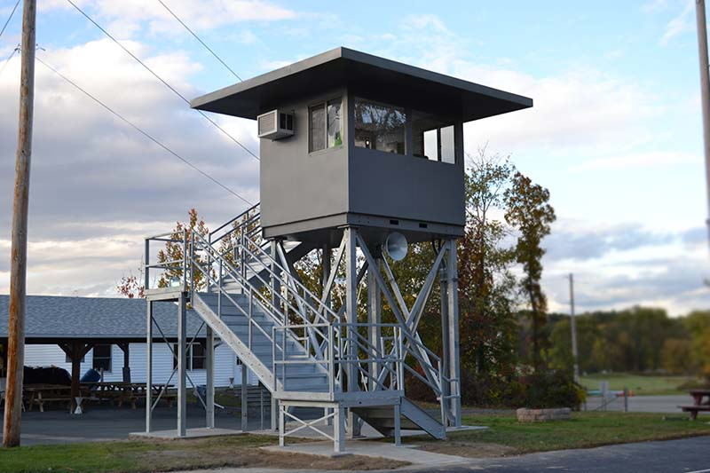
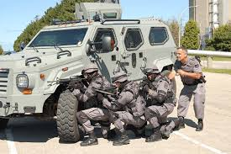
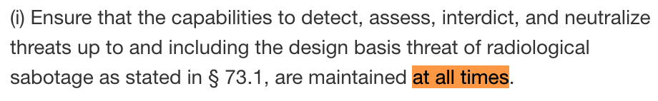
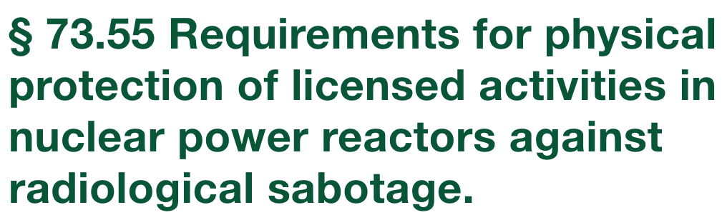
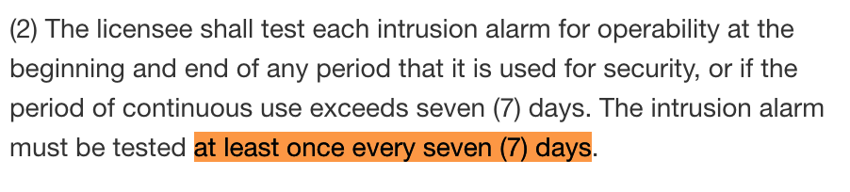
Motivation
Physical security at commercial NPPs is highly labor intensive
  nearly 20% of the entire workforce at several NPPs
Current methods for physical security assessment are static and binary (success/fail)
Current regulations for physical security are prescriptive
US NRC, 10 CFR 73.55: Requirements for physical protection of licensed activities in nuclear power reactors against radiological sabotage

Slide 3
Objectives of Risk-informed Physical Security
Current Security
Risk-informed Security
Binary Assessment
Consequence-based Assessment
Labor Intensive Posture
Staff Reduction Evaluation
Prescriptive Regulation
Risk-informed Performance-based Regulation

Slide 4
Current Security Assessment
Security Analysis Timeline: Current Approach
Limitations
Binary
Subjective
Not connected to plant safety

Slide 5
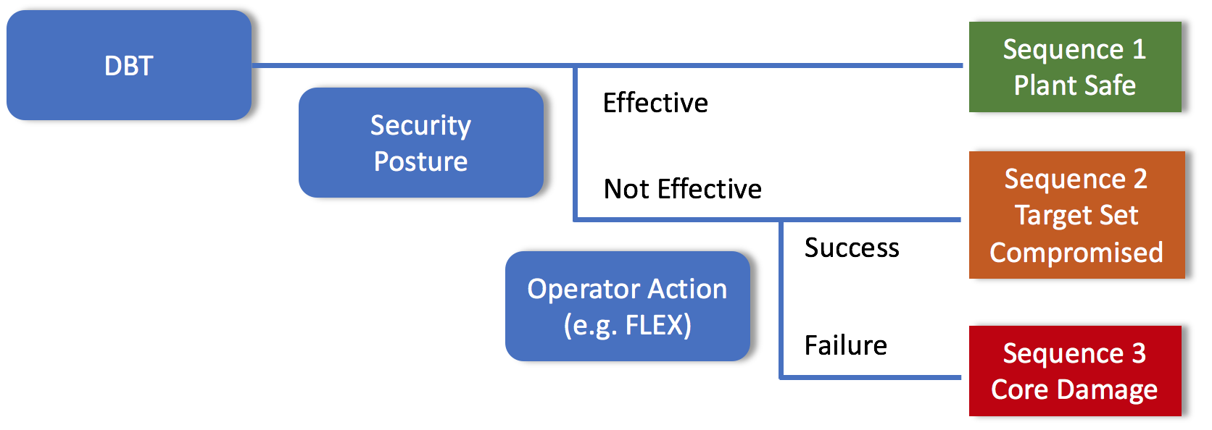
Risk-informed Consequence-based Security

Slide 6
Risk-informed Consequence-based Security
Security Analysis Timeline: Consequence-based Assessment

Slide 7
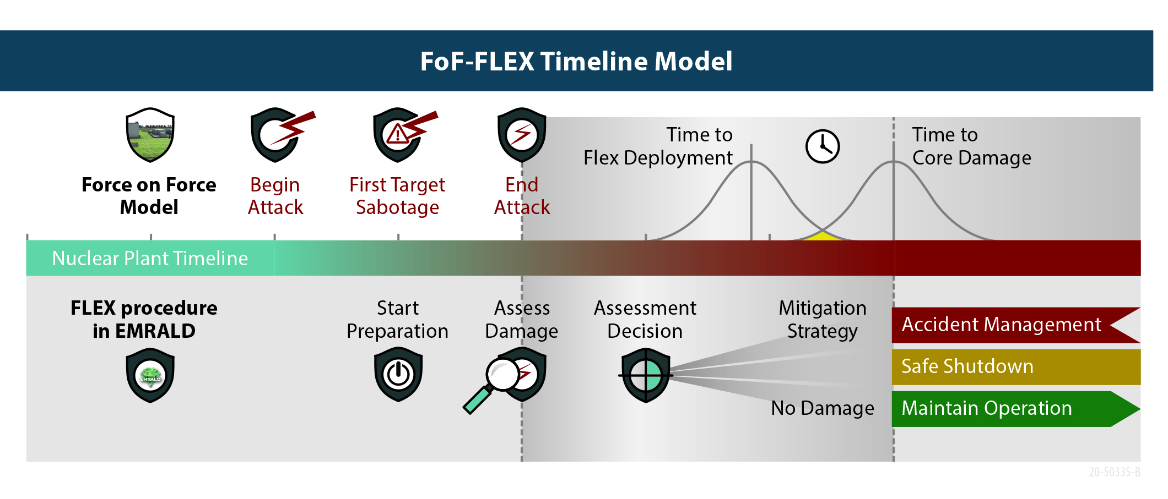
Risk-informed Consequence-based Security

Slide 8
Risk-informed Consequence-based Security
Number of Surviving Adversaries
Number of Remaining EDGs
Goes beyond success/fail
Provides quantitative insights
Can address subjectivity
Total Responder Casualties
Configuration Comparison

Slide 9
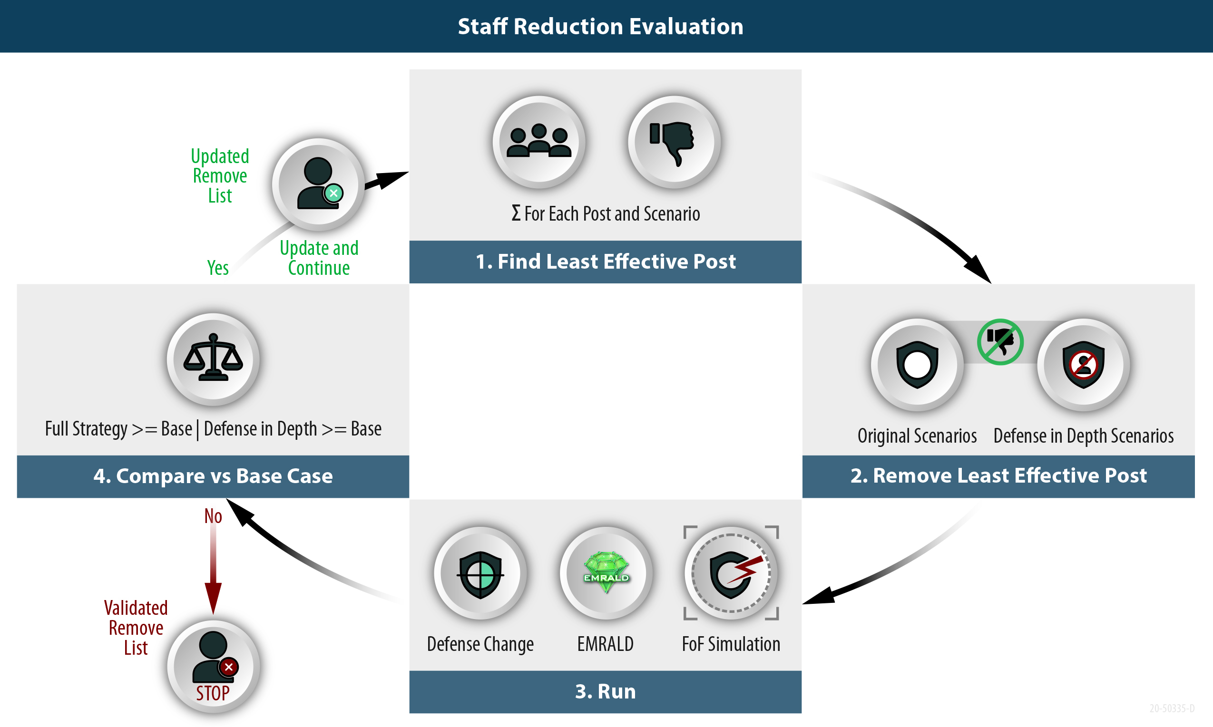

Slide 10
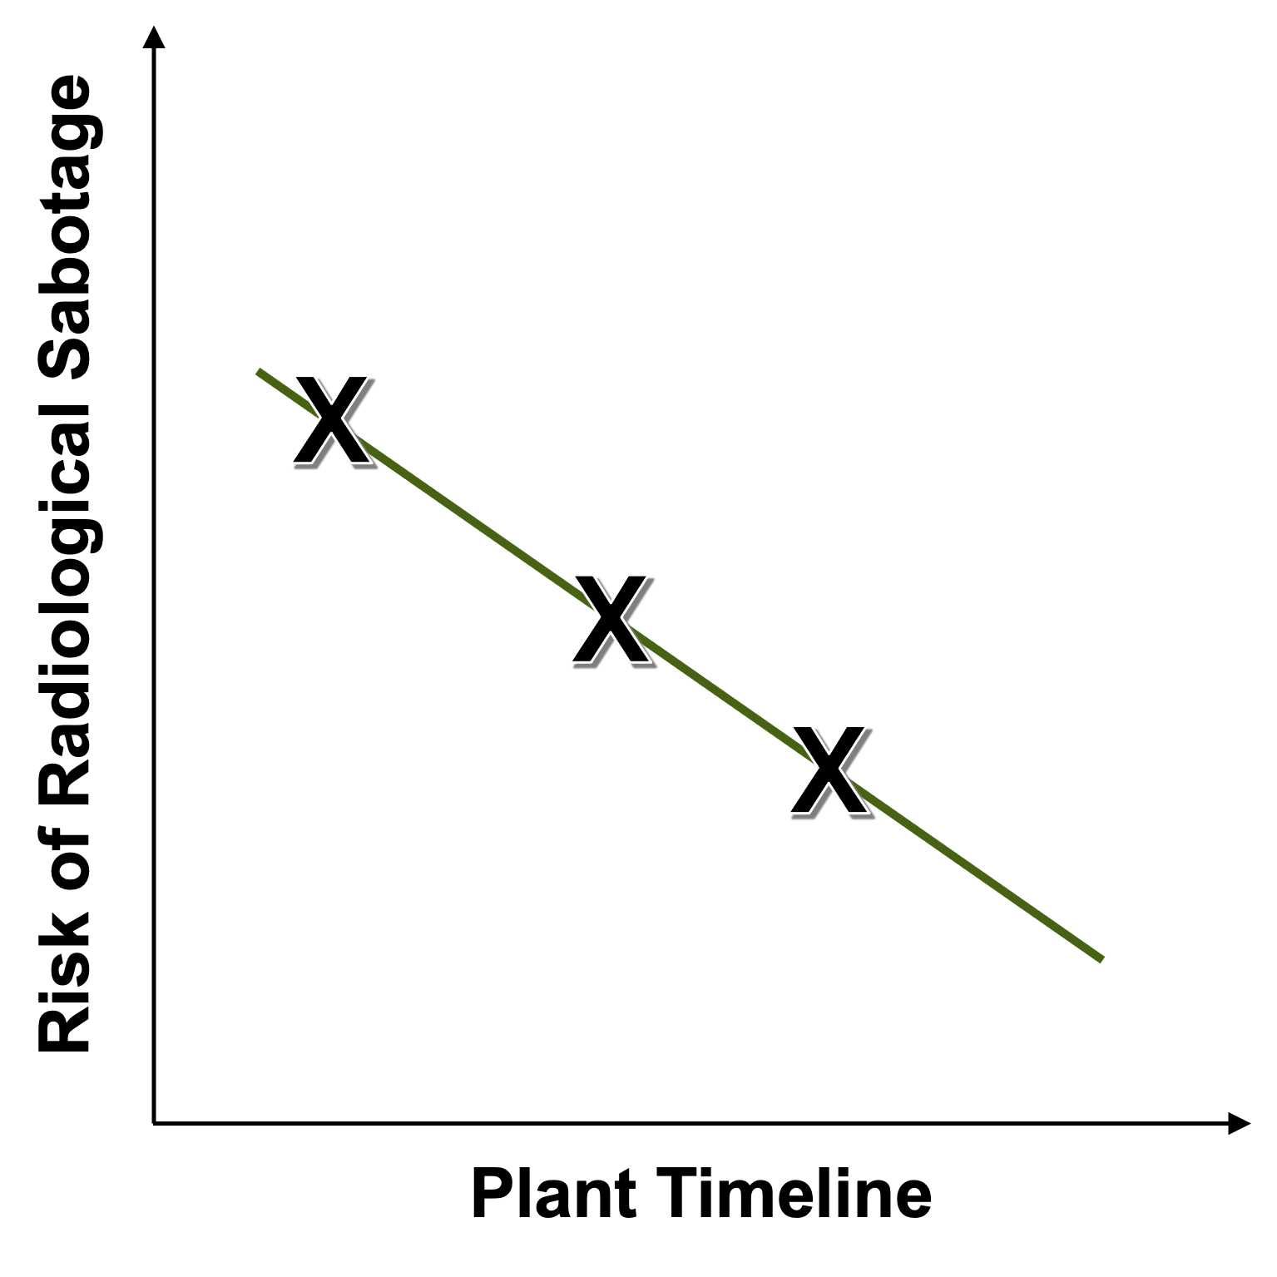
Risk-informed Performance-based Regulation
Risk of radiological sabotage decrease over time following the initiation of an attack due to
  Operation action
  Physical protection program activated
  Adversary attrition and/or resource depletion
SECY-20-0070: Technical Evaluation of the Security Bounding Time Concept for Operating Nuclear Power Plants

Slide 11
Risk-informed Performance-based Regulation
RAPT: Reasonable Assurance of Protection Time
  A concept that considers the many existing layers of protection that would provide reasonable assurance that the licensee can independently defend against the DBT
  Licensee can better focus on protecting more risk-significant target set elements
  Ability to take credit for operator actions that could be performed after the RAPT
SECY-20-0070: Technical Evaluation of the Security Bounding Time Concept for Operating Nuclear Power Plants

Slide 12
Summary
Current efforts at INL are utilizing risk-informed security for
  Optimizing security posture at current fleet
  Crediting Flex in plant specific postures
  Developing guidance with utilities
  Designing security posture for AR
Need for stakeholders to develop consensus on adoption of SBT-RAPT

