Slide 1
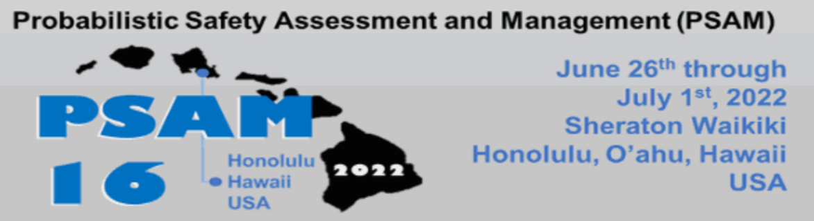
Dynamic Probabilistic Risk Assessment for Cyber Security Risk Analysis in Nuclear Reactors.
Pavan Kumar Vaddi, Yunfei Zhao, and Carol Smidts
Department of Mechanical and Aerospace Engineering, The Ohio State University.
June 30, 2022.

Slide 2
Introduction
Objectives of PRA:
Identify “what can go wrong”
  identifying the initiating events and the possible sequences of events that can result in undesirable consequences.
Identify and Establish “what are the consequences if something went wrong”
  identifying and evaluating the above-mentioned potentially risky consequences when the initiating events occur and evolve.
Quantify “how likely it is for something to go wrong”
  computing the likelihood of occurrence of the above-mentioned initiating events and the probabilities that those initiating events evolve into said dangerous scenarios
A. Mosleh, “PRA: A PERSPECTIVE ON STRENGTHS, CURRENT LIMITATIONS, AND POSSIBLE IMPROVEMENTS,” Nucl. Eng. Technol., vol. 46, no. 1, pp. 1–10, Feb. 2014, doi: 10.5516/NET.03.2014.700.
R. J. Breeding, T. J. Leahy, and J. Young, “Probabilistic risk assessment course documentation. Volume 1: PRA fundamentals,” Energy, Inc., Seattle, WA (USA), NUREG/CR-4350/1; SAND-85-1495/1, Aug. 1985. doi: 10.2172/6277413.

Slide 3
Introduction
Initiating events:
“any event that creates a disturbance in the plant that has the potential to lead to core damage, depending on the successful operation of the required mitigation systems in the plant.”
Component failures – mechanical or software.
Operator errors.
Cyber-attacks.
International Atomic Energy Agency, “Defining initiating events for purposes of probabilistic safety assessment,” IAEA-TECDOC-719, International Atomic Energy Agency. 1993.

Slide 4
Elements of Cyber-Attack on ICS
“interaction” between the attacker and the defender
Attacker
Defender / Operator
Digital Components
Manual Control
Physical Components
Physical World
The ICS under attack

Slide 5
Introduction
Dynamic Probabilistic Risk Assessment
A set of probabilistic risk assessment techniques that uses deterministic physics based dynamic models of the system to study its evolution in the context of random events.
Advantages of DPRA:
  Modeling and incorporating the changes in system properties as functions of physics and time. ex: failure rates.
  Modeling the changes in the behaviour of human operators with respect to system states and time.
  Capturing the evolution of the system over time due to random events.*
  Modeling the changes in the behaviour of attackers and defenders (operators) with respect to system states and time.
J. Devooght and C. Smidts, “Probabilistic Reactor Dynamics—I: The Theory of Continuous Event Trees,” Nucl. Sci. Eng., vol. 111, no. 3, pp. 229–240, Jul. 1992, doi: 10.13182/NSE92-A23937.
T. Aldemir, “A survey of dynamic methodologies for probabilistic safety assessment of nuclear power plants,” Ann. Nucl. Energy, vol. 52, pp. 113–124, Feb. 2013, doi: 10.1016/j.anucene.2012.08.001.

Slide 6
DPRA and Elements of Cyber-Attack on ICS
Existing DPRA techniques
Attacker
Defender / Operator
Digital Components
Physical Components
Physical World
The ICS under attack

Slide 7
DPRA and Elements of Cyber-Attack on ICS
Proposed DPRA framework
“interaction” between the attacker and the defender
Attacker
Defender / Operator
Digital Components
Physical Components
Physical World
The ICS under attack

Slide 8
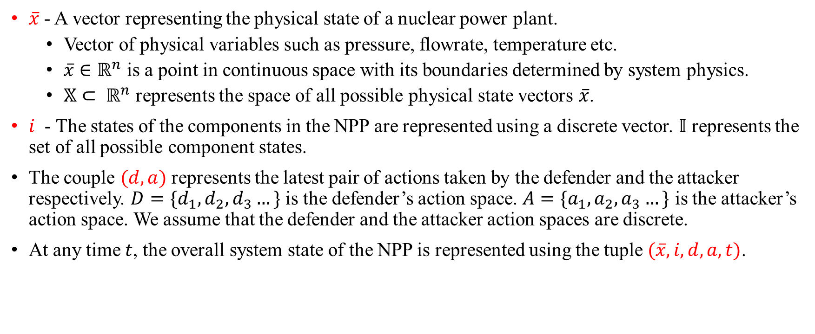
Theory of Continuous Event Trees – System Description
$\overline{x}$ - A vector representing the physical state of a nuclear power plant.
  Vector of physical variables such as pressure, flowrate, temperature etc.
  $\overline{x}∈ℝ^{n}$ is a point in continuous space with its boundaries determined by system physics.
  $𝕏⊂ ℝ^{n}$ represents the space of all possible physical state vectors $\overline{x}$.
$i$ - The states of the components in the NPP are represented using a discrete vector. $𝕀$ represents the set of all possible component states.
The couple $(d, a)$ represents the latest pair of actions taken by the defender and the attacker respectively. $D=\{d_{1}, d_{2}, d_{3}…\}$ is the defender’s action space. $A=\{a_{1}, a_{2}, a_{3}…\}$ is the attacker’s action space. We assume that the defender and the attacker action spaces are discrete.
At any time $t$, the overall system state of the NPP is represented using the tuple $(\overline{x}, i, d, a, t)$.

Slide 9
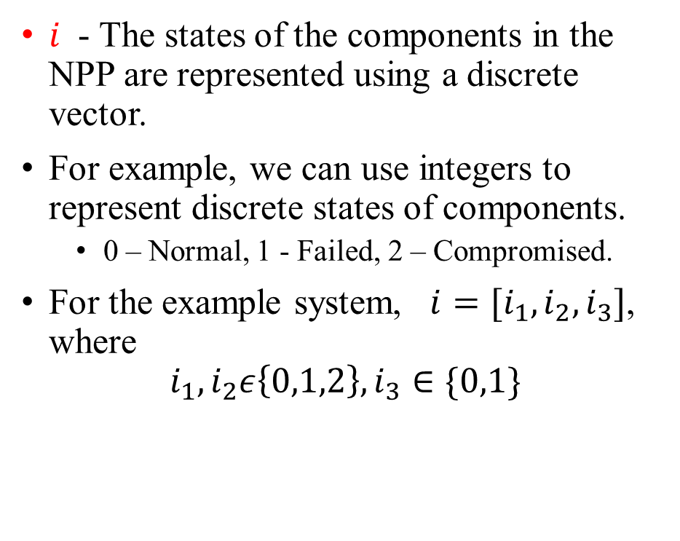
Theory of Continuous Event Trees – System Description
$i$ - The states of the components in the NPP are represented using a discrete vector.
For example, we can use integers to represent discrete states of components.
  0 – Normal, 1 - Failed, 2 – Compromised.
For the example system, $i=[i_{1},i_{2},i_{3}]$, where
$$i_{1},i_{2}ε\left\{0,1,2\right\},i_{3}∈\{0,1\}$$
Controller (1)
Digital flow sensor (2)
Mechanical Valve (3)

Slide 10










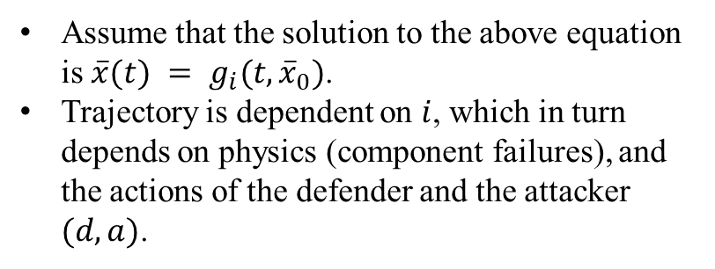
Theory of Continuous Event Trees - Trajectories
$$\frac{∂}{∂t}\overline{x} = f_{i}(\overline{x},t)$$
Trajectories in state space
Assume that the solution to the above equation is $\overline{x}(t) = g_{i}(t, {\overline{x}}_{0})$.
Trajectory is dependent on $i$, which in turn depends on physics (component failures), and the actions of the defender and the attacker $(d,a)$.
$$f_{j}$$
$${\overline{x}}_{1}, j,d_{1},a_{1},τ$$
$$f_{i}$$
$${\overline{x}}_{1}, i,d_{0},a_{0},τ$$
$i⟶j|$ $d_{1},a_{1}$, ${\overline{x}}_{1}$
$$f_{i}$$
$${\overline{x}}_{1}′, i,d_{0},a_{0},τ$$
$${\overline{x}}_{0}, i,d_{0},a_{0},t_{0}$$
$${\overline{x}}_{0}′, i,d_{0},a_{0},t_{0}$$
time
J. Devooght and C. Smidts, “Probabilistic Reactor Dynamics—I: The Theory of Continuous Event Trees,” Nucl. Sci. Eng., vol. 111, no. 3, pp. 229–240, Jul. 1992, doi: 10.13182/NSE92-A23937.

Slide 11
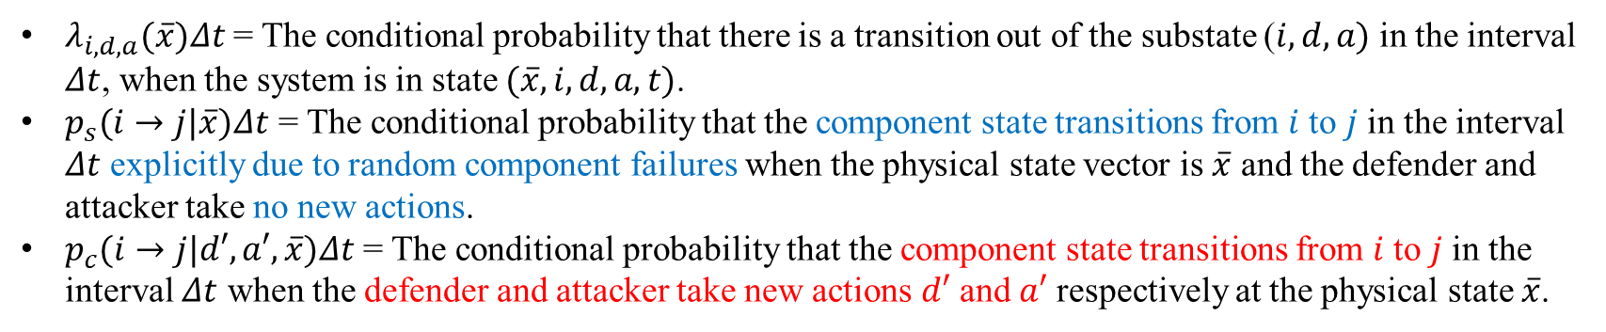
Theory of Continuous Event Trees
$λ_{i, d, a}(\overline{x})Δt$ = The conditional probability that there is a transition out of the substate ($i, d, a)$ in the interval $Δt$, when the system is in state $(\overline{x}, i, d, a, t)$.
$p_{s}(i→j|\overline{x})Δt$ = The conditional probability that the component state transitions from $i$ to $j$ in the interval $Δt$ explicitly due to random component failures when the physical state vector is $\overline{x}$ and the defender and attacker take no new actions.
$p_{c}(i→j|d′, a′, \overline{x})Δt$ = The conditional probability that the component state transitions from $i$ to $j$ in the interval $Δt$ when the defender and attacker take new actions $d′$ and $a′$ respectively at the physical state $\overline{x}$.
The probability that the system evolves along the trajectory defined by $g_{i}$ without leaving the substate $\left(i,d,a\right)$ between time $t_{0}$ and $t$ is $e^{−\int_{t_{0}}^{t}{λ_{i, d, a}[g_{i}(s,\overline{x}(t_{0}))]ds}}$

Slide 12


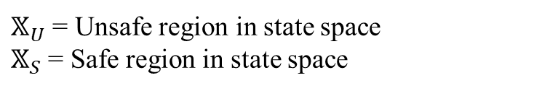

Theory of Continuous Event Trees
$π(\overline{x}, i, d, a, t)$ = the probability density of the overall system state$(\overline{x}, i, d, a, t)$at time $t$.
$$𝕏$$
$$𝕏_{S}$$
$$𝕏_{U}$$
$𝕏_{U}$ = Unsafe region in state space
$𝕏_{S}$ = Safe region in state space

Slide 13


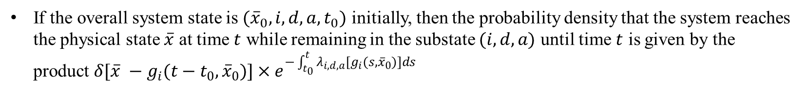
Theory of Continuous Event Trees
The conditional probability density that the system is in state $(\overline{x}, j, d, a, t_{0})$ given the initial state $({\overline{x}}_{0}, i,d_{0},a_{0},t_{0})$, denoted by $π(\overline{x}, j, d, a, t_{0}|{\overline{x}}_{0},i,d_{0},a_{0},t_{0})$
If the overall system state is $({\overline{x}}_{0},i,d,a,t_{0})$ initially, then the probability density that the system reaches the physical state $\overline{x}$ at time $t$ while remaining in the substate $(i, d, a)$ until time $t$ is given by the product $δ[\overline{x} −{g_{i}(t−t_{0}, \overline{x}}_{0})]×e^{−\int_{t_{0}}^{t}{λ_{i, d, a}[g_{i}(s, {\overline{x}}_{0})]ds}}$
$$\overline{x}, i,d,a,t$$
$${\overline{x}}_{0}, i,d,a,t_{0}$$
time
J. Devooght and C. Smidts, “Probabilistic Reactor Dynamics—I: The Theory of Continuous Event Trees,” Nucl. Sci. Eng., vol. 111, no. 3, pp. 229–240, Jul. 1992, doi: 10.13182/NSE92-A23937.

Slide 14
Continuous Event Trees – Extended to Cyber-Attacks

Slide 15



Continuous Event Trees – Extended to Cyber-Attacks
This represents the probability density that the system is initially in the state ($\overline{u}, i, d, a, 0)$, and reaches the physical state $\overline{x}$at time $t$ while remaining in the substate $(i, d, a)$ until time $t$, along the trajectory defined by $g_{i}$.
$$\overline{x}, i,d, a,t$$
$$g_{i}$$
$$\overline{u}, i,d,a,0$$
time

Slide 16






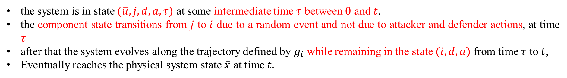

Continuous Event Trees – Extended to Cyber-Attacks
the system is in state $(\overline{u}, j, d, a, τ)$ at some intermediate time $τ$ between $0$ and $t$,
the component state transitions from $j$ to $i$ due to a random event and not due to attacker and defender actions, at time $τ$
after that the system evolves along the trajectory defined by $g_{i}$ while remaining in the state $(i, d, a)$ from time $τ$ to $t$,
Eventually reaches the physical system state $\overline{x}$ at time $t.$
($\overline{u}, j, d, a,τ)$
($\overline{u}, i, d, a,τ)$
$$\overline{x}, i,d, a,t$$
$$g_{i}$$
$$j→i\left|\overline{u}\right.$$
$$g_{j}$$
time
$$τ$$

Slide 17

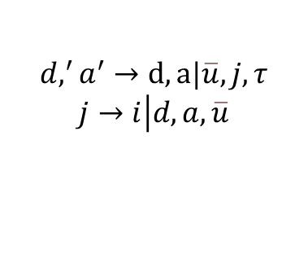

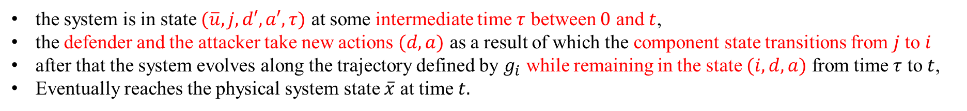
Continuous Event Trees – Extended to Cyber-Attacks
the system is in state $(\overline{u}, j, d′, a′, τ)$ at some intermediate time $τ$ between $0$ and $t$,
the defender and the attacker take new actions $(d,a)$ as a result of which the component state transitions from $j$ to $i$
after that the system evolves along the trajectory defined by $g_{i}$ while remaining in the state $(i, d, a)$ from time $τ$ to $t$,
Eventually reaches the physical system state $\overline{x}$ at time $t.$
($\overline{u}, j, d,′ a′,τ)$
($\overline{u}, i, d, a,τ)$
$$\overline{x}, i,d, a,t$$
$$g_{i}$$
$$d,^{′}a^{′}→d,a|\overline{u},j,τ$$
$$j→i\left|d, a, \overline{u}\right.$$
$$g_{j}$$
time
$$τ$$

Slide 18
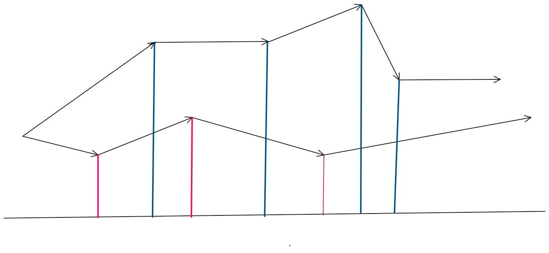














Continuous Event Trees
$$x_{3}^{1}$$
$$x_{1}^{1}$$
$$x_{2}^{1}$$
$$x_{4}^{1}$$
Trajectory
$$x_{2}^{2}$$
Initiating event
Trajectory 2
$$x_{1}^{2}$$
$$x_{2}^{3}$$
time
$$t_{1}^{2}$$
$$t_{1}^{1}$$
$$t_{2}^{2}$$
$$t_{2}^{1}$$
$$t_{3}^{2}$$
$$t_{3}^{1}$$
$$t_{4}^{1}$$
J. Devooght and C. Smidts, “Probabilistic Reactor Dynamics—I: The Theory of Continuous Event Trees,” Nucl. Sci. Eng., vol. 111, no. 3, pp. 229–240, Jul. 1992, doi: 10.13182/NSE92-A23937.

Slide 19



CETs and DDETs
time
$$∆t$$
$$∆t$$
$$∆t$$
If we discretize the timeline and explore all possible* transitions at every time-step, then CET converts into a discrete Dynamic Event Tree.

Slide 20
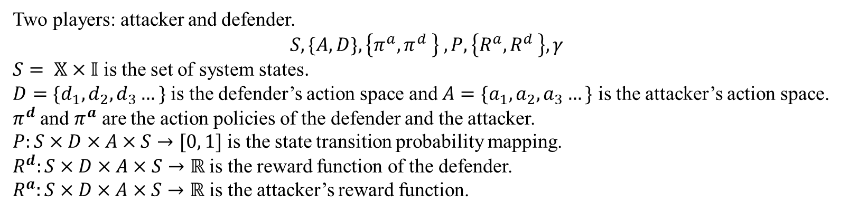
Continuous Event Trees – Extended to Cyber-Attacks
Attacker
Defender / Operator
“interaction” between the attacker and the defender
Modeled using Stochastic Games.
Two players: attacker and defender.
$$S, \{A, D\},\left\{π^{a},π^{d} \right\} , P, \left\{R^{a},R^{d} \right\}, γ$$
$S= 𝕏×𝕀$ is the set of system states.
$D=\{d_{1}, d_{2}, d_{3}…\}$ is the defender’s action space and $A=\{a_{1}, a_{2}, a_{3}…\}$ is the attacker’s action space.
$π^{d}$ and $π^{a}$ are the action policies of the defender and the attacker.
$P:S×D×A×S→[0, 1]$ is the state transition probability mapping.
$R^{d}:S×D×A×S→ℝ$ is the reward function of the defender.
$R^{a}:S×D×A×S→ℝ$ is the attacker’s reward function.

Slide 21
Continuous Event Trees – Extended to Cyber-Attacks
Equation to calculate reward functions:

Slide 22
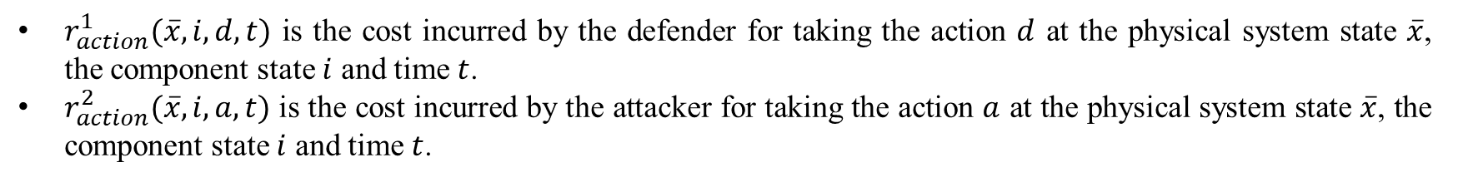
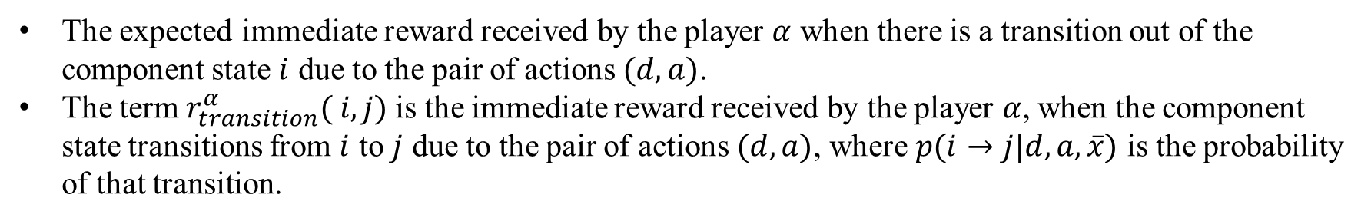
Continuous Event Trees – Extended to Cyber-Attacks
$r_{action}^{1}(\overline{x}, i,d,t)$ is the cost incurred by the defender for taking the action $d$ at the physical system state $\overline{x}$, the component state $i$ and time $t$.
$r_{action}^{2}(\overline{x}, i,a,t)$ is the cost incurred by the attacker for taking the action $a$ at the physical system state $\overline{x}$, the component state $i$ and time $t$.
The expected immediate reward received by the player $α$ when there is a transition out of the component state $i$ due to the pair of actions $(d, a)$.
The term $r_{transition}^{α}( i, j)$is the immediate reward received by the player $α$, when the component state transitions from $i$ to $j$ due to the pair of actions $(d, a)$, where $p(i→j|d, a, \overline{x})$ is the probability of that transition.

Slide 23
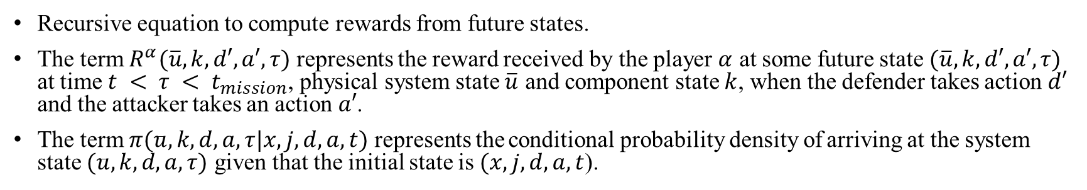
Continuous Event Trees – Extended to Cyber-Attacks
Recursive equation to compute rewards from future states.
The term $R^{α}(\overline{u}, k, d′, a′, τ)$ represents the reward received by the player $α$ at some future state $(\overline{u}, k, d′, a′, τ)$ at time $t < τ < t_{mission}$, physical system state $\overline{u}$ and component state $k$, when the defender takes action $d′$ and the attacker takes an action $a′$.
The term $π(\overline{u}, k, d, a, τ|\overline{x}, j, d, a, t)$ represents the conditional probability density of arriving at the system state $(\overline{u}, k, d, a, τ)$ given that the initial state is $(\overline{x}, j, d, a, t$).

Slide 24
DPRA Simulation Architecture
Post processing module
Data for analysis
DPRA Engine
Possible attacker and defender actions
Sampled attacker and operator actions
Sampled component failures.
Action model
System physical state and component state information
System model

Slide 25
DPRA Engine
DPRA Engine
Component Failure Models of NPP Components
Sampler
sampled transition time, sampled state transition, and sampled actions.
Updated failure rates and failure modes
Data Collection module
Scheduler
System physical state and component state information.
Possible attacker and defender actions
Action model
System model

Slide 26
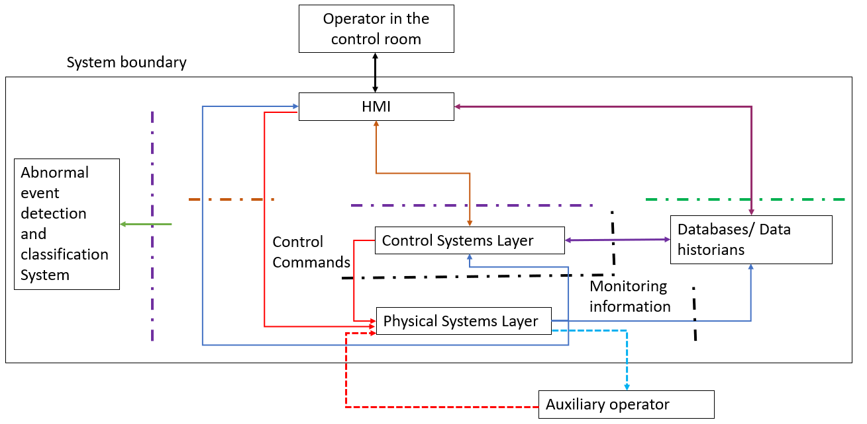
System Model
Monitoring information from sensors to auxiliary operator
Communication between control systems layer and data historians.
Monitoring information from sensors
Control commands to actuators
Control commands from auxiliary operator to actuators
Communication between HMI and operator in control room.
Communication between HMI and data historians.
Communication between HMI and control systems layer.
Network data and sensor information
(All colors) Communication layer between two subsystems

Slide 27
Action Model
DPRA Engine
Observations from system
Set of possible actions
Action Model
End of attack
Procedure Model
Game model
Attack detected
Undetected Attacker Model
System Model

Slide 28
Game Model
Set of possible attacker and defender actions.
Game model
Game
Attacker Model
Spinoff DPRA
Defender Model
System state information

Slide 29
Conclusions
We formalized the continuous event trees framework in the context of cyber-attacks.
  We presented Chapman-Kolmogorov based equations to quantify the probability density that the system is in a given state at any point of time.
We proposed a simulation architecture to implement the extended CETs for cybersecurity risk analysis.

Slide 30
Thank You
Acknowledgements
This research is being performed using funding received from the DOE Office of Nuclear Energy's Nuclear Energy University Program.

