Slide 1
Modeling and simulation of in-hospital medical processes for training and the evaluation of BCP in the event of a disaster
Mizuki Umemotoª, Shunsuke Kadonoª, Daichi Mitsuhashiª, Taro Kannoª, Kazumi Kajiyama^{b}, Sachika Sharikura^{c}, Ryoko Ikari^{b}, Masashi Yoneyama^{c}
a) The University of Tokyo b) Kitasato University Hospital c) Showa University Hospital
The Probabilistic Safety Assessment & Management conference
June 28
Notes:
This is Mizuki Umemoto from the University of Tokyo. I'm in the second year of master's degree. Let me start my presentation. The presentation title is Modeling and simulation of in-hospital medical processes for training and the evaluation of BCP in the event of a disaster.

Slide 2
Table of contents
Background and objectives
Modeling of the hospital disaster response
Simulation of the hospital disaster response
Discussion and conclusion
Notes:
Here is the table of contents. First I explain the background and objectives, which is to develop a highly realistic simulation model of the hospital disaster response Then I'll explain the way to model and simulate the hospital disaster response. Finally I'll talk about the discussion and conclusion

Slide 3
Background and objective
Requirements for disaster base hospitals^{[1]}
Disaster base hospitals play a key role in the event of disasters
Disaster base hospitals must meet some requirements
  Prepare a business continuity plan(BCP)
  Conduct trainings based on CSCATTT
    Command and control/Safety/Communication/Assessment/
    Triage/Treatment/Transportation
[1] Ministry of Health, Labour and Welfare, “Partial Revision of Requirements
for Designation as a Disaster Base Hospital,” 2020, available:
Notes:
First I start with the requirement of disaster base hospitals in Japan. Disaster base hospitals are the hospitals which are supposed to play a key role in the event of disaster. Disaster base hospitals must meet some requirements , such as to prepare a business continuity plan, which is a plan for companies to recover the business at a minimum as soon as possible. And also it is required to conduct trainngs based on CSCATTT which is the principle of the disaster medicine.

Slide 4
Background and objective
Current methods to meet the requirements and their limitations
Requirements | Current methods | Limitations
Conduct trainings | Desktop or live drills ^{[2]} | A great deal of effort to prepare them Limited participation Difficulty in evaluating the result quantitatively
Evaluating BCP | Computer simulations ^{[3][4]} | Low variety of resources and processes considered Simple patient model
[2] https://meccso.jp/emergo/about-emergo.html
[3] Franc JM, Ingrassia PL, Verde M, et al., A Simple Graphical Method for Quantification of Disaster Management Surge Capacity
Using Computer Simulation and Process-control Tools, Prehosp Disaster Med. 30(1):9-15 (2014)
[4] A. Basaglia, E. Spacone, J.W. van de Lindt, T.D. Kirsch, A Discrete-Event Simulation model of hospital patient flow following
major earthquakes, International Journal of Disaster Risk Reduction, 71 (2022)
Notes:
Although currently there are some methods to meet these requirements, each of them has its limitations. To conduct Desktop or Live trainings, There are some tools such as EMERGO, however, Those tools has its limitations. For example, A great deal of effort to prepare them are required. also, participation is limited owing to conflicts with normal hospital operations. Of course, it is difficult to quantitatively evaluate existing BCP., Furthermore, in order to evaluating BCP, the use of computer simulations that can reproduce a hospital response to a disaster is promising. However, few studies have considered various resources such as staff members and medical equipment. In addition, most studies did not consider the detailed processes such as medical examinations. Moreover, they have lacked a detailed patient model that describes not only the triage level but also other detailed information such as vital signs, specific names of injuries , and the necessary medical care processes.

Slide 5
Background and objective
Objectives of this research
Develop a highly realistic simulation model
of the hospital disaster response
Evaluate the response performance
Find bottlenecks in the existing BCP
Make trainings easier to conduct
Notes:
From such backgrounds, we aim to develop a highly realistic simulation model of the hospital disaster response, which can be used to evaluate the response performance, to find bottlenecks in the BCP or to Make trainings easier to conduct

Slide 6
Modeling of the hospital disaster response
Overview
Inputs
Simulation
Outputs
Patients scenario
・Detailed patients
information
・Patients arrival time
Disaster
medicine
processes
Results of
disaster
response
Resource scenario
・Triage
・Treatment
・Examinations
・Length of stay
・Number of patients
in each room
・Staff arrival scenario
・Medical resources
supply scenario
Notes:
This is the model overview. the model was developed through a document analysis, the observation of actual drills, and interviews with disaster response staff members working at a hospital. Patients scenario and resource scenario are inputted into the simulation. In the simulation, patients take each disaster medicine process with the resources. After finishing the simulation, Results of the disaster response are presented. In the folloing slides, I'll explain the each part of them.

Slide 7
Modeling of the hospital disaster response
Patients model
Patient model is created in XML format based on the patient data created for training purposes
Categories | Examples
Basic information | ID/Name/Age/Sex
Vital Signs | Conscious level/Blood pressure/Pulse
Severity of the patient | Triage level/Injury name
Processes required | Resources and time required
Consumable resources (ex : gauze/saline)
Unconsumable resources(ex : stretcher/staff)
Notes:
A detailed patient model was created in XML format based on the patient data created for training purposes.
This patient model describes a variety of information For example, basic information such as the patient’s name and age/vital signs such as blood pressure and conscious level/severity such as triage level and the injury name/details of the medical processes required for the patient.
The resources required for the medical process are classified into consumable and unconsumable.
Consumable resources such as gause and saline are consumed when used.
Unconsumable resources such as stretchers and hospital staff are occupied during use, after which they are released.

Slide 8
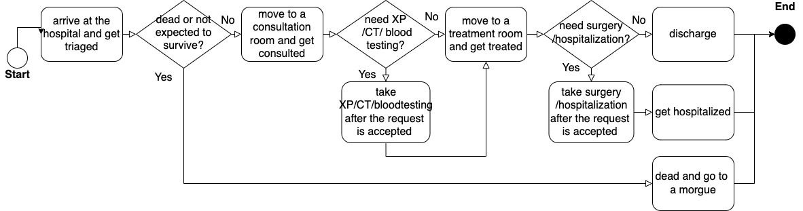
Modeling of the hospital disaster response
Patients flow
The processes from triage to discharge are modeled
Notes:
Here is the Patients flow. The process from triage to discharge are modeled.
Patients arriving at a hospital are triaged at a triage post.
The patients are then taken to the appropriate consultation area according to their triage level.
If a patient requires an examination such as X-ray photography (XP) or computed tomography (CT), a request for the examination is sent to the examination room.
The order of examination is determined based on the patient’s physical condition and the number of resources available in the room.
Patients approved for these requests are transported to the proper examination rooms to undergo XP or CT.
If a patient requires blood testing, the specimen is sent to the laboratory for examination.
After these examinations, the patient receives necessary treatment. If a patient requires surgery or hospitalization, the patient is transferred to the waiting room for those processes. At the same time, a request for surgery or hospitalization is sent to the command post of the medicine, where the surgery or hospitalization order is determined considering the patient’s medical condition and the number of available operating rooms and beds.
Patients approved for these requests are operated on or hospitalized. Patients who have undergone surgery go directly to the waiting room for hospitalization.
Patients who do not require surgery or hospitalization are discharged

Slide 9
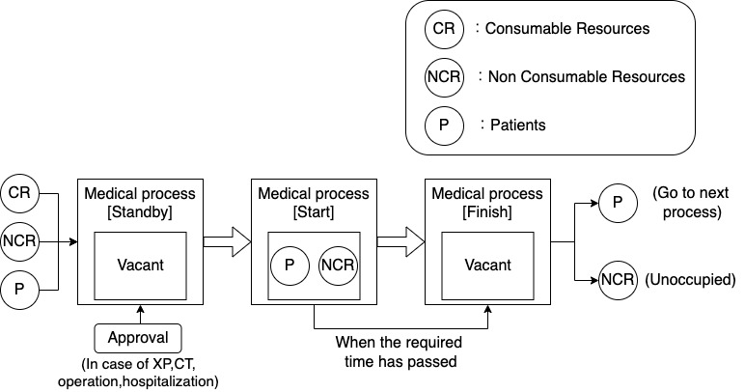
Modeling of the hospital disaster response
Detailed medical processes
Each process is described in an input–process–output format
Notes:
each medical process is described in an input–process–output format. Each process is initiated with patients , sufficient resources, room availability and approval (for XP, CT, surgery, or hospitalization). Once a medical process is initiated, consumed resources are consumed, and non-consumable resources are occupied. The process ends after the time required for the process described in the patient model. The patient is transferred to the next area, and the non-recoverable resources become unoccupied.

Slide 10
Simulation of the hospital disaster response
Scenario Settings
Simulations under 3 different scenario were conducted
 |  | Patients scenario
 | Resource scenario | Normal | Higher volume within a shorter period
Resource scenario | Normal | Base scenario | Severe Scenario
 | Reallocated among areas | Staff reallocating scenario | -
Notes:
With these models, Simulations for hospital disaster response were conducted under 3 scenarios.
First 1 is a basic scenario.
In severe scenario , Higher volume of patients arrive within a shorter period.
In staff reallocating scenario , Resources such as doctors are reallocated among areas.
Simulations were for a 10-h period, with a time step of 10 s

Slide 11
Simulation of the hospital disaster response
Patients scenario
Each patient has different conditions and requires different treatment processes and resources
Arrival time is set according to an exponential distribution
  One time step is 10 s
f(arrival time step = t) = λe^{-λt} + C
* Constant C depends on patient triage level
Notes:
In these simulations, there are 80 patient. Each patient has different conditions and requires different treatment processes and resources. The arrival time is set following an exponential distribution

Slide 12
Simulation of the hospital disaster response
Patients scenario
Triage level | Number of patients | Parameters (Base scenario and Staff reallocating scenario) | Parameters (Severe scenario)
Red (severe) | 13 | λ: 0.005 Ｃ: 360 | λ: 0.005 Ｃ: 180
Yellow (moderate) | 23 | λ: 0.005 Ｃ: 180 | λ: 0.005 Ｃ: 90
Green (minor) | 41 | λ: 0.005 Ｃ: 0 | λ: 0.005 Ｃ: 0
Black (dead) | 3 | λ: 0.005 Ｃ: 180 | λ: 0.005 Ｃ: 180
* f(arrival time step = t) = λe^{-λt} + C
Notes:
These 80 patients consist of 13 patients with a primary triage level of red(severely injured), 23 patients with a level of yellow(moderately injured), 11 patients with a level of green(slightly injured), and 3 patients with a level of black (deceased or unlikely to survive). Scenario 1, unlike scenario 0 or 2, was designed to consider a more severe case. In this scenario, patients visit the hospital within a shorter interval. The arrival time of red patients follows an exponential distribution with λ = 0.005 plus 180 (which is 180 time steps shorter than under Scenario 0), whereas that of the yellow patients follows an exponential distribution with λ = 0.005 plus 90 (which is 90 time steps shorter than under Scenario 0)

Slide 13
Simulation of the hospital disaster response
Resource scenario
Room | Number of doctors/nurses /transportation staff (Base scenario and severe scenario) | Number of doctors/nurses /transportation staff (Staff reallocating scenario )
Triage room | 6/6/6 | 4/4/4
3 consultation room | 6/6/6 | 5/5/5
2 examination room | 6/6/6 | 7/7/7
3 treatment room | 6/6/6 | 7/7/7
Notes:
These are resource scenario settings. In scenario 0 and 1, At first, six doctors, nurses, and transportation staff became available. They were assigned to each area at t = 0. In scenario 2, some staff members are reallocated from one room to another in order to reduce the shortage of human resources. In the triage room, two doctors/nurses /transportation staff are reduced. In 3 consultation rooms two of each staff is reduced. On the other hand, in the XP room, CT room, and for the treatment of the red, yellow, and green patients , one doctor, one nurse, and one transportation staff member are increased. In all scenarios, Because some doctors, nurses, and other staff members may have entered from outside the hospital after the disaster occurs, an additional doctor, nurse, and other staff member were added at t = 180 and 720. Other resources became available and were assigned according to the predetermined time.

Slide 14
Simulation of the hospital disaster response
Results : Base scenario - Length of stay of each patient
There were large amount of waiting time to be reduced
Treatment time
Waiting time
Green(minor) patients
Yellow(moderate) patients
Red(severe) patients
Notes:
This is the result of the simulation. The length of stay of each red, yellow, and green patient under base scenario is shown. The blue bars indicate the total treatment time required for each patient, and the orange bars indicate the wait time. As you can see, There were large amount of waiting time to be reduced. In addition, Patients who arrive late are likely to have longer waiting times because there is already a shortage of resources, such as doctors, during each medical process.

Slide 15
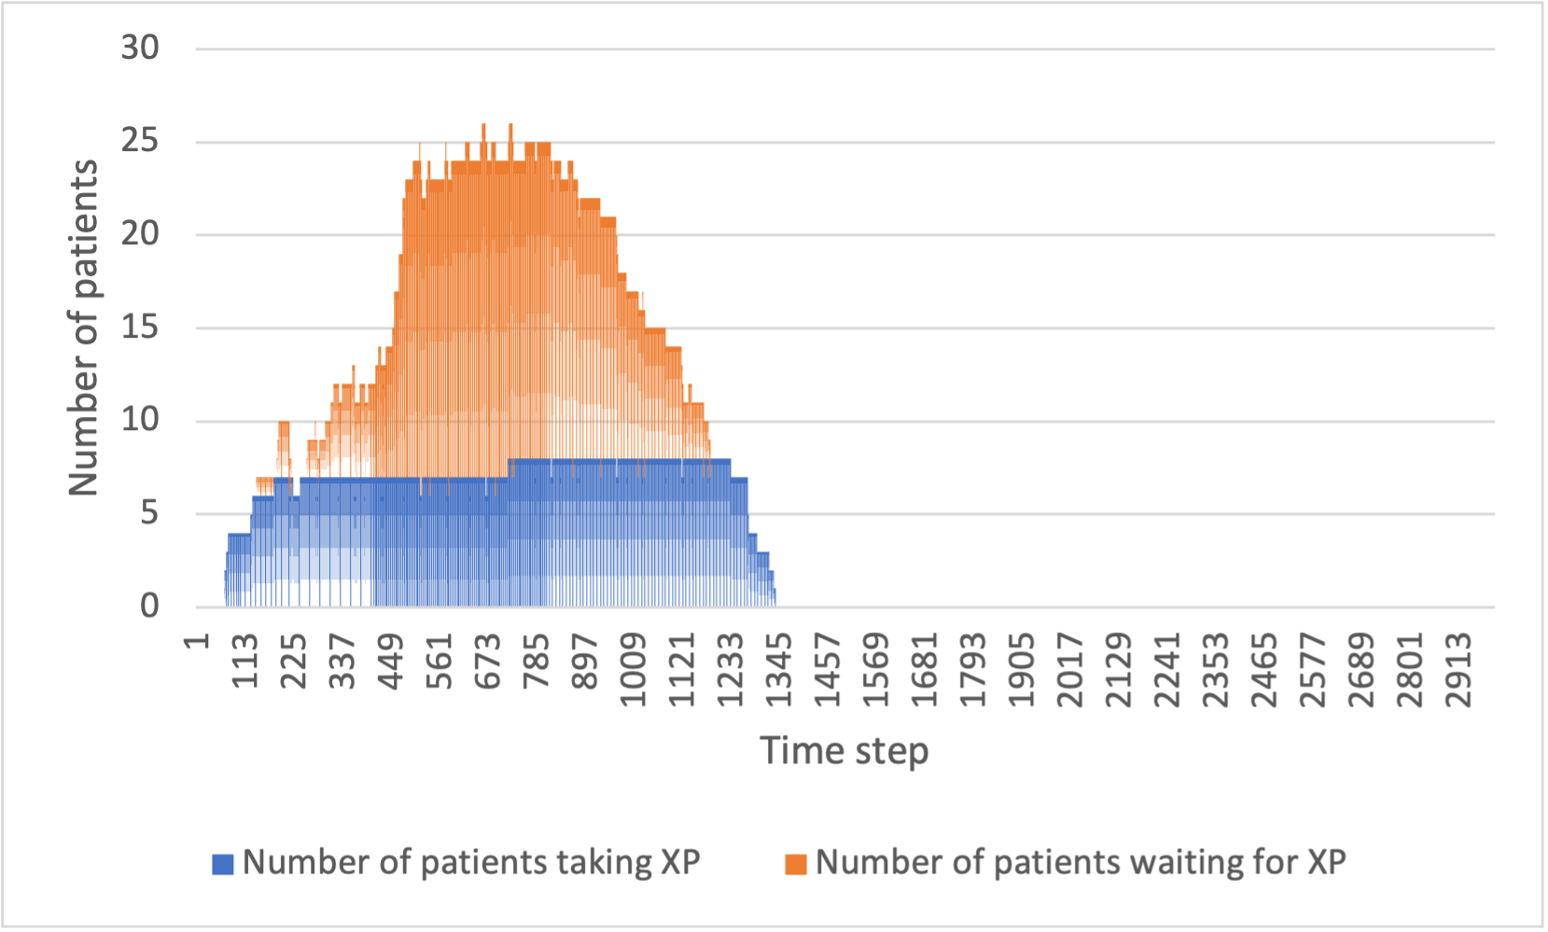
Simulation of the hospital disaster response
Results : Base scenario - Number of patients in XP room
Many patients had to wait in the XP room
Notes:
This shows the number of patients in the XP room over time. The blue bars show the number of patients receiving XP at that time, whereas the orange bars represent the number of patients waiting to receive XP. In this simulation, Many patients had to wait in the XP room because 59 of the 80 patients need an XP examination.

Slide 16
Simulation of the hospital disaster response
Results : Difference in base scenario and severe scenario
Higher volume of patients within a shorter period caused a delay in response
Average length of stay
Patients | Base scenario | Severe scenario
All | 989 | 1018
Red | 1103 | 1162
Yellow | 1139 | 1162
Green | 939 | 964
Black | 28 | 29
The number of patients in the XP room
Notes:
This is the difference in the result of scenario 0 & 1. It was confirmed the simulation under scenario 1 resulted in a longer average LOS and more waiting patients. So we can say that Higher volume of patients within a short period caused a delay in response.

Slide 17
Simulation of the hospital disaster response
Results : Difference in base scenario and staff reallocating scenario
Staff reallocation increased response efficiency
Average length of stay
Patients | Base scenario | Staff reallocation scenario
All | 989 | 965
Red | 1103 | 1054
Yellow | 1139 | 1070
Green | 939 | 947
Black | 28 | 29
Number of patients in XP room
Notes:
This is the difference in the result of scenario 0 & 2. It was confirmed the simulation under scenario 2 resulted in decreased average LOS and the number of patients waiting in each area. So we can say that the staff reallocation was effective in disaster response.

Slide 18
Discussion and conclusion
Discussion
Objective
Findings
Evaluate the response performance
The response performance could be evaluated by the length of stay and number of patients in each room
Severe patient scenarios were identified
The extent to which patients can be treated was identified in each scenario
Find bottlenecks in the existing BCP
Some processes such as XP were found to be bottlenecks
Staff reallocation can solve the bottlenecks
Notes:
So this is the discussion of the results.
The response performance could be evaluated by the length of stay and number of patients in each room. moreover, the extent to which patients can be treated under severe patient scenarios and examined. Also, It was found that some process such as XP were bottlenecks and Staff reallocation can solve the bottleneck.

Slide 19
Discussion and conclusion
Conclusion
A simulation model for more realistic hospital response during a disaster was developed
Simulations under several scenarios were conducted to assess the severity of the situation and the effectiveness of resource reallocation
We will extend the model to include other functions and develop a human-in-the-loop simulation for the training purposes
Notes:
As a conclusion, A simulation model for more realistic hospital response during a disaster was developed. Simulations under several scenarios were conducted to evaluate the severity of the situation and the effectiveness of the resource reallocation. We will extend the model to include other activities and develop a human-in-the-loop simulation and training

