Slide 1
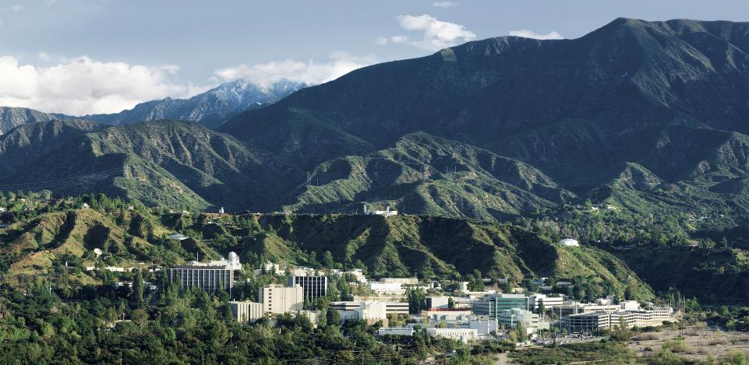
PSAM16 Paper TP76
Reliability Modeling of Complex Components Using Simulation
Todd Paulos, Ph.D. and Andrew Ho.
Jet Propulsion Laboratory, California Institute of Technology, USA
Curtis Smith, Ph.D.
Idaho National Laboratory, USA

Slide 2
Acknowledgement
PSAM 16 Honolulu, HI June 26 - July 1, 2022
Thanks to Caltech/JPL, NASA, Lockheed Martin and Parker Hannifin for inspiration on this topic over the years
“Be quick, be quiet, and be on time” – Kelly Johnson
“I believe in the golden rule: he who has the gold makes the rules” – Ben Rich
“Do not go where the path may lead, go instead where there is no path and leave a trail” – Emerson

Slide 3
Topics
PSAM 16 Honolulu, HI June 26 - July 1, 2022
Review of previous papers
  “A Discussion of Failure Mode Modeling of Complex Components and Overall Component Reliability” presented at PSAM 13
  “Continued Discussion of Failure Mode Modeling and Overall Component Reliability: Are the Data Missing or Censored?” presented at ESREL 2020 / PSAM 15
Basics of Failure Mode simulation
FTA vs. Simulation Comparisons
Results Discussion

Slide 4
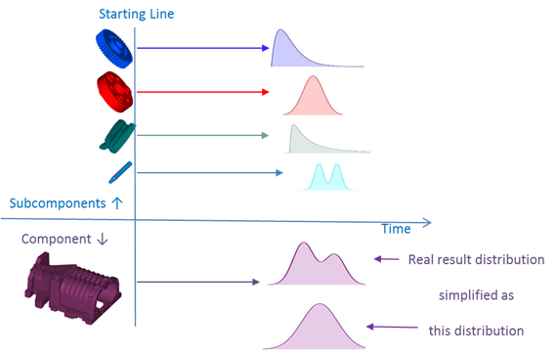
Simple Example: Supercharger
PSAM 16 Honolulu, HI June 26 - July 1, 2022
MTBF
This methodology is useful in industries where there is repair data at the subassembly level, such as automotive, industrial, or aircraft Maintenance, Repair and Overhaul (MRO)

Slide 5
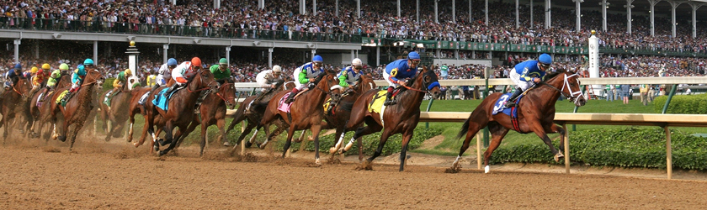
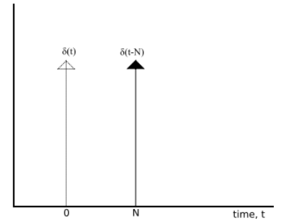
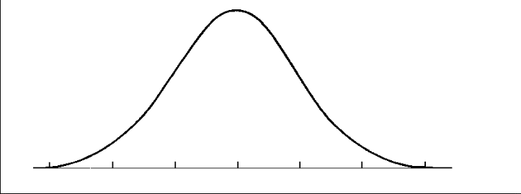



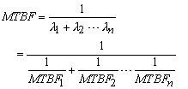

Failure Modes of Complex Assemblies
PSAM 16 Honolulu, HI June 26 - July 1, 2022
Components vs.
Assemblies vs.
Subassemblies vs. …
    X
FM1
FM2
FM3
Time

Slide 6
Three Failure Modes Example
PSAM 16 Honolulu, HI June 26 - July 1, 2022
From “A Discussion of Failure Mode Modeling of Complex Components and Overall Component Reliability”

Slide 7
Exponential vs. Censored vs. Missing Data
PSAM 16 Honolulu, HI June 26 - July 1, 2022
Failure Mode | Exponential (Hrs) | Censored (Hrs) | Missing (Hrs)
A | 367 | 176 | 100
B | 367 | 174 | 125
C | 367 | 166 | 144

Slide 8
Simulation Results Comparison
PSAM 16 Honolulu, HI June 26 - July 1, 2022
Data Set Size = 100
 | FM1 (8,000 Hrs) | FM2 (10,000 Hrs) | FM3 (12,000 Hrs)
Known | 8,000 | 10,000 | 12,000
Exponential | 8,530 | 38,387 | 76,773
Exp Diff | 6.6% | 283.9% | 539.8%
Censored | 13,340 | 12,800 | 12,790
Cens Diff | 66.8% | 28.0% | 6.6%
Missing | 8,012 | 9,978 | 11,610
Miss Diff | 0.1% | 0.2% | 3.3%
The “missing” data approach has reduced all three failure modes to less than 4% error for each

Slide 9
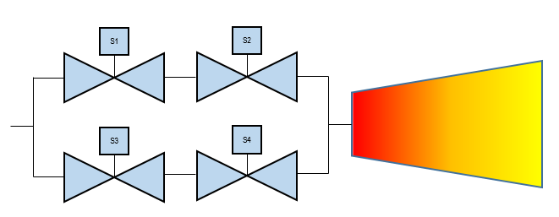
Simple Monoprop Thruster (1/2)
PSAM 16 Honolulu, HI June 26 - July 1, 2022
Compare traditional FTA vs. simulation solution
  Valves can fail open or closed, but not both
Success criteria
  Need at least on flow pathway to operate, need both pathways to close to conserve fuel
Compare various data assessment methods for failure modes and the effect on the results

Slide 10
Monoprop Thruster Failure Data
PSAM 16 Honolulu, HI June 26 - July 1, 2022
Failure Mode | Time to Failure (Hrs)
Fail Open | 45,000
Fail Closed | 45,000
Fail Open | 55,000
Fail Closed | 55,000
Consider failure modes caused by different and unique hardware subassemblies
Method 1: Simple Data Analysis Method
  Failure Modes are exponential
  Each failure mode has a failure rate estimated as 2/200,000 hrs (1E-5 /hr)
Alternative Data Analysis Method 1
  Failure modes are treated as missing data
  Each failure mode has a failure rate estimated as 2/100,000 hrs (2E-5 /hr)
Alternative Data Analysis Method 2
  Bayesian solution with missing data using Jefferys’ non-informative prior (ref: HOPE)
  Each failure mode has a failure rate estimated as 2.5/100,000 hrs (2.5E-5 /hr)

Slide 11
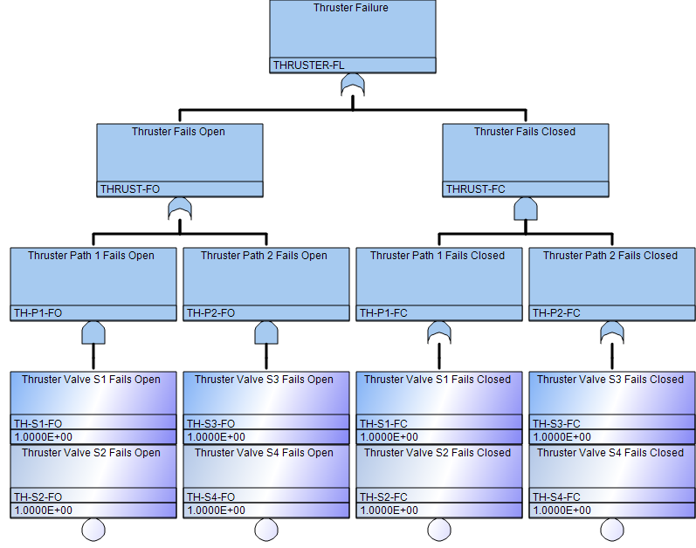
Thruster Fault Tree Analysis
PSAM 16 Honolulu, HI June 26 - July 1, 2022

Slide 12
FTA Minimal Cut Sets
PSAM 16 Honolulu, HI June 26 - July 1, 2022
Minimal Cut Set | Event Description | Boolean Designator
1 | Thruster Valve S1 Fails Open Thruster Valve S2 Fails Open | TH-S1-FO TH-S2-FO
2 | Thruster Valve S3 Fails Open Thruster Valve S4 Fails Open | TH-S3-FO TH-S4-FO
3 | Thruster Valve S1 Fails Closed Thruster Valve S3 Fails Closed | TH-S1-FC TH-S3-FC
4 | Thruster Valve S2 Fails Closed Thruster Valve S3 Fails Closed | TH-S2-FC TH-S3-FC
5 | Thruster Valve S1 Fails Closed Thruster Valve S4 Fails Closed | TH-S1-FC TH-S4-FC
6 | Thruster Valve S2 Fails Closed Thruster Valve S4 Fails Closed | TH-S2-FC TH-S4-FC

Slide 13
Simulation Algorithm
PSAM 16 Honolulu, HI June 26 - July 1, 2022
Step 1 Establish parameters
  Input mission time in hours
  Input the gamma distribution parameters for each component failure mode
  Input number of desired trials k
  Determine a random seed value (or use a common seed from trial to trial to narrow down the number of unknowns)
Step 2 Establish failure criteria for the system. For this simulation, the MCS were used to establish the failure criteria for the system. Although the inspection is easy enough for simple examples, such as in this paper, more complex systems or configurations may require an alternative method to determine the success/failure criteria.

Slide 14
Simulation Algorithm
PSAM 16 Honolulu, HI June 26 - July 1, 2022
Step 3 Simulate component failure mode times by:
  Drawing random values given input distributions from Step 1
  Taking the reciprocal of failure rate to simulate the mean time to failure (MTTF) vector
  Determine the failure mode times (fail open and fail close) for each valve (S1, S2, S3, S4)
Determine the failure mode for each valve, i.e., which component failure mode occurred first and at what time
Does the simulated component time to failure survive mission time, i.e., is time to failure greater than mission time?

Slide 15
Simulation Algorithm
PSAM 16 Honolulu, HI June 26 - July 1, 2022
Step 4 Determine if a system failure occurred in the mission time
  Determine if any of the six system failures occurred during Step 3
  The system failure time taken is the 2nd of the two failure modes.
  Record this MTTF and the specific system failure path
  If more than one system mode fails, take the earlier system failure time
Step 5 Track success and failure statistics and report

Slide 16
One Simulation Trial (No SOK Correlation)
PSAM 16 Honolulu, HI June 26 - July 1, 2022
Comp FM | S1C | S1O | S2C | S2O | S3C | S3O | S4C | S4O
Sim Time to Failure | 96,268 | 23,501 | 106,845 | 25,894 | 20,048 | 139,391 | 55,960 | 89,436
Survives 3 Year Mission? | TRUE | FALSE | TRUE | FALSE | FALSE | TRUE | TRUE | TRUE
1st FM | FALSE | TRUE | FALSE | TRUE | TRUE | FALSE | TRUE | FALSE
System Failure MCS | 1 TH-S1-FO TH-S2-FO | 2 TH-S3-FO TH-S4-FO | 3 TH-S1-FC TH-S3-FC | 4 TH-S2-FC TH-S3-FC | 5 TH-S1-FC TH-S4-FC | 6 TH-S2-FC TH-S4-FC
Sys Failure? | TRUE | FALSE | FALSE | FALSE | FALSE | FALSE
Sys Failure Time | 25,894 | 139,391 | 96,268 | 106,845 | 96,268 | 106,845

Slide 17
FTA Vs. Simulation Results Comparison
PSAM 16 Honolulu, HI June 26 - July 1, 2022
Probability of Failure | FT or Sim | Baseline Failure Rate (1x10⁻⁵ /Hr) or Gamma(2, 200000) | Alt Method 1 Failure Rate (2x10⁻⁵ /Hr) or Gamma(2, 100000) | Alt Method 2 Failure Rate (2.5x10⁻⁵ /Hr) or Gamma(2.5, 100000)
3-Year Mission (26,281 hrs) | FT | 2.8x10⁻¹ | 6.7x10⁻¹ | 8.0x10⁻¹
 | Sim | 7x10⁻⁵ (100k trials) | 5.7x10⁻² | 1.4x10⁻¹
5-Year Mission (43,801 hrs) | FT | 5.5x10⁻¹ | 9.2x10⁻¹ | 9.7x10⁻¹
 | Sim | 1.8x10⁻² | 3.9x10⁻¹ | 6.0x10⁻¹
10-Year Mission (87,603 hrs) | FT | 9.2x10⁻¹ | 9.990x10⁻¹ | 9.991x10⁻¹
 | Sim | 3.8x10⁻¹ | 8.5x10⁻¹ | 9.5x10⁻¹

Slide 18
Discussion of Results
PSAM 16 Honolulu, HI June 26 - July 1, 2022
PRA community has been looking at simulation for some time, but no standard state-of-the-practice exists
Simulations are very different models of the world than traditional models
  Model of life vs. probability of failure give different results
  Simulation trials can give very odd (e.g., unrealistic) life values
Simulations seem better for large failure probability system based upon experience; small probabilities are difficult to compare (some industries have little failure statistics)
Difference between small vs. large statistics, but doesn’t appear to be the main driver

Slide 19
Further Discussions Continued in the Paper
PSAM 16 Honolulu, HI June 26 - July 1, 2022
Comparison of Simulation Routines (Matlab vs. Excel)
Effects of using a diffuse gamma distribution
  1/distribution sample for time to failure
  Maximum life values
Convergence of simulations
State of Knowledge correlations
Additional uses of simulation
  Maintenance
  Useful life or other life statistics
  Mission operation decisions
Further improvements
  More complex components
  Common cause failures
  Better modeling of life times

Slide 20
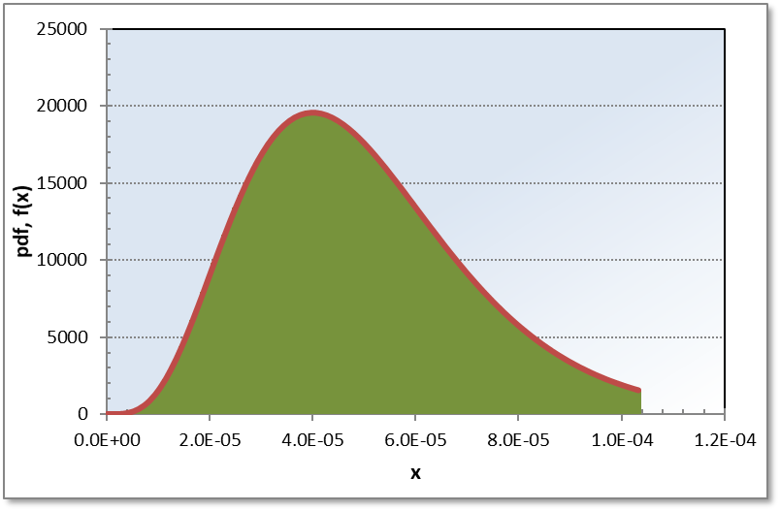
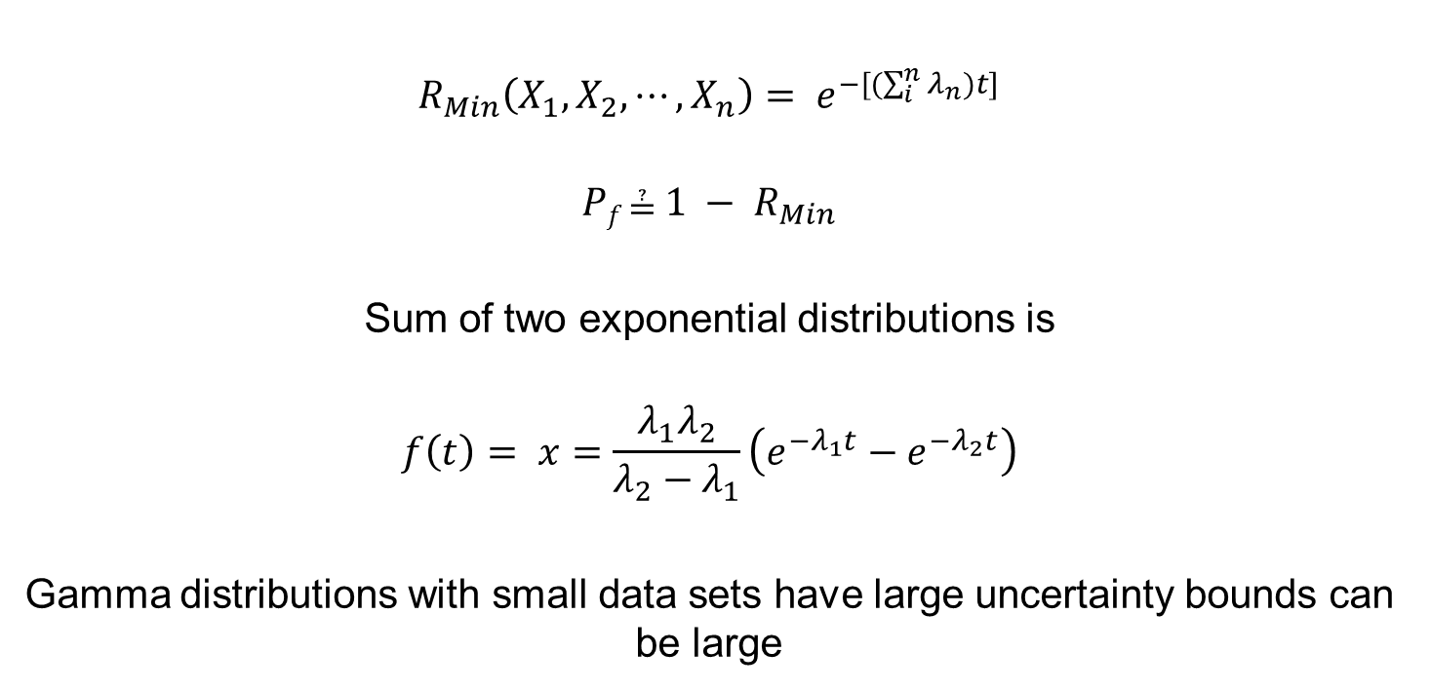
Reminders
PSAM 16 Honolulu, HI June 26 - July 1, 2022
$$R_{Min}\left(X_{1},X_{2},⋯,X_{n}\right)= e^{−[(\sum_{i}^{n}{λ_{n})}t]}$$
$${Pf \text{≟} 1 − R}_{Min}$$
Sum of two exponential distributions is
$$f\left(t\right)= x=\frac{λ_{1}λ_{2}}{λ_{2}−λ_{1}}\left(e^{−λ_{1}t}−e^{−λ_{2}t}\right)$$
Gamma distributions with small data sets have large uncertainty bounds can be large

Slide 21
Questions?
PSAM 16 Honolulu, HI June 26 - July 1, 2022

Slide 22
Backup
PSAM 16 Honolulu, HI June 26 - July 1, 2022

Slide 23
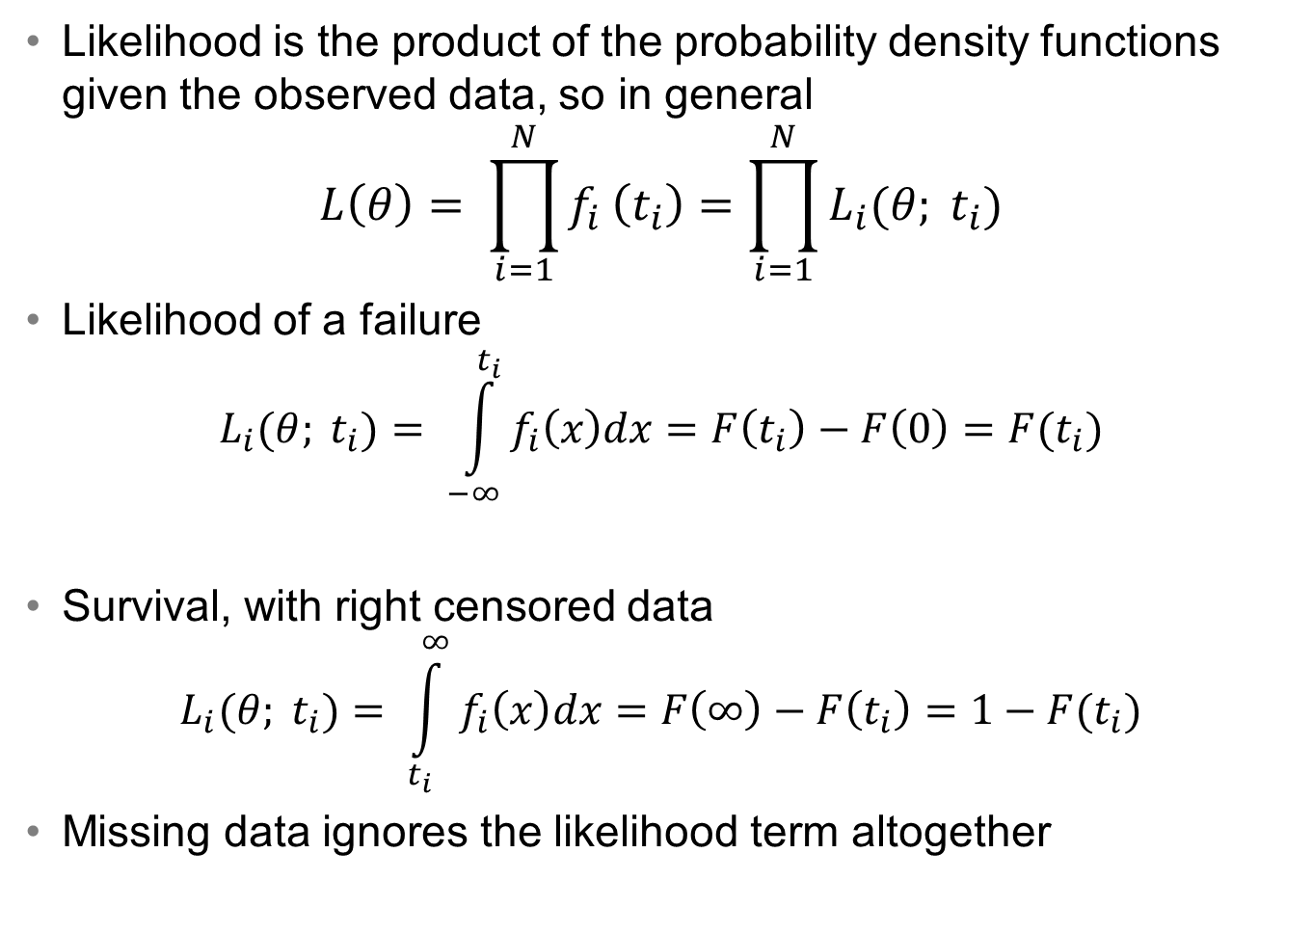
Censored vs. Missing Data
PSAM 16 Honolulu, HI June 26 - July 1, 2022
Likelihood is the product of the probability density functions given the observed data, so in general
$$L\left(θ\right)= \prod_{i=1}^{N}{f_{i}}\left(t_{i}\right)=\prod_{i=1}^{N}{L_{i}(θ; t_{i})}$$
Likelihood of a failure
$$L_{i}(θ; t_{i})= \int_{−∞}^{t_{i}}{f_{i}\left(x\right)dx=F\left(t_{i}\right)−F\left(0\right)=F(t_{i})}$$
Survival, with right censored data
$$L_{i}(θ; t_{i})= \int_{t_{i}}^{∞}{f_{i}\left(x\right)dx=F\left(∞\right)−F\left(t_{i}\right)=1−F(t_{i})}$$
Missing data ignores the likelihood term altogether

Slide 24
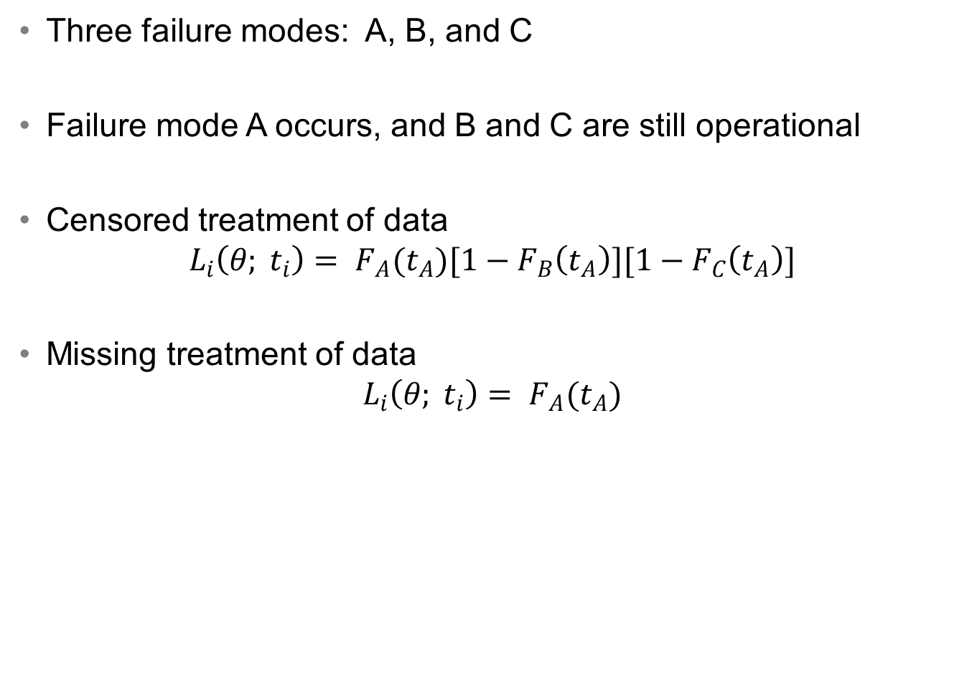
Censored vs. Missing Data Example
PSAM 16 Honolulu, HI June 26 - July 1, 2022
Three failure modes: A, B, and C
Failure mode A occurs, and B and C are still operational
Censored treatment of data
$$L_{i}\left(θ; t_{i}\right)= F_{A}(t_{A})[1−F_{B}\left(t_{A}\right)][1−F_{C}\left(t_{A}\right)]$$
Missing treatment of data
$$L_{i}\left(θ; t_{i}\right)= F_{A}(t_{A})$$

Slide 25

OpenBUGS Simulation with Censored Data
PSAM 16 Honolulu, HI June 26 - July 1, 2022
model {
# Loop through the observed and censored times
for (i in 1:N) {
T.A[i] ~ dnorm(mu.A, tau.A)C(lowerA[i], )
T.B[i] ~ dnorm(mu.B, tau.B)C(lowerB[i], )
T.C[i] ~ dnorm(mu.C, tau.C)C(lowerC[i], )
}
# Replicate the posterior model for failure times
TA ~ dnorm(mu.A, tau.A)
TB ~ dnorm(mu.B, tau.B)
TC ~ dnorm(mu.C, tau.C)
# Find the minimum times
AB <- min(TA, TB)
T.TE <- min(AB, TC)
# diffuse priors
mu.A ~ dflat()
mu.B ~ dflat()
mu.C ~ dflat()
tau.A ~ dunif(0,100)
tau.B ~ dunif(0,100)
tau.C ~ dunif(0,100)
}
data
list(T.A=c(100,NA,NA,75,NA,NA,125,NA,NA), T.B=c(NA,75,NA,NA,100,NA,NA,200,NA),
T.C=c(NA,NA,125,NA,NA,150,NA,NA,150),
lowerA=c(100,75,125,75,100,150,125,200,150), lowerB=c(100,75,125,75,100,150,125,200,150),
lowerC=c(100,75,125,75,100,150,125,200,150), N=9)
inits
list(mu.A=367, mu.B=367, mu.C=367, tau.A=2, tau.B=2, tau.C=2)
list(mu.A=300, mu.B=300, mu.C=300, tau.A=2, tau.B=2, tau.C=2)
New for this paper: Use of Python script to generate OpenBUGS code to reduce errors
Missing and censored versions of the script
Vs.

