Slide 1
Probabilistic Safety Assessment and Management conference (PSAM)
Planning and evaluation of reliability demonstration tests with uncertainties
Prof. Dr.-Ing. Tobias Leopold

Slide 2
Agenda
    Motivation
    Basics of RDT
    Uncertainty in RDT planning
    Case study
    Summary
PSAM16
Planning and evaluation of reliability demonstration tests with uncertainties

Slide 3
Motivation
  Carmakers - recall rate in the United States 1985-2014
Source: https://www.statista.com/statistics/309633/number-of-recalls-per-sale-for-car-manufacturing-groups-in-the-us/

Slide 4
Basics of RDT: Precondition – Reliability Target
  Appropriate reliability target on system level
  derived reliability targets on subsystem, assembly, module and component level
  Definition of suitable load spectra
  Confidence level of reliability proof
  ➔ Failure-free or failure-oriented reliability testing?

Slide 5
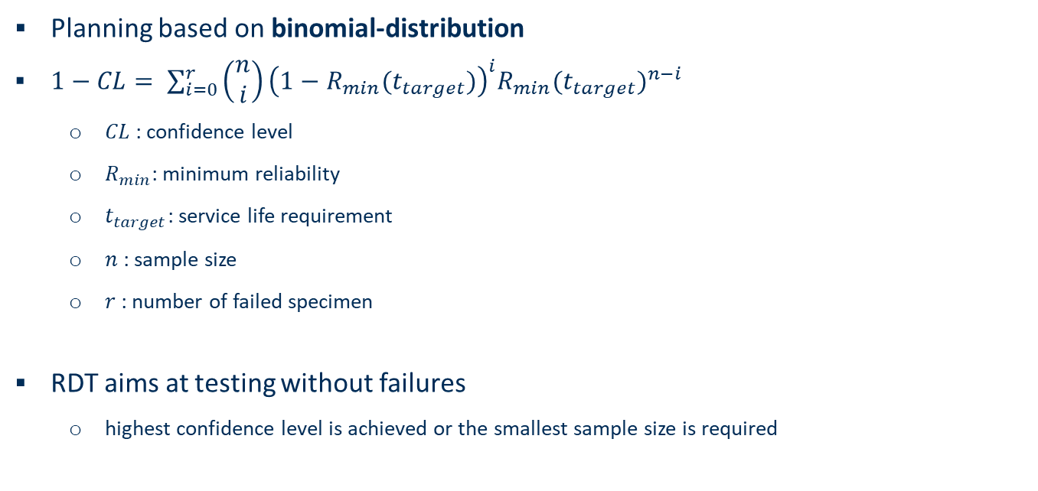
Basics of RDT
  Planning based on binomial-distribution
  $1−CL= \sum_{i=0}^{r}{\left(\begin{matrix}n \\ i\end{matrix}\right){\left(1−R_{min}(t_{target})\right)}^{i}{R_{min}(t_{target})}^{n−i}}$
          $CL$: confidence level
          $R_{min}$: minimum reliability
          $t_{target}$: service life requirement
          $n$: sample size
          $r$: number of failed specimen
  RDT aims at testing without failures
          highest confidence level is achieved or the smallest sample size is required

Slide 6
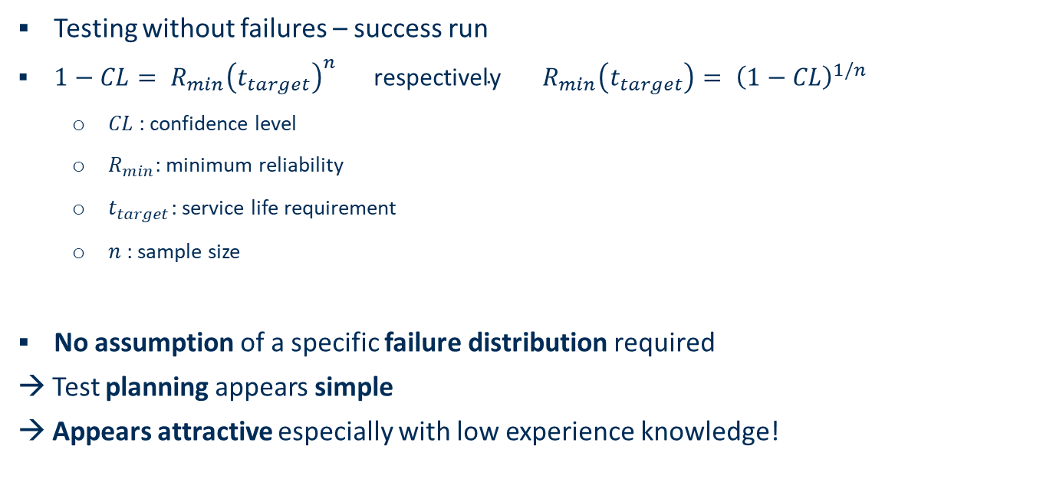
Basics of RDT
  Testing without failures – success run
  $1−CL= {R_{min}\left(t_{target}\right)}^{n} \text{respectively} R_{min}\left(t_{target}\right)= {\left(1−CL\right)}^{1/n}$
          $CL$: confidence level
          $R_{min}$: minimum reliability
          $t_{target}$: service life requirement
          $n$: sample size
  No assumption of a specific failure distribution required
  → Test planning appears simple
  → Appears attractive especially with low experience knowledge!

Slide 7
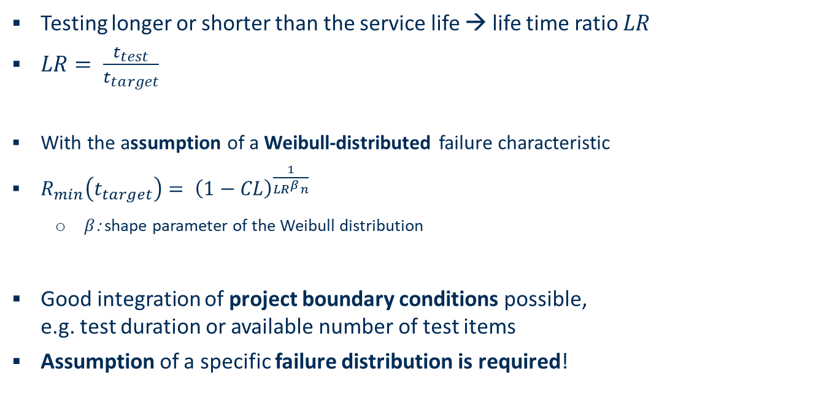
Basics of RDT
  Testing longer or shorter than the service life → life time ratio $LR$
        $LR= \frac{t_{test}}{t_{target}}$
  With the assumption of a Weibull-distributed failure characteristic
  $R_{min}\left(t_{target}\right)= {\left(1−CL\right)}^{\frac{1}{{LR}^{β}n}}$
          $β$: shape parameter of the Weibull distribution
  Good integration of project boundary conditions possible,
  e.g. test duration or available number of test items
  Assumption of a specific failure distribution is required!

Slide 8
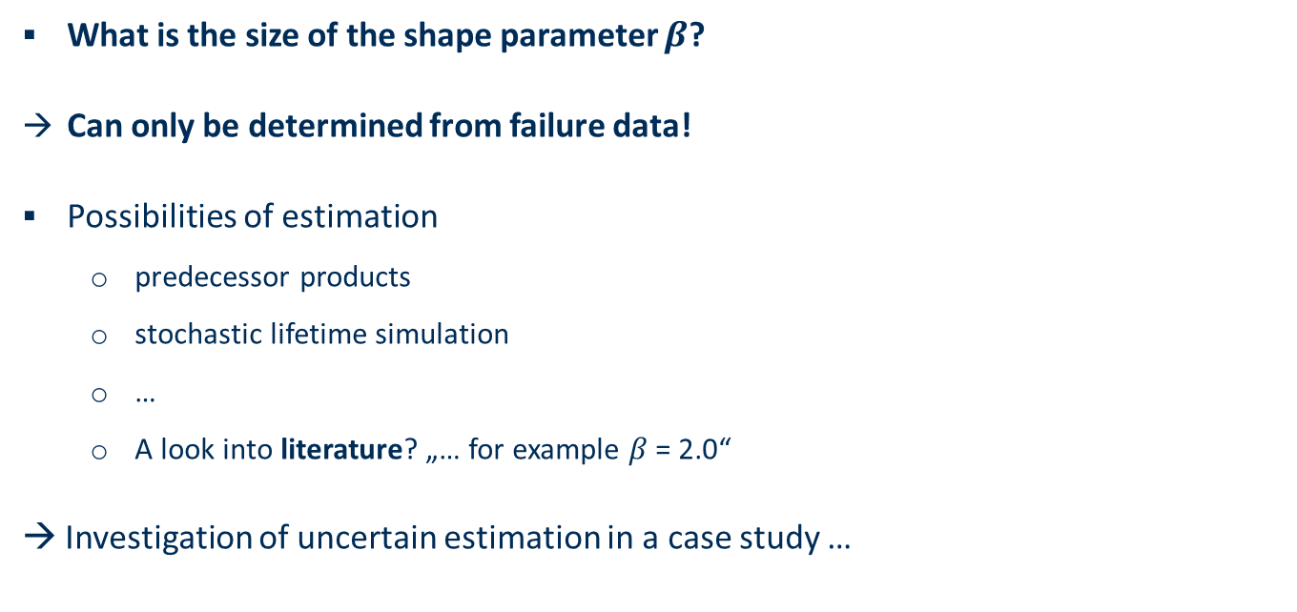
Uncertainty in RDT planning – estimation of shape parameter
  What is the size of the shape parameter $β$?
  Can only be determined from failure data!
  Possibilities of estimation
          predecessor products
          stochastic lifetime simulation
          …
          A look into literature? „… for example $β$ = 2.0“
  → Investigation of uncertain estimation in a case study …

Slide 9
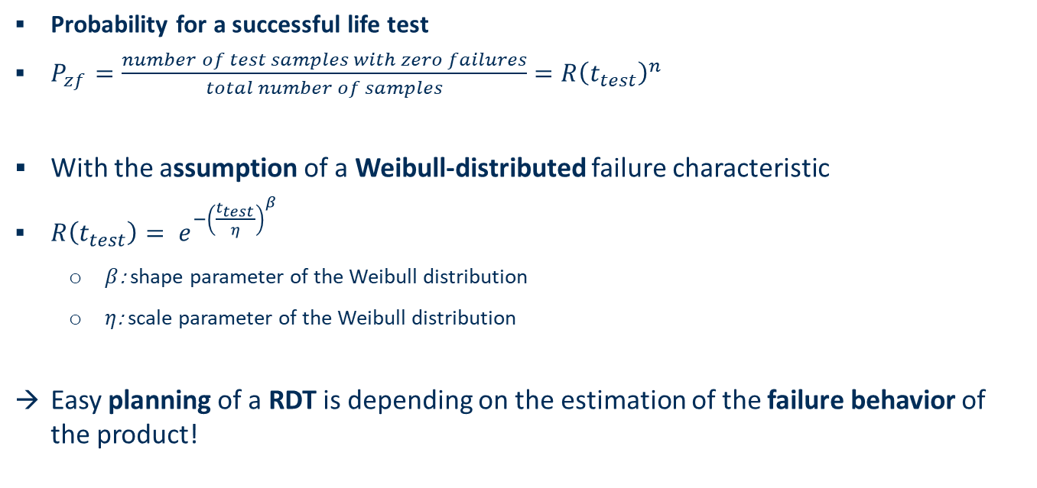
Uncertainty in RDT planning – probability for successful test
  Probability for a successful life test
  $P_{zf}=\frac{number of test samples with zero failures}{total number of samples}={R\left(t_{test}\right)}^{n}$
  With the assumption of a Weibull-distributed failure characteristic
      $R\left(t_{test}\right)= e^{−{\left(\frac{t_{test}}{η}\right)}^{β}}$
          $β$: shape parameter of the Weibull distribution
          $η$: scale parameter of the Weibull distribution
  Easy planning of a RDT is depending on the estimation of the failure behavior of the product!

Slide 10
Case study – overview
  → Investigation of an uncertain estimation in a case study …
  B₁₀ = 100.000 LC, confidence level CL= 90%
  Scenario I: LR = 0.75 → possible test duration of 75.000 LC
  Scenario II: LR = 0.50 → possible test duration of 50.000 LC

Slide 11
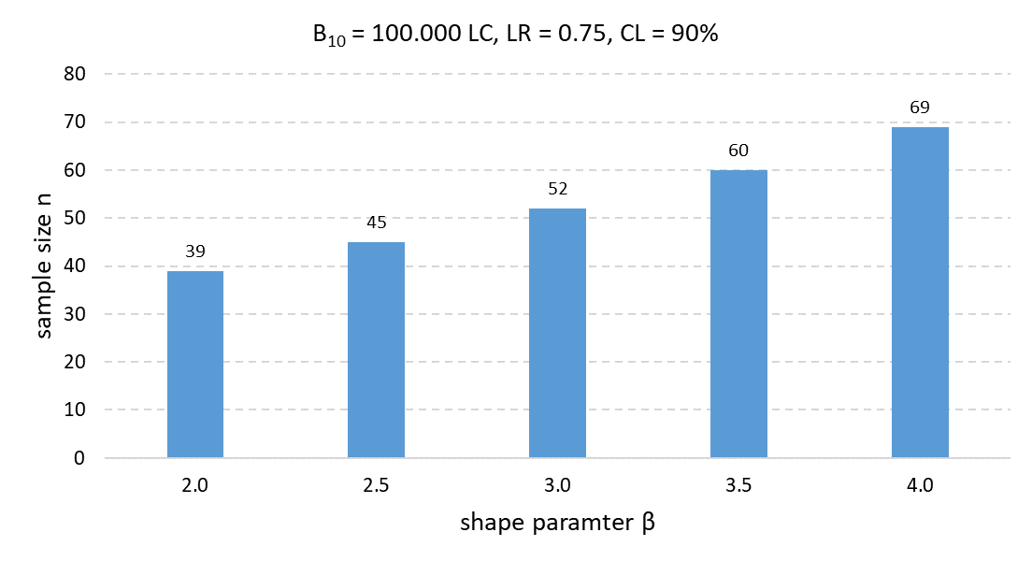
Case study – effect of uncertain shape parameter
  B₁₀ = 100.000 LC, confidence level CL = 90%
  Scenario I: 75.000 LC
  Scenario II: 50.000 LC

Slide 12
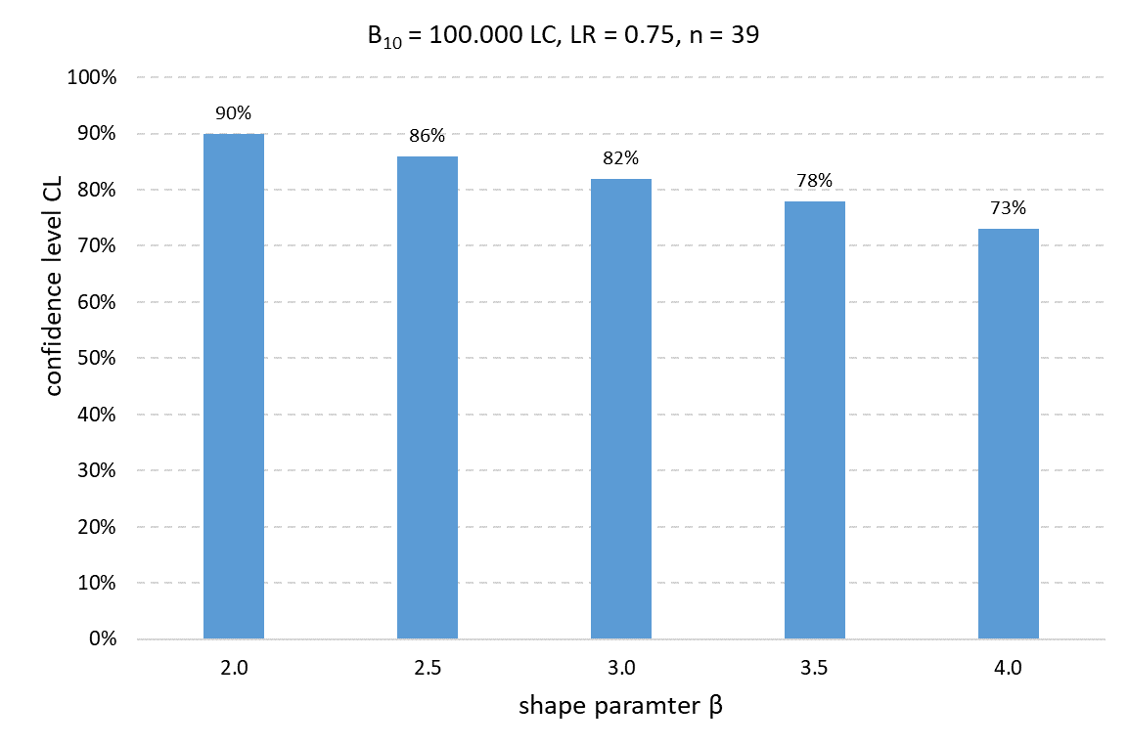
Case study – effect of uncertain shape parameter
  B₁₀ = 100.000 LC, confidence level CL = 90%
  Scenario I: 75.000 LC
  Scenario II: 50.000 LC

Slide 13
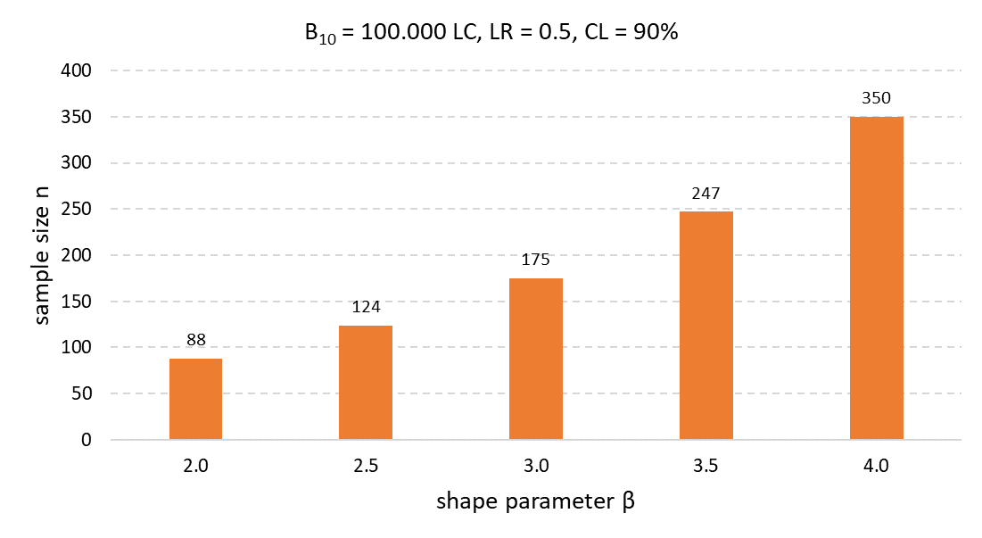
Case study – effect of uncertain shape parameter
  B₁₀ = 100.000 LC, confidence level CL = 90%
  Scenario I: 75.000 LC
  Scenario II: 50.000 LC

Slide 14
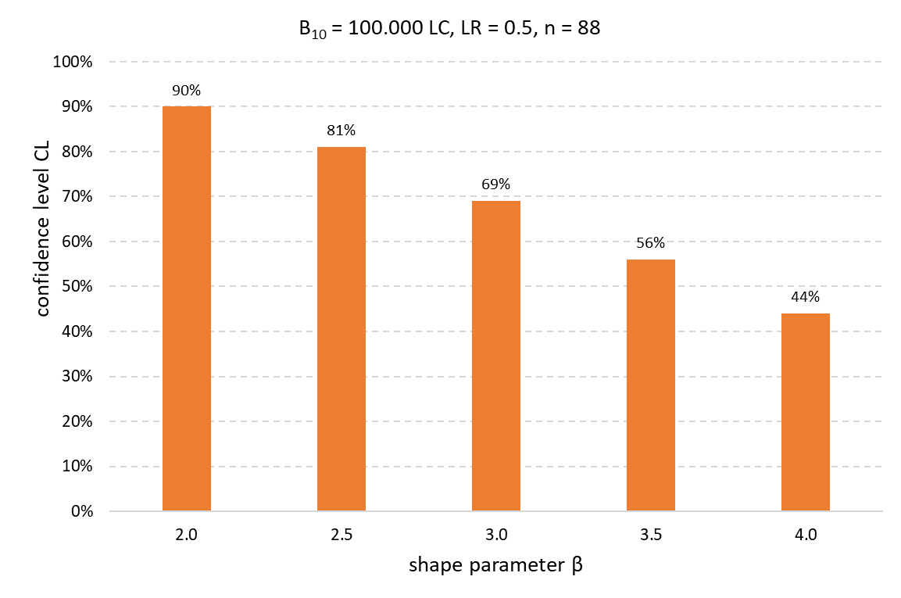
Case study – effect of uncertain shape parameter
  B₁₀ = 100.000 LC, confidence level CL = 90%
  Scenario I: 75.000 LC
  Scenario II: 50.000 LC

Slide 15
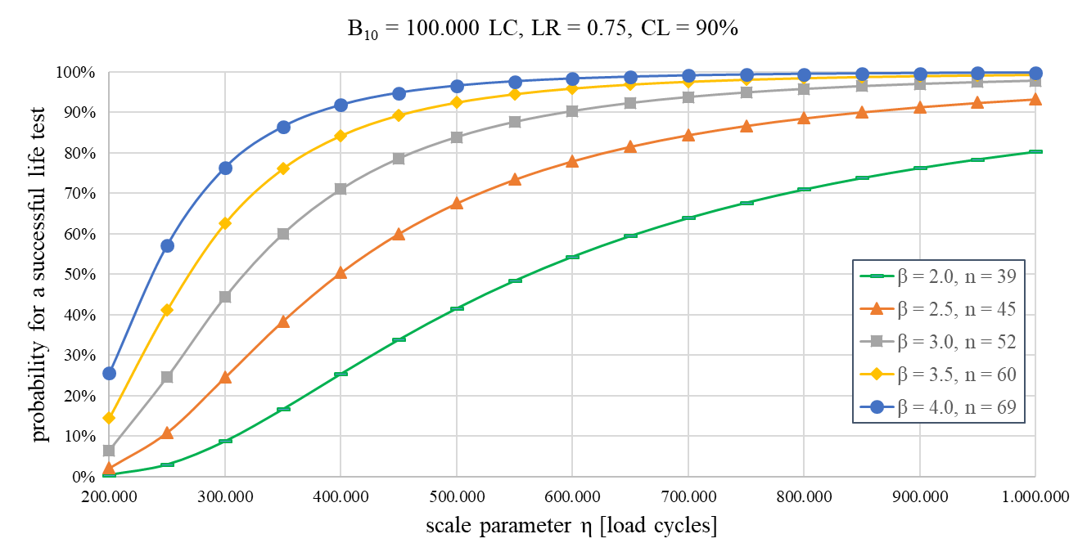
Case study – probability of sucessful life test
correct test planning without uncertainties
  B₁₀ = 100.000 LC, confidence level CL = 90%
  Scenario I: 75.000 LC

Slide 16
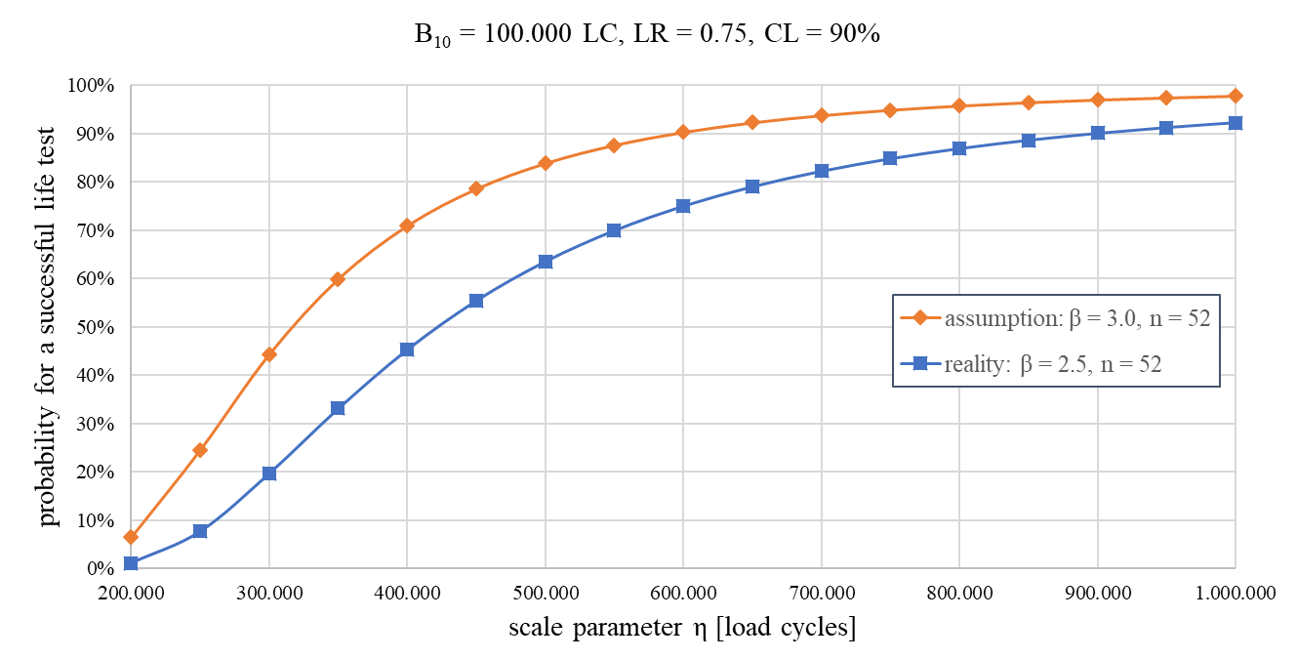
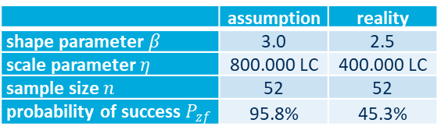
Case study – probability of sucessful life test
  B₁₀ = 100.000 LC, confidence level CL = 90%
  Scenario I: 75.000 LC
  Scenario II: 50.000 LC
test planning with uncertainties
 | assumption | reality
shape parameter $β$ | 3.0 | 2.5
scale parameter $η$ | 800.000 LC | 400.000 LC
sample size $n$ | 52 | 52
probability of success $P_{zf}$ | 95.8% | 45.3%

Slide 17
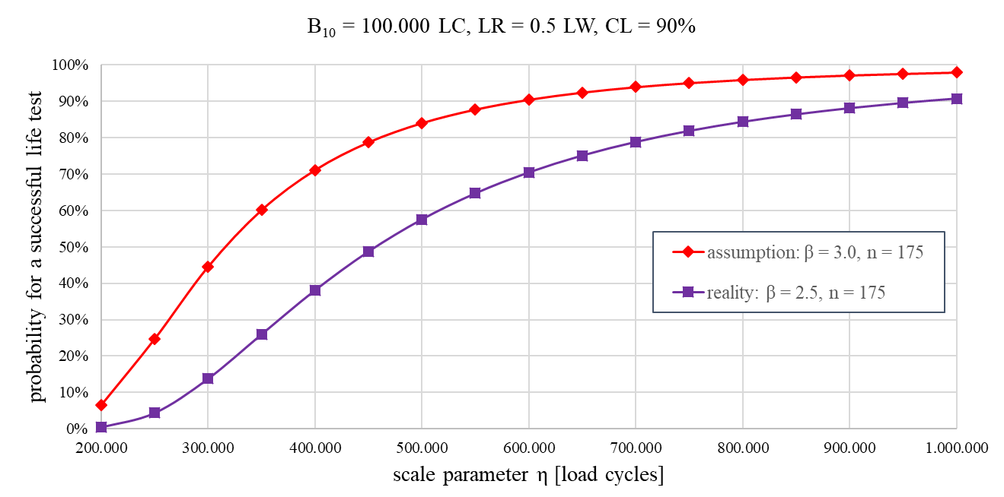
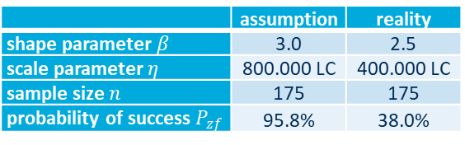
Case study – probability of sucessful life test
  B₁₀ = 100.000 LC, confidence level CL = 90%
  Scenario I: 75.000 LC
  Scenario II: 50.000 LC
test planning with uncertainties
 | assumption | reality
shape parameter $β$ | 3.0 | 2.5
scale parameter $η$ | 800.000 LC | 400.000 LC
sample size $n$ | 175 | 175
probability of success $P_{zf}$ | 95.8% | 38.0%

Slide 18
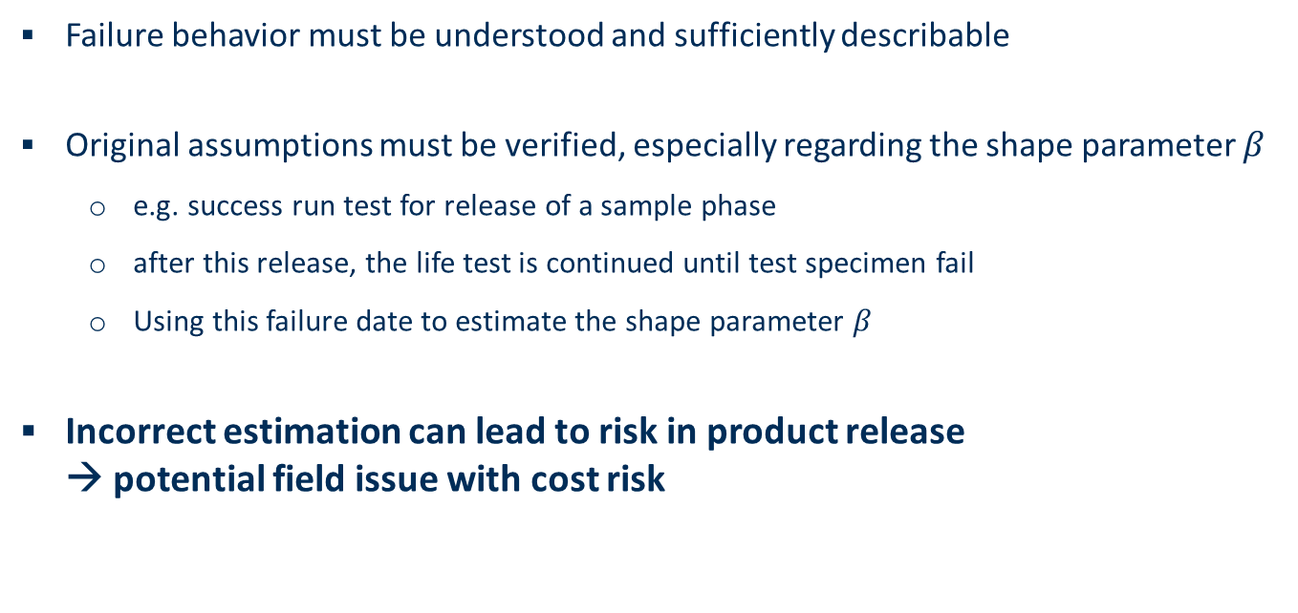
Summary
  Failure behavior must be understood and sufficiently describable
  Original assumptions must be verified, especially regarding the shape parameter $β$
          e.g. success run test for release of a sample phase
          after this release, the life test is continued until test specimen fail
          Using this failure date to estimate the shape parameter $β$
  Incorrect estimation can lead to risk in product release
  → potential field issue with cost risk

Slide 19
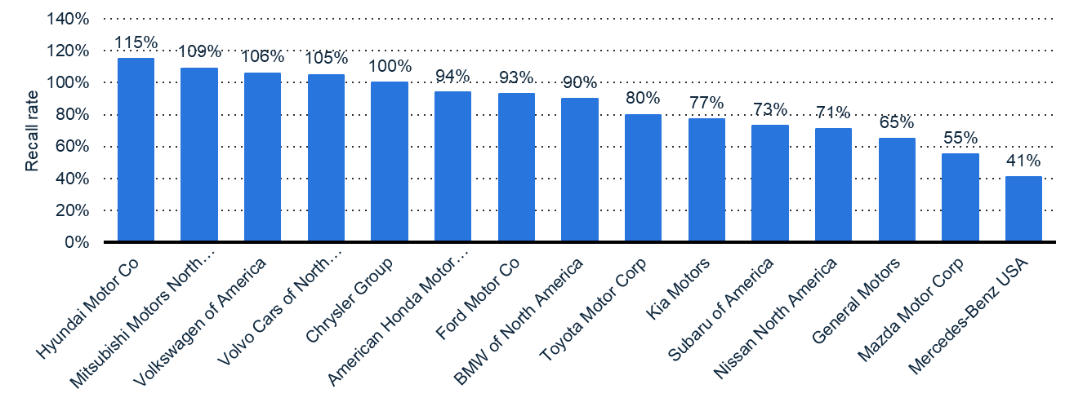
Appeal for the Future
  ➔ Better investing in product reliability testing than in field campaigns!

Slide 20
THANK YOU VERY MUCH FOR
YOUR ATTENTION!
Visit us at:
WWW.HS-ESSLINGEN.DE/EN

