Slide 1
An Application of a Modified Beta Factor Method for the Analysis of Software Common Cause Failures
Tate Shorthill University of Pittsburgh
Han Bao Idaho National Laboratory
Edward Chen North Carolina State University
Heng Ban University of Pittsburgh
6/30/2022

Slide 2
Outline
Project overview
CCF and other definitions
Modeling challenges
Selection of CCF models
Proposed approach for CCF modeling
Case study

Slide 3
Risk assessment framework for digital instrumentation and control (I&C) systems
Goals for Digital I&C Risk Assessment within the Risk-Informed Systems Analysis (RISA) Pathway of the U.S. Department of Energy (DOE) Light Water Reactor Sustainability (LWRS) program:
Develop an advanced risk assessment framework to support industry’s transition from analog to digital technologies for safety-related I&C systems
Develop an integrated platform that includes all aspects of a typical risk assessment: hazard analysis, reliability analysis, and consequence analysis
Provide a systematic, verifiable and reproducible approach based on technically-sound methodologies
Failure Modes
System Failure Probabilities
Probabilistic Estimation of Failure Consequences
Designs of Digital I&C Systems and Plants
LWRS-developed Digital I&C Risk Assessment Framework
CCF modeling
Hazard Analysis
Reliability Analysis
Consequence Analysis
RESHA
(Redundancy-Guided System-Theoretic Hazard Analysis)
PRA + UQ
(Probabilistic Risk Assessment + Uncertainty Quantification)
Multiscale Quantitative Reliability
Analysis
Suggestions to optimize designs and upgrades by quantitatively reducing risks and costs
BAHAMAS
(Bayesian and HRA-Aided Method for the Reliability Analysis of Software)
ORCAS
(Orthogonal Defect Classification for Assessing Software Reliability)
CCF Modeling and Estimation
3

Slide 4
Key definitions for software CCF modeling
Software:
Software refers to the computer programs, codes, procedures and data pertaining to the operation of a digital component or system [1].
Failure:
Termination of the ability of a system to perform a required or intended function or its inability to perform within previously specified limits [1].
Software Failure:
Inability of the software to perform its designed/required or intended functions within specified limits.
Fault:
Defect or vulnerability, that under certain conditions, may cause a failure [2].
Trigger:
An event or operating condition that activates a latent fault. Examples: plant transients, initiating events, external conditions, interactions among systems, human interaction, and internal states [3].
Defect or Fault
Fault Activation
Failure

Slide 5
Key definitions for software CCF modeling
Common Cause Failure (CCF):
A CCF is the occurrence of two or more failure events due the simultaneous occurrence of a shared root failure cause and a coupling factor (or mechanism) [4].
Root Failure Cause:
The most basic reason for a failure event which, if corrected, could prevent the event [4].
Coupling Factor:
The mechanism that creates a condition for multiple components to be affected by the same cause[4].
Common Cause Component Group (CCCG):
The group of components that share coupling mechanisms [4].
Root Cause
Defect or Fault
Activation (Trigger)
Software Failure
Coupling Mechanism
Software CCF

Slide 6
Discussion of CCCGs and the symmetry assumption
CCF models rely on the identification of CCCG, for which the model will then provide a probability of CCF for those components of the CCCG.
The assumption is made that groups of similar components have similar reliability values.
Total failure of the example system is given by the following equation [4]:
Equation for the total failure of the system is simplified by the application of the symmetry assumption [4]:
$$P\left(F\right)=3{Q_{1}}^{2}+3Q_{2}+Q_{3}$$
Component | Installation Procedure | Location | manufacturer
A | Procedure A | Room A | Company A
B | Procedure A | Room A | Company A
C | Procedure A | Room A | Company A
$$P\left(F\right)=P\left(A_{I}\right)P\left(B_{I}\right)+P\left(B_{I}\right)P\left(C_{I}\right)+P\left(A_{I}\right)P\left(C_{I}\right)…$$
$$+ P\left(CCF_{AB}\right)+P\left(CCF_{BC}\right)+ P\left(CCF_{AC}\right)…$$
$$+ P\left(CCF_{ABC}\right)$$
$$Q_{1}^{3}=P\left(A_{I}\right)=P\left(B_{I}\right)=P\left(C_{I}\right)=Q_{1}$$
$$Q_{2}^{3}=P\left(CCF_{AB}\right)=P\left(CCF_{BC}\right)=P\left(CCF_{AC}\right)=Q_{2}$$
$$Q_{3}^{3}=P\left(ABC\right)=Q_{3}$$

Slide 7
Discussion of CCCGs and the symmetry assumption
Sometimes a component might belong to multiple CCCGs
The symmetry assumption may lead to problem, because the total number of components in the CCCG play a role in calculating CCF values.
Component | Installation Procedure | Location
A | Procedure A | Room A
B | Procedure A | Room A
C | Procedure A | Room B
Component | Coupling Mechanism | Components
CCCG1 | Installation (Procedure A) | A, B, C
CCCG2 | Location (Room A) | A, B
CCCG1 symmetry says:
$$Q_{2}^{3}=P\left(CCF_{AB}\right)=P\left(CCF_{BC}\right)=P\left(CCF_{AC}\right)=Q_{2_{CCCG1}}$$
However, CCCG2 symmetry says:
$Q_{2}^{2}=P\left(CCF_{AB}\right)=Q_{2_{CCCG2}}$
There is no guarantee that $Q_{2_{CCCG1}}=Q_{2_{CCCG2}}$

Slide 8
Subtle variations in coupling mechanisms matter
Software failure occurs by activation of latent defects. Activation of latent defects is a result of certain operational conditions i.e., trigger events [3].
We argue that operational conditions are encountered as a result of some external input or demand on the software program.
Given a group of redundant software components, variations in their operating conditions may lead to some, but not all, components failing together. Variations in the operational conditions of otherwise identical components may result from differences in maintenance staff, inputs variables sources, and installation teams; in other words, subtle differences in software-based coupling mechanisms may lead to unique combinations of CCFs even in systems with low design diversity.

Slide 9
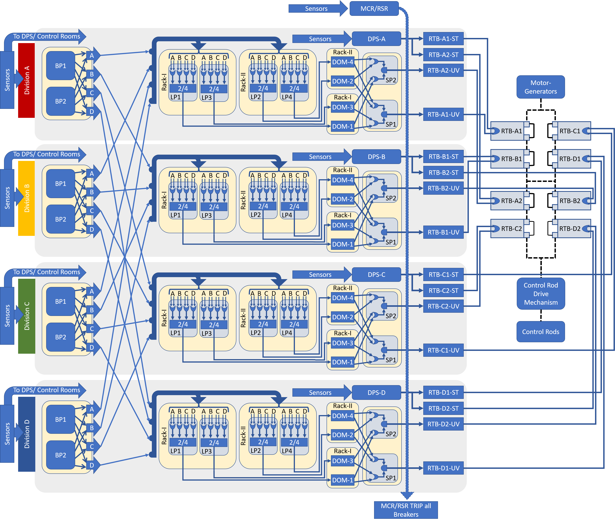
Example:
Bistable Processors (BP) in Division A receive input from division-specific sensors.
Figure: Four-division digital reactor trip system; each division performs redundant reactor trip functions [5].

Slide 10
Existing methods and recent publications
Methods that allow for either asymmetry of the CCCG or were developed to allow single components to be part of multiple CCCGs:
Modified Beta factor model Kančev and Čepin (2012)[6]
Partial Alpha factor model (O'Connor and Mosleh 2014)[7]
General dependency model (O'Connor and Mosleh 2016)[8]
Accounting for asymmetry of failure probabilities (Rasmuson and Kelly 2008)[9]
Multi-unit CCF modeling relying on asymmetric and symmetric details (Higo et al. 2020)[10]
Modification of Higo et al. relies on gamma rather than alpha factor (Soga et al. 2021)[11]
Direct assessment and database collection have been made for CCFs [12]
Limitations: The methods given above may work for asymmetric conditions or multiple CCCGs, but they are data-dependent. For example: they require historical CCF data to define model parameters. Nearly all demonstrations are for hardware components (i.e., EDG, pumps, etc.), the data for which comes from operational experience.
Lack of software CCF data drives us to seek other options.

Slide 11
Lack of software data is a motivation for selecting the modified beta factor model
As a starting point, the model best suited for a limited data scenario may be the one which requires the fewest parameters.
In a system of identical bistable processors (BPs), it is more likely that a CCF will occur over independent failures (e.g., BPs in a Division have identical inputs. Thus, it is most likely that fault activation will occur in both simultaneously.
The scenario for BPs in a single division match well with a beta-factor model which assumes all components of a CCCG fail together [4]. (no combinations of CCFs)
$$Q_{t}=Q_{I}+Q_{D}$$
$$Q_{D}= βQ_{t}$$
$$Q_{I}= (1−β)Q_{t}$$
But BPs can be part of other CCCGs. So, we need a variation of the beta-factor model. The Modified Beta factor model by Kančev and Čepin allows for this [6].

Slide 12
Modified Beta-Factor Method (BFM)
The modified BFM assumes the total failure probability ($Q_{t}$) of a component is the summation of independent ($Q_{I}$) and dependent failures ($Q_{D}$) [6].
$$Q_{D}=P\left(CCCG_{1}\right)+P\left(CCCG_{2}\right)+…P(CCCG_{w})$$
$$P\left(CCCG_{w}\right)= \left(β_{w}\right)Q_{t}$$
$$β_{t}=\sum_{1}^{w}{\left(β_{w }\right)}$$
$$Q_{D}=Q_{t}\sum_{1}^{w}{\left(β_{w }\right)}$$
$$Q_{I}=\left(1−β_{t}\right)Q_{t}=\left[1−\sum_{1}^{w}{\left(β_{w}\right)}\right]Q_{t}$$
Example CCCGs
CCCG | Components | Coupling mechanism
(1) | A1, A2 | Division A Location
(2) | B1, B2 | Division B Location
(3) | C1, C2 | Division C Location
(4) | D1, D2 | Division D Location
(5) | A1, A2, B1, B2, C1, C2, D1, D2 | Function, Hardware, Software, & Manufacturer
How to estimate the beta factors for each CCCG, given a limited-data scenario?

Slide 13
A method to define beta factors for each CCCG
An additive scheme Partial Beta Factor (PBF) method was developed to provide a score for the beta factor by considering a component’s defenses against CCF[13].
A collection attributes, called sub-factors, were selected which are known to contribute to the prevention of CCFs. The method deals with hardware-based failures.
Sub-factors | A | A+ | B | B+ | C | D | E
Redundancy (& Diversity)¹ | 1750 | 875 | 425 | 213 | 100 | 25 | 6
Separation | 2400 |  | 580 |  | 140 | 35 | 8
Understanding | 1750 |  | 425 |  | 100 | 25 | 6
Analysis | 1750 |  | 425 |  | 100 | 25 | 6
Man-Machine Interface (MMI) | 3000 |  | 720 |  | 175 | 40 | 10
Safety Culture | 1500 |  | 360 |  | 90 | 20 | 5
Control | 1750 |  | 425 |  | 100 | 25 | 6
Tests | 1200 |  | 290 |  | 70 | 15 | 4
¹This sub-factor name changed and given the A+ and B+ scores [14].
$$β=\frac{\sum{(Sub_factors)}}{50000}$$
The method is best defined for hardware failures.

Slide 14
The partial beta factor scoring method was modified to address software
The range of beta values the model will produce was increased (i.e., 0.001 – 0.999), allowing for greater applicability to low diversity software systems
Subfactor weights were changed to place greater emphasis the subfactors that influence coupling mechanisms.
Subtle variations in the operational conditions can create quasi-diverse components, ultimately influencing the potential for CCFs
For example: Human interaction may vary across components introducing software faults and effecting coupling mechanisms. Greater weight placed on those defenses that pertain to human interaction and diversity of software.
Beta Factor Estimation Table For Software Failures
Sub-factors | A | A+ | B | B+ | C | D | E
Redundancy (& Diversity)¹ | 23976 | 10112 | 4265 | 1799 | 759 | 135 | 24
Input Similarity | 23976 | 10112 | 4265 |  | 759 | 135 | 24
Understanding | 7992 |  | 1422 |  | 253 | 45 | 8
Analysis | 7992 |  | 1422 |  | 253 | 45 | 8
MMI | 11988 |  | 2132 |  | 379 | 67 | 12
Safety Culture | 6993 |  | 1244 |  | 221 | 39 | 7
Control | 4995 |  | 888 |  | 158 | 28 | 5
Tests | 11988 |  | 2132 |  | 379 | 67 | 12
$$β=\frac{\sum{(Sub_factors)}}{100000}$$

Slide 15
Modified scoring: The Redundancy Sub-factor
Redundancy does not influence reliability of application software (i.e., duplicate codes will have identical failures). Diversity however has the potential to influence and reduce CCF.
The following table is used to score the internal redundancy (i.e., diversity) of the components of the CCCG.
Score | Score for Redundancy (Diversity)
A | No Diversity, $δ=0$
A+ | Very low diversity, $0<δ≤0.167$
B | low diversity, $0.167<δ≤$ 0.333
B+ | Intermediate diversity, $0.333<δ≤0.50$
C | Intermediate/high diversity, $0.50<δ≤0.667$
D | high diversity, $0.667<δ≤0.833$
E | Very high diversity, $0.833<δ≤1$
Internal diversity $δ=(h−θ)/(H−θ)$ $H=$ maximum diversity of attributes within the CCCG, $H=mθ$ $m=$ the number of components within the CCCG $θ=$ number of attributes (e.g., software language, process model, control algorithm) $h=$ number of unique attributes states in the CCCG

Slide 16
Modified scoring: Separation Sub-factor changed to Input Similarity
Subtle differences in coupling mechanisms may lead to unique combinations of CCFs. Variations in the operational environment of otherwise identical components may result from differences in maintenance staff, inputs variables, etc. In other words, input similarity (i.e., diversity) can influence combinations of CCFs.
The following table scores the input similarity sub-factor for software. (external influences of diversity)
Score | R=0 | 0<R<0.5 | 0.5 ≤ R < 1 | R ≥ 1 | Zero Diversity | Partial Diversity | Complete Diversity
A | X |  |  |  | X | X | X
A+ |  | X |  |  | X | X | X
B |  |  | X |  | X
C |  |  | X |  |  | X | X
D |  |  |  | X | X | X
E |  |  |  | X |  |  | X
The input ratio ($R$) is defined: $R=(s−1)/m$ for $s=1$ and $R=s/m$ for $s>1$ where, $m=$ the number of components within the CCCG, and $s=$ number of input sources. Diversity columns assess input source diversity.

Slide 17
Modeling Flowgraph
A formalized flowgraph for modeling CCFs in within INL digital I&C risk assessment framework is shown at the right.
The approach relies on the modified BFM to account for multiple CCCGs and partial beta factor method to define beta factors for each CCCG.
Hazard Analysis
Reliability Analysis
Total Failure Probability
Identification of CCF Groups
Identify identical components and coupling factors
Assign CCCGs
CCF Modeling and Parameter Estimation
Define Beta parameters for CCCGs
Single or multiple CCF groups?
Standard BFM
Modified BFM
Determine CCFs
Estimation of failure probability of DI&C systems

Slide 18
Case Study
Assumptions:
Only software is found in the BPs and LPs.
All other components are digital or analog circuits, but no application software
Previous work identified Software failure and hardware failure. (This work finds CCF)
Figure: Four-division digital reactor trip system; each division performs redundant reactor trip functions [6].

Slide 19
Case Study
CCCGs are assigned
Beta factors are defined for each CCCG
CCF is evaluated for each CCCG
Independent and dependent failures are identified
CCCGs |  | Coupling Factors
1 | All BPs | Function, Hardware, Software, & Manufacturer
2 | Division A: BP1, BP2 | Division A
3 | Division B: BP1, BP2 | Division B
4 | Division C: BP1, BP2 | Division C
5 | Division D: BP1, BP2 | Division D
Sub-factors | Hardware |  | Software
Redundancy (& Diversity) | B+ | 212 | A | 23976
Separation | E | 8 | A+ | 10112
Understanding | A | 1800 | A | 7992
Analysis | D | 25 | D | 45
MMI | C | 173 | C | 379
Safety Culture | E | 5 | E | 7
Control | D | 25 | D | 28
Tests | C | 69 | C | 379
Beta for the CCCG | $β­_{HD1}=0.$045 |  | $$β­_{SW1}=0.429$$
Software Failure Probability
Component | INDIVIDUAL | RACK | DIVISION | ALL | Total
BPs | 5.591E-07 | N/A | 1.062E-04 | 8.030E-05 | 1.871E-04

Slide 20
Results
Component hardware and software failures
Hardware Failure Probability
Component | INDIVIDUAL | RACK | DIVISION | ALL | Total
BPs | 4.000E-05 | N/A | 5.943E-06 | 2.187E-06 | 4.813E-05
LCL Processors | 6.480E-05 | 1.076E-05 | 7.647E-06 | 3.961E-06 | 8.717E-05
DOMs | 1.640E-05 | 1.706E-06 | 1.015E-06 | 1.983E-07 | 1.932E-05
Selective Relay | 6.200E-06 | N/A | 6.073E-07 | 7.059E-08 | 6.878E-06
RTB-UV device | 1.700E-03 | N/A | N/A | 1.763E-05 | 1.718E-03
RTB-Shunt device | 1.200E-04 | N/A | N/A | 1.244E-06 | 1.212E-04
RTB RTSS2 | 4.500E-05 | N/A | N/A | 1.944E-06 | 4.694E-05
Software Failure Probability
Component | INDIVIDUAL | RACK | DIVISION | ALL | Total
BPs | 5.591E-07 | N/A | 1.062E-04 | 8.030E-05 | 1.871E-04
LCL Processors | 8.086E-05 | N/A | N/A | 1.062E-04 | 1.871E-04

Slide 21
Conclusion
Developed a novel combination of existing tools to support CCF modeling for digital I&C systems.
The partial beta factor method, together with the modified BFM, allow for a successful quantification process for the multiple CCCGs under a limited-data scenario
Provided an innovated process for defining software-specific model parameters.
Future work will employ our approach as part of INL’s framework for the risk assessment of digital I&C systems
Evaluation of the reactor trip system fault trees including the software CCFs.

Slide 22
Acknowledgements
The research activities and achievements presented in this work were funded under the Risk Informed Systems Analysis (RISA) Pathway of the United States Department of Energy Light Water Reactor Sustainability Program.
This information was prepared as an account of work sponsored by an agency of the U.S. Government under DOE Contract No. DE-AC07-05ID14517. Neither the U.S. Government nor any agency thereof, nor any of their employees, makes any warranty, express or implied, or assumes any legal liability or responsibility for the accuracy, completeness, or usefulness of any information, apparatus, product, or process disclosed, or represents that its use would not infringe privately owned rights. References herein to any specific commercial product, process, or service by trade name, trademark, manufacturer, or otherwise, does not necessarily constitute or imply its endorsement, recommendation, or favoring by the U.S. Government or any agency thereof. The views and opinions of authors expressed herein do not necessarily state or reflect those of the U.S. Government or any agency thereof.

Slide 23
References
[1] "ISO/IED/IEEE International Standard - Systems and software engineering--Vocabulary," in ISO/IEC/IEEE 24765:2017(E), Institute of Electrical and Electronics Engineers, 2017, pp. 1-541.
[2] Nuclear Energy Agency, "Failure Modes Taxonomy for Reliability Assessment of Digital Instrumentation and Control Systems for Probabilistic Risk Analysis," OECD NEA, 2014.
[3] M. Muhlheim and R. Wood, "Technical Basis for Evaluating Software-Related Common-Cause Failures," Oak Ridge National Laboratory, Oak Ridge, 2016.
[4] A. Mosleh, D. Rasmuson and F. Marshall, "Guidelines on Modeling Common-Cause Failures in Probabilistic Risk Assessment," NUREG/CR-5485, U.S. Nuclear Regulatory Commission, Washington, DC, 1998.
[5] T. Shorthill, H. Bao, Z. Hongbin and H. Ban, "A novel approach for software reliability analysis of digital instrumentation and control systems in nuclear power plants," Annals of Nuclear Energy, vol. 158, 2021.
[6] D. Kančev and M. Čepin, "A new method for explicity modelling of single failure evetn within different common cause failure groups," Reliability Engineering and System Safety, vol. 103, pp. 84-93, 2012.
[7] A. O'Connor and A. Mosleh, "Extending the Alpha Factor Model for Cause Based Treatment of Common Cause Failure Events in PRA and Event Assessment," in PSAM 2014 - Probabilistic Safety Assessment and Management, Honolulu, Hawaii, 2014.

Slide 24
References
[8] A. O'Connor and A. Mosleh, "A general cause based methodology for analysis of common cause and dependent failures in system risk and reliability assessments," Reliability Engineering and System Safety, vol. 145, pp. 341-350, 2016
[9] D. M. Rasmuson and D. L. Kelly, "Common-cause failure analysis in event assessment," Proceedings of the Institution of Mechanical Engineers, Part O: Journal of Risk and Reliability, vol. 222, pp. 521-532, 2008.
[10] E. Higo, S. Soga and H. Miura, "Inter-unit common cause failure analysis based on data from intra-unit cases," in ICONE2020 - Proceedings of the 2020 Conference on Nuclear Engineering, Virtual, 2020
[11] S. Soga, E. Higo and H. Miura, "A systematic approach to estimate an inter-unit common-cause failure probability," Reliability Engineering and System Safety, vol. 2015, 2021
[12] OECD/Nuclear Energy Agency. International common-cause failure data exchange. https://www.oecd-nea.org/jcms/pl_25090/international-common-cause-failure-data-exchange-icde-project
[13] R. A. Humphreys, "Assigning a Numerical Value to the Beta Factor Common Cause Evaluation," in Reliability '87, 1987
[14] V. P. Brand, Ed., UPM 3.1: A pragmatic approach to dependent failures assessment for standard systems, SRDA-R13, Warrington, UK: AEA Technology, Safety and Reliability Directorate, 1996

Slide 25
Questions?

Slide 26
Extra Slides

Slide 27
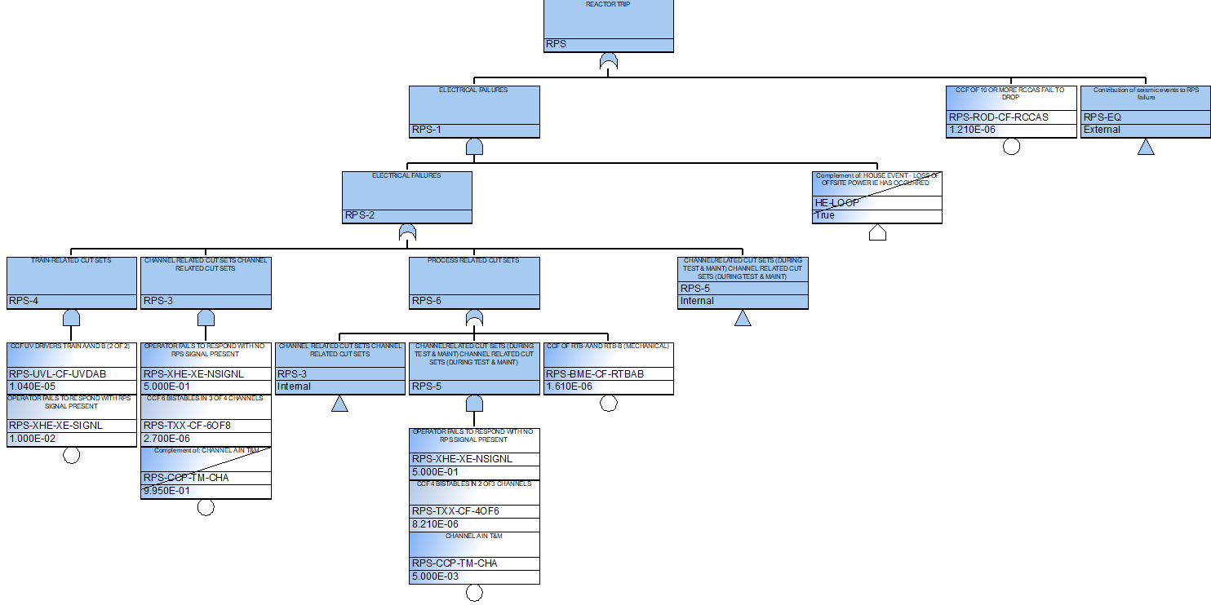
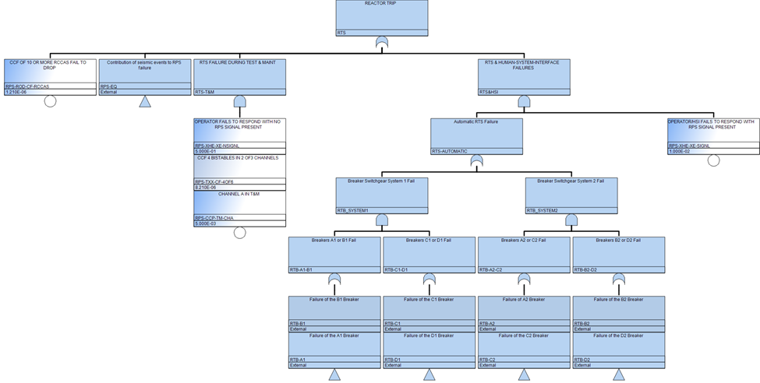
Original and new fault trees for the reactor trip system
original RTS-FT
New RTS-FT
Path Forward: Implement our new CCF model values and evaluate the RTS Cut sets.

Slide 28
Partial Beta Method Subfactor Meanings
High level Definitions for each defense sub-factor [13][14] | High level Definitions for each defense sub-factor
Redundancy (& Diversity) | Measurement of internal similarity
Separation | Measure of external similarity
Understanding | The amount of understanding, experience, and complexity of the design
Analysis | The quality of the safety and fault analysis conducted for the design.
MMI | The degree two which procedures and human interaction with the system are defined
Safety Culture | The amount of training users have been given in addition to their safety culture
Control | Environmental control of the system, control of installation process and general access
Tests | The degree to which the software was tested
Notes:
An overview of the subfactors

Slide 29
Review of R. A. Humphreys Work
Beta values range for identical channels .03-.3 and diverse channels .001-.1 [*]. Hence, .001–.3 is the range for values that this multiple Beta/UPM method will produce.
Fundamental assumption: what design attributes (defenses) reduce a CCF?”
50,000 was used to allow a convenience of whole numbers to be used in the tables.
The using the weighting factors as the whole numbers sum to 51. (51/x = .001) gives aprox. 50K this is where it comes from.
Remaining three columns are assigned according to the curve y = Qe^(rx).
“The method was developed for use with electronic/electrical systems which employ full or partial redundancy.” The model assumes high quality in design and production [**].
 | A | B | C | D | E
Separation | 2400 | 580 | 140 | 35 | 8
Similarity | 1750 | 425 | 100 | 25 | 6
Complexity | 1750 | 425 | 100 | 25 | 6
analysis | 1750 | 425 | 100 | 25 | 6
Procedures | 3000 | 720 | 175 | 40 | 10
Training | 1500 | 360 | 90 | 20 | 5
Control | 1750 | 425 | 100 | 25 | 6
Tests | 1200 | 290 | 70 | 15 | 4
totals | 15100 | 3650 | 875 | 210 | 51
[**] Humphreys, R.A. 1987. "Assigning a Numerical Value to the Beta Factor Common Cause Evaluation." in Reliability '87, Proceedings of the Sixth Conference Birmingham, England; 2C/5/1-2C/5/8.
[*][source in Humphreys] Guidance on the safe use of programmable electronic systems health and safety executive

Slide 30
The model should reflect software-specific assumptions (case study thoughts)
Software components from the Case study: Bistable Processor (BP) and Local Coincidence Logic (LCL) Processor.
BPs software-based failures:
Model assumption: No software diversity, BPs Receive division-specific information.
Each division has its own sensors. Activation (trigger) of hidden software fault is more likely to occur in a single division due to wacky input than for all divisions. Because all divisions would need strange inputs which is less likely.
Independent failure < division-level CCF and CCF of all BPs.
LCL processors software failures:
Model assumption: No software diversity, All LCLs receive same input information.
Each LCL receives the same data and inputs. For software failure: Any activation of a fault within an LCL processor will occur in all divisions because they have identical input. It is unlikely for independent failure to occur over a CCF.
Independent failure < CCF of all LCLs

Slide 31
How the weights changed
Comparison of weights for hardware and software
Sub-factors | Hardware | Software
Redundancy (& Diversity)¹ | 12% | 24%
Separation | 16% | 24%
Understanding | 12% | 8%
Analysis | 12% | 8%
MMI | 20% | 12%
Safety Culture | 10% | 7%
Control | 12% | 5%
Tests | 8% | 12%

Slide 32
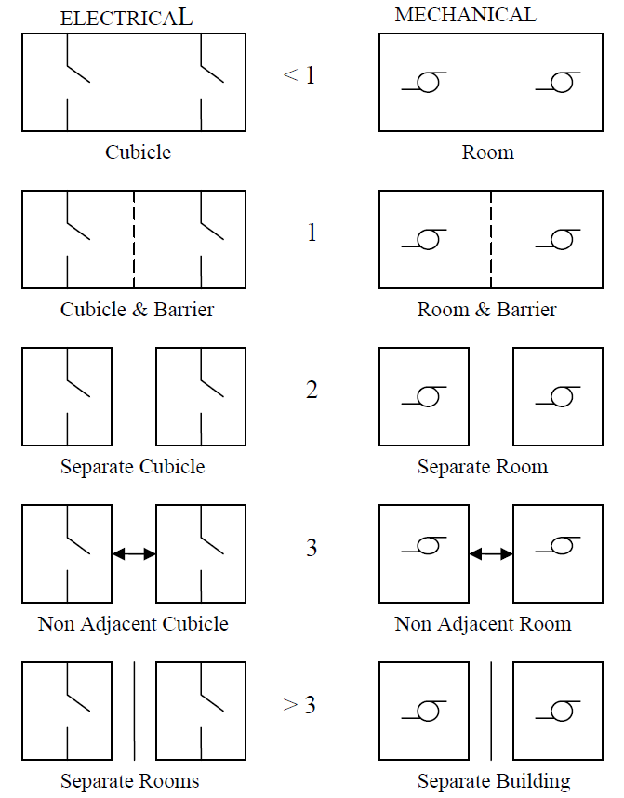
Example of scoring and modified scoring
Physical Separation alone does not influence software failure Unless there is consideration of how that physical separation changes the operational conditions of the components.
Instead of Separation we consider the Input Similarity
HARDWARE Separation Sub-factor Guide [14] | High level Definitions for each defense sub-factor
A | Redundant items, separation less than Level 1
B | Redundant items, separation level 1
C | Redundant items, separation level 2
D | Redundant items, separation level 3
E | Redundant items, separation greater than level 3
Score | R=0 | 0<R<0.5 | 0.5 ≤ R < 1 | R ≥ 1 | Zero source Div. | Partial source Div. | Complete source Div.
A | X |  |  |  | X | X | X
A+ |  | X |  |  | X | X | X
B |  |  | X |  | X
C |  |  | X |  |  | X | X
D |  |  |  | X | X | X
E |  |  |  | X |  |  | X
The input ratio ($R$) is defined: $R=(s−1)/m$ for $s=1$ $R=s/m$ for $s>1$ $m=$ the number of components within the CCCG, $s=$ number of input sources. Diversity columns assess input source diversity.

Slide 33
Modified beta limitation
If $β_{t}=\sum_{1}^{w}{\left(β_{w }\right)}>1$ then dependent failure probability will exceed the total failure probability which is a logical inconsistency. When this occurs, the original authors provide several options.
Currently, we will simply normalize the betas, so they sum to 1.

Slide 34
Regarding IEC 61508
Asymmetry is not discussed. But the beta factor (which is used by IEC 61508 for hardware CCF) does not account for asymmetry.
Software CCF is discussed only in the context of prevention and not quantification
The hardware model differs from Brand’s by applying additional details or questions to provide scoring. They do not rely on the same subfactor scoring. IEC 61508 does not consider a single component as part of multiple CCCGs.
Reference:
International Electrotechnical Commission, "Part 6: Guidelines on the application of parts 2 and 3," in IEC 61508 Functional safety of electrical/ electronic/ programmable electronic safety-related systems, 2 ed., International Electrotechnical Commission, 2010.

