Slide 1
The HUNTER Dynamic Human Reliability Analysis Tool: Procedurally Driven Operator Simulation
  Thomas A. Ulrich, Ronald Boring, Jooyoung Park, Yunyeong Heo, and Jeeyea Ahn
Tom Ulrich
  July 2022

Slide 2
HUNTER Architecture Overview
The HUNTER simulation software supports the ability to execute analyst defined scenarios organized as tasks comprised of procedure steps
Python package supporting csv and json data input and output
Conceptual Model
  Three basic modules
    Individual: What affects person
    performing the task (PSFs)
    Task: What task is being
    performed (procedures)
    Environment: What system is
    being used (plant model)

Slide 3
HUNTER Software Architecture
Dynamic HRA
  Unlike traditional static HRA, model construction requires defining constraints and a suite of all possible human actions organized in a closed and complete system
  Model construction is time consuming (even before considering HRA context)
Analyst workflow based requirements
  Provide expedient task (procedure) model creation and curation
  Provide context construction and mapping to procedures and plant model
  Provide simulation result outputs at various configurable units of analysis

Slide 4
Analyst Workflow for Model Construction and Execution
Construct procedure model
  Assign GOMS primitive
Define context
  Set static and dynamic performance shaping factors
Define the plant model and map procedure and context objects
  Initial starting plant state
  Procedure and PSF objects mappings to plant parameters
Define the simulation configuration
  Run iterations
  Plant Model failure criteria
  Result output unit of analysis
Run the simulation
Analyze results

Slide 5
Procedure data representation in HUNTER v2.0,2.1
Two column emergency post trip response
procedure
Procedure data defined as step/element
Logical outcome and HRA outcome
dictates the path followed for each
simulation run
  Logic must be upheld to proceed
  Evaluation accrues time and repeats
  the step evaluation

Slide 6
Expedient Procedure Entry
Spreadsheet approach affords speed and readability
Procedure element attribute objects
  Step, sub-step, logic (plant parameters), GOMS primitive (HA), PSF
  Each contains multiple parameters and can contain sub-elements
Spreadsheet-based representation options
  Primary key, sub keys (database reference key approach)
    Must keep track of linkages between parent and children
  Nested structure used to define sub-elements
    Columns code the parent and child relationship

Slide 7
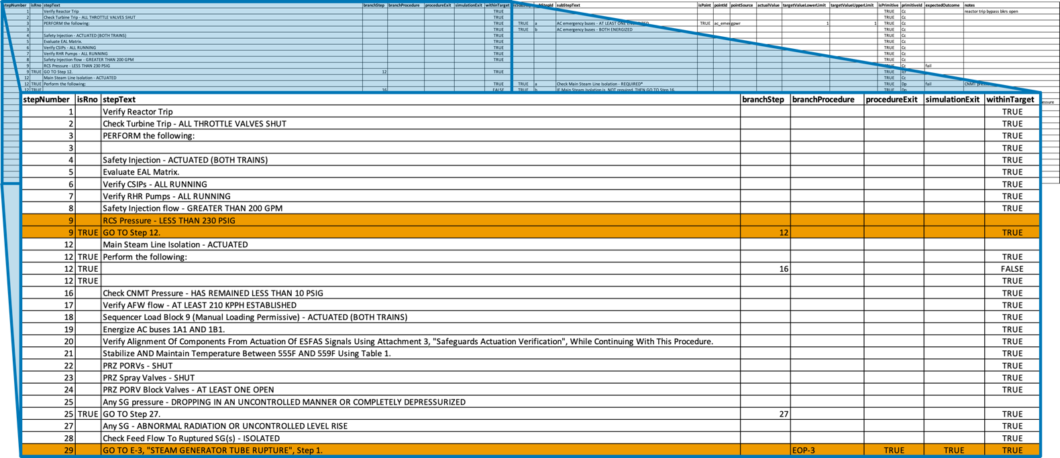
Step Level Entry – with Transitions

Slide 8
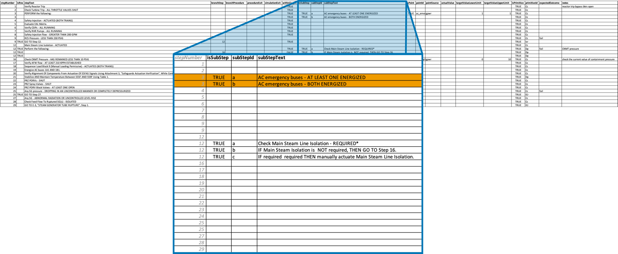
Substep Entry

Slide 9
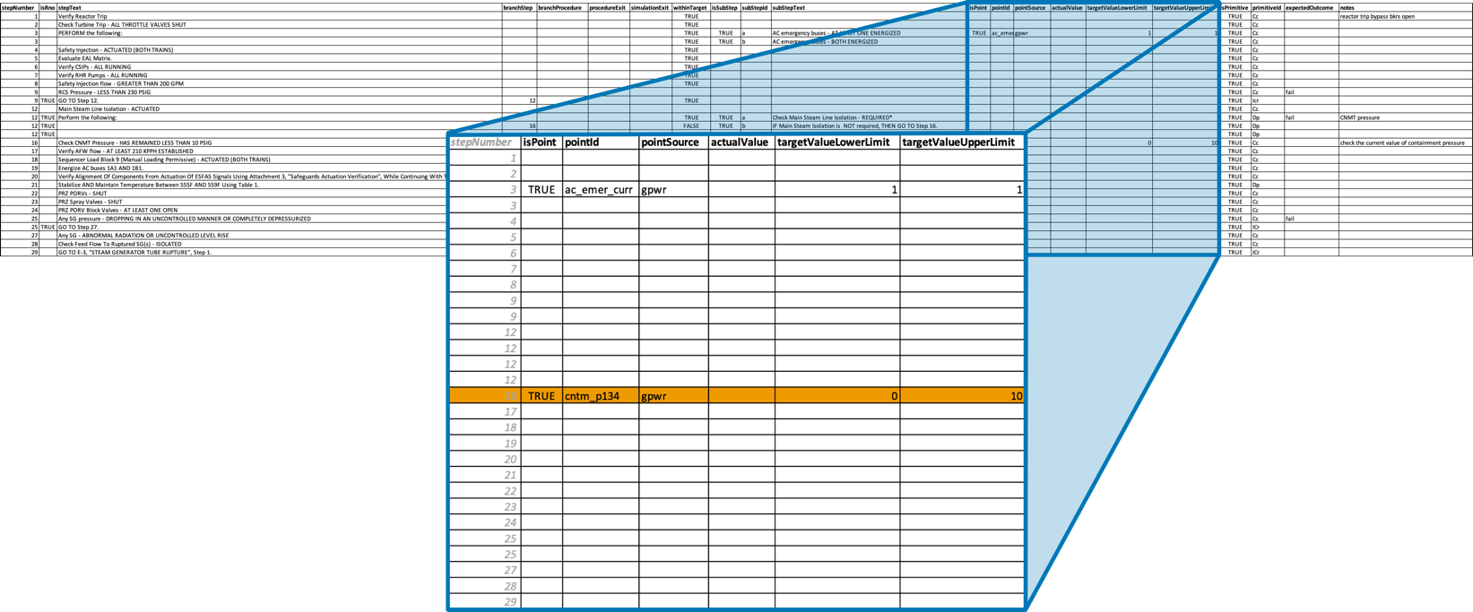
Logic Entry

Slide 10
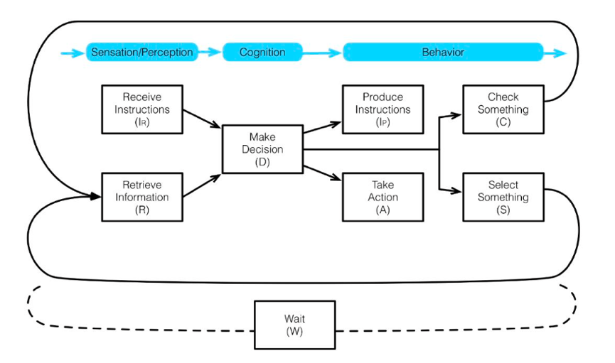
Human Actions – GOMS-Primitives
SHERPA derived suite of basic human actions, i.e. primitives with human error probabilities
Full-scope simulator study derived time distributions for each primitive
Actions (A)—Performing required physical actions on the control boards (A_{C}) or in the field (A_{F})
Checking (C)—Looking for required information on the control boards (C_{C}) or in the field (C_{F})
Retrieval (R)—Obtaining required information on the control boards (R_{C}) or in the field (R_{F})
Instruction Communication (I)—Producing verbal or written instructions (I_{P}) or receiving verbal or written instructions (I_{R})
Selection (S)—Selecting or setting a value on the control boards (S_{C}) or in the field (S_{F})
Decisions (D)—Making a decision based on procedures (D_{P}) or without available procedures (D_{W})

Slide 11
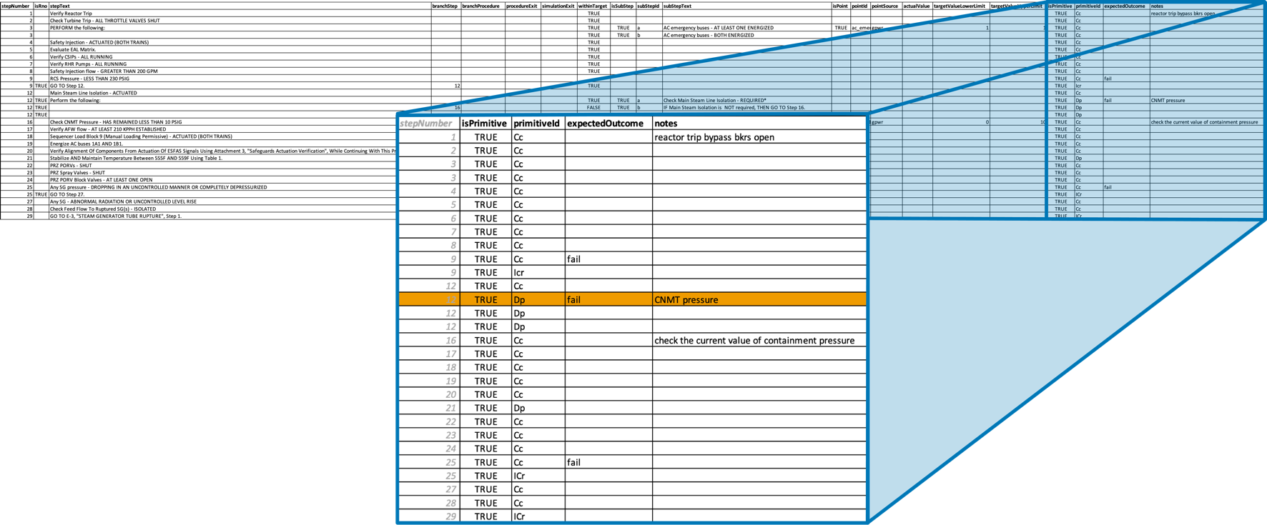
Primitive (fine resolution human actions) entry
GOMS-HRA primitives derived from SHERPA

Slide 12
Scheduler Model Time Step Execution

Slide 13
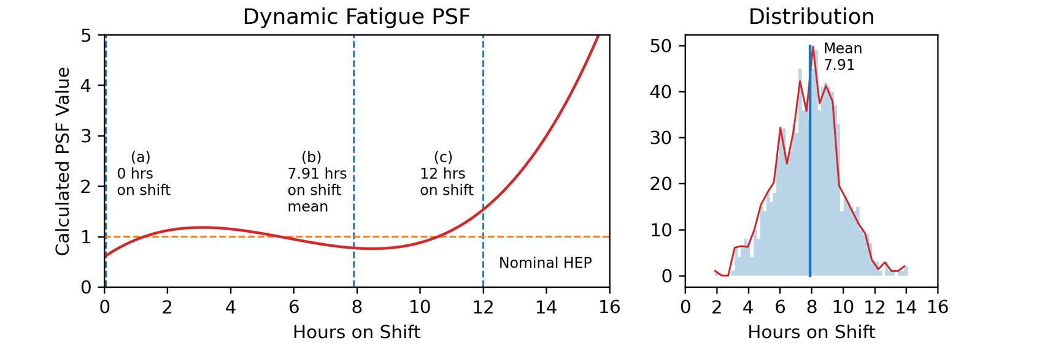
Dynamic PSF Initial Testing – Online Fatigue Calculation
The dynamic fatigue PSF function depicted by the red line the left figure was used to calculate the PSF multiplier value at any given time point based on the cumulative operator hours on shift time. Each simulation began by setting an initial on shift time of (a) zero on shift time, randomly sampled (b) with the associated distribution shown in the right figure, and (c) 12 hours on shift time.

Slide 14

Future Work – HUNTER v3
Coupling with Rancor ROM simulator → greater control/flexibility for plant model
  Computer-based procedure system integration (timing and procedure optimization)
Automatic procedure parsing
  Translate PDF procedure into json (~78% there, large variability in )
Refactored procedure element representations
Better error mode modeling - How do we error?
  Time debt (binary) versus
  Error cascade (errors of commission)
Undergoing Active Development

