Slide 1
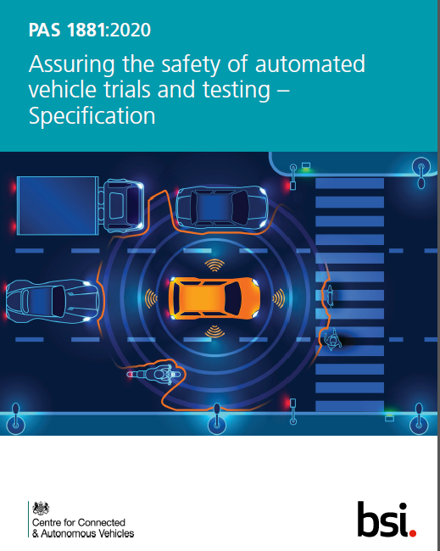
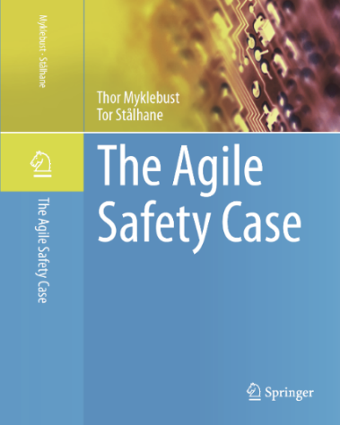
TH14 Safety case for vehicle trial operations
PSAM16
Thor Myklebust
SINTEF Digital

Slide 2
Topics
Introduction
Background
TrustMe project
Standards
Agile safety case for vehicle trial operations
Chapters overview
Main chapters
Conclusion

Slide 3
Introduction
It is essential that the process, including needed evidence for a safety case, are both agile and standardized to ensure confidence and trust by all parties involved.
The objective of this paper is to show how we may ensure that the process, including needed evidence for a safety case, are both agile and standardized to ensure confidence and trust by all parties involved.
The agile approach fits well with the incremental improvement of software for autonomous vehicles, incremental expansion of the operational design domain, and new intelligent roadside units.

Slide 4
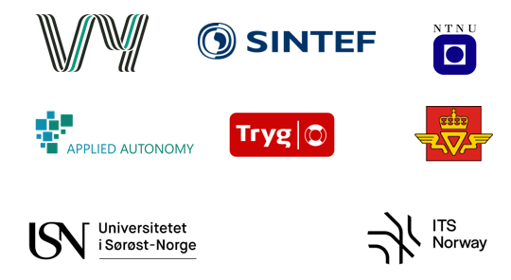
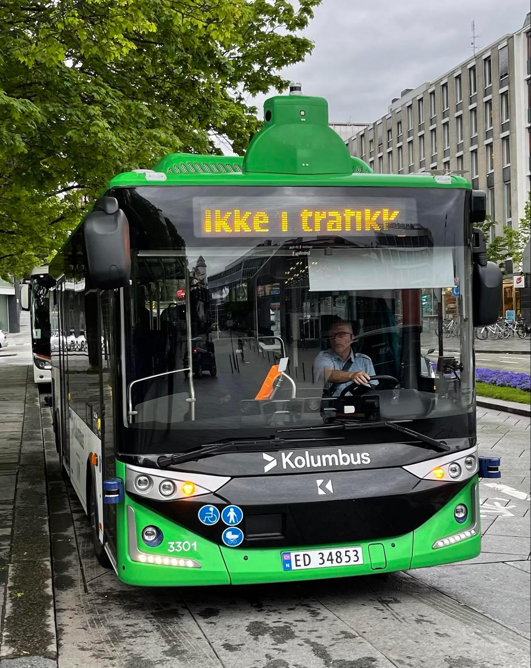
TrustMe project
Started 1st of august 2020
The operator Vy is project owner
Main goal: Develop a Safety case for autonomous busses. ISO 26262 and UL4600 includes requirements for safety case
Sub-Goal 1: Develop a "safety case for the public" that is understandable for the passengers
Sub-Goal 2: Develop a Trust case (relevant information to gain trust, including relevant evidence)
Sub-Goal 3: Arrange seminars. Seminar 4, October 2022
The project last until December 2023

Slide 5
Safety Case
Idea
The idea of a safety case is to
argue as one would in a
court of law –
thus the name safety case.
Names
Safety case
Assurance case
A safety case are structured based on
Claim
Argument: “How do you know” - a request for evidence
Evidence
Evidence without argument is unexplained

Slide 6
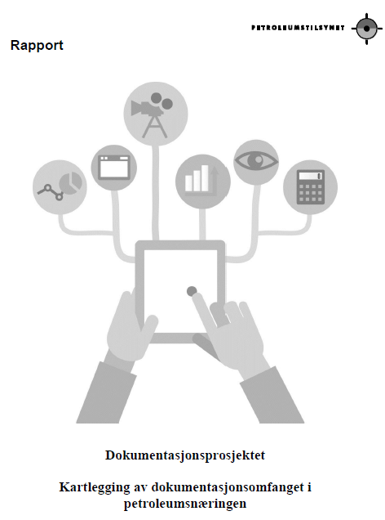
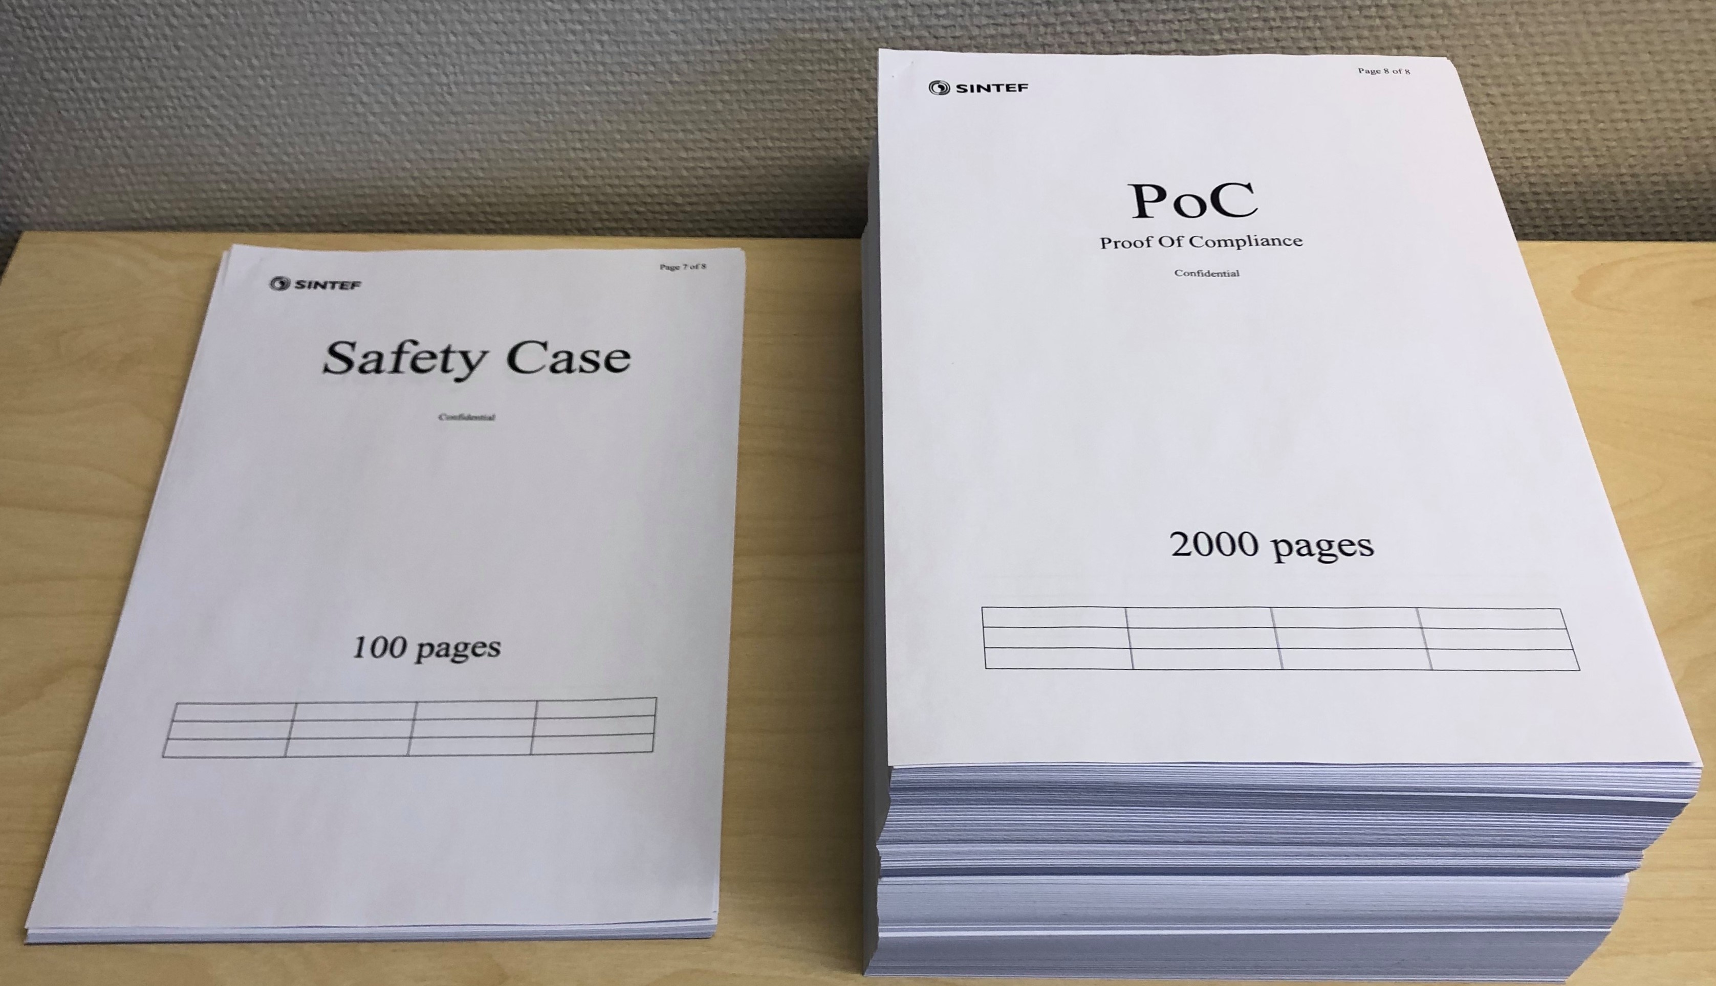
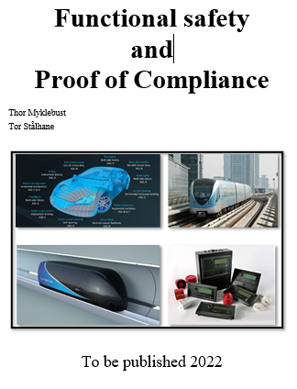
Documentation
Agile:
Only relevant documentation
Easy accessible
Continuous updates (e.g. each sprint)
See the status after each sprint
Reuse
Ptil: Too much documentation is a risk!

Slide 7
Trial operation: Relevant safety case chapters
Introduction, purpose and scope
Automatic/autonomous vehicle system
Operational design domain and test scenarios
Route selection and assessment
Operational risk assessment
Operational guidance
Safety related application conditions (SRAC)
Remote monitoring, operation and control
Security
Security related application conditions, (SecRAC)
Assurance of system safety
Manufacturer, vehicle type, authorisation and license number
Hierarchy of safety cases and related certifications
Vehicle identification number
Software identification number
Vehicle authorisation summary
Modelling and simulator studies
Safety testing and acceptance process
Stakeholder consultation and agreement
Monitoring, reporting and continuous
improvement
14. Summary

Slide 8
1: Introduction, purpose and scope
Include
short description related to the trial, testing or service, including roles together with the involvement of the public.
A few sentences regarding the relevant project
Short information related to purpose and scope together with relevant information based on contract and application documents that should be referenced.
LSAD *** TBD

Slide 9
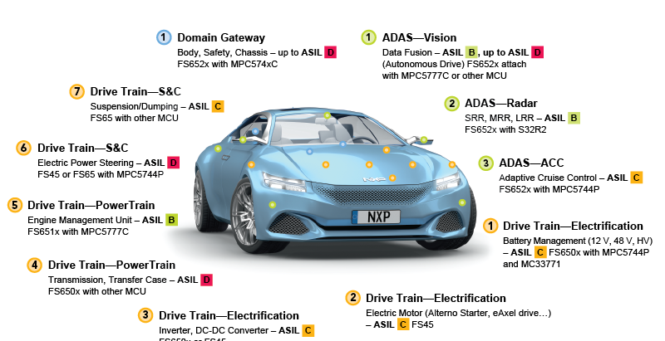
2 Automatic/autonomous vehicle system – Description
A picture or sketch of the product or system should be included
improve the readability and
understanding of the product or system and
can be used to show the vehicle livery (branding applied to a vehicle) and
conspicuity (visibility).
The automatic driving systems that are used must be described.
Often a separate document
Used as basis for hazard analysis when developing the system

Slide 10
3 Operational design domain and test scenarios
Information regarding the ODD including
boundaries
limitations
risk state or
abort condition,
monitoring of ADS behavior
including safety operator interventions and
reliability of operation within ODD
ISAD *** TBD

Slide 11
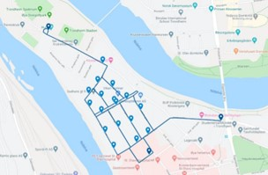
4: Route selection and assessment
Identify the route(s) where the vehicle(s) shall operate.
For testing in the public domain it shall detail how the route(s) were selected.
Detail any changes to infrastructure or street furniture and control measures implemented to minimize the level of risk posed from the vehicle trial

Slide 12
5: Operational risk assessment
The trialling organization shall conduct a suitable and sufficient operational risk assessment.
The safety case shall provide an overview of the methodology used to identify hazards and assess and evaluate all operational risks that are foreseeable for each test scenario.
All affected parties should be included as part of the risk assessment process.

Slide 13
6: Operational guidance - Safety related application conditions, SRAC
Operational guidance documents are required to document safe working practices to be followed to assure safety and security throughout the lifecycle of the trial.
SRACs (Safety Related Application Condition) shall be described:
This section shall define the rules, conditions and constraints relevant to safety which need to be observed in the application of the item/system/vehicle.
Each SRAC shall be linked to at least one hazard

Slide 14
7: Remote monitoring, operation and control
provide sufficient evidence to demonstrate that the safety driver or remote operator can resume full control of the vehicle
safety operator training and competency testing shall be detailed
if the automated vehicle is monitored remotely, the vehicle shall demonstrate that the system is able to deliver the same level of safety, control and response times as an alert and competent safety driver sat in the vehicle’s driving seat
specify what control measures are employed to ensure reliable, safe and secure remote operation, including the integrity and availability of communications and the monitoring and maintenance requirements to ensure that a minimum risk state can always be achieved

Slide 15
8: Security - Security related application conditions, SecRAC
ISO/SAE 21434:2021
The assessment shall include cyber, physical and personnel security and shall include the systems, vehicle, communications, control, monitoring and remote systems.
SecRAC to be included (Security Related Application Conditions)

Slide 16
9: Assurance of system safety
Vehicle authorisation
Ordinary vehicle authorization
Hierarchy of safety cases and related certifications
Related safety cases (underliggende sikkerhetsbevis)
This part shall contain references to the safety cases (or e.g. certificates) of any system, subsystems or equipment on which the system under consideration depends
Vehicle and software identification number

Slide 17
10: Modelling and simulator studies
The safety case shall include information about modelling or simulator testing conducted prior to the trial to support the overall testing programme
the type of model or simulation used
the ODD of the simulation
details of any limitations of the simulator, including any constraints, assumptions or imperfections of the simulation environment
evidence demonstrating validity and reliability of the test results
the technology or scenario tested in the model or simulation, the test objective and test results
details regarding how the results were used including the reliance on the tests for safety assurance
the design of each scenario including operational conditions (for example, traffic flow, vehicle compositions, weather conditions) and the full set of variables within each scenario
a comparison of the simulation environment and ODD, and the intended trial environment and ODD in order to identify any potential differences.

Slide 18
11: Safety testing and acceptance process
The safety case shall include
or make reference to specific tests conducted, test objectives and acceptance criteria.
information regarding the testing being conducted during the trial
ML/AI related documentation
ISO 22737:2021 LSAD
This applies to both safety and security relevant tests

Slide 19
12: Stakeholder consultation and agreement
The safety case shall include a comprehensive list of stakeholders and detail relevant communication and consultation with the identified organizations.
The safety case shall include details of any public education and awareness campaign – see e.g.,
"Safety case for the public" (ESREL 2021 paper)
Trust Case (SAFE paper 2021)
Contact details for the trialling organization and stakeholders consulted shall be included in the safety case (or e.g., the "Safety case for the public").
Approvals and permissions shall be detailed in the safety case, including permissions from landowners, local authorities or licensing agencies to use a route, change the route use or infrastructure, operate the vehicle, or operate a service

Slide 20
13: Monitoring, reporting and continuous improvement
The monitoring being conducted during the trial shall be included in the safety case. The safety case shall include:
the person(s)/role responsible for data capture processes
what data is being collected and how, e.g., via dashcams, sensors, cameras, surveys etc.
how dynamic hazards are monitored, e.g. weather/environment
how the data is being downloaded, stored and analysed
the security of data collection, transfer and storage
any parameters (i.e. start, end, sources etc.) of any logging/monitoring to be stored/saved. This shall also include assurance that data has not been tampered with
the procedure for analysis and reporting of issues that affect trial safety and continuation
the name of a nominated person who is responsible for ensuring compliance to the safety case and to act as a single point of contact for any concerns or questions related to the safety case

Slide 21
13: Monitoring, reporting and continuous improvement
The process for incident and near miss reporting and analysis shall be included in the safety case. Information shall include:
how safety operators identify and report incidents
how incidents and near misses are categorized, for example, emergency, nonemergency, near miss, breakdown, or undesired event
how automatic disengagement for respective automated systems is captured and analyzed
the person(s) responsible for escalating incidents (part of emergency response plan)
the data being captured for the purpose of investigation

Slide 22
13: Monitoring, reporting and continuous improvement
The safety case shall include the process for
learning lessons throughout the trial
ensuring that the safety case is
reviewed,
updated
communicated to reflect learning

Slide 23
Summary
Based on the discussions above, we can make the following important conclusions:
1. We have developed a template (chapter 3) for an agile safety case for trial operations
2. Working with safety cases will increase the stakeholder's safety awareness.
3. A safety cases can be developed incrementally. The trial Safety Case shall be continually updated to provide a record of the progress of the project
Relevant agile approaches are:
MVP (Minimum Viable Product)
incremental development
agile contracts
agile software development process
customer collaboration and
DevOps.

