Slide 1
Use of Preliminary PRA to Inform Decisions During Initial NASA Gateway Development
Teri Hamlin
Gateway PRA Lead, SMA, Teri.l.Hamlin@nasa.gov
6/27/22

Slide 2
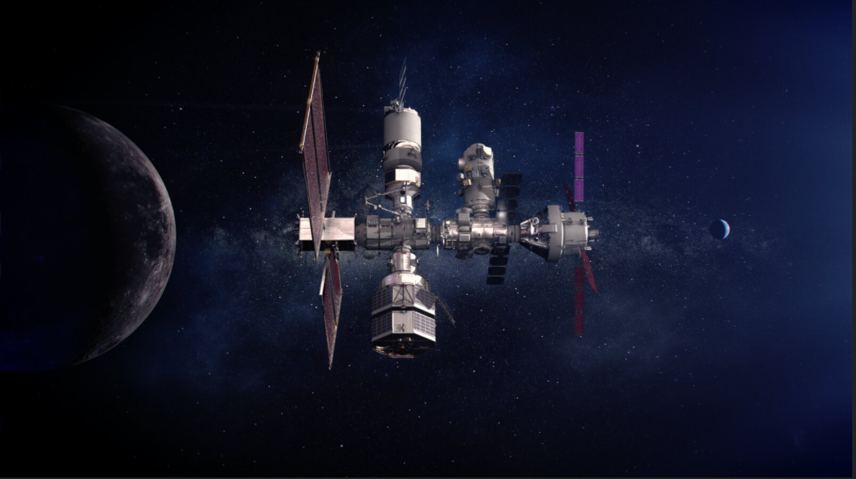
Introduction - Gateway
Gateway will be a lunar outpost that supports missions to the moon and includes several elements/modules developed by NASA and International Partners
The assembly complete Gateway includes
  Power and Propulsion Element (PPE)
  Habitation and Logistics Outpost (HALO) module
  International Habitation (IHAB) module
  Deep Space Logistics (DSL) module
  European Space Agency (ESA) System Providing
  Refueling Infrastructure and Telecommunications
  Refueling Module (ESPRIT-RM)
  Robotic Arm
  Airlock module
Gateway is a critical component of NASA’s Artemis program and is intended to be uncrewed most of its 15-year life
NASA Safety and Mission Assurance (SMA) began supporting Gateway in fall 2017 during initial formulation and continues to support the Gateway Program today

Slide 3
NASA Reference Designs
Early in program formulation before contractors had been selected NASA developed reference designs for Gateway elements/modules. These NASA designs were based upon:
  Assigned functions
  Safety and design requirements
  Historical designs for similar systems
These NASA designs are replaced with actual designs as the contractors are selected and their designs are matured

Slide 4
Gateway Preliminary PRA
High-level model that utilizes data and models from previous spacecraft PRAs such as those developed for the International Space Station (ISS) or Orion
  Each Gateway element/module is broken down by contributions from
    Critical system (e.g., Power, Thermal Control System (TCS), Avionics etc.)
    Phenomenological failure (e.g., Micro-Meteoroid and Orbital Debris (MMOD), Fire, tank rupture etc.)
    Human error
    Software
  PRAs from previous programs were manipulated to represent the NASA designs (e.g., ISS is two failure tolerant to loss of a system but Gateway only single failure tolerant the models were pruned to eliminate a leg of failure tolerance)
Two end states
  Loss of Crew (LOC)
    All credible, quantifiable events that result in death of or permanent debilitating injury to one or more crew members initiated by Gateway from crew entering the rendezvous sphere of Gateway to crew departure from the sphere.
    Evaluated per mission
  Loss of Mission (LOM)
    All credible, quantifiable events that result in the loss of a defined major mission objective (as agreed to be the Gateway Program) initiated by Gateway such as LOC, Loss of Gateway, Inability to dock of a major element, etc.
    Evaluated for 1 year (expected flight rate to Gateway)

Slide 5
Micro-Meteoroid and Orbital Debris (MMOD) Requirement
In lunar orbit, Gateway is exposed to impacts from Meteoroids which could result in LOC or LOM
To mitigate this risk and to ensure a robust design Gateway has a Probability of No Penetration (PNP) requirement similar to ISS (i.e., MMOD requirement)
  Varies in magnitude depending upon the size and duration of exposure
    Larger permanent elements/modules are allowed to have higher overall risk than smaller temporary elements/modules but set a consistent requirement per square meter/year
  Initially based upon based upon ISS visiting vehicle requirement
    Gateway was planned to be smaller than ISS and therefore could accept higher risk per element/module
Gateway grew in size and preliminary MMOD risk estimates showed significant margin to the requirement
  Requirement was re-visited

Slide 6
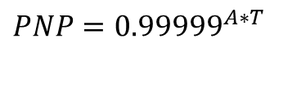
Micro-Meteoroid and Orbital Debris (MMOD) Requirement (2)
Initial PNP Requirement
Updated PNP Requirement
$$PNP={0.99998}^{A∗T}$$
$PNP={0.99999}^{A∗T}$
A equals the critical surface area in square meters
T equals the exposed time in years
Equation sets the requirement value which is then verified by MMOD analysis
  Verification is successful when the results of the MMOD analysis meets or exceeds the calculated requirement value
Gateway Risk Reduction with Updated MMOD (PNP) Requirement
 | MMOD % Change | Gateway % Change
LOC (30 days) | 50% decrease | 21% decrease
LOM (1 year) | 50% decrease | 8.3% decrease
Risk trade was brought forward to the Gateway Program and MMOD requirement was changed

Slide 7
Habitable Volume Valves Remote Isolation Capability
All crewed spacecraft have valves which connect the internal pressurized habitable volume to the vacuum of space
  Positive Pressure Relief Valves (PPRVs) provide protection in the event of an overpressure event
  Vent Valves are nominally used to vent overboard
These valves provide potential leakage paths which could exceed the capability of the pressure control system and result in Gateway depressurization
  For crew tended vehicle such as ISS, caps can be installed by the crew in the event of such leaks
  Gateway is uncrewed most of the year therefore caps would only mitigate a fraction of the risk
In early NASA designs it was not clear whether there would be a capability to isolate these valves remotely
  There was no specific requirement but a general requirement for fault isolation and recovery
Gateway preliminary PRA model was utilized to show the importance of having remote isolation capability
  Without remote isolation Gateway depressurization would have been a top LOM risk driver
  Risk per PPRV is reduced by ~99% with this capability

Slide 8
Thermal Control System (TCS) Configurations
Gateway PRA Team worked with engineering to evaluate six TCS configurations
  Three associated with dual external and internal loops (dual)
  Three associated with dual external and single internal (dual/single)
Interface Hx (IFHX) is where internal and external cooling loops interface
Cross-strapping the internal loops allow for internal loops to utilize heat rejection capability of the other module in the event of dual external loop failure
  Fluid exchange cross-strap physically connects the two module internal loops
    Potentially mitigating both internal and external loop failures
  Heat exchanger cross-strap maintains separation of the internal loops
    Only mitigates external loop failures
Dual External and Internal Loops (Dual)
Dual External and Single Internal (Dual/Single)

Slide 9
Thermal Control System (TCS) Cross-Strap Capability
Summary of LOM Results for TCS Configurations
 | Gateway TCS LOM % Change | Gateway LOM % Change
No Cross- Strap (Dual) | N/A | N/A
Dual Fluid Cross Strap (Parallel) | 51% decrease | 3.5% decrease
Dual Hx Cross Strap | 34% decrease | 2.4% decrease
No Cross Strap (Dual/Single) | 100% increase | 7% increase
Dual/Single Fluid Cross Strap (Parallel) | 24% decrease | 1.6% decrease
Dual/Single Hx Cross Strap | 71% increase | 5% increase
Although dual fluid exchange cross-strapping provided the biggest risk reduction the dual Hx cross-strap option was selected for implementation
  Fluid exchange cross-strapping would have been more difficult to implement
Follow up risk trades were performed with detailed modeling of each of the modules designs as the heat exchanger cross-strapping requirements were defined

Slide 10
LOC/LOM Trending and Mission Duration
Gateway LOC Trend (Normalized)
Gateway LOM Trend (Normalized)
Gateway PRA supports the Gateway Program Integrated Analysis Cycles (IACs) and trending those assessments provides insight into how risk estimates have changed since initial formulation. Changes can be the result of
  Changing Gateway architecture (e.g., eliminating a module or a capability)
  Design maturity (e.g., replacing surrogate models with detailed models of providers designs)
  Data maturity (e.g., availability of operational data)
Mission duration is a major factor in LOC/LOM assessment
  Longer crewed mission could result in lower LOM due to increased capability to perform corrective maintenance

Slide 11
Conclusion
Gateway Program has utilized a preliminary PRA built from previous spacecraft PRAs to inform decisions on requirements and design options
  MMOD and habitable volume valves remote isolation risk trades are examples of how the preliminary PRA was used to inform design requirements
  TCS risk trade is an example of how the preliminary PRA was used to inform design options
Trending has shown how the Gateway LOC and LOM estimates have change over time and the impact of mission duration changes
  The preliminary PRA is being replaced over time with detailed modeling using more traditional PRA techniques as designs become more mature.

