Slide 1
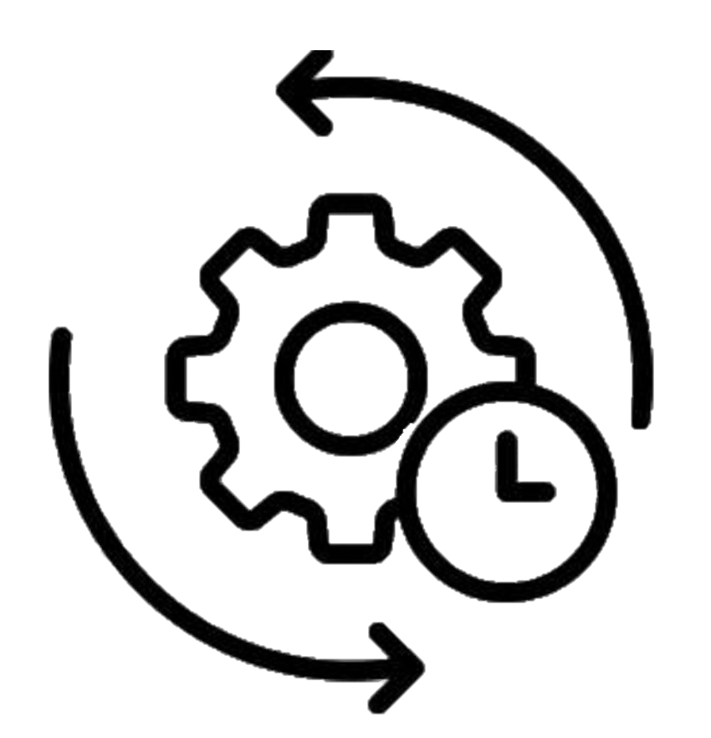
Institute of Machine Components
Reliability Department
A Machine Learning Approach to Enhance the Information on Suspensions in Life Data Analysis
Probabilistic Safety Assessment and Management
PSAM 16
June 27, 2022, Honolulu, Hawaii
Tamer Tevetoğlu, M.Sc

