Slide 1
Applying a Genetic Algorithm for Finding the Worst Scenario during Post-Disaster Recovery of Water Distribution Networks
Shunichi Tada, Taro Kanno, Kazuo Furuta
the School of Engineering, the University of Tokyo

Slide 2
Contents
Introduction
Proposed method: Scenario GA
Results & discussion
Conclusion

Slide 3
Introduction

Slide 4
Background
Water distribution network (WDN)
- Important infrastructure used by many individuals/organizations.
Fast and efficient recovery during post-disaster period is necessary.
For strategies and training,
Simulation-based optimization
interpretability & comprehensiveness
Used for
Develop restoration strategies
Evaluate restoration strategies
Train practitioners
is critical.
Requirements for our simulation:
Interdependencies with other city functions
High interpretability of planning
Worst assumption among various situations
Issues:
Simple simulation model
Low interpretability of planning
Fixed scenarios

Slide 5
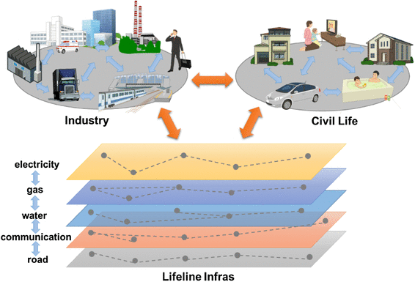






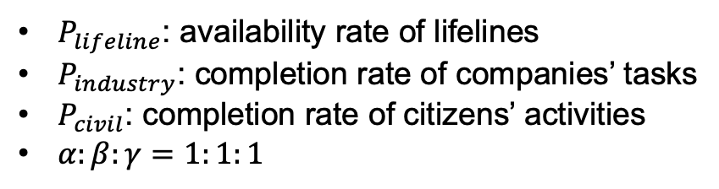
Simulation of post-disaster recovery of WDNs
Main pipe
Evacuation site
Branch pipe
Water source
WDN
Civil life
Industry
Modeling framework of an urban city^{[1]}
Representation of WDN
Evaluation: performance of the city
$$P_{city}=α × P_{lifeline}+β × P_{industry}+γ × P_{civil}$$
[1] Kanno, T., Koike, S., Suzuki, T., and Furuta, K. Human-centered modeling framework of multiple interdependency in urban systems for simulation of post-disaster recovery processes. Cogn Tech Work 21, 301–316 (2019).
  $P_{lifeline}$: availability rate of lifelines
  $P_{industry}$: completion rate of companies’ tasks
  $P_{civil}$: completion rate of citizens’ activities
  $α:β:γ=1:1:1$

Slide 6



Performance from resilience perspective
$$P_{city}=α × P_{lifeline}+β × P_{industry}+γ × P_{civil}$$
$$t_{0}$$
$$t_{f}$$
Normal state
t
$$P_{x}$$
Performance
Restoration
Sub-system performance(t)

Slide 7


Restoration model and optimization method
Restoration plan
Evacuation site
Squad A | 1 | 2 | 5 | 3
Squad B | 4 | 7 | 6
Water source
1
5
6
4
2
3
7
Squad A
Squad B
Heuristic-based optimization^{[2]}: Interpretable strategies
Repair priority
Upstream
Important facility
Main pipe
Many houses
Task assignment
Short duration
Close distance
Area-intensive
[2] Wakayama, K., Kanno, T., Yuji, K., Takahashi, H., Furuta, K. Comparison of the Post-Disaster Recovery of Water Supply System by GA Optimization and Heuristics. Proceedings of the 30th ESREL and the 15th PSAM Conference, (2020).
Different combination of heuristics = Different strategies

Slide 8
Objective
Develop a method for exploring the worst damage distribution of WDN.
Scenario GA
Situations surrounding the WDN restoration
Resource scenario
  Restoration squads
  Stockpiles
  Heavy-machineries
Damage scenario
  Number of damaged pipes
  Distribution of damaged pipes
Reflect the real data
Estimated from past events
Uncertain

Slide 9
Scenario GA

Slide 10
Scenario GA: overview
We applied the genetic-algorithm (GA) for the scenario exploration.
  One individual = one damage scenario (Number + Distribution)
  Used our previous simulation model and heuristic-based optimization method
  to calculate individuals’ fitness.
Aims:
  Explore the worst damage scenario.
  Obtain a set of scenarios with various performance.
  = different difficulties
  Analyze the worse scenarios to obtain bottlenecks.
Utilize for training
Improve strategies

Slide 11
Scenario GA: genotype and phenotype
Genotype
  Chromosome: one scenario
  Gene: one damaged pipe
Phenotype
  Damaged WDN
Run simulation and get performance.

Slide 12


Scenario GA: fitness function
In GA, individuals are updated to get individuals with higher fitness.
To explore a scenario with the worst performance ($0≤P_{city}≤1$),
the fitness is calculated by:
  $fitness=1−P_{city}$
Performance
Fitness
Generation
Generation
$$P_{city}=α × P_{lifeline}+β × P_{industry}+γ × P_{civil}$$

Slide 13
Scenario GA: genetic operators
Operator | Method
Reproduction | Elitism selection Roulette-wheel selection
Crossover | Uniform selection
Mutation | Randomly change genes of randomly selected individual

Slide 14
Results & Discussions

Slide 15
Settings
Attributes of the simulation
Parameters of the Scenario GA
Attributes | Values
Number of pipes | 4610
Number of reservoirs | 1
Number of repair teams | 13
Number of citizens | 6990
- Non-worker citizens | 3064
- Industry worker citizens | 3768
- Lifeline worker citizens | 20
- Repair worker citizens | 105
- Truck worker citizens | 33
Simulation duration | 30 days
Parameters | Values
Length of chromosome | 100
Generation | 100
Population | 100
Rate of elite selection: | 0.2
Rate of roulette wheel selection: | 0.5
Rate of crossover: | 0.3
Rate of mutation: | 0.1
Fixed order of heuristics
Repair priority
1. Upstream → 2. Important facility → 3. Main pipe → 4. Many houses
Task assignment
1. Short duration → 2. Close distance → 3. Area intensive

Slide 16
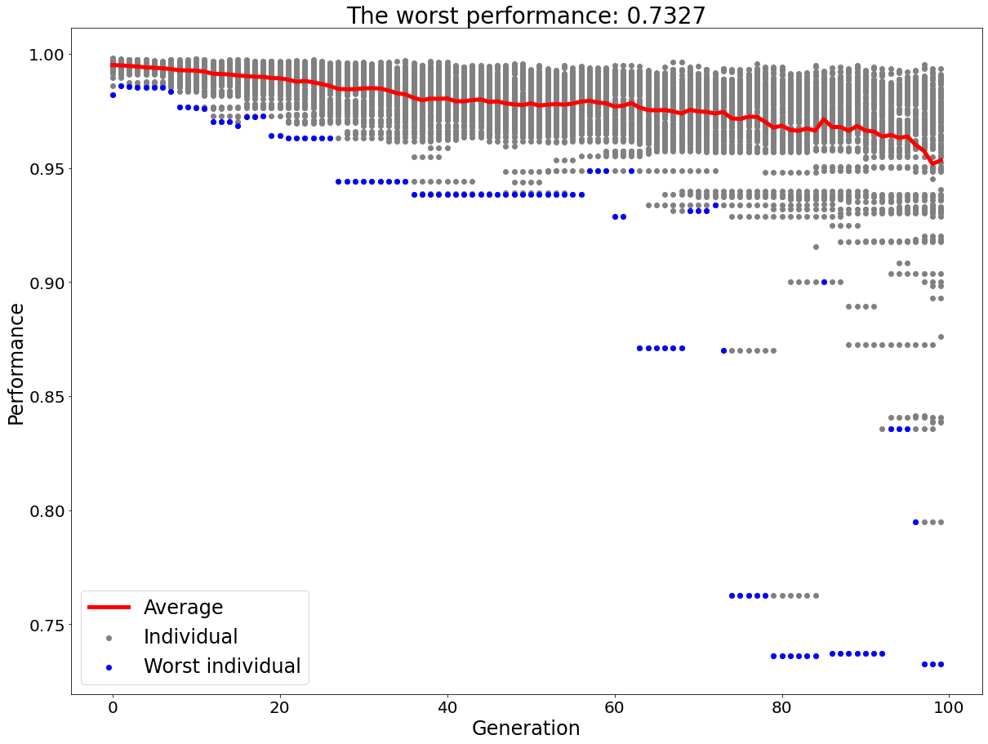
Result: with worse performance
Variety of performances
0.7327: likely to be the worst

Slide 17
Discussion: analysis of the obtained scenarios
Squads’ initial position
Squads
#1979
1st prioritized
Closest to squads’ initial position
#961
Water source
#1595
3rd prioritized
Main pipes shared
in the worst scenarios
Critical for citizens in the area
Closest to the water source
#838, #873, #961, #1595,
#1979, #2748
#873
2nd prioritized
Area with
5 evacuation sites
& 700 citizens
Issue:
Current heuristics are not efficient for this situation.
#838
Part of WDN

Slide 18
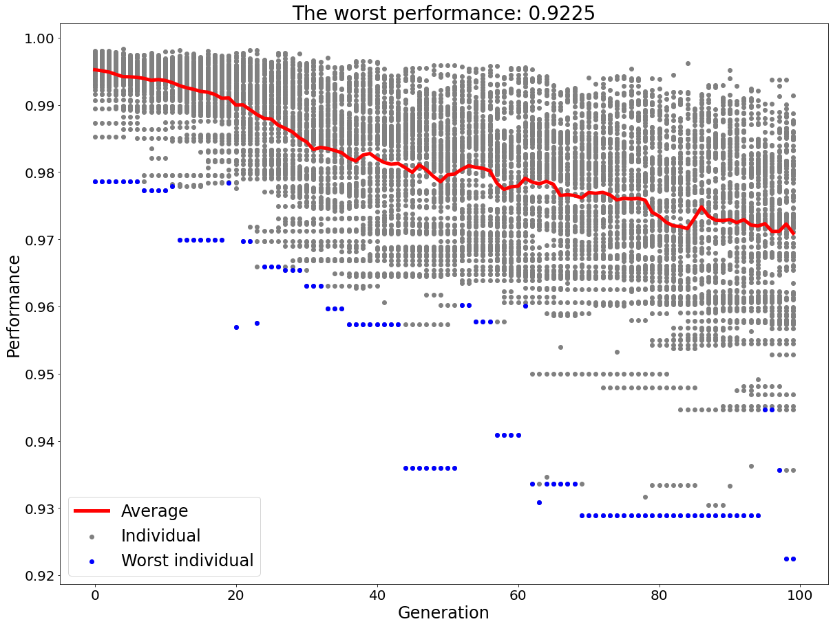
Result: without worse performance
0.9225: not so bad

Slide 19

Discussion: exploration efficiency
Search space in this problem:
$${}_{4610}^{}{C_{100}≈8.5×{10}^{207}}$$
Parameters of GA exploration:
Generation: 100
Population: 100
Only 10000 scenarios were explored.
Rate of crossover: 0.3
Rate of mutation: 0.1
Most of scenarios were not changed.
Issue:
Need for parameter-tuning

Slide 20
Conclusion

Slide 21
Conclusion
Exploration of the worst scenario was successfully done.
Scenarios with different difficulties were obtained.
  They can be utilized for training scenarios
Critical pipes in restoration process were found.
  They can be utilized for improving restoration strategies

Slide 22
Future studies
Parameter tuning of the Scenario GA
Analysis between bad and good scenarios
Exploration with multiple restoration strategies
Collaboration with the exploration of heuristic

Slide 23
Thank you for your listening!

