Slide 1
RISK-INFORMED SYSTEMS ANALYSIS (RISA) – Projects and Value to the Industry
Lana Lawrence
Svetlana.Lawrence@inl.gov
PSAM-16 Conference
June 2022

Slide 2
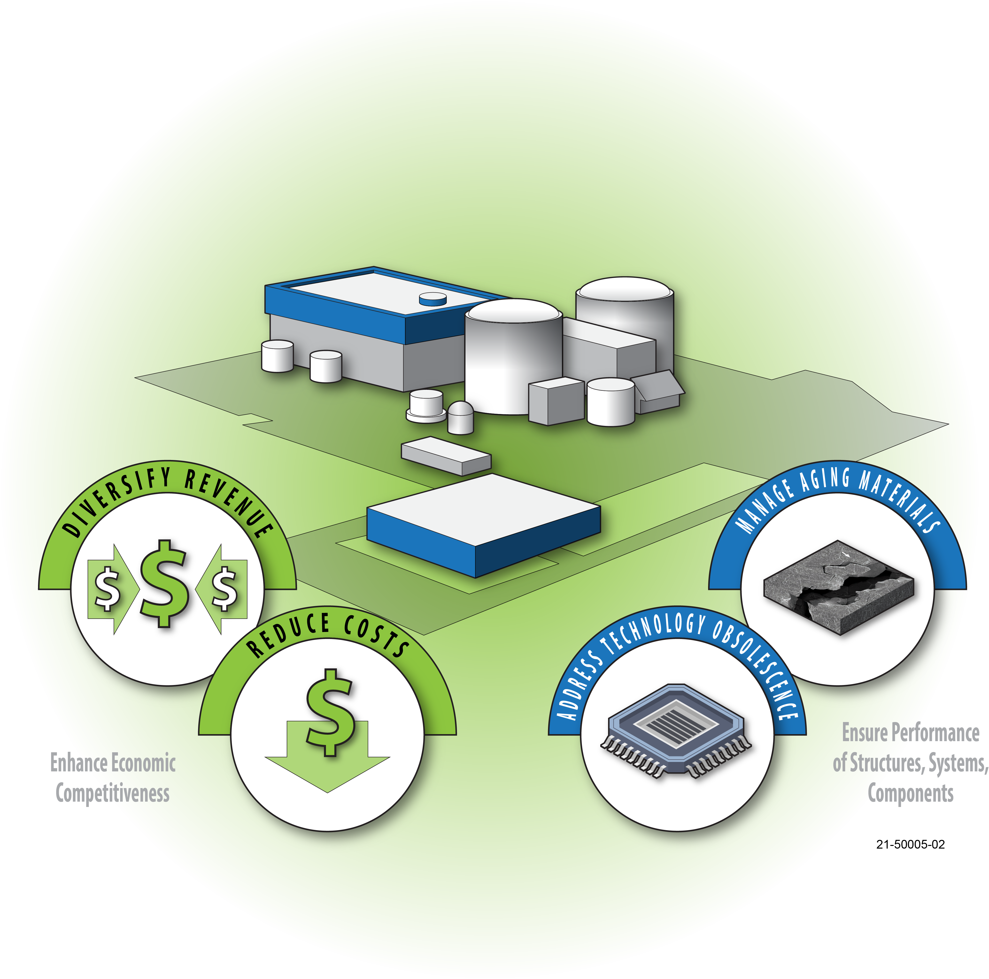
Light Water Reactor Sustainability Program (LWRS)
LWRS Goal:
Enhance the safe, efficient, and economical performance of our nation's nuclear fleet and extend the operating lifetimes of this reliable source of electricity
Plant Modernization
Enable plant efficiency improvements through a strategy for long-term modernization
Flexible Plant Operation & Generation
Enable diversification of light-water reactors to produce non-electrical products
Risk Informed System Analysis
Develop analysis methods and tools to optimize safety and economics
Materials Research
Understand and predict long-term behavior of materials
Physical Security
Develop technologies to optimize physical security
Notes:
Plant Modernization: R&D to address nuclear-plant economic viability in current and future energy markets through innovation, efficiency gains, and business-model transformation using digital technologies. The resulting R&D products will enable nuclear power plant owner-operators, vendors, and suppliers to modernize plant systems and processes and transition to a technology-centered business-model that achieves improved performance at lower cost.
Flexible Plant Operation and Generation: R&D to identify opportunities and develop methods for light-water reactors to directly supply energy to industrial processes to diversify approaches to revenue generation. Plant modernization was looking to reduce O&M costs while this area is looking to increase revenue opportunities.
Adapt and use analysis tools developed by DOE to complete technical and economic assessments
Engineering development and design, testing, and demonstration of integrating nuclear power plants with other industrial processes
Pertinent safety assessments and licensing approaches
Risk-informed Systems Analysis: R&D to develop and deploy risk-informed tools and methods to achieve high levels of safety and economic efficiencies.
These tools and methods were developed throughout the last eight years with a focus on coupling (a) risk-assessment (probabilistic) and (b) systems margin quantification (deterministic) to achieve very accurate modeling and representation of margins for the long term benefit of nuclear power plants.
Materials Research: R&D to develop the scientific basis for understanding long-term environmental degradation and predicting the performance of materials in nuclear power plants.
Research in this area addresses the scientific research gaps identified in the DOE and NRC Expanded Materials Degradation Assessment (EMDA, NUREG CR-7153) for extended reactor operations.
Physical Security: R&D to develop methods, tools, and technologies to optimize and modernize a nuclear facility’s security posture.
(1) conduct research on risk-informed techniques
(2) apply advanced modeling and simulation tools
(3) assess benefits from proposed enhancements and novel mitigation strategies
(4) enhance and provide the technical basis for stakeholders to employ new security methods, tools, and technologies.

Slide 3
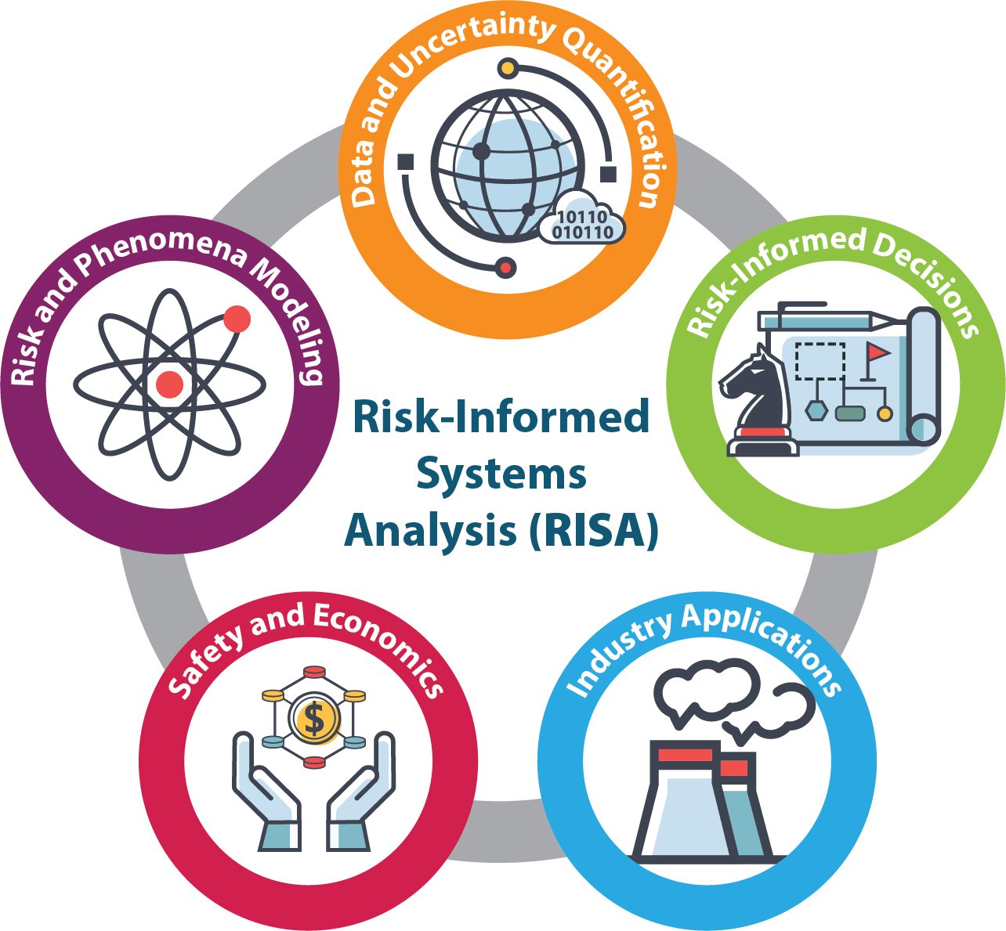
Risk-Informed Systems Analysis (RISA)
Objective (the what)
R&D to optimize safety margins and minimize uncertainties to achieve economic efficiencies while maintaining high levels of safety
Approach (the how)
Provide scientific basis to better represent safety margins and factors that contribute to cost and safety
Develop new technologies that reduce operating costs
Areas of Expertise
Advanced modeling of physics-based phenomena
Thermal-hydraulics, neutronics and reactor physics, risk-informed material degradation, uncertainty propagation
Advanced Data Analytics and Digital Modeling
Diagnostic and prognostic analyses, resource optimization, AI/ML technologies, digital twins, uncertainty propagation
Probabilistic Risk Assessment (PRA) and Human-Reliability Analysis (HRA)
RISA Framework

Slide 4
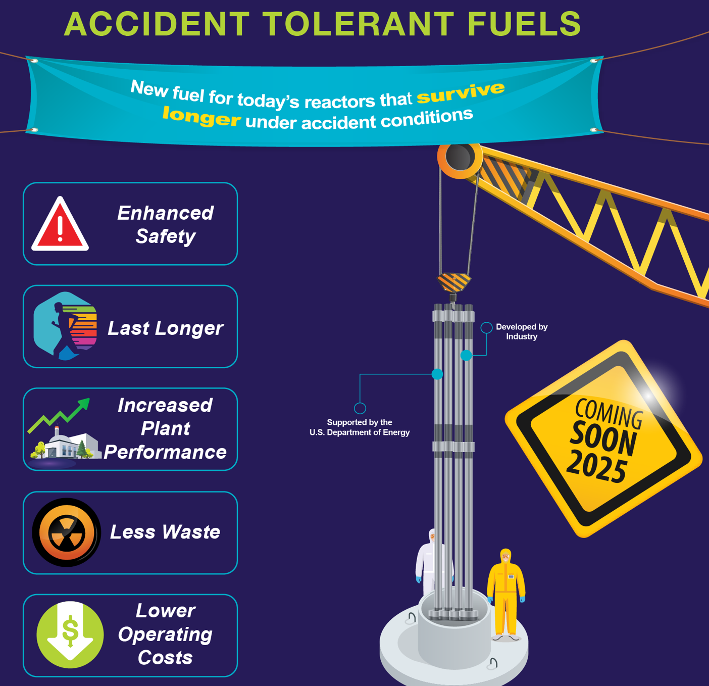
Evaluations of accident-tolerant fuel (ATF) with Higher Burnup
Objectives:
Safety assessments of ATFs with increased enrichment and higher burnup (HBU)
Specific focus of addressing Fuel Fragmentation, Relocation, and Dispersal (FFRD) issue
Support of regulatory approvals of HBU ATFs
Risk-Informed approach is seen as the most likely pathway to regulatory approvals
Benefits of HBU ATF Implementation:
Economic gains via extended refueling cycle
Reduced fuel costs due to better utilization of fuel in the reactor core
Reduced costs for spent fuel processing
Image Credit: U.S. Department of Energy

Slide 5
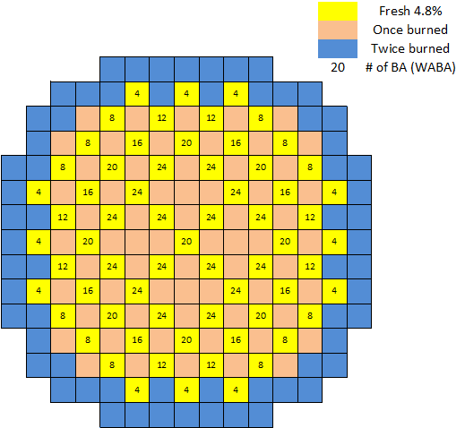
Plant Reload Optimization
Objectives:
All-inclusive integrated framework for fuel reload analyses
Optimization of core configuration to minimize new fuel volume
Benefits:
5-10% reduction in new fuel cost
Innovative core load analysis framework
Traditional methods (developed decades ago) are labor-intensive and time-consuming
Explicit consideration of flexible power output operations
Framework supports ATFs, high burnup and longer cycle
Since already transitioning to ATFs, why not implement more efficient reload analysis tools at the same time?
Configuration of Reactor Core

Slide 6
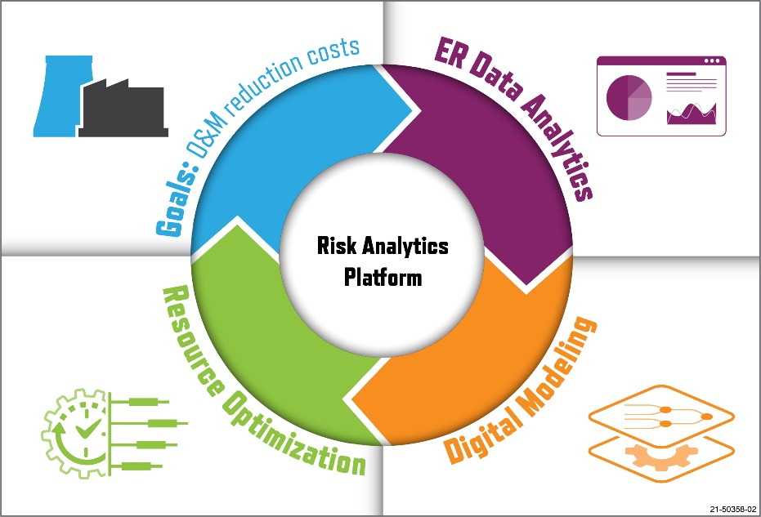
Risk-Informed Asset Management
Objectives:
Optimization of plant health monitoring and asset management to lower O&M costs
Provide information about system performance in clear and effective way
Benefits:
Reduced O&M Costs
Enhanced system performance
Optimized plant resources
Reduced Capital Costs
Effective reliability / ageing management
Support of decision-making processes related to system performance
Detailed information available to systems engineers and plant management
Data
Models
Decisions
Methods
Risk-Informed Asset Management Conceptual Framework
Risk-Informed Asset Management: Integrated Processes

Slide 7
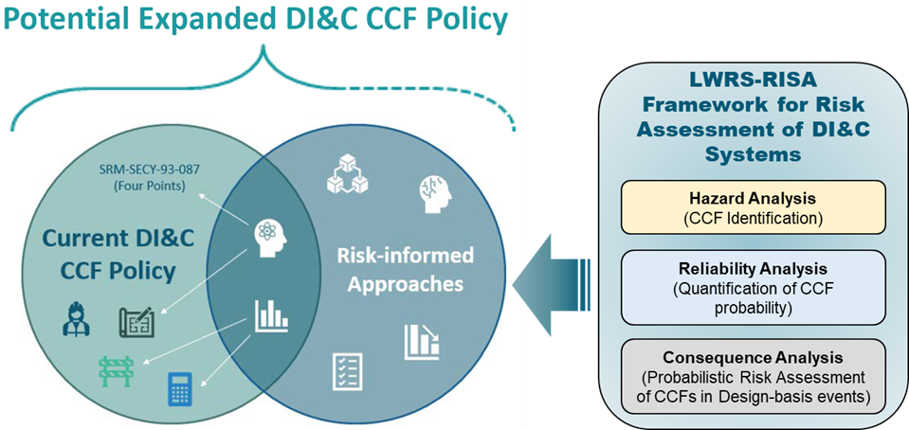
Risk Assessment of Digital I&C Systems
Objectives:
Develop an integrated platform for risk assessments of Digital I&C Systems
Support Risk-Informed approaches
Left: The NRC staff’s plan to expand the current NRC policy for addressing CCFs
Right: Risk-informed capabilities developed in RISA framework for risk assessment of digital systems.
Benefits:
Potential elimination of the requirement for diverse systems to mitigate consequences of CCFs
An approach to evaluate various system architectures
Allows to find a “Good Enough” system design
Reduce efforts for validation and testing of safety-related DI&C systems

Slide 8
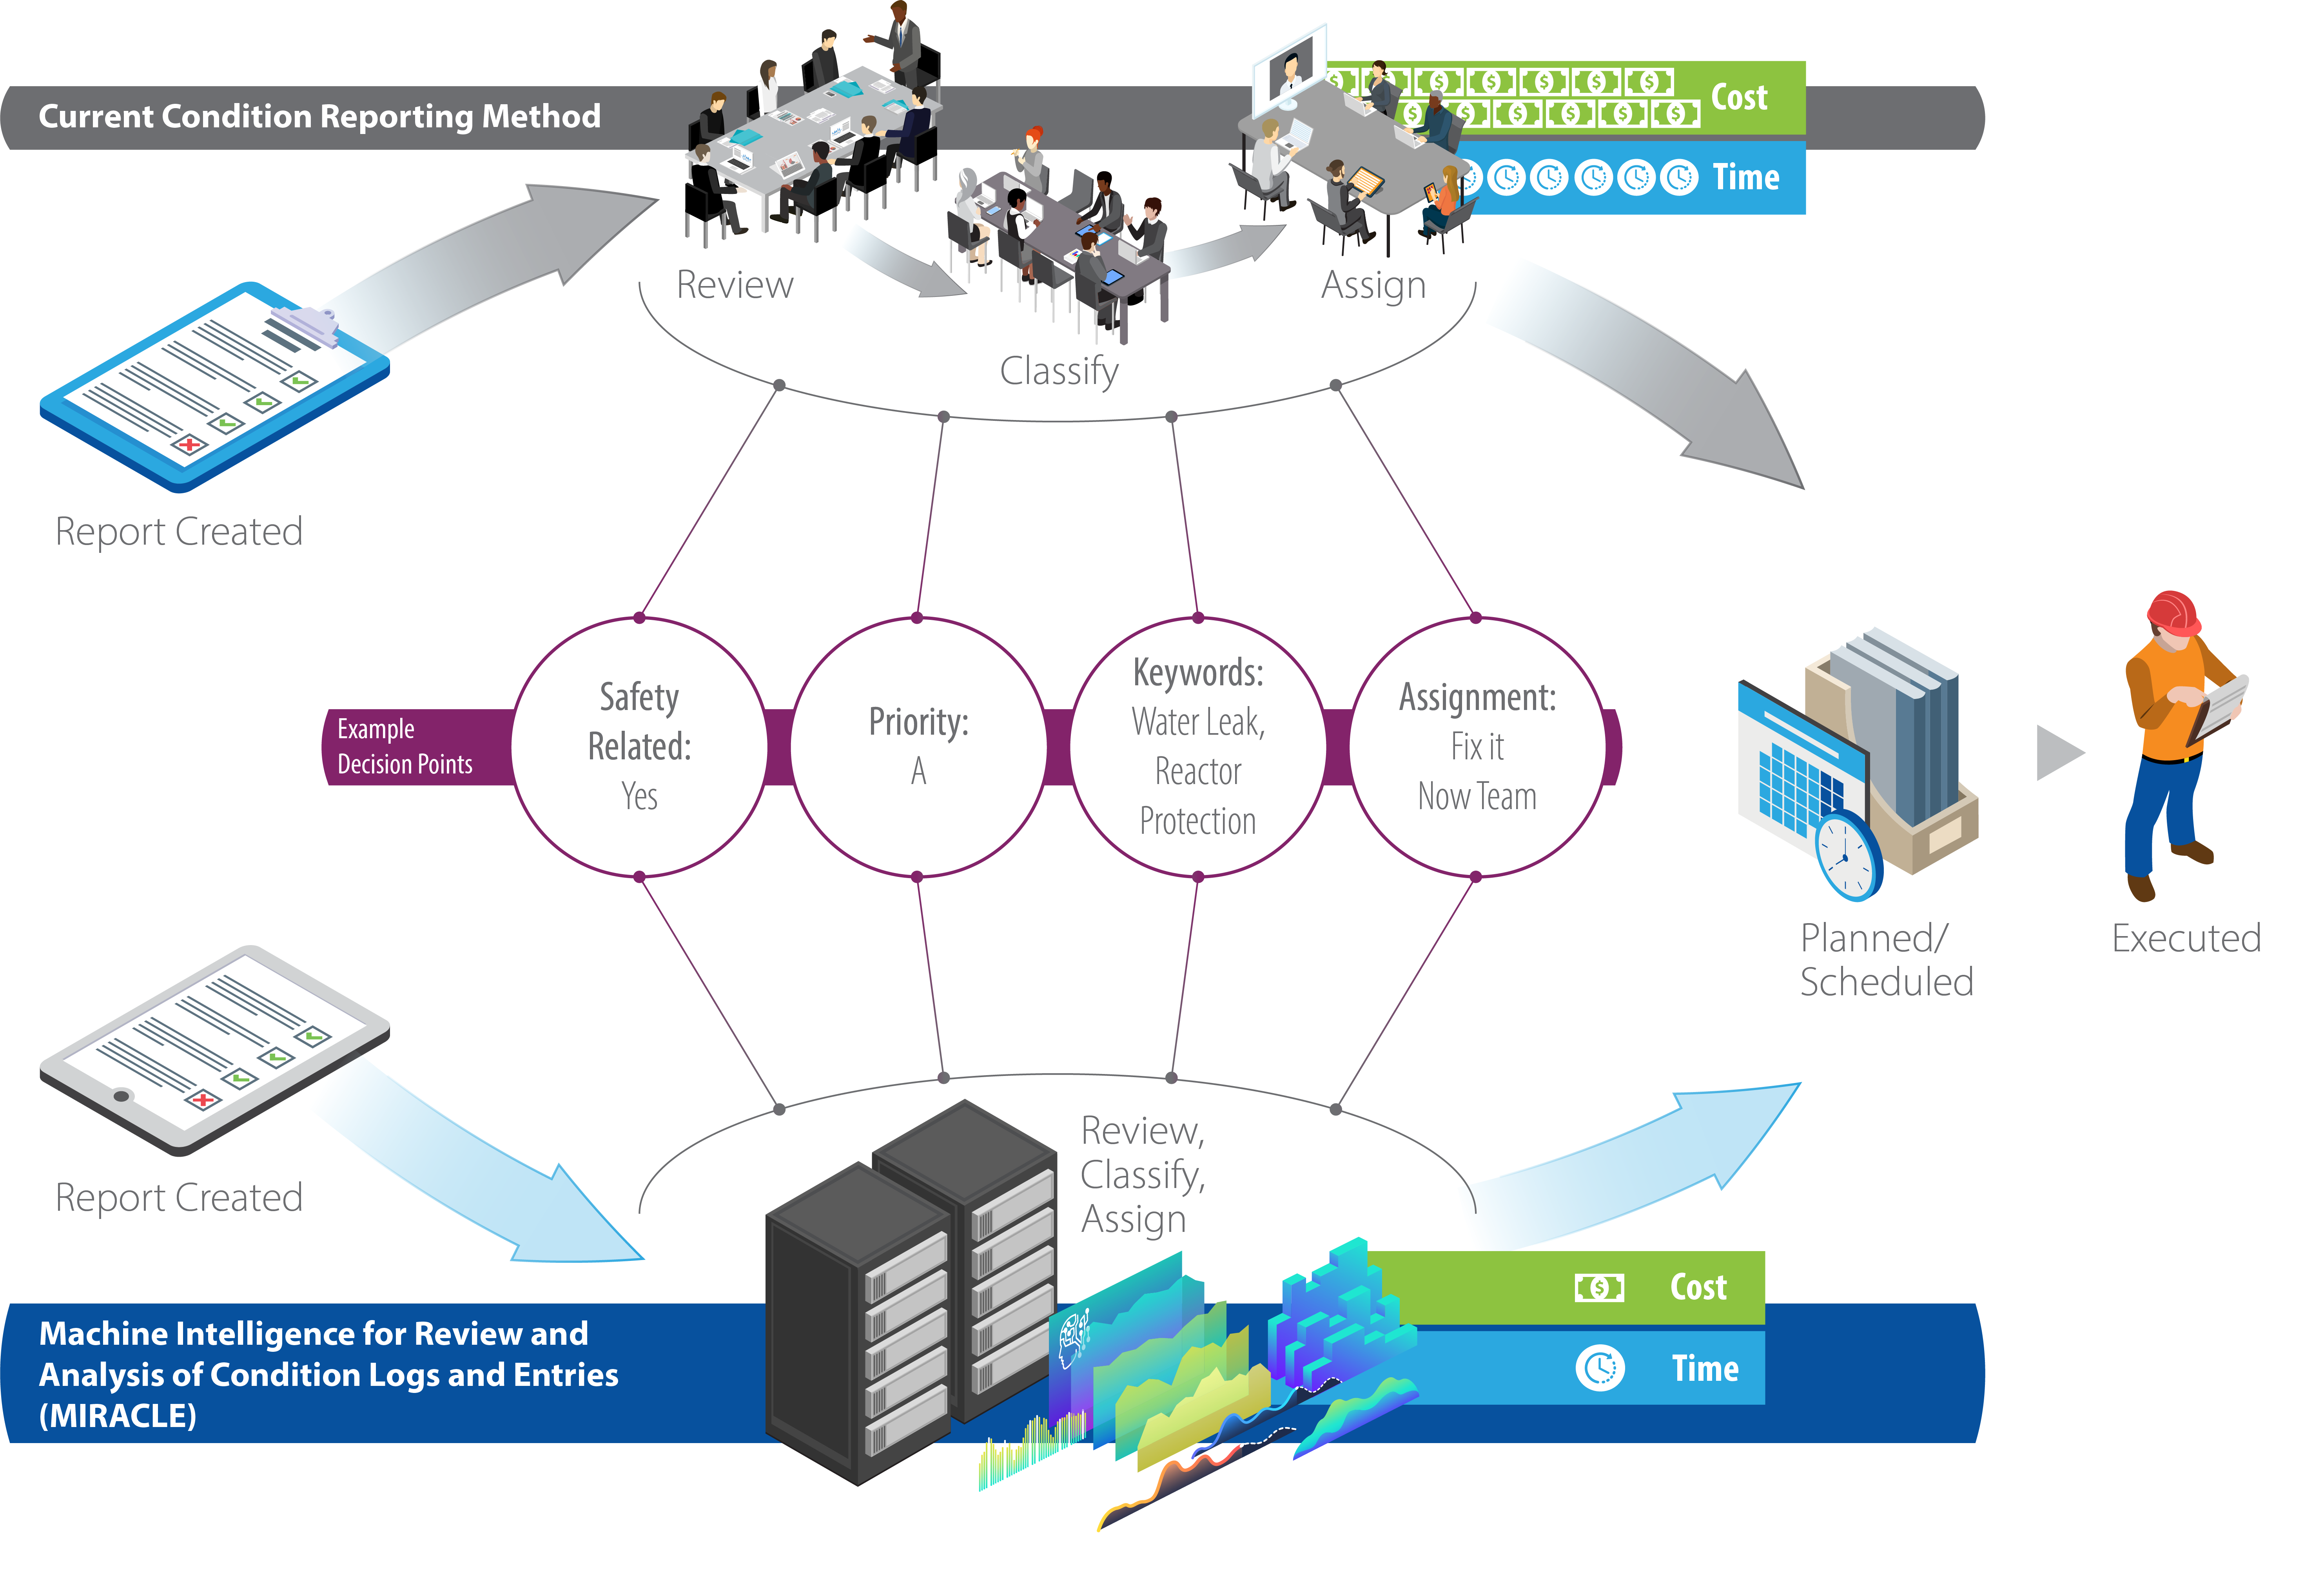
Risk-Aligned Data-Driven Inspections and Compliance Activities
Objectives:
Automation of Corrective Action Program (CAP)
Use data to inform compliance activities
Development of equipment performance trends
Benefits:
Significantly reduced manual labor
Performance trends provide valuable information to support compliance activates and risk-informed decision making
Schematic of Workflow for CAP-Related Assessments

Slide 9
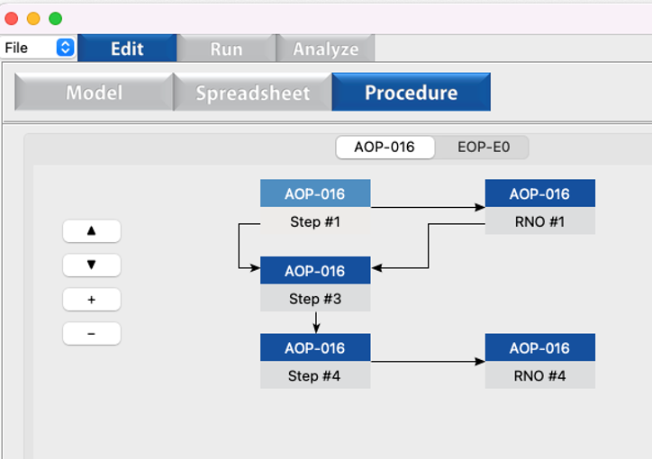
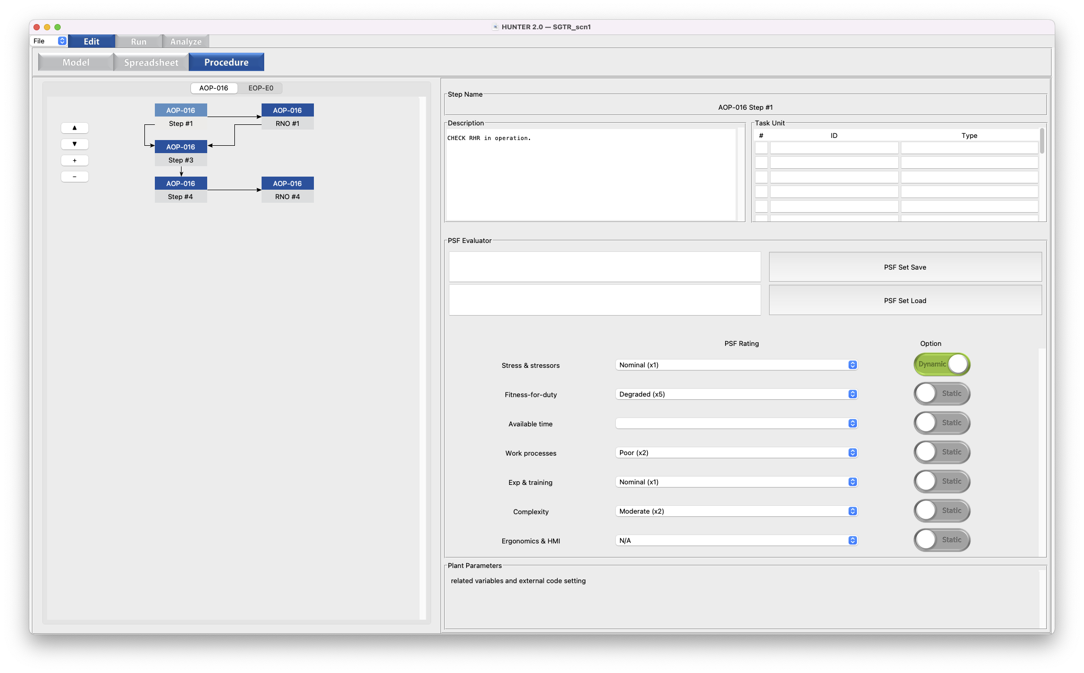
Dynamic Human Reliability Analysis
Objectives:
Create a usable and adaptable standalone software tool for dynamic human reliability analysis (HRA)
Develop example applications and use cases to meet industry HRA needs
Drag and drop procedure modeling
Benefits & Accomplishments
Easy-to-use software tool built on plant operating procedures
Auto-calculation of performance shaping factors during scenarios
Coupling with RELAP5-3D for plant simulation
Demonstration of industry-relevant accident scenarios
Dynamic calculation of performance shaping factors

