Slide 1
Reliability and Integrity Management (RIM)
Team:
Lana Lawrence (Svetlana.Lawrence@inl.gov) - presenter
Diego Mandelli (Diego.Mandelli@inl.gov)
Todd Anselmi (Todd.Anselmi@inl.gov)
Curtis Smith (Curtis.Smith@inl.gov)
Jason Christensen (Jason.Christensen@inl.gov)
PSAM-16 Conference

Slide 2
Project Overview
Goal:
Support industry with guidance of the establishment of RI-MANDE RIM program [Risk-Informed Monitoring and Non-Destructive Examination Reliability and Integrity Management Program] based on various requirements, constraints, and considerations in accordance with ASME Section XI, Division 2 code.
Why is it being done?
The near-term advanced reactor license applicants are following the LMP's risk-informed and performance-based licensing approach endorsed by NRC via Reg. Guide 1.233. Selection of reliability targets for systems and components and assurance of their performance is the integral part of the LMP approach.
Industry requested help with effective ways to establish a risk-informed reliability management program that also complies with ASME requirements and guidance.
Draft Regulatory Guide DG-1383 endorses (with conditions) the ASME code Section XI, Division 2 as an acceptable approach for the development and implementation of Reliability and Integrity Management (RIM) program for non-LWRs.
Who will benefit?
The technology-inclusive framework being developed will offer methodology and tools for an effective RIM program selection and implementation
The guidance that is being developed along with the demonstration case helps adherence with regulatory requirements and promotes consistency between licensing applications which supports efficient regulatory reviews and approvals

Slide 3
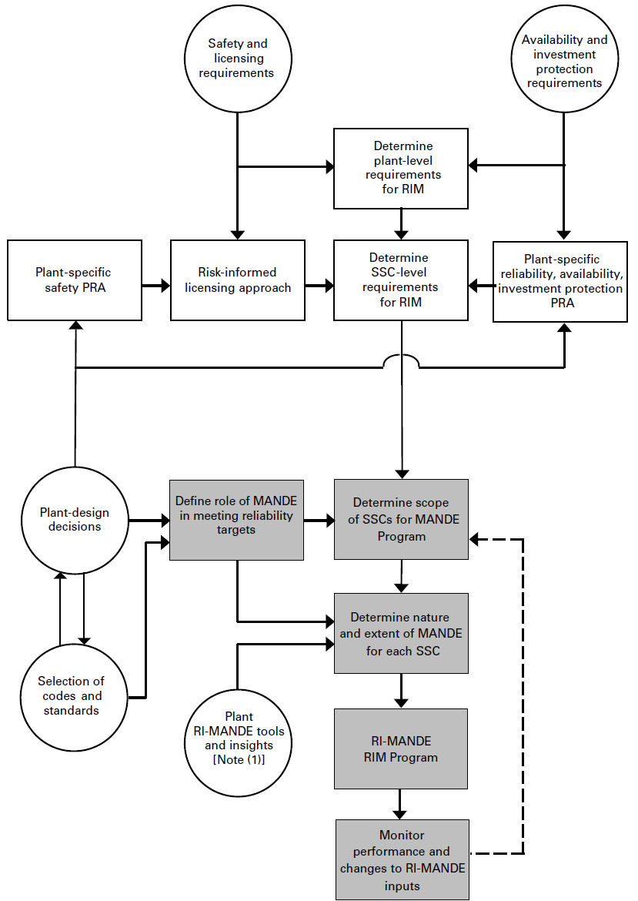
RIM Program Concept
Goal:
Establishment of RI-MANDE RIM program [Risk-Informed Monitoring and Non-Destructive Examination Reliability and Integrity Management Program] based on various requirements, constraints, and considerations
Which requires determination of:
WHAT to monitor/examine to meet the end-goal plant operational requirements (i.e., safety, investment protection, licensing), and
HOW to monitor/examine the “selected what”
Provides a “RIM Strategy” for each SSC
ASME BPVC.XI.2-2019 Figure I-1.1-1 Conceptual Framework for RIM Program

Slide 4
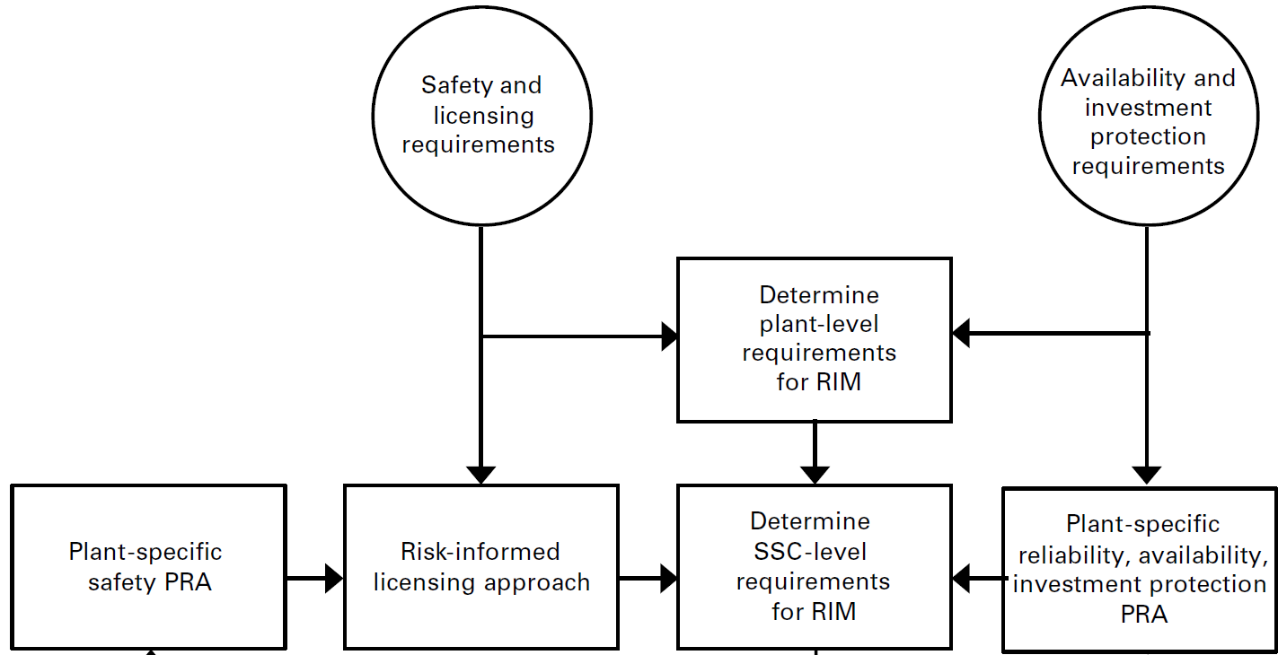
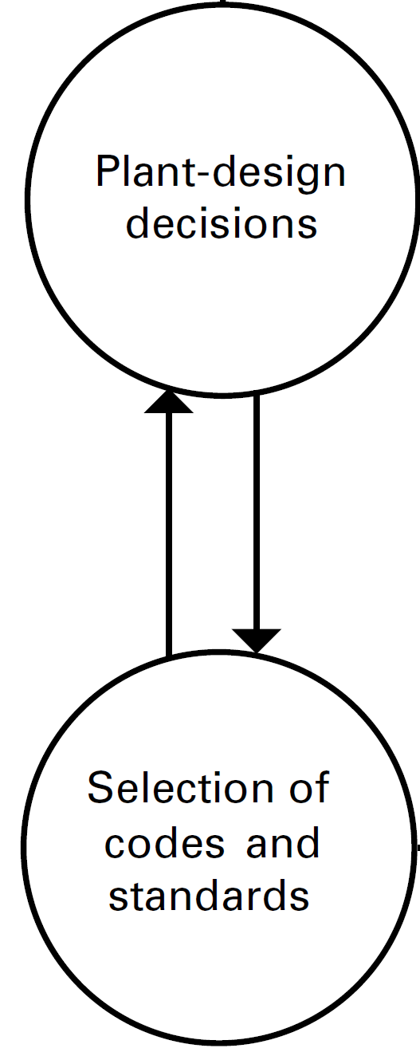
Inputs for RIM Scope Definition
MANY inputs are required to define the RIM Program Scope
Some inputs may not yet be available for various reactor designs (depending on the stage of design / licensing processes) to support a case study
Assumptions and hypothetical data are needed to cover the gaps
Initial case study uses generic data and simplified assumptions to demonstrate the concept
A case study system: Reactor Cavity Cooling System (RCCS) for a High-Temperature Gas-Cooled Reactor (HGTR)
Parameters: generic pipe failure data, simplified model parameters for RIM strategies
RIM Program Scope
Excerpts from ASME BPVC.XI.2-2019
Figure I-1.1-1 Conceptual Framework for RIM Program

Slide 5
RCCS RIM Strategies Analysis
RCCS function
Protects the concrete walls of the reactor cavity
Removes thermal radiation from the reactor vessel and, it releases this heat to atmosphere
Design types
PBMR: water cooled
HTGR: air cooled
Starting point
Reliability modeling performed by K. Fleming in PBMR Passive Component Reliability Integrity Management (RIM) Pilot Study*
Our goal
Include RIM economic aspects
Identify optimal RIM posture for the RCCS
*Reference: Karl Fleming, Steve Gosselin, Ron Gamble, “PBMR Passive Component Reliability Integrity Management (RIM) Pilot Study”, Prepared for PBMR (Pty) Ltd., Technology Insights, 2007
Source: AREVA

Slide 6
Models and Methods
RCCS RIM Strategies
Base pipe model developed/tested
2 groups of components: standpipes and connecting pipes
Non-Destructive Evaluation (NDE) options
Types:
Phased_array [Probability of detection (POD) = 0.5]¹
EddyCurrent + ultrasonic [POD = 0.9, assumed] ¹
Do_nothing
Frequency: 3,6,9,15 years
On-line Leak Detection (OLLD) options
Types:
Visual [POD = 0.5] ¹
Imaging_spectra [POD = 0.9] ¹
Do_nothing
Frequency: 1.5, 3.0, 4.5, 6.0 years
¹ Probability of Detection values are simplified for the initial case study
Source: AREVA

Slide 7
Models and Methods (continued)
RCCS RIM Cost Model
Fixed costs
Apparatus
Personnel training
Variable costs (per inspection session):
Inspection setting time
Inspection time [per pipe]
# personnel required
FTE cost multiplier (base FTE cost=100 $/hr)¹
Visual (1.0),
Phased_array and imaging_spectra (2.0),
EddyUltra (2.5)
Costs are evaluated throughout the lifespan the plant (60 years)
Source: AREVA
¹ Base cost is simplified for the initial case study

Slide 8
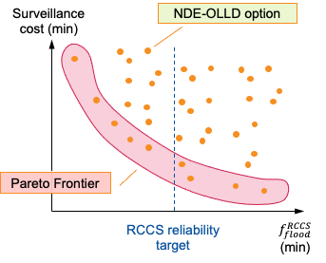
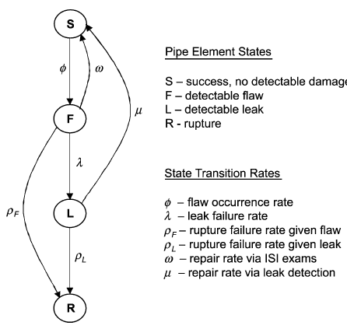
Models and Methods (continued)
Methods (RAVEN)
Multi-objective optimization
Pareto frontier
Uncertainty propagation
Sensitivity analysis
RCCS RIM Model
Two models have been developed
RCCS reliability model
RCCS cost model
Both models directly interfaced to RAVEN
NDE inspection
Leak inspection

Slide 9
RIM Strategies Analysis
Analysis steps completed:
Evaluation of all scenarios
RIM scenario = NDE & OLLD option for standing and connecting pipes
No correlation between options
# Scenarios = 9801
Evaluation of Pareto frontier
Analysis steps underway:
Uncertainty propagation
Reliability and cost data
For points located on the Pareto frontier
Sensitivity analysis
Example of RCCS RIM Strategy
RCCS Part | NDE | OLLD
Standpipes | Phased_array | Visual
Connecting pipes | Phased_array | Do_nothing
RCCS model
RIM cost
RCCS RIM
scenario
Frequency of cavity flood

Slide 10
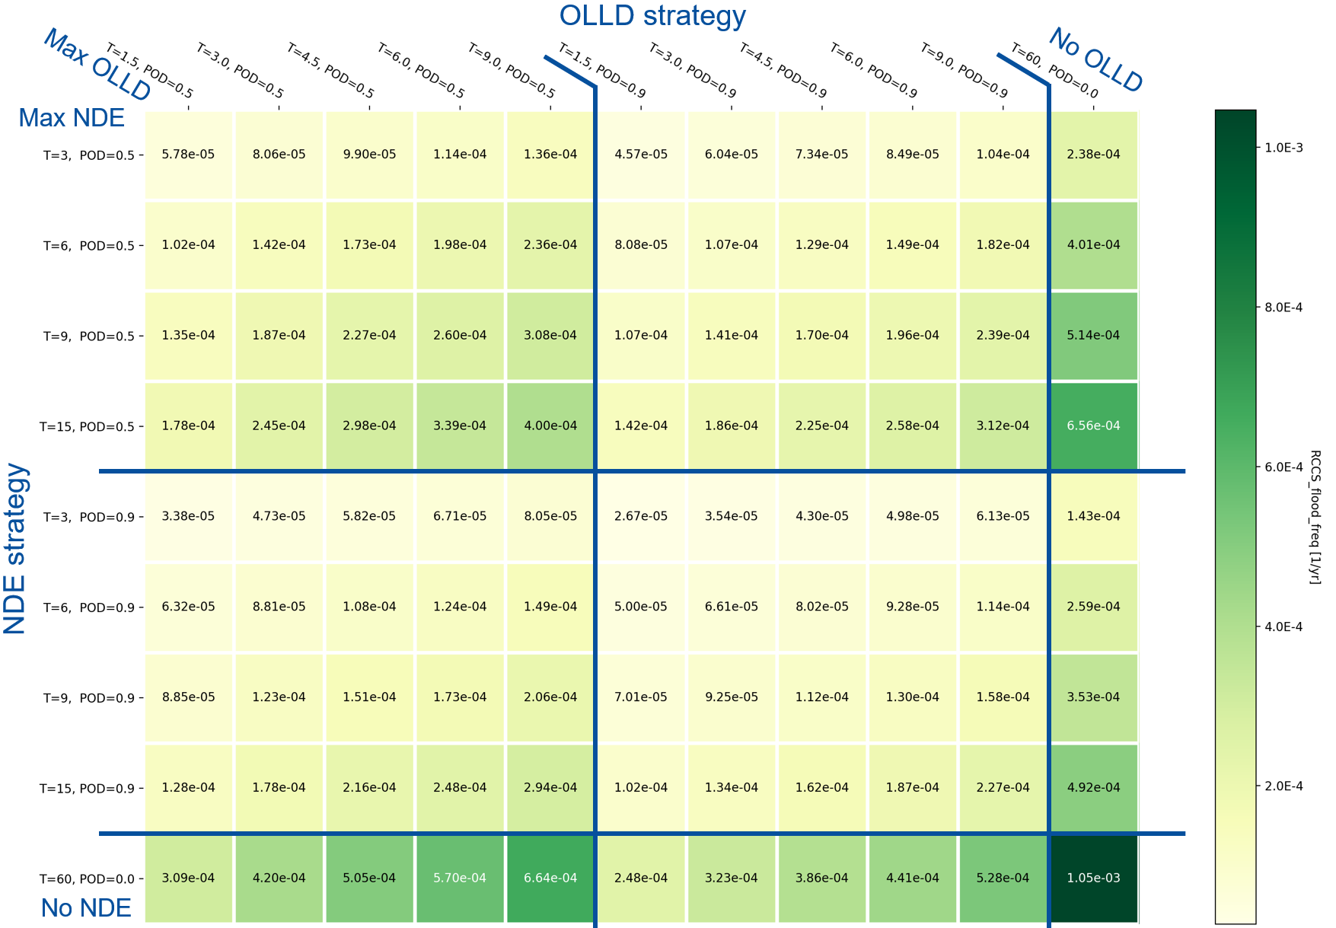
RIM Strategies vs Risk
NDE and OLLD maximized
No NDE and No OLLD

Slide 11
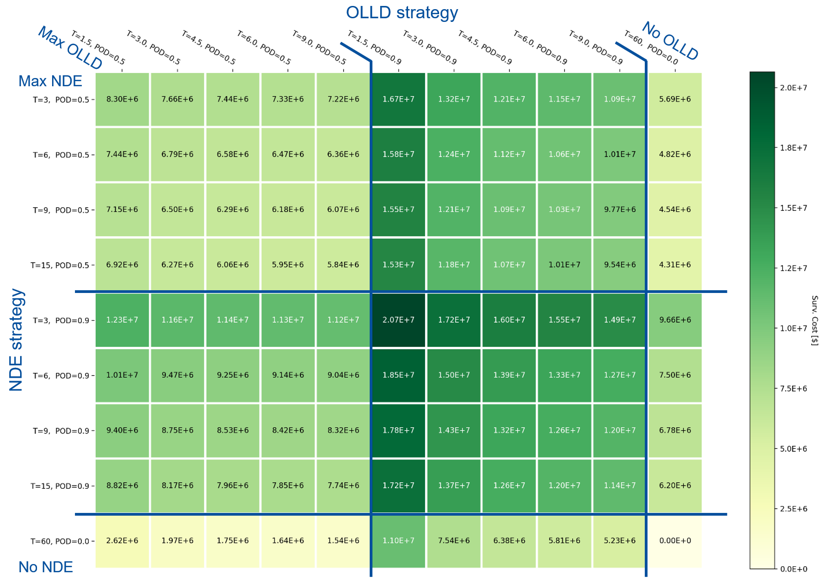
RIM Strategies vs Cost
NDE and OLLD maximized
No NDE and No OLLD

Slide 12
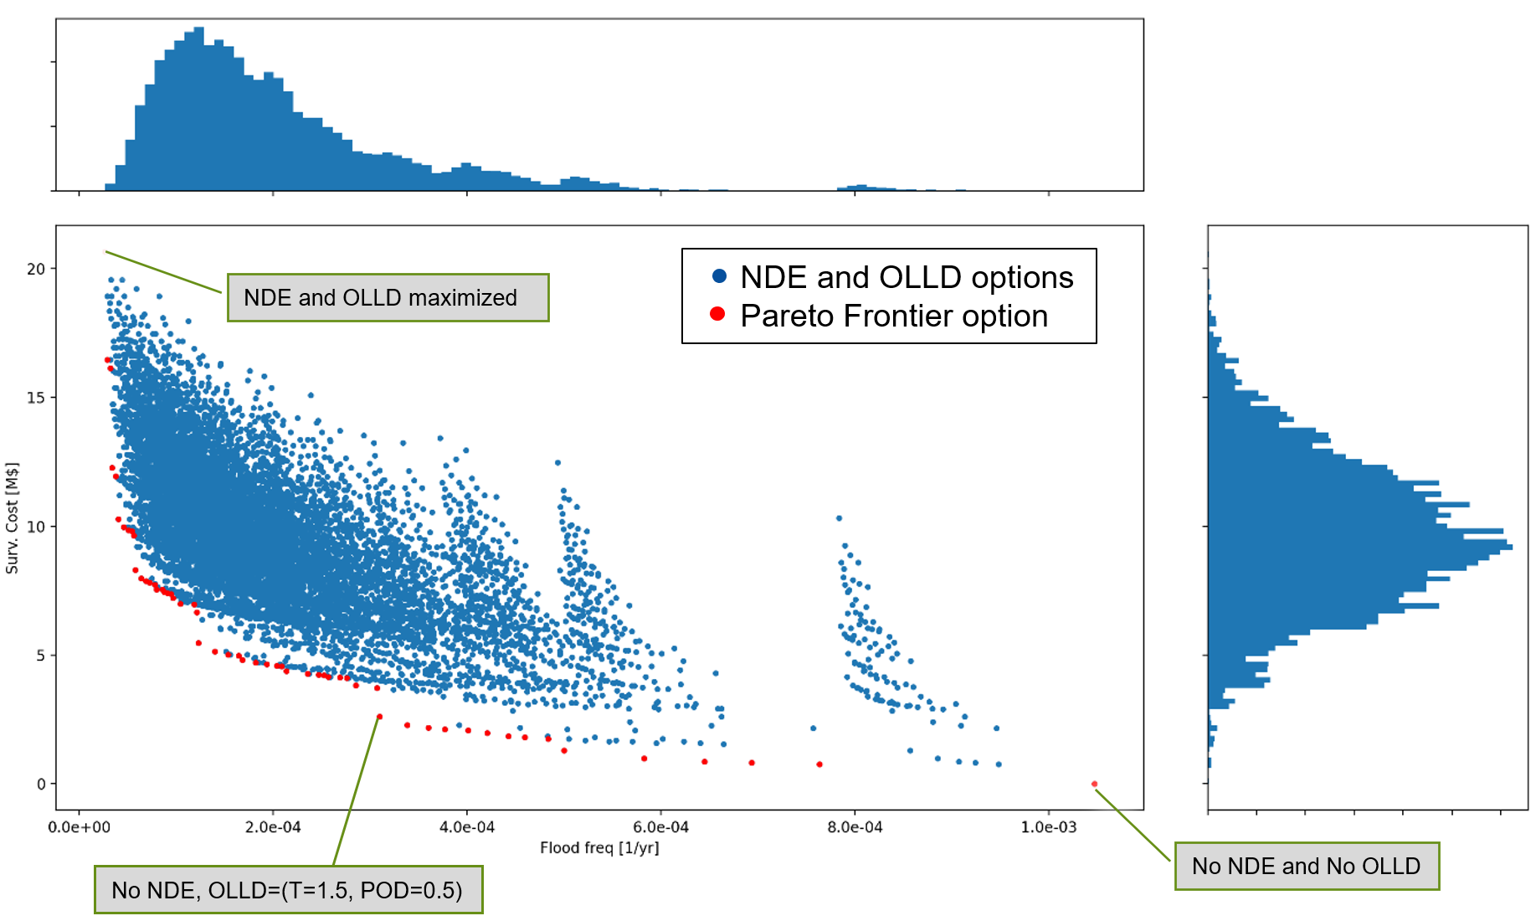
Cost-Benefit Analysis
Outcome of multi-objective optimization
Optimal RIM scenarios in the Pareto frontier (red dots)
RCCS reliability target can be added to filter Pareto frontier furthermore
Multiple reliability targets can be analyzed simultaneously
Uncertainty propagation and sensitivity analysis can be applied to the Pareto frontier
12

Slide 13
Project Activities
Accomplished:
Explored avenues of how applicable tools, methods, and approaches that have been developed and/or successfully implemented for LWRs can be used to support RIM program development for the advanced reactors
Case Study: Reactor Cavity Cooling System (RCCS) for a High-Temperature Gas-Cooled Reactor (HTGR); PBMR Passive Component Reliability Integrity Management pilot study* was used as the initial basis for the research
Risk-Informed Asset Management framework developed under the Light Water Reactor Sustainability (LWRS) program was applied for the generic case study
Proof-of-concept demonstration of RCCS RIM strategies is completed and compared against risk and cost metrics in a generic case study (i.e., using generic data and simplified assumptions)
*Reference: Karl Fleming, Steve Gosselin, Ron Gamble, “PBMR Passive Component Reliability Integrity Management (RIM) Pilot Study”, Prepared for PBMR (Pty) Ltd., Technology Insights, 2007

Slide 14
Project Activities (continued)
On-Going
Collection of data for better estimates of model parameters
More realistic pipe failure data
NDE Probability of Detection
RIM Strategy Costs
Uncertainty distributions
Sensitivity analyses using variation of inputs
Upcoming
Modify the case study to use reactor-specific data and more realistic parameters for RIM strategies
Address damage mechanisms and evaluation of uncertainty
Issue a DRAFT report (June 2022) outlining project findings and solicit industry feedback
Adjust the case study / data / approach based on received comments
Issue the final report (September 2022)

Slide 15
RIM Strategy Development Problem – Expanding the Context
Inputs | Project Case Study System (9801 possible RIM strategy scenarios) | More Complex System
# of components | Essentially 2 – all “same” pipes are grouped into 1) standing pipes or 2) connecting pipes | Many more than 2 & different types: e.g., pipes, valves, pumps, heat exchangers, etc.
NDE / OLLD options | Only 2 NDE and 2 OLLD options with simplified assumptions for a probability of detection (POD) and cost The same option is applied for all the components (pipes) in the group | Multiple options are available, each associated with estimates of POD and costs (estimates include uncertainties) A different strategy and different frequency can be applied for each component / group of components
Operating Environment | Simple (i.e., atmospheric pressure, low temperature) Same for the entire system | Complex (e.g., high temperature, pressure, vibration, etc.) Varying for different components in the system
Degradation Mechanisms | Essentially no applicable degradation mechanisms, random failure is postulated | Multiple degradation mechanisms Variable mechanisms for different components
Materials | Same material for all system components | Variable materials for different system components
Lifespan | Same for all system components | Possibility of variable lifespan for different components in the system (e.g., 100+ yrs for not accessible / high safety significant components, 20 yrs for rest)

Slide 16
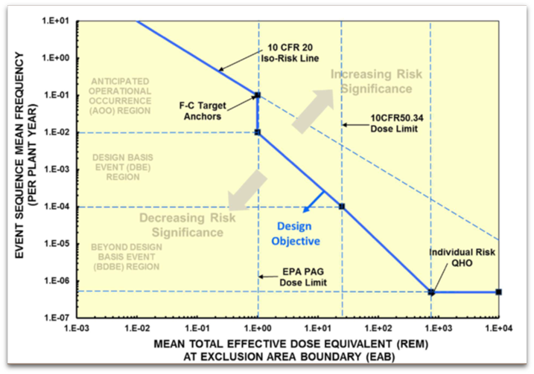
Reliability Target Selection Process
RIM Strategy Development Problem – Expanding the Context (continued)
Risk Target = Scenario Frequency & Consequence (Dose)
Hazard Initiating Event
Plant Reliability
Release
Mitigation of Release
Scenario Representing Risk Target
Dominant Risk Scenario 1
Risk Result → Risk Target
Reliability Target
Reliability Target
Systems
Frequency of Enabling Condition
Reliability of System or Function A
Reliability of System or Function B
Reliability of System or Function C
X
X
These may be external or internal to the reactor
Subsystems
Probability Condition Leads to Initiating Event
R(A.1)
X+
R(A.2)
R(B.1)
R(C.1)
X+
R(C.2)
X+
R(C.3)
Components
R(A.1.1)
R(A.1.2)
R(A.1.3)
R(A.2.1)
R(A.2.2)
R(B.1.1)
R(C.1.1)
R(C.3.1)
…
Etc.
3 components in a system
2 components in a system
1 component in a system

Slide 17
RIM Strategy Development Problem – Expanding the Context (continued)
Hypothetical Example of Reliability Target Selection
Risk Target = 1E-03/yr & Dose=0.2rem
Hazard Initiating Event
Plant Reliability
Release
Mitigation of Release
Scenario Representing Risk Target
Dominant Risk Scenario 1
Risk Result → Risk Target
= 0.1/yr
=0.01/yr
Systems
0.1/yr
0.5
0.1
0.2
X
X
These may be external or internal to the reactor
Subsystems
1.0
0.2
0.3
0.1
0.05
0.09
0.06
+
+
+
Identified Difficulties:
Passive-only components consideration for the RIM program
Problem is too large to solve
SSCs supporting multiple event sequences
Components
0.2
0.0001
0.0001
0.6
0.5
0.1
Etc.
3 components in a system
2 components in a system
1 component in a system

Slide 18
Questions

