Slide 1
Dynamic risk analysis of maritime autonomous surface ships
Susanna D. Kristensen$^{1}$, Yiliu Liu$^{2}$, Ingrid B. Utne$^{1}$
$^{1}$Department of Marine Technology, NTNU, Trondheim
$^{2}$Department of Mechanical and Industrial Engineering, NTNU, Trondheim
PSAM-16
26. June – 01. July 2022
Norwegian University of Science and Technology

Slide 2
Outline
Introduction
Method
Case study
Results and discussion
Conclusion
References

Slide 3
Introduction
Notes:
As an introduction I will talk about the motivation behind the study:
Objective
State of the art
Gaps in information I seek to fill out
Research question or hypothesis I intend to investigate:

Slide 4
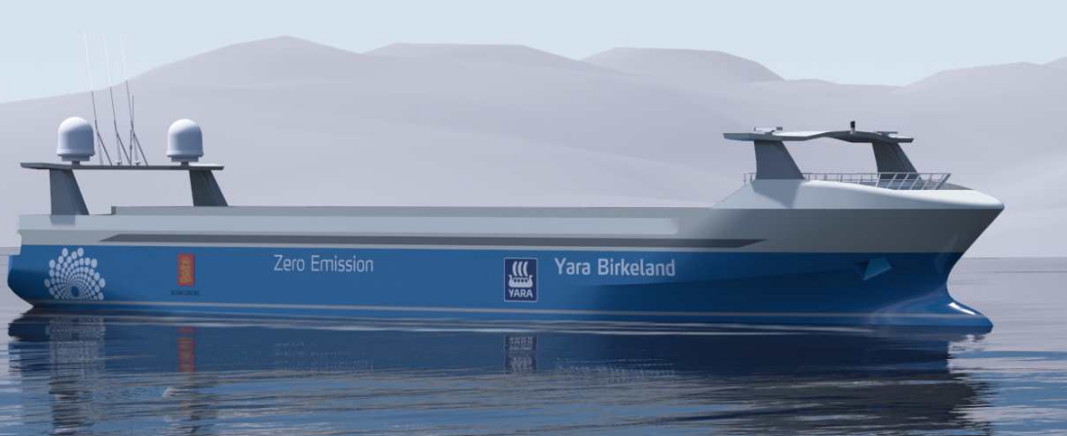
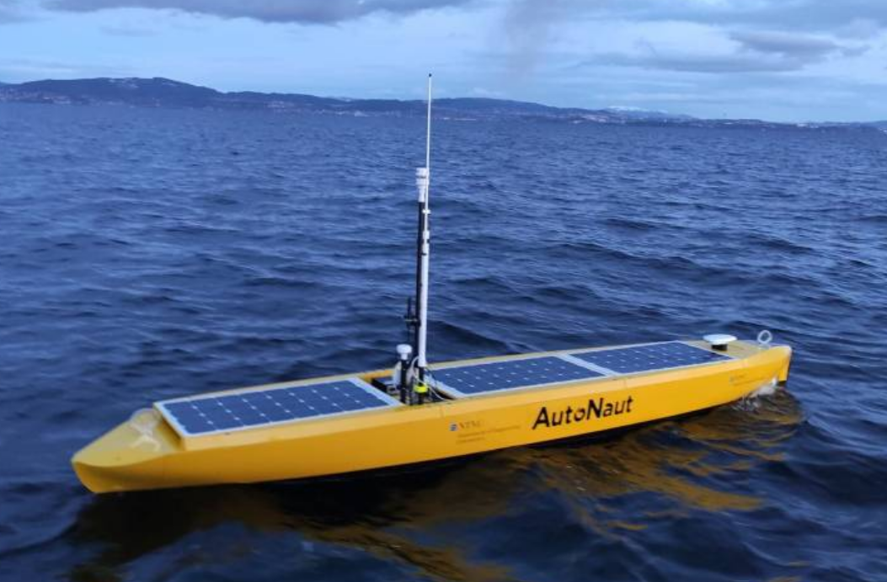
Possible developments in maritime industry
Higher level of autonomy
Crew reduction
Green energy
Image from [1]
Image from [2]
Notes:
Many developments in the maritime industry
Motivation is to make safer, more efficient, and more environmental friendly systems

Slide 5
Implication for ships and ship operations
Higher LOA
Sensors, actuators, and computers take over tasks
Crew reduction
Situation awareness must be ensured by use of technical components
Green energy
Stable energy supply dependent on environmental factors
Notes:
Highly autonomous ships are under development, and no such ship has been put into commerical operation
The changes in the systems and operation are not fully known at this time

Slide 6
Related research
Risk assessment for MASS
Focus on collision risk [4]
Identification of RIFs [3][4]
DRA of marine system
DBN for ship-ice collision for conventional ships [5]
DBN for autonomous underwater vehicle operational risk [6]
Less focus on:
Power management
Other consequences than collision
Notes:
GAP: focus on other consequence dimensions than those related to navigation
risk analysis with focus on power management and risk
Previous research has been focused on
Navigation risk (risk of collision/stranding/allission) for autonomous ships
Use of DBNs, but for
Conventional vessels (ship-ice collision)
AUVs and operational risk depending on the operational environment
Autonomous ships, but for reliability

Slide 7
Implications for risk
More sensors give a better situation awareness
More sensors use more power
→ Must make trade-off between preserving power and keeping an adequate level of situation awareness
Influenced by dynamic factors, including available and needed power
Notes:
The risk related to autonomous ship operations is not known now
Different systems and types of operations may influence the risk level
May not be the same as for conventional vessel
Can focus on the differences between conventional and autonomous vessels
→ Dynamic risk level depending on state of system, type of operation, and type of environment

Slide 8
Objective of paper
Analyze risk related to power management of MASS
Focus on the effect of situation awareness and energy consumption on the mission performance
Notes:
Focus on this one difference between conventional and autonomous vessels
How does it affect risk and does it vary with time?
Novelty of developed method:
How use of power affect risk for autonomous ships
Not neccisarily only risk-reducing effect
Step towards more autonomous operation
Develop a method for performing DRA of MASS using DBN

Slide 9
Method

Slide 10
Proposed modeling tool
Bayesian networks
Conditional dependence between variables
Determine probability of hazardous event
Dynamic Bayesian networks
Includes development over defined no. of time steps
Incorporate time-dependent factors
Notes:
BN because
Can combine different sources of data
Can update with new data and evidence
DBN
Gives the possibility to add time-dependent factors
Probability of running out of power in one time step is not independent of the probability in the previous time step
DBN can incorporate this

Slide 11
Proposed methodology
Describe the aim and context of the DBN
Collect and group information
Determine the type of MASS
Determine type of operation
Determine relevant environmental factors for type of MASS and operation
Connect nodes and arcs
Identify time-dependent nodes and arcs
Develop CPTs and quantify
Validate the risk model
Based on [9]
Notes:
How to develop the risk model, from defining the problem to collecting data and building the model

Slide 12
Collect and group information
Relevant nodes
Target node
Mission failure
System
Available power
SA
LOA
Energy consumption
Energy generation
Operation
Sub-tasks
Organization, collaboration, communication
Propulsion and steering
Duration of mission
Environment
Temperature
Wave height
Sun exposure
Wind speed/direction
Current strength/direction
Distance to refuel
Obstacle density
Communication coverage
Notes:
Based on available literature
The information that is collected is limited to the factors that influence the focus area of the model
Other factors may influence the overall operaitonal risk, but are not considered here because they are outside the focus area
Relevant information was collected from the available literature
Three major categories
System
Operation
Environment

Slide 13
Case study
Notes:
A case study was performed to see if the methodology could give a valid risk model

Slide 14
System description
System aspect | Description
Type of vessel | USV
Source of power (utility) | PV panels
Source of power (propulsion) | Wave foils
Weight | 360 kg (w/payload)
Length | 5 m
Max speed | 2 knots (~1 m/s)
Based on descriptions in [7] [8]
Notes:
The system
A USV
Named AutoNaut – commercially available system
Owned and operated by NTNU
Balancing power generation and consumption is critical for this vessel

Slide 15
Operation description
Duration: 19 days
Goal: collect water quality samples along pre-defined path
Mode of operation: autonomous with human supervision from remote location
Area of operation
Based on descriptions in [7] [8]
Notes:
This operation was performed on the coast of Norway in march/april 2021
The purpose was to collect data about the water quality
The weather condition was challenging, meaning high waves, strong winds, and limited sunlight
Descriptions of the operation show that the mission was affected. The following things happened:
The data coollection could not be used continuously
Strong wind and high waves caused the vessel to strand
Energy harvesting was a challenge

Slide 16
Operation description
Severe weather conditions
Limited sun exposure
Vessel was retrieved and re-charged on shore two times
Vessel stranded due to weather conditions one time

Slide 17
Aim and context of DBN
Aim: determine the effect of SA and power consumption on mission performance
End node: mission failure
Def.: A situation where it is not possible to perform the defined mission within the defined operational specifications, without manual intervention
Notes:
Here: mission failure defined as not possible to performe the defined mission within the defined operational specifications, without manual intervention

Slide 18
Collect and group information
Notes:
Green frame indicates node related to the environment
Yellow – related to operation
Blue – related to system
Quantification is also shown here
Some information could be found based on the published papers, system information, and external sources
Other had to be based on assumptions
CPTs were developed based on subjective knowledge

Slide 19
Risk model
Connecting nodes and arcs
Risk model made in GeNIe

Slide 20
Risk model
Time-dependent nodes and arcs
Time step = 2h
Notes:
The equations show the dynamic nodes and arcs

Slide 21
Develop CPTs and quantify
Prior probabilities and CPTs: literature, statistics, expert opinion
Validate the risk model
Sensitivity analysis
Comparison to operational experience
Notes:
Different methods for quantification exists
Different methods for validation exists
- Validation can be a challenge for autonomous ships because there are few systems operating and therefore limited operational experience

Slide 22
Setting evidence
Evidence based on system and operational description
Exposure to sun
Wind speed
Wave height
Battery level in initial time step
Temperature
Notes:
As the vessel was retrieved, only the last part of mission was modelled, when it was assumed that the vessel has been re-charged

Slide 23
Results, discussion, and conclusion

Slide 24
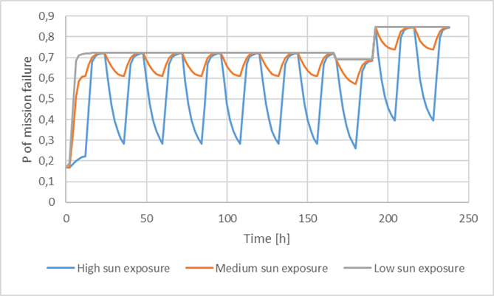
Results and discussion
Case study
Risk changes with time
Risk of mission failure is relatively high
Use of USV, not MASS
Operational experience
Mission failure due to low energy generation and severe environmental conditions
Sensitivity analysis:
Generation of power has strong influence on risk
Notes:
Probability of mission performance being affected was very high in the period of the operation that was analysed
Strict definition of mission failure: in this case it is defined as «not possible to perform defined mission within defined operational specifications, without manual intervention
Sensitivity analysis show that exposure to sun is important for the operational risk for this vessel

Slide 25
Conclusion
MASS operational risk changes with time
Use of green energy sources can make system more vulnerable
Opportunity for power generation is critical
DRA using DBN can contribute to risk reduction
Mission planning
Risk-informed decision-making during operation
Notes:
Risk is strongly influenced by the opportunity to generate power
Risk level is dynamic and changes throughout the operation
DRA for MASS can contribute to risk reduction
Can be used by operators to plan mission if they have details about the area of operation
Can be used to make decisions during operations
If it is predicted that risk will increase, it can be an option to implemement risk-reducing measures

Slide 26
References
[1] Kongsberg, “AUTONOMOUS SHIP PROJECT, KEY FACTS ABOUT YARA BIRKELAND”, from https://www.kongsberg.com/no/maritime/support/themes/autonomous-ship-project-key-facts-about-yara-birkeland/ (retrieved 01.06.2022)
[2] NTNU AutoNaut Docmentation Wiki, “The AutoNaut - Wave-Propelled Unmanned Surface Vehicle”, from https://autonaut.itk.ntnu.no/doku.php?id=start (retrieved 01.06.2022)
[3] I. B. Utne, A. J. Sørensen and I. Schjølberg, “Risk management of autonomous marine systems and operations,” in ASME 2017 36th International Conference on Ocean, Offshore and Arctic Engineering, Trondheim, 2017.
[4] C. Fan, K. Wróbel, J. Montewka, M. Gil, C. Wan and D. Zhang, “A framework to identify factors influencing navigational risk for Maritime Autonomous Surface Ships,” Ocean engineering, vol. 202, p. 107188, 2020.
[5] B. Khan, F. Khan and B. Veitch, “A Dynamic Bayesian Network model for ship-ice collision risk in the Arctic waters,” Safety Science, vol. 130, p. 104858, 2020.
[6] R. Yang, I. B. Utne, Y. Liu and N. Paltrinieri, “Dynamic Risk Analysis of Operation of the Autonomous Underwater Vehicle (AUV),” in Proceedings of the 30th European Safety and Reliability Conference and the 15th Probabilistic Safety Assessment and Management Conference, Singapore, 2020.
[7] A. Dallolio, Doctoral thesis: Design and Experimental Validation of a Control Architecture for a Wave-Propelled USV, Trondheim: NTNU, 2022.
[8] A. Dallolio, B. Agdal, A. Zolich, J. A. Alfredsen and T. A. Johansen, “Long-Endurance Green Energy Autonomous Surface Vehicle Control Architecture,” in OCEANS 2019 MTS/IEEE SEATTLE, Seattle, 2019.
[9] C. A. Thieme and I. B. Utne, “A risk model for autonomous marine systems and operation focusing on human–autonomy collaboration,” in Proc IMechE Part O: J Risk and Reliability, California, 2017

Slide 27
Thank you for your attention!

Slide 28
Ideas for futher work
Include more factors in the model
Apply it to other systems
Investigate time-dependence and include more dynamic nodes and arcs

Slide 29
1. Describe the aim and context of the DBN
Aim of risk model determines end node
End node: Mission failure
Relation to other nodes is determined by system/operation/environment details

Slide 30
3. Connect nodes and arcs
How does the identified node affect the end node
→ Construct BBN
4. Identify time-dependent nodes
Available power and needed power
→ Construct DBN
Notes:
The idea is to build a static network, and then condsider the dynamic elements after, and then develop a dynamic network
3.
Nodes that are dependent must be connected with arcs
4.
Investigate effect of time on node or connection
Determine temporal order

